Slide 1
Towards High Performance Data Analytics with Java
SALIYA EKANAYAKE
sekanaya@cs.indiana.edu

Slide 2
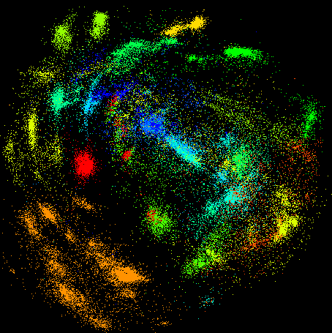
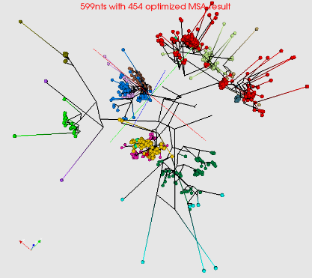
A Bit of Background
Gene Sequence Clustering and Visualization
Projects
Million sequence project http://salsahpc.indiana.edu/millionseq/
Work on COG (Protein) sequences http://salsacog.blogspot.com/
Work on phylogenetic trees http://salsafungiphy.blogspot.com/
Publications
G. L. H. Yang Ruan, Saliya Ekanayake, Ursel Schütte, James D. Bever, Haixu Tang, Geoffrey Fox, “Integration of Clustering and Multidimensional Scaling to Determine Phylogenetic Trees as Spherical Phylograms Visualized in 3 Dimensions,” in C4Bio 2014 of IEEE/ACM CCGrid 2014, Chicago, USA, 2014
L. Stanberry, R. Higdon, W. Haynes, N. Kolker, W. Broomall, S. Ekanayake, A. Hughes, Y. Ruan, J. Qiu, E. Kolker, and G. Fox, “Visualizing the protein sequence universe,” in Proceedings of the 3rd international workshop on Emerging computational methods for the life sciences, Delft, The Netherlands, 2012, pp. 13-22
Y. Ruan, S. Ekanayake, M. Rho, H. Tang, S.-H. Bae, J. Qiu, and G. Fox, “DACIDR: deterministic annealed clustering with interpolative dimension reduction using a large collection of 16S rRNA sequences,” in Proceedings of the ACM Conference on Bioinformatics, Computational Biology and Biomedicine, Orlando, Florida, 2012, pp. 329-336
A. Hughes, Y. Ruan, S. Ekanayake, S. H. Bae, Q. Dong, M. Rho, J. Qiu, and G. Fox, “Interpolative multidimensional scaling techniques for the identification of clusters in very large sequence sets,” BMC Bioinformatics, vol. 13 Suppl 2, pp. S9, 2012
Gene Sequences
>G0H13NN01D34CL
GTCGTTTAAGCCATTACGTC …
>G0H13NN01DK2OZ
GTCGTTAAGCCATTACGTC …
Determine, Represent, and Verify Clusters
Sequence | Cluster
0 | 2
1 | 1
… | …
Represent and Verify
Visualize in 3D
Generate Phylogenetic Trees
Compared to Traditional 2D

Slide 3
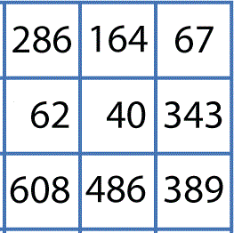
Under the Hood
# | X | Y | Z
0 | 0.358 | 0.262 | 0. 295
1 | 0.252 | 0.422 | 0.372
Algorithms
Alignment and Distance Calculation
SALSA-SWG ← C# MPI
SALSA-SWG-MBF ← C# MPI
SALSA-NW-MBF ← C# MPI
SALSA-SWG-MBF2Java ← Java MapReduce
SALSA-NW-BioJava ← Java MapReduce
Dimension Reduction
MDSasChisq ← C# MPI
DA-SMACOF ← C# MPI
Twister DA-SMACOF ← Java Iterative MapReduce
WDA-SMACOF ← Java Iterative MapReduce
Clustering
DAPWC ← C# MPI
DAVS ← C# MPI
>G0H13NN01D34CL
GTCGTTTAAGCCATTACGTC …
>G0H13NN01DK2OZ
GTCGTTAAGCCATTACGTC …
Dimension Reduction
D3
Alignment and Distance Calculation
D1
D2
Visualization
D5
Clustering
D4
# | Cluster
0 | 1
1 | 3
Reality Is More Complex
Study of Biological Sequence Structure
http://salsahpc.blogspot.com/2013/05/study-of-biological-sequence-structure.html
Million Sequence Processes
http://salsahpc.indiana.edu/millionseq/fungi2/fungi2_index.html
Runs On
Tempest ← Windows HPC Cluster
FutureGrid, BigRed II, Quarry ← Traditional Linux Based HPC Clusters

Slide 4
Towards Java
Motivation
Immediate → Limited Windows HPC Clusters
Future → Integrate with Apache Big Data Stack (ABDS)
Options
Keep C#
Run on Azure cloud ← Not the best for MPI because of high latencies and low bandwidths
Run on Mono ← We tried, it worked, but poor in performance
Convert to Java
Time consuming, but gained good results
“Java Ready” Applications
Deterministic Annealing Vector Sponge (DAVS)
Deterministic Annealing Pairwise Clustering (DAPWC)

Slide 5
Evaluations
MPI Frameworks
MPI.NET ← A high performance message passing interface for .NET environment
FastMPJ ← A pure Java implementation of mpiJava 1.2 specification
OpenMPI ← Java wrapper for native MPI implementation
Nightly snapshot 1.9a1r28881 (OMPI-nightly) – conforms with mpiJava 1.2 specification
Source tree revision 30301 (OMPI-trunk)
Release candidate version 1.7.5rc5 (OMPI-175rc5) – latest of the three
Kernel Benchmarks
Ohio MicroBenchmark (OMB) Suite
Send and receive
Allreduce
Application Benchmarks
DAVS and DAPWC on Real Data
Parallel Patterns of T x P x N
T - # threads per process
P - # MPI processes per node
N - # nodes
Threads from Habanero Java Library ←Mainly for Parallel Loops
← Your code was here!!

Slide 6
Kernel Benchmarks
MPI Send and Receive
Performance with Different MPI Frameworks
OMPI-trunk Performance with and without Infiniband

Slide 7
Kernel Benchmarks
MPI Allreduce
Performance with Different MPI Frameworks
OMPI-trunk Performance with and without Infiniband

Slide 8
DAVS Performance
Mode – Charge5
Pure MPI
MPI with Threads
Pure MPI Speedup

Slide 9
DAVS Performance
Mode – Charge2
Pure MPI
MPI with Threads
Pure MPI Speedup

Slide 10
DAVS Performance
Single Node Charge 2, Charge 5 and Charge 6
Points
OMPI-trunk performed the best and OMPI-nightly was near too
MPI.NET may be suffering from bad Infiniband
FastMPJ had issues that prevented it from running the applications
Performance with threading is not up to expected for Java
Charge 2
Charge 5
Charge 6

Slide 11
DAPWC Performance
OMPI-175 Only (Chosen over OMPI-trunk)

Slide 12
DAPWC Performance
Parallelism ≥ 16

Slide 13
DAPWC Performance
Speedup
Points
Performance with threads is better than DAVS, but Tx1xN is peculiar
FastMPJ failed as before
MPI.NET and OMPI-nightly runs are yet to perform

Slide 14
Current Tasks and Future
Current
Complete migration of applications to Java
Evaluate performance
Investigate “not so great” thread performance
Future
How to integrate with ABDS?
Provide SaaS?

Slide 15
Thank you!

