Slide 1


Design Pattern for Scientific Applications in DryadLINQ CTP
DataCloud-SC11
Hui Li
Yang Ruan, Yuduo Zhou
Judy Qiu, Geoffrey Fox

Slide 2
Motivation
One of latest release of DryadLINQ was published on Dec 2010
Investigate usability and performance of using DryadLINQ language to develop data intensive applications
Generalize programming patterns for scientific applications in DryadLINQ
Programing model is important for eScience infrastructure, one reason why cloud over grid is that cloud has practical programming model
Notes:
Programming model is very critical to runtime and computation infrastructure, one reason why cloud over grid is that is provide the mapreduce runtime. IN geffrey’s talk the programming model is immportant for computation infrastructure, and runti.

Slide 3


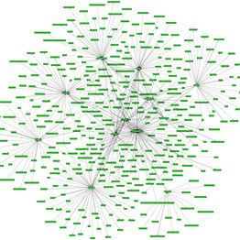
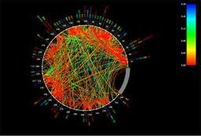







Big Data Challenge
Peta 10^15
Tera 10^12
Giga 10^9
Mega 10^6
Notes:
The primary function of data flow language and runtimes is the management and manipulation of data. The sample systems include the MapReduce architecture pioneered by Google and the open-source implementation called Hadoop. 30 peta new gene data per data. High through put gene sequence data .

Slide 4
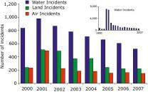
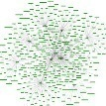


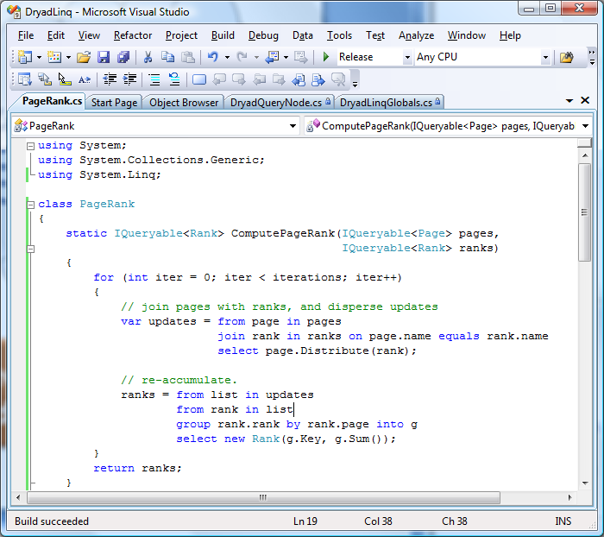
MapReduce Processing Model
Scheduling
Fault tolerance
Workload balance
Communication

Slide 5
Disadvantages in MapReduce
Rigid and flat data processing paradigm are difficult to express semantic of relational operation, such as Join.
Pig or Hive can solve above issue to some extent but has several limitations:
  Relational operations are converted into a set of MapReduce tasks for execution
  For some equal join, it needs to materialize entire cross product to the disk
Sample: MapReduce PageRank
Notes:
The classic MapReduce PageRank is very inefficient as the Join step in MapReduce PageRank spawns a very large number of Map and Reduce tasks during the processing; table. (MapReduce Not efficient for relational operation for large scale input data)

Slide 6
Microsoft Dryad Processing Model
Outputs
Directed Acyclic Graph (DAG)
Processing
vertices
Channels
(file, pipe,
shared
memory)
Inputs

Slide 7
Microsoft DryadLINQ Programming Model
Higher level programing interface for Dryad
Based on LINQ model
Unified data model
Integrated into .NET language
Strong typed .NET objects
Common LINQ providers
Provider | Base class
<T> | Strong typed .NET objects
LINQ-to-objects | IEnumerable<T>
PLINQ | ParallelQuery<T>
DryadLINQ | DistributedQuery<T>
Notes:
Matrix Multiplication, sequential, threads, multinodes, OpenMPI, DryadLINQ provide unified data model based on LINQ and .NET language

Slide 8
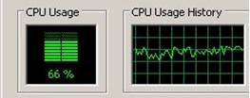

Pleasingly Parallel Programing Patterns
Sample applications:
SAT problem
Parameter sweep
Blast, SW-G bio
Issue:
Scheduling resources in the granularity of node rather than core
Query
DryadLINQ
Subquery
Subquery
Subquery
Subquery
Subquery
User defined function
User defined function
Application Program
Legacy Code

Slide 9
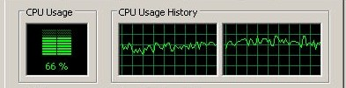

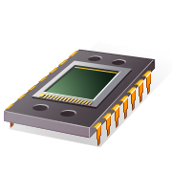
Hybrid Parallel Programming Pattern
Query
Sample applications:
  Matrix Multiplication
  GTM and MDS
Solve previous issue by using PLINQ, TPL, Thread Pool technologies
DryadLINQ
subquery
User defined
function
PLINQ
TPL
Notes:
(Font color, todo ) MPI+OpenMP; DyradLINQ and PLINQ have same data model, its very easy to use them just PLINQ asParallel.

Slide 10
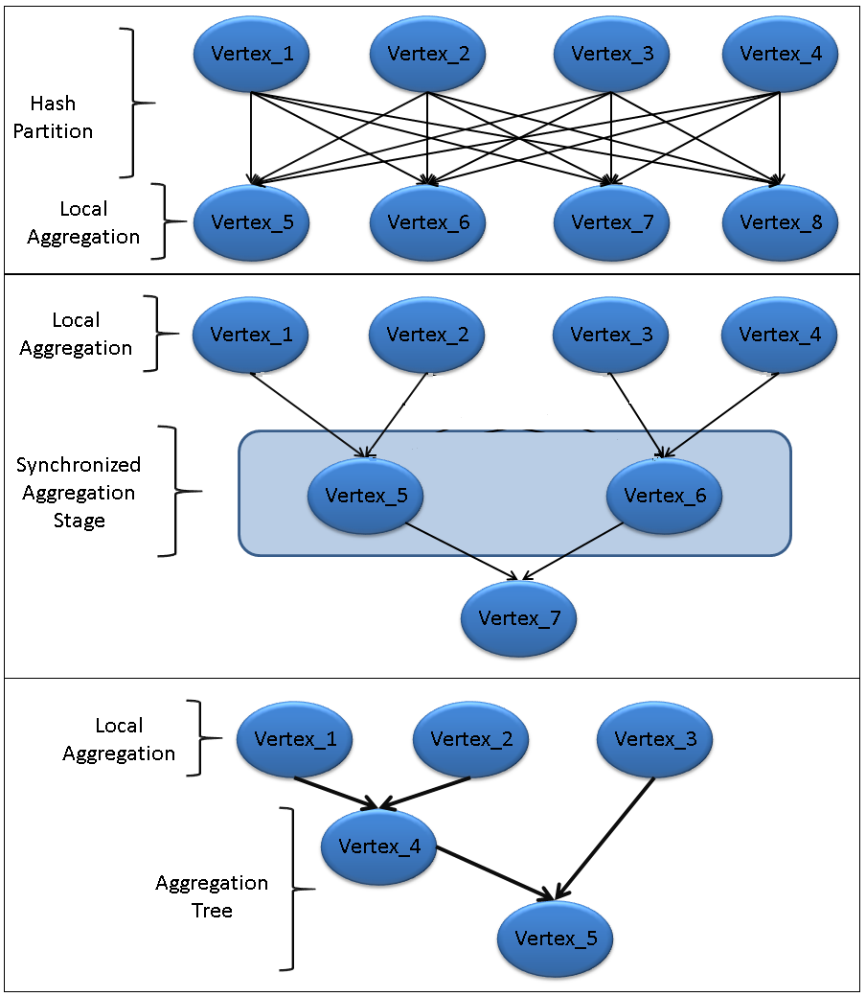
Distributed Grouped Aggregation Pattern
Sample applications:
  Word count
  PageRank
Three aggregation approaches:
  Naïve aggregation
  Hierarchical aggregation
  Aggregation tree

Slide 11
Implementation and Performance
Hardware configuration
TEMPEST | TEMPEST | TEMPEST-CNXX
CPU | Intel E7450 | Intel E7450
Cores | 24 | 24
Memory | 24.0 GB | 50.0 GB
Memory/Core | 1 GB | 2 GB
STORM | STORM-CN01,CN02, CN03 | STORM-CN04,CN05 | STORM-CN06,CN07
CPU | AMD 2356 | AMD 8356 | Intel E7450
Cores | 8 | 16 | 24
Memory | 16 GB | 16 GB | 48 GB
Memory/Core | 2 GB | 1 GB | 2 GB
We use DryadLINQ CTP version released in December 2010
Windows HPC R2 SP2
.NET 4.0, Visual Studio 2010

Slide 12
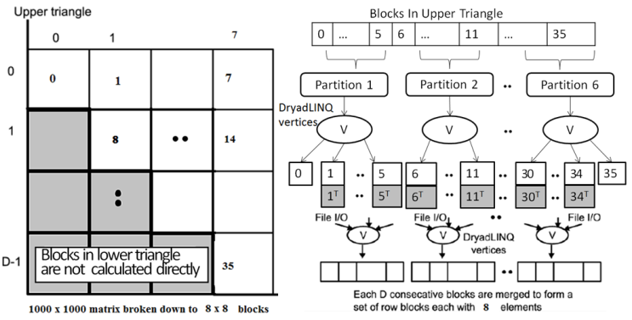
Pairwise sequence comparison using Smith Waterman Gotoh
Pleasingly parallel application
Easy to program with DryadLINQ
Easy to tune task granularity with DryadLINQ API
Var SWG_Blocks = create_SWG_Blocks(AluGeneFile, numOfBlocks, BlockSize)
Var inputs= SWG_Blocks.AsDistributedFromPartitions();
Var outputs= inputs.Select(distributedObject => SWG_Program(distributedObject));
Notes:
The purpose of this job is to study the performance of scheduling in new dryad; and we’ll use the SW-G application to do this job.
in previous report there is issue the scheduling in prvious dryad do not perform as well as that in hadoop for inhomogenesou tasks.

Slide 13
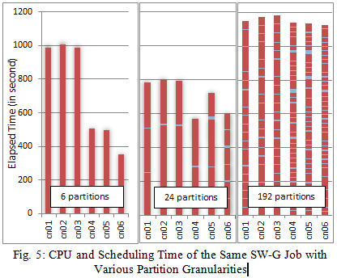
Workload balance in SW-G
SWG tasks are heterogeneous in CPU time.
Coarse task granularity brings workload balance issue
Finer task granularity has more scheduling overhead
Simply solution: tune the task granularity with DryadLINQ API
Related API:
  AsDistributedFromPartition()
  RangePartition<Type t>()

Slide 14
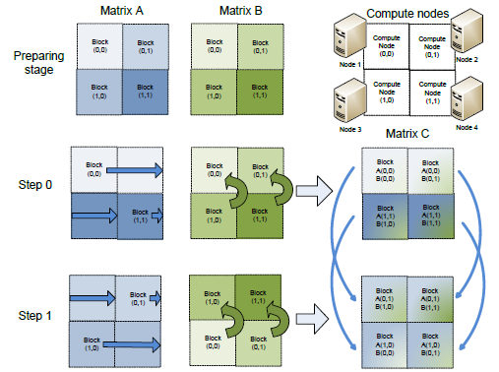
Square dense matrix multiplication
Parallel MM algorithms:
1.Row partition
2.Row/Column partition
3.Fox algorithm
Multiple core parallel technologies:
1.PLINQ,
2.TPL,
3.Thread Pool
Pseudo Code of Fox algorithm:
Partitioned matrix A, B to blocks
For each iteration i:
1) broadcast matrix A block (k,j) to row k
2) compute matrix C blocks, and add the partial results to the previous result of matrix C block
3) roll-up matrix B block by column
Notes:
Program easily scale from multiple core to multiple nodes; it cost 300 lines to implement Fox algorithm with DryadLINQ. Implement Row partition is easy cost about 50 lines; do not pipeline the communication. MPI can broadcast to a subset of grid of processors, while DryadLinq not. It can pipeline the communication, while Dryad can pipeline the execution of computation steps.

Slide 15
Matrix multiplication performance results
1core on 16 nodes V.S 24 cores on 16 nodes
Notes:
Font Size (todo) X , Y axis, add box to set of results, number of nodes

Slide 16
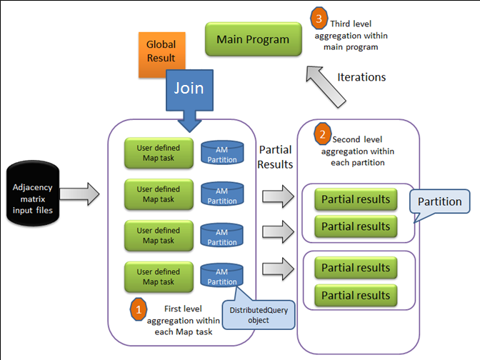
PageRank
Three distributed grouped aggregation approaches
  Naïve aggregation
  Hierarchical aggregation
  Aggregation Tree
Foreach iteration
{
join edges with ranks
distribute ranks on edges
groupBy edge destination
aggregate into ranks
}
PageRank with hierarchical aggregation approach
[1] Pagerank Algorithm, http://en.wikipedia.org/wiki/PageRank
[2] ClueWeb09 Data Set, http://boston.lti.cs.cmu.edu/Data/clueweb09/
Notes:
Calculate the ranking of a set web pages by propogate the score of pages by go through the hyper links within web graph.
PageRank is basical join the rank value table and web graph table.

Slide 17
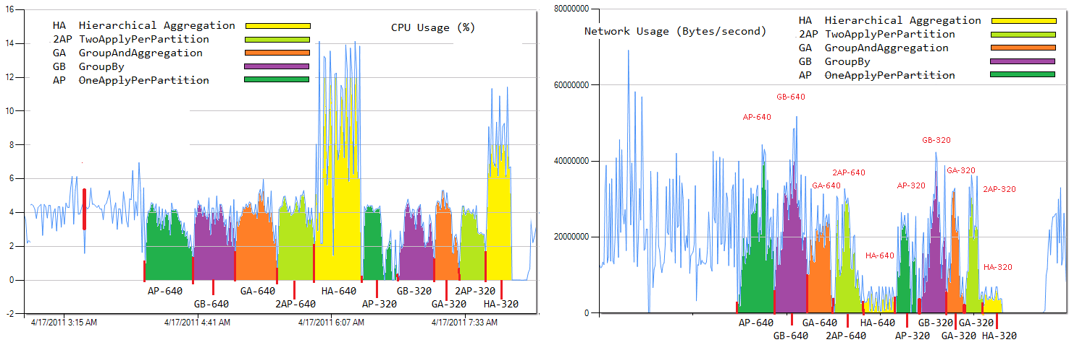
PageRank performance results
Naïve aggregation v.s Aggregation Tree
Notes:
The purpose of this job is to evalute the grouped aggregation in dryadlinq. Diverge, converge

Slide 18
Conclusion
  We investigated the usability and performance of using DryadLINQ to develop three applications: SW-G, Matrix Multiply, PageRank. And we abstracted three design patterns: pleasingly parallel programming pattern, hybrid parallel programming pattern, distributed aggregation pattern
Usability
  It is easy to tune task granularity with DryadLINQ data model and interfaces
  The unified data model and interface enable developers to easily utilize the parallelism of single-core, multi-core and multi-node environments.
  DryadLINQ provide optimized distributed aggregation approaches, and the choice of approaches have materialized effect on the performance
Performance
  The parallel MM algorithm scale up for large matrices sizes.
  Distributed aggregation optimization can speed up the program by 30% than naïve approach
Notes:
(Change programming model into patterns)!

Slide 19
Question?
Thank you!

Slide 20
Outline
Introduction
  Big Data Challenge
  MapReduce
  DryadLINQ CTP
Programming Model Using DryadLINQ
  Pleasingly
  Hybrid
  Distributed Grouped Aggregation
Implementation
Discussion and Conclusion

Slide 21
Workflow of Dryad job
Notes:
DryadLinq is library for the .Net framework that enables developes to easilty write prorams that process large disttirubed data sets
Distributred objects that developers can apply some application LINQ operation on these objects like select, groupby

