Slide 1
Data Intensive Biomedical Computing Systems
Statewide IT Conference
October 1, 2009, Indianapolis
Judy Qiu
xqiu@indiana.edu www.infomall.org/salsa
Community Grids Laboratory,
Pervasive Technology Institute
Indiana University

Slide 2
Indiana University
SALSA Technology Team
Geoffrey Fox
Judy Qiu
Scott Beason
Jaliya Ekanayake
Thilina Gunarathne
Jong Youl Choi
Yang Ruan
Seung-Hee Bae
Hui Li
Community Grids Lab
and UITS RT – PTI

Slide 3
Data Intensive Science Applications
We study computer system architecture and novel software technologies including MapReduce and Clouds.
We stress study of data intensive biomedical applications in areas of
  Expressed Sequence Tag (EST) sequence assembly using CAP3,
  pairwise Alu sequence alignment using Smith Waterman dissimilarity,
  correlating childhood obesity with environmental factors using various statistical analysis technologies,
  mapping over 20 million entries in PubChem into two or three dimensions to aid selection of related chemicals for drug discovery.
We develop a suite of high performance data mining tools to provide an end-to-end solution.
  Deterministic Annealing Clustering,
  Pairwise Clustering, MDS (Multi Dimensional Scaling),
  GTM (Generative Topographic Mapping)
  Plotviz visualization

Slide 4
Data Intensive Architecture
Database
Database
Database
Instruments
User Data
Files
Files
Files
Visualization
User Portal
Knowledge
Discovery
Database
Database
Database
Users
Files
Files
Files
Database
Database
Database
Files
Files
Files
Initial
Processing
Higher Level Processing
(e.g. R, PCA, Clustering
Correlations)
maybe MPI
Prepare for Visualization
(e.g. MDS)

Slide 5
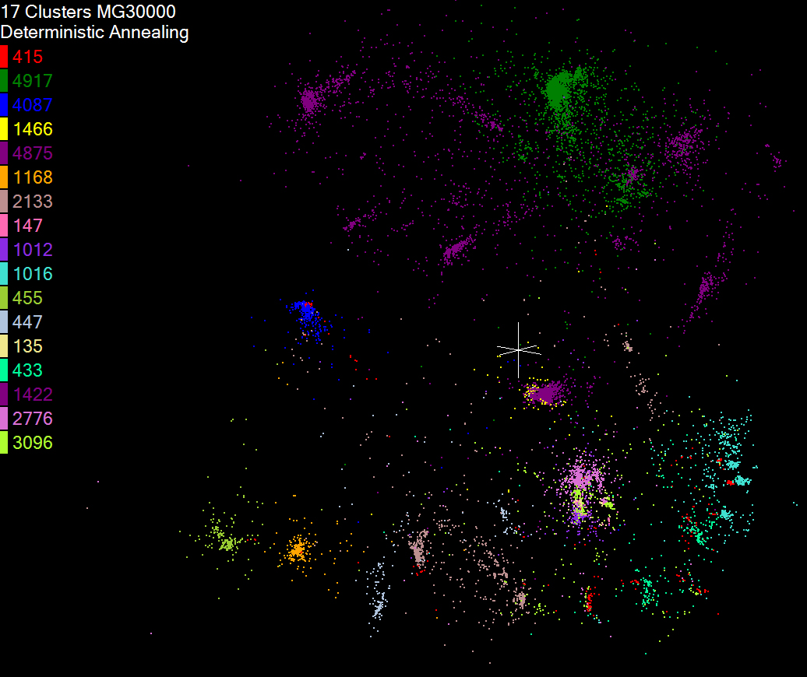
Initial Clustering of 16sRNA Sequences

Slide 6
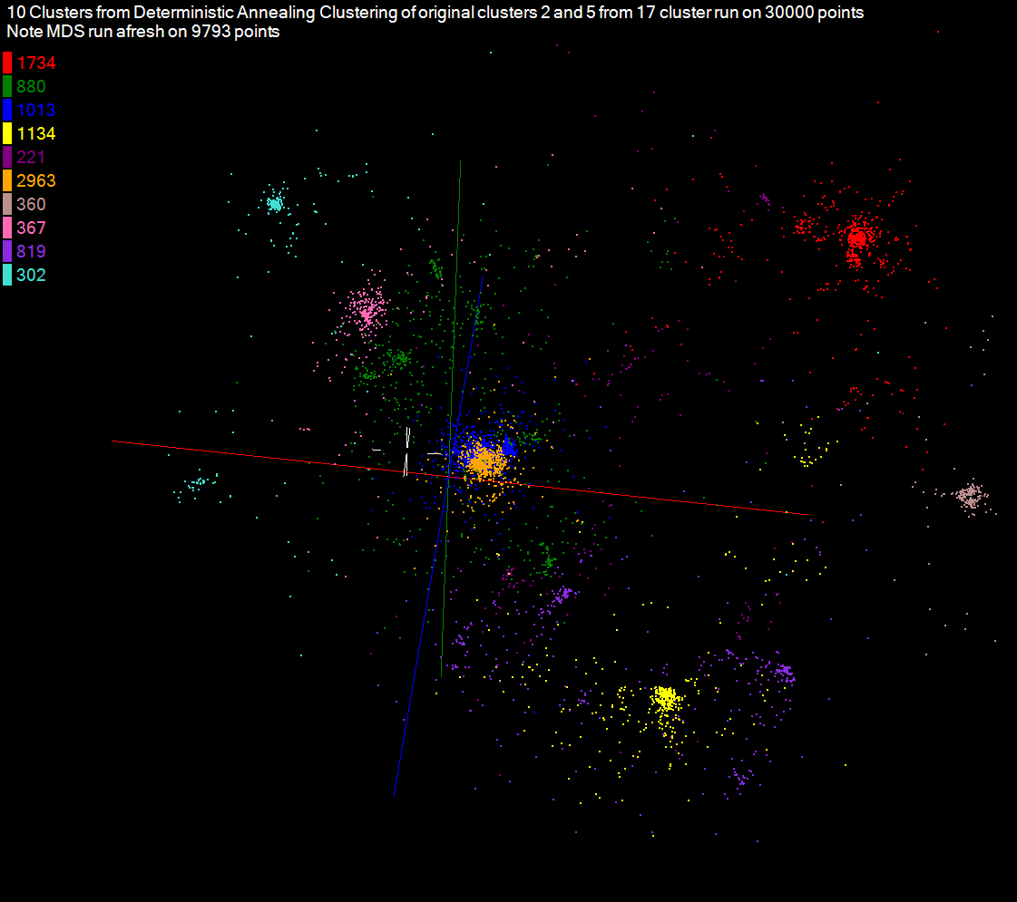
Hierarchical Clustering of subgroups of 16sRNA Sequences

Slide 7
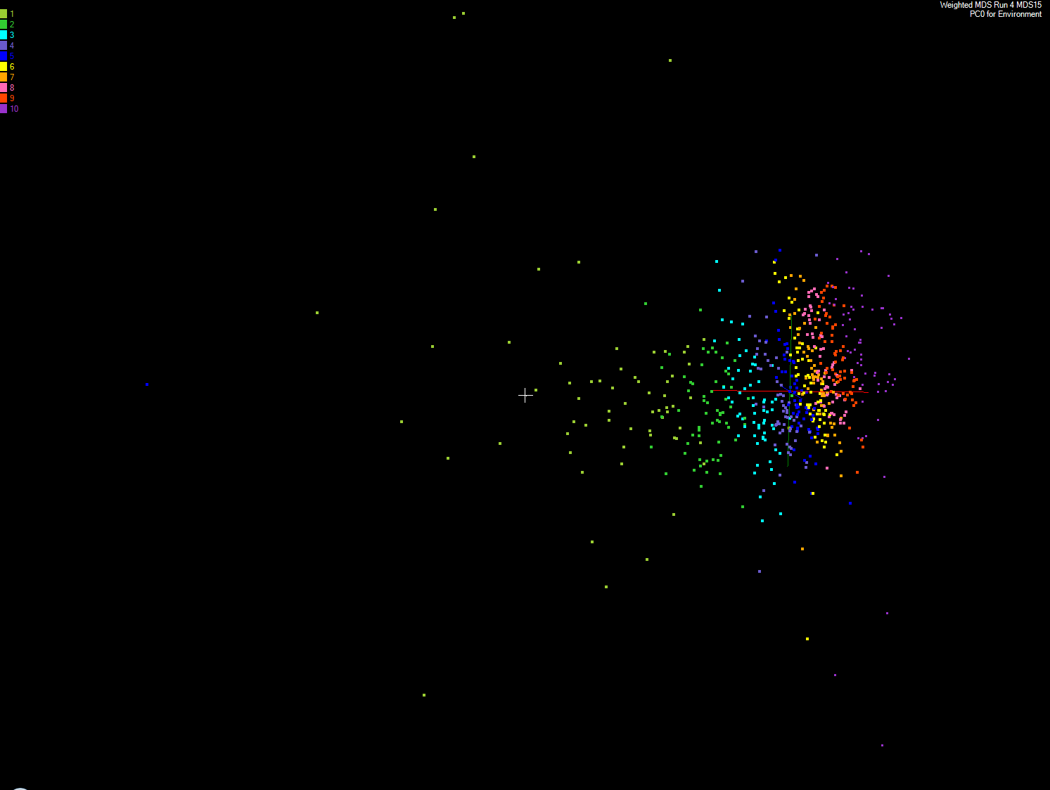
Correlating Childhood obesity with environmental factors
Apply MDS to Patient Record Data and correlation to GIS properties
MDS of 635 Census Blocks with 97 Environmental Properties
Shows expected Correlation with Principal Component – color varies from greenish to reddish as projection of leading eigenvector changes value
Ten color bins used

Slide 8
Key Features of our Approach
Initially we will make key capabilities available as services that we eventually be implemented on virtual clusters (clouds) to address very large problems
  Basic Pairwise dissimilarity calculations
  R (done already by us and others)
  MDS in various forms
  Vector and Pairwise Deterministic annealing clustering
Point viewer (Plotviz) either as download (to Windows!) or as a Web service
Note all our code written in C# (high performance managed code) and runs on Microsoft HPCS 2008 (with Dryad extensions)

Slide 9
Cloud Computing: Infrastructure and Runtimes
Cloud infrastructure: outsourcing of servers, computing, data, file space, etc.
  Handled through Web services that control virtual machine lifecycles.
Cloud runtimes: tools (for using clouds) to do data-parallel computations.
  Apache Hadoop, Google MapReduce, Microsoft Dryad, and others
  Designed for information retrieval but are excellent for a wide range of science data analysis applications
  Can also do much traditional parallel computing for data-mining if extended to support iterative operations
  Not usually on Virtual Machines

Slide 10
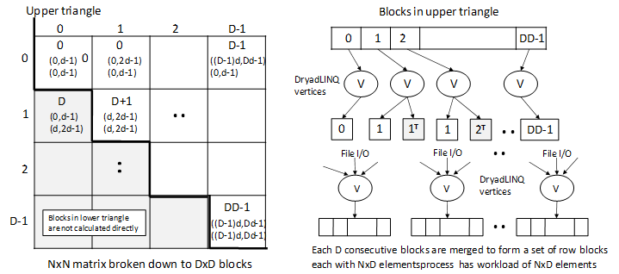
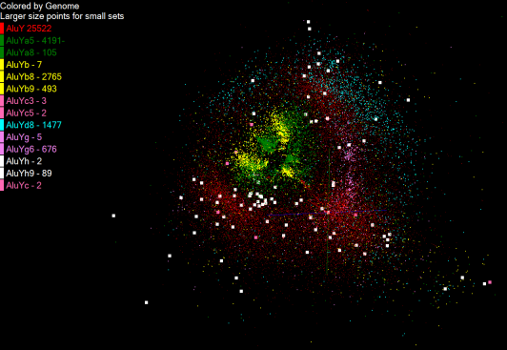
Pairwise Distances – ALU Sequencing
125 million distances
4 hours & 46 minutes
Calculate pairwise distances for a collection of genes (used for clustering, MDS)
O(N^2) problem
“Doubly Data Parallel” at Dryad Stage
Performance close to MPI
Performed on 768 cores (Tempest Cluster)
Processes work better than threads when used inside vertices
100% utilization vs. 70%
Notes:
1~180 lines without threading in DryadLINQ, with threading, it is about 400 lines
MPI ~500 lines
The Alu clustering problem [27] is one of the most challenging problems for sequencing clustering because Alus represent the largest repeat families in human genome. There are about 1 million copies of Alu sequences in human genome, in which most insertions can be found in other primates and only a small fraction (~ 7000) are human-specific. This indicates that the classification of Alu repeats can be deduced solely from the 1 million human Alu elements. Notable, Alu clustering can be viewed as a classical case study for the capacity of computational infrastructures because it is not only of great intrinsic biological interests, but also a problem of a scale that will remain as the upper limit of many other clustering problem in bioinformatics for the next few years, e.g. the automated protein family classification for a few millions of proteins predicted from large metagenomics projects. In our work here we examine Alu samples of 35339 and 50,000 sequences.

Slide 11
Applications & Different Interconnection Patterns
Map Only | Classic MapReduce | Iterative Reductions | Loosely Synchronous
CAP3 Analysis Document conversion (PDF -> HTML) Brute force searches in cryptography Parametric sweeps | High Energy Physics (HEP) Histograms Distributed search Distributed sorting Information retrieval | Expectation maximization algorithms Clustering Linear Algebra | Many MPI scientific applications utilizing wide variety of communication constructs including local interactions
- CAP3 Gene Assembly - PolarGrid Matlab data analysis | - Information Retrieval - HEP Data Analysis - Calculation of Pairwise Distances for ALU Sequences | Kmeans Deterministic Annealing Clustering - Multidimensional Scaling MDS | - Solving Differential Equations and - particle dynamics with short range forces
Input
iterations
Input
Input
map
map
map
Pij
reduce
Output
reduce
Domain of MapReduce and Iterative Extensions
MPI

Slide 12
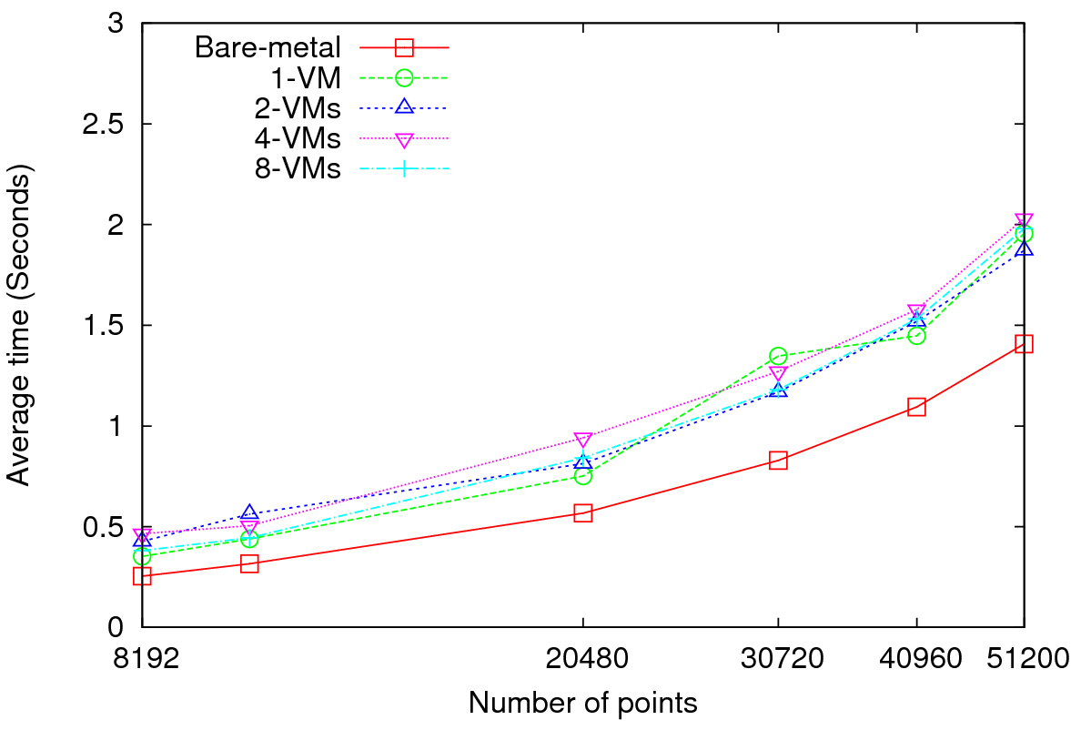
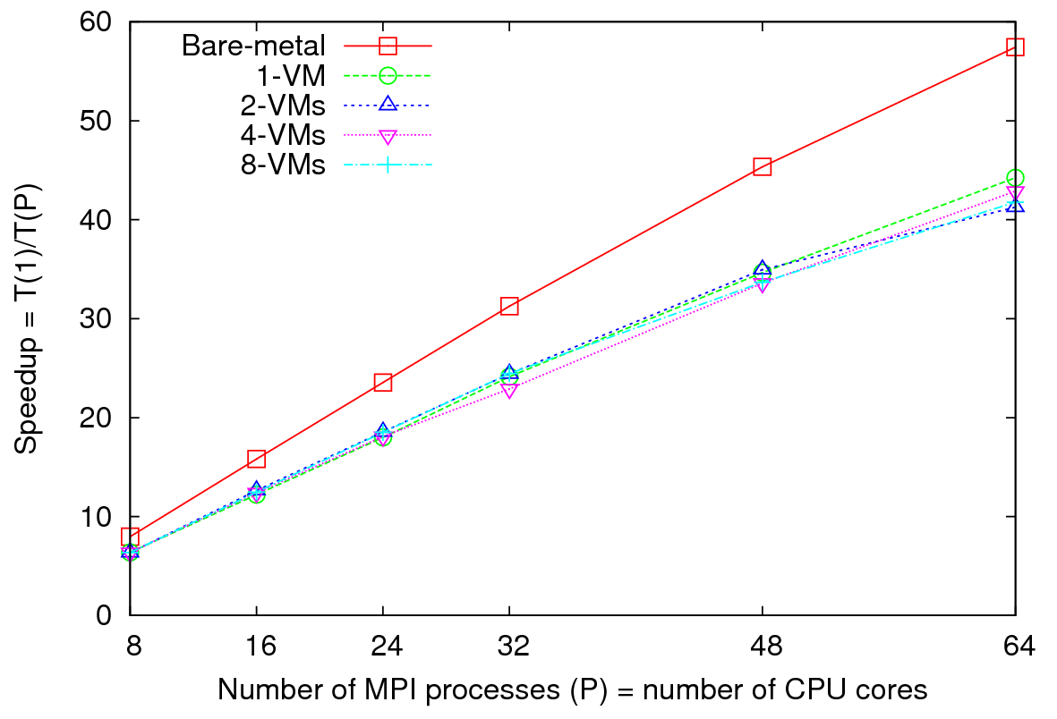
MPI on Clouds
Parallel Wave Equation Solver
Performance - 64 CPU cores
Total Speedup – 30720 data points
Clear difference in performance and speedups between VMs and bare-metal
Very small messages (the message size in each MPI_Sendrecv() call is only 8 bytes)
More susceptible to latency
At 51200 data points, at least 40% decrease in performance is observed in VMs

Slide 13
Dryad versus MPI for Smith Waterman
Flat is perfect scaling

Slide 14
Dryad versus MPI for Smith Waterman
Flat is perfect scaling

Slide 15


Slide 16
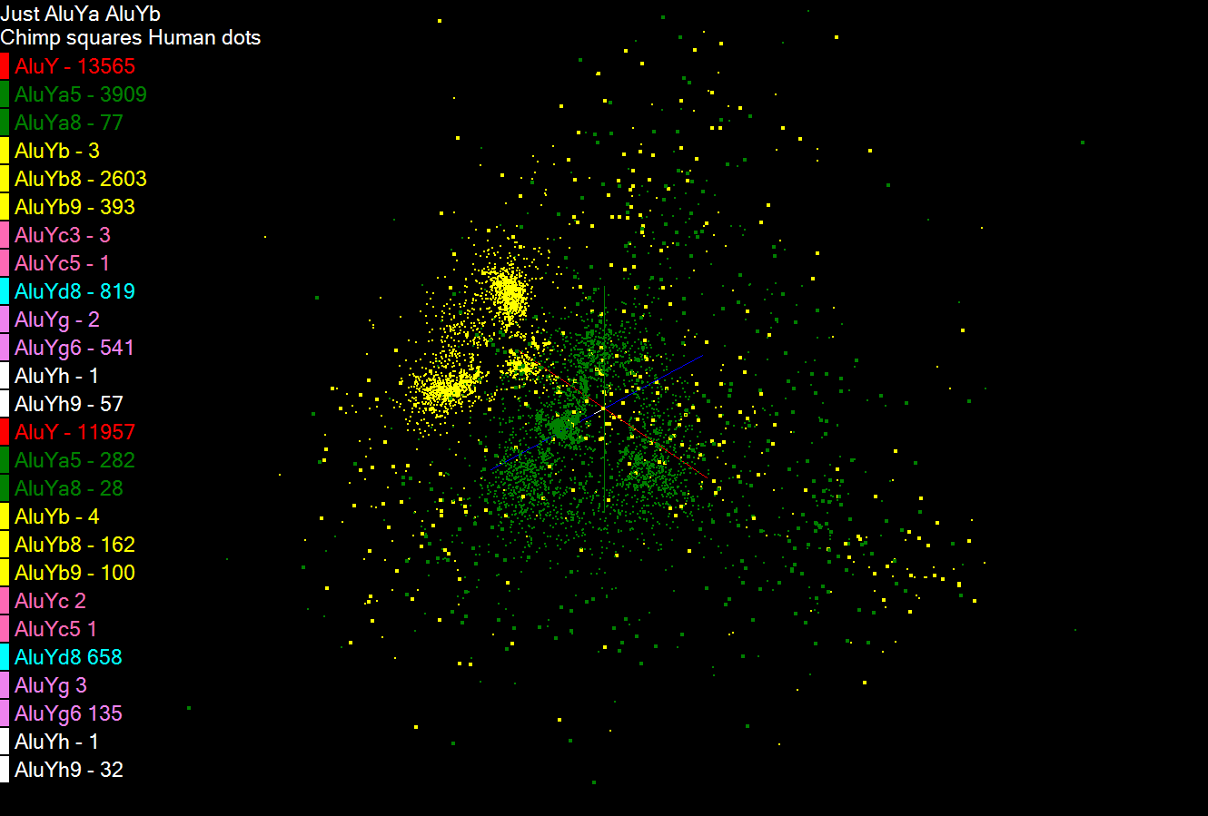

Slide 17
Scheduling of Tasks
DryadLINQ Job
Partitions
/vertices
DryadLINQ schedules
Partitions to nodes
Hadoop Schedules map/reduce tasks
directly to CPU cores
1
PLINQ sub tasks
PLINQ explores
Further parallelism
2
Threads
Threads map PLINQ
Tasks to CPU cores
3
CPU cores
Problem
1
4 CPU cores
4 CPU cores
Partitions
1
2
3
Time
Partitions
1
2
3
Time
Better utilization when tasks are homogenous
Under utilization when tasks are non-homogenous

Slide 18
DryadLINQ on Cloud
HPC release of DryadLINQ requires Windows Server 2008
Amazon does not provide this VM yet
Used GoGrid cloud provider
Before Running Applications
  Create VM image with necessary software
    E.g. NET framework
  Deploy a collection of images (one by one – a feature of GoGrid)
  Configure IP addresses (requires login to individual nodes)
  Configure an HPC cluster
  Install DryadLINQ
  Copying data from “cloud storage”
  We configured a 32 node virtual cluster in GoGrid

Slide 19
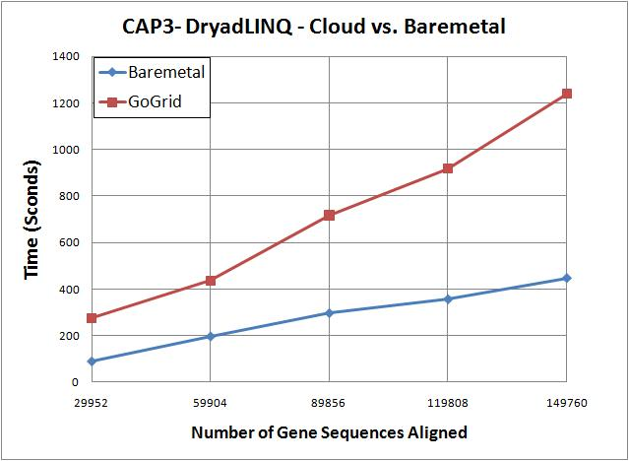
DryadLINQ on Cloud contd..
CAP3 works on cloud
Used 32 CPU cores
100% utilization of virtual CPU cores
3 times more time in cloud than the bare-metal runs on different
CloudBurst and Kmeans did not run on cloud
VMs were crashing/freezing even at data partitioning
  Communication and data accessing simply freeze VMs
  VMs become unreachable
We expect some communication overhead, but the above observations are more GoGrid related than to Cloud

Slide 20
Data Intensive Architecture
Instruments
User Data
Files
Files
Files
Visualization
User Portal
Knowledge
Discovery
Users
Files
Files
Files
Initial
Processing
Higher Level
Processing
Such as R
PCA, Clustering
Correlations …
Maybe MPI
Prepare for
Viz
MDS

Slide 21
Scheduling of Tasks contd..
Problem
2
PLINQ Scheduler and coarse grained tasks
E.g. A data partition contains 16 records, 8 CPU cores in a node of MSR Cluster
We expect the scheduling of tasks to be as follows
X-ray tool shows this ->
8 CPU cores
100% 50% 50%
utilization of CPU cores
Heuristics at PLINQ (version 3.5) scheduler does not seem to work well for coarse grained tasks
Workaround
  Use “Apply” instead of “Select”
  Apply allows iterating over the complete partition (“Select” allows accessing a single element only)
  Use multi-threaded program inside “Apply” (Ugly solution invoking processes!)
  Bypass PLINQ
Problem
3
Discussed Later

Slide 22
