Slide 1
Scalable Deep Analytics on Cloud and High Performance Computing Environments
NASA SACD Lecture Series on Complex Systems and Deep Analytics
NASA Langley Research Center Building 1209, Room 180 Conference Room
August 8 2012
Geoffrey Fox
gcf@indiana.edu
http://www.infomall.org http://www.futuregrid.org
School of Informatics and Computing
Digital Science Center
Indiana University Bloomington

Slide 2
Abstract
We posit that big data implies robust data-mining algorithms that must run in parallel to achieve needed performance.
Ability to use Cloud computing allows us to tap cheap commercial resources and several important data and programming advances. Nevertheless we also need to exploit traditional HPC environments. We discuss our approach to this challenge which involves Iterative MapReduce as an interoperable Cloud-HPC runtime.
We stress that the communication structure of data analytics is very different from classic parallel algorithms as one uses large collective operations (reductions or broadcasts) rather than the many small messages familiar from parallel particle dynamics and partial differential equation solvers.
One needs different runtime optimizations from those in typical MPI runtimes.
We describe our experience using deterministic annealing to build robust parallel algorithms for clustering, dimension reduction and hidden topic/context determination.
We suggest that a coordinated effort is needed to build quality scalable robust data mining libraries to enable big data analysis across many fields.

Slide 3
Clouds Grids and HPC

Slide 4
Science Computing Environments
Large Scale Supercomputers – Multicore nodes linked by high performance low latency network
  Increasingly with GPU enhancement
  Suitable for highly parallel simulations
High Throughput Systems such as European Grid Initiative EGI or Open Science Grid OSG typically aimed at pleasingly parallel jobs
  Can use “cycle stealing”
  Classic example is LHC data analysis
Grids federate resources as in EGI/OSG or enable convenient access to multiple backend systems including supercomputers
  Portals make access convenient and
  Workflow integrates multiple processes into a single job
Specialized visualization, shared memory parallelization etc. machines

Slide 5
Clouds and Grids/HPC
Synchronization/communication Performance
Grids > Clouds > Classic HPC Systems
Clouds naturally execute effectively Grid workloads but are less clear for closely coupled HPC applications
Service Oriented Architectures portals and workflow appear to work similarly in both grids and clouds
May be for immediate future, science supported by a mixture of
  Clouds – some practical differences between private and public clouds – size and software
  High Throughput Systems (moving to clouds as convenient)
  Grids for distributed data and access
  Supercomputers (“MPI Engines”) going to exascale

Slide 6
What Applications work in Clouds
Pleasingly parallel applications of all sorts with roughly independent data or spawning independent simulations
  Long tail of science and integration of distributed sensors
Commercial and Science Data analytics that can use MapReduce (some of such apps) or its iterative variants (most other data analytics apps)
Which science applications are using clouds?
  Many demonstrations –Conferences, OOI, HEP ….
  Venus-C (Azure in Europe): 27 applications not using Scheduler, Workflow or MapReduce (except roll your own)
  50% of applications on FutureGrid are from Life Science but there is more computer science than total applications
  Locally Lilly corporation is major commercial cloud user (for drug discovery) but Biology department is not

Slide 7
2 Aspects of Cloud Computing:
Infrastructure and Runtimes
Cloud infrastructure: outsourcing of servers, computing, data, file space, utility computing, etc..
Cloud runtimes or Platform: tools to do data-parallel (and other) computations. Valid on Clouds and traditional clusters
  Apache Hadoop, Google MapReduce, Microsoft Dryad, Bigtable, Chubby and others
  MapReduce designed for information retrieval but is excellent for a wide range of science data analysis applications
  Can also do much traditional parallel computing for data-mining if extended to support iterative operations
  Data Parallel File system as in HDFS and Bigtable

Slide 8
Analytics and Parallel Computing on Clouds and HPC

Slide 9
Classic Parallel Computing
HPC: Typically SPMD (Single Program Multiple Data) “maps” typically processing particles or mesh points interspersed with multitude of low latency messages supported by specialized networks such as Infiniband and technologies like MPI
  Often run large capability jobs with 100K (going to 1.5M) cores on same job
  National DoE/NSF/NASA facilities run 100% utilization
  Fault fragile and cannot tolerate “outlier maps” taking longer than others
Clouds: MapReduce has asynchronous maps typically processing data points with results saved to disk. Final reduce phase integrates results from different maps
  Fault tolerant and does not require map synchronization
  Map only useful special case
HPC + Clouds: Iterative MapReduce caches results between “MapReduce” steps and supports SPMD parallel computing with large messages as seen in parallel kernels (linear algebra) in clustering and other data mining

Slide 10
4 Forms of MapReduce
(a) Map Only
(b) Classic MapReduce
(c) Iterative MapReduce
(d) Loosely Synchronous
Input
Input
Iterations
Input
map
map
map
P_{ij}
reduce
reduce
Output
BLAST Analysis
Parametric sweep
Pleasingly Parallel
High Energy Physics (HEP) Histograms
Distributed search
Expectation maximization Clustering e.g. Kmeans
Linear Algebra, Page Rank
Classic MPI
PDE Solvers and particle dynamics
Domain of MapReduce and Iterative Extensions
Science Clouds
MPI
Exascale

Slide 11
Commercial “Web 2.0” Cloud Applications
Internet search, Social networking, e-commerce, cloud storage
These are larger systems than used in HPC with huge levels of parallelism coming from
  Processing of lots of users or
  An intrinsically parallel Tweet or Web search
Classic MapReduce is suitable (although Page Rank component of search is parallel linear algebra)
Data Intensive
Do not need microsecond messaging latency

Slide 12
Data Intensive Applications
Applications tend to be new and so can consider emerging technologies such as clouds
Do not have lots of small messages but rather large reduction (aka Collective) operations
  New optimizations e.g. for huge messages
  e.g. Expectation Maximization (EM) dominated by broadcasts and reductions
Not clearly a single exascale job but rather many smaller (but not sequential) jobs e.g. to analyze groups of sequences
Algorithms not clearly robust enough to analyze lots of data
  Current standard algorithms such as those in R library not designed for big data
Our Experience
  Multidimensional Scaling MDS is iterative rectangular matrix-matrix multiplication controlled by EM
  Deterministically Annealed Pairwise Clustering as an EM example

Slide 13
Twister for Data Intensive
Iterative Applications
Generalize to arbitrary Collective
Broadcast
Compute
Communication
Reduce/ barrier
New Iteration
Smaller Loop-Variant Data
Larger Loop-Invariant Data
(Iterative) MapReduce structure with Map-Collective is framework
Twister runs on Linux or Azure
Twister4Azure is built on top of Azure tables, queues, storage
Notes:
Most of these applications consists of iterative computation and communication steps where single iterations can easily be specified as MapReduce computations.
Large input data sizes which are loop-invariant and can be reused across iterations.
Loop-variant results.. Orders of magnitude smaller…
While these can be performed using traditional MapReduce frameworks, Traditional is not efficient for these types of computations. MR leaves lot of room for improvements in terms of iterative applications.

Slide 14





Performance – Kmeans Clustering
Overhead between iterations
First iteration performs the initial data fetch
Twister4Azure
Task Execution Time Histogram
Number of Executing Map Task Histogram
Hadoop
Twister
Hadoop on bare metal scales worst
Twister4Azure(adjusted for C#/Java)
Strong Scaling with 128M Data Points
Weak Scaling
Qiu, Gunarathne
Performance with/without
data caching
Speedup gained using data cache
Scaling speedup
Increasing number of iterations

Slide 15
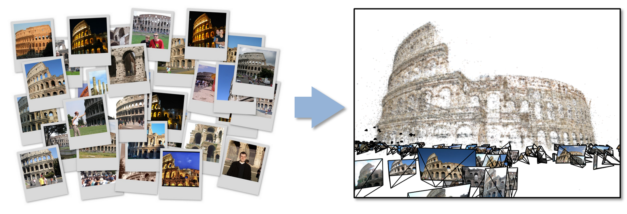
Data Intensive Kmeans Clustering
  ─ Image Classification: 1.5 TB; 500 features per image;10k clusters
  1000 Map tasks; 1GB data transfer per Map task
Work of Qiu and Zhang

Slide 16
Twister Communication Steps
Broadcast
Broadcasting
  Data could be large
  Chain & MST
Map Collectives
  Local merge
Reduce Collectives
  Collect but no merge
Combine
  Direct download or Gather
Map Tasks
Map Tasks
Map Tasks
Map Collective
Map Collective
Map Collective
Reduce Tasks
Reduce Tasks
Reduce Tasks
Reduce Collective
Reduce Collective
Reduce Collective
Work of Qiu and Zhang
Gather

Slide 17
Polymorphic Scatter-Allgather in Twister
Work of Qiu and Zhang

Slide 18
Twister Performance on Kmeans Clustering
Work of Qiu and Zhang

Slide 19
Data Analytics

Slide 20
General Remarks I
No agreement as to what is data analytics and what tools/computers needed
  Databases or NOSQL?
  Shared repositories or bring computing to data
  What is repository architecture?
Data from observation or simulation
Data analysis, Datamining, Data analytics., machine learning, Information visualization
Computer Science, Statistics, Application Fields
Big data (cell phone interactions) v. Little data (Ethnography, surveys, interviews)
Provenance, Metadata, Data Management

Slide 21
General Remarks II
Regression analysis; biostatistics; neural nets; bayesian nets; support vector machines; classification; clustering; dimension reduction; artificial intelligence
Patient records growing fast
Abstract graphs from net leads to community detection
Some data in metric spaces; others very high dimension or none
Large Hadron Collider analysis mainly histogramming – all can be done with MapReduce
Google, Bing largest data analytics in world
Time Series from Earthquakes to Tweets to Stock Market
  Pattern Informatics
Image Processing from climate simulations to NASA to DoD
Financial decision support; marketing; fraud detection; automatic preference detection (map users to books, films)

Slide 22
Traditional File System?
S
Data
C
C
C
C
S
C
C
C
C
Archive
Data
S
C
C
C
C
Data
C
C
C
C
S
Data
Compute Cluster
Storage Nodes
Typically a shared file system (Lustre, NFS …) used to support high performance computing
Big advantages in flexible computing on shared data but doesn’t “bring computing to data”
Object stores similar structure (separate data and compute) to this

Slide 23
Data Parallel File System?
Block1
Replicate each block
File1
Block2
……
Breakup
BlockN
C
C
C
C
Data
Data
Data
Data
C
C
C
C
Data
Data
Data
Data
C
C
C
C
Data
Data
Data
Data
C
C
C
C
Data
Data
Data
Data
Block1
File1
Block2
……
Breakup
Replicate each block
BlockN
No archival storage and computing brought to data

Slide 24
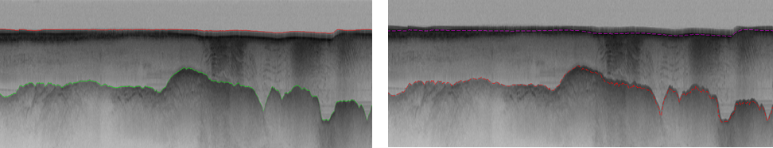
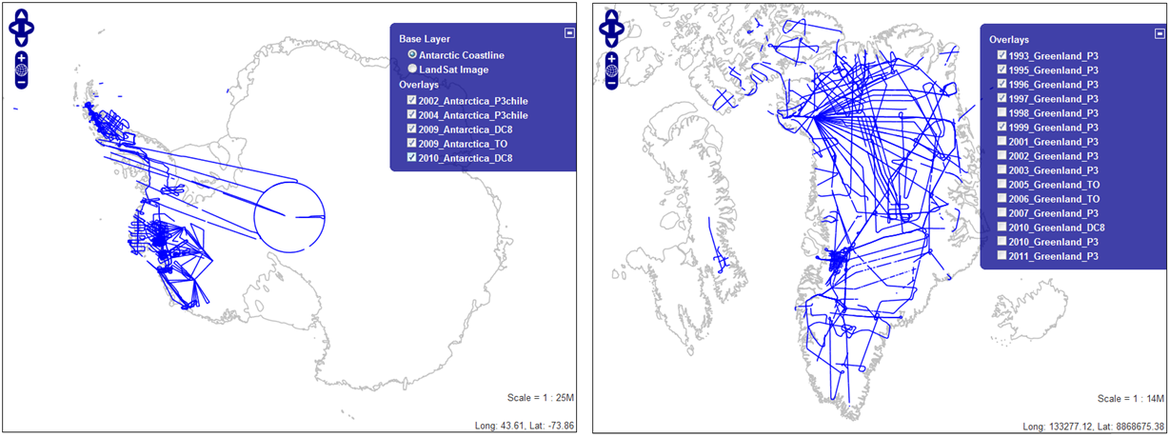
Building High Level Tools
Automatic Layer Determination developed by David Crandall added to collaboration from the faculty at Indiana University
Hidden Markov Method based Layer Finding Algorithm.
automatic layer finding algorithm
manual method
Data Browser

Slide 25
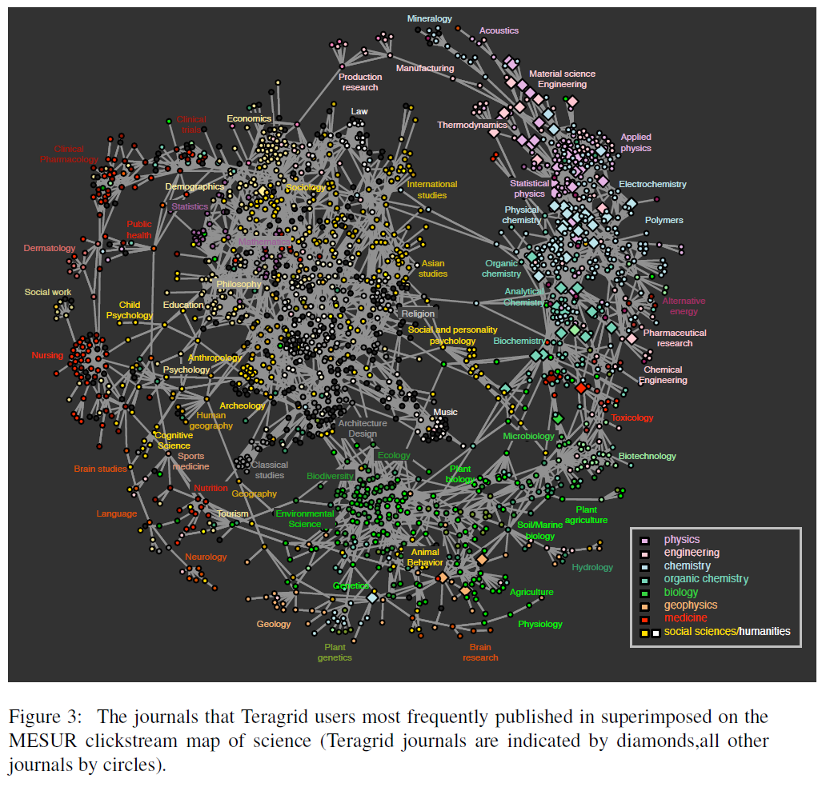
“Science of Science”
TeraGrid
User Areas

Slide 26
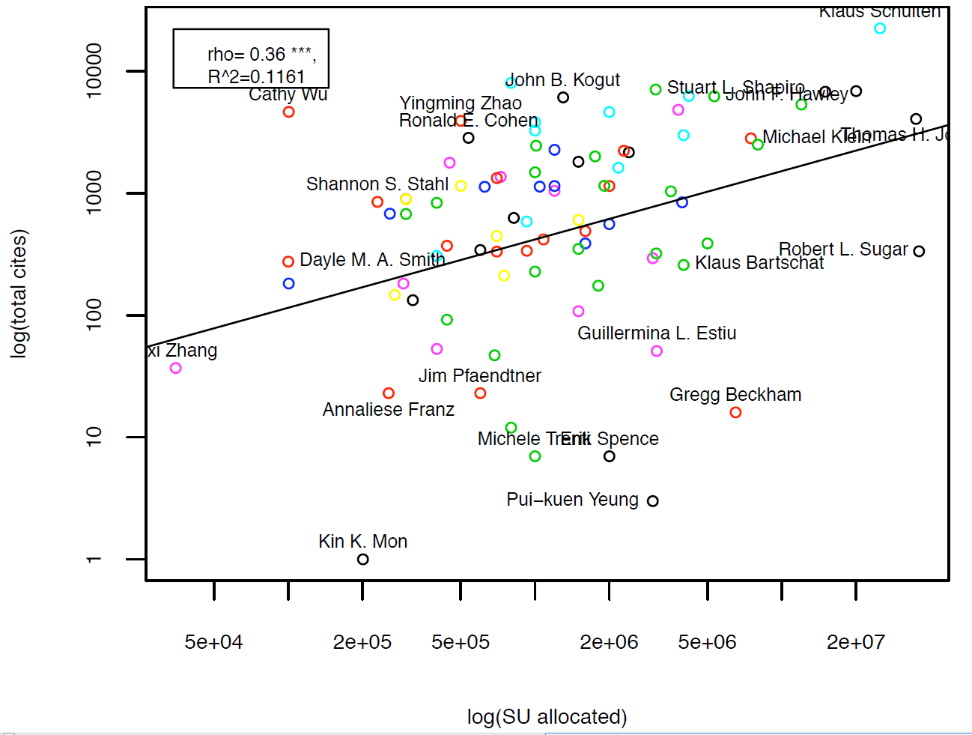
Science Impact Occurs
Throughout the Branscomb Pyramid

Slide 27
School | Program | On-Campus | Online | Degrees
Undergraduate
George Mason University cos.gmu.edu/academics/undergraduate/majors/computational-and-data-sciences | Computational and Data Sciences: the combination of applied math, real world CS skills, data acquisition and analysis, and scientific modeling | Yes | No | B.S.
Illinois Institute of Technology http://www.iit.edu/csl/cs/programs/data_science.shtml | CS Specialization in Data Science CIS specialization in Data Science |  |  | B.S.
Oxford University | Data and Systems Analysis | ? | Yes | Adv. Diploma
Masters
Bentley University graduate.bentley.edu/ms/marketing-analytics | Marketing Analytics: knowledge and skills that marketing professionals need for a rapidly evolving, data-focused, global business environment. | Yes | ? | M.S.
Carnegie Mellon http://vlis.isri.cmu.edu/ | MISM Business Intelligence and Data Analytics: an elite set of graduates cross-trained in business process analysis and skilled in predictive modeling, GIS mapping, analytical reporting, segmentation analysis, and data visualization. | Yes |  | M.S. 9 courses
Carnegie Mellon http://vlis.isri.cmu.edu/ | Very Large Information Systems: train technologists to (a) develop the layers of technology involved in the next generation of massive IS deployments (b) analyze the data these systems generate
DePaul University www.cdm.depaul.edu/academics/Pages/MSinPredictiveAnalytics.aspx | Predictive Analytics: analyze large datasets and develop modeling solutions for decision making, an understanding of the fundamental principles of marketing and CRM | Yes | ? | MS.
Georgia Southern University online.georgiasouthern.edu/index.php?link=grad_ComputerScience | Comp Sci with concentration in Data and Know. Systems: covers speech and vision recognition systems, expert systems, data storage systems, and IR systems, such as online search engines | No | Yes | M.S. 30 cr

Slide 28
Illinois Institute of Technology http://www.iit.edu/csl/cs/programs/data_science.shtml | CS specialization in Data Analytics: intended for learning how to discover patterns in large amounts of data in information systems and how to use these to draw conclusions. | Yes | ? | Masters 4 courses
Louisiana State University businessanalytics.lsu.edu/ | Business Analytics: designed to meet the growing demand for professionals with skills in specialized methods of predictive analytics 36 cr | Yes | No | M.S. 36 cr
Michigan State University broad.msu.edu/businessanalytics/ | Business Analytics: courses in business strategy, data mining, applied statistics, project management, marketing technologies, communications and ethics | Yes | No | M.S.
North Carolina State University: Institute for Advanced Analytics analytics.ncsu.edu/?page_id=1799 | Analytics: designed to equip individuals to derive insights from a vast quantity and variety of data | Yes | No | M.S.: 30 cr.
Northwestern University www.analytics.northwestern.edu/ | Predictive Analytics: a comprehensive and applied curriculum exploring data science, IT and business of analytics | Yes | Yes | M.S.
New York University www.stern.nyu.edu/programs-admissions/global-degrees/business-analytics/index.htm | Business Analytics: unlocks predictive potential of data analysis to improve financial performance, strategic management and operational efficiency | Yes | No | M.S. 1 yr
Stevens Institute of Technology www.stevens.edu/howeschool/graduate-programs/business-intelligence-analytics-bia-ms/ | Business Intel. & Analytics: offers the most advanced curriculum available for leveraging quant methods and evidence-based decision making for optimal business performance | Yes | Yes | M.S.: 36 cr.
University of Cincinnati business.uc.edu/programs/graduate/msbana.html | Business Analytics: combines operations research and applied stats, using applied math and computer applications, in a business environment | Yes | No | M.S.
University of San Francisco www.usfca.edu/analytics/ | Analytics: provides students with skills necessary to develop techniques and processes for data-driven decision-making — the key to effective business strategies | Yes | No | M.S.

Slide 29
Certificate
iSchool @ Syracuse ischool.syr.edu/academics/graduate/datascience/index.aspx/ | Data Science: for those with background or experience in science, stats, research, and/or IT interested in interdiscip work managing big data using IT tools | Yes | ? | Grad Cert. 5 courses
Rice University bigdatasi.rice.edu/ | Big Data Summer Institute: organized to address a growing demand for skills that will help individuals and corporations make sense of huge data sets | Yes | No | Cert.
Stanford University scpd.stanford.edu/public/category/courseCategoryCertificateProfile.do?method=load&certificateId=1209602 | Data Mining and Applications: introduces important new ideas in data mining and machine learning, explains them in a statistical framework, and describes their applications to business, science, and technology | No | Yes | Grad Cert.
University of California San Diego extension.ucsd.edu/programs/index.cfm?vAction=certDetail&vCertificateID=128&vStudyAreaID=14 | Data Mining: designed to provide individuals in business and scientific communities with the skills necessary to design, build, verify and test predictive data models | No | Yes | Grad Cert. 6 courses
University of Washington www.pce.uw.edu/certificates/data-science.html | Data Science: Develop the computer science, mathematics and analytical skills in the context of practical application needed to enter the field of data science | Yes | Yes | Cert.
Ph.D
George Mason University spacs.gmu.edu/content/phd-computational-sciences-and-informatics | Computational Sci and Informatics: role of computation in sci, math, and engineering, | Yes | No | Ph.D.
IU SoIC | Informatics | Yes | No | Ph.D

Slide 30
Data Intensive Futures?
PETSc and ScaLAPACK and similar libraries very important in supporting parallel simulations
Need equivalent Data Analytics libraries
Include datamining (Clustering, SVM, HMM, Bayesian Nets …), image processing, information retrieval including hidden factor analysis (LDA), global inference, dimension reduction
  Many libraries/toolkits (R, Matlab) and web sites (BLAST) but typically not aimed at scalable high performance algorithms
Should support clouds and HPC; MPI and MapReduce
  Iterative MapReduce an interesting runtime; Hadoop has many limitations
Need a coordinated Academic Business Government Collaboration to build robust algorithms that scale well
  Crosses Science, Business Network Science, Social Science
Propose to build community to define & implement
SPIDAL or Scalable Parallel Interoperable Data Analytics Library

Slide 31
Deterministic Annealing

Slide 32

Some Motivation
Big Data requires high performance – achieve with parallel computing
Big Data requires robust algorithms as more opportunity to make mistakes
Deterministic annealing (DA) is one of better approaches to optimization
  Tends to remove local optima
  Addresses overfitting
  Faster than simulated annealing
Return to my heritage (physics) with an approach I called Physical Computation (cf. also genetic algs) -- methods based on analogies to nature
Physics systems find true lowest energy state if you anneal i.e. you equilibrate at each temperature as you cool

Slide 33
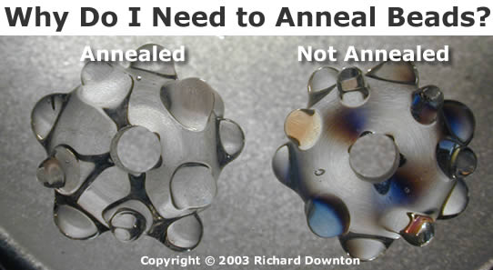
Some Ideas
Deterministic annealing is better than many well-used optimization problems
  Started as “Elastic Net” by Durbin for Travelling Salesman Problem TSP
Basic idea behind deterministic annealing is mean field approximation, which is also used in “Variational Bayes” and many “neural network approaches”
  Markov chain Monte Carlo (MCMC) methods are roughly single temperature simulated annealing
  Less sensitive to initial conditions
  Avoid local optima
  Not equivalent to trying random initial starts
Notes:
Color on right is stress from polarizing filters

Slide 34
Uses of Deterministic Annealing
Clustering
  Vectors: Rose (Gurewitz and Fox)
  Clusters with fixed sizes and no tails (Proteomics team at Broad)
  No Vectors: Hofmann and Buhmann (Just use pairwise distances)
Dimension Reduction for visualization and analysis
  Vectors: GTM
  No vectors: MDS (Just use pairwise distances)
Can apply to HMM & general mixture models (less study)
  Gaussian Mixture Models
  Probabilistic Latent Semantic Analysis with Deterministic Annealing DA-PLSA as alternative to Latent Dirichlet Allocation applied to documents or file access classification

Slide 35
Basic Deterministic Annealing
Gibbs Distribution at Temperature T
P(χ) = exp( - H(χ)/T) / ∫ dχ exp( - H(χ)/T)
Or P(χ) = exp( - H(χ)/T + F/T )
Minimize Free Energy combining Objective Function and Entropy
F = < H - T S(P) > = ∫ dχ {P(χ)H + T P(χ) lnP(χ)}
H is objective function to be minimized as a function of parameters χ
Simulated annealing corresponds to doing these integrals by Monte Carlo
Deterministic annealing corresponds to doing integrals analytically (by mean field approximation) and is much faster than Monte Carlo
In each case temperature is lowered slowly – say by a factor 0.95 to 0.99 at each iteration
  I used 0.9998484 in recent case when finding 29000 clusters

Slide 36
Implementation of DA Central Clustering
Here points are in a metric space
Clustering variables are M_{i}(k) where this is probability that point i belongs to cluster k and ∑_{k=1}^{K} M_{i}(k) = 1
In Central or PW Clustering, take H₀ = ∑_{i=1}^{N} ∑_{k=1}^{K} M_{i}(k) ε_{i}(k)
  Linear form allows DA integrals to be done analytically
Central clustering has ε_{i}(k) = (X(i)- Y(k))² and M_{i}(k) determined by Expectation step
  H_{Central} = ∑_{i=1}^{N} ∑_{k=1}^{K} M_{i}(k) (X(i)- Y(k))²
<M_{i}(k)> = exp( -ε_{i}(k)/T ) / ∑_{k=1}^{K} exp( -ε_{i}(k)/T )
  Centers Y(k) are determined in M step of EM method

Slide 37
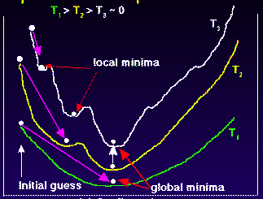
Deterministic
Annealing
F({y}, T)
Solve Linear Equations for each temperature
Nonlinear effects mitigated by initializing with solution at previous higher temperature
Configuration {y}
Minimum evolving as temperature decreases
Movement at fixed temperature going to false minima if not initialized “correctly

Slide 38
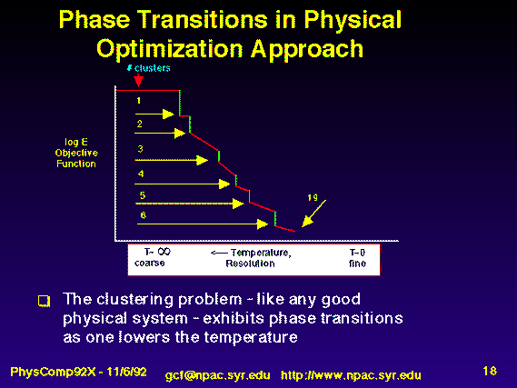
Rose, K., Gurewitz, E., and Fox, G. C. ``Statistical mechanics and phase transitions in clustering,'' Physical Review Letters, 65(8):945-948, August 1990.
My #6 most cited article (424 cites including 14 in 2012)
System becomes unstable as Temperature lowered and there is a phase transition and one splits cluster into two and continues EM iteration
One can start with just one cluster

Slide 39
General Features of DA
Deterministic Annealing DA is related to Variational Inference or Variational Bayes methods
In many problems, decreasing temperature is classic multiscale – finer resolution (√T is “just” distance scale)
  We have factors like (X(i)- Y(k))² / T
In clustering, one then looks at second derivative matrix of F_{R} (P₀) wrt ε and as temperature is lowered this develops negative eigenvalue corresponding to instability
  Or have multiple clusters at each center and perturb
This is a phase transition and one splits cluster into two and continues EM iteration
One can start with just one cluster

Slide 40
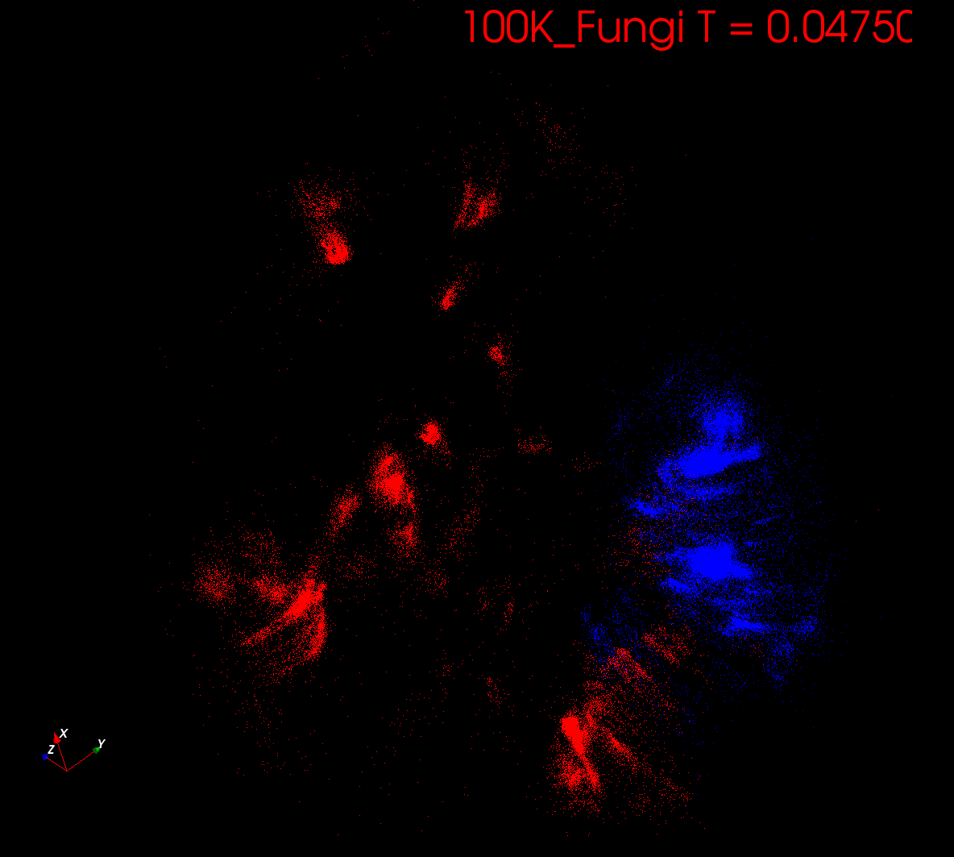
Start at T= “∞” with 1 Cluster
Decrease T, Clusters emerge at instabilities

Slide 41
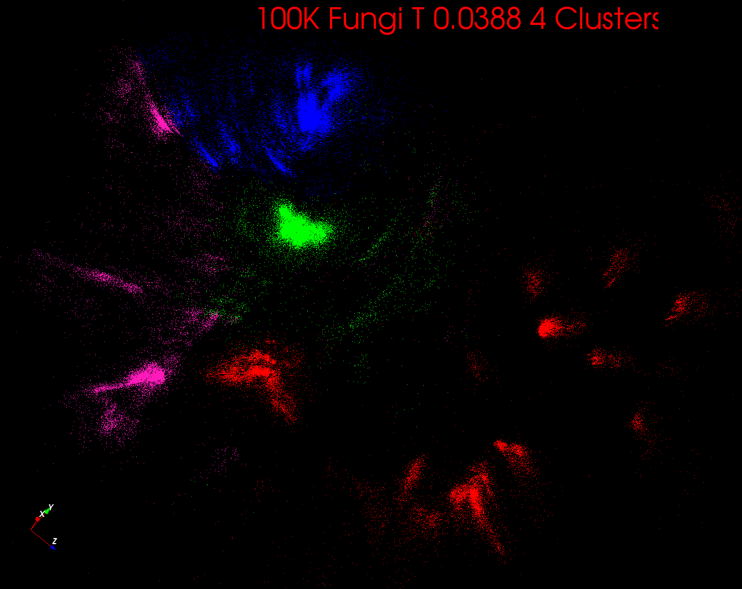

Slide 42
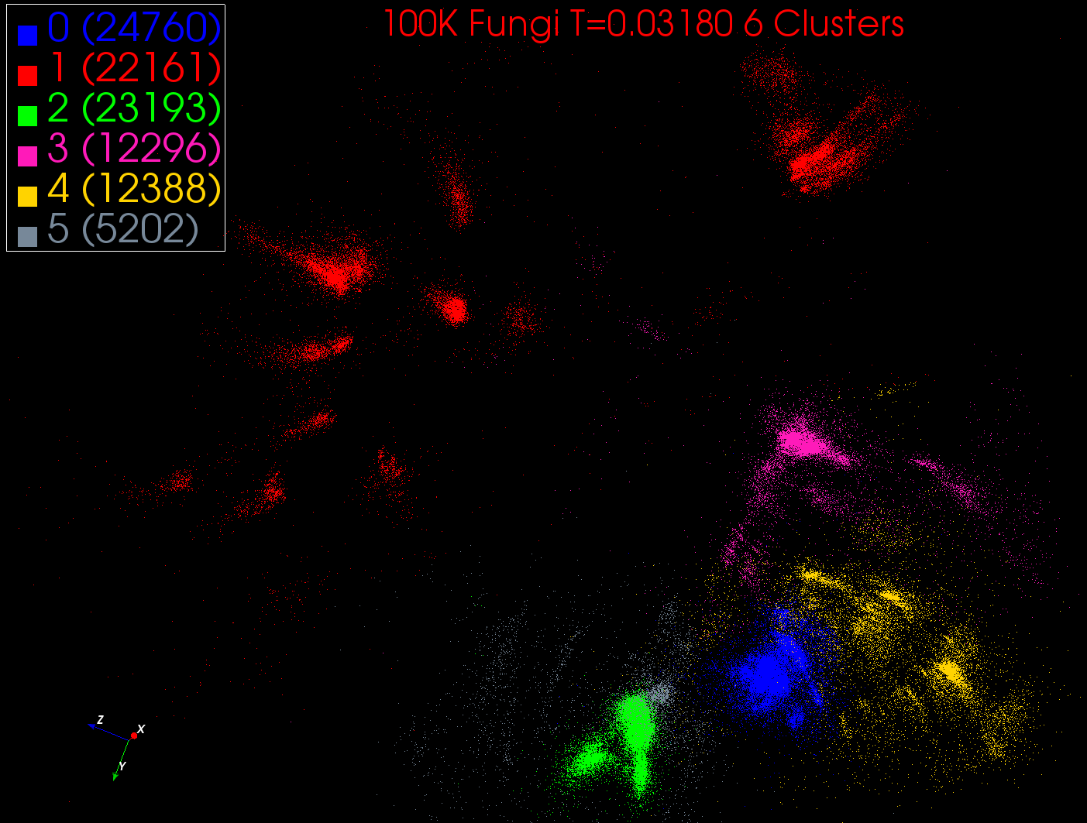

Slide 43
Some non-DA Ideas
Dimension reduction gives Low dimension mappings of data to both visualize and apply geometric hashing
No-vector (can’t define metric space) problems are O(N²)
  Genes are no-vector unless multiply aligned
For no-vector case, one can develop O(N) or O(NlogN) methods as in “Fast Multipole and OctTree methods”
  Map high dimensional data to 3D and use classic methods developed originally to speed up O(N²) 3D particle dynamics problems

Slide 44
General Deterministic Annealing
For some cases such as vector clustering and Mixture Models one can do integrals by hand but usually that will be impossible
So introduce Hamiltonian H₀(χ, ε) which by choice of ε can be made similar to real Hamiltonian H_{R}(χ) and which has tractable integrals
P₀(χ) = exp( - H₀(χ)/T + F₀/T ) approximate Gibbs for H_{R}
F_{R} (P₀) = < H_{R} - T S₀(P₀) >|₀ = < H_{R} – H₀> |₀ + F₀(P₀)
Where <…>|₀ denotes ∫ dχ P_{o}(χ)
Easy to show that real Free Energy (the Gibb’s inequality)
F_{R} (P_{R}) ≤ F_{R} (P₀) (Kullback-Leibler divergence)
Expectation step E is find ε minimizing F_{R} (P₀) and
Follow with M step (of EM) setting χ = <χ> |₀ = ∫ dχ χ P_{o}(χ) (mean field) and one follows with a traditional minimization of remaining parameters
Note 3 types of variables
ε used to approximate real Hamiltonian
χ subject to annealing
The rest – optimized by traditional methods

Slide 45
Implementation of DA-PWC
Clustering variables are again M_{i}(k) (these are χ in general approach) where this is probability point i belongs to cluster k
Pairwise Clustering Hamiltonian given by nonlinear form
H_{PWC} = 0.5 ∑_{i=1}^{N} ∑_{j=1}^{N} δ(i, j) ∑_{k=1}^{K} M_{i}(k) M_{j}(k) / C(k)
δ(i, j) is pairwise distance between points i and j
with C(k) = ∑_{i=1}^{N} M_{i}(k) as number of points in Cluster k
Take same form H₀ = ∑_{i=1}^{N} ∑_{k=1}^{K} M_{i}(k) ε_{i}(k) as for central clustering
ε_{i}(k) determined to minimize F_{PWC} (P₀) = < H_{PWC} - T S₀(P₀) >|₀ where integrals can be easily done
And now linear (in M_{i}(k)) H₀ and quadratic H_{PC} are different
Again <M_{i}(k)> = exp( -ε_{i}(k)/T ) / ∑_{k=1}^{K} exp( -ε_{i}(k)/T )

Slide 46
Continuous Clustering
This is a subtlety introduced by Ken Rose but not widely known
Take a cluster k and split into 2 with centers Y(k)_{A} and Y(k)_{B} with initial values Y(k)_{A} = Y(k)_{B} at original center Y(k)
Then typically if you make this change
and perturb the Y(k)_{A} Y(k)_{B}, they will
return to starting position
as F at stable minimum
But instability can develop and one finds
Implement by adding arbitrary number p(k) of centers for each cluster Z_{i} = ∑_{k=1}^{K} p(k) exp(-ε_{i}(k)/T) and M step gives p(k) = C(k)/N
Halve p(k) at splits; can’t split easily in standard case p(k) = 1
Free Energy F
Y(k)_{A} and Y(k)_{B}
Free Energy F
Free Energy F
Y(k)_{A} + Y(k)_{B}
Y(k)_{A} - Y(k)_{B}

Slide 47
Trimmed Clustering
(“Sponge Vector”)
Deterministic Annealing

Slide 48
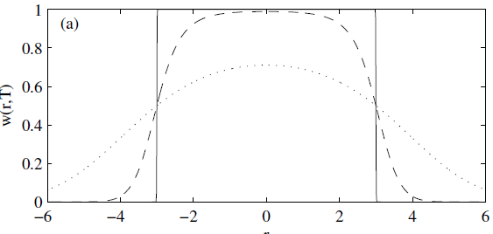
Trimmed Clustering
Clustering with position-specific constraints on variance: Applying redescending M-estimators to label-free LC-MS data analysis (Rudolf Frühwirth , D R Mani and Saumyadipta Pyne) BMC Bioinformatics 2011, 12:358
H_{TCC} = ∑_{k=0}^{K} ∑_{i=1}^{N} M_{i}(k) f(i,k)
  f(i,k) = (X(i) - Y(k))²/2σ(k)² k > 0
  f(i,0) = c² / 2 k = 0
The 0’th cluster captures (at zero temperature) all points outside clusters (background)
Clusters are trimmed
(X(i) - Y(k))²/2σ(k)² < c² / 2
Applied to
Proteomics
Mass Spectrometry
T = 1
T ~ 0
T = 5
Distance from cluster center

Slide 49
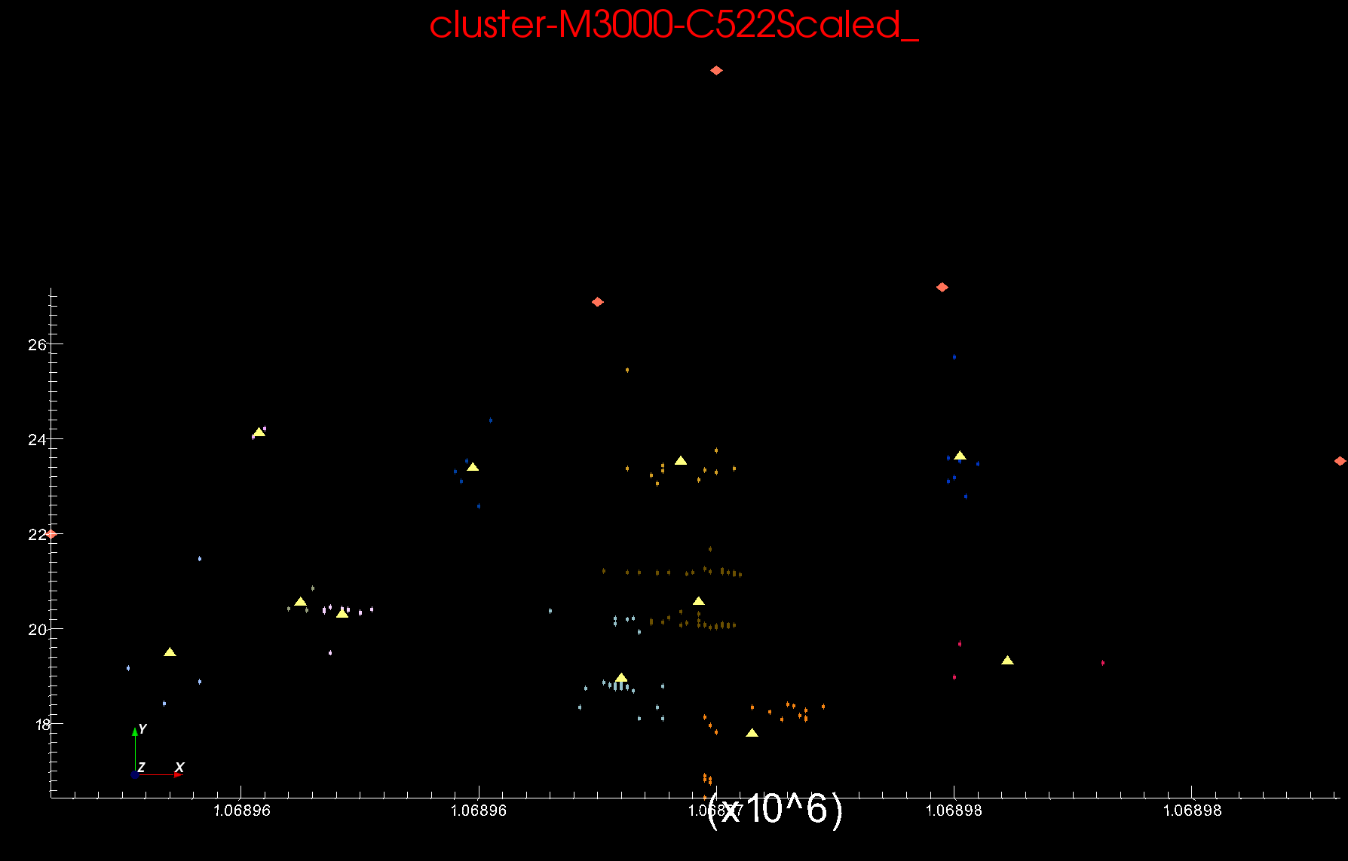
Proteomics 2D DA Clustering
Sponge Peaks
Centers

Slide 50
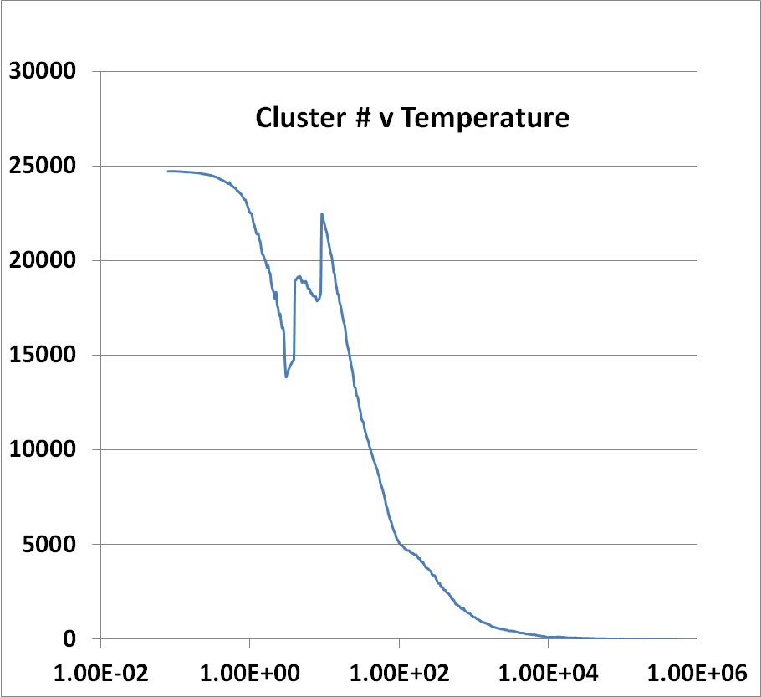
Introduce Sponge
Running on 8 nodes, 16 cores each
241605 Peaks
Complex Parallelization of
Peaks=points (usual) and
Clusters (Switch on after # gets large)
Low Temperature -- End
High Temperature -- Start

Slide 51
Cluster Count v. # Clusters
Approach Singleton #Clusters Max Count Avg Count >=2
DAVS 14377 28994 163 7.837
Medea 29731 32129 130 6.594
MClust 50689 33530 118 5.694
# Clusters
#Peaks in Cluster

Slide 52
Dimension Reduction

Slide 53
High Performance Dimension Reduction and Visualization
Need is pervasive
  Large and high dimensional data are everywhere: biology, physics, Internet, …
  Visualization can help data analysis
Visualization of large datasets with high performance
  Map high-dimensional data into low dimensions (2D or 3D).
  Need Parallel programming for processing large data sets
  Developing high performance dimension reduction algorithms:
    MDS(Multi-dimensional Scaling)
    GTM(Generative Topographic Mapping)
    DA-MDS(Deterministic Annealing MDS)
    DA-GTM(Deterministic Annealing GTM)
  Interactive visualization tool PlotViz
Notes:
With David Wild

Slide 54
Multidimensional Scaling MDS
Map points in high dimension to lower dimensions
Many such dimension reduction algorithms (PCA Principal component analysis easiest); simplest but perhaps best at times is MDS
Minimize Stress
σ(X) = Σ_{i<j=1}^{n} weight(i,j) (δ(i, j) - d(X_{i} , X_{j}))²
δ(i, j) are input dissimilarities and d(X_{i} , X_{j}) the Euclidean distance squared in embedding space (3D usually)
SMACOF or Scaling by minimizing a complicated function is clever steepest descent (expectation maximization EM) algorithm
Computational complexity goes like N² * Reduced Dimension
We developed a Deterministic annealed version of it which is much better
Could just view as non linear χ² problem (Tapia et al. Rice)
  Slower but more general
All parallelize with high efficiency

Slide 55
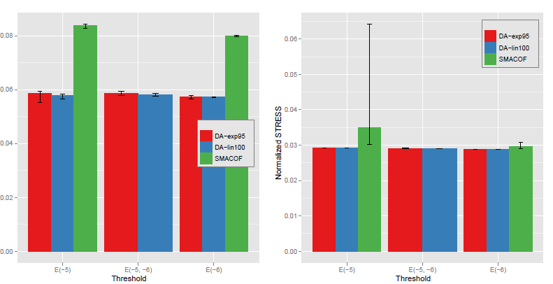
Quality of DA versus EM MDS
Normalized STRESS
Variation
in different
runs
Map to 2D 100K Metagenomics Map to 3D

Slide 56
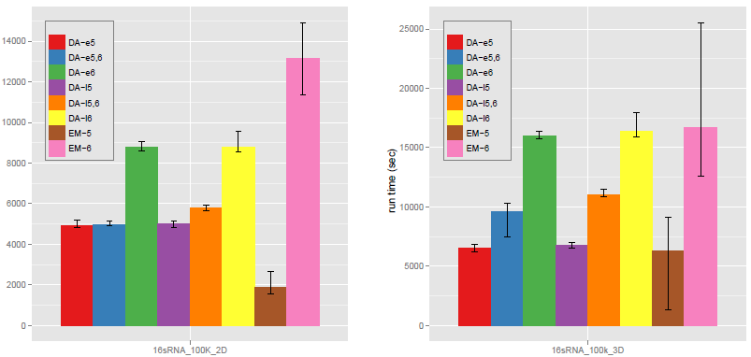
Run Time of DA versus EM MDS
Run time
secs
Map to 2D 100K Metagenomics Map to 3D

Slide 57
Metagenomics Example

Slide 58
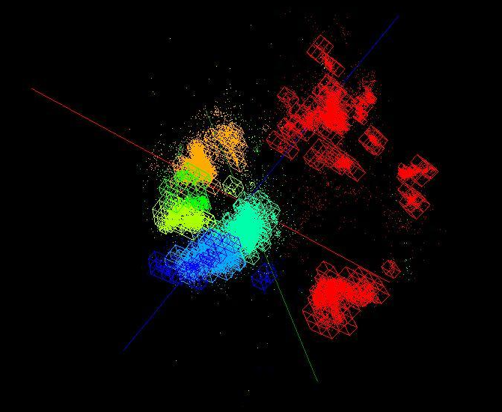
OctTree for 100K sample of Fungi
We use OctTree for logarithmic interpolation

Slide 59
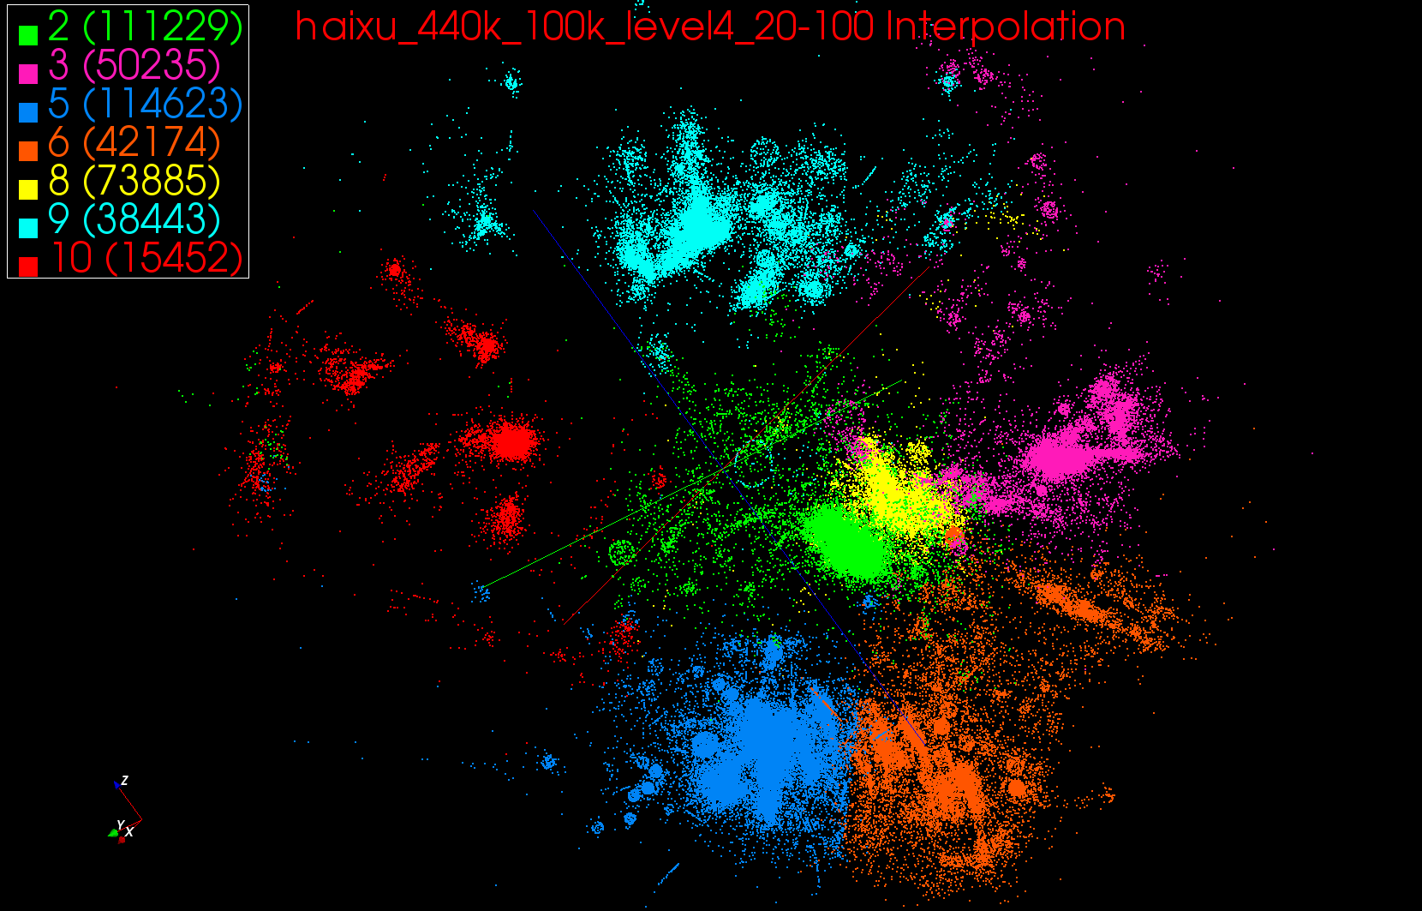
440K Interpolated

Slide 60
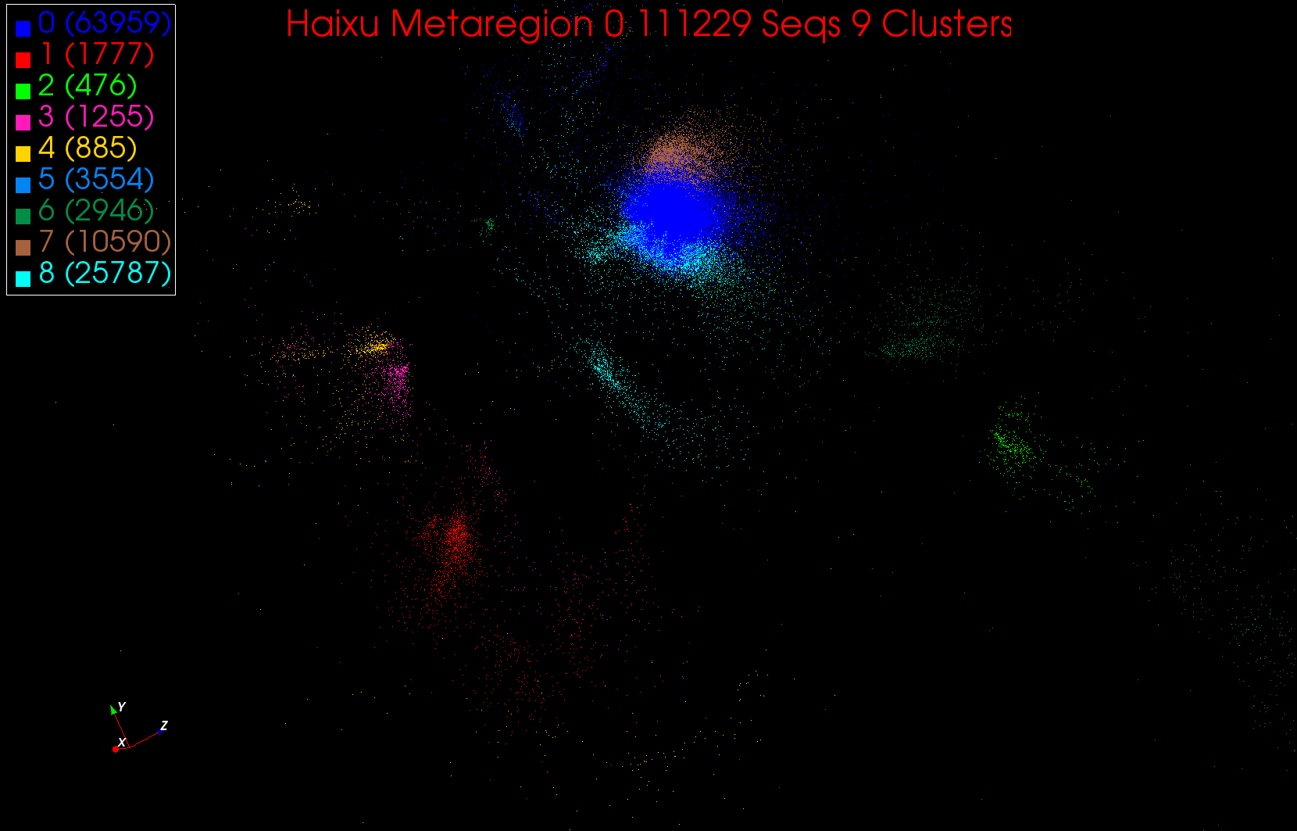
A large cluster in Region 0

Slide 61
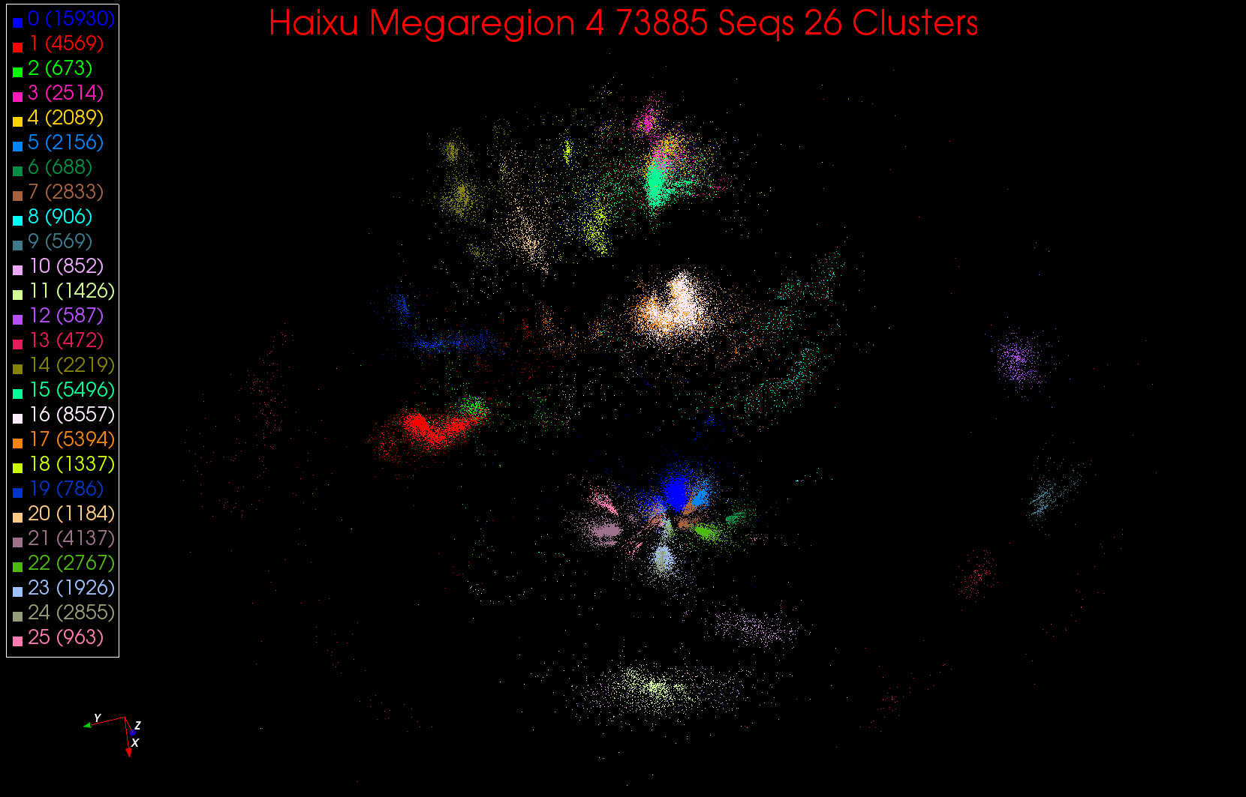
26 Clusters in Region 4

Slide 62
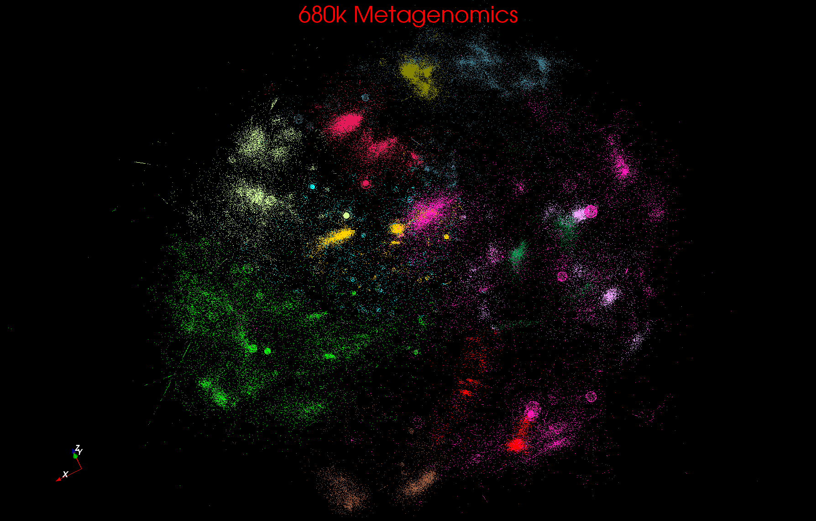
Metagenomics

Slide 63
Metagenomics with 3 Clustering Methods
DA-PWC 188 Clusters; CD-Hit 6000; UCLUST 8418
DA-PWC doesn’t need seeding like other methods – All clusters found by splitting
# Clusters

Slide 64
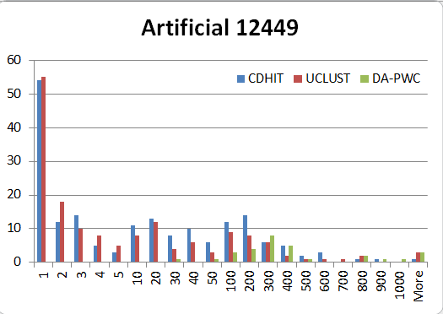
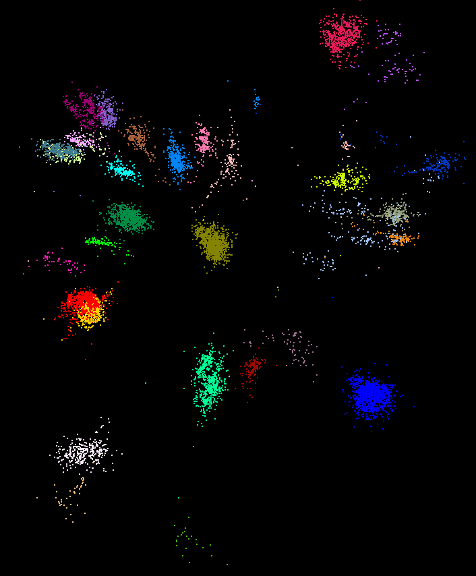
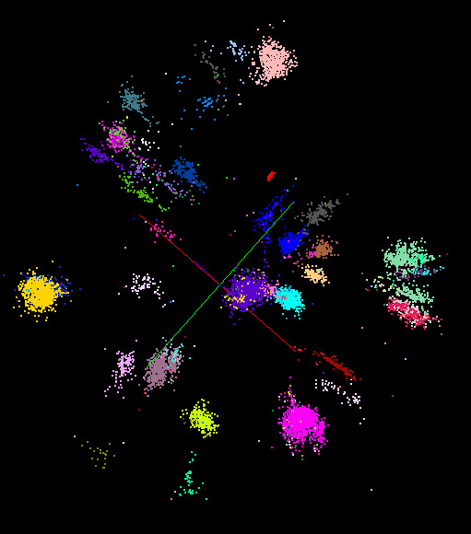
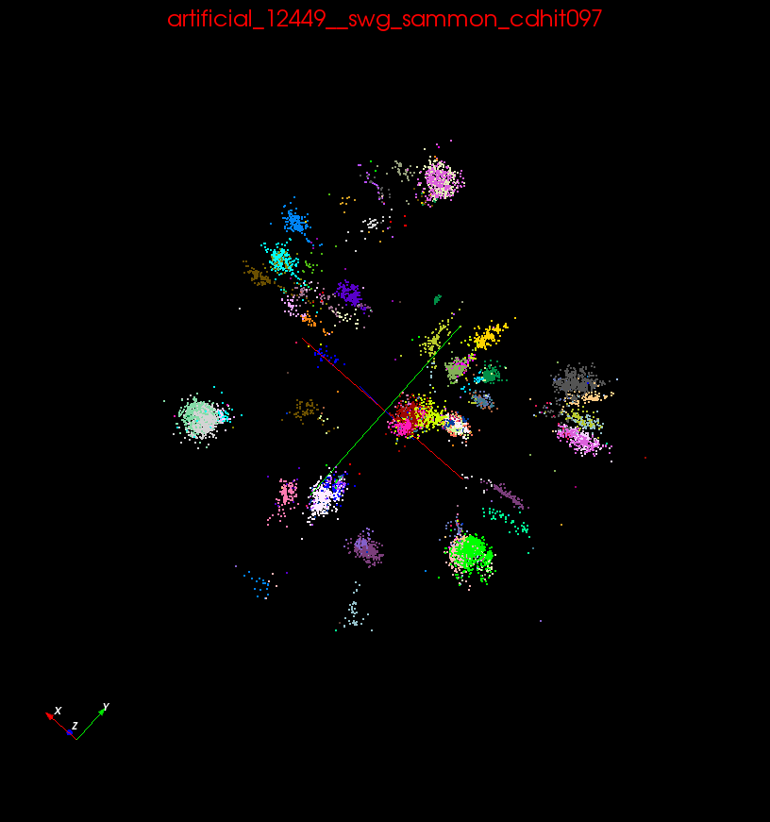
“Artificial” Data Sample
89 True Sequences
~30 identifiable clusters
DA-PWC
UClust
CDhit

Slide 65
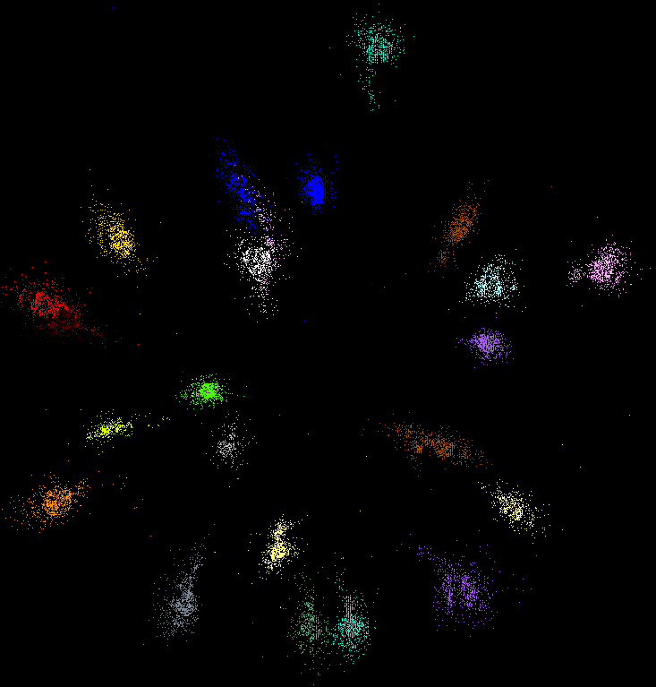
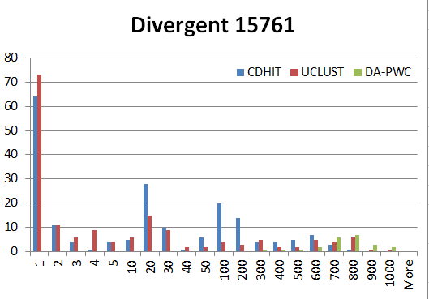
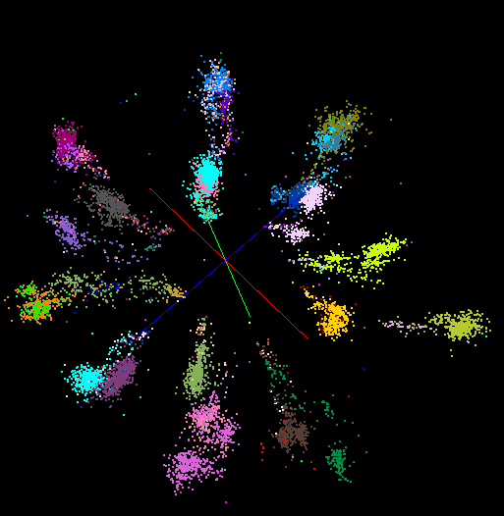
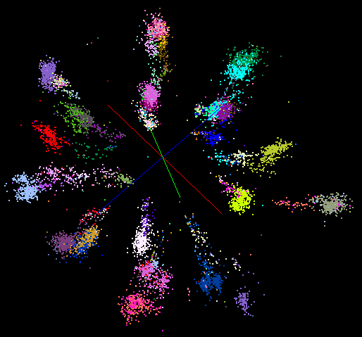
“Divergent” Data Sample
23 True Sequences
DA-PWC
UClust
CDhit
Divergent Data Set UClust (Cuts 0.65 to 0.95)
DAPWC 0.65 0.75 0.85 0.95
Total # of clusters 23 4 10 36 91
Total # of clusters uniquely identified 23 0 0 13 16
(i.e. one original cluster goes to 1 uclust cluster )
Total # of shared clusters with significant sharing 0 4 10 5 0
(one uclust cluster goes to > 1 real cluster)
Total # of uclust clusters that are just part of a real cluster 0 4 10 17(11) 72(62)
(numbers in brackets only have one member)
Total # of real clusters that are 1 uclust cluster 0 14 9 5 0
but uclust cluster is spread over multiple real clusters
Total # of real clusters that have 0 9 14 5 7
significant contribution from > 1 uclust cluster

Slide 66
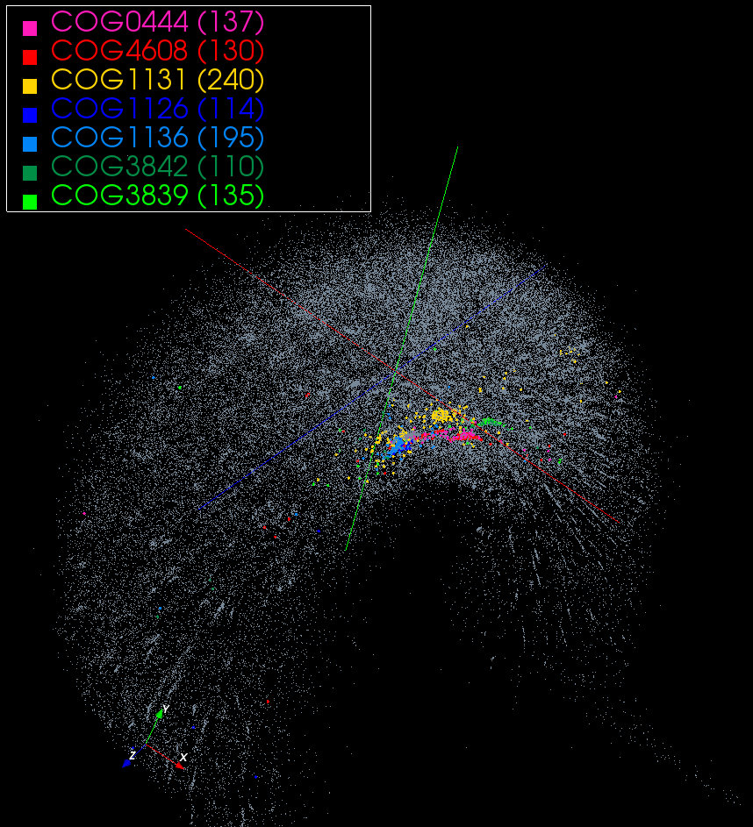
~100K COG with 7 clusters from database

Slide 67
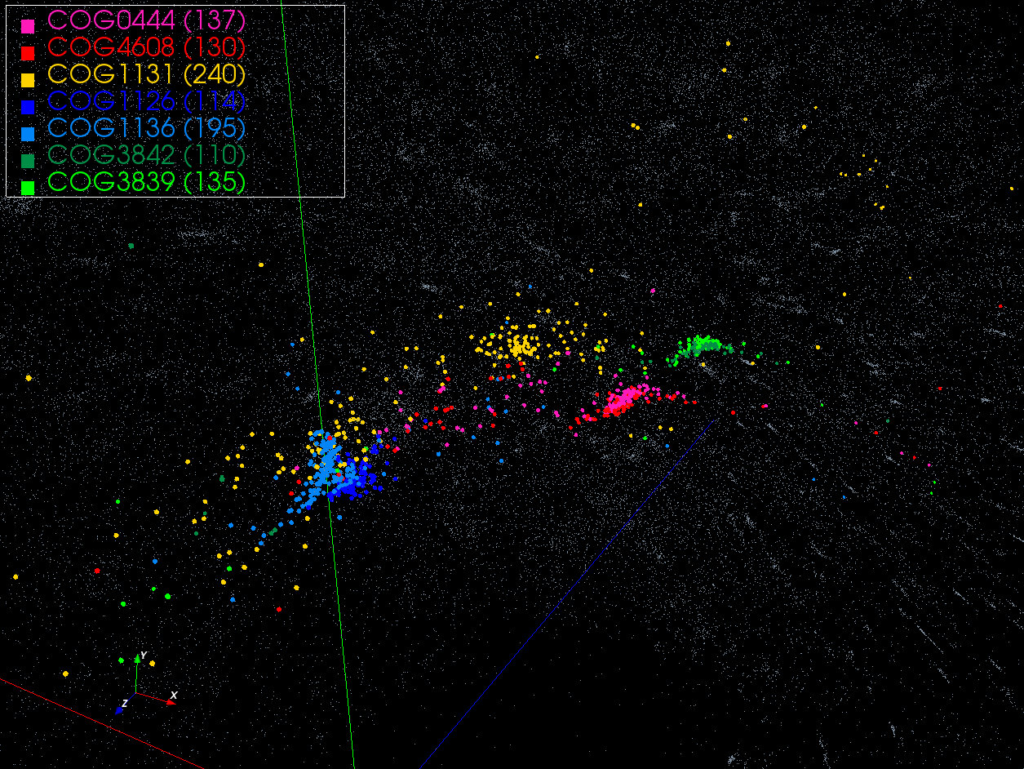

Slide 68
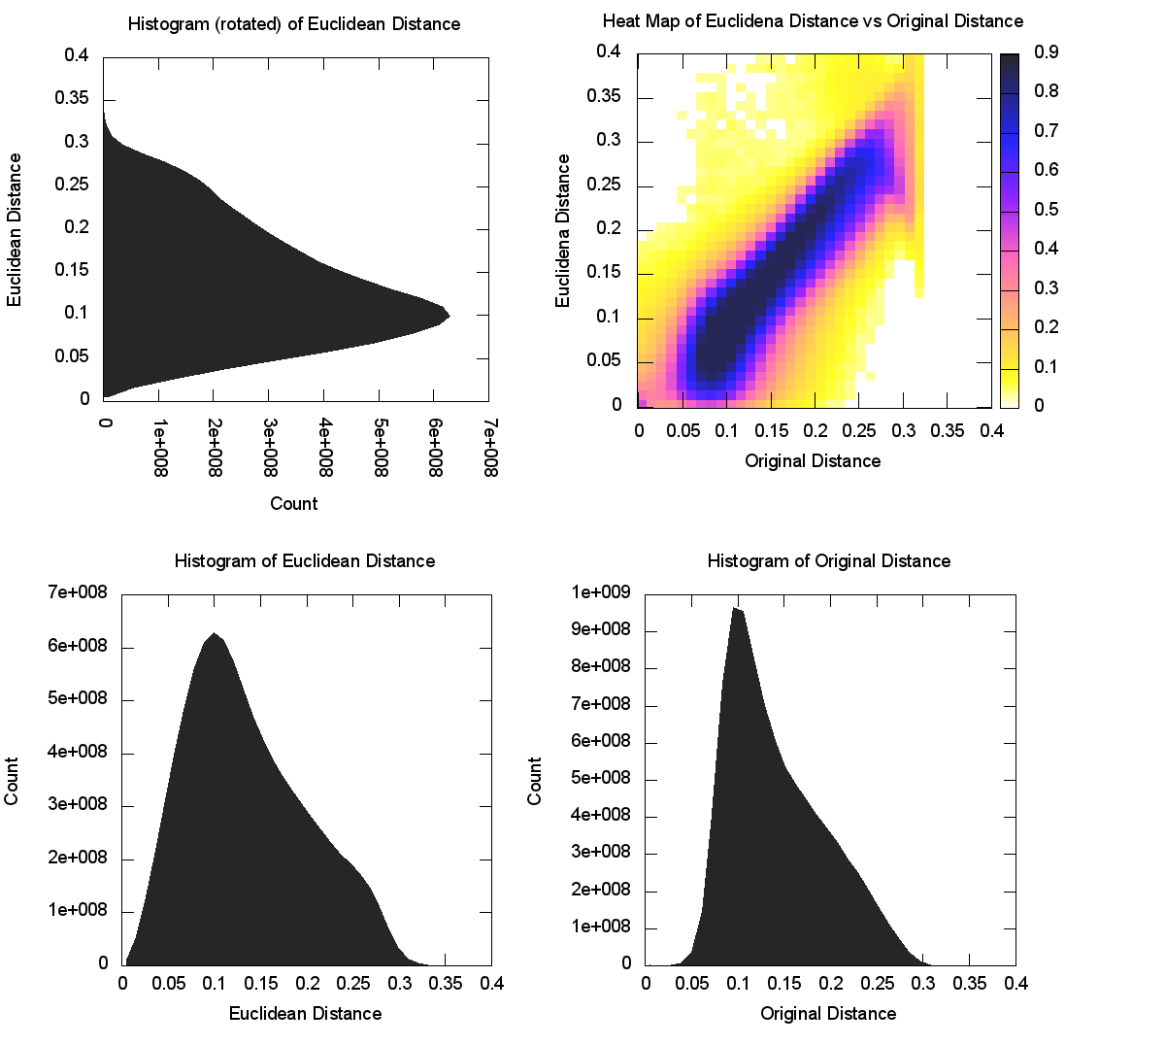
CoG
NW
Sqrt
(4D)

Slide 69
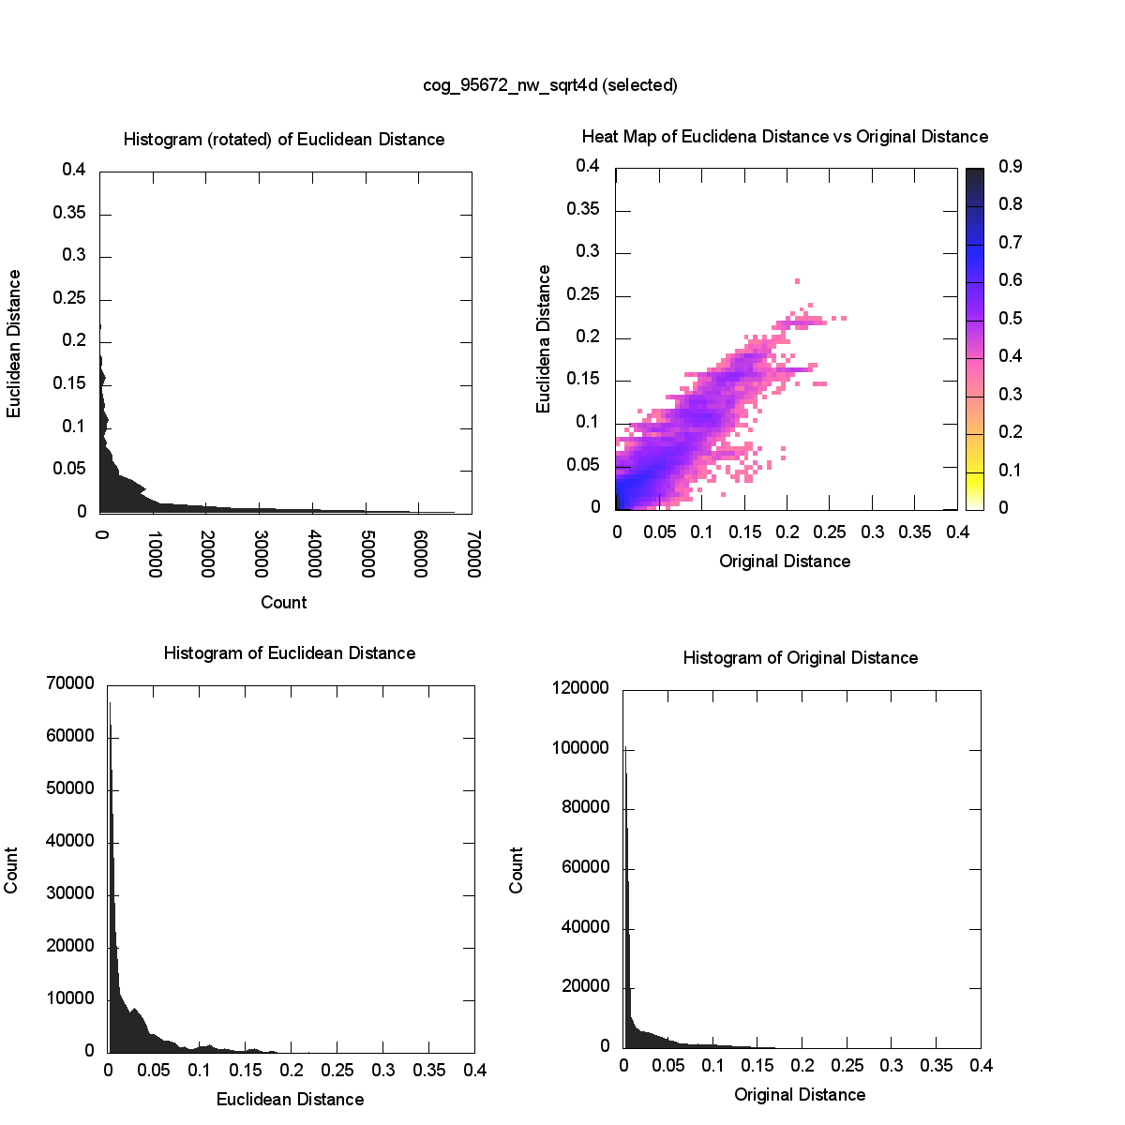
CoG
NW
Sqrt
(4D)
Intra- Cluster
Distances

Slide 70
MDS on Clouds

Slide 71
Expectation Maximization and Iterative MapReduce
Clustering and Multidimensional Scaling are both EM (expectation maximization) using deterministic annealing for improved performance
EM tends to be good for clouds and Iterative MapReduce
  Quite complicated computations (so compute largish compared to communicate)
  Communication is Reduction operations (global sums or linear algebra in our case)
  See also Latent Dirichlet Allocation and related Information Retrieval algorithms similar EM structure

Slide 72
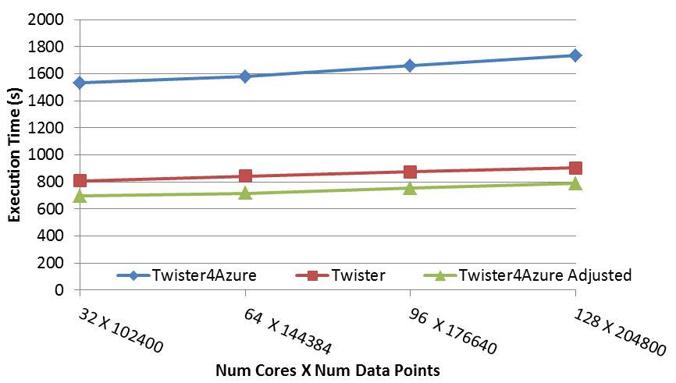
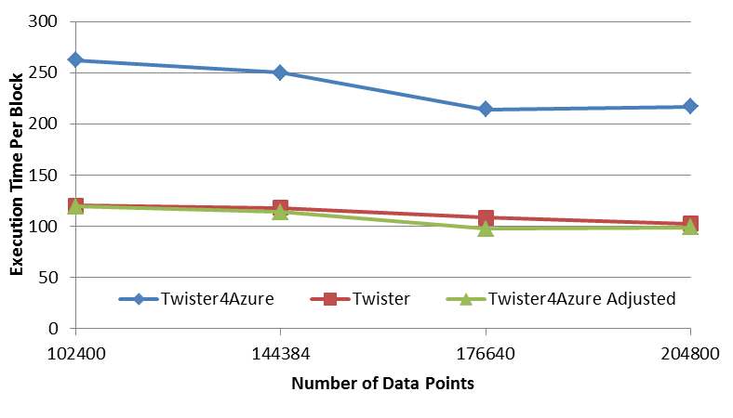
Multi Dimensional Scaling
BC: Calculate BX
X: Calculate invV (BX)
Calculate Stress
Map
Reduce
Merge
Map
Reduce
Merge
Map
Reduce
Merge
New Iteration
Performance adjusted for sequential performance difference
Weak Scaling
Data Size Scaling
Scalable Parallel Scientific Computing Using Twister4Azure. Thilina Gunarathne, BingJing Zang, Tak-Lon Wu and Judy Qiu. Submitted to Journal of Future Generation Computer Systems. (Invited as one of the best 6 papers of UCC 2011)
Notes:
The Java HPC Twister experiment was performed in a dedicated large-memory cluster of Intel(R) Xeon(R) CPU E5620 (2.4GHz) x 8 cores with 192GB memory per compute node and with Gigabit Ethernet on Linux. Java HPC Twister results do not include the initial data distribution time.
Azure large instances with 4 workers per instances is used. Memory mapped based caching and AllGather primitive are used.
Left: Weak scaling where workload per core is ~constant. Ideal is a straight horizontal line. X axis is
Right: Data size scaling with 128 Azure small instances/cores, 20 iterations.
The Twister4Azure adjusted (t_{a}) depicts the performance of Twister4Azure normalized according to the sequential MDS BC calculation and Stress calculation performance ratio between the Azure(t_{sa}) and Cluster(t_{sc}) environments used for Java HPC Twister. It is calculated using t_{a} x (t_{sc}/t_{sa}). This estimation however does not account for the overheads that remain constant irrespective of the computation time. Hence Twister4Azure seems to perform better, but in reality when the task execution times become smaller, twister4Azure overheads will become relatively larger and the performance would not be as good as shown in the adjusted curve.

Slide 73
Multi Dimensional Scaling on Azure

Slide 74
Deterministic Annealing on Mixture Models

Slide 75
Metric Space: GTM with DA (DA-GTM)
Map to Grid (like SOM)
K latent points
N data points
GTM is an algorithm for dimension reduction
  Find optimal K latent variables in Latent Space
  f is a non-linear mapping function
  Traditional algorithm use EM for model fitting
DA optimization can improve the fitting process

Slide 76
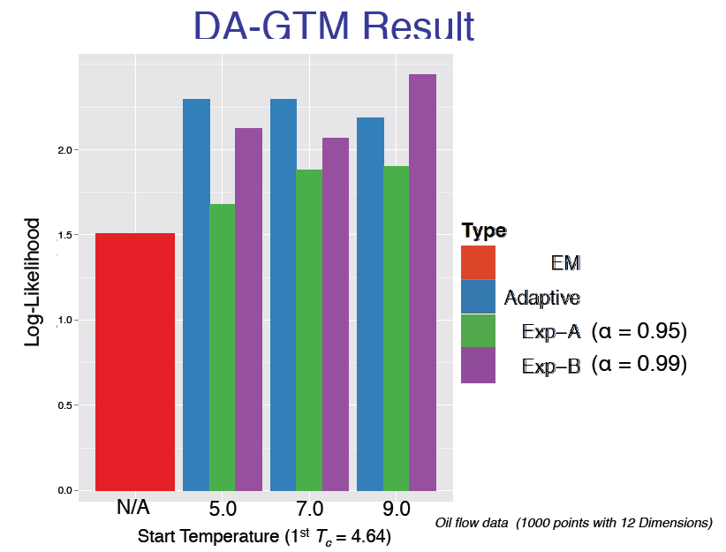
Annealed

Slide 77
DA-Mixture Models
Mixture models take general form
H = - Σ_{n=1}^{N} Σ_{k=1}^{K} M_{n}(k) ln L(n|k)
Σ_{k=1}^{K} M_{n}(k) = 1 for each n
n runs over things being decomposed (documents in this case)
k runs over component things– Grid points for GTM, Gaussians for Gaussian mixtures, topics for PLSA
Anneal on “spins” M_{n}(k) so H is linear and do not need another Hamiltonian as H = H₀
Note L(n|k) is function of “interesting” parameters and these are found as in non annealed case by a separate optimization in the M step

Slide 78
Probabilistic Latent Semantic Analysis (PLSA)
Topic model (or latent or factor model)
  Assume generative K topics (document generator)
  Each document is a mixture of K topics
  The original proposal used EM for model fitting
Can apply to find job types in computer center analysis
Topic 1
Topic 2
Topic K
Doc 1
Doc 2
Doc N

Slide 79
Conclusions

Slide 80
Conclusions
Clouds and HPC are here to stay and one should plan on using both
Data Intensive programs are not like simulations as they have large “reductions” (“collectives”) and do not have many small messages
Iterative MapReduce an interesting approach; need to optimize collectives for new applications (Data analytics) and resources (clouds, GPU’s …)
Need an initiative to build scalable high performance data analytics library on top of interoperable cloud-HPC platform
Consortium from Physical/Biological/Social/Network Science, Image Processing, Business
Many promising algorithms such as deterministic annealing not used as implementations not available in R/Matlab etc. – DA clearly superior in theory and practice than well used systems
  More software and runs longer but can be efficiently parallelized so runtime not a big issue

