Slide 1




Analysis Tools for
Data Enabled Science
SALSA HPC Group
http://salsahpc.indiana.edu
School of Informatics and Computing
Indiana University

Slide 2
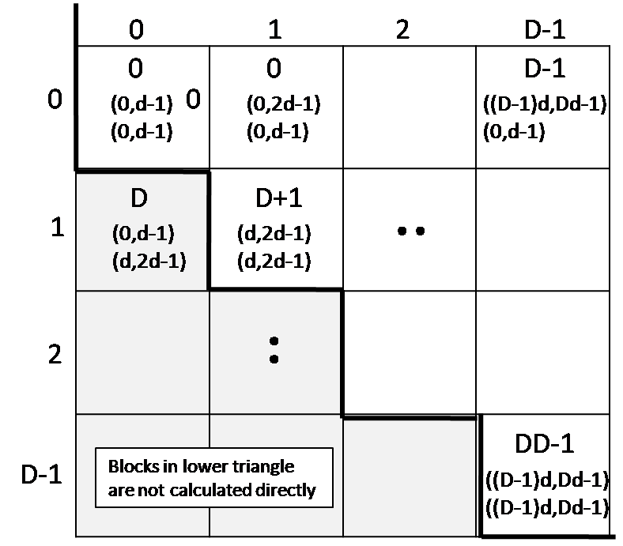
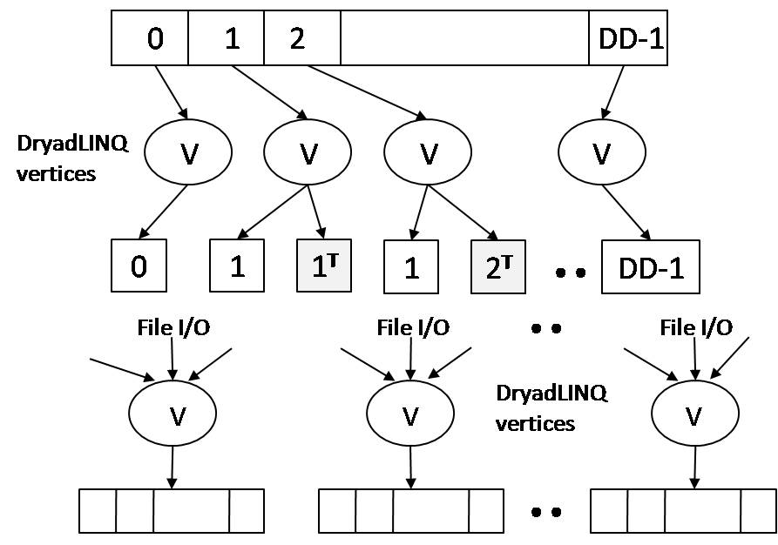
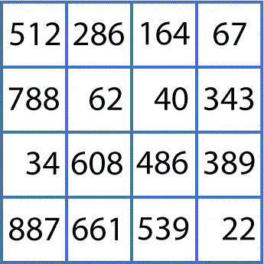
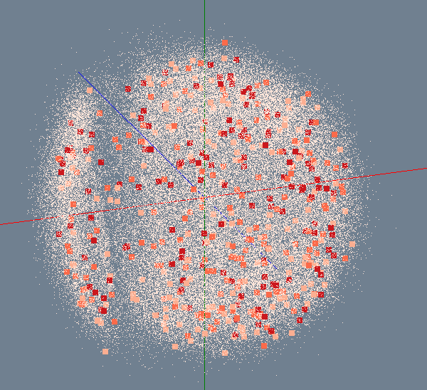

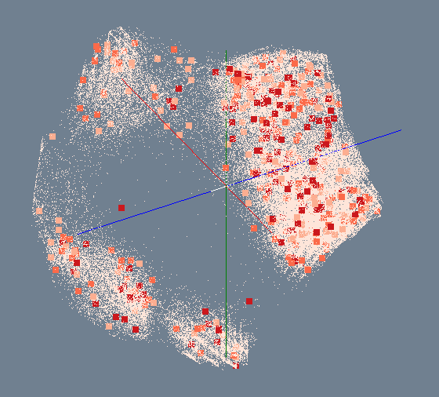

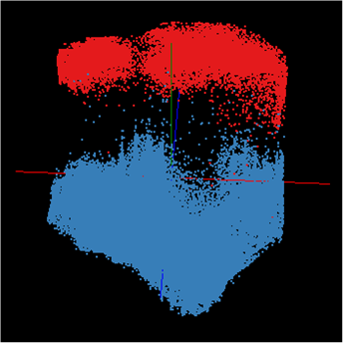
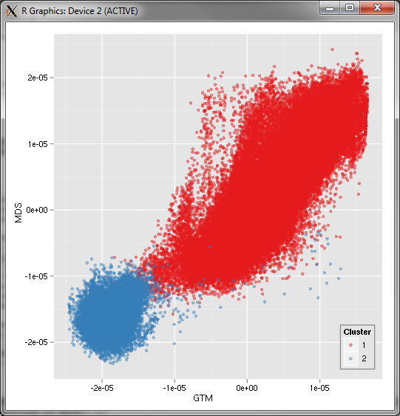
Bioinformatics Pipeline
Gene Sequences (N = 1 Million)
Pairwise Alignment & Distance Calculation
Distance Matrix
Select Reference
Reference Sequence Set (M = 100K)
Reference Coordinates
N - M Sequence Set (900K)
Interpolative MDS with Pairwise Distance Calculation
x, y, z
Multi-Dimensional Scaling (MDS)
O(N²)
N - M Coordinates
x, y, z
Visualization
3D Plot

Slide 3
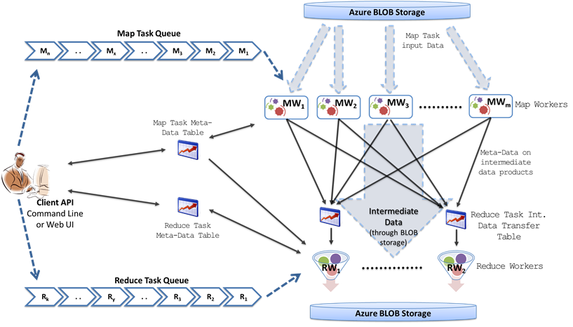
Structure of Twister4Azure

Slide 4
Iterative MapReduce for Azure
Merge Step
In-Memory Caching of static data
Cache aware hybrid scheduling using Queues as well as using a bulletin board (special table)

Slide 5




Performance – Kmeans Clustering
Performance with/without
data caching
Speedup gained using data cache
Scaling speedup
Increasing number of iterations
Notes:
KMeans iterative MapReduce performance. 16 Azure Small instances, 6 iterations, 8 to 48 million 20-D data points.
Left: Performance with and without data caching.
Right: Speedup obtained from using the data cache
Left: Scaling speedup with increasing number of instances (Azure Small) & data for 10 iterations.
Right: Increasing number of iterations using 16 million data points with caching using 16 Azure Small instances.

Slide 6

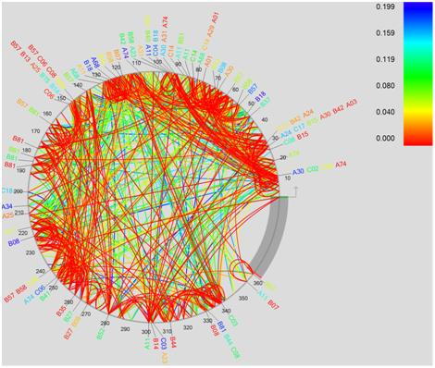
Performance Comparisons
BLAST Sequence Search
Smith Watermann
Sequence Alignment
Cap3 Sequence Assembly

Slide 7
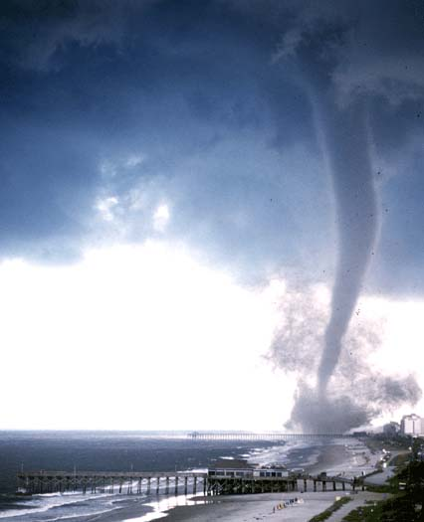

Twister v0.9
  New Infrastructure for Iterative MapReduce Programming
  Configuration Program to setup Twister environment automatically on a cluster
  Full mesh network of brokers for facilitating communication
  New messaging interface for reducing the message serialization overhead
  Memory Cache to share data between tasks and jobs

Slide 8

Twister-MDS Demo
This demo is for real time visualization of the process of multidimensional scaling(MDS) calculation.
We use Twister to do parallel calculation inside the cluster, and use PlotViz to show the intermediate results at the user client computer.
The process of computation and monitoring is automated by the program.

Slide 9
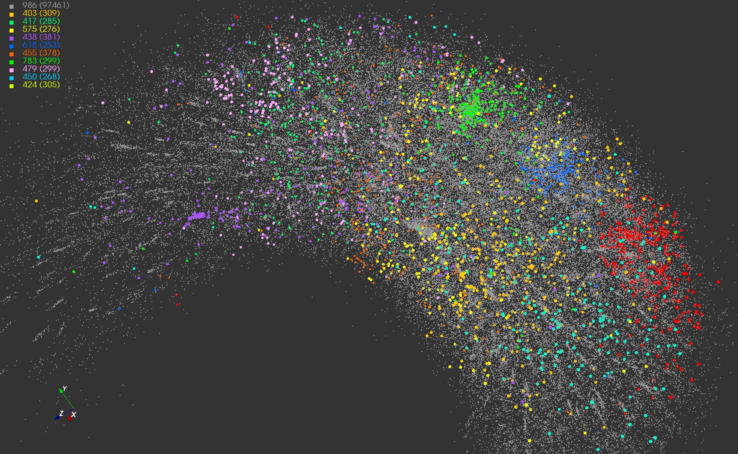
Twister-MDS Output
MDS projection of 100,000 protein sequences showing a few experimentally
identified clusters in preliminary work with Seattle Children’s Research Institute.

Slide 10
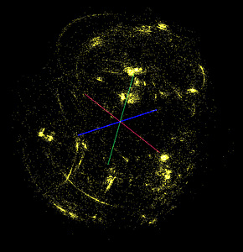
Twister-MDS Work Flow
Client Node
II. Send intermediate results
Master Node
ActiveMQ
Broker
Twister
Driver
MDS Monitor
Twister-MDS
PlotViz
I. Send message to start the job
III. Write data
IV. Read data
Local Disk

Slide 11
Twister-MDS Structure
Master Node
Twister
Driver
Pub/Sub Broker Network
MDS Output Monitoring Interface
Twister-MDS
Twister Daemon
Twister Daemon
map
reduce
calculateBC
map
reduce
calculateStress
Worker Pool
Worker Pool
Worker Node
Worker Node

Slide 12
New Network of Messaging Brokers
Twister Daemon Node
ActiveMQ Broker Node
Twister Driver
Node
Hierarchical Sending
7 Brokers and 32 Computing Nodes in total
Full Mesh Network
Broker-Driver Connection
Broker-Daemon Connection
Broker-Broker Connection

Slide 13
Performance Improvements

Slide 14
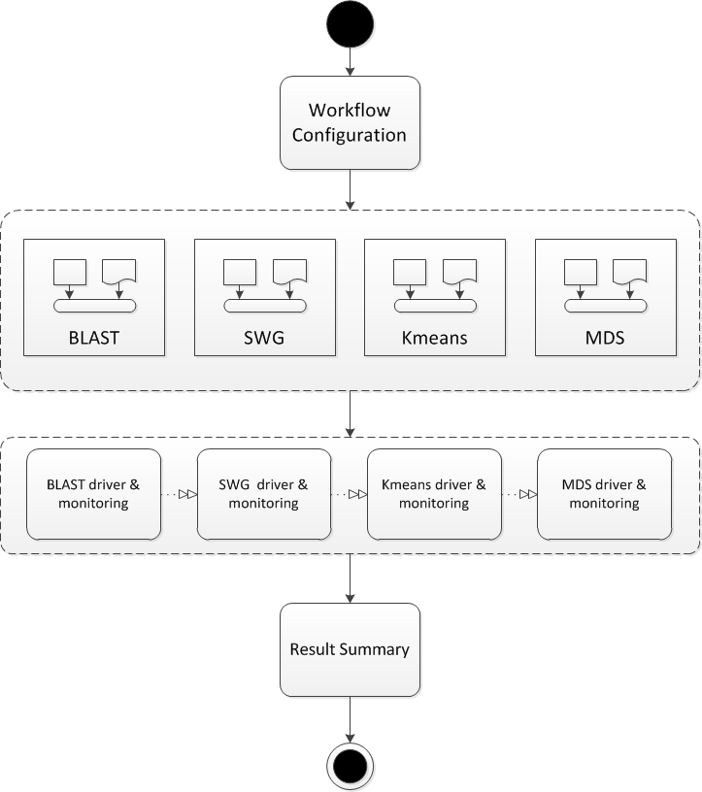
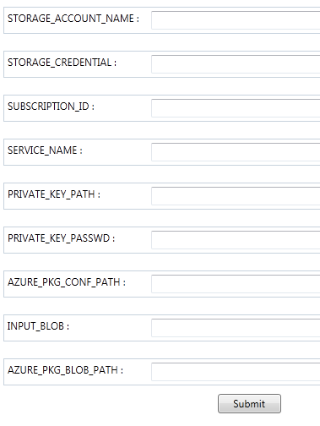
Harnessing the Power of Workflow
Configure Trident Jobs
Design Workflow Pattern

Slide 15
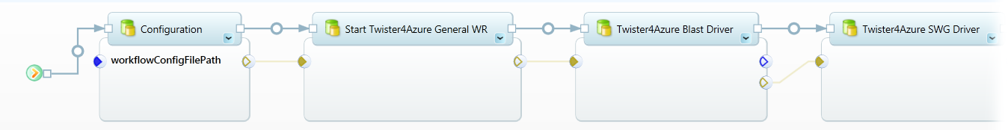
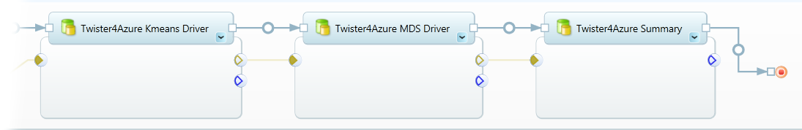
Harnessing the Power of Workflow
Future Work: Combine Windows Trident with Twister

Slide 16
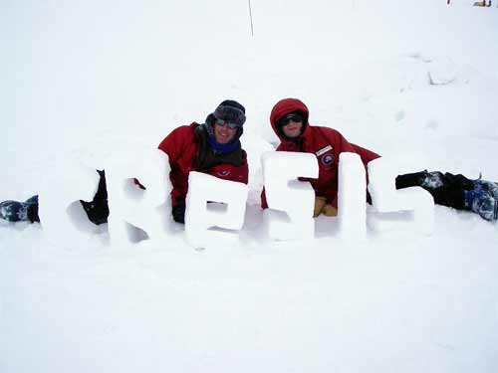

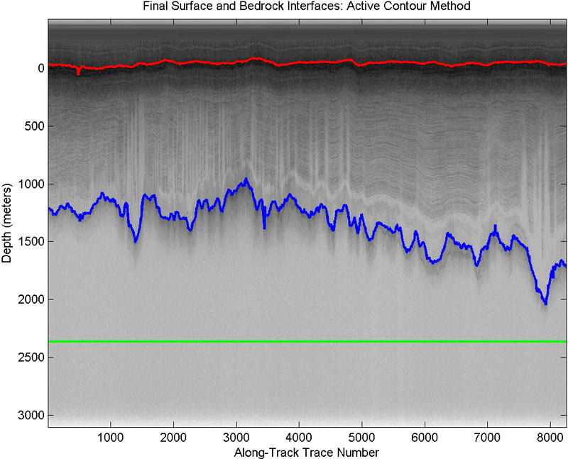

Twister for Polar Science
The Center for Remote Sensing of Ice Sheets
Research
Education
Knowledge Transfer
Utilizing the Power of Twister to Perform Large Scale Scientific Calculation

Slide 17



Twister for Polar Science
Deploying a Twister
Appliance for Polar Grid
Group
VPN
instantiate
…
GroupVPN
Credentials
copy
Virtual IP - DHCP
5.5.1.1
Virtual IP - DHCP
5.5.1.2
(from
Web site)
Virtual Machines

Slide 18
Twister Architecture
Support Scientific Simulations (Data Mining and Data Analysis)
Life Sciences, Physics, Information Retrieval, Social Network
Smith Waterman Dissimilarities, CAP-3 Gene Assembly, PhyloD, High Energy Physics, Clustering, Multidimensional Scaling, Generative Topological Mapping
Applications
Services and Workflow
Runtimes
High Level Language
Cross Platform Iterative MapReduce
Messaging Middleware
Storage and Data Parallel File System
Linux HPC
Bare-system
Amazon Cloud
Windows Server HPC
Bare-system
Azure Cloud
Grid Appliance
Infrastructure software
Virtualization
Virtualization
Hardware
CPU Nodes
GPU Nodes

Slide 19

Twister Futures
Development of library of Collectives to use at Reduce phase
  Broadcast and Gather needed by current applications
  Discover other important ones
  Implement efficiently on each platform – especially Azure
Better software message routing with broker networks using asynchronous I/O with communication fault tolerance
Support nearby location of data and computing using data parallel file systems
Clearer application fault tolerance model based on implicit synchronizations points at iteration end points
Later: Investigate GPU support
Later: run time for data parallel languages like Sawzall, Pig Latin, LINQ

Slide 20
Twister Futures
(a) Map Only
(b) Classic MapReduce
(c) Iterative MapReduce
(d) Loosely Synchronous
Input
Input
Iterations
Input
map
map
map
P_{ij}
reduce
reduce
Output
CAP3 Analysis
Smith-Waterman Distances
Parametric sweeps
PolarGrid Matlab data analysis
High Energy Physics (HEP) Histograms
Distributed search
Distributed sorting
Information retrieval
Expectation maximization clustering e.g. Kmeans
Linear Algebra
Multimensional Scaling
Page Rank
Many MPI scientific applications such as solving differential equations and particle dynamics
Domain of MapReduce and Iterative Extensions
MPI

Slide 21


Education and Broader Impact
We devote a lot to guide students
who are interested in computing

Slide 22

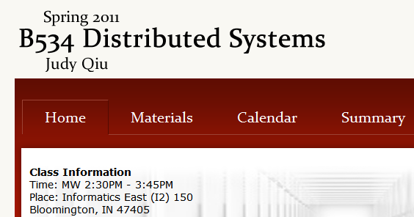
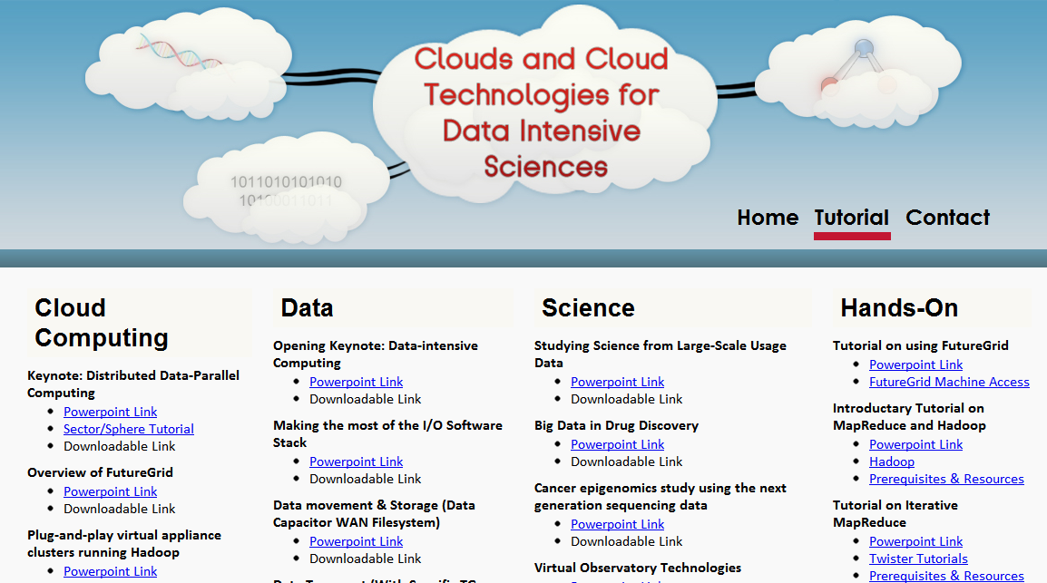
Education
We offer classes with new topic
Together with tutorials on the most popular cloud computing tools

Slide 23
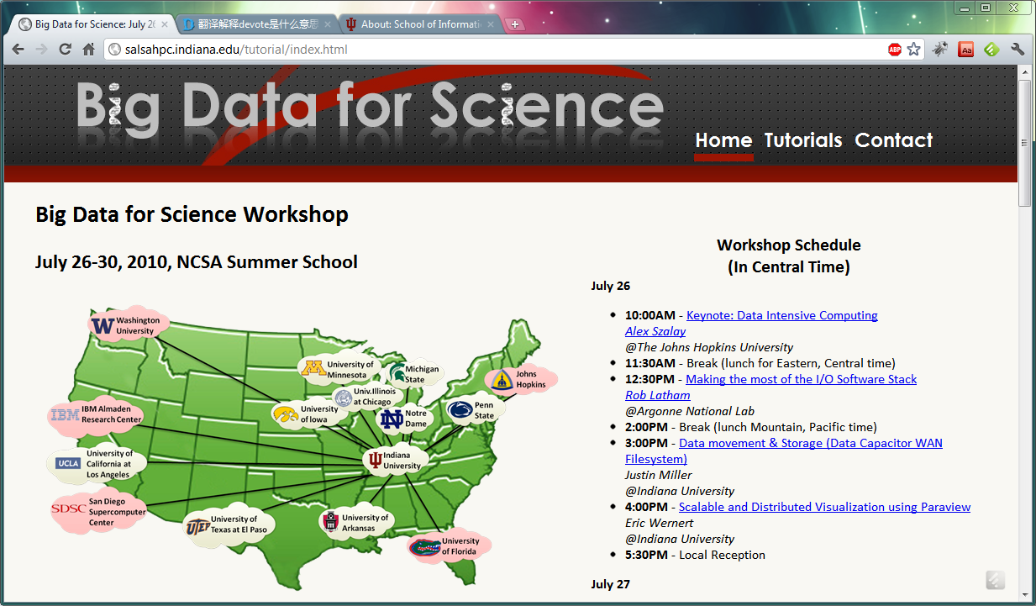
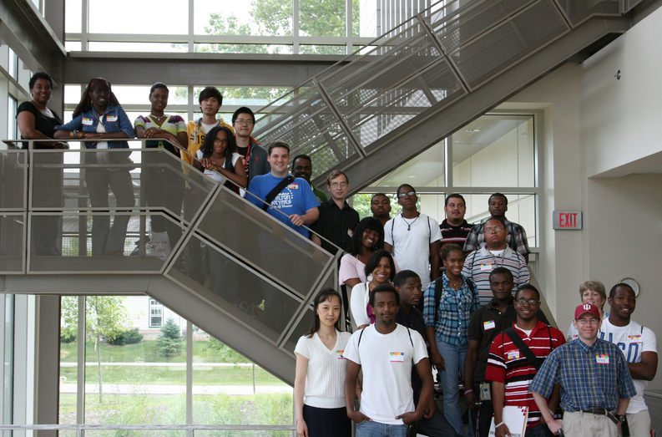

Broader Impact
Hosting workshops and spreading our technology across the nation
Giving students unforgettable research experience

Slide 24





Acknowledgement
SALSA HPC Group
Indiana University
http://salsahpc.indiana.edu

