Slide 1
Deterministic Annealing and
Robust Scalable Data mining for the Data Deluge
Future Internet Technology Building
Tsinghua University, Beijing, China
December 22 2011
Geoffrey Fox
gcf@indiana.edu
http://www.infomall.org http://www.futuregrid.org
Director, Digital Science Center, Pervasive Technology Institute
Associate Dean for Research and Graduate Studies, School of Informatics and Computing
Indiana University Bloomington

Slide 2
Abstract
We describe data analytics on large systems using a suite of robust parallel algorithms running on both clouds and HPC systems.
We apply this to cases where the data is defined in a vector space and when only pairwise distances between points are defined.
We introduce new O(N logN) algorithms for pairwise cases, where direct algorithms are O(N²) for N points.
We show the value of visualization using dimension reduction for steering complex analytics and illustrate the value of deterministic annealing for relatively fast robust algorithms.
We apply methods to metagenomics applications.

Slide 3
References
Ken Rose, Deterministic Annealing for Clustering, Compression, Classification, Regression, and Related Optimization Problems. Proceedings of the IEEE, 1998. 86: p. 2210--2239.
  References earlier papers including his Caltech Elec. Eng. PhD 1990
T Hofmann, JM Buhmann, “Pairwise data clustering by deterministic annealing”, IEEE Transactions on Pattern Analysis and Machine Intelligence 19, pp1-13 1997.
Hansjörg Klock and Joachim M. Buhmann, “Data visualization by multidimensional scaling: a deterministic annealing approach”, Pattern Recognition, Volume 33, Issue 4, April 2000, Pages 651-669.
Review http://grids.ucs.indiana.edu/ptliupages/publications/pdac24g-fox.pdf
Recent algorithm work by Seung-Hee Bae, Jong Youl Choi (Indiana CS PhD’s)
http://grids.ucs.indiana.edu/ptliupages/publications/CetraroWriteupJune11-09.pdf
http://grids.ucs.indiana.edu/ptliupages/publications/hpdc2010_submission_57.pdf

Slide 4

Some Goals
We are building a library of parallel data mining tools that have best known (to me) robustness and performance characteristics
  Big data needs super algorithms?
A lot of statistics tools (e.g. in R) are not the best algorithm and not always well parallelized
Deterministic annealing (DA) is one of better approaches to optimization
  Tends to remove local optima
  Addresses overfitting
  Faster than simulated annealing
Return to my heritage (physics) with an approach I called Physical Computation (23 years ago) -- methods based on analogies to nature
Physics systems find true lowest energy state if you anneal i.e. you equilibrate at each temperature as you cool

Slide 5
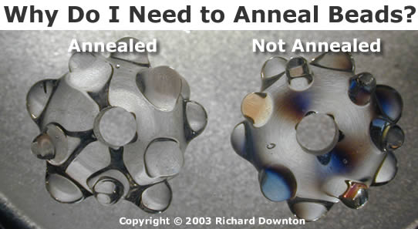
Some Ideas I
Deterministic annealing is better than many well-used optimization problems
  Started as “Elastic Net” by Durbin for Travelling Salesman Problem TSP
Basic idea behind deterministic annealing is mean field approximation, which is also used in “Variational Bayes” and many “neural network approaches”
  Markov chain Monte Carlo (MCMC) methods are roughly single temperature simulated annealing
  Less sensitive to initial conditions
  Avoid local optima
  Not equivalent to trying random initial starts

Slide 6
Some non-DA Ideas II
Dimension reduction gives Low dimension mappings of data to both visualize and apply geometric hashing
No-vector (can’t define metric space) problems are O(N²)
For no-vector case, one can develop O(N) or O(NlogN) methods as in “Fast Multipole and OctTree methods”
  Map high dimensional data to 3D and use classic methods developed originally to speed up O(N²) 3D particle dynamics problems

Slide 7
Uses of Deterministic Annealing
Clustering
  Vectors: Rose (Gurewitz and Fox)
  Clusters with fixed sizes and no tails (Proteomics team at Broad)
  No Vectors: Hofmann and Buhmann (Just use pairwise distances)
Dimension Reduction for visualization and analysis
  Vectors: GTM
  No vectors: MDS (Just use pairwise distances)
Can apply to general mixture models (but less study)
  Gaussian Mixture Models
  Probabilistic Latent Semantic Analysis with Deterministic Annealing DA-PLSA as alternative to Latent Dirichlet Allocation (typical informational retrieval/global inference topic model)

Slide 8
Deterministic Annealing I
Gibbs Distribution at Temperature T
P(χ) = exp( - H(χ)/T) / ∫ dχ exp( - H(χ)/T)
Or P(χ) = exp( - H(χ)/T + F/T )
Minimize Free Energy combining Objective Function and Entropy
F = < H - T S(P) > = ∫ dχ {P(χ)H + T P(χ) lnP(χ)}
Where χ are (a subset of) parameters to be minimized
Simulated annealing corresponds to doing these integrals by Monte Carlo
Deterministic annealing corresponds to doing integrals analytically (by mean field approximation) and is naturally much faster than Monte Carlo
In each case temperature is lowered slowly – say by a factor 0.95 to 0.99 at each iteration

Slide 9
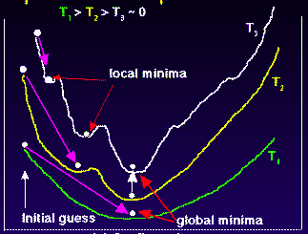
Deterministic
Annealing
F({y}, T)
Solve Linear Equations for each temperature
Nonlinear effects mitigated by initializing with solution at previous higher temperature
Configuration {y}
Minimum evolving as temperature decreases
Movement at fixed temperature going to local minima if not initialized “correctly

Slide 10
Deterministic Annealing II
For some cases such as vector clustering and Mixture Models one can do integrals by hand but usually will be impossible
So introduce Hamiltonian H₀(χ, ε) which by choice of ε can be made similar to real Hamiltonian H_{R}(χ) and which has tractable integrals
P₀(χ) = exp( - H₀(χ)/T + F₀/T ) approximate Gibbs for H_{R}
F_{R} (P₀) = < H_{R} - T S₀(P₀) >|₀ = < H_{R} – H₀> |₀ + F₀(P₀)
Where <…>|₀ denotes ∫ dχ P_{o}(χ)
Easy to show that real Free Energy (the Gibb’s inequality)
F_{R} (P_{R}) ≤ F_{R} (P₀) (Kullback-Leibler divergence)
Expectation step E is find ε minimizing F_{R} (P₀) and
Follow with M step (of EM) setting χ = <χ> |₀ = ∫ dχ χ P_{o}(χ) (mean field) and one follows with a traditional minimization of remaining parameters
Note 3 types of variables
ε used to approximate real Hamiltonian
χ subject to annealing
The rest – optimized by traditional methods

Slide 11
Implementation of DA Central Clustering
Clustering variables are M_{i}(k) (these are χ in general approach) where this is probability point i belongs to cluster k
In Central or PW Clustering, take H₀ = ∑_{i=1}^{N} ∑_{k=1}^{K} M_{i}(k) ε_{i}(k)
  Linear form allows DA integrals to be done analytically
Central clustering has ε_{i}(k) = (X(i)- Y(k))² and M_{i}(k) determined by Expectation step
  H_{Central} = ∑_{i=1}^{N} ∑_{k=1}^{K} M_{i}(k) (X(i)- Y(k))²
  H_{central} and H₀ are identical
<M_{i}(k)> = exp( -ε_{i}(k)/T ) / ∑_{k=1}^{K} exp( -ε_{i}(k)/T )
  Centers Y(k) are determined in M step

Slide 12
Implementation of DA-PWC
Clustering variables are again M_{i}(k) (these are χ in general approach) where this is probability point i belongs to cluster k
Pairwise Clustering Hamiltonian given by nonlinear form
H_{PWC} = 0.5 ∑_{i=1}^{N} ∑_{j=1}^{N} δ(i, j) ∑_{k=1}^{K} M_{i}(k) M_{j}(k) / C(k)
δ(i, j) is pairwise distance between points i and j
with C(k) = ∑_{i=1}^{N} M_{i}(k) as number of points in Cluster k
Take same form H₀ = ∑_{i=1}^{N} ∑_{k=1}^{K} M_{i}(k) ε_{i}(k) as for central clustering
ε_{i}(k) determined to minimize F_{PWC} (P₀) = < H_{PWC} - T S₀(P₀) >|₀ where integrals can be easily done
And now linear (in M_{i}(k)) H₀ and quadratic H_{PC} are different
Again <M_{i}(k)> = exp( -ε_{i}(k)/T ) / ∑_{k=1}^{K} exp( -ε_{i}(k)/T )

Slide 13
General Features of DA
Deterministic Annealing DA is related to Variational Inference or Variational Bayes methods
In many problems, decreasing temperature is classic multiscale – finer resolution (√T is “just” distance scale)
  We have factors like (X(i)- Y(k))² / T
In clustering, one then looks at second derivative matrix of F_{R} (P₀) wrt ε and as temperature is lowered this develops negative eigenvalue corresponding to instability
  Or have multiple clusters at each center and perturb
This is a phase transition and one splits cluster into two and continues EM iteration
One can start with just one cluster

Slide 14
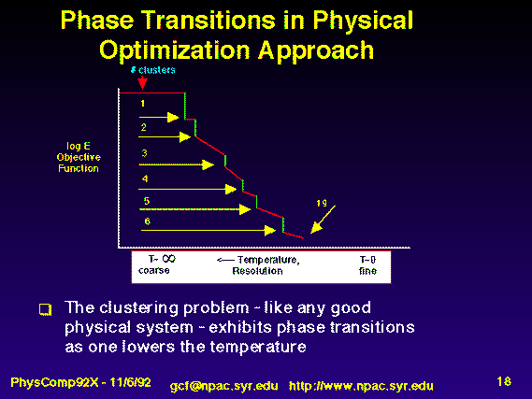
Rose, K., Gurewitz, E., and Fox, G. C. ``Statistical mechanics and phase transitions in clustering,'' Physical Review Letters, 65(8):945-948, August 1990.
My #6 most cited article (401 cites including 15 in 2011)

Slide 15
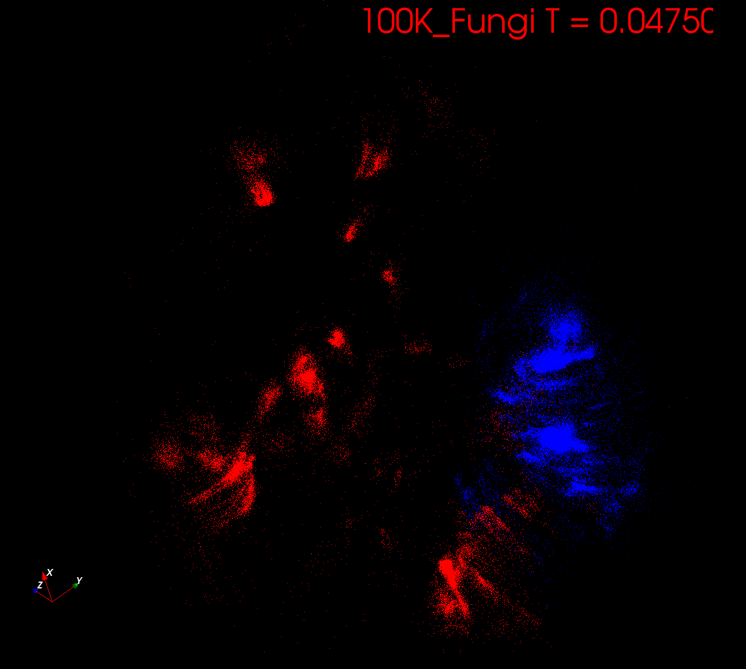
Start at T= “∞” with 1 Cluster
Decrease T, Clusters emerge at instabilities

Slide 16
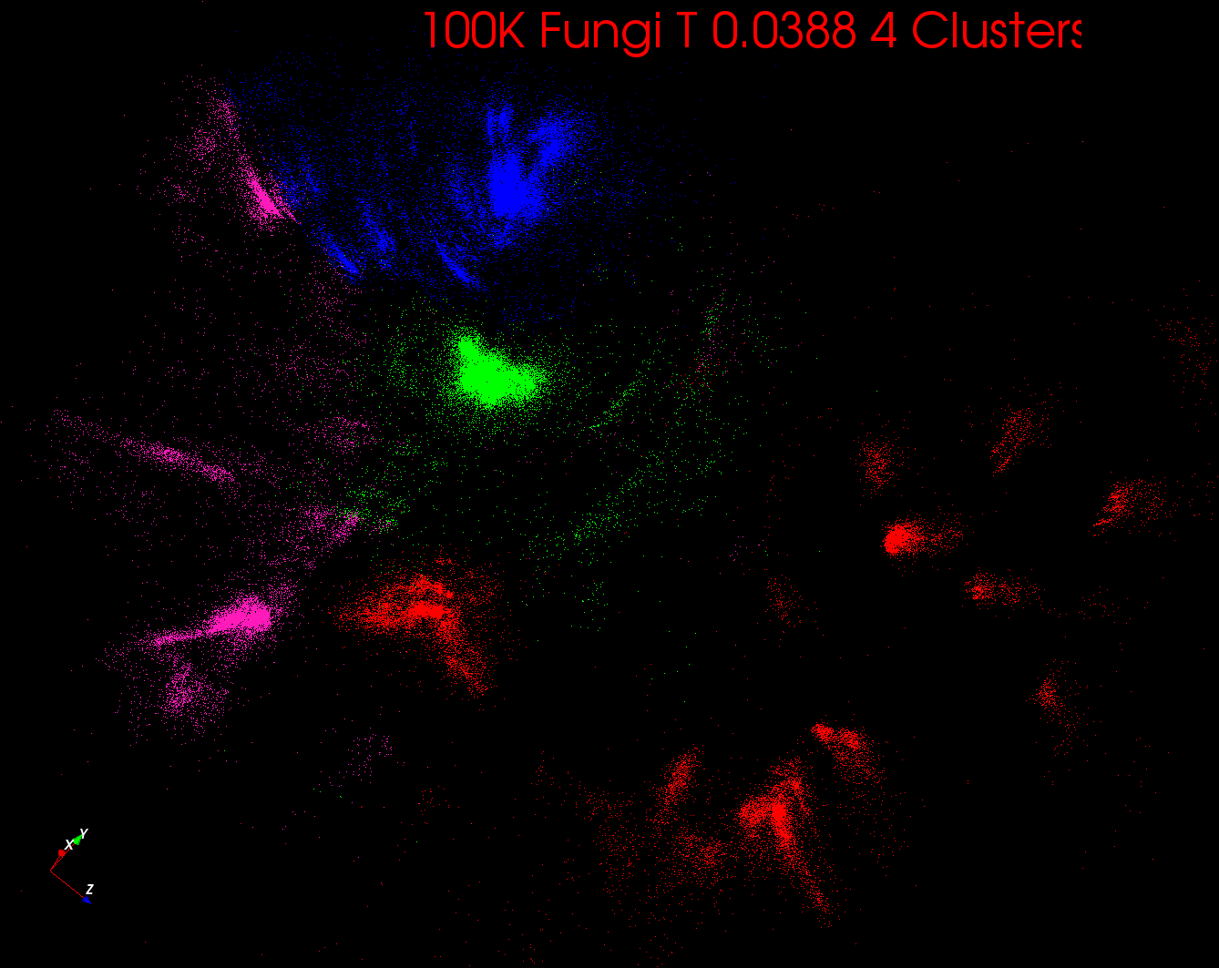

Slide 17
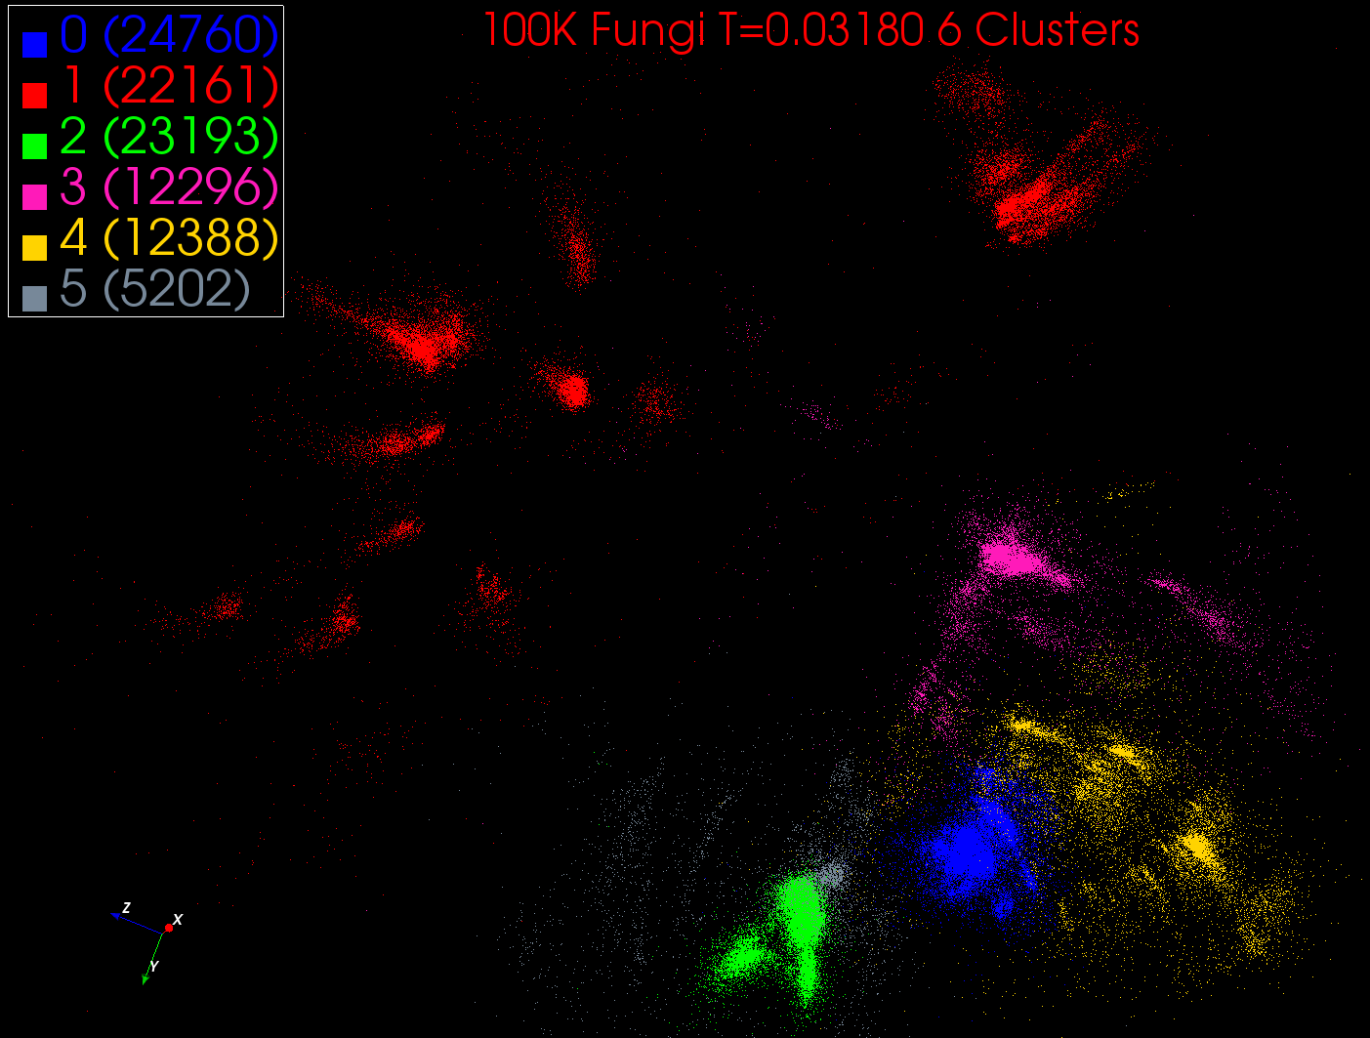

Slide 18
DA-PWC EM Steps (E is red, M Black) k runs over clusters; i,j points
A(k) = - 0.5 ∑_{i=1}^{N} ∑_{j=1}^{N} δ(i, j) <M_{i}(k)> <M_{j}(k)> / <C(k)>²
B_{j}(k) = ∑_{i=1}^{N} δ(i, j) <M_{i}(k)> / <C(k)>
ε_{i}(k) = (B_{i}(k) + A(k))
<M_{i}(k)> = p(k) exp( -ε_{i}(k)/T )/∑_{k=1}^{K} p(k) exp(-ε_{i}(k)/T)
C(k) = ∑_{i=1}^{N} <M_{i}(k)>
p(k) = C(k) / N
Loop to converge variables; decrease T from ∞; split centers by halving p(k)
Steps 1 global sum (reduction)
Step 1, 2, 5 local sum if <M_{i}(k)> broadcast

Slide 19
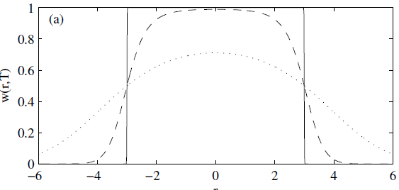
Trimmed Clustering
Clustering with position-specific constraints on variance: Applying redescending M-estimators to label-free LC-MS data analysis (Rudolf Frühwirth , D R Mani and Saumyadipta Pyne) BMC Bioinformatics 2011, 12:358
H_{TCC} = ∑_{k=0}^{K} ∑_{i=1}^{N} M_{i}(k) f(i,k)
  f(i,k) = (X(i) - Y(k))²/2σ(k)² k > 0
  f(i,0) = c² / 2 k = 0
The 0’th cluster captures (at zero temperature) all points outside clusters (background)
Clusters are trimmed
(X(i) - Y(k))²/2σ(k)² < c² / 2
Another case when H₀ is
same as target Hamiltonian
Proteomics Mass Spectrometry
T = 1
T ~ 0
T = 5
Distance from cluster center

Slide 20
High Performance Dimension Reduction and Visualization
Need is pervasive
  Large and high dimensional data are everywhere: biology, physics, Internet, …
  Visualization can help data analysis
Visualization of large datasets with high performance
  Map high-dimensional data into low dimensions (2D or 3D).
  Need Parallel programming for processing large data sets
  Developing high performance dimension reduction algorithms:
    MDS(Multi-dimensional Scaling)
    GTM(Generative Topographic Mapping)
    DA-MDS(Deterministic Annealing MDS)
    DA-GTM(Deterministic Annealing GTM)
  Interactive visualization tool PlotViz
Notes:
With David Wild

Slide 21
Multidimensional Scaling MDS
Map points in high dimension to lower dimensions
Many such dimension reduction algorithms (PCA Principal component analysis easiest); simplest but perhaps best at times is MDS
Minimize Stress
σ(X) = Σ_{i<j=1}^{n} weight(i,j) (δ(i, j) - d(X_{i} , X_{j}))²
δ(i, j) are input dissimilarities and d(X_{i} , X_{j}) the Euclidean distance squared in embedding space (3D usually)
SMACOF or Scaling by minimizing a complicated function is clever steepest descent (expectation maximization EM) algorithm
Computational complexity goes like N² * Reduced Dimension
We describe Deterministic annealed version of it which is much better
Could just view as non linear χ² problem (Tapia et al. Rice)
  Slower but more general
All parallelize with high efficiency

Slide 22
Implementation of MDS
H_{MDS} = Σ_{i< j=1}^{n} weight(i,j) (δ(i, j) - d(X(i) , X(j) ))²
Where δ(i, j) are observed dissimilarities and we want to represent as Euclidean distance d between points X(i) and X(j)
H_{MDS} is quartic or involves square roots, so we need the idea of an approximate Hamiltonian H₀
One tractable integral form for H₀ was linear Hamiltonians
Another is Gaussian H₀ = Σ_{i=1}^{n} (X(i) - μ(i))² / 2
Where X(i) are vectors to be determined as in formula for Multidimensional scaling
The E step is minimize
Σ_{i< j=1}^{n} weight(i,j) (δ(i, j) – constant.T - (μ(i) - μ(j))² )²
with solution μ(i) = 0 at large Temperature T
Points pop out from origin as Temperature lowered

Slide 23
Pairwise Clustering and MDS are O(N²) Problems
100,000 sequences takes a few days on 768 cores 32 nodes Windows Cluster Tempest
Could just run 680K on 6.8² larger machine but lets try to be “cleverer” and use hierarchical methods
Start with 100K sample run fully
Divide into “megaregions” using 3D projection
Interpolate full sample into megaregions and analyze latter separately
See http://salsahpc.org/millionseq/16SrRNA_index.html

Slide 24
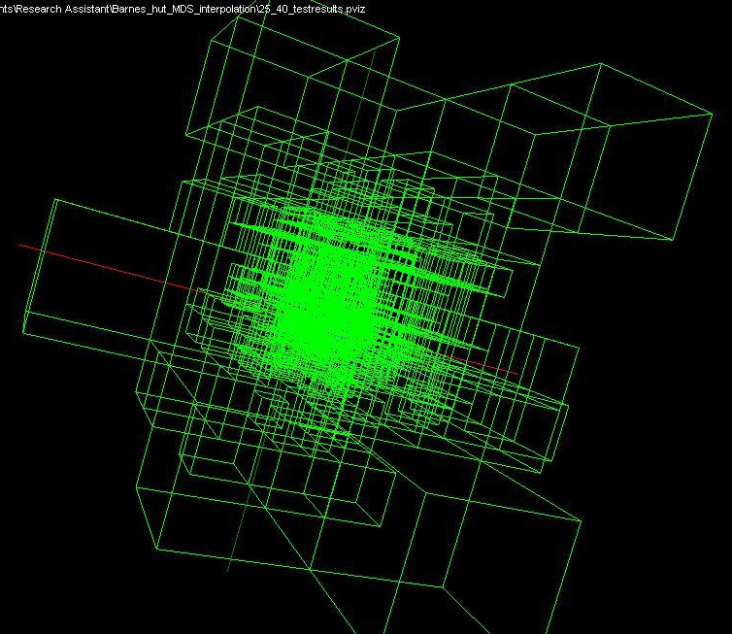
Use Barnes Hut OctTree originally developed to make O(N²) astrophysics O(NlogN)

Slide 25
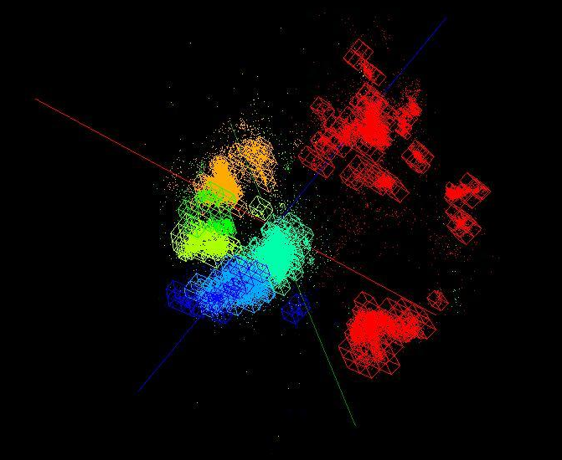
OctTree for 100K sample of Fungi
We use OctTree for logarithmic interpolation

Slide 26
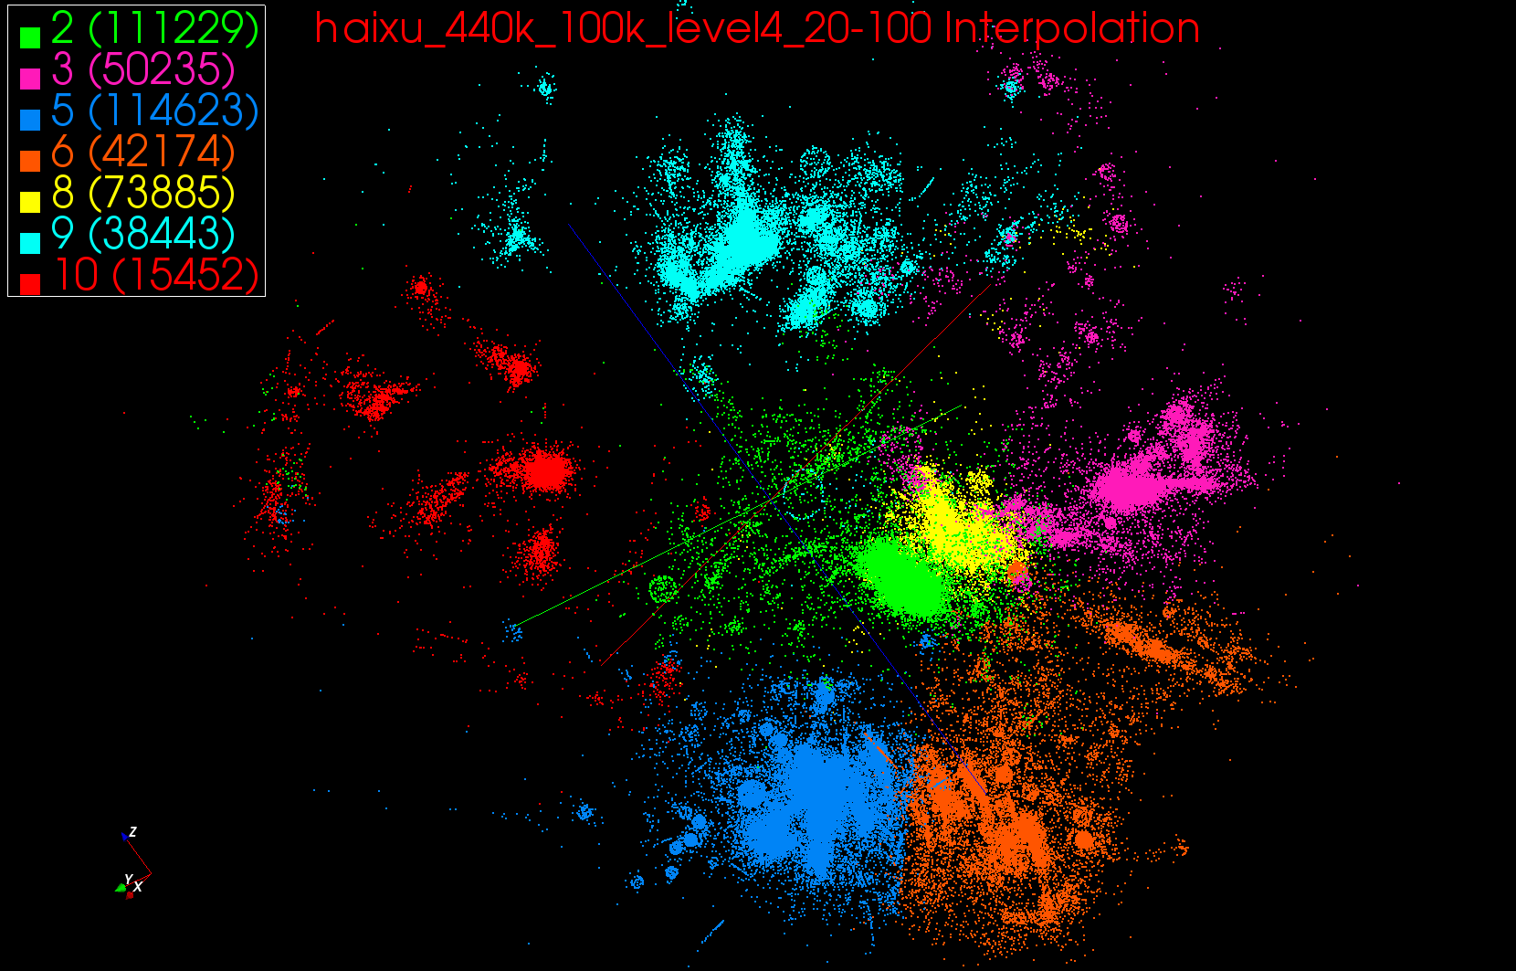
440K Interpolated

Slide 27
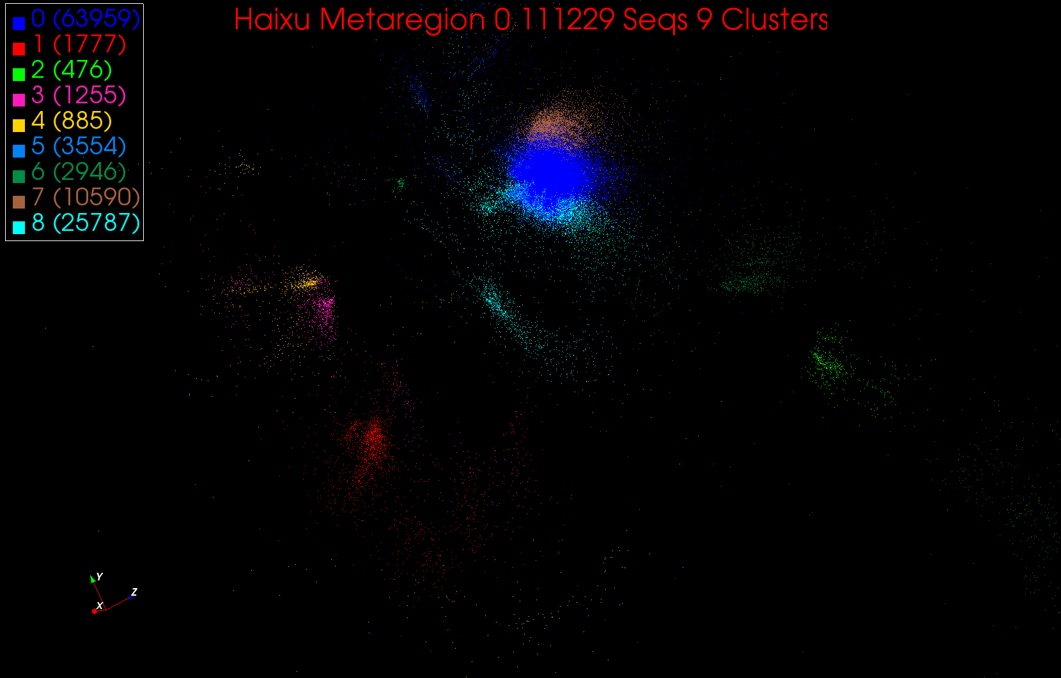
A large cluster in Region 0

Slide 28
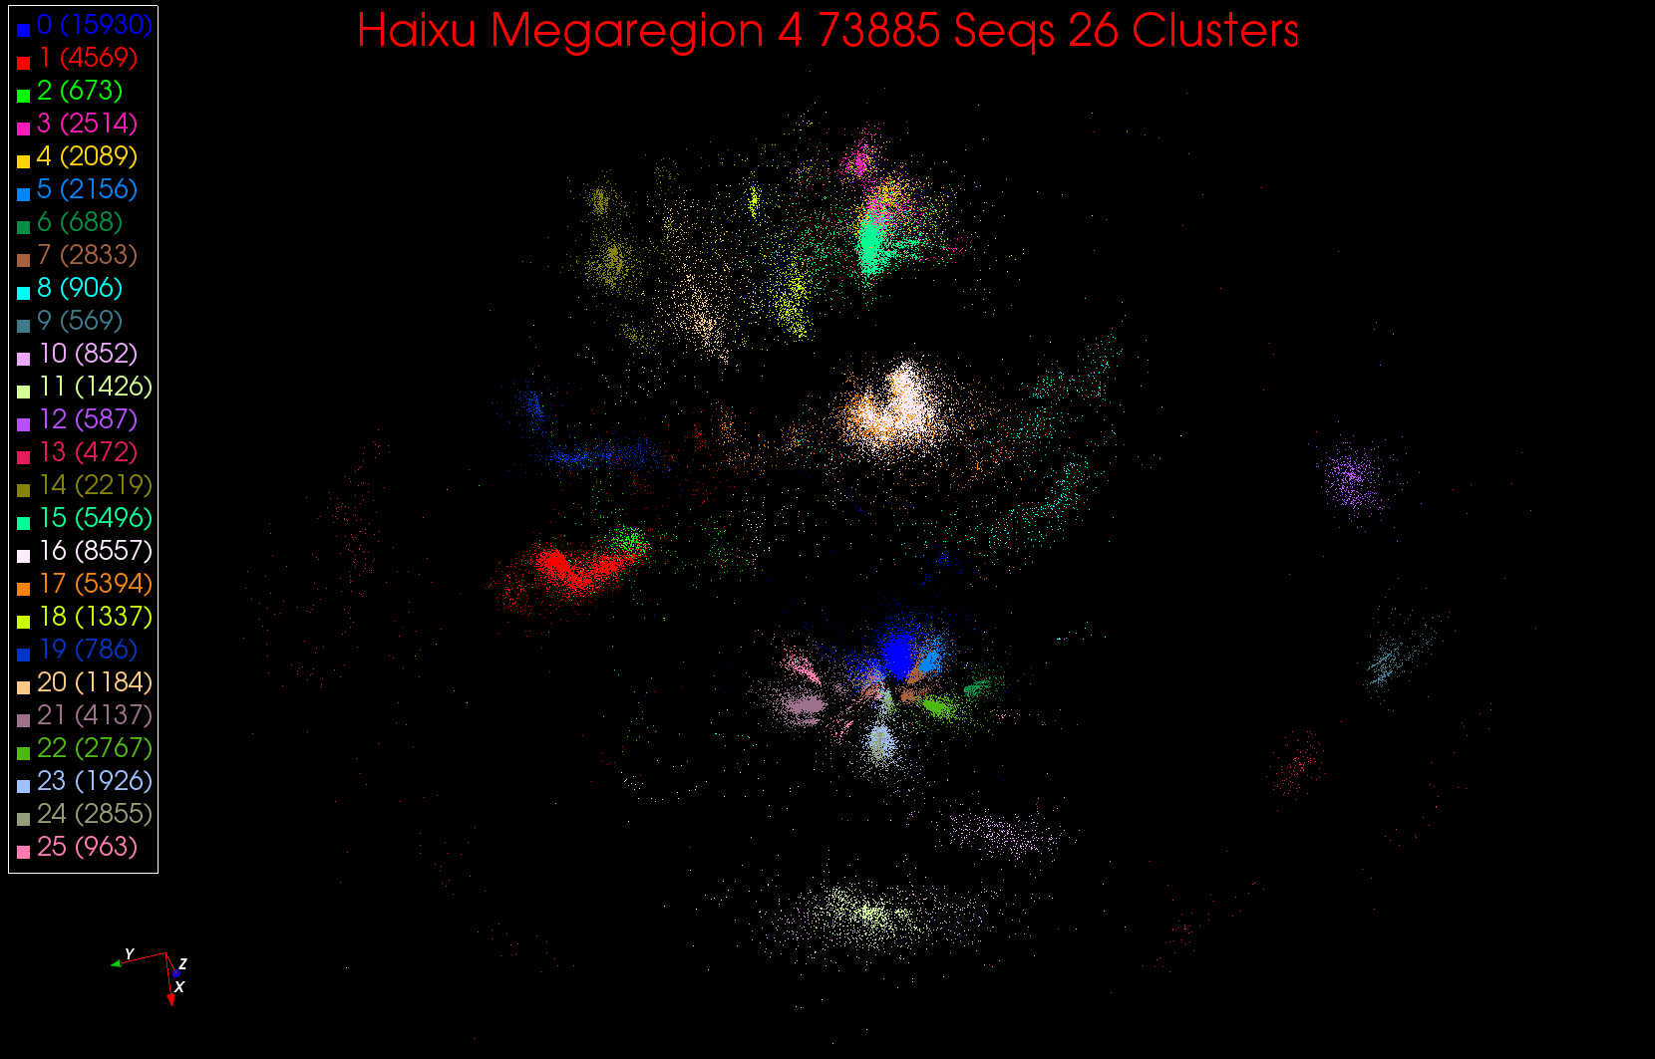
26 Clusters in Region 4

Slide 29
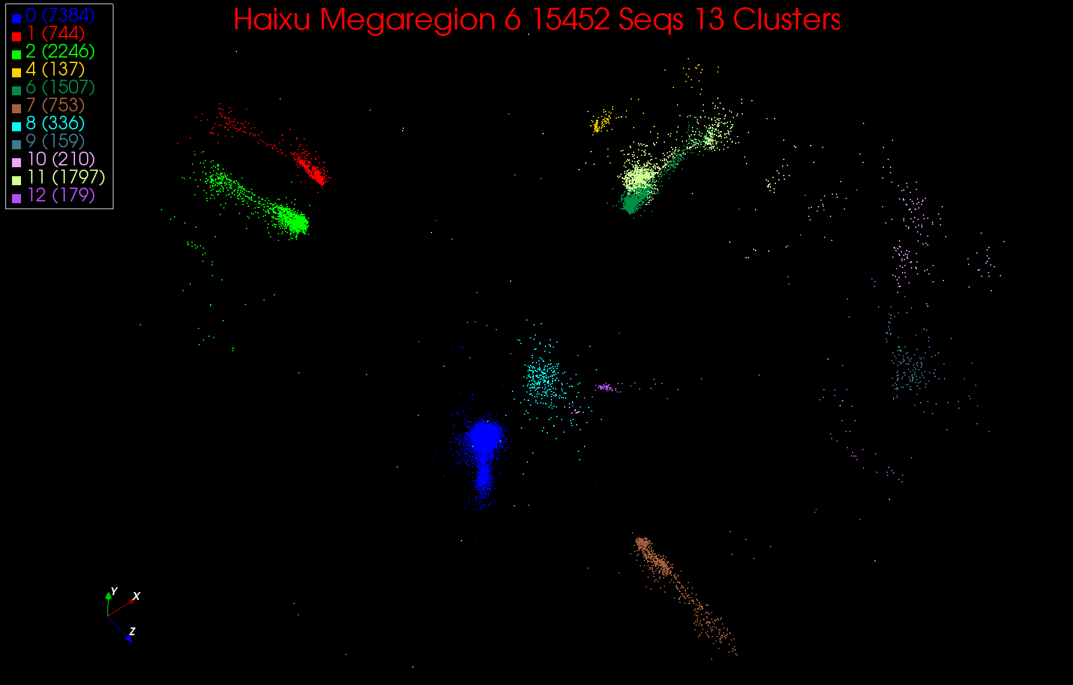
13 Clusters in Region 6

Slide 30
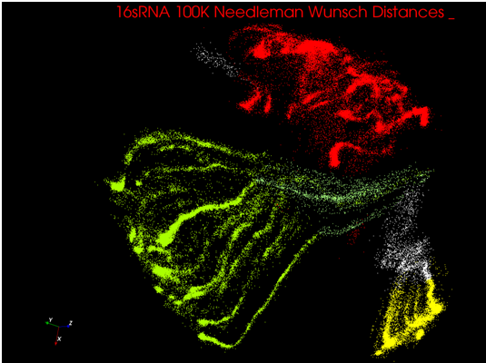
Understanding the Octopi

Slide 31
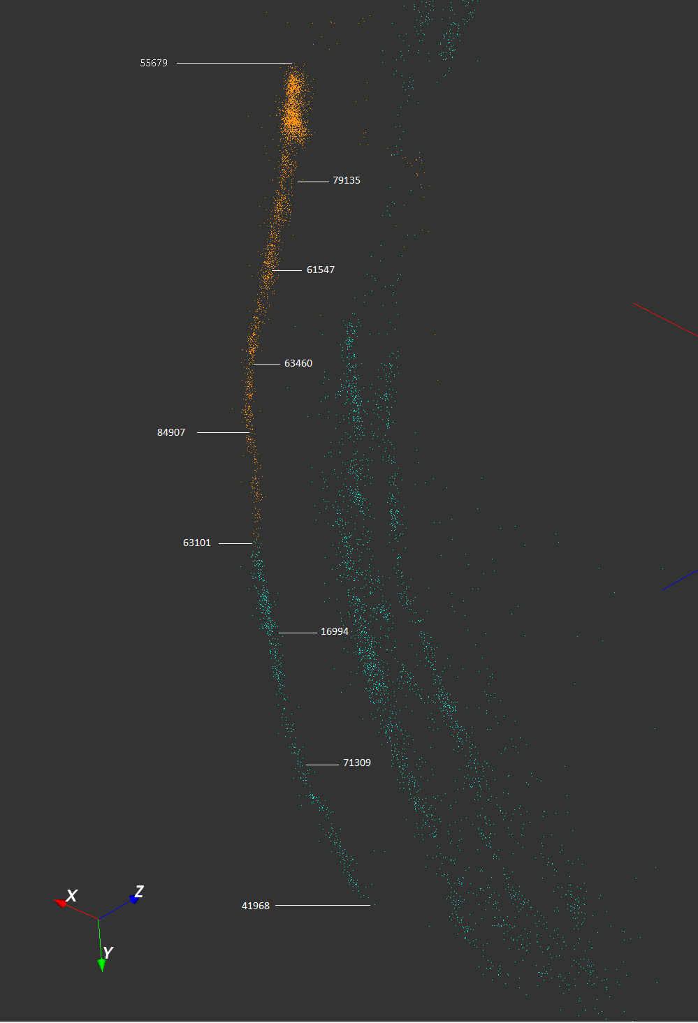
The octopi are globular clusters distorted by length dependence of dissimilarity measure
Sequences are 200 to 500 base pairs long
We restarted project using local (SWG) not global (NW) alignment

Slide 32
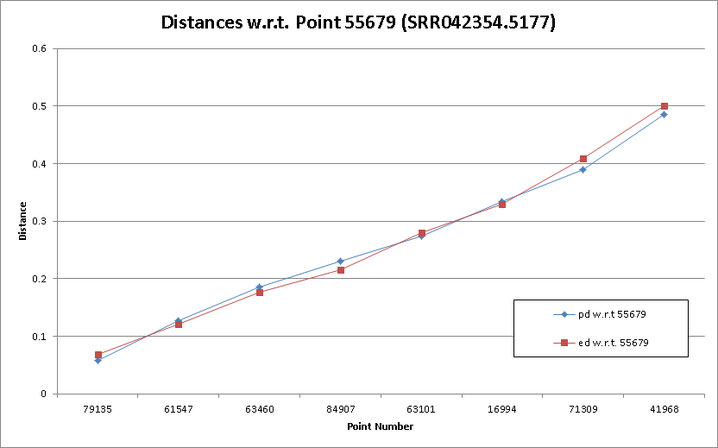
Note mapped (Euclidean 3D shown as red) and abstract dissimilarity (blue) are very similar

Slide 33
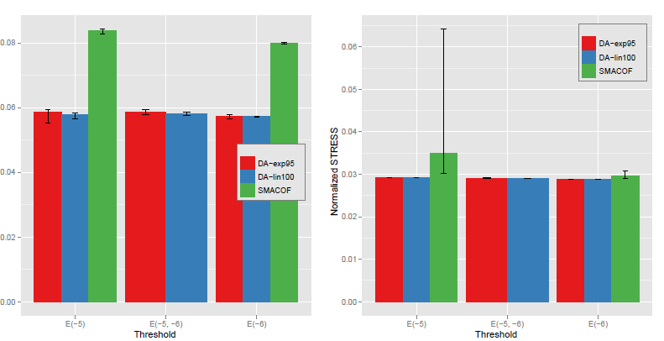
Quality of DA versus EM MDS
Normalized STRESS
Variation
in different
runs
Map to 2D 100K Metagenomics Map to 3D

Slide 34
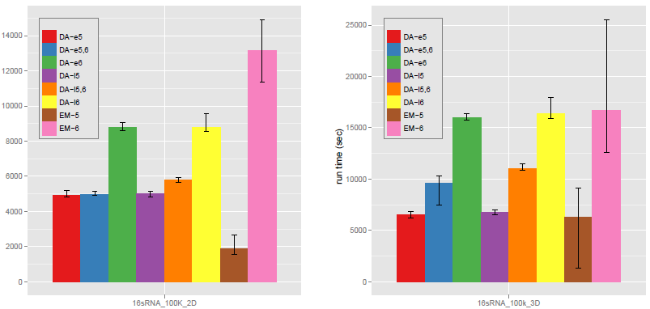
Run Time of DA versus EM MDS
Run time
secs
Map to 2D 100K Metagenomics Map to 3D

Slide 35
GTM with DA (DA-GTM)
Map to Grid (like SOM)
K latent points
N data points
GTM is an algorithm for dimension reduction
  Find optimal K latent variables in Latent Space
  f is a non-linear mapping function
  Traditional algorithm use EM for model fitting
DA optimization can improve the fitting process

Slide 36
Advantages of GTM
Computational complexity is O(KN), where
  N is the number of data points
  K is the number of latent variables or clusters. K << N
Efficient, compared with MDS which is O(N²)
Produce more separable map (right) than PCA (left)
PCA
GTM
Oil flow data
1000 points
12 Dimensions
3 Clusters

Slide 37
Free Energy for DA-GTM
Free Energy
  D : expected distortion
  H : Shannon entropy
  T : computational temperature
  Z_{n} : partitioning function
Partition Function for GTM

Slide 38
DA-GTM vs. EM-GTM
EM-GTM
DA-GTM
Optimization
Maximize log-likelihood L
Minimize free energy F
Objective
Function
When T = 1, L = -F.
Pros & Cons
Very sensitive
Trapped in local optima
Faster
Large deviation
Less sensitive to an initial condition
Find global optimum
Require more computational time
Smaller standard deviation

Slide 39
DA-GTM Result
496
466
427
511
(α = 0.95)
(α = 0.99)
(1st T_{c} = 4.64)

Slide 40
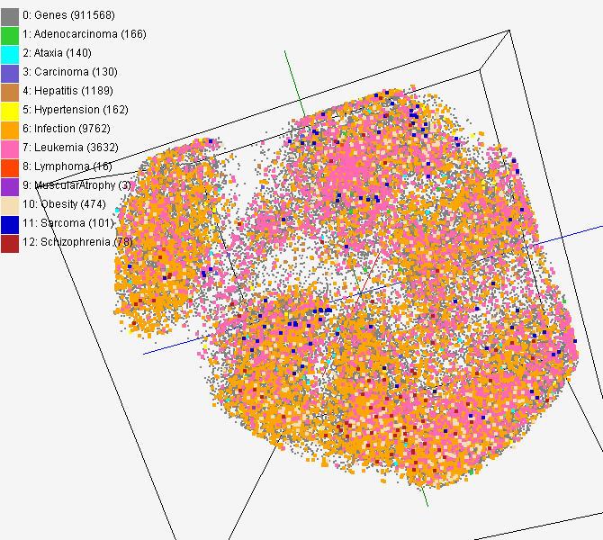
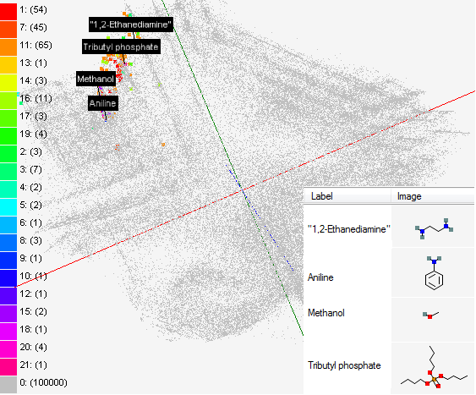
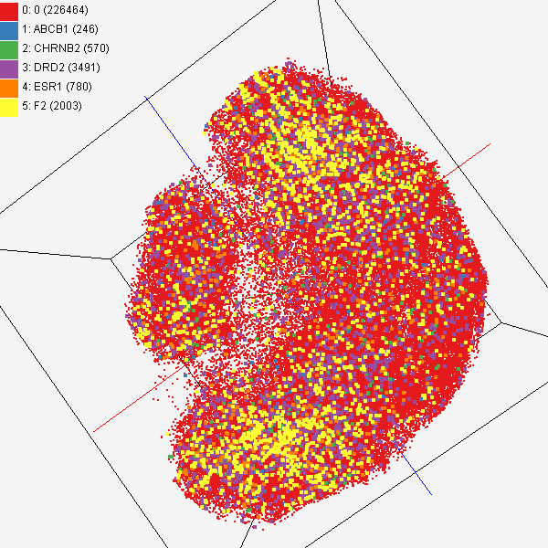
Data Mining Projects using GTM
Visualizing 215 solvents by GTM-Interpolation
215 solvents (colored and labeled) are embedded with 100,000 chemical compounds (colored in grey) in PubChem database
Chemical compounds reported in literatures
Visualized 234,000 chemical compounds which may be related with a set of 5 genes of interest (ABCB1, CHRNB2, DRD2, ESR1, and F2) based on the dataset collected from major journal literatures
PubChem data with CTD visualization
About 930,000 chemical compounds are visualized in a 3D space, annotated by the related genes in Comparative Toxicogenomics Database (CTD)

Slide 41
Probabilistic Latent Semantic Analysis (PLSA)
Topic model (or latent model)
  Assume generative K topics (document generator)
  Each document is a mixture of K topics
  The original proposal used EM for model fitting
Topic 1
Topic 2
Topic K
Doc 1
Doc 2
Doc N

Slide 42
DA-Mixture Models
Mixture models take general form
H = - Σ_{n=1}^{N} Σ_{k=1}^{K} M_{n}(k) ln L(n|k)
Σ_{k=1}^{K} M_{n}(k) = 1 for each n
n runs over things being decomposed (documents in this case)
k runs over component things– Grid points for GTM, Gaussians for Gaussian mixtures, topics for PLSA
Anneal on “spins” M_{n}(k) so H is linear and do not need another Hamiltonian as H = H₀
Note L(n|k) is function of “interesting” parameters and these are found as in non annealed case by a separate optimization in the M step

Slide 43
EM vs. DA-{GTM, PLSA}
EM
DA
Optimization
Maximize log-likelihood L
Minimize free energy F
Objective
Functions
GTM
PLSA
Note: When T = 1, L = -F.
This implies EM can be treated as a special case in DA
Pros & Cons
Very sensitive
Trapped in local optima
Faster
Large deviation
Less sensitive to an initial condition
Find global optimum
Require more computational time
Small deviation
Notes:
-T \sum_{n=1}^N \ln \sum_{k=1}^K \left\{ \psi_{nk} {\rm Multi}(\textbf{\em x}_n | \textbf{\em y}_k )\right\}^{1 \over T}

Slide 44
DA-PLSA Features
DA is good at both of the following:
  To improve model fitting quality compared to EM
  To avoid over-fitting and hence increase predicting power (generalization)
    Find better relaxed model than EM by stopping T > 1
    Note Tempered-EM, proposed by Hofmann (the original author of PLSA) is similar to DA but annealing is done in reversed way
LDA uses prior distribution to get effects similar to annealed smoothing

Slide 45
An example of DA-PLSA
Top 10 popular words of the AP news dataset for 30 topics. Processed by DA-PLSI and showing only 5 topics among 30 topics

Slide 46
Annealing in DA-PLSA
Improved fitting quality of training set during annealing
Annealing progresses from high temp to low temp
Proposed early-stop condition
Over-fitting at Temp=1

Slide 47
Predicting Power in DA-PLSA
AP Word Probabilities (100 topics for 10473 words)
Word Index
Word Index
optimized stop
(Temp = 49.98)
Over-fitting (most word probabilities are zero)
at T = 1

Slide 48
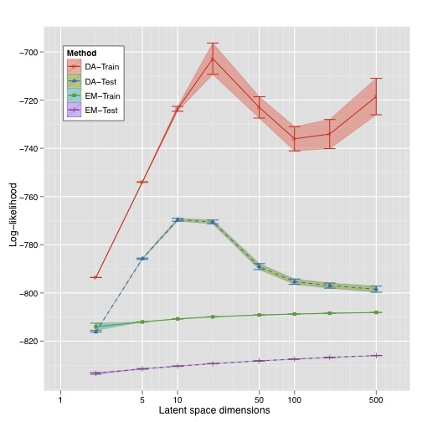
Training & Testing in DA-PLSA I
Here terminate on maximum of testing set
DA outperform EM
Improvements in training set matched by improvement in testing results
DA-Train
DA-Test
EM-Train
EM-Test

Slide 49
Training & Testing in DA-PLSA II
DA-Train
EM-Train
Here terminate on maximum of training set
Improvements in training set NOT matched by improvement in testing results
DA-Test
EM-Test

Slide 50
Hard to Compare LDA and PLSA as different objective functions.
This is LDA and PLSA for LDA Objective function
LDA
PLSA

Slide 51
Best Temperature for 3 stopping Criteria
Testing Set Only
which gives best result
90% Testing Set
10% Testing Set

Slide 52
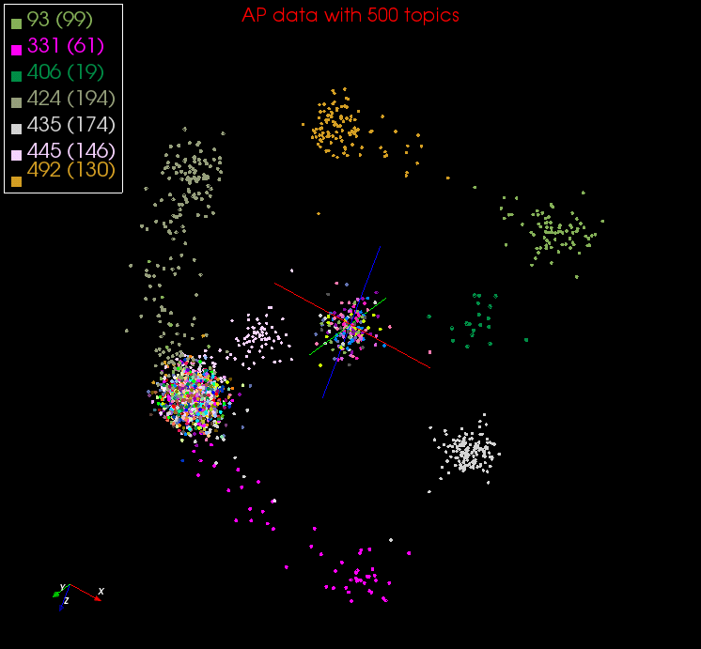
DA-PLSA with DA-GTM
Corpus
(Set of documents)
DA-PLSA
Corpus
in K-dimension
DA-GTM
Embedded Corpus in 3D

Slide 53
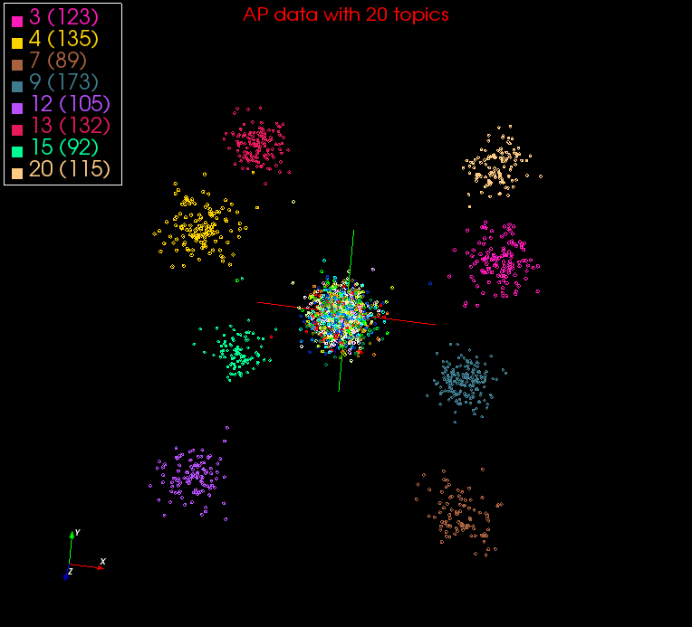

Slide 54
What was/can be done where?
Dissimilarity Computation (largest time)
  Done using Twister (Iterative MapReduce) on HPC
  Have running on Azure and Dryad
  Used Tempest (24 cores per node, 32 nodes) with MPI as well (MPI.NET failed(!), Twister didn’t)
Full MDS
  Done using MPI on Tempest
  Have running well using Twister on HPC clusters and Azure
Pairwise Clustering
  Done using MPI on Tempest
  Probably need to change algorithm to get good efficiency on cloud but HPC parallel efficiency high
Interpolation (smallest time)
  Done using Twister on HPC
  Running on Azure

Slide 55


Twister
Pub/Sub Broker Network
Map Worker
M
Worker Nodes
R
Reduce Worker
Streaming based communication
Intermediate results are directly transferred from the map tasks to the reduce tasks – eliminates local files
Cacheable map/reduce tasks
  Static data remains in memory
Combine phase to combine reductions
User Program is the composer of MapReduce computations
Extends the MapReduce model to iterative computations
D
D
MR
Driver
User
Program
M
M
M
M
D
MRDeamon
R
R
R
R
Data Read/Write
Communication
Data Split
File System
Iterate
Static
data
Configure()
User Program
Map(Key, Value)
δ flow
Reduce (Key, List<Value>)
Combine (Key, List<Value>)
Different synchronization and intercommunication mechanisms used by the parallel runtimes
Close()

Slide 56
Multi-Dimensional-Scaling
Many iterations
Memory & Data intensive
3 Map Reduce jobs per iteration
X_{k} = invV * B(X_{(k-1)}) * X_{(k-1)}
2 matrix vector multiplications termed BC and X
BC: Calculate BX
X: Calculate invV (BX)
Calculate Stress
Map
Reduce
Merge
Map
Reduce
Merge
Map
Reduce
Merge
New Iteration

Slide 57
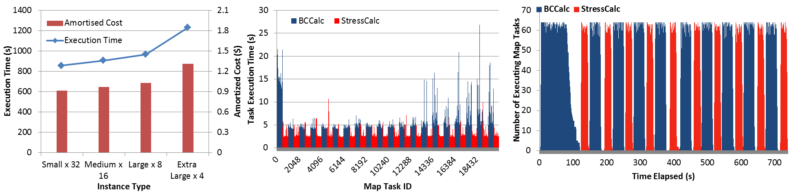
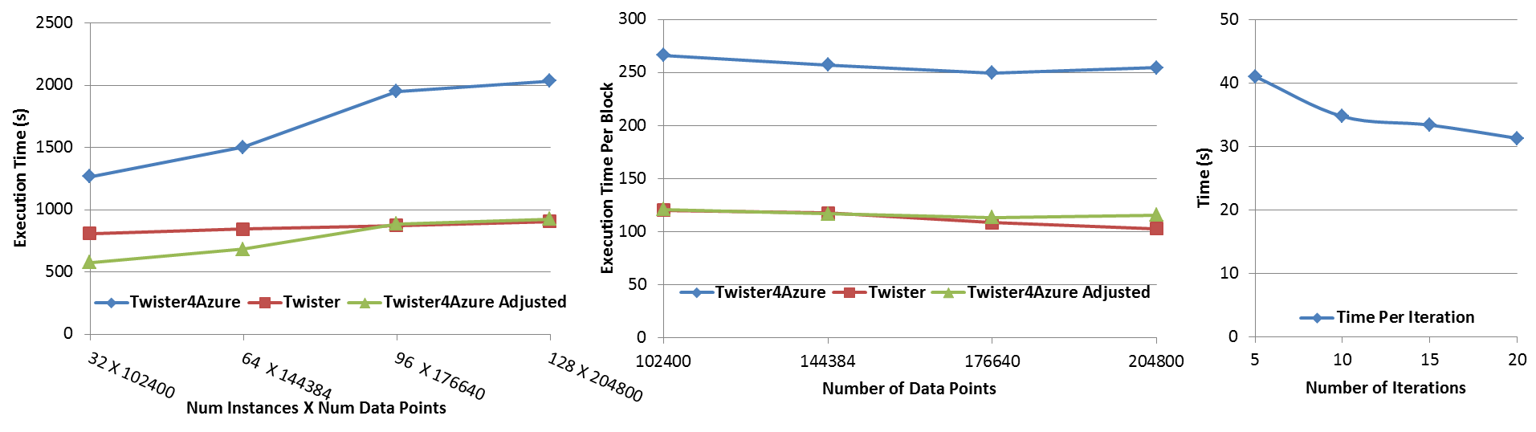




Performance – Multi Dimensional Scaling
Azure Instance Type Study
Task Execution Time Histogram
Number of Executing Map Task Histogram
Weak Scaling
Data Size Scaling
Increasing Number of Iterations
Performance with/without
data caching
Speedup gained using data cache
Scaling speedup
Increasing number of iterations
Notes:
Figure 6. Twister4Azure MDS performance Left: Instance type study using 76800 data points, 32 instances, 20 iterations. Center: Twister4Azure MDS individual task execution time histogram for 144384 x144384 distance matrix in 64 Azure small instances, 10 iterations Right: Twister4Azure executing Map Task histogram for 144384 x144384 distance matrix in 64 Azure small instances, 10 iterations
Figure 7. Left: Weak scaling where workload per core is ~constant. Ideal is a straight horizontal line. Center : Data size scaling with 128 Azure small instances/cores, 20 iterations. Right: Time per iteration with increasing number of iterations 30k x 30k distance matrix, 15 instances.

Slide 58
Expectation Maximization and Iterative MapReduce
Clustering and Multidimensional Scaling are both EM (expectation maximization) using deterministic annealing for improved performance
EM tends to be good for clouds and Iterative MapReduce
  Quite complicated computations (so compute largish compared to communicate)
  Communication is Reduction operations (global sums in our case)
  See also Latent Dirichlet Allocation and related Information Retrieval algorithms similar EM structure

Slide 59
May Need New Algorithms
DA-PWC (Deterministically Annealed Pairwise Clustering) splits clusters automatically as temperature lowers and reveals clusters of size O(√T)
Two approaches to splitting
  Look at correlation matrix and see when becomes singular which is a separate parallel step
  Formulate problem with multiple centers for each cluster and perturb ever so often spitting centers into 2 groups; unstable clusters separate
Current MPI code uses first method which will run on Twister as matrix singularity analysis is the usual “power eigenvalue method” (as is page rank)
  However not super good compute/communicate ratio
Experiment with second method which “just” EM with better compute/communicate ratio (simpler code as well)

Slide 60
Next Steps
Finalize MPI and Twister versions of Deterministically Annealed Expectation Maximization for
  Vector Clustering
  Vector Clustering with trimmed clusters
  Pairwise non vector Clustering
  MDS SMACOF
Extend O(NlogN) Barnes Hut methods to all codes
Allow missing distances in MDS (Blast gives this) and allow arbitrary weightings (Sammon’s method)
  Have done for χ² approach to MDS
Explore DA-PLSA as alternative to LDA
Exploit better Twister and Twister4Azure runtimes

