Slide 1
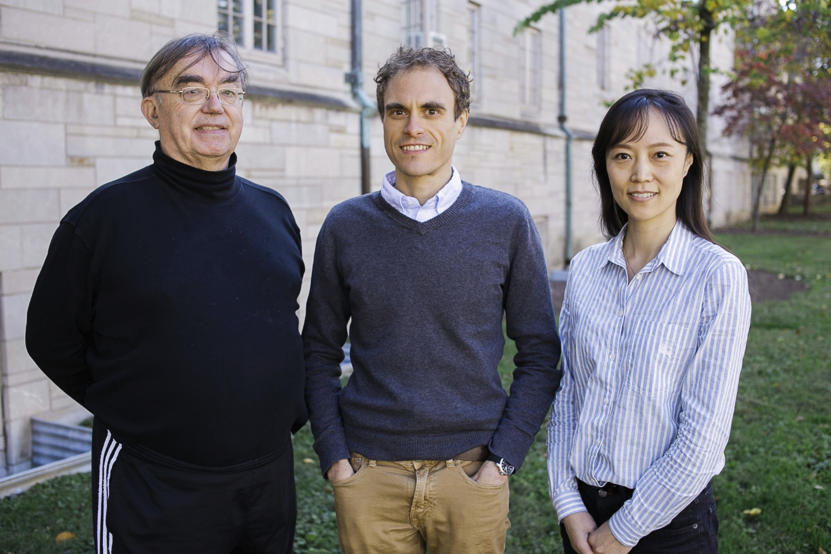
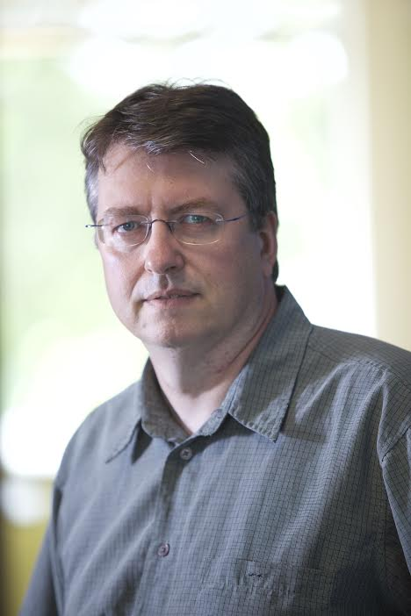
Dibbs Research at
Digital Science Center@SOIC
Indiana University Faculty
Geoffrey Fox, David Crandall, Judy Qiu, Gregor von Laszewski

Slide 2
Big Data Ogres and their Facets
51 Big Data use cases: http://bigdatawg.nist.gov/usecases.php
Ogres classify Big Data Applications with facets and benchmarks
Facets I: Features identified from 51 use cases: PP(26), MR(18), MR-Statistics(7), MR-Iterative(23), Graph(9), Fusion(11), Streaming/DDDAS(41), Classify(30), Search/Query(12), Collaborative Filtering(4), LML(36), GML(23), Workflow(51), GIS(16), HPC(5), Agents(2)
  MR MapReduce; L/GML Local/Global Machine Learning
Facets II: Some broad features familiar from past like
  BSP (Bulk Synchronous Processing) or not?
  SPMD (Single Program Multiple Data) or not?
  Iterative or not?
  Regular or Irregular?
  Static or dynamic?,
  communication/compute and I-O/compute ratios
  Data abstraction (array, key-value, pixels, graph…)
Facets III: Data Processing Architectures

Slide 3
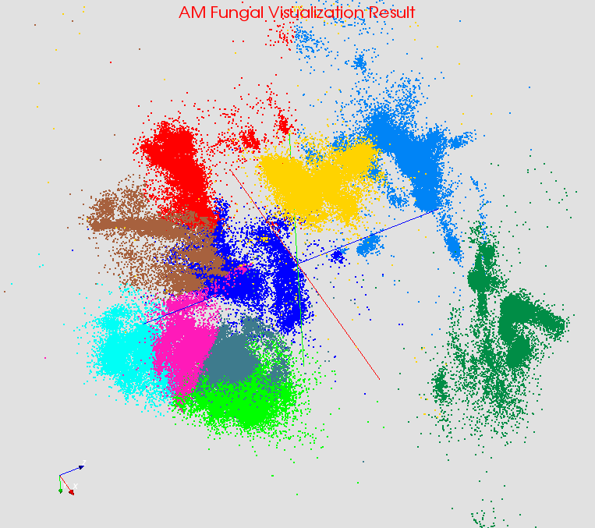

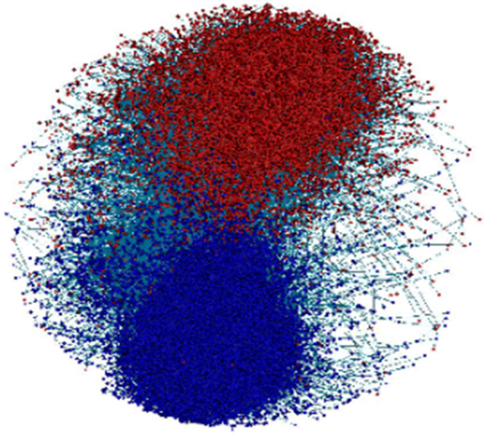

Large-Scale Data Analysis Applications
    Data analysis plays an important role in data-driven scientific discovery and commercial services. An interesting principle is that HPC ideas should integrate well with Apache (and other) open source big data technologies (ABDS). ABDS seems a winner as it has a clear vitality and innovation with a sustainable software model. Our current catalog has identified 266 software subsystems divided into 17 layers.
    Illustrating this principle, we have shown that previous standalone enhanced versions of MapReduce can be replaced by a Hadoop plug-in that offers both data abstractions useful for high performance iteration and communication using best available (MPI) approaches that are portable to HPC and Cloud.
    This iterative solver would enable robustness, scalability, productivity, and sustainability for applications including Computer Vision, Pathology, Information Visualization, Network Science, Remote sensing, Physical Simulation, as well as many commercial applications. This variety of applications should allow tests of memory architecture, vectorization and parallelization approach on the different Multicore and GPU systems.
Classified OUT
IN
Bioinformatics
Computer Vision
Complex Networks
Deep Learning
Million sequence challenge
Image processing and classification
Streaming data analysis
Speedup DL and training

Slide 4
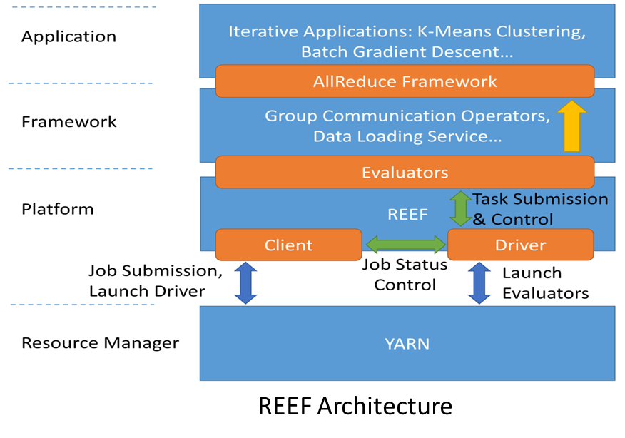
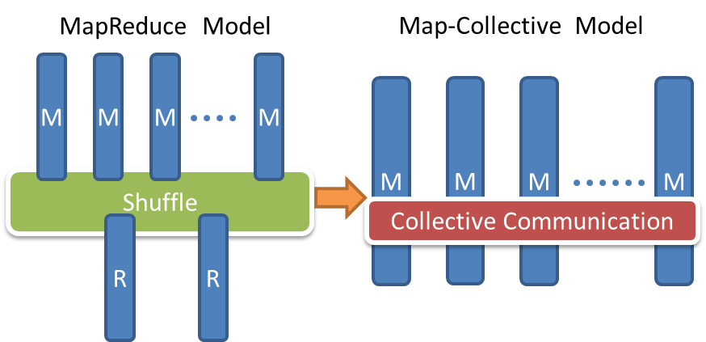
Map-Collective Communication Model
  Hadoop Plugin (on Hadoop 1.2.1 and Hadoop 2.2.0)
Software Architecture
Parallelism Model
  We generalize the Map-Reduce concept to Map-Collective, noting that large collectives (high performance data movement) are a distinguishing feature of data intensive and data mining applications.

Slide 5

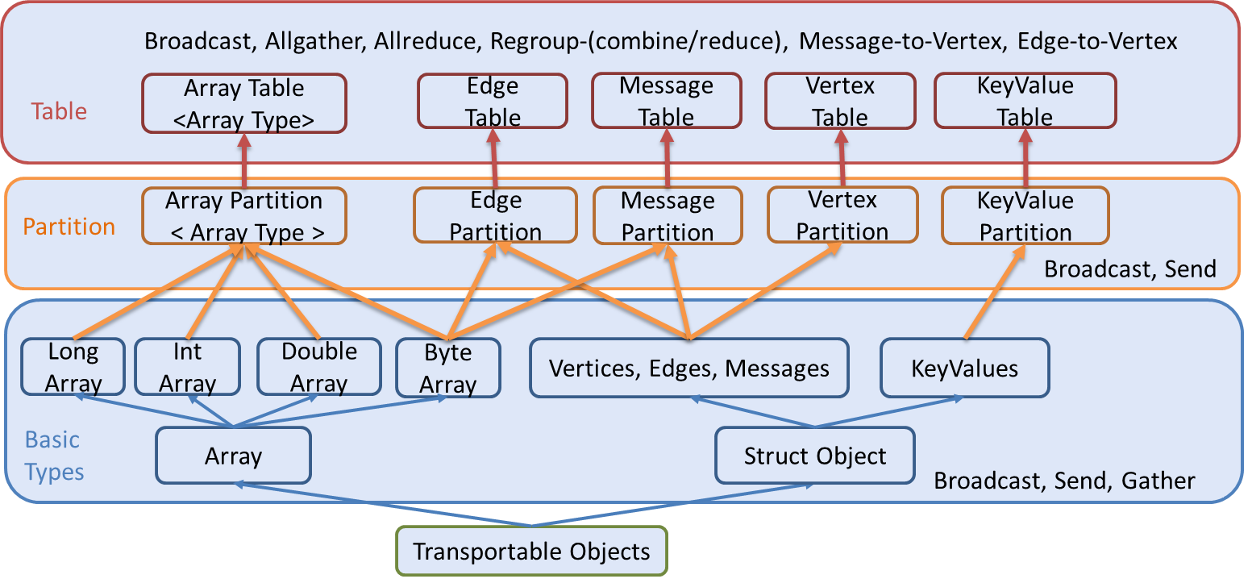
Hierarchical Data Abstraction and Collective Communication
We create abstractions and connect to other communities so we can collaborate on common software building blocks

Slide 6
Harp Plug-in to Hadoop
Make ABDS high performance – do not replace it!
Work of Judy Qiu and Bingjing Zhang.
Left diagram shows architecture of Harp Hadoop Plug-in that adds high performance communication, Iteration (caching) and support for rich data abstractions including key-value
Right side shows efficiency for 16 to 128 nodes (each 32 cores) on WDA-SMACOF dimension reduction dominated by conjugate gradient

Slide 7

Typical MDS: Protein Universe Browser for COG Sequences with a few illustrative biologically identified clusters

Slide 8
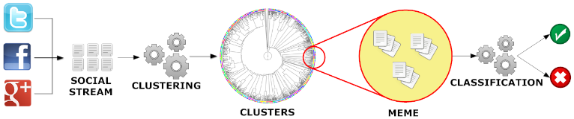
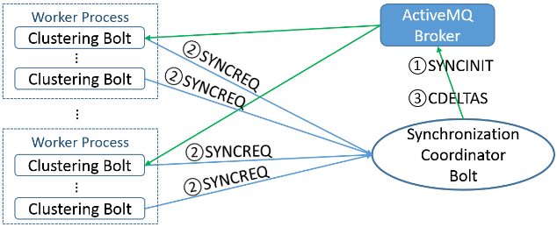
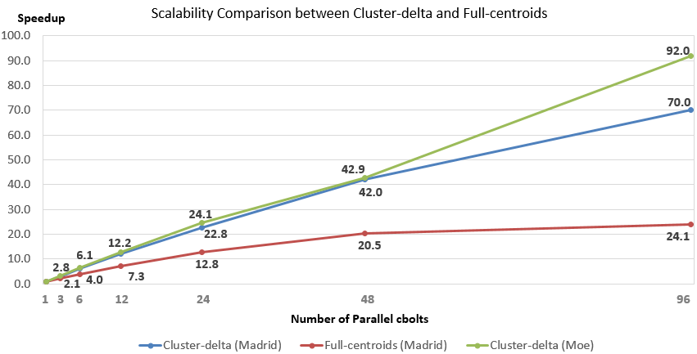
Parallel Tweet Clustering with Storm
Judy Qiu and Xiaoming Gao
Storm Bolts coordinated by ActiveMQ to synchronize parallel cluster center updates
Speedup on up to 96 bolts on two clusters Moe and Madrid
Red curve is old algorithm;
green and blue new algorithm

Slide 9
Cloud DIKW based on HPC-ABDS to integrate streaming and batch Big Data
System Orchestration / Dataflow / Workflow
Archival Storage – NOSQL like Hbase
Batch Processing (Iterative MapReduce)
Analytics
Raw Data
Data
Information
Knowledge
Wisdom
Decisions
Analytics
Streaming Processing (Iterative MapReduce)
Storm
Storm
Storm
Storm
Storm
Storm
Pub-Sub
Internet of Things (Smart Grid)

Slide 10
RabbitMQ out-performs Kafka with Storm
Kafka Latency
RabbitMQ Latency

Slide 11
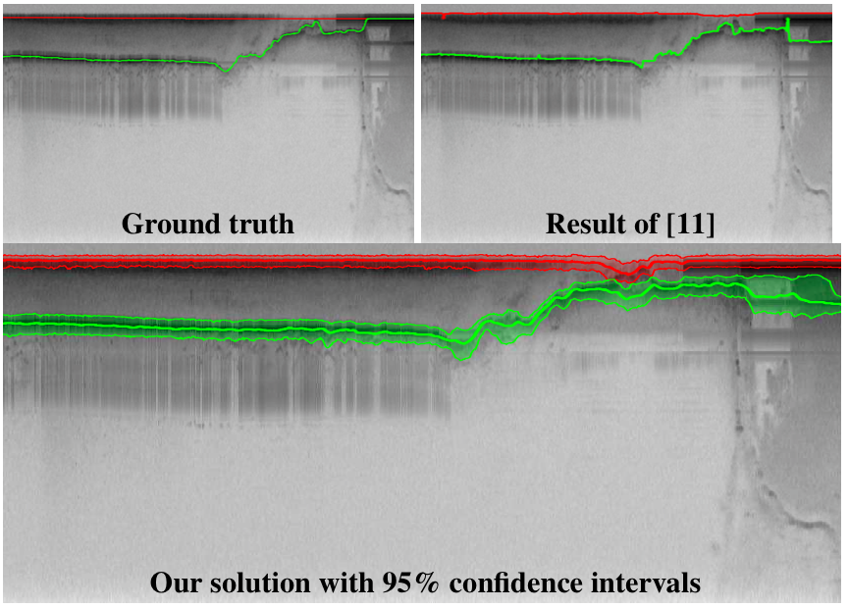
Layer-finding for radar informatics
Developing flexible, robust techniques using probabilistic graphical models
Sampling-based (MCMC) inference to find best solutions and confidence intervals
ICIP 2014 and ICPR 2012 papers studied ice surface and bedrock layers
Six month goal is to extend to internal layers case where # of layers is unknown, and to begin to reconstruct in full 3D in collaboration with CReSIS

Slide 12
Image processing & machine learning
We have begun developing an image processing library for Hadoop MapReduce, supporting basic algorithms on large image sets
  Supports low-level operations like feature extraction, segmentation, image preprocessing, etc.
  Simple machine learning algorithms, currently: SVM classification (not learning), Bayesian classifers, sampling-based inference
  Currently in use for processing large-scale social photo collections
Year 1 goal is to port these and selected other open-source image processing and machine learning algorithms to DIBBs, with focus on pleasingly parallel algorithms for now

Slide 13
Cloudmesh Software Defined System Toolkit
Cloudmesh Open source http://cloudmesh.github.io/ supporting
  The ability to federate a number of resources from academia and industry. This includes existing FutureSystems infrastructure, Amazon Web Services, Azure, HP Cloud, Karlsruhe using several IaaS frameworks
  IPython-based workflow as an interoperable onramp
Supports reproducible computing environments
Uses internally Libcloud and Cobbler
Celery Task/Query manager (AMQP - RabbitMQ)
MongoDB
Gregor von Laszewski
Fugang Wang
Notes:
Due to its integrated services Cloudmesh provides the ability to be an onramp for other clouds.
It provides information services to various system level sensors to give access to sensor and utilization data. Internally, it can be used to optimize the system usage.
The provisioning experience from FutureGrid has taught us that we need to provide
the creation of new clouds (rain)
the repartitioning of resources between services (cloud shifting)
and the integration of external cloud resources in case of over provisioning (cloud bursting)
As we deal with many IaaS frameworks, we need an abstraction layer on top of the IaaS framework.
Experiment management is conducted with workflows controlled in shells, Python/iPython, as well as systems such as OpenStack's Heat.
Accounting is supported through additional services such as user management and charge rate management.
Not all features are yet implemented. Figure shows the main functionality that we target at this time to implement.

