Slide 1
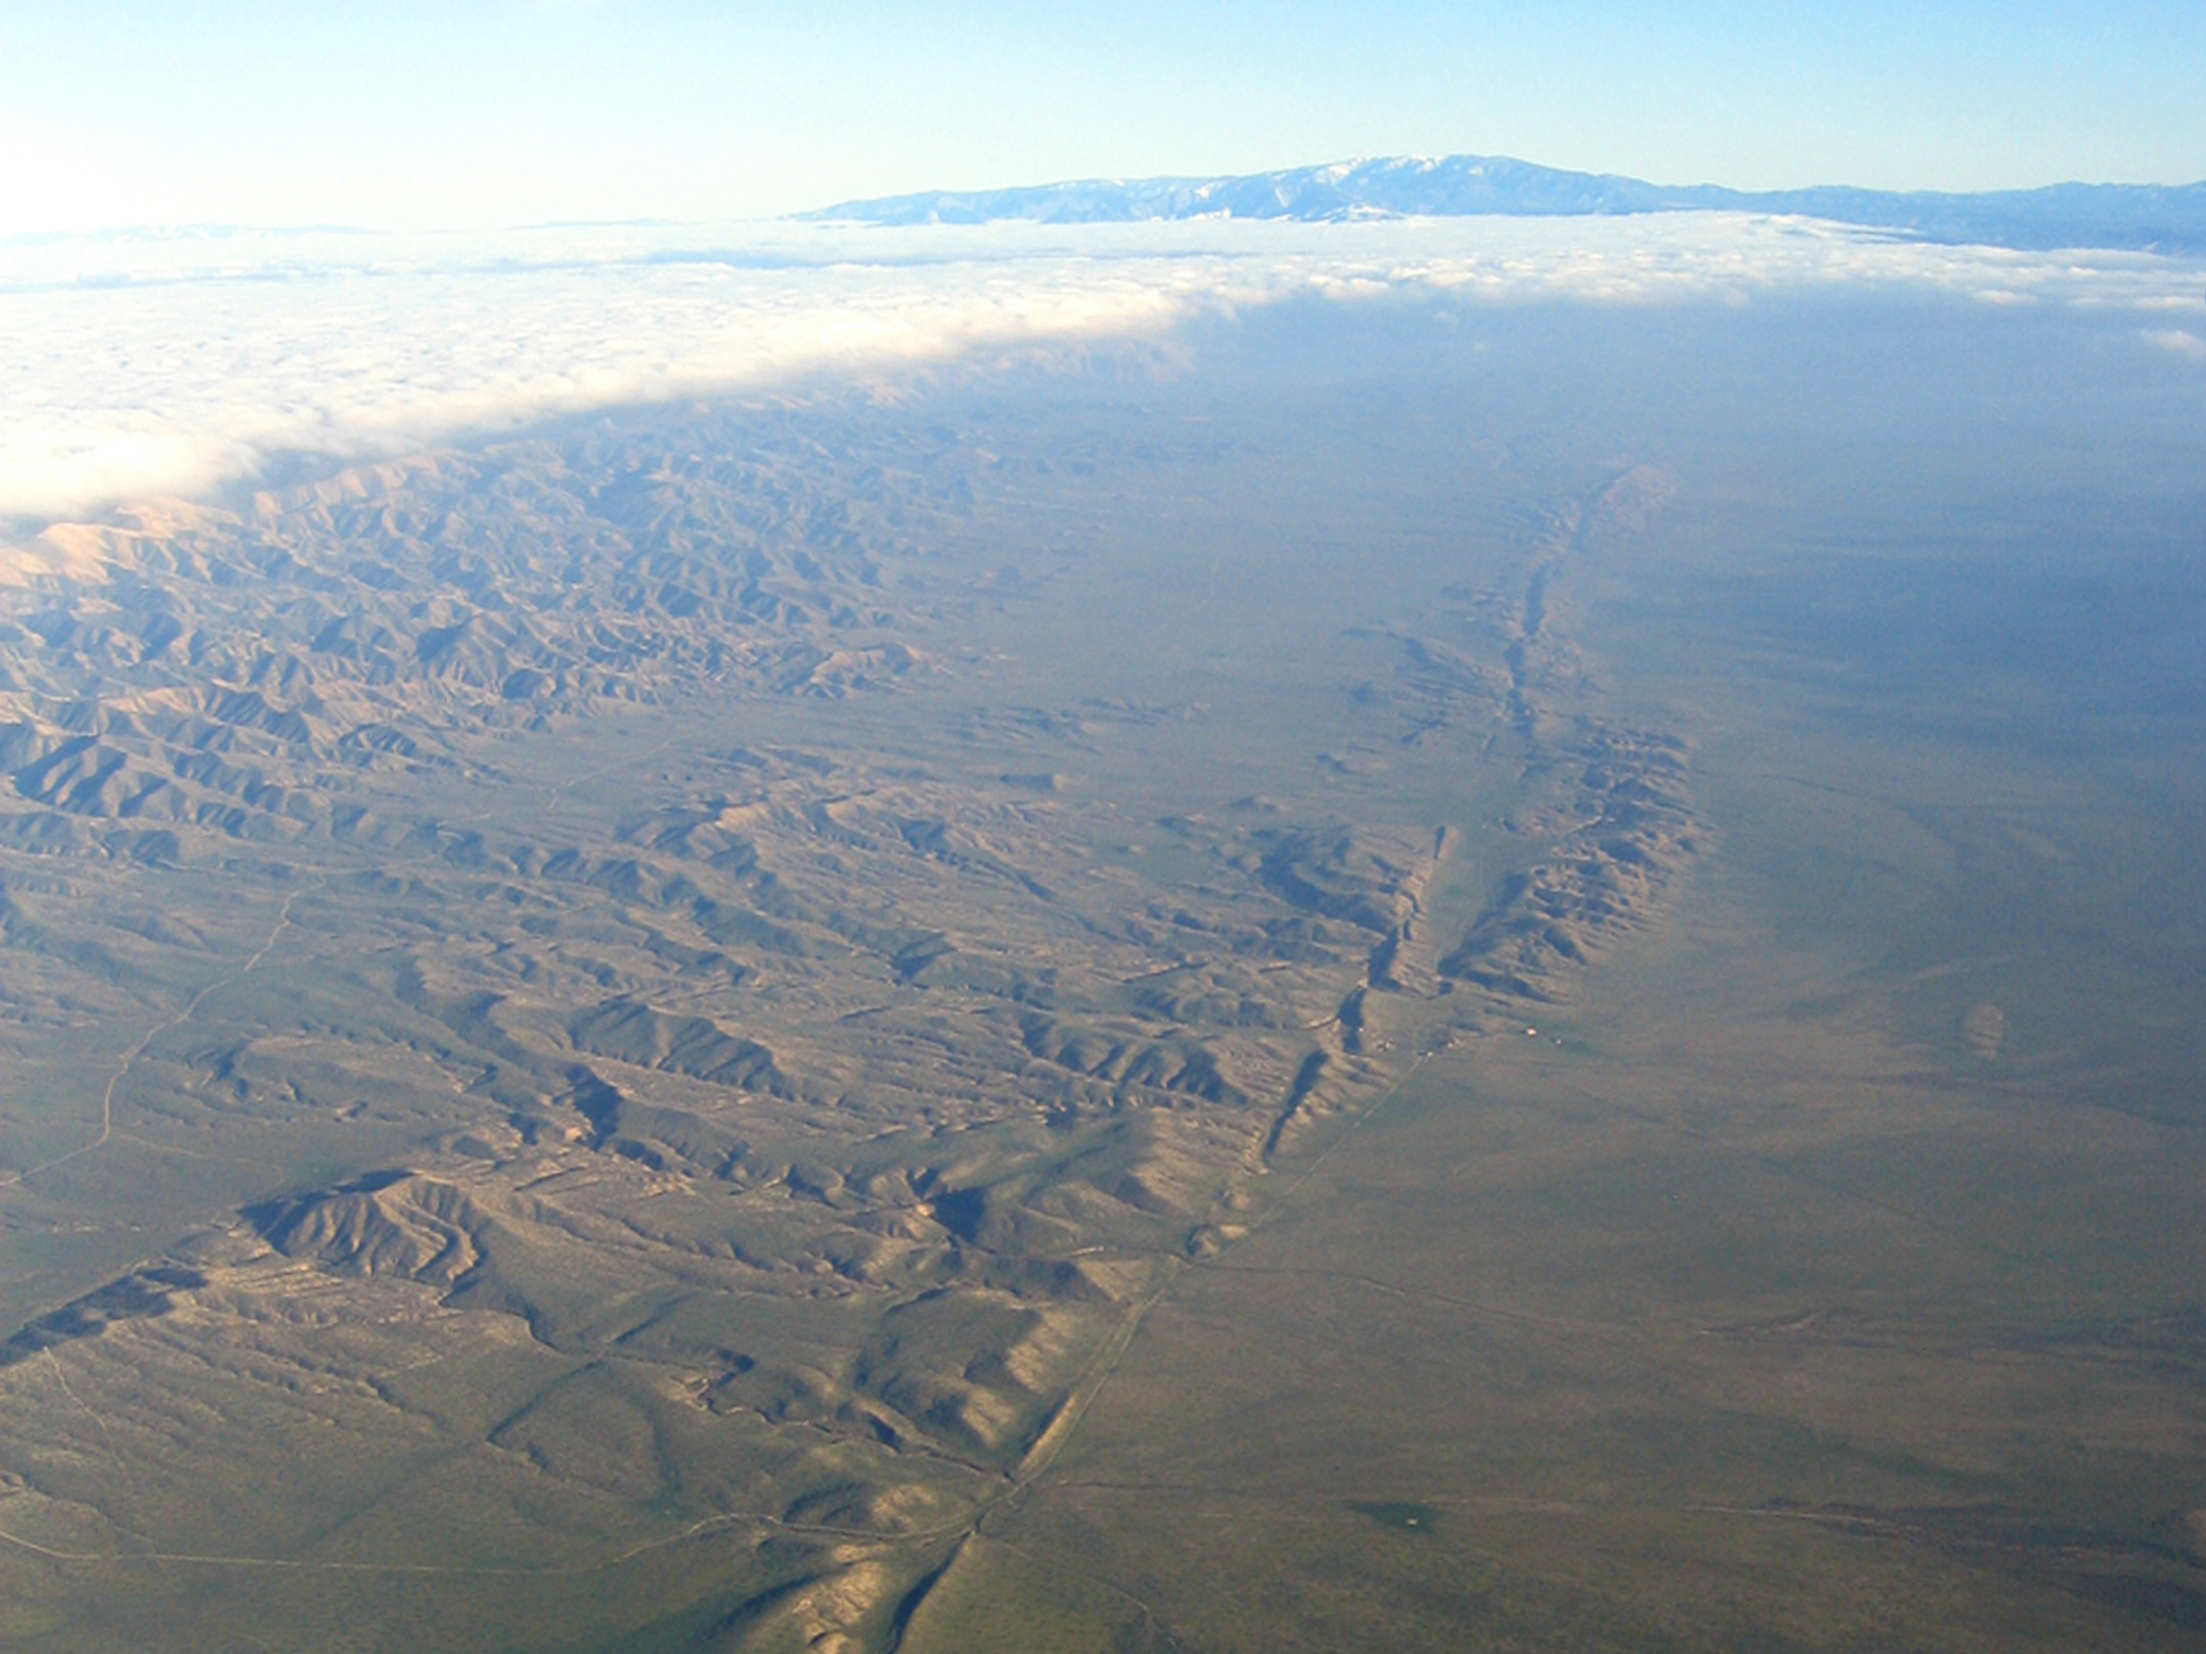
Integrating Remotely Sensed and Ground Observations for Modeling, Analysis, and Decision Support
Andrea Donnellan (JPL)
Margaret Glasscoe, Jay Parker, Robert Granat (JPL)
Marlon Pierce, Jun Wang, Geoffrey Fox (Indiana University)
Dennis McLeod (University of Southern California)
John Rundle, Eric Heien (UC Davis)
Lisa Grant Ludwig (UC Irvine)
2013 IEEE Aerospace Conference
© 2013 California Institute of Technology. Government sponsorship acknowledged.

Slide 2
Earthquake science and emergency response require integration of many data types and models that cover a broad range of scales in time and space
Timely and efficient earthquake analysis and response require automated processes and a system in which the interfaces between models and applications are established and well defined
Geodetic imaging data provide observations of crustal deformation from which strain accumulation and release associated with earthquakes can be inferred
Data products are growing and tend to be either relatively large in size, on the order of 1 GB per image with hundreds or thousands of images, or high data rate, such as from 1 second GPS solutions
Products can be computationally intensive to manipulate, analyze, or model, and are unwieldy to transfer across wide area networks
Required computing resources can be large, even for a few users, and can spike when new data are made available or when an earthquake occurs
A cloud computing environment is the natural extension for some components of QuakeSim as an increasing number of data products and model applications become available to users
Storing the data near the model applications improves performance for the user

Slide 3

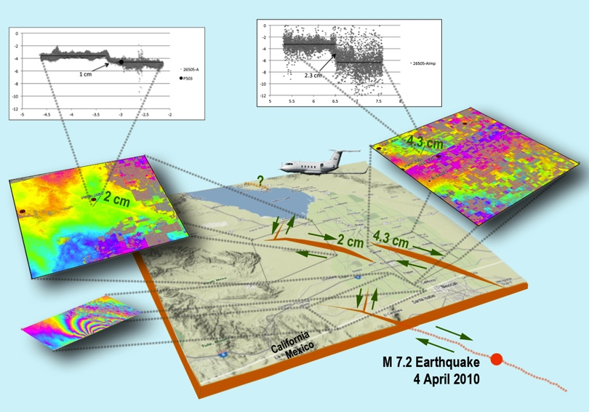
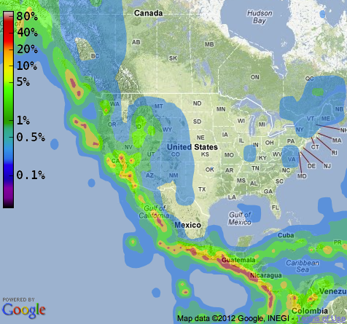
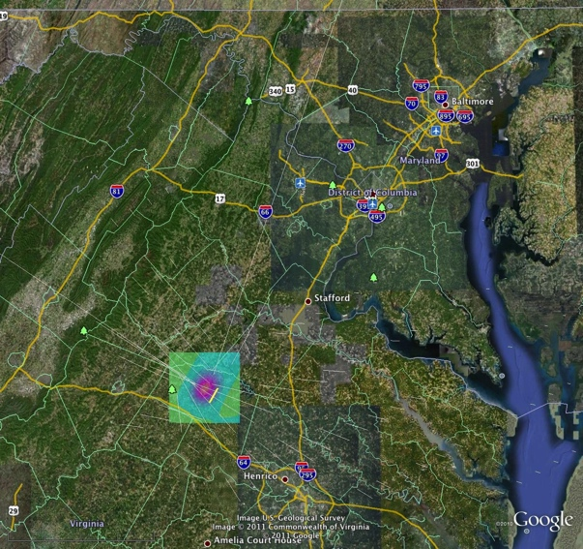
Understanding
Forecasting
Response
Virginia Earthquake
Current Forecast
Creeping faults
Location and size of future earthquakes, stress transfer and fault interactions
Mitigating losses through preparedness and targeted retrofitting
Damage assessment
Impact to critical infrastructure
Computational infrastructure for integrating remotely sensed and other data with mapping, modeling, and analysis tools for understanding earthquake processes

Slide 4
Workflow
Data Products Providers
Applications
Outputs
Faults
Scientific publications, official data sets,
inferred from models
Crustal Deformation
Fault geometries
Fault slip rates
Strain migration
Earthquake fault system simulators
InSAR/UAVSAR
JPL, ASF
Earthquake fault behavior
Raw data
Response
GPS
JPL, SOPAC, UNAVCO, UNR
Time series analysis
Crustal deformation anomalies
Seismicity
USGS, SCSN, NCSN, ANSS
Forecast
Earthquake likelihood
Notes:
QuakeSim inputs, outputs, and feedback to data providers. Multiple data products are used from numerous providers. These are used in applications for understanding faults and forecasting earthquake likelihood. At times output from the applications identifies issues with the data products, which can be in the form of previously unrecognized faults, unmodeled error sources, or processing issues.

Slide 5
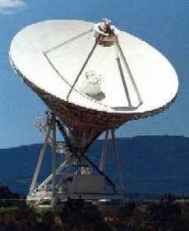
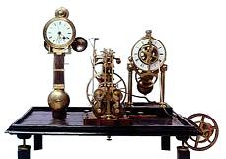
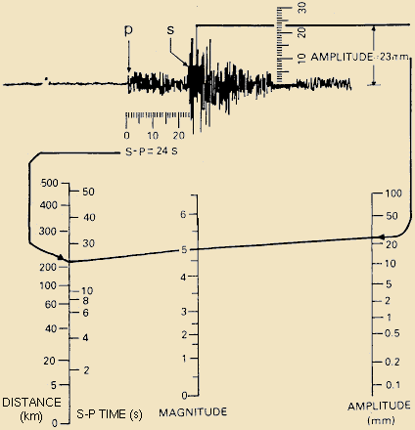
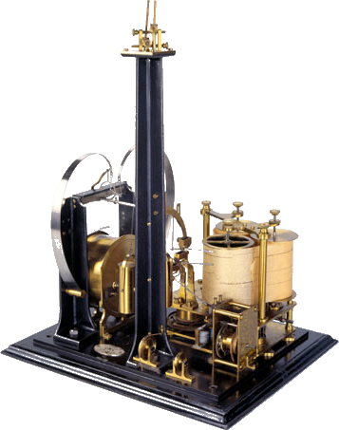
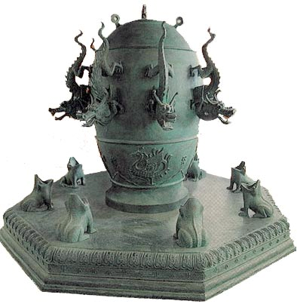
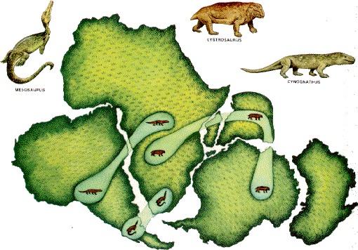
A Brief History
Space Geodesy
Luigi Palmieri, Italy
Richter Scale
Milne, Ewing, Gray:
British professors
in Japan
1855
Time, Duration
Intensity
1984
Measured plate tectonics
China Seismometer
1935
Intensity of earthquake
1880
Waveforms
Hanks & Kanamori
Wegner
L
Slip
W
Area x Slip x Rigidity
132
Direction
1979
Moment Magnitude
1915
Continental Drift
AD
0
500
1000
1500
2000

Slide 6
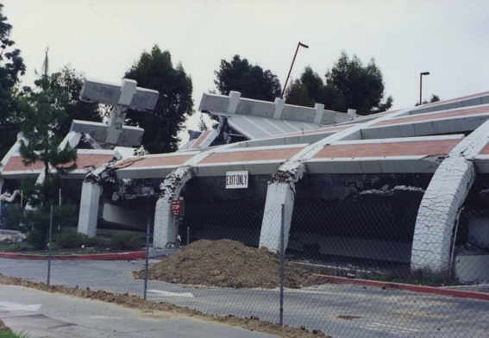
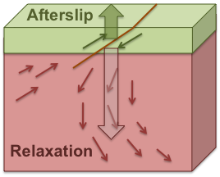
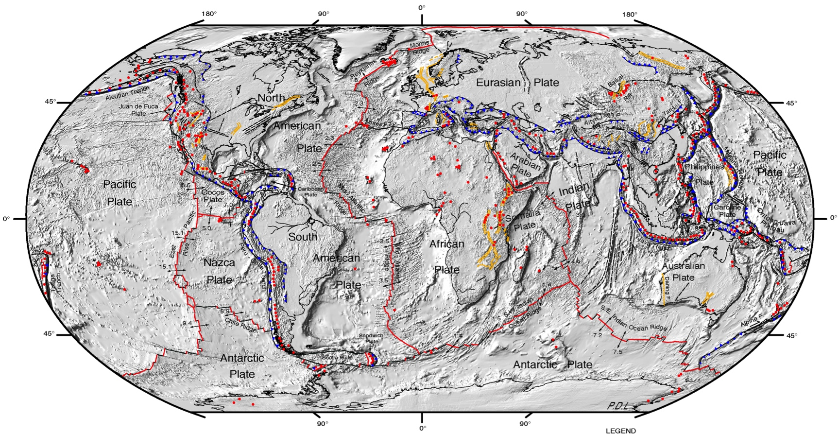
Earthquakes Occur over Many Scales
Earthquakes – nucleate over meters/milliseconds
Strain accumulation – kilometers/decades
Postseismic adjustment – kilometer/month scales
Magnitude 7
in California:
$200-300B losses
and thousands of lives
Plate Tectonics – Global/millennia

Slide 7
Geodesy Observes the Earthquake Cycle
Strain accumulation and release

Slide 8
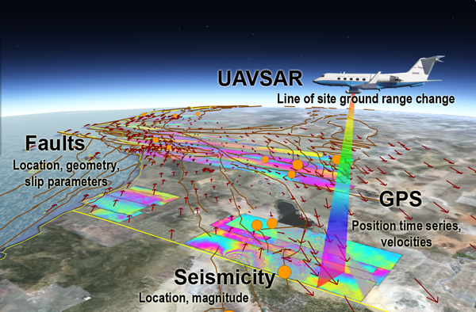
Geodetic Imaging Products
GPS
  Smooth in time, not space
InSAR
  Smooth in space, not time
InSAR
GPS Position Series
Epoch 0
Epoch n

Slide 9
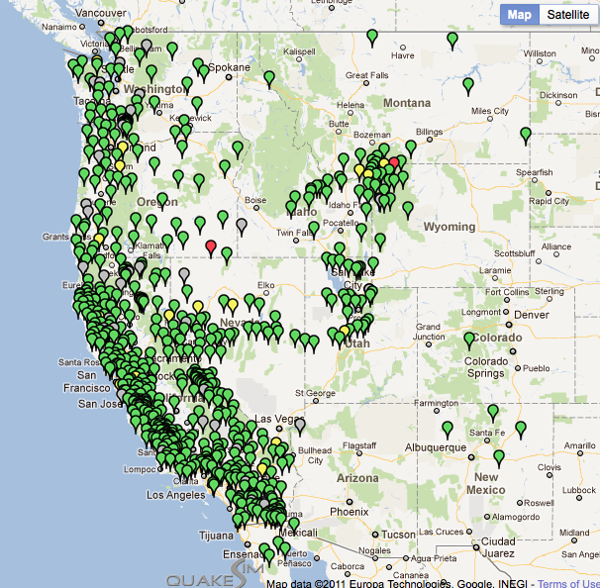
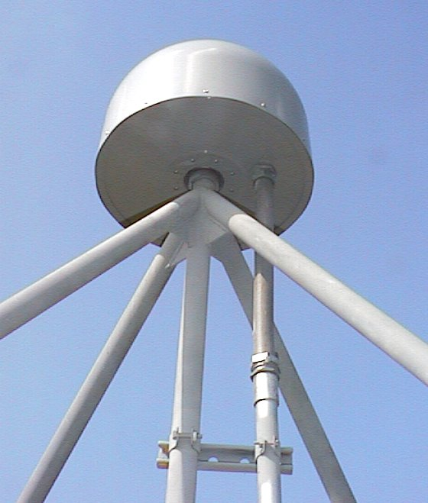
GPS
Horizontal position accuracy 1 mm
Vertical position accuracy 2 mm
1 mm/yr horizontal velocities

Slide 10
GPS Position Time Series Analysis
Substantial postseismic motion northeast of the El Mayor – Cucapah Rupture

Slide 11
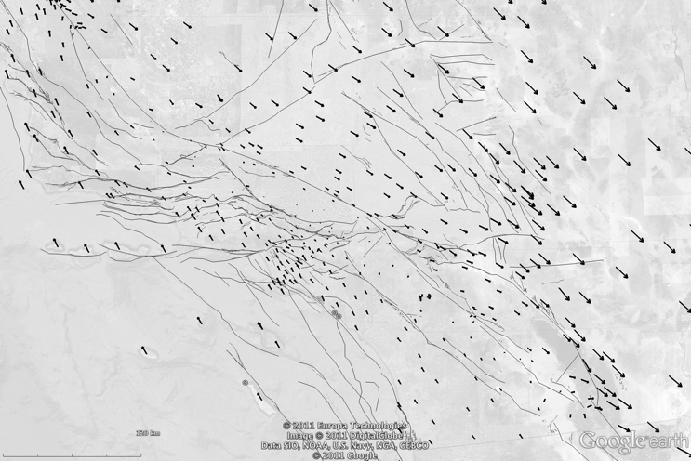
California GPS Deformation
Los Angeles

Slide 12
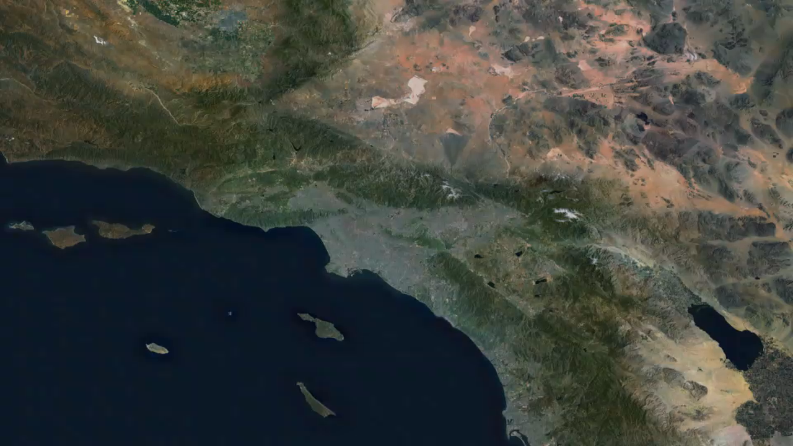
Visualizing Crustal Deformation

Slide 13
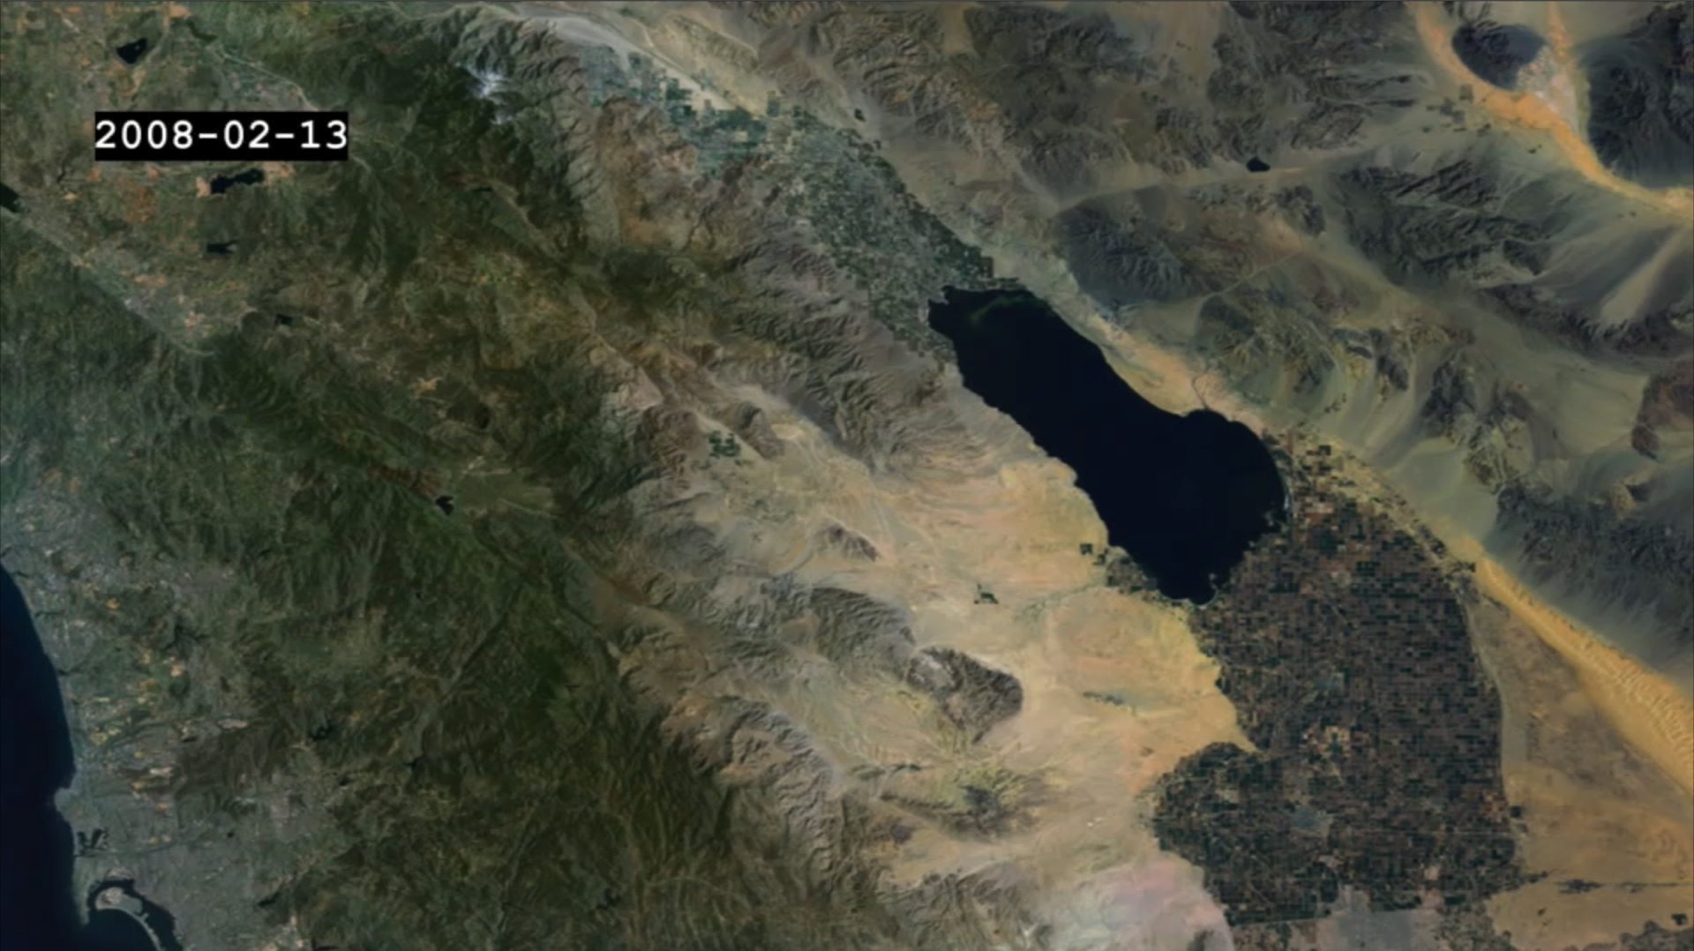
Salton Trough
Two years before the 2010 M 7.2 El Mayor – Cucapah Earthquake
Reference

Slide 14
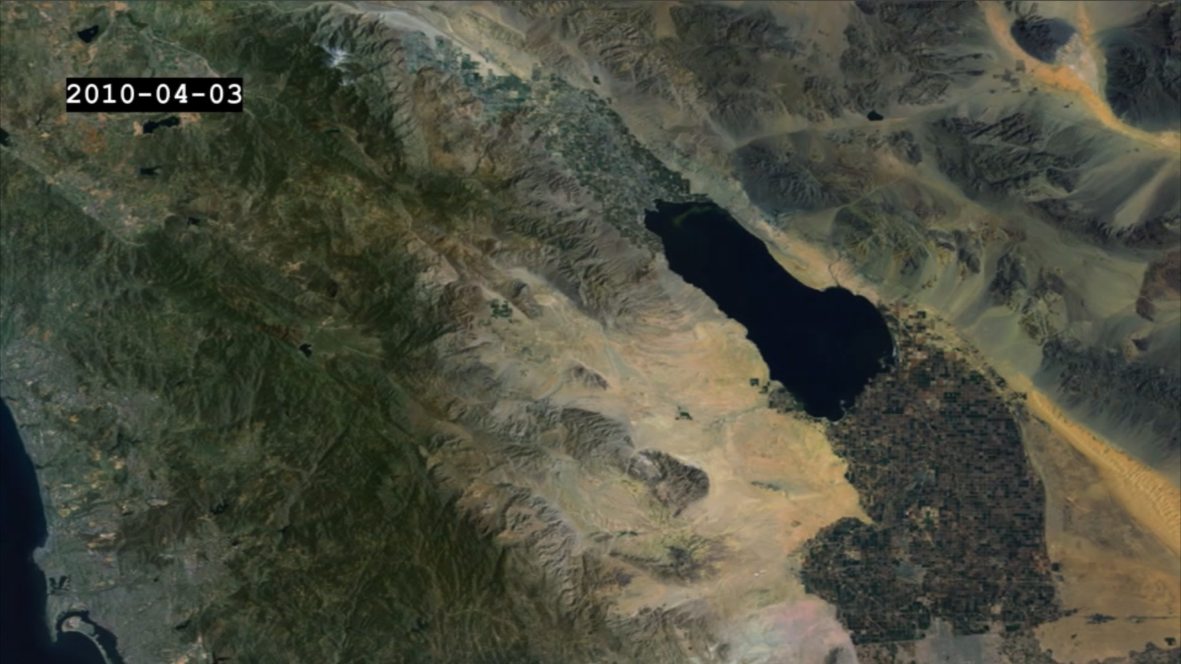
Salton Trough
Regional shear
Two days before the 2010 M 7.2 El Mayor – Cucapah Earthquake

Slide 15

Salton Trough
Three days after the 2010 M 7.2 El Mayor – Cucapah Earthquake
Coseismic

Slide 16
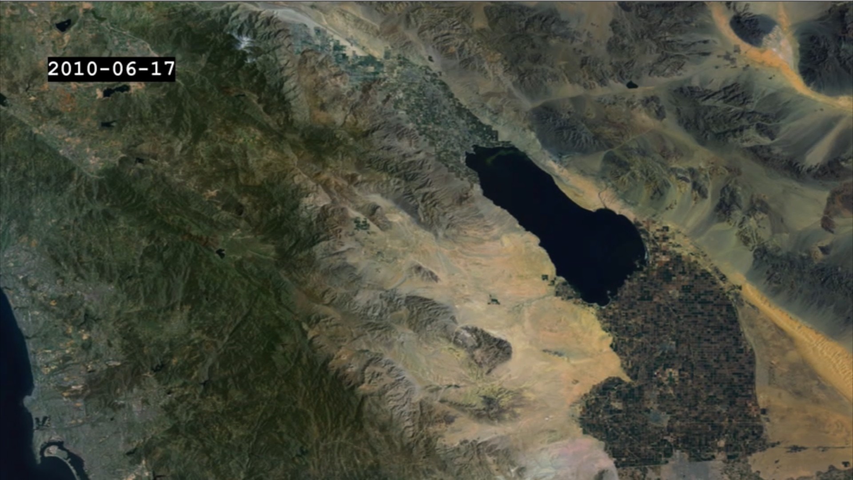
Salton Trough
Two months after the 2010 M 7.2 El Mayor – Cucapah Earthquake
Postseismic shear

Slide 17

Salton Trough
Seven months after the 2010 M 7.2 El Mayor – Cucapah Earthquake
Postseismic shear

Slide 18
Salton Trough
2 years
Two years before the 2010 M 7.2 El Mayor – Cucapah Earthquake
Reference

Slide 19
Salton Trough
2 years
5 days
Two days before the 2010 M 7.2 El Mayor – Cucapah Earthquake
Regional shear

Slide 20
Salton Trough
5 days
2 months
Three days after the 2010 M 7.2 El Mayor – Cucapah Earthquake
Coseismic

Slide 21
Salton Trough
2 months
1.3 years
Two months after the 2010 M 7.2 El Mayor – Cucapah Earthquake
Postseismic shear

Slide 22
Salton Trough
1.3 years
1 ½ years after the 2010 M 7.2 El Mayor – Cucapah Earthquake
Postseismic shear

Slide 23
Visualizing Crustal Deformation

Slide 24
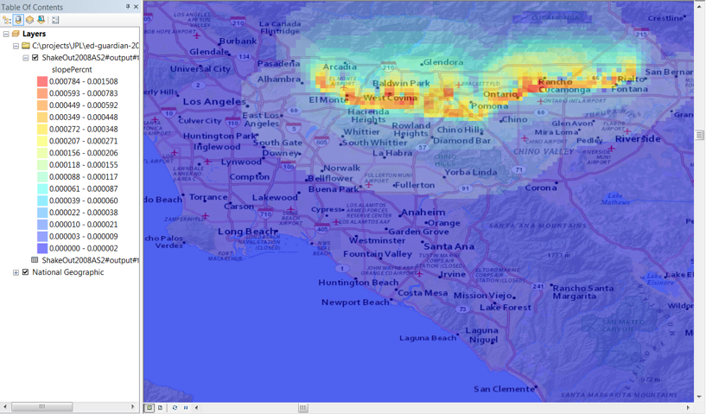
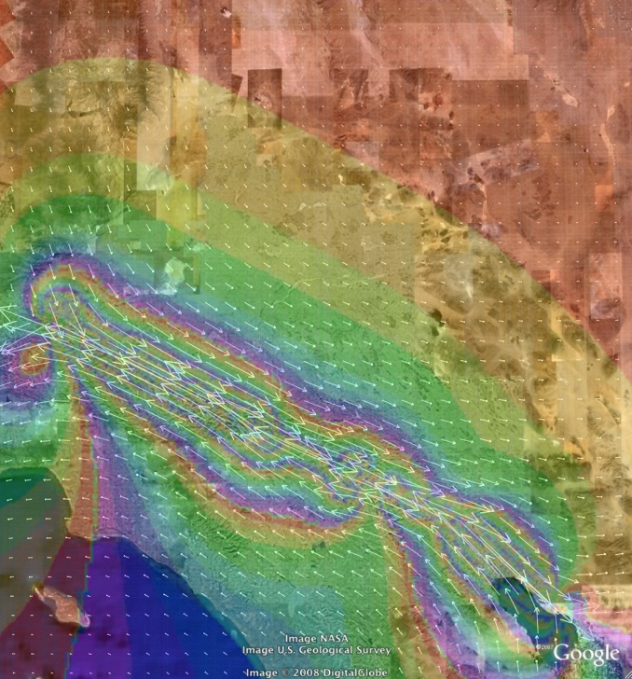


Earthquake Response
Tilt maps show where water and sewer lines may run backwards for an event on the Cucamonga Fault (Golden Guardian 2012)
Modeled San Andreas fault earthquake scenario (ShakeOut 2008)

Slide 25
Decision Support

Slide 26


UAVSAR
L-band radar
Flies on a Gulfstream III aircraft

Slide 27
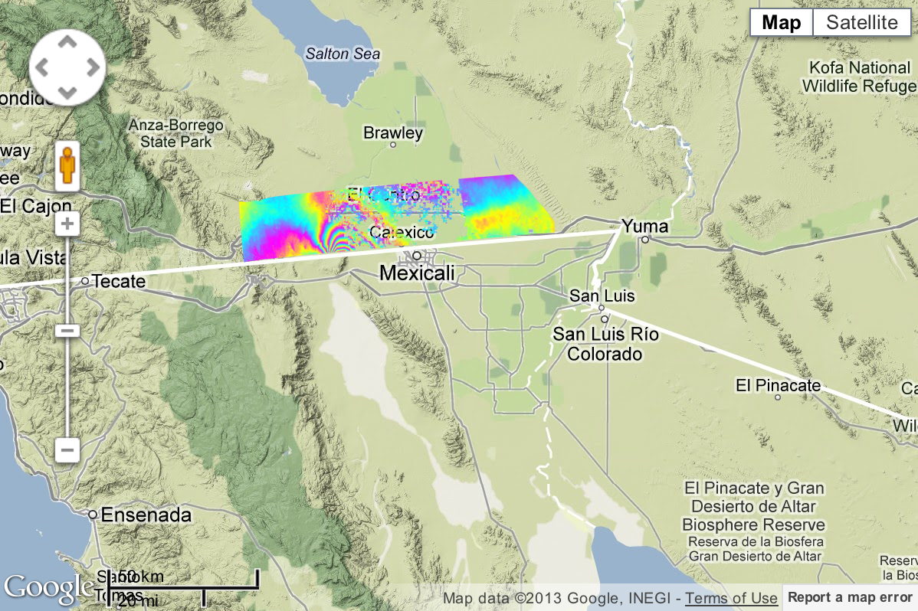
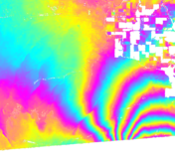
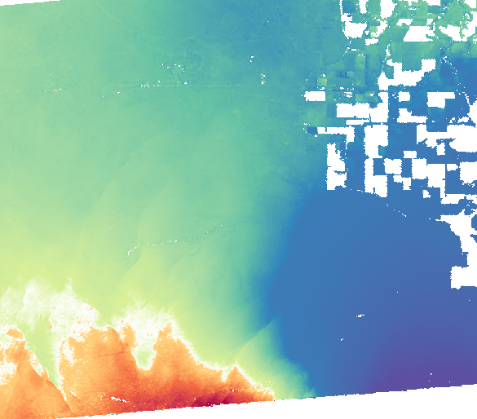
Image of 2010 M 7.2 Earthquake in Baja
California-Mexico Border
Each fringe represents 12 cm displacement to/from instrument
Lower plot shows total displacement to/from the instrument
California-Mexico Border

Slide 28
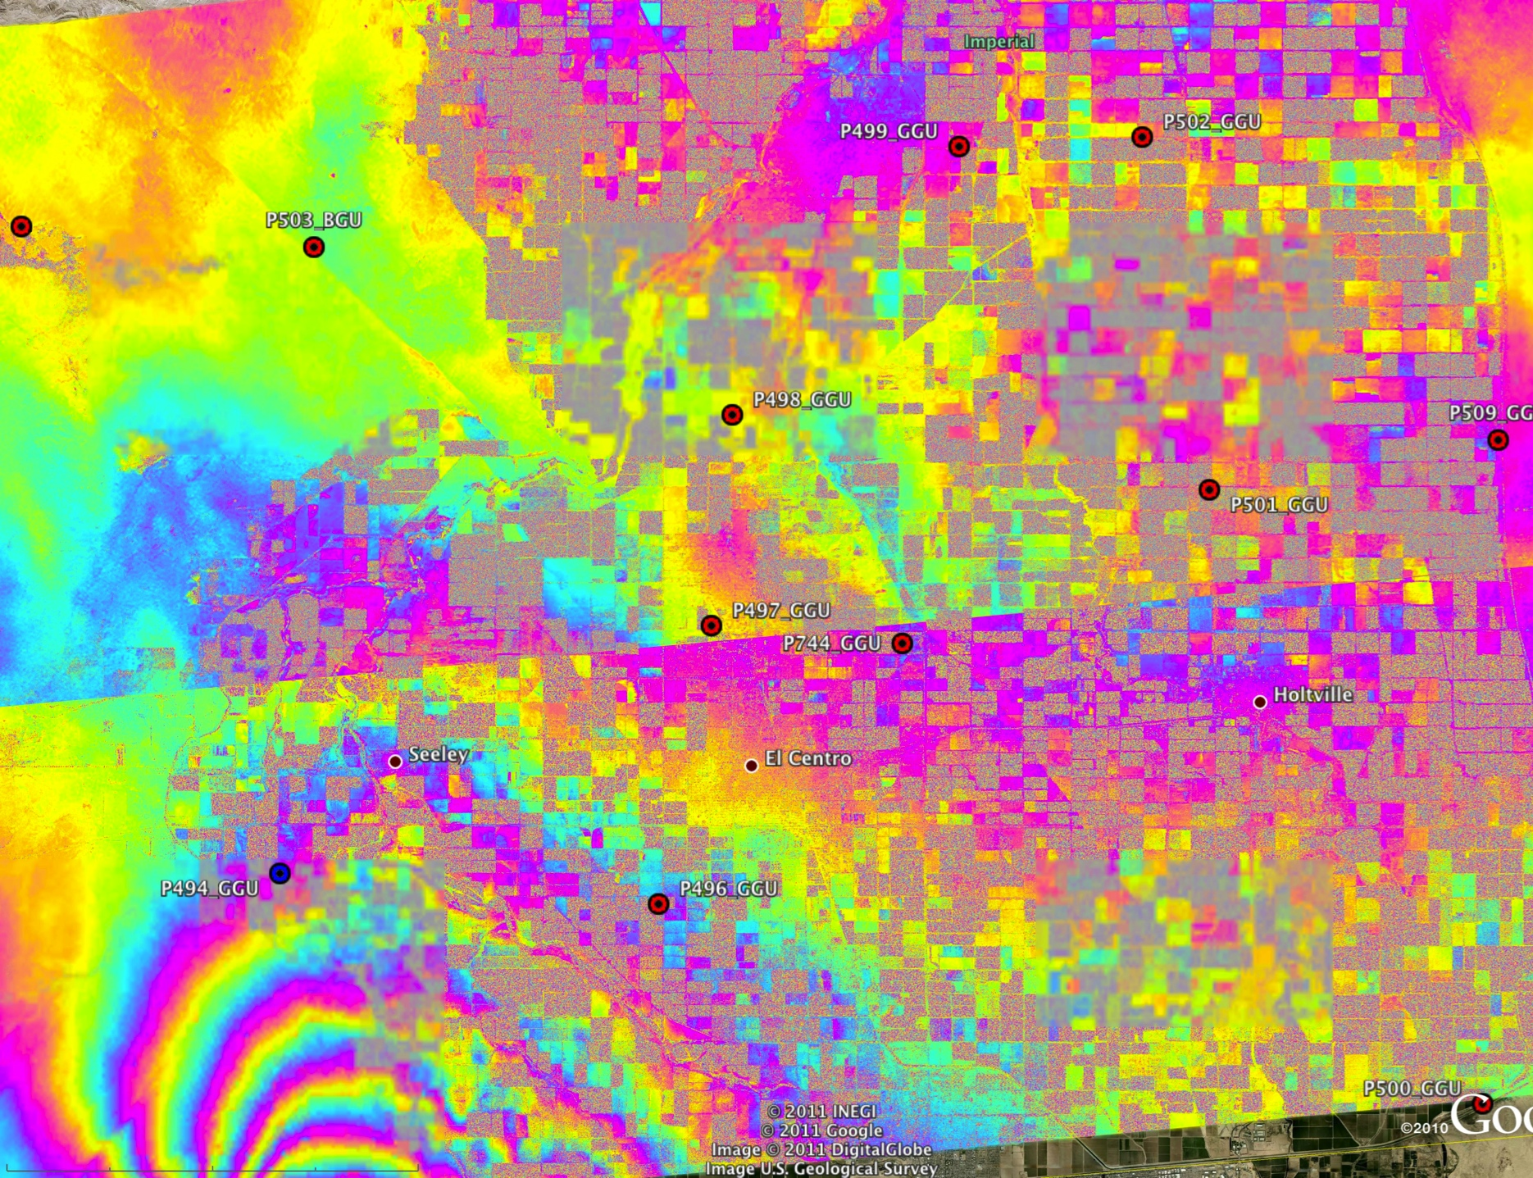
Creep Occurred on Faults to the North
Superstition Hills Fault
P503
Imperial Fault
1 cm
2.3 cm

Slide 29
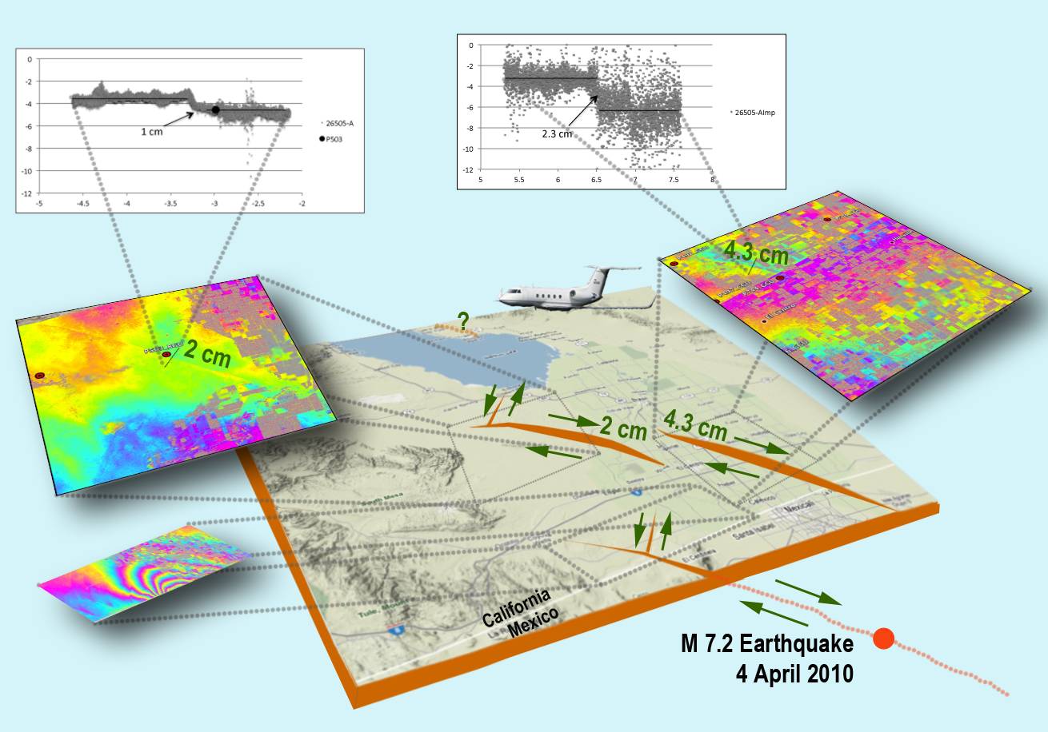
Complex Pattern of Fault Slip
What are the implications for stress accumulation on the San Andreas Fault?

Slide 30
Clouds
Centralization of computing capacity into highly scalable data centers
Cloud Computing provides potentially greater computing capacity but with larger latencies compared to traditional high performance computing
Good for “big data” problems in which the same operations need to be performed on very large data sets
  Little communication between individual processes or movement of data is needed
The earthquake problem is highly scalable
  Earthquake events or new data can result in spikey usage
  Model and simulation runs can be quite large
Applications
  InSAR geodetic imaging data as volumes grow over time
  High rate GPS data products
  Simulations and inversions where similar runs are done with different initial conditions

Slide 31
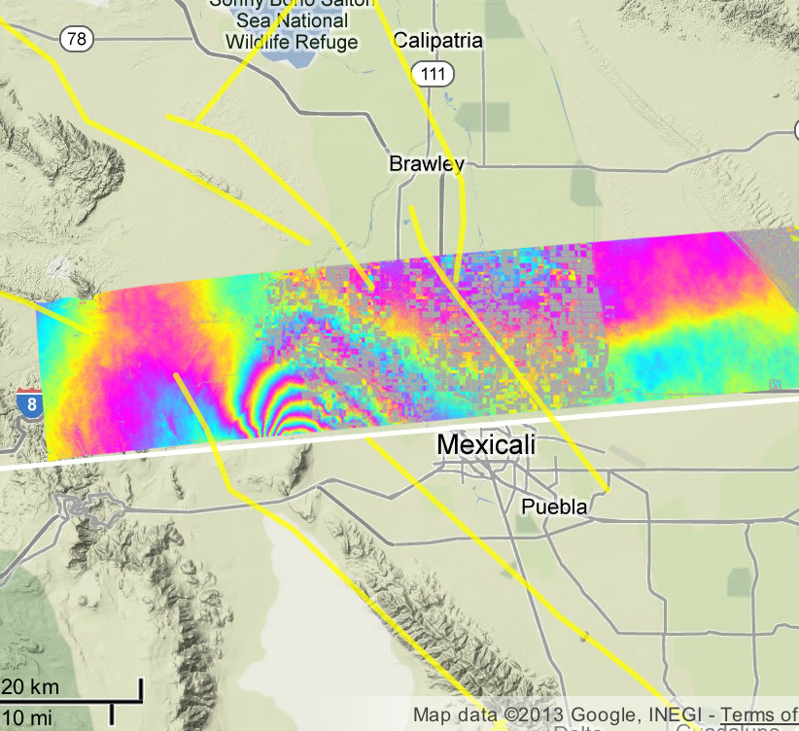
Infrastructure as a Service
Virtual Machines to provide access to hosted servers and resources that appear to the user as “just another server”
Resources are elastic and can be scaled up or down as needed
  Event driven for QuakeSim
    Earthquake
    New data products

Slide 32
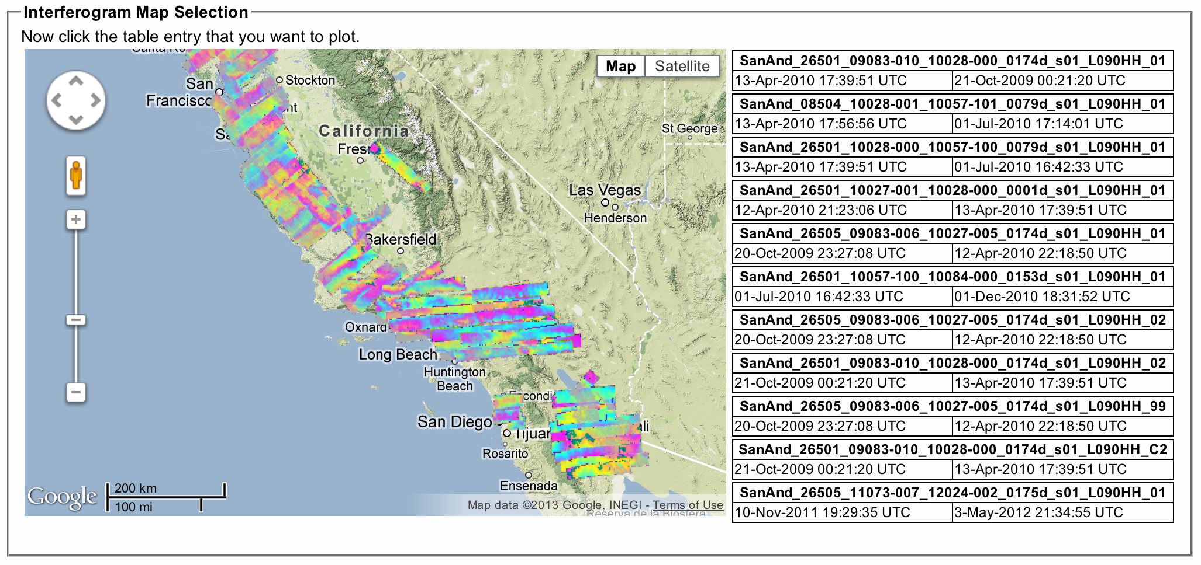
Platform as a Service
Allows the user to deploy user-created applications within a specific cloud framework into the cloud for use by others

Slide 33
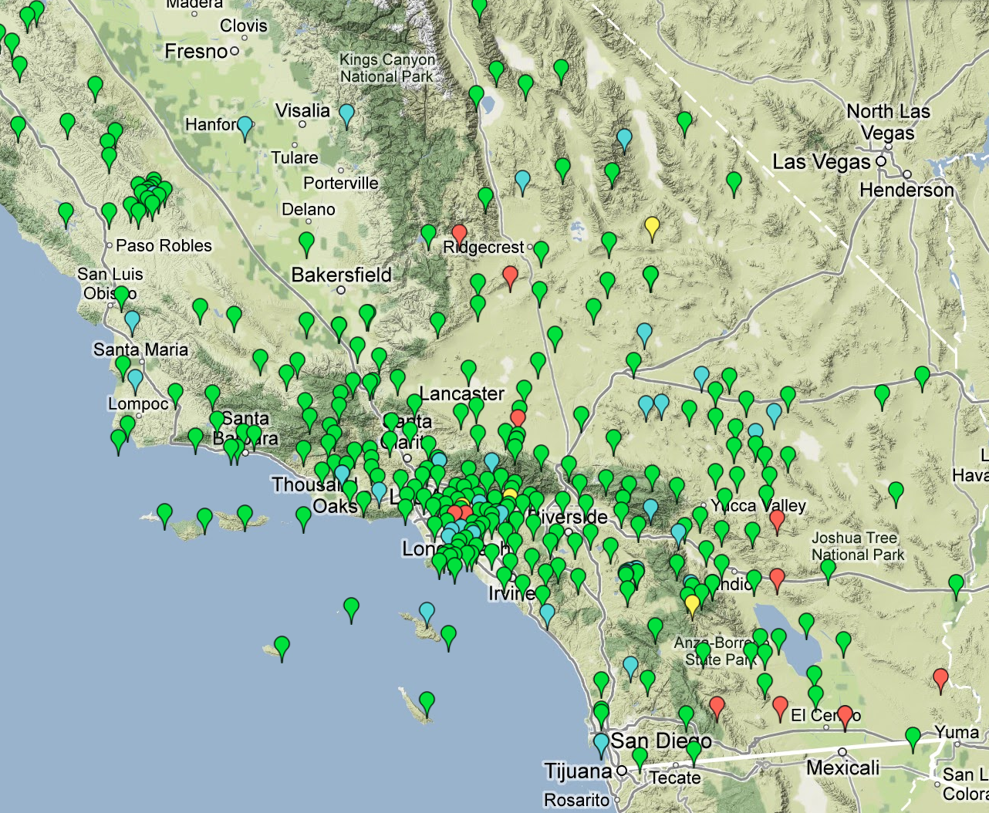
Software as a Service
The cloud provider provides a specific capability or software to the user
Individual services
corresponding to
different QuakeSim
tools
  InSAR profiles
  Forward and inverse
  models
  GPS time series
  analysis
GPS time series state changes after the 2010 M 7.2 El Mayor-Cucapah earthquake

Slide 34
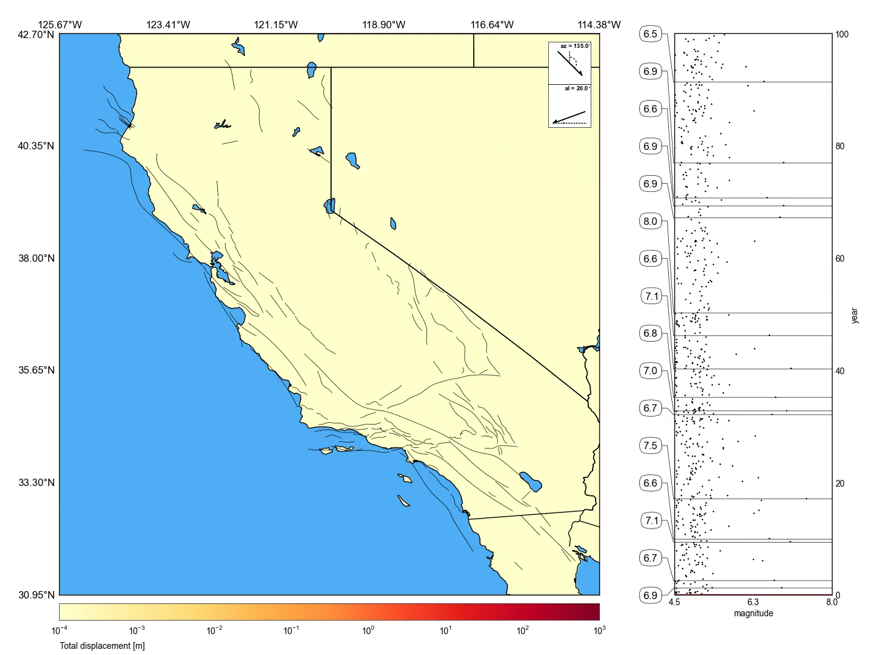
Virtual California
Simulating earthquake fault interactions

Slide 35
Web Coverage Service (WCS) Performance
OGC standard to retrieve raster data based on spatial constraints and other query criteria
Testing procedure
  Randomly choose one InSAR image
  Randomly generate a small rectangle bounding box inside an InSAR image
  Send a request to GeoServer and retrieve the image in GeoTiff
Performance is measured by the average response time of one user request call, which includes GeoServer response time and network transfer time
 | Test Client from IU |  | Test Client from Amazon
 | IUII | Amazon | IUII | Amazon
Native Resolution | 0.57 | 1.28 | 1.30 | 0.54
Resample | 0.27 | 0.73 | 0.70 | 0.23
Resample + ReProjection | 0.34 | 0.78 | 0.71 | 0.24

Slide 36
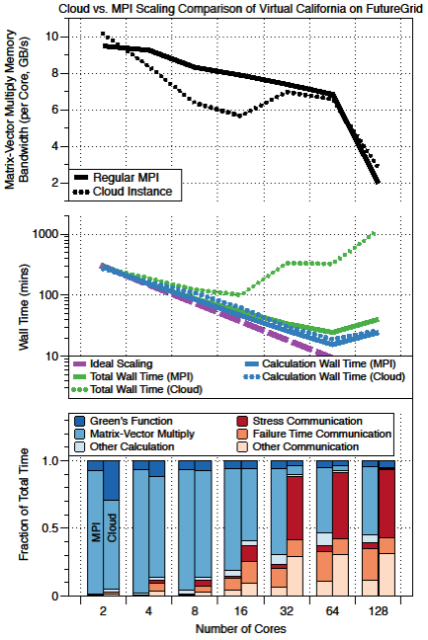
Virtual California Performance
Parallel scaling and performance analysis on FutureGrid test bed
3000 year simulation runs are shown on “bare metal” (regular MPI) and OpenStack (Cloud)
At the bottom results are presented on 2, 4, 8, 16, 32, 64 and 128 cores for compute-communication fractions
  Regular MPI on the left
  OpenStack on the right

Slide 37
Summary
QuakeSim has several components
  Model applications
  Analysis tools
  Map browsers
  Data product access
Several Interfaces
  Organizations and their data products
  Internal interfaces to database, map viewer, applications
Clouds are a promising new method for analysis and modeling of large data product sets and for multiple parallel runs
  In some instances it may be better to use standard resources instead of clouds
  Careful consideration should be given to what resources to use for various tasks
Collaboration between QuakeSim developers, data product providers, and downstream consumers early on will result in improved efficiency
http://quakesim.org

