Slide 1
Hybrid MapReduce Workflow
Yang Ruan, Zhenhua Guo, Yuduo Zhou, Judy Qiu, Geoffrey Fox
Indiana University, US

Slide 2
Outline
Introduction and Background
MapReduce
Iterative MapReduce
Distributed Workflow Management Systems
Hybrid MapReduce (HyMR)
Architecture
Implementation
Use case
Experiments
Performance
Scaleup
Fault tolerance
Conclusions

Slide 3
MapReduce
Introduced by Google
Hadoop is an open source MapReduce framework
User
Program
Mapper: read input data, emit key/value pairs
Reducer: accept a key and all the values belongs to that key, emits final output
fork
fork
fork
Master
Map
assign
map
assign
reduce
Reduce
Input Data
Worker
write
Output
File 0
Split 0
local
write
Worker
Split 1
read
Worker
Split 2
Output
File 1
Worker
Worker
remote read, sort

Slide 4
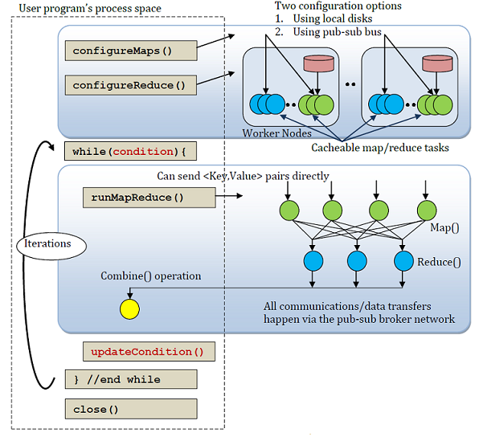
Iterative MapReduce(Twister)
Iterative applications: K-means, EM
An extension to MapReduce
Long-running mappers and reducers.
Use data streaming instead of
file I/O
Keep static data in memory
Use broadcast to send out
updated data to all mappers
Use a pub/sub messaging
infrastructure
Naturally support parallel
iterative applications efficiently

Slide 5
Workflow Systems
Traditional Workflow Systems
Focused on dynamic resource allocation
Pegasus, Kepler, Taverna
MapReduce Workflow Systems
Oozie
Apache Project
Use XML to describe workflows
MRGIS
Focus on GIS applications
CloudWF
Optimized for usage in Cloud
All based on Hadoop

Slide 6
Why Hybrid?
MapReduce
Lack of the support of parallel iterative applications
High overhead on iterative application execution
Strong fault tolerance support
File system support
Iterative MapReduce
No file system support, the data are saved in local disk or NFS
Weak fault tolerance support
Efficient iterative application execution

Slide 7
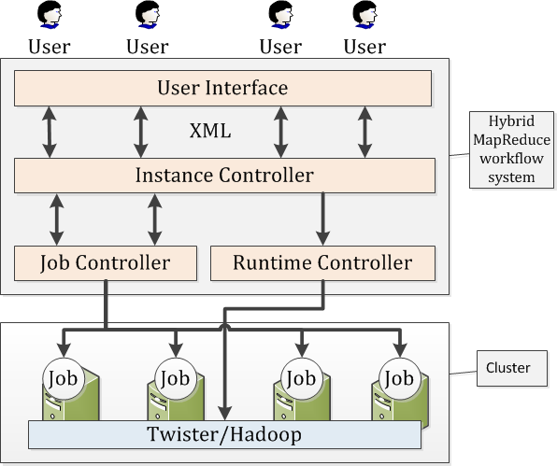
HyMR Architecture
Concrete model
Use PBS/TORQUE for resource allocation
Focused on efficient workflow
execution after resource is
allocated
User Interface
WF definition in Script/XML
Instance Controller
WF model: DAG
Manage workflow execution
Job status checker
Status updates in XML

Slide 8
Job and Runtime Controller
Job Controller
Manage job execution
Single Node Job: File Distributor, File Partitioner
Multi-Node Job: MapReduce Job, Iterative MapReduce Job
Twister Fault Checker: Detect faults and notify Instance Controller
Runtime Controller
Runtime Configuration: save the user from complicate Hadoop and Twister configuration and start the runtime automatically
Persistent Runtime: reduce time cost of restarting runtimes once a job is finished
Support Hadoop and Twister

Slide 9
File System Support in Twister
Add HDFS support for Twister
Before: explicit data staging phase
After: implicit data staging as same as Hadoop
Notes:
The red area means HyMR consider it as one job
Green area means Twister job
Yellow area is the sub-job of a HyMR job

Slide 10
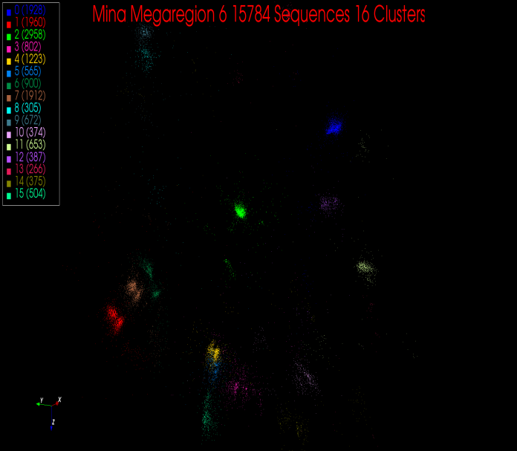
A Bioinfo Data Visualization Pipeline
Input: FASTA File
Output: A coordinates file contains the mapping result from dimension reduction
3 main components:
Pairwise Sequence alignment: reads FASTA file, generates dissimilarity matrix
Multidimensional Scaling(MDS): reads dissimilarity matrix, generates coordinates file
Interpolation: reads FASTA file and coordinates file, generates final result
…
>SRR042317.123
CTGGCACGT…
>SRR042317.129
CTGGCACGT…
>SRR042317.145
CTGGCACGG…
…
Notes:
Left is the original inputs before apply the pipeline
Right is the visualization used PlotViz, reads the output coordinates file from the pipeline

Slide 11
Twister-Pipeline
Hadoop does not directly support MDS (iterative application). Incur high overhead
All of the data staging are explicitly considered as a job
Notes:
Explained why we do not use a Hadoop-pipeline for comparison
Distributed jobs:
All-Pair pairwise sequence alignment (PSA)
Multidimensional Scaling (MDS)
Interpolation (MI-MDS)
Single Node job:
File Spliter: split input FASTA file into sample file and out-sample file
File Partitioner: partition the files into the number of cores
File Distributor: distributed files onto each node’s local disk

Slide 12
Hybrid-Pipeline
In HyMR pipeline, distributed data are stored in HDFS. No explicit data staging is needed as partitioned data are write into and read from HDFS directly.

Slide 13
Pairwise Sequence Alignment
Block (0,0)
Map
Reduce
Input Sample Fasta Partition 1
Dissimilarity Matrix Partition 1
Block (0,1)
M
Input Sample FastaPartition 2
R
Dissimilarity Matrix Partition 2
…
M
…
Block (n,0)
…
…
…
R
Input Sample Fasta Partition n
…
Dissimilarity Matrix Partition n
M
Block
(n-1,n-1)
Sample Data File I/O
Network Communication
Block (0,0)
Block (0,1)
Block (0,2)
Block (0,n-1)
Used for generating all-pair dissimilarity matrix
Use Smith-Waterman as alignment algorithm
Improve task granularity to reduce scheduling overhead
Block (1,0)
Block (1,1)
Block (1,2)
Block (1,n-1)
Block (2,0)
Block (2,1)
Block (2,2)
Block (2,n-1)
Block (n-1, 0)
Block
(n-1, 1)
Block
(n-1,n-1)
Notes:
Only needs to compute the blue part

Slide 14
Multidimensional Scaling (MDS)
Scaling by Majorizing a Complicated Function (SMACOF)
Two MapReduce Job in one iteration
Sample Data File I/O
Sample Label File I/O
Network Communication
Map
Reduce
Map
Reduce
Input Dissimilarity Matrix Partition 1
M
M
Input Dissimilarity Matrix Partition 2
M
M
R
C
R
C
Sample Coordinates
…
…
…
Input Dissimilarity Matrix Partition n
M
M
Parallelized SMACOF Algorithm
Stress
Calculation
Notes:
A set of dimension reduction techniques

Slide 15
MDS Interpolation
SMACOF use O(N²) memory, which limits its applicability on large collection of data
Interpolate out-sample sequences into target dimension space by giving k nearest neighbor sample sequences’ mapping result
Input Sample Coordinates
Map
Reduce
Input Sample Fasta
Input Out-Sample Fasta Partition 1
M
R
Input Out-Sample Fasta Partition 2
M
…
Final Output
C
…
…
R
Input Out-Sample Fasta Partition n
M
Sample Data File I/O
Out-Sample Data File I/O
Network Communication

Slide 16
Experiment Setup
PolarGrid cluster in Indiana University (8 cores per machine)
16S rRNA data from the NCBI database.
Num. of sequences: from 6144 to 36864
Sample set and out-sample set: 50 – 50
Node/Core number from 32/256 to 128/1024

Slide 17
Performance Comparison
Tested on 96 nodes, 768 cores
Differences increases when data size is larger
Write/read files to/from HDFS directly
Runtime starts take longer time
Execution includes read/write I/O, which is higher than local disk
Notes:
Hadoop scheduling overhead is fixed when node number is fixed
HDFS use multi nodes to transfer data while Twister use single node script to transfer data

Slide 18
Detail Time Analysis
Twister-pipeline
Data Staging time is longer when data size increases
Less runtime start/stop time
Hybrid-pipeline
Data Staging time is fixed due to map task number is fixed
Longer execution time
Notes:
Execution time: PSA + MDS + Interpolation
Runtime Control: Starts/Stop runtime
Data Staging for Twister: File partitoner and Distributor
Data Staging for Hadoop: Task Scheduling

Slide 19
Scale-up Test
Hybrid-pipeline performs better when # of node increases
Data distribution overhead from Twister increases
Scheduling overhead for Hadoop increases, but not much
For pure computation time: Twister-pipeline performs slightly better since all the files are in local disk when jobs are run

Slide 20
Fault Tolerance Test
Fault tolerance, kill 1/10 nodes manually at different time during execution
10% and 25% are at PSA; 40% is at MDS; 55%, 70% and 85% are at Interpolation
If the node is killed when using Hadoop runtime, the tasks will be rescheduled immediately; Otherwise HyMR will restart the job

Slide 21
Conclusions
First hybrid workflow system based on MapReduce and iterative MapReduce runtimes
Support iterative parallel application efficiently
Fault tolerance and HDFS support added for Twister

Slide 22
Questions?

Slide 23
Supplement

Slide 24
Other iterative MapReduce runtimes
Haloop | Spark | Pregel
Extension based on Hadoop | Iterative MapReduce by keeping long running mappers and reducers | Large scale iterative graphic processing framework
Task Scheduler keeps data locality for mappers and reducers Input and output are cached on local disks to reduce I/O cost between iterations | Build on Nexus, a cluster manger keep long running executor on each node. Static data are cached in memory between iterations. | Use long living workers to keep the updated vertices between Super Steps. Vertices update their status during each Super Step. Use aggregator for global coordinates.
Fault tolerance same as Hadoop. Reconstruct cache to the worker assigned with failed worker’s partition. | Use Resilient Distributed Dataset to ensure the fault tolerance | Keep check point through each Super Step. If one worker fail, all the other work will need to reverse.

Slide 25
Different Runtimes Comparison
Name | Iterative | Fault Tolerance | File System | Scheduling | Higher level language | Caching | Worker Unit | Environment
Google | No | Strong | GFS | Dynamic | Sawzall | -- | Process | C++
Hadoop | No | Strong | HDFS | Dynamic | Pig | -- | Process | Java
Twister | Yes | Weak | -- | Static | -- | Memory | Thread | Java
Haloop | Yes | Strong | HDFS | Dynamic | -- | Disk | Process | Java
Spark | Yes | Weak | HDFS | Static | Scala | Memory | Thread | Java
Pregel | Yes | Weak | GFS | Static | -- | Memory | Process | C++
Notes:
----- Meeting Notes (8/5/11 14:43) -----
add definition for iterative mapreduce

