Slide 1
Progress Report: Hazard Map Generation with OpenSHA
E-DECIDER IU Team

Slide 2
PESH Generation for E-DECIDER
OpenSHA is an open-source, Java-based platform for conducting Seismic Hazard Analysis (SHA). (http://www.opensha.org/)
  Has tools for generating PESH files
We are interested in generating Hazus shape files (PESH) for scenario earthquake.
  Disloc, Simplex and GeoFEST all use similar geometric fault models; stored in QuakeTables
Some scenarios
  Simulate RIPI hotspot earthquakes with data from QuakeTables
  Tie to auto-generated Disloc input models from USGS fault RSS feeds
  Tie to Simplex for model inversion from InSAR inputs
  PESH generation service tied to either of these.

Slide 3
OpenSHA and PESH
Major parameters:
  Fault geometry
  Intensity-Measure Relationship: Attenuation
  Earthquake Magnitude
  Hypercenter Location
Fault geometries may come from QuakeTables
  CGNS, UCERF
Can also get these from Simplex inversions of surface displacements.
Attenuation model has to be chosen.
  Not part of QuakeSim codes

Slide 4
Attenuation Relationship
14 models are implemented in OpenSHA
  Example: Peak ground velocity (PGV) from different models for 7.2 earthquake with a strike-slip fault

Slide 5
Case Study: Scenario Earthquake
Fault: Laguna Salada
Model data from QuakeTables fault database

Slide 6
Earthquake and Laguna Salada Fault
2010-4-4, Baja 7.2 earthquake
Earthquake spatial distributions before and after the major earthquake
Data from USGS Earthquake database
What if a 7.2 earthquake hits here?
Baja 7.2

Slide 7
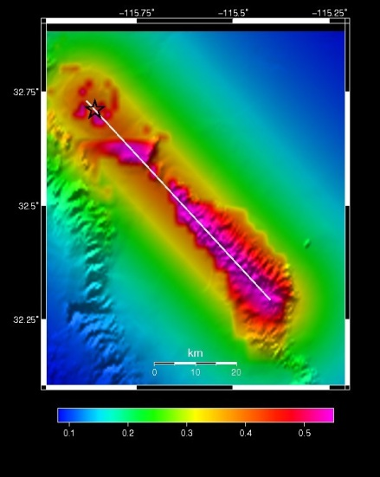
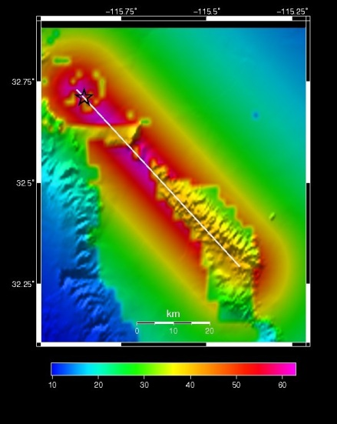
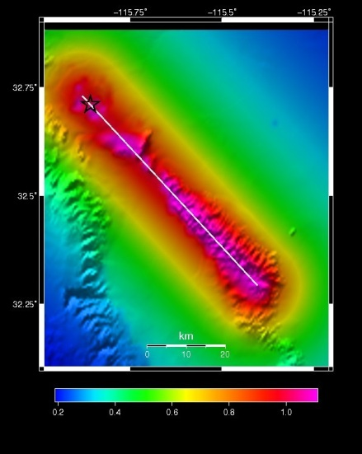

PESH Generation with OpenSHA and QuakeTables for Simulated 7.2M Earthquake
PGA
PGV
SA03
SA10

Slide 8
HAZUS with 7.2 Scenario Earthquake
2% about 861 buildings will be at least moderately damaged, the total building-related losses were $64.35 m
The total economic loss estimated for the earthquake is $290.98 m
Damage estimation is close to the estimated $371.44 m losses of the Baja 7.2 earthquake from Hazus simulation using USGS PESH file
  Main difference is from building-related losses.
    For Baja 7.2, 4% buildings are damaged
We conclude we can automate PESH generation using data in QuakeTables.
  Simplex inversion models also feasible to automate.
We need advice on use-cases.
  Ex: Create for every fault in hotspot forecast maps by Rundle’s group.

Slide 9
Summary
In our test case, OpenSHA works smoothly as a link between QuakeTable and Hazus.
The loss estimation of scenario earthquake is influenced by the different attenuation relationship
QuakeTable can be potentially developed as the interface to suggest scenario earthquakes for Hazus user.

Slide 10
Next Steps ?
We need guidance on next steps
  Automatically generate hazard map from disloc rss feed
  Simplex could be used to extract fault models from InSAR, but we need help here

