Slide 1
FutureGrid and Cyberinfrastructure supporting Data Analysis
October 11 2010
Googleplex
Mountain View CA
Geoffrey Fox
gcf@indiana.edu
http://www.infomall.org http://www.futuregrid.org
Community Grids Laboratory, Pervasive Technology Institute
Associate Dean for Research and Graduate Studies, School of Informatics and Computing
Indiana University Bloomington

Slide 2
Abstract
TeraGrid has been NSF's production environment typified by large scale scientific computing simulations typically using MPI.
Recently TeraGrid has added three experimental environments: Keeneland (a GPGPU cluster), Gordon (a distributed shared memory cluster with SSD disks aimed at data analysis and visualization), and FutureGrid.
Futuregrid is a small distributed set of clusters (~5000 cores) supporting HPC, Cloud and Grid computing experiments for both applications and computer science.
Users can request arbitrary configurations and those FutureGrid nodes are rebooted on demand from a library of certified images.
FutureGrid will in particular allow traditional Grid and MPI researchers to explore the value of new technologies such as MapReduce, Bigtable and basic cloud VM infrastructure.
Further it supports development of the needed new approaches to data intensive applications which have typically not used TeraGrid. we give some examples of MPI and Mapreduce applications in gene sequencing problems.

Slide 3
US Cyberinfrastructure Context
There are a rich set of facilities
  Production TeraGrid facilities with distributed and shared memory
  Experimental “Track 2D” Awards
    FutureGrid: Distributed Systems experiments cf. Grid5000
    Keeneland: Powerful GPU Cluster
    Gordon: Large (distributed) Shared memory system with SSD aimed at data analysis/visualization
  Open Science Grid aimed at High Throughput computing and strong campus bridging

Slide 4
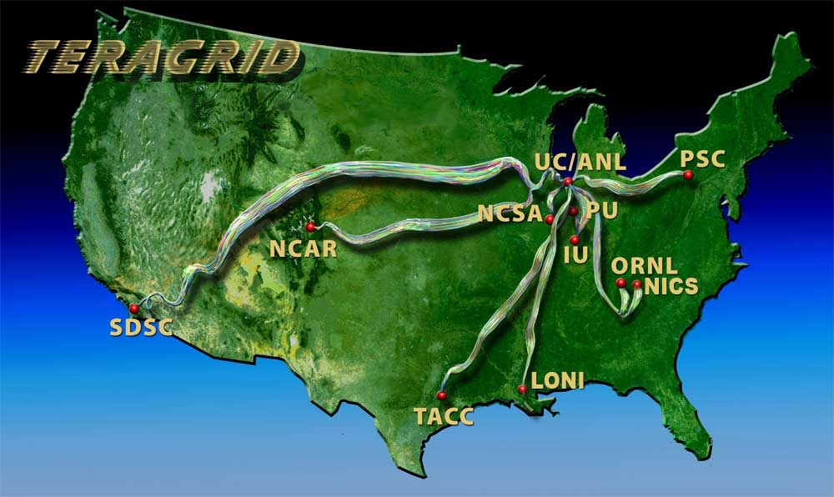
TeraGrid
~2 Petaflops; over 20 PetaBytes of storage (disk and tape), over 100 scientific data collections
UW
Grid Infrastructure Group (UChicago)
UC/ANL
PSC
NCAR
PU
NCSA
Caltech
IU
UNC/RENCI
ORNL
USC/ISI
NICS
SDSC
LONI
TACC
Resource Provider (RP)
Software Integration Partner
Network Hub

Slide 5
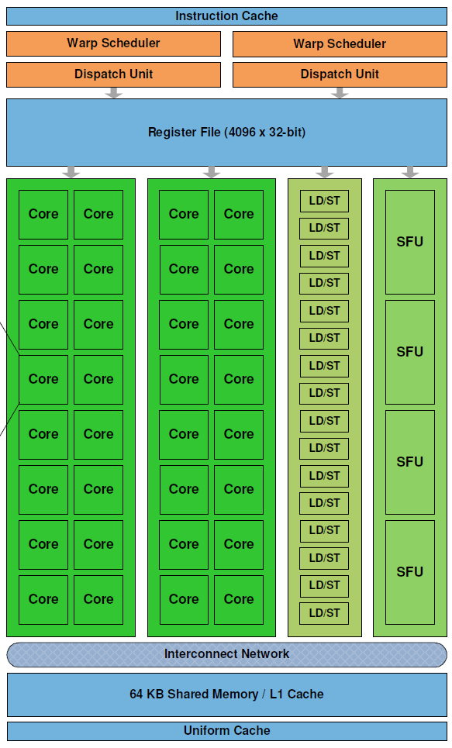
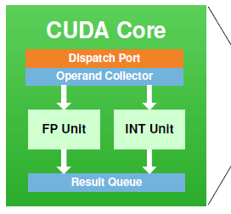
Keeneland – NSF-Funded Partnership to Enable Large-scale Computational Science on Heterogeneous Architectures
NSF Track 2D System of Innovative Design
  Georgia Tech
  UTK NICS
  ORNL
  UTK
Two GPU clusters
  Initial delivery (~250 CPU, 250 GPU)
    Being built now; Expected availability is November 2010
  Full scale (> 500 GPU) – Spring 2012
  NVIDIA, HP, Intel, Qlogic
Operations, user support
Education, Outreach, Training for scientists, students, industry
Software tools, application development
Exploit graphics processors to provide extreme performance and energy efficiency
Prof. Jeffrey S. Vetter
Prof. Richard Fujimoto
Prof. Karsten Schwan
Prof. Jack Dongarra
Dr. Thomas Schulthess
Prof. Sudha Yalamanchili
Jeremy Meredith
Dr. Philip Roth
Richard Glassbrook
Patricia Kovatch
Stephen McNally
Dr. Bruce Loftis
Jim Ferguson
James Rogers
Kathlyn Boudwin
Arlene Washington
Many others…
NVIDIA’s new Fermi GPU
http://keeneland.gatech.edu
http://ft.ornl.gov

Slide 8
FutureGrid key Concepts I
FutureGrid is an international testbed modeled on Grid5000
Rather than loading images onto VM’s, FutureGrid supports Cloud, Grid and Parallel computing environments by dynamically provisioning software as needed onto “bare-metal” using Moab/xCAT
  Image library for MPI, OpenMP, Hadoop, Dryad, gLite, Unicore, Globus, Xen, ScaleMP (distributed Shared Memory), Nimbus, Eucalyptus, OpenNebula, KVM, Windows …..
The FutureGrid testbed provides to its users:
  A flexible development and testing platform for middleware and application users looking at interoperability, functionality and performance
  Each use of FutureGrid is an experiment that is reproducible
  A rich education and teaching platform for advanced cyberinfrastructure classes
Growth comes from users depositing novel images in library

Slide 9
Dynamic Provisioning Results
Time minutes
Number of nodes
Time elapsed between requesting a job and the jobs reported start time on the provisioned node. The numbers here are an average of 2 sets of experiments.

Slide 10
FutureGrid key Concepts II
Support Computer Science and Computational Science
  Industry and Academia
  Europe and USA
FutureGrid has ~5000 distributed cores with a dedicated network and a Spirent XGEM network fault and delay generator
Key early user oriented milestones:
  June 2010 Initial users
  November 2010-September 2011 Increasing number of users allocated by FutureGrid
  October 2011 FutureGrid allocatable via TeraGrid process
  3 classes using FutureGrid this fall
Apply now to use FutureGrid on web site www.futuregrid.org

Slide 11
FutureGrid Partners
Indiana University (Architecture, core software, Support)
  Collaboration between research and infrastructure groups
Purdue University (HTC Hardware)
San Diego Supercomputer Center at University of California San Diego (INCA, Monitoring)
University of Chicago/Argonne National Labs (Nimbus)
University of Florida (ViNE, Education and Outreach)
University of Southern California Information Sciences (Pegasus to manage experiments)
University of Tennessee Knoxville (Benchmarking)
University of Texas at Austin/Texas Advanced Computing Center (Portal)
University of Virginia (OGF, Advisory Board and allocation)
Center for Information Services and GWT-TUD from Technische Universtität Dresden. (VAMPIR)
Red institutions have FutureGrid hardware

Slide 12
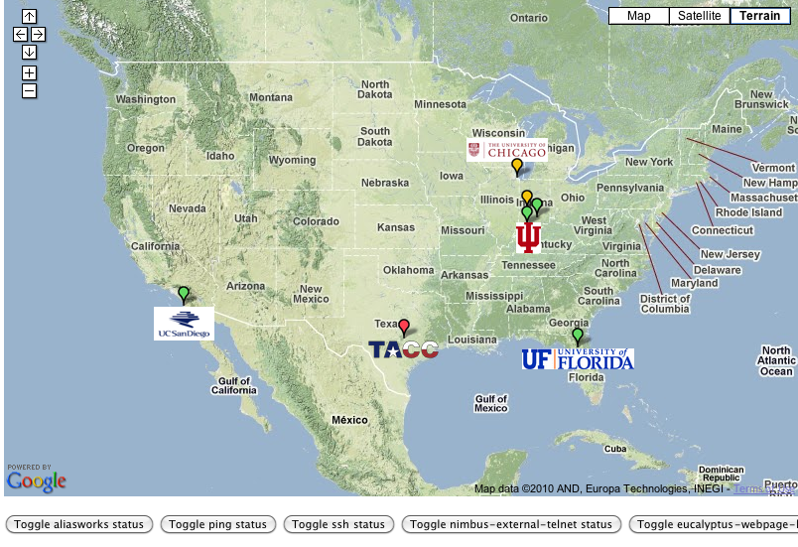
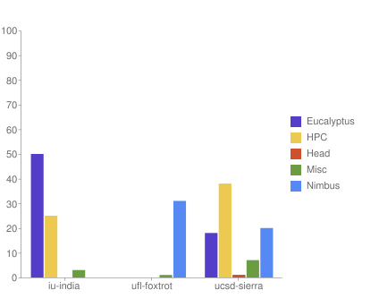

FutureGrid: a Grid/Cloud/HPC Testbed
Operational: IU Cray operational; IU , UCSD, UF & UC IBM iDataPlex operational
Network, NID operational
TACC Dell finished acceptance tests
INCA Node Operating Mode Statistics
NID: Network Impairment Device
Private
Public
FG Network

Slide 13
Network & Internal Interconnects
FutureGrid has dedicated network (except to TACC) and a network fault and delay generator
Can isolate experiments on request; IU runs Network for NLR/Internet2
(Many) additional partner machines will run FutureGrid software and be supported (but allocated in specialized ways)
Machine | Name | Internal Network
IU Cray | xray | Cray 2D Torus SeaStar
IU iDataPlex | india | DDR IB, QLogic switch with Mellanox ConnectX adapters Blade Network Technologies & Force10 Ethernet switches
SDSC iDataPlex | sierra | DDR IB, Cisco switch with Mellanox ConnectX adapters Juniper Ethernet switches
UC iDataPlex | hotel | DDR IB, QLogic switch with Mellanox ConnectX adapters Blade Network Technologies & Juniper switches
UF iDataPlex | foxtrot | Gigabit Ethernet only (Blade Network Technologies; Force10 switches)
TACC Dell | alamo | QDR IB, Mellanox switches and adapters Dell Ethernet switches

Slide 14
Network Impairment Device
Spirent XGEM Network Impairments Simulator for jitter, errors, delay, etc
Full Bidirectional 10G w/64 byte packets
up to 15 seconds introduced delay (in 16ns increments)
0-100% introduced packet loss in .0001% increments
Packet manipulation in first 2000 bytes
up to 16k frame size
TCL for scripting, HTML for manual configuration

Slide 15
FutureGrid Usage Model
The goal of FutureGrid is to support the research on the future of distributed, grid, and cloud computing
FutureGrid will build a robustly managed simulation environment and test-bed to support the development and early use in science of new technologies at all levels of the software stack: from networking to middleware to scientific applications
The environment will mimic TeraGrid and/or general parallel and distributed systems – FutureGrid is part of TeraGrid (but not part of formal TeraGrid process for first two years)
  Supports Grids, Clouds, and classic HPC
  It will mimic commercial clouds (initially IaaS not PaaS)
  Expect FutureGrid PaaS to grow in importance
FutureGrid can be considered as a (small ~5000 core) Science/Computer Science Cloud but it is more accurately a virtual machine or bare-metal based simulation environment
This test-bed will succeed if it enables major advances in science and engineering through collaborative development of science applications and related software

Slide 16

Some Current FutureGrid early uses
Two Recent Projects
Investigate metascheduling approaches on Cray and iDataPlex
Deploy Genesis II and Unicore end points on Cray and iDataPlex clusters
Develop new Nimbus cloud capabilities
Prototype applications (BLAST) across multiple FutureGrid clusters and Grid’5000
Compare Amazon, Azure with FutureGrid hardware running Linux, Linux on Xen or Windows for data intensive applications
Test ScaleMP software shared memory for genome assembly
Develop Genetic algorithms on Hadoop for optimization
Attach power monitoring equipment to iDataPlex nodes to study power use versus use characteristics
Industry (Columbus IN) running CFD codes to study combustion strategies to maximize energy efficiency
Support evaluation needed by XD TIS and TAS services
Investigate performance of Kepler workflow engine
Study scalability of SAGA in difference latency scenarios
Test and evaluate new algorithms for phylogenetics/systematics research in CIPRES portal
Investigate performance overheads of clouds in parallel and distributed environments
Support tutorials and classes in cloud, grid and parallel computing (IU, Florida, LSU)
~12 active/finished users out of ~32 early user applicants

Slide 17
Grid Interoperability from Andrew Grimshaw
Colleagues,
FutureGrid has as two of its many goals the creation of a Grid middleware testing and interoperability testbed as well as the maintenance of standards compliant endpoints against which experiments can be executed. We at the University of Virginia are tasked with bringing up three stacks as well as maintaining standard-endpoints against which these experiments can be run.
We currently have UNICORE 6 and Genesis II endpoints functioning on X-Ray (a Cray). Over the next few weeks we expect to bring two additional resources, India and Sierra (essentially Linux clusters), on-line in a similar manner (Genesis II is already up on Sierra). As called for in the FutureGrid program execution plan, once those two stacks are operational we will begin to work on g-lite (with help we may be able to accelerate that). Other standards-compliant endpoints are welcome in the future , but not part of the current funding plan.
I’m writing the PGI and GIN working groups to see if there is interest in using these resources (endpoints) as a part of either the GIN or PGI work, in particular in demonstrations or projects for OGF in October or SC in November. One of the key differences between these endpoints and others is that they can be expected to persist. These resources will not go away when a demo is done. They will be there as a testbed for future application and middleware development (e.g., a metascheduler that works across g-lite and Unicore 6).
We RENKEI/NAREGI project are interested in the participation for interoperation demonstrations or projects for OGF and SC. We have a prototype middleware which can submit and receive jobs using the HPCBP specification. Can we have more detailed information of your endpoints(authentication, data staging method, and so on) and the participation conditions of the demonstrations/projects.

Slide 18

OGF’10 Demo
SDSC
Rennes
Grid’5000 firewall
UF
Lille
UC
Sophia
ViNe provided the necessary inter-cloud connectivity to deploy CloudBLAST across 5 Nimbus sites, with a mix of public and private subnets.

Slide 19


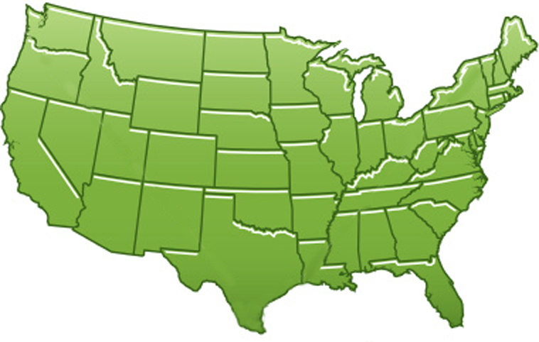















300+ Students learning about Twister & Hadoop
MapReduce technologies, supported by FutureGrid.
July 26-30, 2010 NCSA Summer School Workshop
http://salsahpc.indiana.edu/tutorial
Washington
University
University of
Minnesota
Michigan
State
Johns
Hopkins
Univ.Illinois
at Chicago
Iowa
State
Penn
State
IBM Almaden
Research Center
Notre
Dame
University of
California at
Los Angeles
Indiana
University
San Diego
Supercomputer
Center
University of
Texas at El Paso
University of
Arkansas
University
of Florida

Slide 20
Software Components
Portals including “Support” “use FutureGrid” “Outreach”
Monitoring – INCA, Power (GreenIT)
Experiment Manager: specify/workflow
Image Generation and Repository
Intercloud Networking ViNE
Virtual Clusters built with virtual networks
Performance library
Rain or Runtime Adaptable InsertioN Service: Schedule and Deploy images
Security (including use of isolated network), Authentication, Authorization,

Slide 21
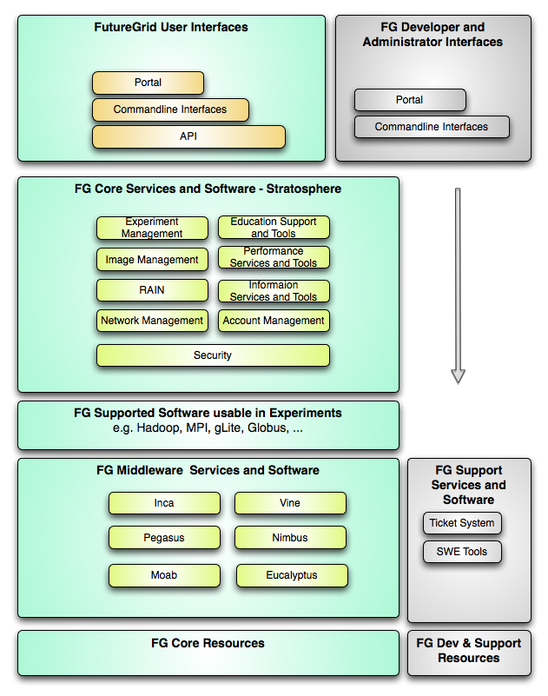
FutureGrid
Layered Software Stack
User Supported Software usable in Experiments e.g. OpenNebula, Charm++, Other MPI, Bigtable

Slide 22
FutureGrid Interaction with Commercial Clouds
We support experiments that link Commercial Clouds and FutureGrid with one or more workflow environments and portal technology installed to link components across these platforms
We support environments on FutureGrid that are similar to Commercial Clouds and natural for performance and functionality comparisons
  These can both be used to prepare for using Commercial Clouds and as the most likely starting point for porting to them
  One example would be support of MapReduce-like environments on FutureGrid including Hadoop on Linux and Dryad on Windows HPCS which are already part of FutureGrid portfolio of supported software
We develop expertise and support porting to Commercial Clouds from other Windows or Linux environments
We support comparisons between and integration of multiple commercial Cloud environments – especially Amazon and Azure in the immediate future
We develop tutorials and expertise to help users move to Commercial Clouds from other environments

Slide 23

194 papers submitted to main track; 48 accepted; 4 days of tutorials including OpenNebula

Slide 24
Scientific Computing Architecture
Traditional Supercomputers (TeraGrid and DEISA) for large scale parallel computing – mainly simulations
  Likely to offer major GPU enhanced systems
Traditional Grids for handling distributed data – especially instruments and sensors
Clouds for “high throughput computing” including much data analysis and emerging areas such as Life Sciences using loosely coupled parallel computations
  May offer small clusters for MPI style jobs
  Certainly offer MapReduce
What is architecture for data analysis?
  MapReduce Style? Certainly good in several cases
  MPI Style? Data analysis uses linear algeabra, iterative EM
  Shared Memory? NSF Gordon
Integrating these needs new work on distributed file systems and high quality data transfer service
  Link Lustre WAN, Amazon/Google/Hadoop/Dryad File System
  Offer Bigtable

Slide 25

Application Classes
Old classification of Parallel software/hardware in terms of
5 (becoming 6) “Application architecture” Structures)
1 | Synchronous | Lockstep Operation as in SIMD architectures | SIMD
2 | Loosely Synchronous | Iterative Compute-Communication stages with independent compute (map) operations for each CPU. Heart of most MPI jobs | MPP
3 | Asynchronous | Computer Chess; Combinatorial Search often supported by dynamic threads | MPP
4 | Pleasingly Parallel | Each component independent – in 1988, Fox estimated at 20% of total number of applications | Grids
5 | Metaproblems | Coarse grain (asynchronous) combinations of classes 1)-4). The preserve of workflow. | Grids
6 | MapReduce and Enhancements | It describes file(database) to file(database) operations which has subcategories including. Pleasingly Parallel Map Only Map followed by reductions Iterative “Map followed by reductions” – Extension of Current Technologies that supports much linear algebra and data mining | Clouds Hadoop/ Dryad Twister Pregel

Slide 26
Applications & Different Interconnection Patterns
Map Only | Classic MapReduce | Iterative Reductions MapReduce++ | Loosely Synchronous
CAP3 Analysis Document conversion (PDF -> HTML) Brute force searches in cryptography Parametric sweeps | High Energy Physics (HEP) Histograms SWG gene alignment Distributed search Distributed sorting Information retrieval | Expectation maximization algorithms Clustering Linear Algebra | Many MPI scientific applications utilizing wide variety of communication constructs including local interactions
- CAP3 Gene Assembly - PolarGrid Matlab data analysis | - Information Retrieval - HEP Data Analysis - Calculation of Pairwise Distances for ALU Sequences | Kmeans Deterministic Annealing Clustering - Multidimensional Scaling MDS | - Solving Differential Equations and - particle dynamics with short range forces
Input
iterations
Input
Input
map
map
map
Pij
reduce
Output
reduce
Domain of MapReduce and Iterative Extensions
MPI

Slide 27
What hardware/software is needed for data analysis?
Largest compute systems in world are commercial systems used for internet and commerce data analysis
Largest US academic systems (TeraGrid) are essentially not used for data analysis
  Open Science Grid and EGI (European Grid Initiative) have large CERN LHC data analysis component – largely pleasingly parallel problems
  TeraGrid “data systems” shared memory
Runtime models
  “Dynamic Scheduling”, MapReduce, MPI …. (when they work, all ~same performance)
Agreement on architecture for large scale simulation (GPGPU relevance question of detail); little consensus on scientific data analysis architecture

Slide 28
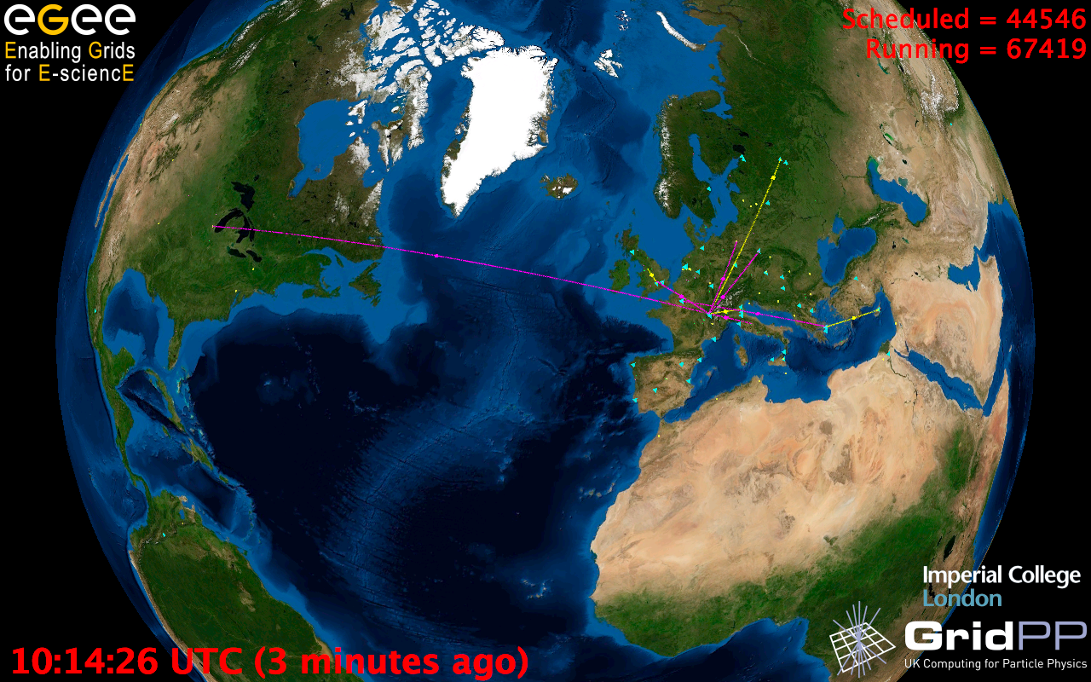
European Grid Infrastructure
Status April 2010 (yearly increase)
10000 users: +5%
243020 LCPUs (cores): +75%
40PB disk: +60%
61PB tape: +56%
15 million jobs/month: +10%
317 sites: +18%
52 countries: +8%
175 VOs: +8%
29 active VOs: +32%

Slide 29

Performance Study
MapReduce v Scheduling
Linux,
Linux on VM, Windows, Azure,
Amazon
on
Bioinformatics

Slide 30
Hadoop/Dryad Comparison
Inhomogeneous Data I
Inhomogeneity of data does not have a significant effect when the sequence lengths are randomly distributed
Dryad with Windows HPCS compared to Hadoop with Linux RHEL on Idataplex (32 nodes)

Slide 31
Scaled Timing with
Azure/Amazon MapReduce

Slide 32
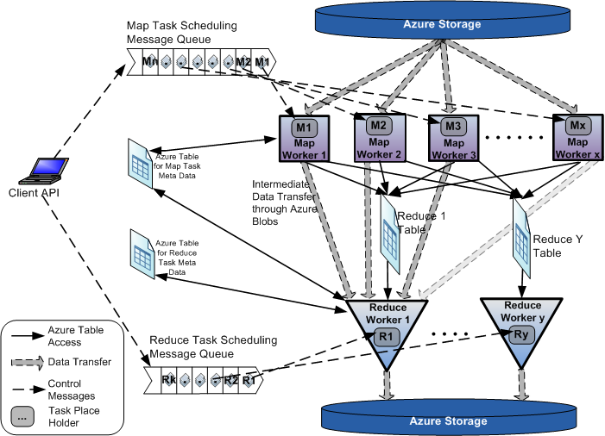
AzureMapReduce

Slide 33
Smith Waterman
MPI DryadLINQ Hadoop
Hadoop is Java; MPI and Dryad are C#

Slide 34
Parallel Data Analysis Algorithms
Developed a suite of parallel data-analysis capabilities using deterministic annealing
  Clustering
    Vector based O(N)
    Distance based O(N²)
  Dimension Reduction for visualization and analysis
    Vector based Generative Topographic Map GTM O(N)
    Distance based Multidimensional Scaling MDS O(N²)
  All have faster hierarchical (interpolation) algorithms
  All with deterministic annealing (DA)
  Easy to parallelize but linear algebra/Iterative EM – need MPI

Slide 35


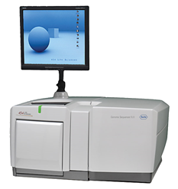
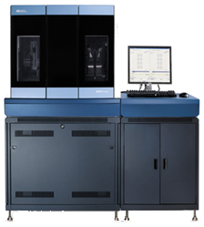
Typical Application Challenge:
DNA Sequencing Pipeline
MapReduce
Pairwise
clustering
FASTA File
N Sequences
block
Pairings
Sequence
Alignment/
Assembly
Dissimilarity
Matrix
N(N-1)/2 values
MPI
Visualization
Blocking
MDS
Read Alignment
Illumina/Solexa Roche/454 Life Sciences Applied Biosystems/SOLiD
Internet
Modern Commercial Gene Sequencers
Linear Algebra or Expectation Maximization based data mining poor on MapReduce – equivalent to using MPI writing messages to disk and restarting processes each step/iteration of algorithm

Slide 36

Metagenomics
This visualizes results of dimension reduction to 3D of 30000 gene sequences from an environmental sample. The many different genes are classified by clustering algorithm and visualized by MDS dimension reduction

Slide 37
General Deterministic Annealing Formula
N data points E(x) in D dimensions space and minimize F by EM
  Deterministic Annealing Clustering (DAC)
F is Free Energy (E(x) is energy to be minimized)
p(x) with Σ p(x) =1
T is annealing temperature varied down from ∞ with final value of 1
Determine cluster center Y(k) by EM method
EM is well known expectation maximization method corresponding to steepest descent
K (number of clusters) starts at 1 and is incremented by algorithm

Slide 38
Deterministic Annealing I
Gibbs Distribution at Temperature T
P(χ) = exp( - H(χ)/T) / ∫ dχ exp( - H(χ)/T)
Or P(χ) = exp( - H(χ)/T + F/T )
Minimize Free Energy
F = < H - T S(P) > = ∫ dχ {P(χ)H + T P(χ) lnP(χ)}
Where χ are (a subset of) parameters to be minimized
Simulated annealing corresponds to doing these integrals by Monte Carlo
Deterministic annealing corresponds to doing integrals analytically and is naturally much faster
In each case temperature is lowered slowly – say by a factor 0.99 at each iteration

Slide 39
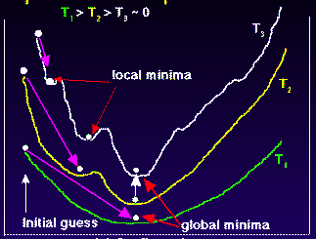
Deterministic
Annealing
F({y}, T)
Solve Linear Equations for each temperature
Nonlinearity effects mitigated by initializing with solution at previous higher temperature
Configuration {y}
Minimum evolving as temperature decreases
Movement at fixed temperature going to local minima if not initialized “correctly

Slide 40
Deterministic Annealing II
For some cases such as vector clustering and Gaussian Mixture Models one can do integrals by hand but usually will be impossible
So introduce Hamiltonian H₀(χ, ε) which by choice of ε can be made similar to H(χ) and which has tractable integrals
P₀(χ) = exp( - H₀(χ)/T + F₀/T ) approximate Gibbs
F_{R} (P₀) = < H_{R} - T S₀(P₀) >|₀ = < H_{R} – H₀> |₀ + F₀(P₀)
Where <…>|₀ denotes ∫ dχ P_{o}(χ)
Easy to show that real Free Energy
F_{A} (P_{A}) ≤ F_{R} (P₀)
In many problems, decreasing temperature is classic multiscale – finer resolution (T is “just” distance scale)
Related to variational inference

Slide 41
Implementation of DA I
Expectation step E is find ε minimizing F_{R} (P₀) and
Follow with M step setting χ = <χ> |₀ = ∫ dχ χ P_{o}(χ) and if one does not anneal over all parameters and one follows with a traditional minimization of remaining parameters
In clustering, one then looks at second derivative matrix of F_{R} (P₀) wrt ε and as temperature is lowered this develops negative eigenvalue corresponding to instability
This is a phase transition and one splits cluster into two and continues EM iteration
One starts with just one cluster

Slide 42
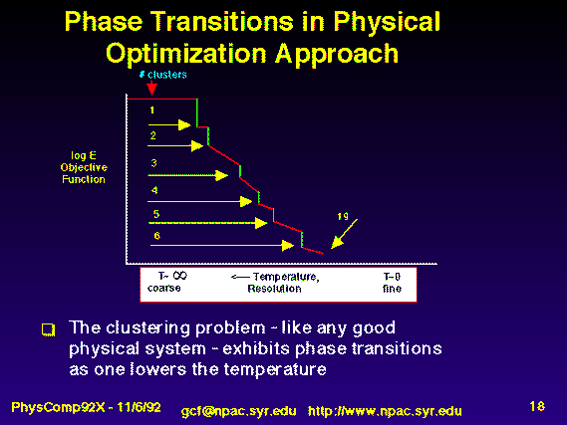
Rose, K., Gurewitz, E., and Fox, G. C. ``Statistical mechanics and phase transitions in clustering,'' Physical Review Letters, 65(8):945-948, August 1990.
My #5 my most cited article (311)

Slide 43
Implementation II
Clustering variables are M_{i}(k) where this is probability point i belongs to cluster k
In Clustering, take H₀ = ∑_{i=1}^{N} ∑_{k=1}^{K} M_{i}(k) ε_{i}(k)
<M_{i}(k)> = exp( -ε_{i}(k)/T ) / ∑_{k=1}^{K} exp( -ε_{i}(k)/T )
Central clustering has ε_{i}(k) = (X(i)- Y(k))² and ε_{i}(k) determined by Expectation step in pairwise clustering
  H_{Central} = ∑_{i=1}^{N} ∑_{k=1}^{K} M_{i}(k) (X(i)- Y(k))²
  H_{central} and H₀ are identical
  Centers Y(k) are determined in M step
Pairwise Clustering given by nonlinear form
H_{PC} = 0.5 ∑_{i=1}^{N} ∑_{j=1}^{N} δ(i, j) ∑_{k=1}^{K} M_{i}(k) M_{j}(k) / C(k)
with C(k) = ∑_{i=1}^{N} M_{i}(k) as number of points in Cluster k
And now H₀ and H_{PC} are different

Slide 44
Multidimensional Scaling MDS
Map points in high dimension to lower dimensions
Many such dimension reduction algorithm (PCA Principal component analysis easiest); simplest but perhaps best is MDS
Minimize Stress
σ(X) = Σ_{i<j=1}^{n} weight(i,j) (δ_{ij} - d(X_{i} , X_{j}))²
δ_{ij} are input dissimilarities and d(X_{i} , X_{j}) the Euclidean distance squared in embedding space (3D usually)
SMACOF or Scaling by minimizing a complicated function is clever steepest descent (expectation maximization EM) algorithm
Computational complexity goes like N². Reduced Dimension
There is Deterministic annealed version of it
Could just view as non linear χ² problem (Tapia et al. Rice)
All will/do parallelize with high efficiency

Slide 45
Implementation III
One tractable form was a linear Hamiltonian
Another is Gaussian H₀ = Σ_{i=1}^{n} (X(i) - μ(i))² / 2
Where X(i) are vectors to be determined as in formula for Multidimensional scaling
H_{MDS} = Σ_{i< j=1}^{n} weight(i,j) (δ(i, j) - d(X(i) , X(j) ))²
Where δ(i, j) are observed dissimilarities and we want to represent as Euclidean distance between points X(i) and X(j) (H_{MDS} is quartic or involves square roots)
The E step is minimize
Σ_{i< j=1}^{n} weight(i,j) (δ(i, j) – constant.T - (μ(i) - μ(j))² )²
with solution μ(i) = 0 at large T
Points pop out from origin as Temperature lowered

Slide 46
MPI & Iterative MapReduce papers
MapReduce on MPI Torsten Hoefler, Andrew Lumsdaine and Jack Dongarra, Towards Efficient MapReduce Using MPI, Recent Advances in Parallel Virtual Machine and Message Passing Interface Lecture Notes in Computer Science, 2009, Volume 5759/2009, 240-249
MPI with generalized MapReduce
Jaliya Ekanayake, Hui Li, Bingjing Zhang, Thilina Gunarathne, Seung-Hee Bae, Judy Qiu, Geoffrey Fox Twister: A Runtime for Iterative MapReduce, Proceedings of the First International Workshop on MapReduce and its Applications of ACM HPDC 2010 conference, Chicago, Illinois, June 20-25, 2010 http://grids.ucs.indiana.edu/ptliupages/publications/twister__hpdc_mapreduce.pdf http://www.iterativemapreduce.org/
Grzegorz Malewicz, Matthew H. Austern, Aart J. C. Bik, James C. Dehnert, Ilan Horn, Naty Leiser, and Grzegorz Czajkowski Pregel: A System for Large-Scale Graph Processing, Proceedings of the 2010 international conference on Management of data Indianapolis, Indiana, USA Pages: 135-146 2010
Yingyi Bu, Bill Howe, Magdalena Balazinska, Michael D. Ernst HaLoop: Efficient Iterative Data Processing on Large Clusters, Proceedings of the VLDB Endowment, Vol. 3, No. 1, The 36th International Conference on Very Large Data Bases, September 1317, 2010, Singapore.
Matei Zaharia, Mosharaf Chowdhury, Michael J. Franklin, Scott Shenker, Ion Stoica Spark: Cluster Computing with Working Sets poster at http://radlab.cs.berkeley.edu/w/upload/9/9c/Spark-retreat-poster-s10.pdf

Slide 47

Twister
Pub/Sub Broker Network
Map Worker
M
Worker Nodes
R
Reduce Worker
Streaming based communication
Intermediate results are directly transferred from the map tasks to the reduce tasks – eliminates local files
Cacheable map/reduce tasks
  Static data remains in memory
Combine phase to combine reductions
User Program is the composer of MapReduce computations
Extends the MapReduce model to iterative computations
D
D
MR
Driver
User
Program
M
M
M
M
D
MRDeamon
R
R
R
R
Data Read/Write
Communication
Data Split
File System
Iterate
Static
data
Configure()
User Program
Map(Key, Value)
δ flow
Reduce (Key, List<Value>)
Combine (Key, List<Value>)
Different synchronization and intercommunication mechanisms used by the parallel runtimes
Close()

Slide 48

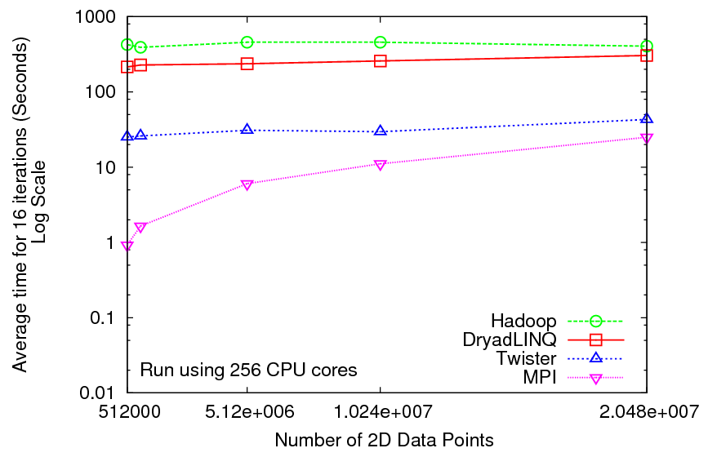
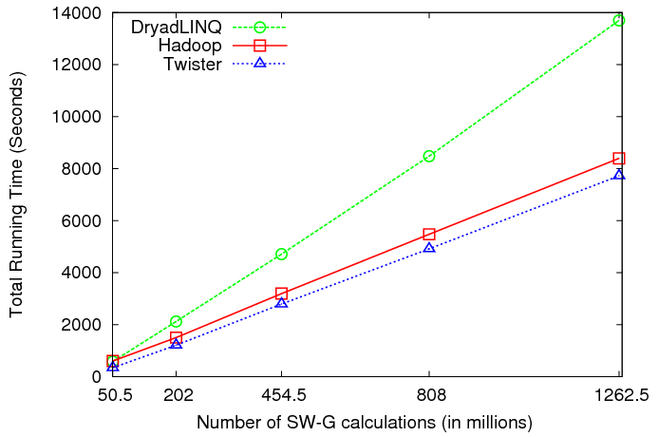
Iterative and non-Iterative Computations
K-means
Smith Waterman is a non iterative case and of course runs fine
Performance of K-Means

Slide 49
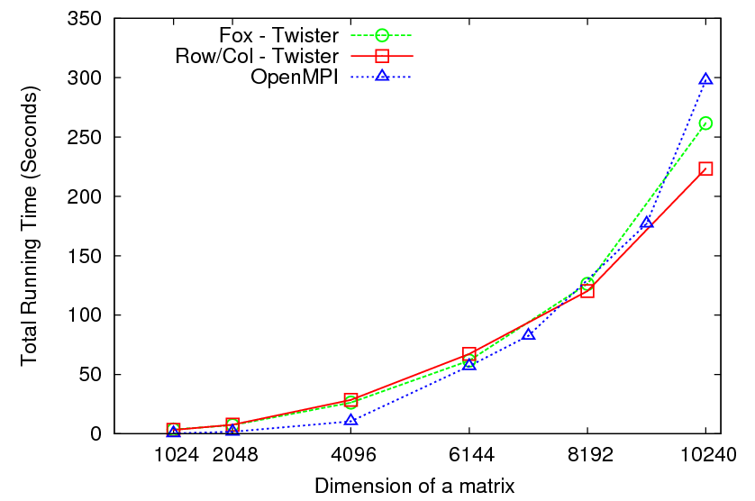

Matrix Multiplication 64 cores
Square blocks Twister
Row/Col decomp Twister
Square blocks OpenMPI

Slide 50
Overhead OpenMPI v Twister negative overhead due to cache

Slide 51

Performance of Pagerank using
ClueWeb Data (Time for 20 iterations)
using 32 nodes (256 CPU cores) of Crevasse

Slide 52
Fault Tolerance and MapReduce
MPI does “maps” followed by “communication” including “reduce” but does this iteratively
There must (for most communication patterns of interest) be a strict synchronization at end of each communication phase
  Thus if a process fails then everything grinds to a halt
In MapReduce, all Map processes and all reduce processes are independent and stateless and read and write to disks
  As 1 or 2 (reduce+map) iterations, no difficult synchronization issues
Thus failures can easily be recovered by rerunning process without other jobs hanging around waiting
Re-examine MPI fault tolerance in light of MapReduce
  Relevant for Exascale?
Re-examine MapReduce in light of MPI experience …..

Slide 53
TwisterMPIReduce
PairwiseClustering
MPI
Multi Dimensional Scaling MPI
Generative Topographic Mapping MPI
Other …
TwisterMPIReduce
Azure Twister (C# C++)
Java Twister
Microsoft Azure
FutureGrid
Local Cluster
Amazon EC2
Runtime package supporting subset of MPI mapped to Twister
Set-up, Barrier, Broadcast, Reduce

Slide 54
Some Issues with AzureTwister and AzureMapReduce
Transporting data to Azure: Blobs (HTTP), Drives (GridFTP etc.), Fedex disks
Intermediate data Transfer: Blobs (current choice) versus Drives (should be faster but don’t seem to be)
Azure Table v Azure SQL: Handle all metadata
Messaging Queues: Use real publish-subscribe system in place of Azure Queues to get scaling (?) with multiple brokers – especially AzureTwister
Azure Affinity Groups: Could allow better data-compute and compute-compute affinity

Slide 55
Research Issues
Clouds are suitable for “Loosely coupled” data parallel applications
“Map Only” (really pleasingly parallel) certainly run well on clouds (subject to data affinity) with many programming paradigms
Parallel FFT and adaptive mesh PDE solver very bad on MapReduce but suitable for classic MPI engines.
MapReduce is more dynamic and fault tolerant than MPI; it is simpler and easier to use
Is there an intermediate class of problems for which Iterative MapReduce useful?
  Long running processes?
  Mutable data small in size compared to fixed data(base)?
  Only support reductions?
  Is it really different from a fault tolerant MPI?
  Multicore implementation
  Link to HDFS or equivalent data parallel file system
  Relation to Exascale fault tolerance

