Slide 1
FutureGrid Computing Testbed as a Service NSF Presentation
NSF April 9 2013
Geoffrey Fox for FutureGrid Team
gcf@indiana.edu
http://www.infomall.org http://www.futuregrid.org
School of Informatics and Computing
Digital Science Center
Indiana University Bloomington

Slide 2
FutureGrid Testbed as a Service
FutureGrid is part of XSEDE set up as a testbed with cloud focus
Operational since Summer 2010 (i.e. now in third year of use)
The FutureGrid testbed supports Computer Science and Computational Science research with
A flexible development and test platform for CS systems and application users looking at interoperability, functionality, performance or evaluation
User-customizable, accessed interactively environment for Grid, Cloud and HPC software with and without VM’s
A rich education and teaching platform for classes
Offers OpenStack, Eucalyptus, Nimbus, OpenNebula, HPC (MPI) on same hardware moving to software defined systems
Rather than loading images onto VM’s, FutureGrid supports Cloud, Grid and Parallel computing environments by provisioning software as needed onto “bare-metal” or VM’s/Hypervisors using (changing) open source tools

Slide 3
4 Use Types for FutureGrid TestbedaaS
292 approved projects (1734 users) April 6 2013
USA(79%), Puerto Rico(3%- Students in class), India, China, lots of European countries (Italy at 2% as class)
Industry, Government, Academia
Computer science and Middleware (55.6%)
Computer Science and Cyberinfrastructure; Interoperability (3.6%) for Grids and Clouds such as Open Grid Forum OGF Standards
New Domain Science applications (20.4%)
Life science highlighted (10.5%), Non Life Science (9.9%)
Training Education and Outreach (14.9%)
Semester and short events; focus on outreach to HBCU
Computer Systems Evaluation (9.1%)
XSEDE (TIS, TAS), OSG, EGI; Campuses

Slide 4
Heterogeneous Systems Hardware
Name | System type | # CPUs | # Cores | TFLOPS | Total RAM (GB) | Secondary Storage (TB) | Site | Status
India | IBM iDataPlex | 256 | 1024 | 11 | 3072 | 512 | IU | Operational
Alamo | Dell PowerEdge | 192 | 768 | 8 | 1152 | 30 | TACC | Operational
Hotel | IBM iDataPlex | 168 | 672 | 7 | 2016 | 120 | UC | Operational
Sierra | IBM iDataPlex | 168 | 672 | 7 | 2688 | 96 | SDSC | Operational
Xray | Cray XT5m | 168 | 672 | 6 | 1344 | 180 | IU | Operational
Foxtrot | IBM iDataPlex | 64 | 256 | 2 | 768 | 24 | UF | Operational
Bravo | Large Disk & memory | 32 | 128 | 1.5 | 3072 (192GB per node) | 192 (12 TB per Server) | IU | Operational
Delta | Large Disk & memory With Tesla GPU’s | 32 CPU 32 GPU’s | 192 | 9 | 3072 (192GB per node) | 192 (12 TB per Server) | IU | Operational
Lima | SSD Test System | 16 | 128 | 1.3 | 512 | 3.8(SSD) 8(SATA) | SDSC | Operational
Echo | Large memory ScaleMP | 32 | 192 | 2 | 6144 | 192 | IU | Beta
TOTAL |  | 1128 + 32 GPU | 4704 +14336 GPU | 54.8 | 23840 | 1550
Small systems avoid interference of specialized technologies

Slide 5
FutureGrid Partners
Indiana University (Architecture, core software, Support)
San Diego Supercomputer Center at University of California San Diego (INCA, Monitoring)
University of Chicago/Argonne National Labs (Nimbus)
University of Florida (ViNE, Education and Outreach)
University of Southern California Information Sciences (Pegasus to manage experiments)
University of Tennessee Knoxville (Benchmarking)
University of Texas at Austin/Texas Advanced Computing Center (Portal, XSEDE Integration)
University of Virginia (OGF, XSEDE Software stack)
Red institutions have FutureGrid hardware

Slide 6
Sample FutureGrid Projects I
FG18 Privacy preserving gene read mapping developed hybrid MapReduce. Small private secure + large public with safe data. Won 2011 PET Award for Outstanding Research in Privacy Enhancing Technologies
FG132, Power Grid Sensor analytics on the cloud with distributed Hadoop. Won the IEEE Scaling challenge at CCGrid2012.
FG156 Integrated System for End-to-end High Performance Networking showed that the RDMA (Remote Direct Memory Access) over Converged Ethernet Roce (InfiniBand made to work over Ethernet network frames) protocol could be used over wide-area networks
FG172 Cloud-TM on distributed concurrency control (software transactional memory): "When Scalability Meets Consistency: Genuine Multiversion Update Serializable Partial Data Replication,“ 32nd International Conference on Distributed Computing Systems (ICDCS'12) (good conference) used 40 nodes of FutureGrid

Slide 7
Sample FutureGrid Projects II
FG42,45 SAGA Pilot Job P* abstraction and applications. XSEDE Cyberinfrastructure used on clouds
FG130 Optimizing Scientific Workflows on Clouds. Scheduling Pegasus on distributed systems with overhead measured and reduced. Used Eucalyptus on FutureGrid
FG133 Supply Chain Network Simulator Using Cloud Computing with dynamic virtual machines supporting Monte Carlo simulation with Grid Appliance and Nimbus
FG257 Particle Physics Data analysis for ATLAS LHC experiment used FutureGrid + Canadian Cloud resources to study data analysis on Nimbus + OpenStack with up to 600 simultaneous jobs
FG254 Information Diffusion in Online Social Networks is evaluating NoSQL databases (Hbase, MongoDB, Riak) to support analysis of Twitter feeds
FG323 SSD performance benchmarking for HDFS on Lima

Slide 8
Education and Training Use of FutureGrid
27 Semester long classes: 563+ students
Cloud Computing, Distributed Systems, Scientific Computing and Data Analytics
3 one week summer schools: 390+ students
Big Data, Cloudy View of Computing (for HBCU’s), Science Clouds
1 two day workshop: 28 students
5 one day tutorials: 173 students
From 19 Institutions
Developing 2 MOOC’s (Google Course Builder) on Cloud Computing and use of FutureGrid supported by either FutureGrid or downloadable appliances (custom images)
See http://cgltestcloud1.appspot.com/preview
FutureGrid appliances support Condor/MPI/Hadoop/Iterative MapReduce virtual clusters

Slide 9
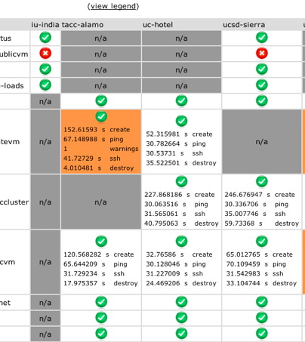
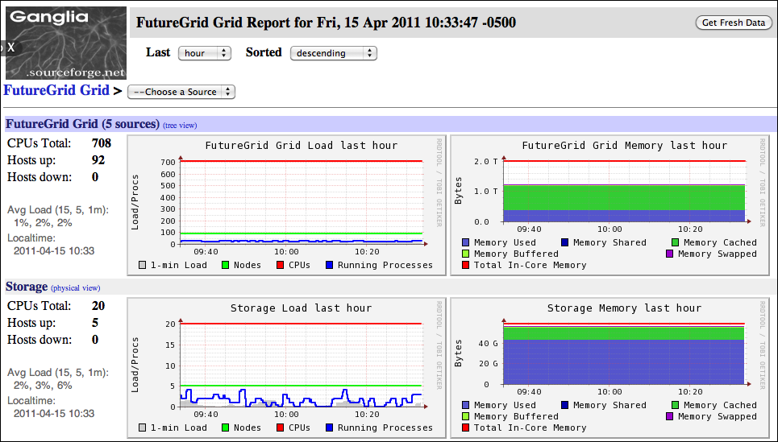
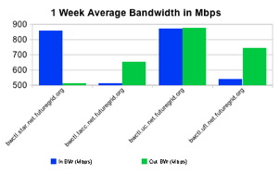
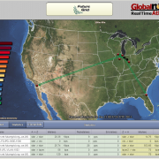
Inca
Software functionality and performance
Ganglia
Cluster monitoring
perfSONAR
Network monitoring - Iperf measurements
SNAPP
Network monitoring – SNMP measurements
Monitoring on FutureGrid
Important and even more needs to be done
Notes:
Listing of the monitoring tools currently deployed on FutureGrid

Slide 10
Link FutureGrid and GENI
Identify how to use the ORCA federation framework to integrate FutureGrid (and more of XSEDE?) into ExoGENI
Allow FG(XSEDE) users to access the GENI resources and vice versa
Leverage the Image generation capabilities of FG and the bare metal deployment strategies of FG within the GENI context.
Software defined networks plus cloud/bare metal dynamic provisioning gives software defined systems
Enable PaaS level services (such as a distributed Hbase or Hadoop) to be deployed across FG and GENI resources
Initial project on virtual distributed data systems

Slide 11
Essential and Different features of FutureGrid
Unlike many clouds such as Amazon and Azure, FutureGrid allows robust reproducible (in performance and functionality) research (you can request same node with and without VM)
Open Transparent Technology Environment
FutureGrid is more than a Cloud; it is a general distributed Sandbox; a cloud grid HPC testbed
Supports 3 different IaaS environments (Nimbus, Eucalyptus, OpenStack) and projects involve 5 (also CloudStack, OpenNebula)
Supports research on cloud tools, cloud middleware and cloud-based systems as well as use of clouds in applications
FutureGrid has developed middleware and interfaces for Computing TestbedaaS e.g. Phantom (cloud user interface) Vine (virtual network) RAIN (deploy systems) and security/metric integration
FutureGrid has experience in running cloud systems

Slide 12
FutureGrid as an onramp to other systems
FG supports Education & Training for all systems
User can do all work on FutureGrid OR
User soon can use FutureGrid CloudMesh to jump to chosen production system using image tested on FutureGrid
Uses general templated image to install on various IaaS & bare metal including Amazon, Azure, Eucalyptus, Openstack, OpenNebula, Nimbus, HPC
Provisions the complete system needed by user and not just a single image; copes with resource limitations and deploys full range of software
Integrates our VM metrics package (TAS collaboration) that links to XSEDE (VM's are different from traditional Linux in metrics supported and needed)
Related to OpenStack Horizon, but aimed at multiple federated systems.
Built on current FutureGrid provisioning technology and tools like libcloud, boto with protocol (EC2) or programmatic API (python)
User can download Appliances based on templated image on to local machines (Virtual Box)

Slide 13
Lessons learnt from FutureGrid
Unexpected major use from Computer Science and Middleware
Rapid evolution of Technology Eucalyptus → Nimbus → OpenStack
Open source IaaS maturing as in “Paypal To Drop VMware From 80,000 Servers and Replace It With OpenStack” (Forbes) eBay to switch broadly?
Need interactive not batch use; nearly all jobs short
Substantial TestbedaaS technology needed and FutureGrid developed (RAIN, CloudMesh, Operational model) some
Lessons more positive than DoE Magellan report (aimed as an early science cloud) but goals different
Still serious performance problems in clouds for networking and device (GPU) linkage; many activities outside FG addressing
One can get good Infiniband performance (MPI) on a peculiar OS + Mellanox drivers but not general yet
We identified characteristics of “optimal hardware”
Run system with integrated software (computer science) and systems administration team
Build Computer Testbed as a Service Community

Slide 14
Future Directions for FutureGrid
Poised to support more users as technology like OpenStack matures
Please encourage new users and new challenges
More focus on academic Platform as a Service (PaaS) - high-level middleware (e.g. Hadoop, Hbase, MongoDB) – as IaaS gets easier to deploy
Expect increased Big Data challenges
Improve Education and Training with model for MOOC laboratories
Finish CloudMesh (and integrate with Nimbus Phantom) to make FutureGrid as hub to jump to multiple different “production” clouds commercially, nationally and on campuses; allow cloud bursting
Several collaborations developing
Build underlying software defined system model with integration with GENI and high performance virtualized devices (MIC, GPU)
Improved ubiquitous monitoring at PaaS IaaS and NaaS levels
Improve “Reproducible Experiment Management” environment
Expand and renew hardware via federation

Slide 15
Extras

Slide 16
Selected List of Services Offered
FutureGrid
IaaS
Nimbus
Cloud PaaS
Hadoop
Iterative MapReduce
HDFS
Hbase
Swift Object Store
MPI
TestbedaaS
FG RAIN, CloudMesh
Portal
Inca
Eucalyptus
OpenStack
ViNE
HPCaaS
Ganglia
Devops (Chef, Puppet, Salt)
Experiment Management e.g. Pegasus
OpenMP
CUDA
GridaaS
Unicore
SAGA
Globus
Genesis II

Slide 17
FutureGrid offers
Computing Testbed as a Service
FutureGrid Uses
Testbed-aaS Tools
Provisioning
Image Management
IaaS Interoperability
NaaS, IaaS tools
Expt management
Dynamic IaaS NaaS
Devops
CS Research Use e.g. test new compiler or storage model
Class Usages e.g. run GPU & multicore
Applications
Software
(Application
Or Usage) SaaS
Cloud e.g. MapReduce
HPC e.g. PETSc, SAGA
Computer Science e.g. Compiler tools, Sensor nets, Monitors
FutureGrid RAIN uses Dynamic Provisioning and Image Management to provide custom environments that need to be created.
A Rain request may involves (1) creating, (2) deploying, and (3) provisioning of one or more images in a set of machines on demand
Platform PaaS
Infra
structure
IaaS
Software Defined Computing (virtual Clusters)
Hypervisor, Bare Metal
Operating System
Network
NaaS
Software Defined Networks
OpenFlow GENI

Slide 18
Performance of Dynamic Provisioning
4 Phases a) Design and create image (security vet) b) Store in repository as template with components c) Register Image to VM Manager (cached ahead of time) d) Instantiate (Provision) image

Slide 19
Security issues in FutureGrid Operation
Security for TestBedaaS is a good research area (and Cybersecurity research supported on FutureGrid)!
Authentication and Authorization model
This is different from those in use in XSEDE and changes in different releases of VM Management systems
We need to largely isolate users from these changes for obvious reasons
Non secure deployment defaults (in case of OpenStack)
OpenStack Grizzly (just released) has reworked the role based access control mechanisms and introduced a better token format based on standard PKI (as used in AWS, Google, Azure)
Custom: We integrate with our distributed LDAP between the FutureGrid portal and VM managers. LDAP server will soon synchronize via AMIE to XSEDE
Security of Dynamically Provisioned Images
Templated image generation process automatically puts security restrictions into the image; This includes the removal of root access
Images include service allowing designated users (project members) to log in
Images vetted before allowing role-dependent bare metal deployment
No SSH keys stored in images (just call to identity service) so only certified users can use

Slide 20
Related Projects
Grid5000 (Europe) and OpenCirrus with managed flexible environments are closest to FutureGrid and are collaborators
PlanetLab has a networking focus with less managed system
Several GENI related activities including network centric EmuLab, PRObE (Parallel Reconfigurable Observational Environment), ProtoGENI, ExoGENI, InstaGENI and GENICloud
BonFire (Europe) similar to Emulab
Recent EGI Federated Cloud with OpenStack and OpenNebula aimed at EU Grid/Cloud federation
Private Clouds: Red Cloud (XSEDE), Wispy (XSEDE), Open Science Data Cloud and the Open Cloud Consortium are typically aimed at computational science
Public Clouds such as AWS do not allow reproducible experiments and bare-metal/VM comparison; do not support experiments on low level cloud technology

