Slide 1
FutureGrid Overview for
VSCSE Summer School on Science Clouds
Science Cloud Summer School
VSCSE@Indiana University
July 30 2012
Geoffrey Fox
gcf@indiana.edu
Informatics, Computing and Physics
Pervasive Technology Institute
Indiana University Bloomington

Slide 2
FutureGrid key Concepts I
FutureGrid is an international testbed modeled on Grid5000
  July 15 2012: 223 Projects, ~968 users
Supporting international Computer Science and Computational Science research in cloud, grid and parallel computing (HPC)
The FutureGrid testbed provides to its users:
  A flexible development and testing platform for middleware and application users looking at interoperability, functionality, performance or evaluation
  FutureGrid is user-customizable, accessed interactively and supports Grid, Cloud and HPC software with and without VM’s
  A rich education and teaching platform for classes
See G. Fox, G. von Laszewski, J. Diaz, K. Keahey, J. Fortes, R. Figueiredo, S. Smallen, W. Smith, A. Grimshaw, FutureGrid - a reconfigurable testbed for Cloud, HPC and Grid Computing, Bookchapter – draft

Slide 3

FutureGrid key Concepts II
Rather than loading images onto VM’s, FutureGrid supports Cloud, Grid and Parallel computing environments by provisioning software as needed onto “bare-metal” using Moab/xCAT (need to generalize)
  Image library for MPI, OpenMP, MapReduce (Hadoop, (Dryad), Twister), gLite, Unicore, Globus, Xen, ScaleMP (distributed Shared Memory), Nimbus, Eucalyptus, OpenNebula, KVM, Windows …..
  Either statically or dynamically
Growth comes from users depositing novel images in library
FutureGrid has ~4400 distributed cores with a dedicated network and a Spirent XGEM network fault and delay generator
Image1
Image2
…
ImageN
Choose
Load
Run

Slide 4
FutureGrid Partners
Indiana University (Architecture, core software, Support)
San Diego Supercomputer Center at University of California San Diego (INCA, Monitoring)
University of Chicago/Argonne National Labs (Nimbus)
University of Florida (ViNE, Education and Outreach)
University of Southern California Information Sciences (Pegasus to manage experiments)
University of Tennessee Knoxville (Benchmarking)
University of Texas at Austin/Texas Advanced Computing Center (Portal)
University of Virginia (OGF, XSEDE Software stack)
Center for Information Services and GWT-TUD from Technische Universtität Dresden. (VAMPIR)
Red institutions have FutureGrid hardware

Slide 5

FutureGrid: a Grid/Cloud/HPC Testbed
12TF Disk rich + GPU 512 cores
NID: Network Impairment Device
Private
Public
FG Network

Slide 6
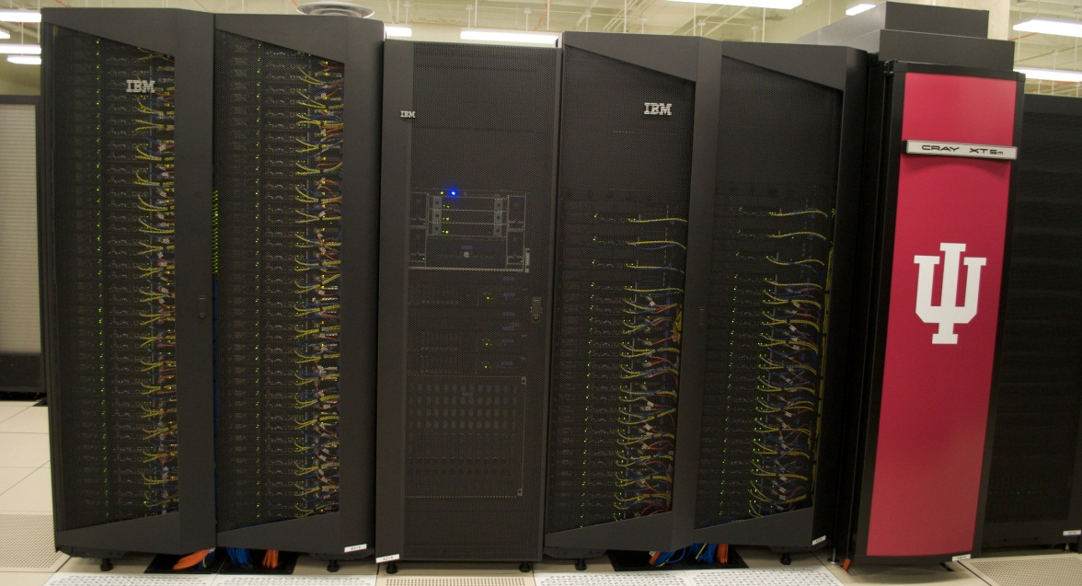
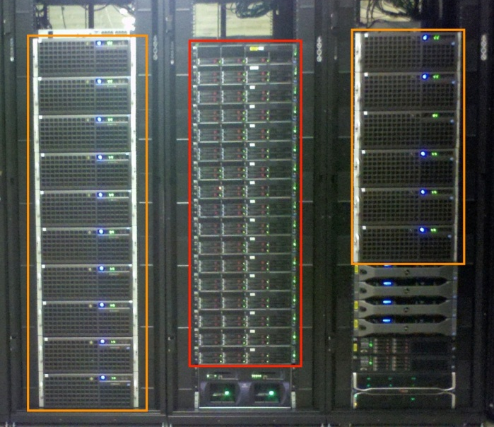
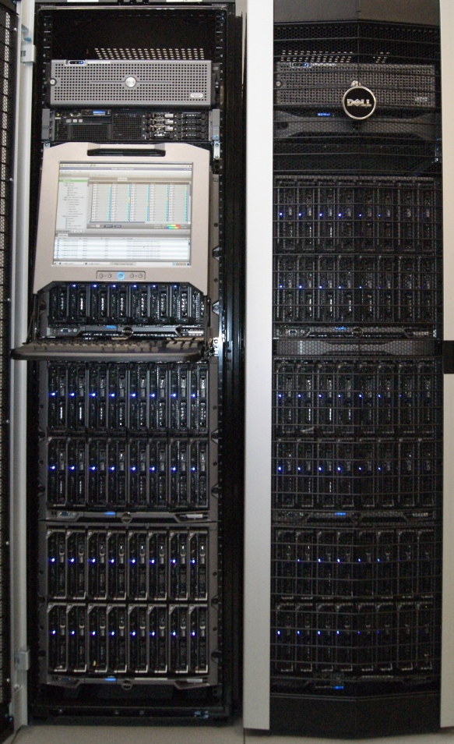
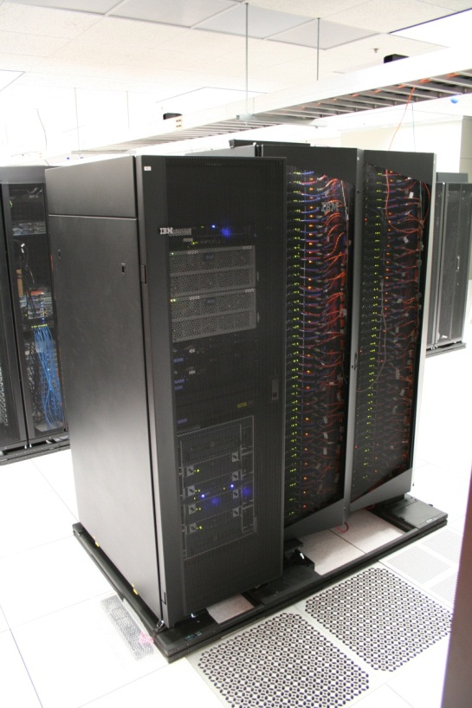
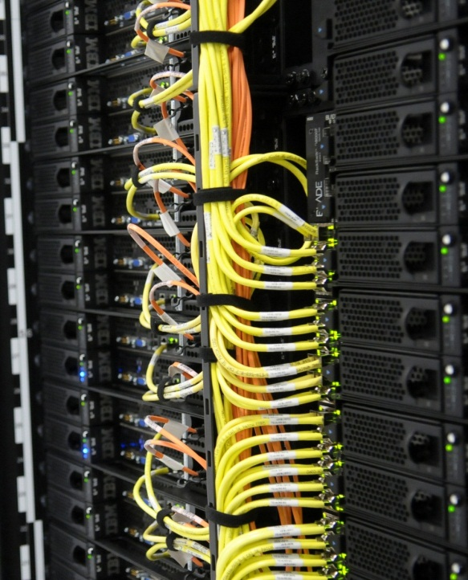
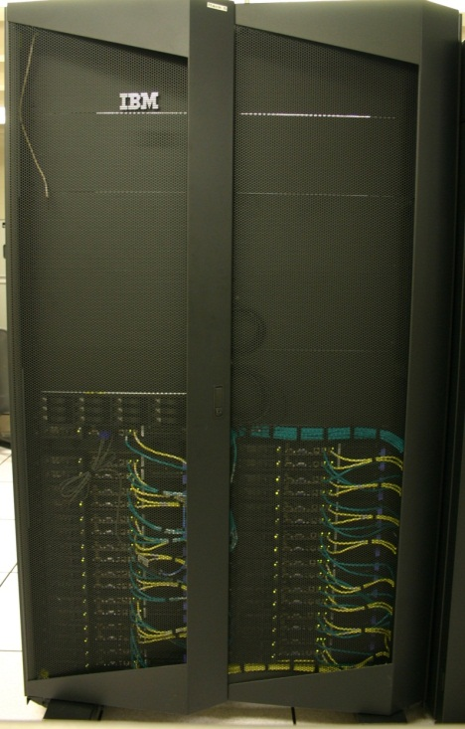
FutureGrid Distributed Testbed-aaS
Bravo Delta (IU)
India (IBM) and Xray (Cray) (IU)
Hotel (Chicago)
Foxtrot (UF)
Sierra (SDSC)
Alamo (TACC)

Slide 7
Compute Hardware
Name | System type | # CPUs | # Cores | TFLOPS | Total RAM (GB) | Secondary Storage (TB) | Site | Status
india | IBM iDataPlex | 256 | 1024 | 11 | 3072 | 180 | IU | Operational
alamo | Dell PowerEdge | 192 | 768 | 8 | 1152 | 30 | TACC | Operational
hotel | IBM iDataPlex | 168 | 672 | 7 | 2016 | 120 | UC | Operational
sierra | IBM iDataPlex | 168 | 672 | 7 | 2688 | 96 | SDSC | Operational
xray | Cray XT5m | 168 | 672 | 6 | 1344 | 180 | IU | Operational
foxtrot | IBM iDataPlex | 64 | 256 | 2 | 768 | 24 | UF | Operational
Bravo | Large Disk & memory | 32 | 128 | 1.5 | 3072 (192GB per node) | 192 (12 TB per Server) | IU | Operational
Delta | Large Disk & memory With Tesla GPU’s | 32 CPU 32 GPU’s | 192+ 14336 GPU | ? 9 | 1536 (192GB per node) | 192 (12 TB per Server) | IU | Operational
 |  |  | TOTAL Cores 4384
Echo (ScaleMP) | Large Disk & Memory | 32 CPU | 192 | 2 | 6144 | 192 | IU | On Order

Slide 8
Storage Hardware
System Type | Capacity (TB) | File System | Site | Status
Xanadu 360 | 180 | NFS | IU | New System
DDN 6620 | 120 | GPFS | UC | New System
SunFire x4170 | 96 | ZFS | SDSC | New System
Dell MD3000 | 30 | NFS | TACC | New System
IBM | 24 | NFS | UF | New System
Substantial back up storage at IU: Data Capacitor and HPSS
Support
Traditional Drupal Portal with usual functions
Traditional Ticket System
System Admin and User facing support (small)
Outreach group (small)
Strong Systems Admin Collaboration with Software group

Slide 9
4 Use Types for FutureGrid TestbedaaS
223 approved projects (968 users) July 14 2012
  USA, China, India, Pakistan, lots of European countries
  Industry, Government, Academia
Training Education and Outreach (10%)
  Semester and short events; interesting outreach to small universities
Computer science and Middleware (59%)
  Core CS and Cyberinfrastructure; Interoperability (2%) for Grids and Clouds; Open Grid Forum OGF Standards
Computer Systems Evaluation (29%)
  XSEDE (TIS, TAS), OSG, EGI; Campuses
New Domain Science applications (26%)
  Life science highlighted (14%), Non Life Science (12%)
  Generalize to building Research Computing-aaS
Fractions are as of July 15 2012 add to > 100%

Slide 10
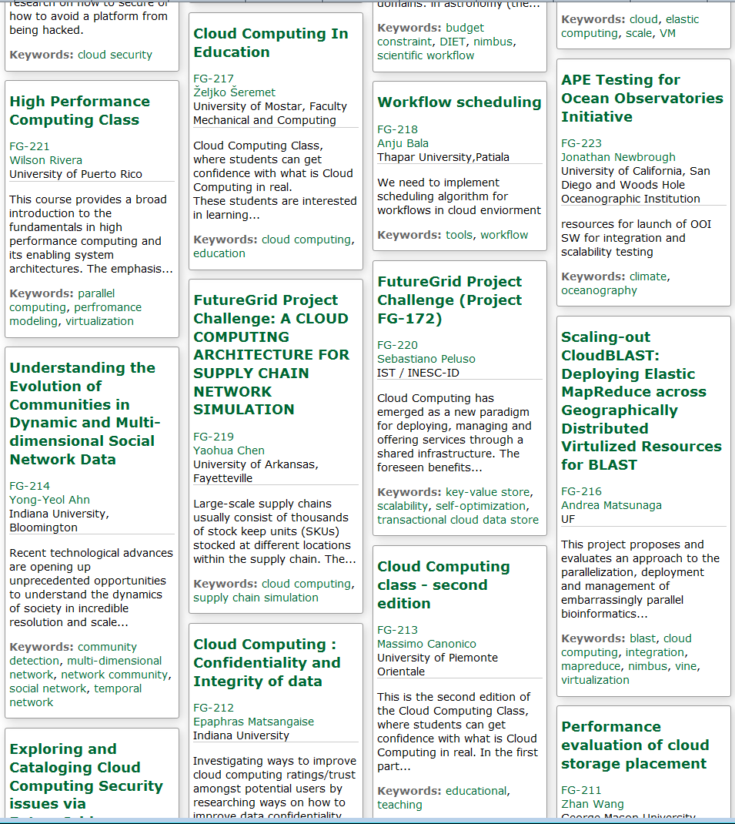
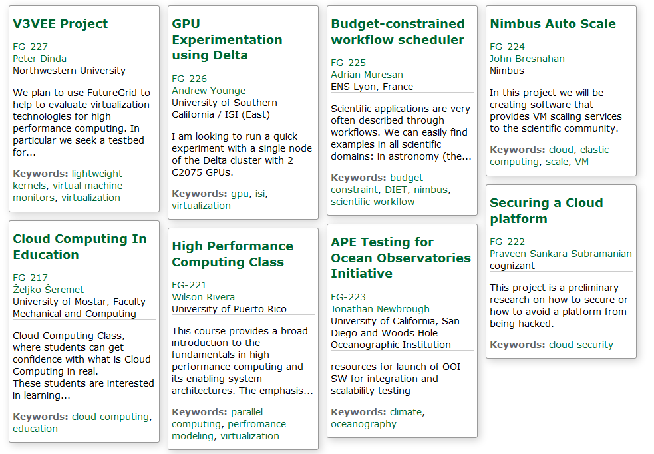
Recent Projects
Have Competitions
Last one just finished
Grand Prize
Trip to SC12
Next Competition starts
Beginning of August
for this Science Cloud Summer School

Slide 11
FutureGrid Supports
Education and Training
Jerome Mitchell HBCU Cloud View of Computing workshop June 2011
Cloud Summer School July 30—August 3 2012 with 10 HBCU attendees
Mitchell and Younge building “Cloud Computing Handbook” loosely based on my book with Hwang and Dongarra
Several classes around the world each semester
Possible Interaction with (200 team) Student Competition in China organized by Beihang Univ.

Slide 12
First FutureGrid Challenge Competition
Core Computer Science FG-172 Cloud-TM from Portugal: on distributed concurrency control (software transactional memory): "When Scalability Meets Consistency: Genuine Multiversion Update Serializable Partial Data Replication,“ 32nd International Conference on Distributed Computing Systems (ICDCS'12) (top conference) used 40 nodes of FutureGrid
Core Cyberinfrastructure FG-42,45 LSU/Rutgers: SAGA Pilot Job P* abstraction and applications. SAGA/BigJob use on clouds
Core Cyberinfrastructure FG-130 USC : Optimizing Scientific Workflows on Clouds. Scheduling Pegasus on distributed systems with overhead measured and reduced. Used Eucalyptus on FG.
Interesting application FG-133 from Univ. Arkansas: Supply Chain Network Simulator Using Cloud Computing with dynamic virtual machines supporting Monte Carlo simulation with Grid Appliance and Nimbus

Slide 13
FutureGrid Tutorials
Cloud Provisioning Platforms
Using Nimbus on FutureGrid [novice]
Nimbus One-click Cluster Guide
Using OpenStack Nova on FutureGrid Using Eucalyptus on FutureGrid [novice]
Connecting private network VMs across Nimbus clusters using ViNe [novice]
Using the Grid Appliance to run FutureGrid Cloud Clients [novice]
Cloud Run-time Platforms
Running Hadoop as a batch job using MyHadoop [novice]
Running SalsaHadoop (one-click Hadoop) on HPC environment [beginner]
Running Twister on HPC environment
Running SalsaHadoop on Eucalyptus
Running FG-Twister on Eucalyptus
Running One-click Hadoop WordCount on Eucalyptus [beginner]
Running One-click Twister K-means on Eucalyptus
Image Management and Rain
Using Image Management and Rain [novice]
Storage
Using HPSS from FutureGrid [novice]
Educational Grid Virtual Appliances
Running a Grid Appliance on your desktop
Running a Grid Appliance on FutureGrid
Running an OpenStack virtual appliance on FutureGrid
Running Condor tasks on the Grid Appliance
Running MPI tasks on the Grid Appliance
Running Hadoop tasks on the Grid Appliance
Deploying virtual private Grid Appliance clusters using Nimbus
Building an educational appliance from Ubuntu 10.04
Customizing and registering Grid Appliance images using Eucalyptus
High Performance Computing
Basic High Performance Computing
Running Hadoop as a batch job using MyHadoop
Performance Analysis with Vampir
Instrumentation and tracing with VampirTrace
Experiment Management
Running interactive experiments [novice]
Running workflow experiments using Pegasus
Pegasus 4.0 on FutureGrid Walkthrough [novice]
Pegasus 4.0 on FutureGrid Tutorial [intermediary]
Pegasus 4.0 on FutureGrid Virtual Cluster [advanced]

Slide 14
Selected List of Services Offered
FutureGrid
IaaS
Nimbus
Cloud PaaS
Hadoop
Twister
HDFS
Swift Object Store
MPI
TestbedaaS
FG RAIN
Portal
Inca
Eucalyptus
OpenStack
ViNE
HPCaaS
Ganglia
Devops
Exper. Manag./Pegasus
OpenMP
CUDA
GridaaS
Unicore
SAGA
Globus
Genesis II

Slide 15
Services Offered
 | India | Sierra | Hotel | Foxtrot | Alamo | Xray | Bravo | Delta | Echo
myHadoop | ✔ | ✔ |  |  | ✔
Nimbus |  | ✔ | ✔ | ✔ | ✔
OpenStack | ✔ |  |  |  |  |  |  | ✔
Eucalyptus | ✔ | ✔
ViNe¹ | ☑ | ✔ | ☑ | ✔ | ☑
Genesis II | ✔ | ✔ |  |  | ✔ | ✔
Unicore | ✔ | ✔ |  |  |  | ✔
MPI | ✔ | ✔ | ✔ | ✔ | ✔ | ✔ | ✔
OpenMP |  |  |  |  |  | ✔
ScaleMP | Old |  |  |  |  |  |  |  | ✔
Ganglia | ✔ |  | ✔
Pegasus³ | ☑ | ☑ | ☑ | ☑ | ☑
Inca | ✔ | ✔ | ✔ | ✔ | ✔ | ✔
Portal² | ☒ | ☒ | ☒ | ☒ | ☒ | ☒
PAPI |  |  |  |  |  | ✔
Globus |  |  |  |  | ✔
ViNe can be installed on the
other resources via Nimbus ☑
Access to the resource is requested through the portal ☒
Pegasus available via Nimbus and Eucalyptus images

Slide 16
FutureGrid Technology and Project Requests
Total Projects and Categories
Notes:
There is a bug in google charts that does not allow us to print this beyond June after new categories were introduced.
Fugang and I try to find a way to export the data and print otherwise.
took Fugang a long time to find out ☹

Slide 17
Software Components
Portals including “Support” “use FutureGrid” “Outreach”
Monitoring – INCA, Power (GreenIT)
Experiment Manager: specify/workflow
Image Generation and Repository
Intercloud Networking ViNE
Virtual Clusters built with virtual networks
Performance library
Rain or Runtime Adaptable InsertioN Service for images
Security Authentication, Authorization,
Note Software integrated across institutions and between middleware and systems Management (Google docs, Jira, Mediawiki)
Note many software groups are also FG users
“Research”
Above and below
Nimbus OpenStack Eucalyptus

Slide 18
FutureGrid offers
Computing Testbed as a Service
FutureGrid Uses
Testbed-aaS Tools
Provisioning
Image Management
IaaS Interoperability
IaaS tools
Expt management
Dynamic Network
Devops
Research
Computing
aaS
Custom Images
Courses
Consulting
Portals
Archival Storage
System e.g. SQL, GlobusOnline
Applications e.g. Amber, Blast
SaaS
FutureGrid Usages
Computer Science
Applications and understanding Science Clouds
Technology Evaluation including XSEDE testing
Education and Training
Cloud e.g. MapReduce
HPC e.g. PETSc, SAGA
Computer Science e.g. Languages, Sensor nets
PaaS
Hypervisor
Bare Metal
Operating System
Virtual Clusters, Networks
IaaS

Slide 19
Research Computing as a Service
Traditional Computer Center has a variety of capabilities supporting (scientific computing/scholarly research) users.
  Could also call this Computational Science as a Service
IaaS, PaaS and SaaS are lower level parts of these capabilities but commercial clouds do not include
  Developing roles/appliances for particular users
  Supplying custom SaaS aimed at user communities
  Community Portals
  Integration across disparate resources for data and compute (i.e. grids)
  Data transfer and network link services
  Archival storage, preservation, visualization
  Consulting on use of particular appliances and SaaS i.e. on particular software components
  Debugging and other problem solving
  Administrative issues such as (local) accounting
This allows us to develop a new model of a computer center where commercial companies operate base hardware/software
A combination of XSEDE, Internet2 and computer center supply 1) to 9)?

Slide 20
FG Challenge 2: A Competition for You
6 prizes of up to $500 awarded to best projects submitted in next 2 months
  Up to 3 prizes awarded for projects submitted by September 1
  Remaining prizes for projects submitted by October 1
Criteria include:
  Innovation, Scaling, Utility
  Quality of associated publications acknowledging FutureGrid
  Contributions to Education and Outreach
  International and/or Interdisciplinary Collaboration
If you are working in a global project like FG241, submit a request for your own project
You must email help@futuregrid.org when you want to submit project; indicate if this is a student project
Aim at least 4 out of 6 prizes go to students

Slide 21
Web Resources
Science Cloud Summer School 2012 website:
http://sciencecloudsummer2012.tumblr.com/
Science Cloud Summer School schedule:
http://sciencecloudsummer2012.tumblr.com/schedule
FG-241 Science Cloud Summer School 2012 project page:
https://portal.futuregrid.org/projects/241
Instructions for obtaining FutureGrid accounts for Science Cloud Summer School 2012:
https://portal.futuregrid.org/projects/241/register
Science Cloud Summer School 2012 Forum:
https://portal.futuregrid.org/forums/fg-class-and-tutorial-forums/summer-school-2012
Twitter hashtag: #ScienceCloudSummer

Slide 22
Many Thanks to
Funding Organizations: NSF, Lilly Foundation
VSCSE: Sharon Glotzer, Eric Hofer, Scott Lathrop, Meagan Lefebvre
Video Infrastructure: Mike Miller (NCSA), Chris Eller, Jeff Rogers
Organizers and AI’s at 10 sites
Speakers acknowledged as they are announced
IU Hospitality: Mary Nell Shiflet
Staff at FutureGrid: John Bresnahan, Ti Leggett, David Gignac, Gary Miksik, Barbara Ann O'Leary, Javier Diaz Montes, Sharif Islam, Koji Tanaka, Fugang Wang, Gregor von Laszewski
Many dedicated students

