Slide 1
FutureGrid Overview
July 15 2012
XSEDE UAB Meeting
Geoffrey Fox
gcf@indiana.edu
http://www.infomall.org https://portal.futuregrid.org
Director, Digital Science Center, Pervasive Technology Institute
Associate Dean for Research and Graduate Studies, School of Informatics and Computing
Indiana University Bloomington

Slide 2
FutureGrid key Concepts I
FutureGrid is an international testbed modeled on Grid5000
  July 15 2012: 223 Projects, ~968 users
Supporting international Computer Science and Computational Science research in cloud, grid and parallel computing (HPC)
The FutureGrid testbed provides to its users:
  A flexible development and testing platform for middleware and application users looking at interoperability, functionality, performance or evaluation
  FutureGrid is user-customizable, accessed interactively and supports Grid, Cloud and HPC software with and without VM’s
  A rich education and teaching platform for classes
See G. Fox, G. von Laszewski, J. Diaz, K. Keahey, J. Fortes, R. Figueiredo, S. Smallen, W. Smith, A. Grimshaw, FutureGrid - a reconfigurable testbed for Cloud, HPC and Grid Computing, Bookchapter – draft

Slide 3

FutureGrid key Concepts II
Rather than loading images onto VM’s, FutureGrid supports Cloud, Grid and Parallel computing environments by provisioning software as needed onto “bare-metal” using (changing) package of open source tools
  Image library for MPI, OpenMP, MapReduce (Hadoop, (Dryad), Twister), gLite, Unicore, Globus, Xen, ScaleMP (distributed Shared Memory), Nimbus, Eucalyptus, OpenNebula, KVM, Windows …..
  Either statically or dynamically
Growth comes from users depositing novel images in library
FutureGrid has ~4700 distributed cores with a dedicated network
Image1
Image2
…
ImageN
Choose
Load
Run

Slide 4
FutureGrid Partners
Indiana University (Architecture, core software, Support)
San Diego Supercomputer Center at University of California San Diego (INCA, Monitoring)
University of Chicago/Argonne National Labs (Nimbus)
University of Florida (ViNE, Education and Outreach)
University of Southern California Information Sciences (Pegasus to manage experiments)
University of Tennessee Knoxville (Benchmarking)
University of Texas at Austin/Texas Advanced Computing Center (Portal)
University of Virginia (OGF, XSEDE Software stack)
Center for Information Services and GWT-TUD from Technische Universtität Dresden. (VAMPIR)
Red institutions have FutureGrid hardware

Slide 5

FutureGrid: a Grid/Cloud/HPC Testbed
12TF Disk rich + GPU 512 cores
NID: Network Impairment Device
Private
Public
FG Network

Slide 6
Compute Hardware
Name | System type | # CPUs | # Cores | TFLOPS | Total RAM (GB) | Secondary Storage (TB) | Site | Status
india | IBM iDataPlex | 256 | 1024 | 11 | 3072 | 180 | IU | Operational
alamo | Dell PowerEdge | 192 | 768 | 8 | 1152 | 30 | TACC | Operational
hotel | IBM iDataPlex | 168 | 672 | 7 | 2016 | 120 | UC | Operational
sierra | IBM iDataPlex | 168 | 672 | 7 | 2688 | 96 | SDSC | Operational
xray | Cray XT5m | 168 | 672 | 6 | 1344 | 180 | IU | Operational
foxtrot | IBM iDataPlex | 64 | 256 | 2 | 768 | 24 | UF | Operational
Bravo | Large Disk & memory | 32 | 128 | 1.5 | 3072 (192GB per node) | 192 (12 TB per Server) | IU | Operational
Delta | Large Disk & memory With Tesla GPU’s | 32 CPU 32 GPU’s | 192+ 14336 GPU | ? 9 | 1536 (192GB per node) | 192 (12 TB per Server) | IU | Operational
 |  |  | TOTAL Cores 4384
Echo (ScaleMP) | Large Disk & Memory | 32 CPU | 192 | 2 | 6144 | 192 | IU | On Order

Slide 7
Storage Hardware
System Type | Capacity (TB) | File System | Site | Status
Xanadu 360 | 180 | NFS | IU | New System
DDN 6620 | 120 | GPFS | UC | New System
SunFire x4170 | 96 | ZFS | SDSC | New System
Dell MD3000 | 30 | NFS | TACC | New System
IBM | 24 | NFS | UF | New System
Substantial back up storage at IU: Data Capacitor and HPSS
Support
Traditional Drupal Portal with usual functions
Traditional Ticket System
System Admin and User facing support (small)
Outreach group (small)
Strong Systems Admin Collaboration with Software group

Slide 8
5 Use Types for FutureGrid (red latest)
223 approved projects (968 users) July 14 2012
  USA, China, India, Pakistan, lots of European countries
  Industry, Government, Academia
Training Education and Outreach (8%)(10%)
  Semester and short events; interesting outreach to HBCU
Interoperability test-beds (3%)(2%)
  Grids and Clouds; Standards; from Open Grid Forum OGF
Domain Science applications (31%)(26%)
  Life science highlighted (18%)(14%), Non Life Science (13%)(12%)
Computer science (47%)(57%)
  Largest current category
Computer Systems Evaluation (27%)(29%)
  XSEDE (TIS, TAS), OSG, EGI
  See Andrew Grimshaw’s discussion of XSEDE testing in Book Chapter

Slide 9
Some Training Education and Outreach Project Highlights
See summary in Jerome Mitchell’s XSEDE12 paper and Renato Figueiredo’s BOF Tuesday
Cloud Summer School July 30—August 3 with 10 HBCU attendees
Mitchell and Younge building “Cloud Computing Handbook” loosely based on my book with Hwang and Dongarra
Several classes around the world each semester
Possible Interaction with (200 team) Student Competition in China organized by Beihang Univ.

Slide 10
FutureGrid Challenge Competition
Core Computer Science FG-172 Cloud-TM from Portugal: on distributed concurrency control (software transactional memory): "When Scalability Meets Consistency: Genuine Multiversion Update Serializable Partial Data Replication,“ 32nd International Conference on Distributed Computing Systems (ICDCS'12) (top conference) used 40 nodes of FutureGrid
Core Cyberinfrastructure FG-42,45 LSU/Rutgers: SAGA Pilot Job P* abstraction and applications. SAGA/BigJob use on clouds
Core Cyberinfrastructure FG-130: Optimizing Scientific Workflows on Clouds. Scheduling Pegasus on distributed systems with overhead measured and reduced. Used Eucalyptus on FutureGrid
Interesting application FG-133 from Univ. Arkansas: Supply Chain Network Simulator Using Cloud Computing with dynamic virtual machines supporting Monte Carlo simulation with Grid Appliance and Nimbus

Slide 11
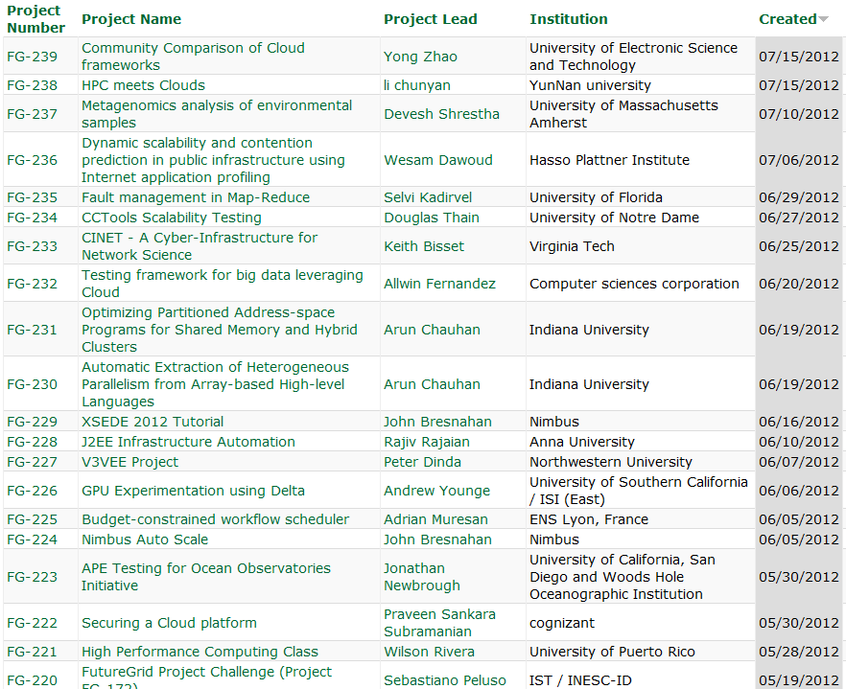
  https://portal.futuregrid.org/projects

Slide 12
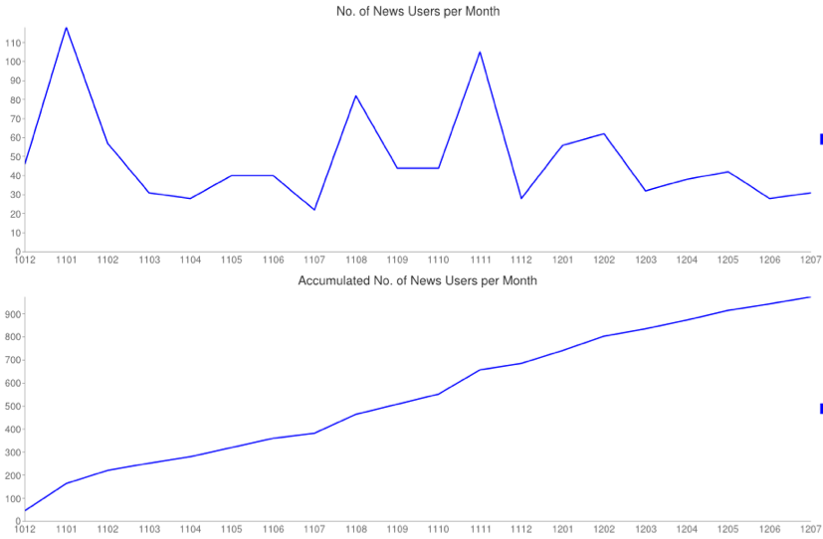
New users per month
0.5 Month
XSEDE
Tutorial
New Courses
SC11 Tutorial
Cumulative
Notes:
Combines last two slides in one slide

Slide 13
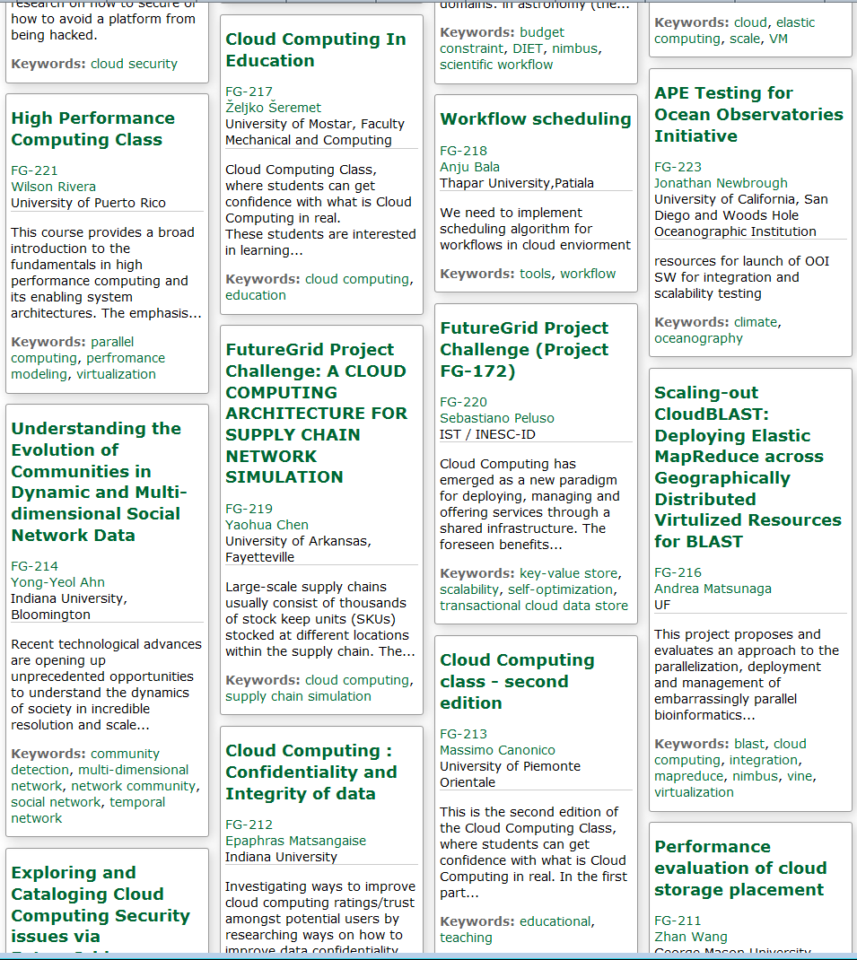
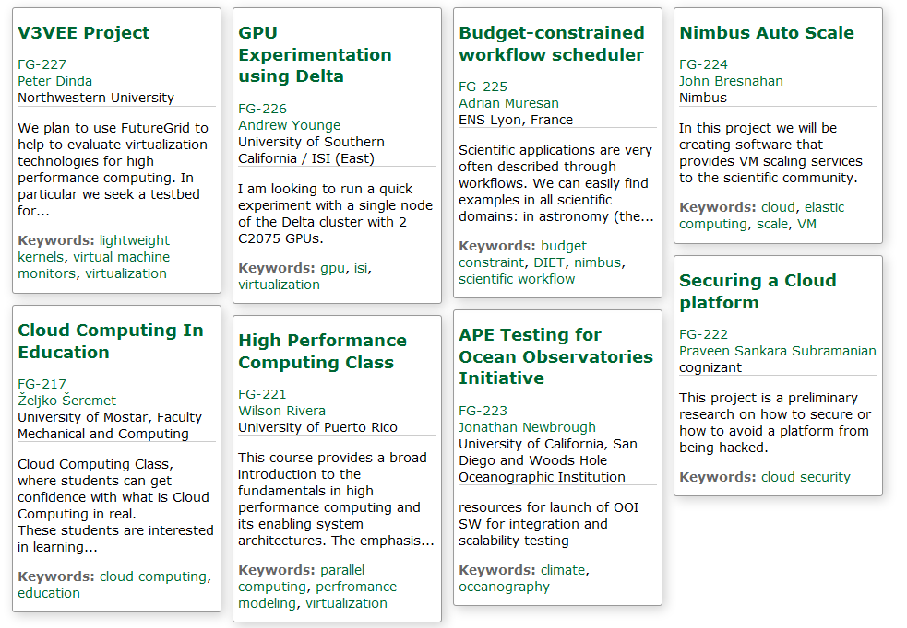
Recent Projects
Have Competitions
Last one just finished
Grand Prize
Trip to SC12
Next Competition
Beginning of August
For our Science Cloud Summer School

Slide 14
FutureGrid Tutorials
Cloud Provisioning Platforms
Using Nimbus on FutureGrid [novice]
Nimbus One-click Cluster Guide
Using OpenStack Nova on FutureGrid Using Eucalyptus on FutureGrid [novice]
Connecting private network VMs across Nimbus clusters using ViNe [novice]
Using the Grid Appliance to run FutureGrid Cloud Clients [novice]
Cloud Run-time Platforms
Running Hadoop as a batch job using MyHadoop [novice]
Running SalsaHadoop (one-click Hadoop) on HPC environment [beginner]
Running Twister on HPC environment
Running SalsaHadoop on Eucalyptus
Running FG-Twister on Eucalyptus
Running One-click Hadoop WordCount on Eucalyptus [beginner]
Running One-click Twister K-means on Eucalyptus
Image Management and Rain
Using Image Management and Rain [novice]
Storage
Using HPSS from FutureGrid [novice]
Educational Grid Virtual Appliances
Running a Grid Appliance on your desktop
Running a Grid Appliance on FutureGrid
Running an OpenStack virtual appliance on FutureGrid
Running Condor tasks on the Grid Appliance
Running MPI tasks on the Grid Appliance
Running Hadoop tasks on the Grid Appliance
Deploying virtual private Grid Appliance clusters using Nimbus
Building an educational appliance from Ubuntu 10.04
Customizing and registering Grid Appliance images using Eucalyptus
High Performance Computing
Basic High Performance Computing
Running Hadoop as a batch job using MyHadoop
Performance Analysis with Vampir
Instrumentation and tracing with VampirTrace
Experiment Management
Running interactive experiments [novice]
Running workflow experiments using Pegasus
Pegasus 4.0 on FutureGrid Walkthrough [novice]
Pegasus 4.0 on FutureGrid Tutorial [intermediary]
Pegasus 4.0 on FutureGrid Virtual Cluster [advanced]

Slide 15
Portal Page Hits
Not even
Installed on
FutureGrid

Slide 16
Selected List of Services Offered
FutureGrid
IaaS
Nimbus
Cloud PaaS
Hadoop
Twister
HDFS
Swift Object Store
MPI
TestbedaaS
FG RAIN
Portal
Inca
Eucalyptus
OpenStack
ViNE
HPCaaS
Ganglia
Devops
Exper. Manag./Pegasus
OpenMP
CUDA
GridaaS
Unicore
SAGA
Globus
Genesis II

Slide 17
Services Offered
 | India | Sierra | Hotel | Foxtrot | Alamo | Xray | Bravo | Delta | Echo
myHadoop | ✔ | ✔ |  |  | ✔
Nimbus |  | ✔ | ✔ | ✔ | ✔
OpenStack | ✔ |  |  |  |  |  |  | ✔
Eucalyptus | ✔ | ✔
ViNe¹ | ☑ | ✔ | ☑ | ✔ | ☑
Genesis II | ✔ | ✔ |  |  | ✔ | ✔
Unicore | ✔ | ✔ |  |  |  | ✔
MPI | ✔ | ✔ | ✔ | ✔ | ✔ | ✔ | ✔
OpenMP |  |  |  |  |  | ✔
ScaleMP | Old |  |  |  |  |  |  |  | ✔
Ganglia | ✔ |  | ✔
Pegasus³ | ☑ | ☑ | ☑ | ☑ | ☑
Inca | ✔ | ✔ | ✔ | ✔ | ✔ | ✔
Portal² | ☒ | ☒ | ☒ | ☒ | ☒ | ☒
PAPI |  |  |  |  |  | ✔
Globus |  |  |  |  | ✔
ViNe can be installed on the
other resources via Nimbus ☑
Access to the resource is requested through the portal ☒
Pegasus available via Nimbus and Eucalyptus images

Slide 18
FutureGrid Technology and Project Requests
Total Projects and Categories
Notes:
There is a bug in google charts that does not allow us to print this beyond June after new categories were introduced.
Fugang and I try to find a way to export the data and print otherwise.
took Fugang a long time to find out ☹

Slide 19
Software Components
Portals including “Support” “use FutureGrid” “Outreach”
Monitoring – INCA, Power (GreenIT)
Experiment Manager: specify/workflow
Image Generation and Repository
Intercloud Networking ViNE
Virtual Clusters built with virtual networks
Performance library
Rain or Runtime Adaptable InsertioN Service for images
Security Authentication, Authorization,
Note Software integrated across institutions and between middleware and systems Management (Google docs, Jira, Mediawiki)
Note many software groups are also FG users
“Research”
Above and below
Nimbus OpenStack Eucalyptus

Slide 20
New Developments
Eucalyptus 3.0
  First academic cloud to have access to it and installed it
  Presentation at User Group meeting well received
OpenStack
  Update to Essex
  Problems with our network hardware
  We need new switches
FG Cloud Metric Dashboard
  Display details of the usage of IaaS frameworks: Reduced millions of Log entries to tens of thousands of instance traces

Slide 21

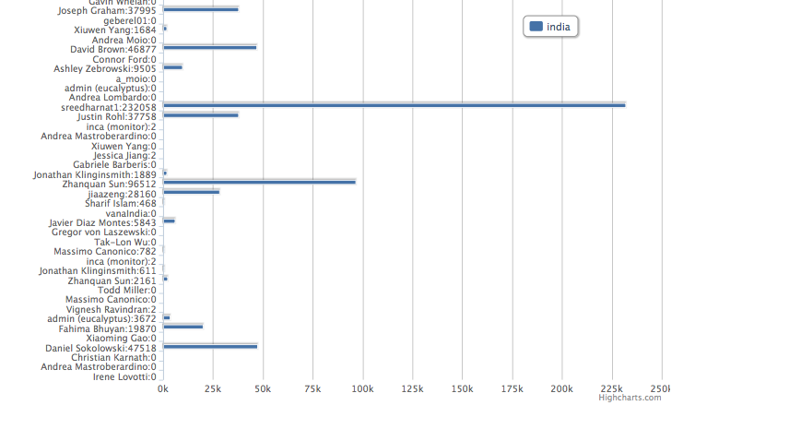
May 2012 Preliminary
Runtime Consumed
Core Minutes

Slide 22
Image Management and RAIN
RAIN manages tools to dynamically provide custom HPC environment, Cloud environment, or virtual networks on-demand
Bare Metal, Eucalyptus, OpenStack, TODO: Nimbus, OpenNebula, Amazon, Azure, Google IaaS Interoperability
Collaboration between Systems and Software groups
Several recent papers
von Laszewski, G., J. Diaz, F. Wang, and G. Fox, Comparison of Multiple Cloud Frameworks, IEEE Cloud 2012, 06/2012
Diaz, J., G. von Laszewski, F. Wang, and G. Fox, Abstract Image Management and Universal Image Registration for Cloud and HPC Infrastructures, IEEE Cloud 2012, 06/2012
Gregor von Laszewski, Hyungro Lee, Javier Diaz, Fugang Wang, Koji Tanaka, Shubhada Karavinkoppa, Geoffrey C. Fox, Tom Furlani, Design of a Dynamic Provisioning System for a Federated Cloud and Bare-metal Environment (under preparation, draft available)

Slide 23
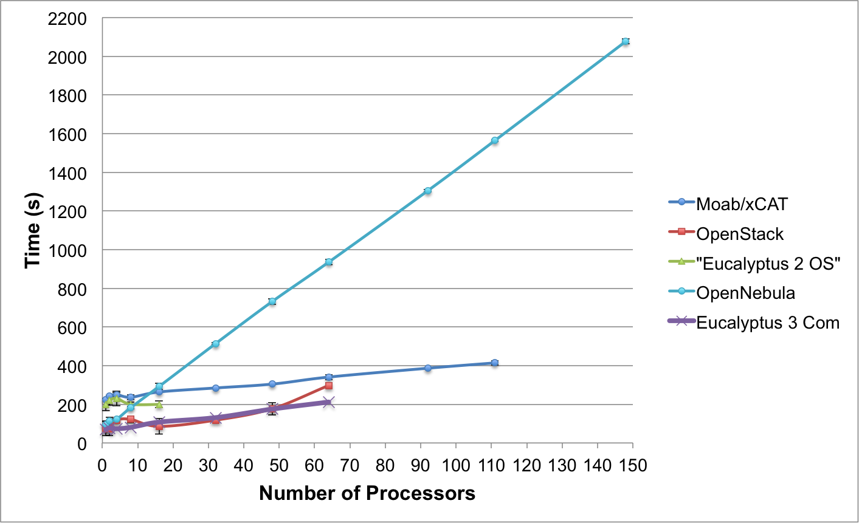
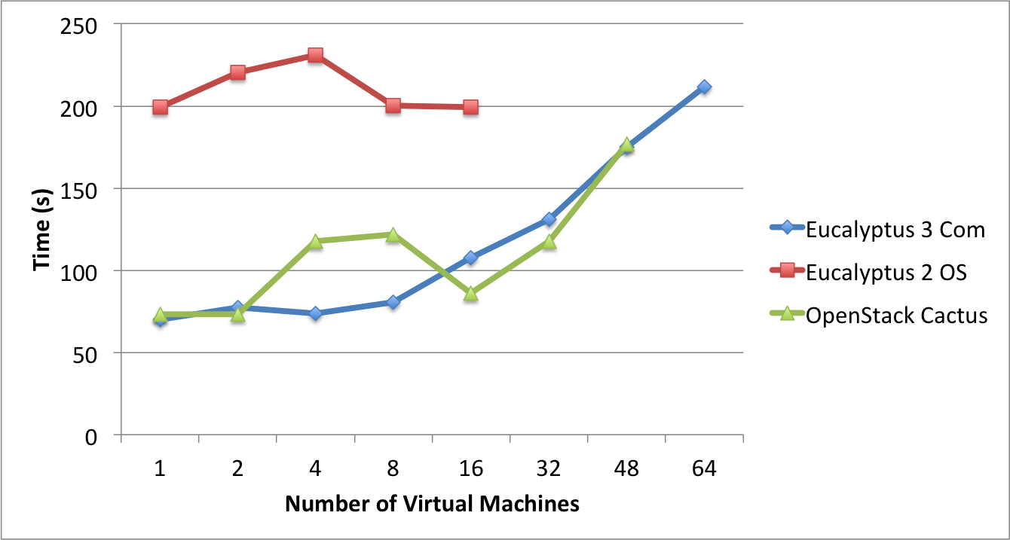
Templated(Abstract) Dynamic Provisioning
Abstract Specification of image mapped to various HPC and Cloud environments
OpenNebula
Parallel provisioning now supported
Moab/xCAT HPC – high as need reboot before use
Essex replaces Cactus
Current Eucalyptus 3 commercial while version 2 Open Source

Slide 24
Possible FutureGrid Futures
Official End Date September 30 2013
FutureGrid is a Testbed – it is not (just) a Science Cloud
  Technology Evaluation, Education and training, Cyberinfrastructure/Computer Science more important than expected
However it is a very good place to learn how to support a Science Cloud -- develop “Computational Science as a service” whether hosted commercially or academically
  Good commercial links
Now modus operandi and core software well understood, can explore “Federating other sites in FutureGrid umbrella”
  US Europe China interest
  Need resource to explore larger scaling experiments (e.g. for MapReduce)
Very little support funded in current FG but clear opportunity
Experimental hosting of SaaS based environments
New user mode? Join existing project to learn about its technology
  Open IaaS, MapReduce, MPI … projects as EOT offering

Slide 25
Computational Science as a Service
Traditional Computer Center has a variety of capabilities supporting (scientific computing/scholarly research) users.
  Lets call this Computational Science as a Service
IaaS, PaaS and SaaS are lower level parts of these capabilities but commercial clouds do not include
  Developing roles/appliances for particular users
  Supplying custom SaaS aimed at user communities
  Community Portals
  Integration across disparate resources for data and compute (i.e. grids)
  Consulting on use of particular appliances and SaaS i.e. on particular software components
  Debugging and other problem solving
  Data transfer and network link services
  Archival storage
  Administrative issues such as (local) accounting
This allows us to develop a new model of a computer center where commercial companies operate base hardware/software
A combination of XSEDE, Internet2 (USA) and computer center supply 1) to 9)

Slide 26
Using Science Clouds in a Nutshell
High Throughput Computing; pleasingly parallel; grid applications
Multiple users (long tail of science) and usages (parameter searches)
Internet of Things (Sensor nets) as in cloud support of smart phones
(Iterative) MapReduce including “most” data analysis
Exploiting elasticity and platforms (HDFS, Object Stores, Queues ..)
Use worker roles, services, portals (gateways) and workflow
Good Strategies:
  Build the application as a service;
  Build on existing cloud deployments such as Hadoop;
  Use PaaS if possible;
  Design for failure;
  Use as a Service (e.g. SQLaaS) where possible;
  Address Challenge of Moving Data
See Fox+Gannon Cloud Programming Paradigms for Technical Computing Applications

