Slide 1
Overview of the FG Software
Gregor von Laszewski

Slide 2
What to do on FG?
Find out what it can do.
Get access.
  Manage a project
Use deployed software and services.
Provision/deploy your own software and services.
Share results, images, software, services, …
Run repeatable experiments

Slide 3
Answers
This talk will provide answers to the questions.
We like also to engage with you in discussions on driving the development
We would find it great if some of you join development efforts
E.g. OCCI on FG would be great …

Slide 4
Overview of Existing Services
Gregor von Laszewski
laszewski@gmail.com
(15 min)

Slide 5
Categories
PaaS: Platform as a Service
  Delivery of a computing platform and solution stack
IaaS: Infrastructure as a Service
  Deliver a compute infrastructure as a service
Grid:
  Deliver services to support the creation of virtual organizations contributing resources
HPCC: High Performance Computing Cluster
  Traditional high performance computing cluster environment
Other Services
  Other services useful for the users as part of the FG service offerings

Slide 6

Selected List of Services Offered
FutureGrid
User
IaaS
Nimbus
PaaS
Hadoop
(Twister)
(Sphere/Sector)
MPI
Others
Portal
Inca
Eucalyptus
ViNE
(OpenStack)
(OpenNebula)
HPCC
Ganglia
(Exper. Manag./(Pegasus
(Rain)
OpenMP
ScaleMP
(XD Stack)
Grid
(Globus)
Unicore
SAGA
Genesis II
(will be added in future)

Slide 7
Services Offered
 | India | Sierra | Hotel | Foxtrot | Alamo | Xray | Bravo
myHadoop | ✔ | ✔ |  |  | ✔
Nimbus |  | ✔ | ✔ | ✔ | ✔
Eucalyptus | ✔ | ✔
ViNe¹ | ☑ | ✔ | ☑ | ✔ | ☑
Genesis II | ✔ | ✔ |  |  | ✔ | ✔
Unicore | ✔ | ✔ |  |  |  | ✔
MPI | ✔ | ✔ | ✔ | ✔ | ✔ | ✔ | ✔
OpenMP |  |  |  |  |  | ✔
ScaleMP | ✔
Ganglia | ✔ |  | ✔
Pegasus³ | ☑ | ☑ | ☑ | ☑ | ☑
Inca | ✔ | ✔ | ✔ | ✔ | ✔ | ✔
Portal² | ☒ | ☒ | ☒ | ☒ | ☒ | ☒
PAPI |  |  |  |  |  | ✔
Vampir
ViNe can be installed on the
other resources via Nimbus ☑
Access to the resource is requested through the portal ☒
Pegasus available via Nimbus and Eucalyptus images

Slide 8
Which Services should we install?
We look at statistics on what users request
We look at interesting projects as part of the project description
We look for projects which we intend to integrate with: e.g. XD TAS, XD XSEDE
We leverage experience and comments from the community

Slide 9
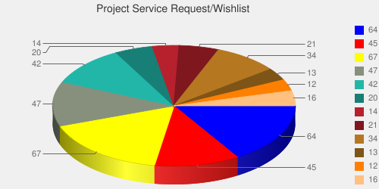
User demand influences service deployment
Based on User input we focused on
  Nimbus (53%)
  Eucalyptus (51%)
  Hadoop (37%)
  HPC (36%)
Eucalyptus: 64(50.8%)
High Performance Computing Environment: 45(35.7%)
Nimbus: 67(53.2%)
Hadoop: 47(37.3%)
MapReduce: 42(33.3%)
Twister: 20(15.9%)
OpenNebula: 14(11.1%)
Genesis II: 21(16.7%)
Common TeraGrid Software Stack: 34(27%)
Unicore 6: 13(10.3%)
gLite: 12(9.5%)
OpenStack: 16(12.7%)
* Note: We will improve the way we gather statistics in order to avoid inaccuracy during the information gathering at project and user registration time.

Slide 10
Software Architecture

Slide 11
Software Architecture

Slide 12
Next we present selected Services
☒
☒
☒
☒
☒
☒
☒
☒
☒
☒
☒

Slide 13
Portal
Gregor von Laszewski
http://futuregrid.org

Slide 14
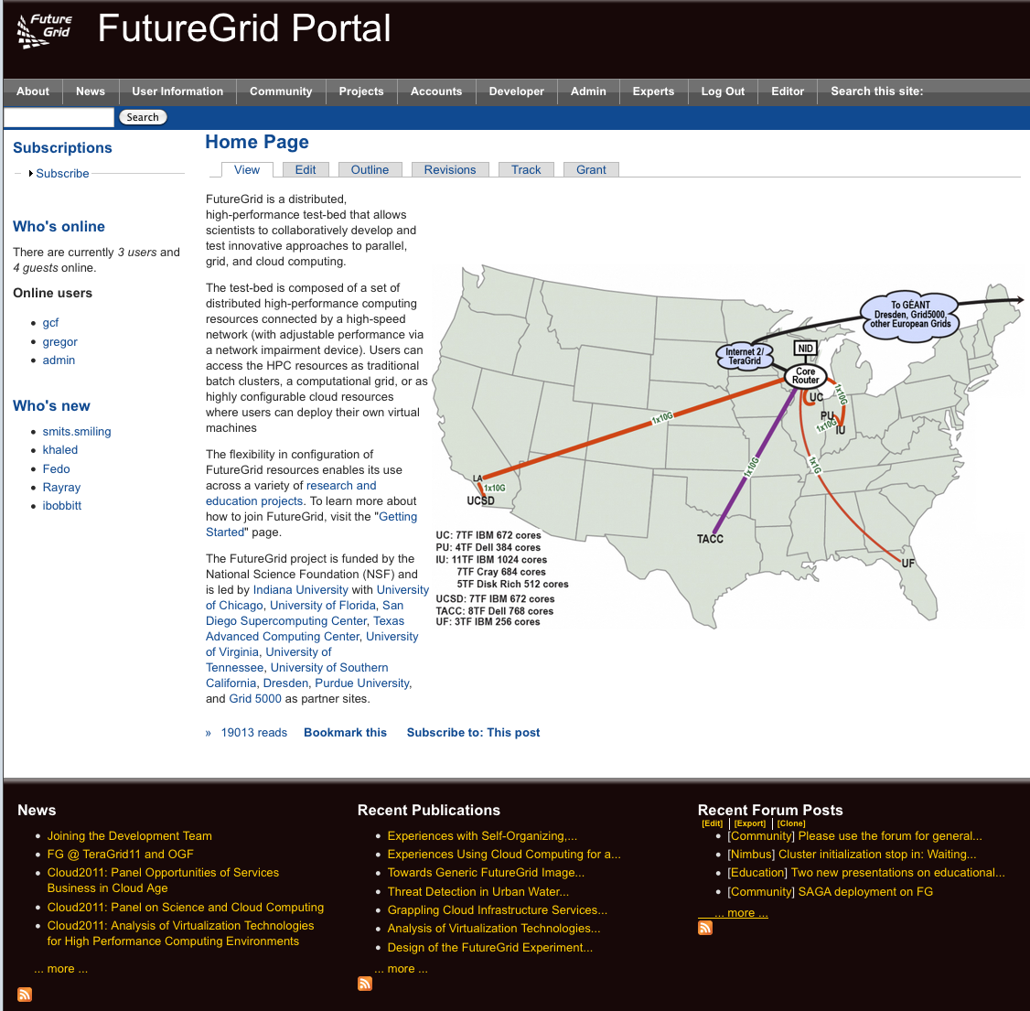
FG Portal
Coordination of Projects and users
  Project management
    Membership
    Results
  User Management
    Contact Information
    Keys, OpenID
Coordination of Information
  Manuals, tutorials, FAQ, Help
  Status
    Resources, outages, usage, …
Coordination of the Community
  Information exchange: Forum, comments, community pages
  Feedback: rating, polls
Focus on support of additional FG processes through the Portal

Slide 15
Portal Subsystem
http://futuregrid.org

Slide 16
Portal provides access to Information Services
  What is happening on the system?
    System administrator
    User
    Project Management & Funding agency
  Remember FG is not just an HPC queue!
    Which software is used?
    Which images are used?
    Which FG services are used (Nimbus, Eucalyptus, …?)
    Is the performance we expect reached?
    What happens on the network
http://futuregrid.org

Slide 17
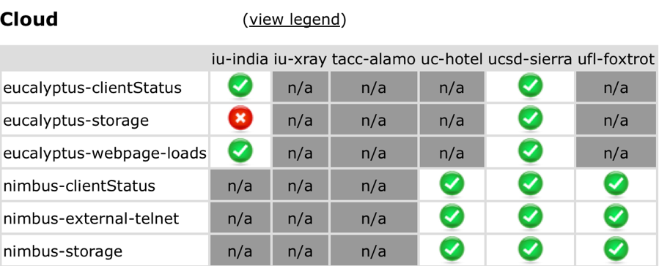
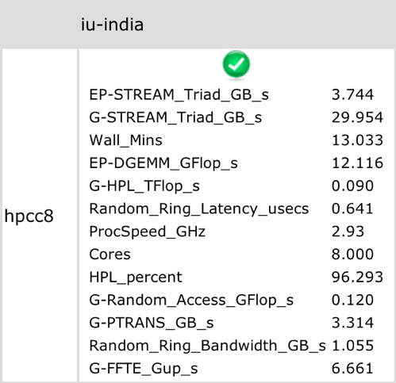
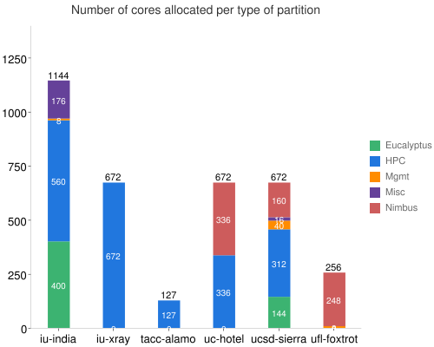
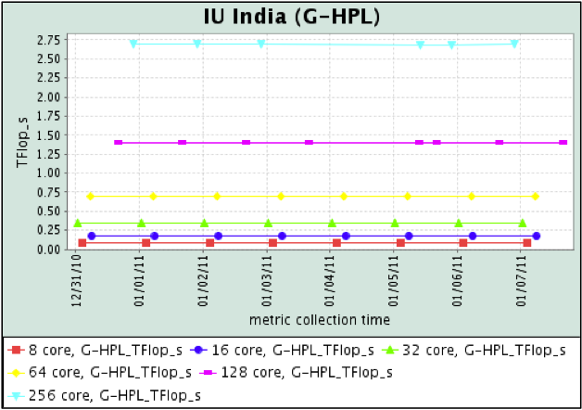
https://portal.futuregrid.org/status
Statistics displayed from HPCC performance measurement
Status of cloud services
History of HPCC performance
Information on machine partitioning

Slide 18
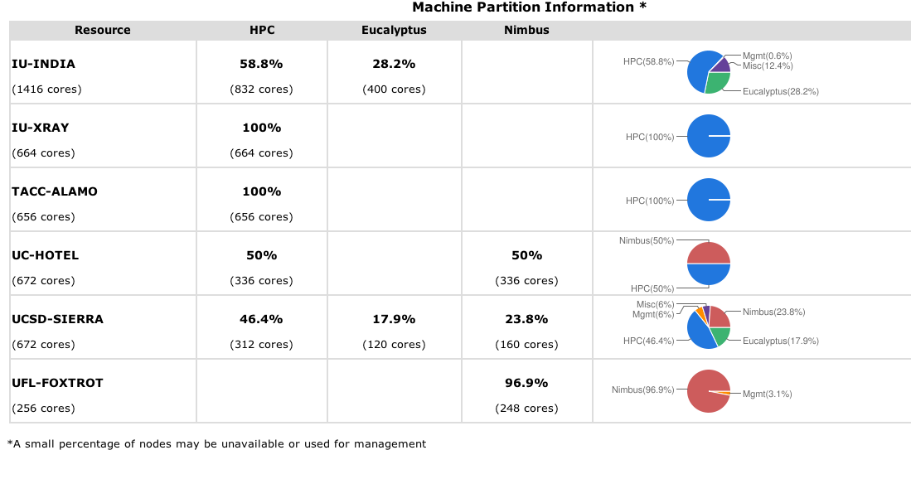
Simple Overview
http://futuregrid.org

Slide 19
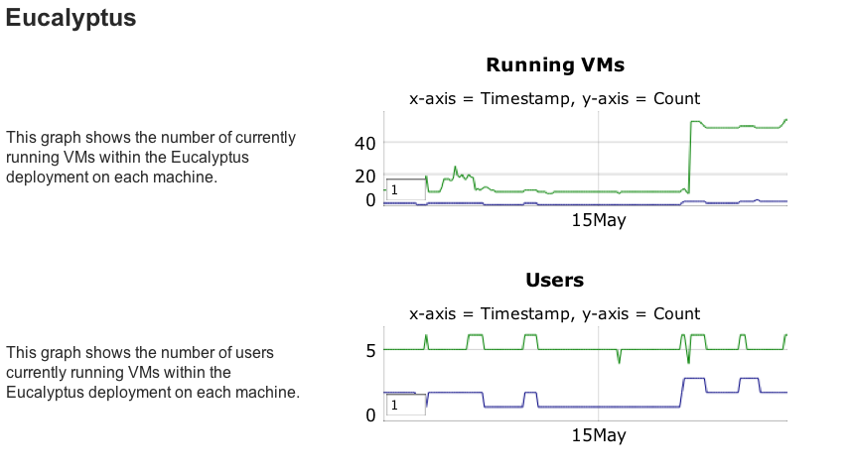
Eucalyptus Monitoring

Slide 20
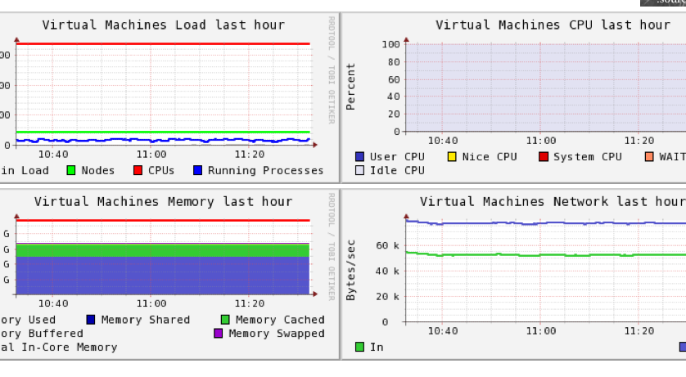
Ganglia
On India, Sierra

Slide 21
Getting Access to FutureGrid
Gregor von Laszewski

Slide 22
Portal Account,
Projects, and System Accounts
The main entry point to get access to the systems and services is the FutureGrid Portal.
We distinguish the portal account from system and service accounts.
  We have multiple system accounts and may have to apply for them separately, e.g. Eucalyptus, Nimbus
  Why several accounts:
    Some services may not be important for you, so you will not need an account for all of them.
      In future we may change this and have only one application step for all system services.
    Some services may not be easily integratable in a general authentication framework
    It is a testbed, separating accounts may be part of your research.

Slide 23
Get access
Project Lead
Project Member
Create a portal account
Create a project
Add project members
Create a portal account
Ask your project lead to add you to the project
Once the project you participate in is approved
Apply for an HPC & Nimbus account
  You will need an ssh key
Apply for a Eucalyptus Account

Slide 24
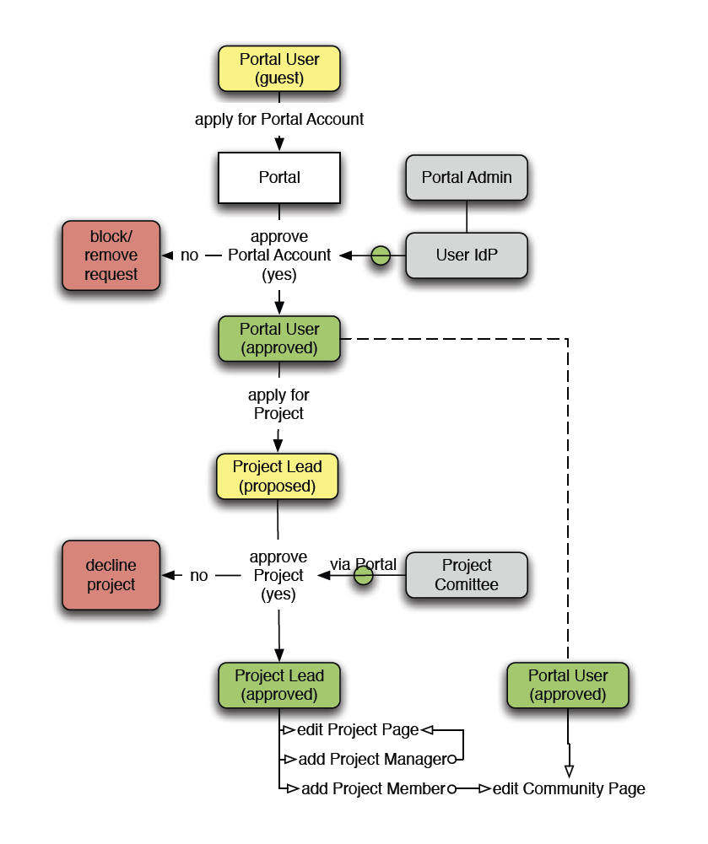
The Process: A new Project
(1) get a portal account
  portal account is approved
(2) propose a project
  project is approved
(3) ask your partners for their portal account names and add them to your projects as members
  No further approval needed
(4) if you need an additional person being able to add members designate him as project manager (currently there can only be one).
  No further approval needed
You are in charge who is added or not!
  Similar model as in Web 2.0 Cloud services, e.g. sourceforge
(1)
(2)
(4)
(3)

Slide 25
The Process: Join A Project
(1) get a portal account
  portal account is approved
Skip steps (2) – (4)
(2u) Communicate with your project lead which project to join and give him your portal account name
Next step done by project lead
  (3) The project lead will add you to the project
You are responsible to make sure the project lead adds you!
  Similar model as in Web 2.0 Cloud services, e.g. sourceforge
(1)
(2u)
(3)

Slide 26
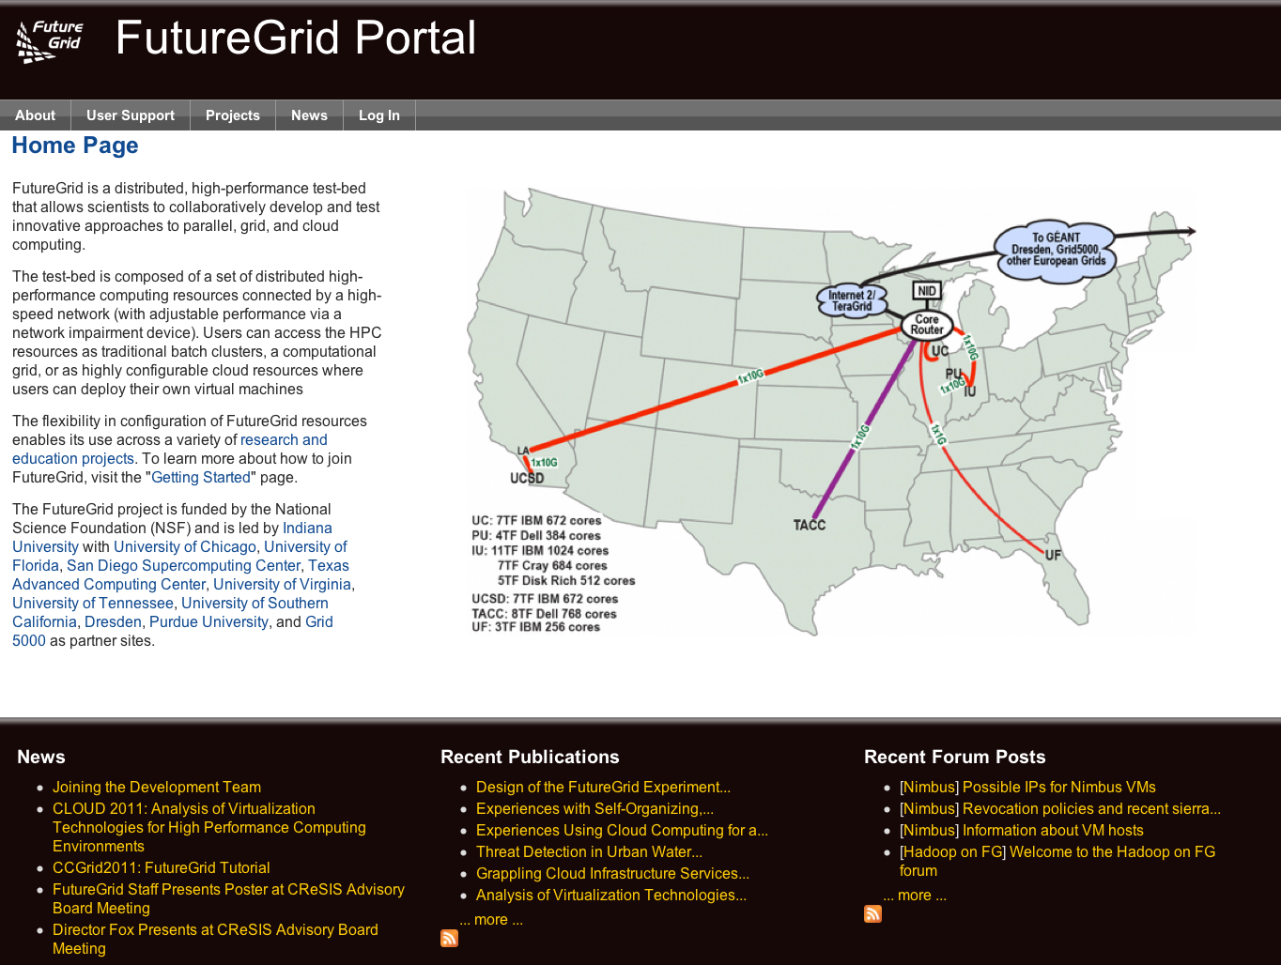
Apply for a Portal Account

Slide 27
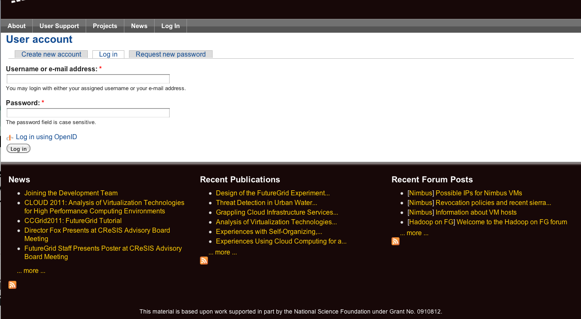
Apply for a Portal Account

Slide 28
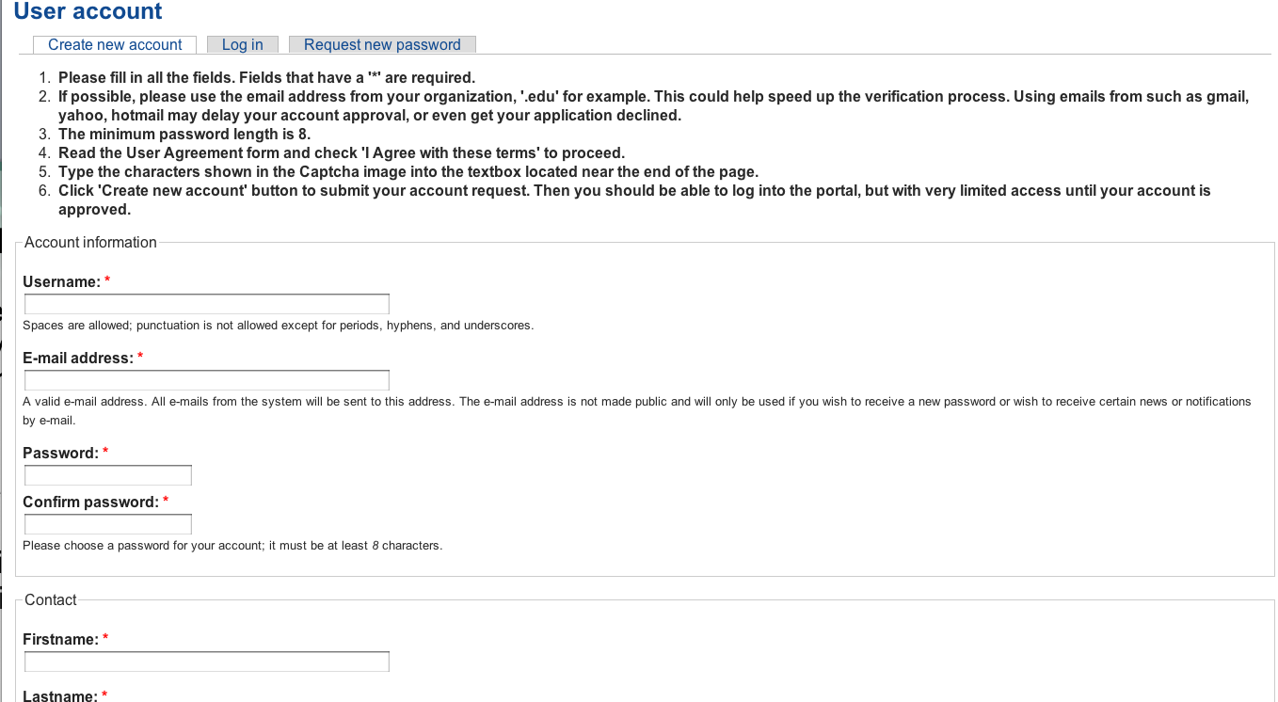
Apply for a Portal Account
Please Fill Out.
Use proper capitalization
Use e-mail from your organization
(yahoo,gmail, hotmail, … emails may result in rejection of your account request)
Chose a strong password

Slide 29
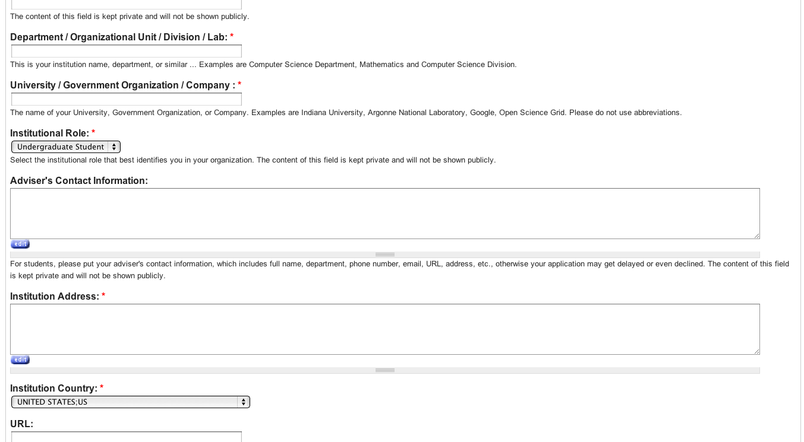
Apply for a Portal Account
Please Fill Out.
Use proper department and university
Specify advisor or supervisors contact
Use the postal address, use proper capitalization

Slide 30
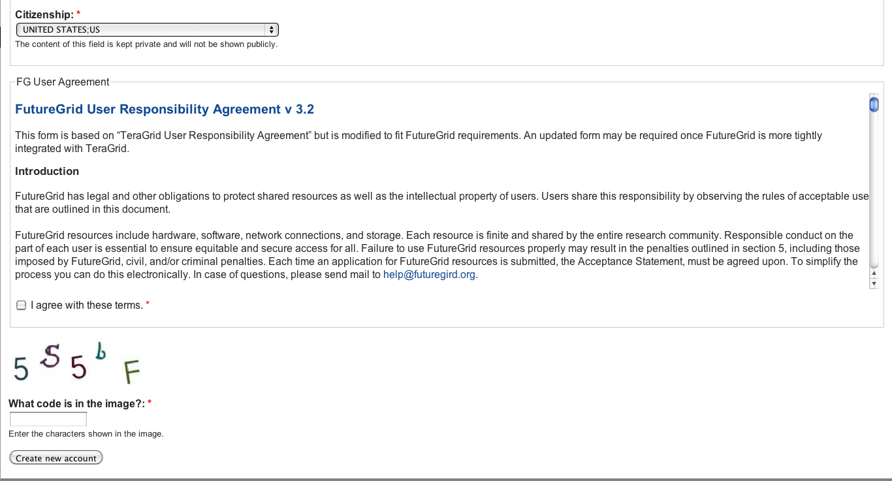
Apply for a Portal Account
Please Fill Out.
Report your citizenship
READ THE RESPONSIBILITY AGREEMENT
AGREE IF YOU DO. IF NOT CONTACT FG.
You may not be able to use it.

Slide 31
Wait
Wait till you get notified that you have a portal account.
Now you have a portal account (cont.)

Slide 32
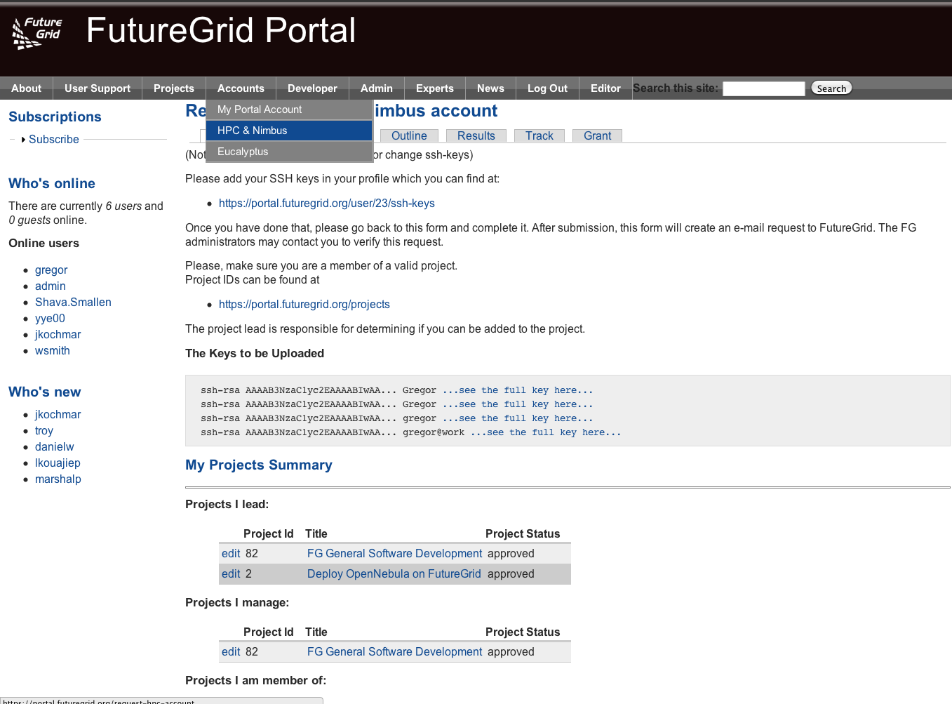
Apply for an HPC and Nimbus account
Login into the portal
Simple go to
  Accounts->
  HPC&Nimbus
(1) add you ssh keys
(3) make sure you are in a
valid project
(2) wait for up to 3 business days
  No accounts will be granted on
  Weekends
  Friday 5pm EST – Monday 9 am EST

Slide 33
Generating an SSH key pair
  For Mac or Linux users
    ssh-keygen –t rsa –C yourname@hostname
    Copy the contents of ~/.ssh/id_rsa.pub to the web form
  For Windows users, this is more difficult
    Download putty.exe and puttygen.exe
    Puttygen is used to generate an SSH key pair
      Run puttygen and click “Generate”
    The public portion of your key is in the box labeled “SSH key for pasting into OpenSSH authorized_keys file”
http://futuregrid.org
Notes:
-c comment

Slide 34
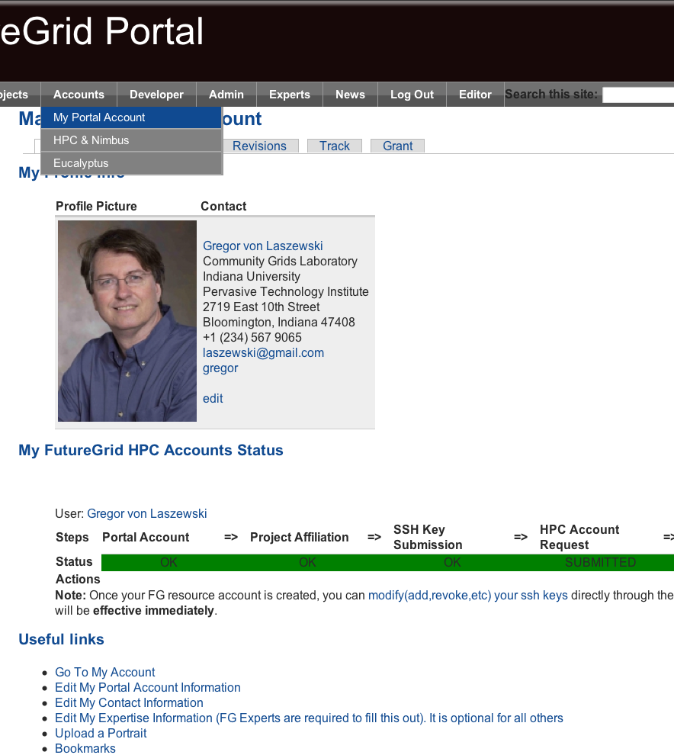
Check your Account Status
Goto:
  Accounts-My Portal Account
Check if the account status bar is green
  Errors will indicate an issue or a task that requires waiting
Since you are already here:
  Upload a portrait
  Check if you have other things that need updating
  Add ssh keys if needed

Slide 35
Eucalyptus Account Creation
  YOU MUST BE IN A VALID FG PROJECT OR YOUR REQUEST GETS DENIED
  Use the Eucalyptus Web Interfaces at
  https://eucalyptus.india.futuregrid.org:8443/
  On the Login page click on Apply for account.
  On the next page that pops up fill out ALL the Mandatory AND optional fields of the form.
  Once complete click on signup and the Eucalyptus administrator will be notified of the account request.
  You will get an email once the account has been approved.
  Click on the link provided in the email to confirm and complete the account creation process
http://futuregrid.org

Slide 36
HPCC Services
Login via ssh
Allow comparison to HPCC
Activated via modules on the resources
Provide queuing system not only for MPI jobs but also for
  Dynamic provisioning
  Hadoop
  Other services if desired

Slide 37
Nimbus
You get a nimbus account immediately when you apply for an HPC account

Slide 38


Hadoop
Goal:
  Simplify running Hadoop jobs thru FutureGrid batch queue systems
  Allows user customized install of Hadoop
Status and Milestones
  Today
    myHadoop 0.2a released early this year, deployed to Sierra and India, tutorial written, announced to users last month
  In future
    deploy to Alamo, Hotel, Xray (end of year 2)

Slide 39
Management Services
Image Management
Dynamic Provisioning
Experiment Management
Monitoring and Information Services
Goals:
  Comparison with bare metal (not just virtualized images)
  Allow images on FG to be provisioned by authorized users
  Allow repeatable experiments
  Allow experiments to be coordinated through workflows
  Allow monitoring and steering of the execution

Slide 40
Management Services
Image Management
Dynamic Provisioning
Experiment Management
Monitoring and Information Services
Select Features
< LAPACK
< MongoDB
Generate Image
> Meta data
> Raw Image
Store Image
> Repository
> Local file system
If image is not available

Slide 41
Management Services
Image Management
Dynamic Provisioning
Experiment Management
Monitoring and Information Services
Submit
Job
< Image
< Job description
Provision Image
> Access Image
> Place on Resources
Execute
> Run Job
> Get Results

Slide 42
Provisioning
HPC, Grid, and Cloud Services

Slide 43
Dynamic Provisioning & RAIN on FutureGrid
Technology Preview
Gregor von Laszewski
http://futuregrid.org

Slide 44
Classical Dynamic Provisioning
Technology Preview
  Dynamically partition a set of resources
  Dynamically allocate the resources to users
  Dynamically define the environment that the resource use
  Dynamically assign them based on user request
  Deallocate the resources so they can be dynamically allocated again
http://futuregrid.org

Slide 45
Use Cases of Dynamic Provisioning
Technology Preview
  Static provisioning:
    Resources in a cluster may be statically reassigned based on the anticipated user requirements, part of an HPC or cloud service. It is still dynamic, but control is with the administrator. (Note some call this also dynamic provisioning.)
  Automatic Dynamic provisioning:
    Replace the administrator with intelligent scheduler.
  Queue-based dynamic provisioning:
    provisioning of images is time consuming, group jobs using a similar environment and reuse the image. User just sees queue.
  Deployment:
    dynamic provisioning features are provided by a combination of using XCAT and Moab
http://futuregrid.org

Slide 46
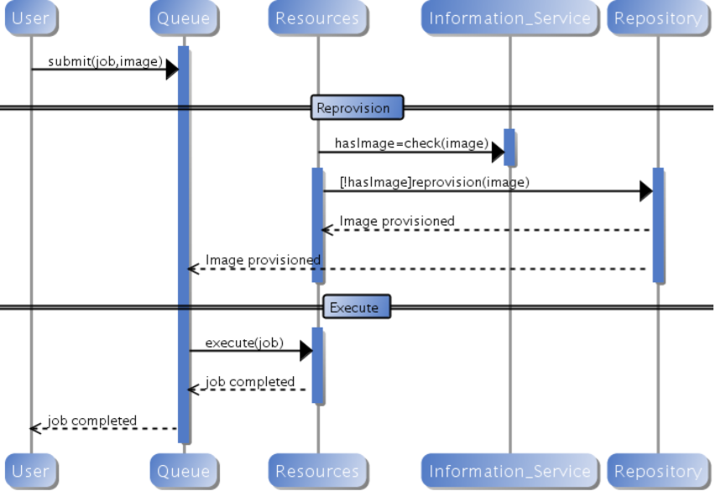
Generic Reprovisioning
Technology Preview
http://futuregrid.org

Slide 47
Dynamic Provisioning Examples
Technology Preview
  Give me a virtual cluster with 30 nodes based on Xen
  Give me 15 KVM nodes each in Chicago and Texas linked to Azure and Grid5000
  Give me a Eucalyptus environment with 10 nodes
  Give 32 MPI nodes running on first Linux and then Windows
  Give me a Hadoop environment with 160 nodes
  Give me a 1000 BLAST instances linked to Grid5000
  Run my application on Hadoop, Dryad, Amazon and Azure … and compare the performance
http://futuregrid.org

Slide 48
From Dynamic Provisioning to “RAIN”
Technology Preview
  In FG dynamic provisioning goes beyond the services offered by common scheduling tools that provide such features.
    Dynamic provisioning in FutureGrid means more than just providing an image
    adapts the image at runtime and provides besides IaaS, PaaS, also SaaS
    We call this “raining” an environment
  Rain = Runtime Adaptable INsertion Configurator
    Users want to ``rain'' an HPC, a Cloud environment, or a virtual network onto our resources with little effort.
    Command line tools supporting this task.
    Integrated into Portal
  Example ``rain'' a Hadoop environment defined by an user on a cluster.
    fg-hadoop -n 8 -app myHadoopApp.jar …
    Users and administrators do not have to set up the Hadoop environment as it is being done for them
http://futuregrid.org

Slide 49
FG RAIN Commands
Technology Preview
  fg-rain –h hostfile –iaas nimbus –image img
  fg-rain –h hostfile –paas hadoop …
  fg-rain –h hostfile –paas dryad …
  fg-rain –h hostfile –gaas gLite …
  fg-rain –h hostfile –image img
  Additional Authorization is required to use fg-rain without virtualization.
http://futuregrid.org

Slide 50
What happens internally?
Technology Preview
Generate a Centos image with several packages
  fg-image-generate –o centos –v 5.6 –a x86_64 –s emacs, openmpi –u javi
  > returns image: centosjavi3058834494.tgz
Deploy the image for HPC (xCAT)
  ./fg-image-register -x im1r –m india -s india -t /N/scratch/ -i centosjavi3058834494.tgz -u jdiaz
Submit a job with that image
  qsub -l os=centosjavi3058834494 testjob.sh

Slide 51
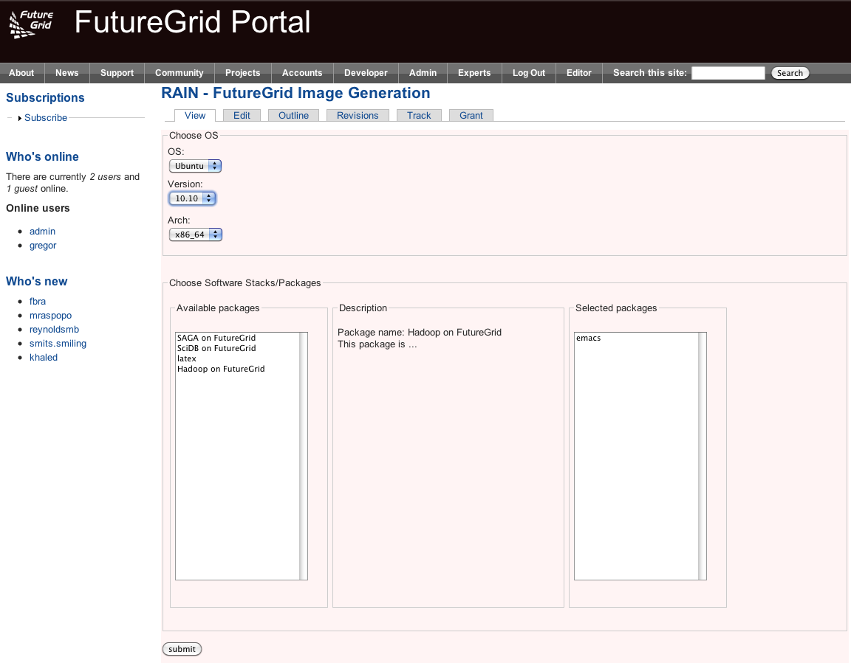

Slide 52
Experiment Management
Goals
Support rigorous experimentation
  Define experiments in detail
  Record experimental results
    User-specified measurements (placement and granularity)
  Share experiment information
    Experiments can be repeated and verified
    Variations on experiments can be performed
Convenient execution of experiments
  FutureGrid has distributed resources and services
  Isn’t one true way to run an experiment

Slide 53
Experiment Management
Approach
Provide tools to execute distributed experiments
  Access (potentially many) resources
  Interact with a number of services
  Support execution of experiment plans
Support several usage models
  Workflow (often large, automatic, batched, unattended)
  Interactive (attended)
  Hybrid
Store experiment information for later use
  Plans (workflows or recordings) and results
  Searchable and shareable
  Re-run experiments or run modified versions

Slide 54
Experiment Management
Available Components
Pegasus
  Workflow-based experiment management
  Builds on existing Pegasus software
    Kickstart to record job execution and its environment
    Details of Pegasus presented elsewhere
TakTuk
  Basic interactive experiment management
  Reuse tool deployed on Grid 5000
Host List Manager
  Organize provisioned systems into groups, generate host lists for TakTuk
  Set of simple command line programs

Slide 55
Experiment Management
Planned Components
Messaging-based Execution and Monitoring System (MEMS)
  More sophisticated interactive experiment management
  Integrated message streams for commands, results, and monitoring
Pegasus provisioning workflows
  Include resource provisioning into workflow
Experiment Repository
  Store and retrieve information about experiments
  Uses the FG Image Repository as component.
User Portal integration
Convert experiment plans
  Help users migrate from one tool to another
  TakTuk commands <-> MEMS messages <-> Pegasus Workflows <->

Slide 56
Software Architecture
Technology Preview

Slide 57
Interfacing with OGF
Deployments
  Genesis II
  Unicore
  Globus
  SAGA
Some thoughts
  How can FG get OCCI from a community effort?
  Is FG useful for OGF community?
  What other features are desired for OGF community?

Slide 58
What is next?
https://portal.futuregrid.org/help
Questions about SW design:
laszewski@gmail.com

