Slide 1
FutureGrid Overview
Support for Experimental Computer Science
Workshop at SC11
http://graal.ens-lyon.fr/~desprez/SC11workshop.htm
November 18 2011
Geoffrey Fox
gcf@indiana.edu
http://www.infomall.org https://portal.futuregrid.org
Director, Digital Science Center, Pervasive Technology Institute
Associate Dean for Research and Graduate Studies, School of Informatics and Computing
Indiana University Bloomington

Slide 2
FutureGrid key Concepts I
FutureGrid is an international testbed modeled on Grid5000
Supporting international Computer Science and Computational Science research in cloud, grid and parallel computing (HPC)
Industry and Academia
The FutureGrid testbed provides to its users:
A flexible development and testing platform for middleware and application users looking at interoperability, functionality, performance or evaluation
Each use of FutureGrid is an experiment that is reproducible
A rich education and teaching platform for advanced cyberinfrastructure (computer science) classes

Slide 3
FutureGrid key Concepts II
FutureGrid has a complementary focus to both the Open Science Grid and the other parts of XSEDE (TeraGrid).
FutureGrid is user-customizable, accessed interactively and supports Grid, Cloud and HPC software with and without virtualization.
FutureGrid is an experimental platform where computer science applications can explore many facets of distributed systems
and where domain sciences can explore various deployment scenarios and tuning parameters and in the future possibly migrate to the large-scale national Cyberinfrastructure.
FutureGrid supports Interoperability Testbeds – OGF really needed!
Note much of current use Education, Computer Science Systems and Biology/Bioinformatics

Slide 4
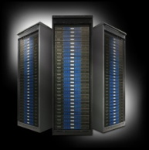
FutureGrid key Concepts III
Rather than loading images onto VM’s, FutureGrid supports Cloud, Grid and Parallel computing environments by provisioning software as needed onto “bare-metal” using Moab/xCAT
Image library for MPI, OpenMP, MapReduce (Hadoop, Dryad, Twister), gLite, Unicore, Globus, Xen, ScaleMP (distributed Shared Memory), Nimbus, Eucalyptus, OpenNebula, KVM, Windows …..
Either statically or dynamically
Growth comes from users depositing novel images in library
FutureGrid has ~4000 (will grow to ~5000) distributed cores with a dedicated network and a Spirent XGEM network fault and delay generator
Image1
Image2
…
ImageN
Choose
Load
Run

Slide 5
FutureGrid Partners
Indiana University (Architecture, core software, Support)
Purdue University (HTC Hardware)
San Diego Supercomputer Center at University of California San Diego (INCA, Monitoring)
University of Chicago/Argonne National Labs (Nimbus)
University of Florida (ViNE, Education and Outreach)
University of Southern California Information Sciences (Pegasus to manage experiments)
University of Tennessee Knoxville (Benchmarking)
University of Texas at Austin/Texas Advanced Computing Center (Portal)
University of Virginia (OGF, Advisory Board and allocation)
Center for Information Services and GWT-TUD from Technische Universtität Dresden. (VAMPIR)
Red institutions have FutureGrid hardware

Slide 6
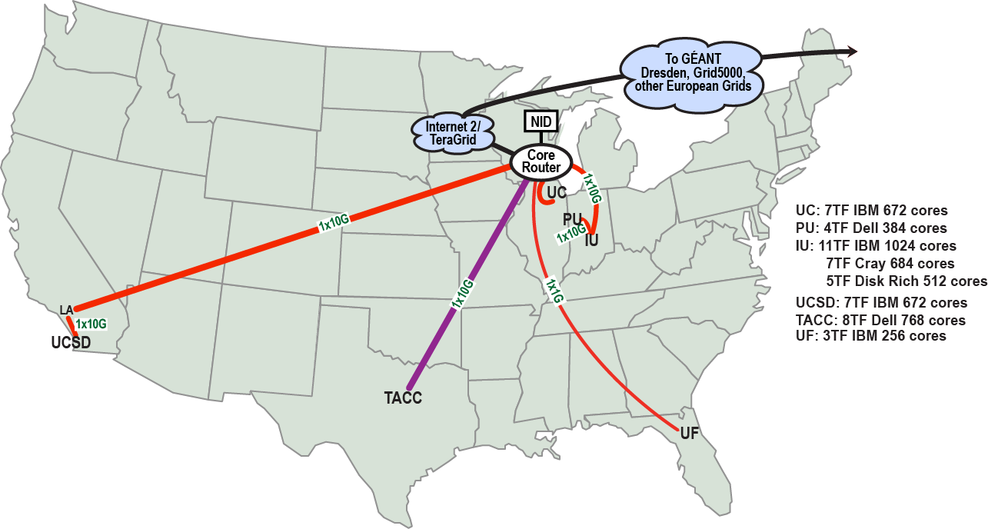
FutureGrid: a Grid/Cloud/HPC Testbed
NID: Network Impairment Device
Private Public
FG Network

Slide 7
Compute Hardware
Name | System type | # CPUs | # Cores | TFLOPS | Total RAM (GB) | Secondary Storage (TB) | Site | Status
india | IBM iDataPlex | 256 | 1024 | 11 | 3072 | 339 + 16 | IU | Operational
alamo | Dell PowerEdge | 192 | 768 | 8 | 1152 | 30 | TACC | Operational
hotel | IBM iDataPlex | 168 | 672 | 7 | 2016 | 120 | UC | Operational
sierra | IBM iDataPlex | 168 | 672 | 7 | 2688 | 96 | SDSC | Operational
xray | Cray XT5m | 168 | 672 | 6 | 1344 | 339 | IU | Operational
foxtrot | IBM iDataPlex | 64 | 256 | 2 | 768 | 24 | UF | Operational
Bravo | Large Disk & memory | 32 | 128 | 1.5 | 3072 (192GB per node) | 144 (12 TB per Server) | IU | Operational
Delta | Large Disk & memory With Tesla GPU’s | 16 16 GPU’s | 96 | ? 3 | 1536 (192GB per node) | 96 (12 TB per Server) | IU | ~Dec 31 2011
 |  |  | TOTAL Cores 4288

Slide 8
Storage Hardware
System Type | Capacity (TB) | File System | Site | Status
DDN 9550 (Data Capacitor)* | 339 shared with IU + 16 TB dedicated | Lustre | IU | Existing System
DDN 6620 | 120 | GPFS | UC | New System
SunFire x4170 | 96 | ZFS | SDSC | New System
Dell MD3000 | 30 | NFS | TACC | New System
IBM | 24 | NFS | UF | New System
* Being upgraded

Slide 9
Network Impairment Device
Spirent XGEM Network Impairments Simulator for jitter, errors, delay, etc
Full Bidirectional 10G w/64 byte packets
up to 15 seconds introduced delay (in 16ns increments)
0-100% introduced packet loss in .0001% increments
Packet manipulation in first 2000 bytes
up to 16k frame size
TCL for scripting, HTML for manual configuration

Slide 10
FutureGrid: Online Inca Summary

Slide 11
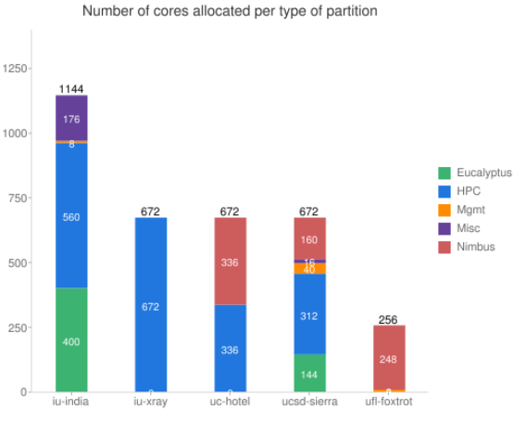
FutureGrid: Inca Monitoring

Slide 12
5 Use Types for FutureGrid
160 approved projects November 16 2011
https://portal.futuregrid.org/projects
Training Education and Outreach (8%)
Semester and short events; promising for small universities
Interoperability test-beds (3%)
Grids and Clouds; Standards; from Open Grid Forum OGF
Domain Science applications (31%)
Life science highlighted (18%), Non Life Science (13%)
Computer science (47%)
Largest current category
Computer Systems Evaluation (27%)
TeraGrid (TIS, TAS, XSEDE), OSG, EGI
Clouds are meant to need less support than other models; FutureGrid needs more user support …….

Slide 13
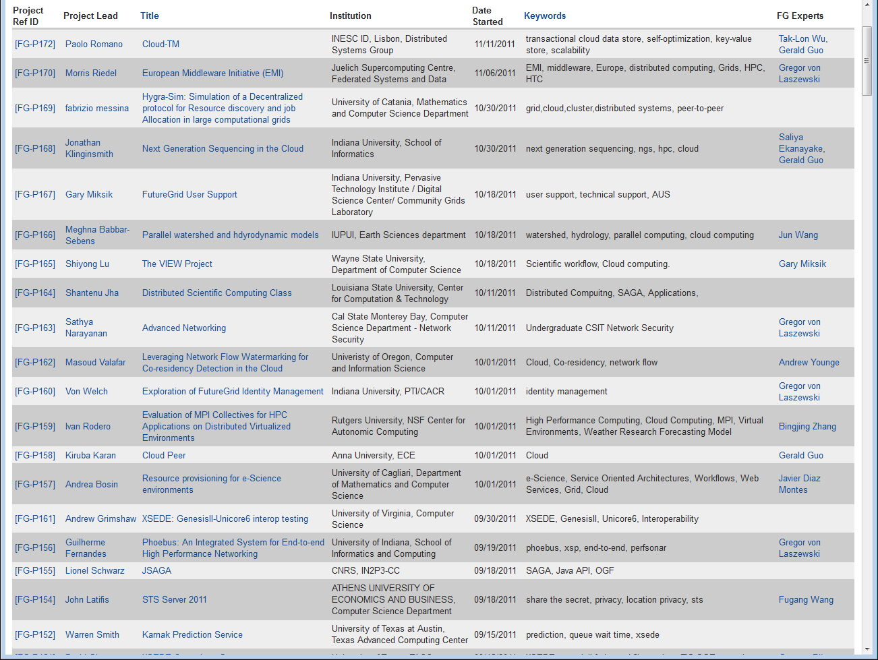
https://portal.futuregrid.org/projects

Slide 14
Current Education projects
System Programming and Cloud Computing, Fresno State, Teaches system programming and cloud computing in different computing environments
REU: Cloud Computing, Arkansas, Offers hands-on experience with FutureGrid tools and technologies
Workshop: A Cloud View on Computing, Indiana School of Informatics and Computing (SOIC), Boot camp on MapReduce for faculty and graduate students from underserved ADMI institutions
Topics on Systems: Distributed Systems, Indiana SOIC, Covers core computer science distributed system curricula (for 60 students)

Slide 15
Current Interoperability Projects
SAGA, Louisiana State, Explores use of FutureGrid components for extensive portability and interoperability testing of Simple API for Grid Applications, and scale-up and scale-out experiments
XSEDE/OGF Unicore and Genesis Grid endpoints tests for new US and European grids

Slide 16
Current Bio Application Projects
Metagenomics Clustering, North Texas, Analyzes metagenomic data from samples collected from patients
Next Generation Sequencing in the Cloud, Indiana and Lilly, investigate clouds for next generation sequencing using MapReduce
Hadoop-GIS: Emory, High Performance Query System for Analytical Medical Imaging, Geographic Information System like interface to nearly a million derived markups and hundred million features per image.

Slide 17
Current Non-Bio Application Projects
Physics: Higgs boson, Virginia, Matrix Element calculations representing production and decay mechanisms for Higgs and background processes
Business Intelligence on MapReduce, Cal State - L.A., Market basket and customer analysis designed to execute MapReduce on Hadoop platform
CFD and Workload Management Experimentation Cummins – a major truck engine company testing new simulation approaches

Slide 18
Current Technology Projects
ScaleMP for Gene Assembly, Indiana Pervasive Technology Institute (PTI) and Biology, Investigates distributed shared memory over 16 nodes for SOAPdenovo assembly of Daphnia genomes
XSEDE, Virginia, Uses FutureGrid resources as a testbed for XSEDE software development
EMI, European Middleware Initiative will deploy software on FutureGrid for training and use by international users
Bioinformatics and Clouds, University of Oregon installed a local cloud on the UO campus, and used FutureGrid to get a head start on creating and using VMs.

Slide 19
Current Computer Science Projects I
Data Transfer Throughput, Buffalo, End-to-end optimization of data transfer throughput over wide-area, high-speed networks
Elastic Computing, Colorado, Tools and technologies to create elastic computing environments using IaaS clouds that adjust to changes in demand automatically and transparently
Cloud-TM, Portugal, Cloud-Transactional Memory programming model
The VIEW Project, Wayne State, Investigates Nimbus and Eucalyptus as cloud platforms for elastic workflow scheduling and resource provisioning

Slide 20
Current Computer Science Projects II
Leveraging Network Flow Watermarking for Co-residency Detection in the Cloud, Oregon Looking at security risks in virtualization and ways of mitigating
Distributed MapReduce, Minnesota. Support data analytics with Hadoop with distributed real time data sources
Evaluation of MPI Collectives for HPC Applications on Distributed Virtualized Environments, Rutgers supporting virtualized simulations for WRF weather codes

Slide 21
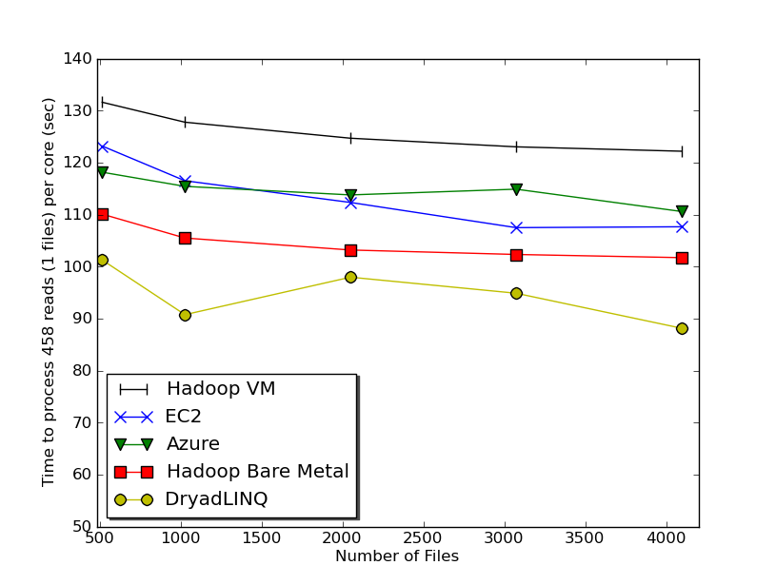
Typical FutureGrid Performance Study
Linux, Linux on VM, Windows, Azure, Amazon Bioinformatics

Slide 22
OGF 2010 Demo from Rennes
SDSC
Rennes
Grid’5000 firewall
UF
Lille
UC
Sophia
ViNe provided the necessary inter-cloud connectivity to deploy CloudBLAST across 6 Nimbus sites, with a mix of public and private subnets.

Slide 23
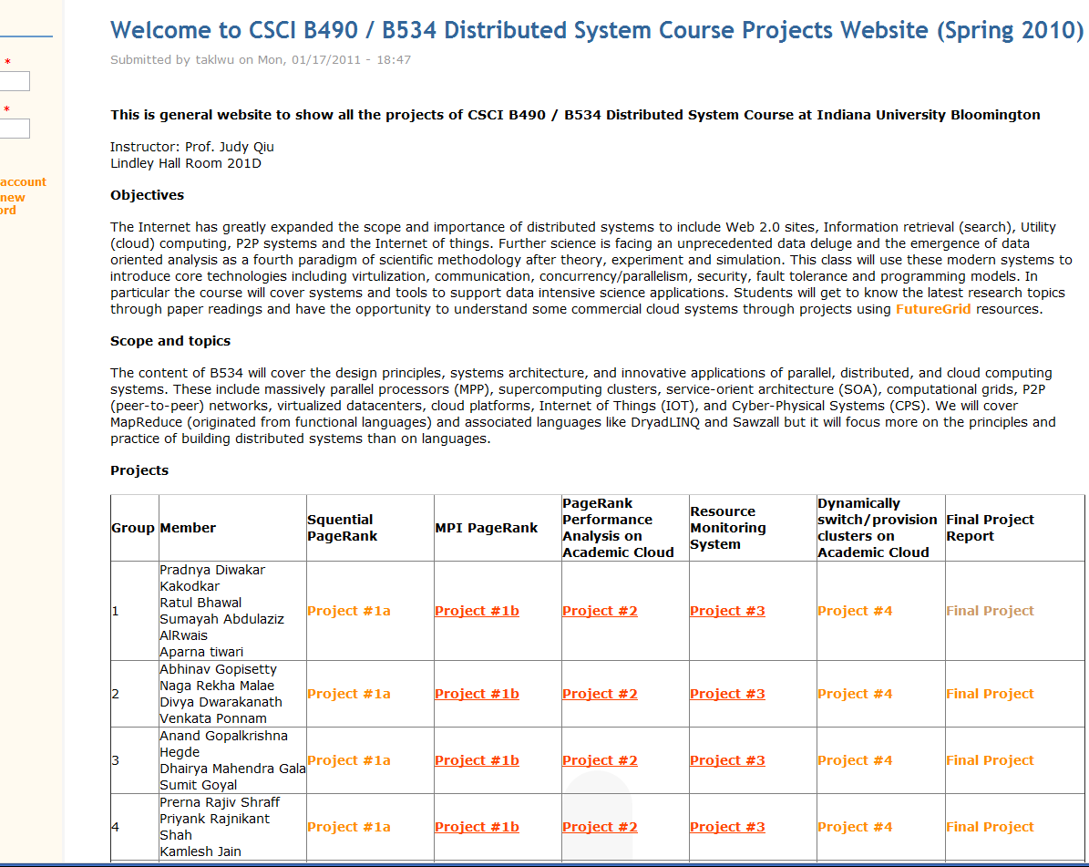
B534 Distributed Systems Class
17 3-4 person projects

Slide 24
ADMI Cloudy View on Computing Workshop June 2011
Concept and Delivery by Jerome Mitchell:
Undergraduate ECSU,
Masters Kansas, PhD Indiana
Jerome took two courses from IU in this area Fall 2010 and Spring 2011 on FutureGrid
ADMI: Association of Computer and Information Science/Engineering Departments at Minority Institutions
Offered on FutureGrid
10 Faculty and Graduate Students from ADMI Universities
The workshop provided information from cloud programming models to case studies of scientific applications on FutureGrid.
At the conclusion of the workshop, the participants indicated that they would incorporate cloud computing into their courses and/or research.

Slide 25
Workshop Purpose
Introduce ADMI to the basics of the emerging Cloud Computing paradigm
Learn how it came about
Understand its enabling technologies
Understand the computer systems constraints, tradeoffs, and techniques of setting up and using cloud
Teach ADMI how to implement algorithms in the Cloud
Gain competence in cloud programming models for distributed processing of large datasets.
Understand how different algorithms can be implemented and executed on cloud frameworks
Evaluating the performance and identifying bottlenecks when mapping applications to the clouds

Slide 26
FutureGrid Tutorials
Tutorial topic 1: Cloud Provisioning Platforms
Using Nimbus on FutureGrid [novice]
Nimbus One-click Cluster Guide [intermediate]
Using OpenStack Nova on FutureGrid [novice]
Using Eucalyptus on FutureGrid [novice]
Connecting private network VMs across Nimbus clusters using ViNe [novice]
Using the Grid Appliance to run FutureGrid Cloud Clients [novice]
Tutorial topic 2: Cloud Run-time Platforms
Running Hadoop on Eucalyptus
Running Twister on Eucalyptus
Other Tutorials and Educational Materials
Additional tutorials on FutureGrid-related technologies
FutureGrid community educational materials
Tutorial topic 3: Educational Virtual Appliances
Running a Grid Appliance on your desktop
Running a Grid Appliance on FutureGrid
Running an OpenStack virtual appliance on FutureGrid
Running Condor tasks on the Grid Appliance
Running MPI tasks on the Grid Appliance
Running Hadoop tasks on the Grid Appliance
Deploying virtual private Grid Appliance clusters using Nimbus
Building an educational appliance from Ubuntu 10.04
Customizing and registering Grid Appliance images using Eucalyptus
Tutorial topic 4: High Performance Computing
Basic High Performance Computing
Running Hadoop as a batch job using MyHadoop
Performance Analysis with Vampir
Instrumentation and tracing with VampirTrace
Tutorial Topic 5: Experiment Management
Running interactive experiments

Slide 27
FutureGrid Viral Growth Model
Users apply for a project
Users improve/develop some software in project
This project leads to new images which are placed in FutureGrid repository
Project report and other web pages document use of new images
Images are used by other users
And so on ad infinitum ………
Please bring your nifty software up on FutureGrid!!

Slide 28
Software Components
Portals including “Support” “use FutureGrid” “Outreach”
Monitoring – INCA, Power (GreenIT)
Experiment Manager: specify/workflow
Image Generation and Repository
Intercloud Networking ViNE
Virtual Clusters built with virtual networks
Performance library
Rain or Runtime Adaptable InsertioN Service for images
Security Authentication, Authorization,
Note Software integrated across institutions and between middleware and systems Management (Google docs, Jira, Mediawiki)
Note many software groups are also FG users
“Research”
Above and below
Nimbus OpenStack Eucalyptus

Slide 29
FutureGrid Software Architecture
Note on Authentication and Authorization
We have different environments and requirements from TeraGrid
Non trivial to integrate/align security model with TeraGrid

Slide 30
Detailed Software Architecture

Slide 31
Motivation: Image Management and Rain on FutureGrid
Allow users to take control of installing the OS on a system on bare metal (without the administrator)
By providing users with the ability to create their own environments to run their projects (OS, packages, software)
Users can deploy their environments in both bare-metal and virtualized infrastructures
Security is obviously important
RAIN manages tools to dynamically provide custom HPC environment, Cloud environment, or virtual networks on-demand

Slide 32
Architecture
Notes:
IM provides a unified environment to create and maintain VM and bare-metal images
Integrate images through a repository to instantiate services on demand with RAIN
Essentially enables the rapid development and deployment of Platform services on FutureGrid infrastructure

Slide 33
Image Generation
Creates and customizes images according to user requirements
Images are not aimed to any specific infrastructure

Slide 34
Image Deployment
Customizes and deploys images for specific infrastructures
Two main infrastructures types:
HPC Deployment
Cloud Deployment
https://portal.futuregrid.org

Slide 35
FutureGrid in a nutshell
The FutureGrid project mission is to enable experimental work that advances:
Innovation and scientific understanding of distributed computing and parallel computing paradigms,
The engineering science of middleware that enables these paradigms,
The use and drivers of these paradigms by important applications, and,
The education of a new generation of students and workforce on the use of these paradigms and their applications.
The implementation of mission includes
Distributed flexible hardware with supported use
Identified IaaS and PaaS “core” software with supported use
Growing list of software from FG partners and users
Outreach
What else?

