Slide 1
Outsourcing Ecosystem for Science: Applications and Patterns
Workshop on Science Agency Uses of Clouds and Grids
Kate Keahey
keahey@mcs.anl.gov
Argonne National Laboratory
Computation Institute, University of Chicago

Slide 2
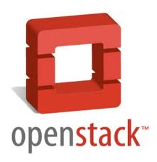
Nimbus Components
High-quality, extensible, customizable,
open source implementation
Nimbus Platform
Enable users to use IaaS clouds
Context Broker
Cloudinit.d
Elastic Scaling Tools
Gateway
Enable providers to build IaaS clouds
Nimbus Infrastructure
Workspace Service
Cumulus
Enable developers to extend,
experiment and customize

Slide 3
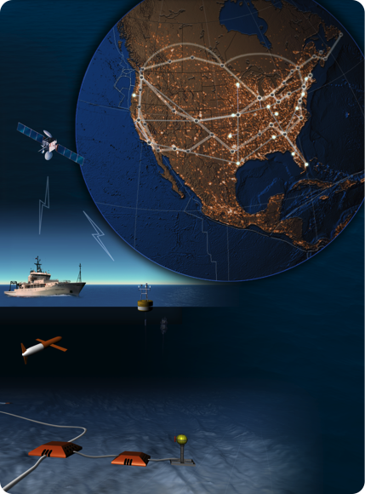
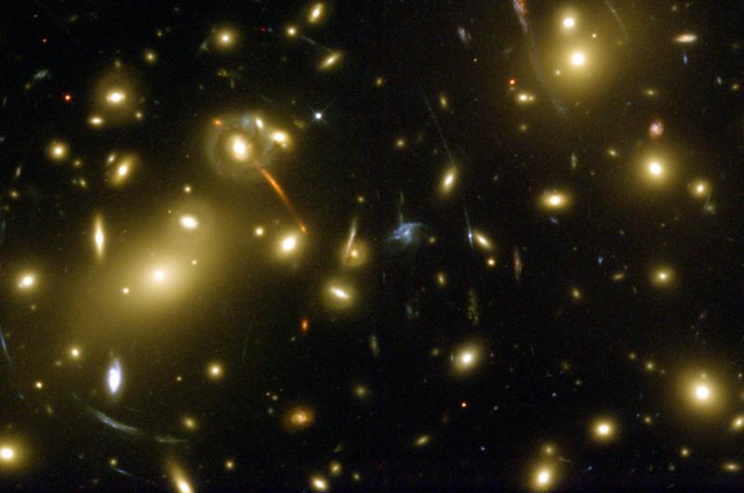
On the Nimbus Team…
Do whatever it takes to enable
Infrastructure clouds for science
Applications and Patterns
?
How do we turn a “bad cloud”
Into a “good cloud”?

Slide 4
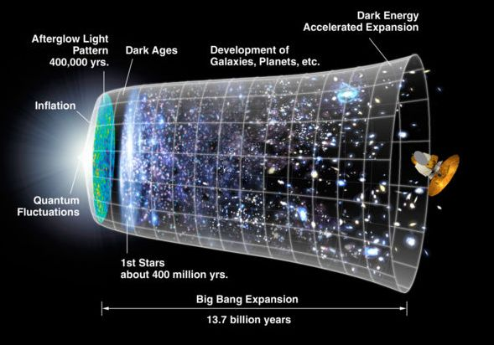
Work by Jerome Lauret (BNL) et al.
STAR: a nuclear physics experiment at Brookhaven National Laboratory
Approach:
Nimbus Science Clouds -> EC2 runs
Virtual OSG clusters with Nimbus Context Broker
Impact
Production runs on EC2 since 2007
The Quark Matter 2009 deadline: producing just-in time results
The small issues of cost

Slide 5
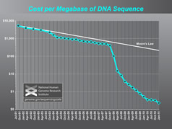
Sam Angiuoli
Institute for Genome Sciences
University of Maryland School of Medicine
The emergent need for processing
A virtual appliance for automated and portable sequence analysis
Approach:
Running on Nimbus Science Clouds, Magellan and EC2
A platform for building appliances representing push-button pipelines
Impact
From desktop to cloud
http://clovr.org

Slide 6
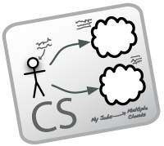
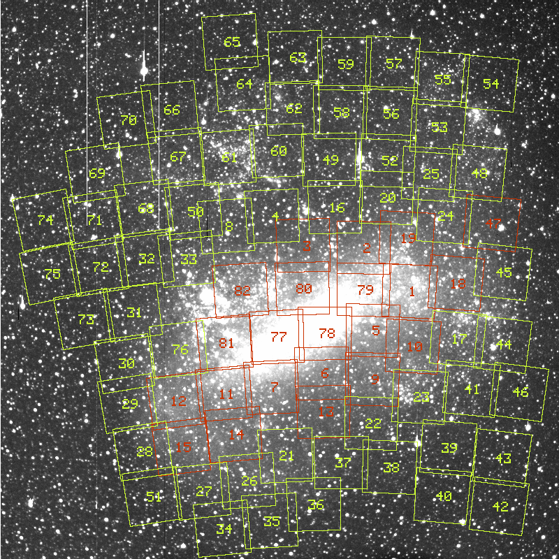
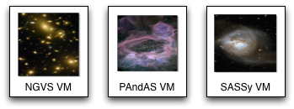
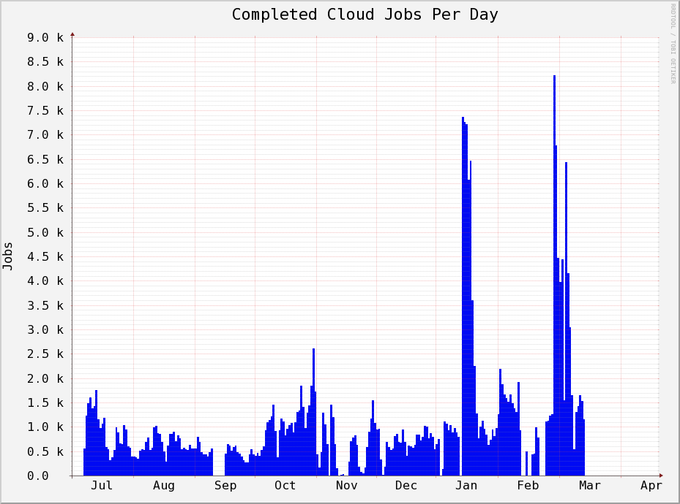
Work by the UVIC team
Detailed analysis of data from the MACHO experiment Dark Matter search
Provide infrastructure for six observational astronomy survey projects
Approach:
Running on a Nimbus cloud on WestGrid
Appliance creation and management
Dynamic Condor pool for astronomy
Status:
In production operation since July 2010

Slide 7
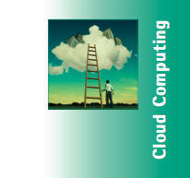
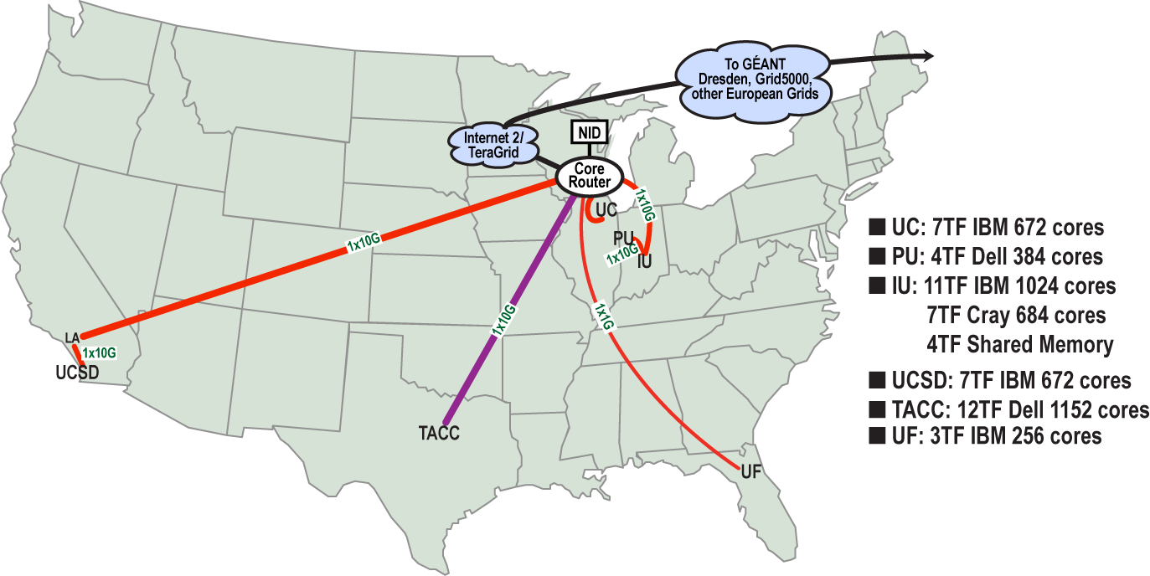
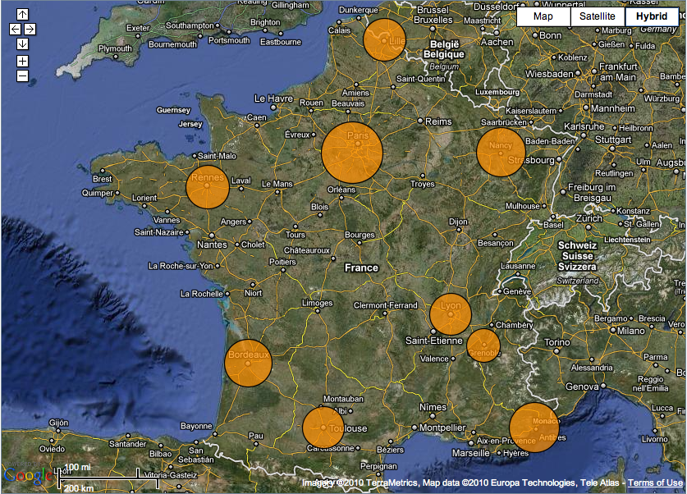
Sky Computing
Work by Pierre Riteau et al,
University of Rennes 1
Sky Computing = a Federation of Clouds
Approach:
Combine resources obtained in multiple Nimbus clouds in FutureGrid and Grid’ 5000
Combine Context Broker, ViNe, fast image deployment
Deployed a virtual cluster of over 1000 cores on Grid5000 and FutureGrid – largest ever of this type
Grid’5000 Large Scale Deployment Challenge award
Demonstrated at OGF 29 06/10
TeraGrid ’10 poster
More at: www.isgtw.org/?pid=1002832
“Sky Computing”
IEEE Internet Computing, September 2009

Slide 8
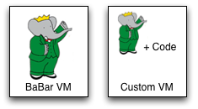
Work by the UVIC team
Canadian Efforts
BarBar Experiment at SLAC in Stanford, CA
Using clouds to simulating electron-positron collisions in their detector
Exploring virtualization as a vehicle for data preservation
Approach:
Appliance preparation and management
Distributed Nimbus clouds
Cloud Scheduler
Running production BaBar workloads

Slide 9
More About
Searching for the W-boson -- and nearly finding it!
Typical timelines:
5 months of data taking
10 months of detector calibration, reconstruction and analysis
Benefits of running in the cloud:
Reducing "time to science” (by ~ 6 months)
Near real-time processing

Slide 10
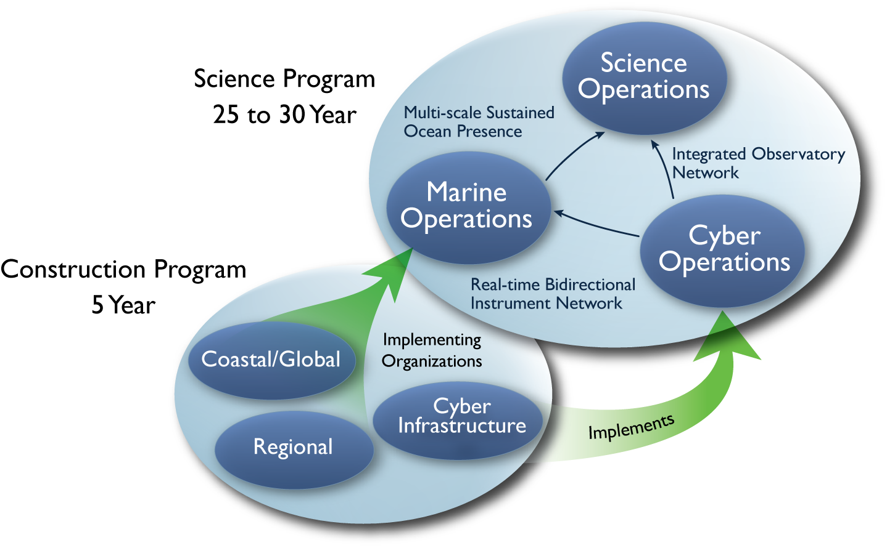
Large NSF-funded observatory with requirements for adaptive, reliable, elastic computing
Approach:
Private Nimbus regional clouds -> commercial clouds
Highly Available (HA) services that provision resources on many clouds based on need
Significant OOI CI infrastructure in data and sensor management based on this model
Status:
Scalability and reliability tests on 100s of EC2, FutureGrid and Magellan resources
HA elastic services release in 2011 (Nimbus 3)
Trail-blazing project

Slide 11
Nimbus Platform

Slide 12
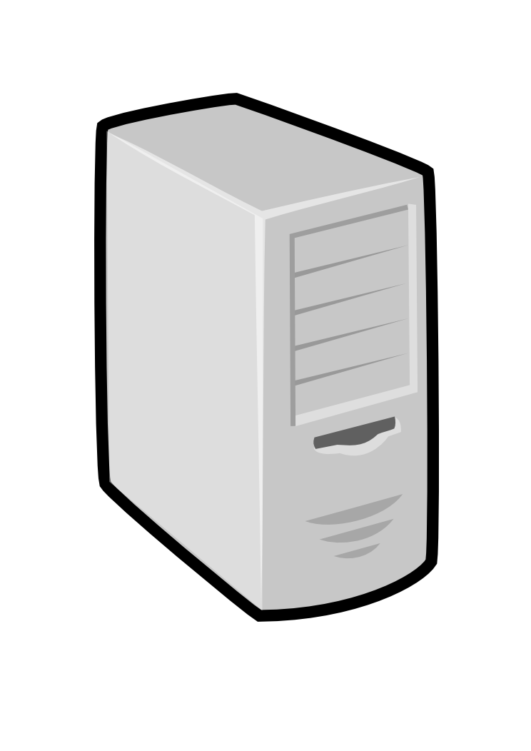
Nimbus Platform: Working with Hybrid Clouds
Creating Common Context
Allow users to build turnkey dynamic virtual clusters
Nimbus Elastic Provisioning
interoperability
automatic scaling
HA provisioning
policies
private clouds
(e.g., FNAL)
community clouds
(e.g., FutureGrid)
public clouds
(e.g., EC2)

Slide 13
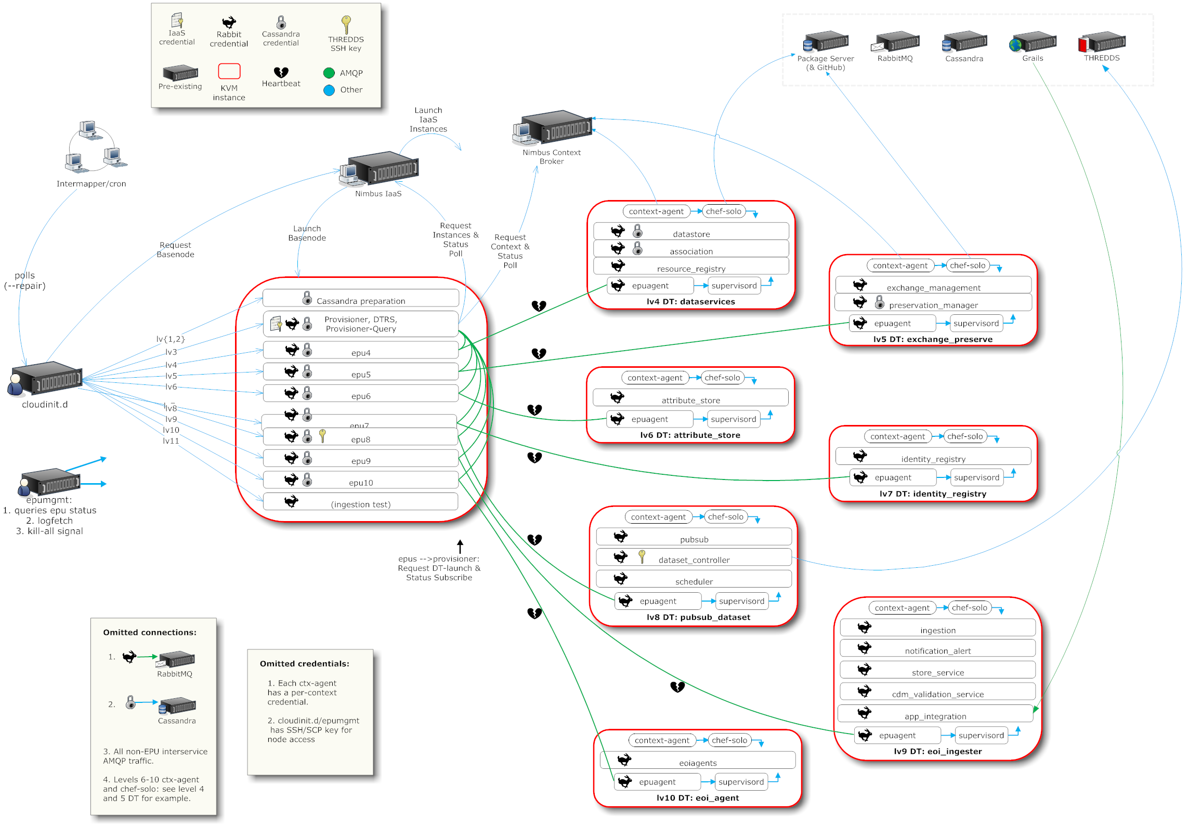
A Simplified Deployment Scenario

Slide 14
Cloudinit.d
Repeatable deployment: write a launch plan once, deploy many times
Coordination of inter-dependent launches via attributes
Deploy on cloud and non-cloud resources from many providers
User-defined launch tests (assertions)
Test-based monitoring
Policy-driven repair of a launch
Lightweight and easy to use
Currently in RC1
Come to our talk at TG’11 tomorrow!
Web
Server
NFS
Server
Web
Server
Postgress
Database
Web
Server
Run-level 1
Run-level 2

Slide 15
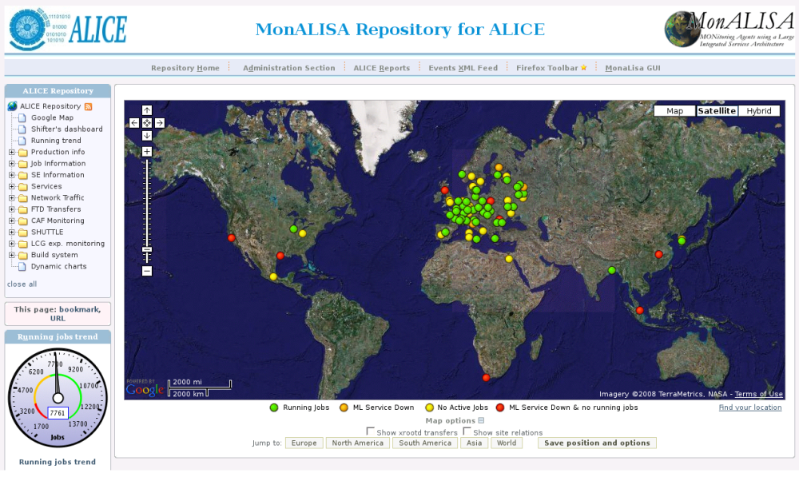
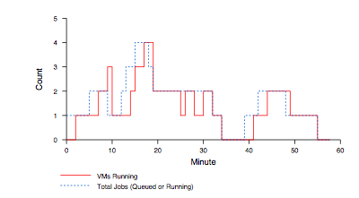
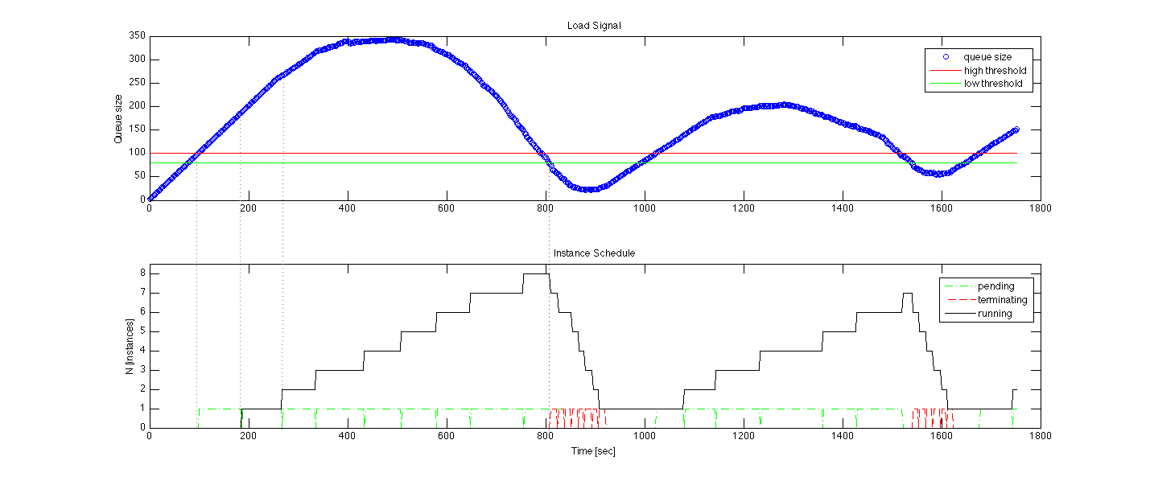
Elasticity, Reliability and Failure
Elasticity and reliability are different sides of the same coin.
2008: The ALICE proof-of-concept
2009: ElasticSite prototype
2009: OOI pilot
Paper: “Elastic Site”, CCGrid 2010
Challenge:
a generic HA
elastic service model

Slide 16
Elasticity, Reliability and Failure
Assumption: a workload queue
ALiEn, PBS, AMQP,…
React to sensor information
Queue, deployment status, VM health…
Evaluate against policies
Scale to demand
Across different cloud providers
Use contextualization to integrate machines across hybrid clouds
Scalable: latest tests scale to 100s of nodes on EC2, target is thousands
Highly Available – designed to support resiliency of all components
Release later in 2011
Customizable to input, policy, decision engine, provider, etc.
Start with a queue
Other sensor information
Apply Policy
Provision resources
private
EC2
community

Slide 17
Elastic Scaling Tools: Towards “Bottomless Resources”
Early efforts:
2008: The ALICE proof-of-concept
2009: ElasticSite prototype
2009: OOI pilot
Challenge: a generic HA Service Model
React to sensor information
Queue: the workload sensor
Scale to demand
Across different cloud providers
Use contextualization to integrate machines into the network
Customizable
Routinely 100s of nodes on EC2
Coming in Nimbus 3
Paper: “Elastic Site”, CCGrid 2010

Slide 18
Context Broker
Contextualization
Shared trust/security context
Shared configuration/context information
Applications
Turnkey virtual clusters
Adding provisioned resources to a site or a domain
Features
Work with any appliance, any provider, and across multiple providers

Slide 19
Parting Thoughts
Cloud Computing Challenge: Outsourcing
Benefits
Economy of scale, access to different resources, no operation overhead, more flexible use
Criteria
Does it provide the right offering? Is it scalable? Easy to use? Easy to outsource? Cost-effective?
Changing patterns of how people work
On-demand availability, acceptance of bursty demand, ease-of-portability
Many challenges left!

Slide 20
www.nimbusproject.com
Let’s make cloud computing for science happen.

