Slide 1
Cloud Computing with Nimbus on FutureGrid
TeraGrid’11 tutorial, Salt Late City, UT
Kate Keahey
keahey@mcs.anl.gov
Argonne National Laboratory
Computation Institute, University of Chicago

Slide 2
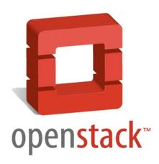
Nimbus Components
High-quality, extensible, customizable,
open source implementation
Nimbus Platform
Enable users to use IaaS clouds
Context Broker
Cloudinit.d
Elastic Scaling Tools
Gateway
Enable providers to build IaaS clouds
Nimbus Infrastructure
Workspace Service
Cumulus
Enable developers to extend,
experiment and customize

Slide 3
Nimbus Infrastructure

Slide 4
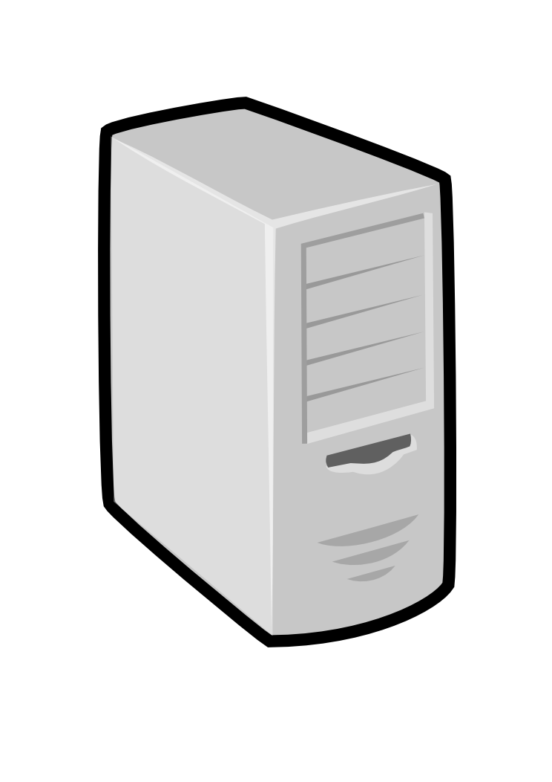
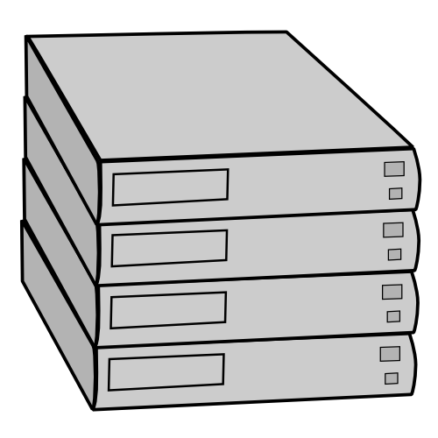
IaaS: How it Works
Pool
node
Pool
node
Pool
node
Nimbus
Pool
node
Pool
node
Pool
node
Pool
node
Pool
node
Pool
node
Pool
node
Pool
node
Pool
node

Slide 5
IaaS: How it Works
Nimbus publishes
information about each VM
Pool
node
Pool
node
Pool
node
Nimbus
Pool
node
Pool
node
Pool
node
Users can find out
information about their
VM (e.g. what IP
the VM was bound to)
Pool
node
Pool
node
Pool
node
Pool
node
Pool
node
Pool
node
Users can interact directly with their VM in the same way the would with a physical machine.

Slide 6
Nimbus on FutureGrid
Hotel (University of Chicago) -- Xen 41 nodes, 328 cores
Foxtrot (University of Florida) -- Xen 26 nodes, 208 cores
Sierra (SDSC) -- Xen 18 nodes, 144 cores
Alamo (TACC) -- KVM 15 nodes, 120 cores

Slide 7
FutureGrid: Getting Started
To get a FutureGrid account:
Sign up for portal account: https://portal.futuregrid.org/user/register
Once approved, apply for HPC account: https://portal.futuregrid.org/request-hpc-account
Your Nimbus credentials will be in your home directory
Follow the tutorial at: https://portal.futuregrid.org/tutorials/nimbus
or Nimbus quickstart at http://www.nimbusproject.org/docs/2.7/clouds/cloudquickstart.html

Slide 8
FutureGrid: VM Images
[bresnaha@login1 nimbus-cloud-client-018]$ ./bin/cloud-client.sh –conf\
~/.nimbus/hotel.conf –list
----
[Image] 'base-cluster-cc12.gz' Read only
Modified: Jan 13 2011 @ 14:17 Size: 535592810 bytes (~510 MB)
[Image] 'centos-5.5-x64.gz' Read only
Modified: Jan 13 2011 @ 14:17 Size: 253383115 bytes (~241 MB)
[Image] 'debian-lenny.gz' Read only
Modified: Jan 13 2011 @ 14:19 Size: 1132582530 bytes (~1080 MB)
[Image] 'debian-tutorial.gz' Read only
Modified: Nov 23 2010 @ 20:43 Size: 299347090 bytes (~285 MB)
[Image] 'grid-appliance-jaunty-amd64.gz' Read only
Modified: Jan 13 2011 @ 14:20 Size: 440428997 bytes (~420 MB)
[Image] 'grid-appliance-jaunty-hadoop-amd64.gz' Read only
Modified: Jan 13 2011 @ 14:21 Size: 507862950 bytes (~484 MB)
[Image] 'grid-appliance-mpi-jaunty-amd64.gz' Read only
Modified: Feb 18 2011 @ 13:32 Size: 428580708 bytes (~408 MB)
[Image] 'hello-cloud' Read only
Modified: Jan 13 2011 @ 14:15 Size: 576716800 bytes (~550 MB)

Slide 9
Nimbus Infrastructure: a Highly-Configurable IaaS Architecture
Workspace Interfaces
Cumulus interfaces
EC2 SOAP
EC2 Query
WSRF
S3
Workspace API
Cumulus API
Workspace Service Implementation
Cumulus Service Implementation
Workspace RM options
Default
Default+backfill/spot
Workspace pilot
Workspace Control Protocol
Cumulus Storage API
Workspace Control
Cumulus Implementation options
Virtualization
(libvirt)
Image Mngm
Network
Ctx
ssh
…
POSIX
Xen
KVM
LANtorrent
HDFS

Slide 10
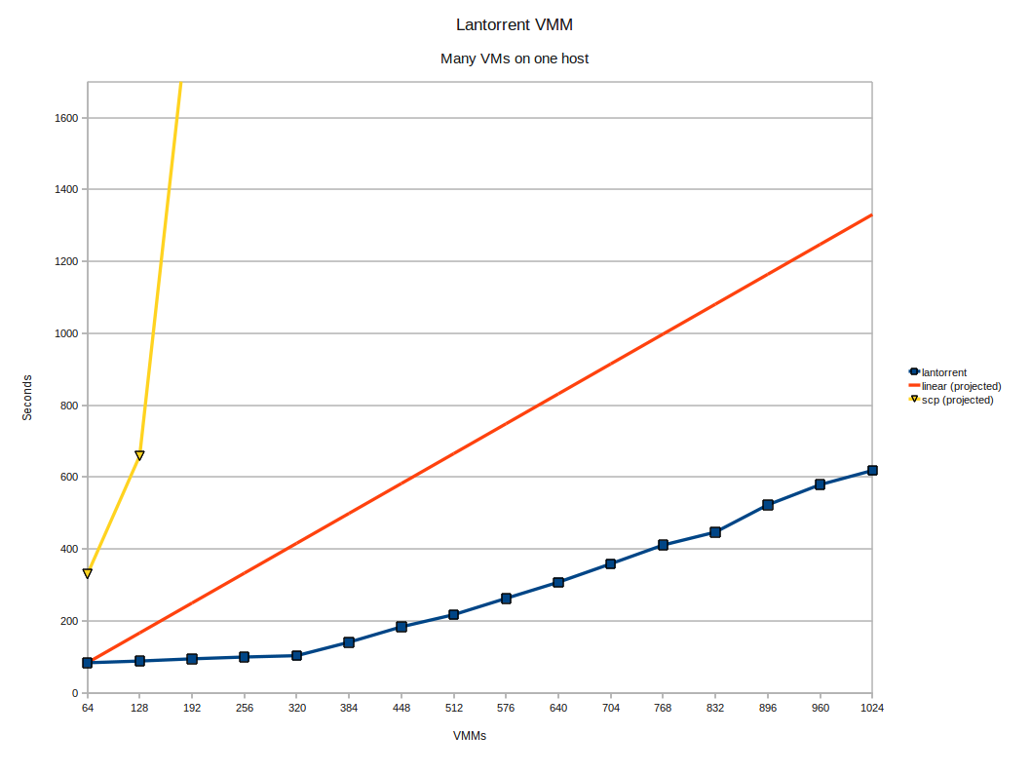
LANTorrent: Fast Image Deployment
Challenge: make image deployment faster
Moving images is the main component of VM deployment
LANTorrent: the BitTorrent principle on a LAN
Streaming
Minimizes congestion at the switch
Detecting and eliminating duplicate transfers
Bottom line: a thousand VMs in 10 minutes on Magellan
Nimbus release 2.6, see www.scienceclouds.org/blog
Preliminary data using the Magellan resource
At Argonne National Laboratory

Slide 11
Nimbus Platform

Slide 12
Nimbus Platform: Working with Hybrid Clouds
Creating Common Context
Allow users to build turnkey dynamic virtual clusters
Nimbus Elastic Provisioning
interoperability
automatic scaling
HA provisioning
policies
private clouds
(e.g., FNAL)
community clouds
(e.g., FutureGrid)
public clouds
(e.g., EC2)

Slide 13
Cloudinit.d
Repeatable deployment of sets of VMs
Coordinates launches via attributes
Works with multiple IaaS providers
User-defined launch tests (assertions)
Test-based monitoring
Policy-driven repair of a launch
Currently in RC2
Come to our talk at TG’11
Web
Server
NFS
Server
Web
Server
Postgress
Database
Web
Server
Run-level 1
Run-level 2

Slide 14
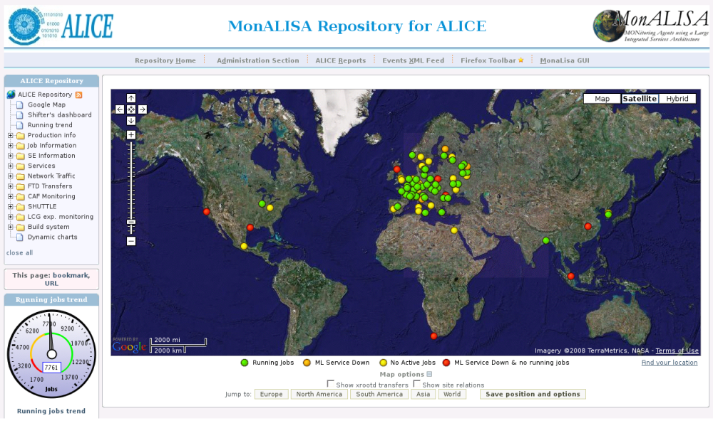
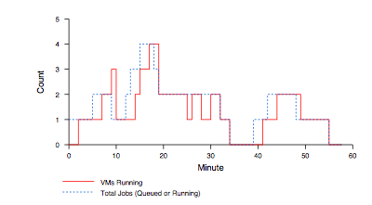
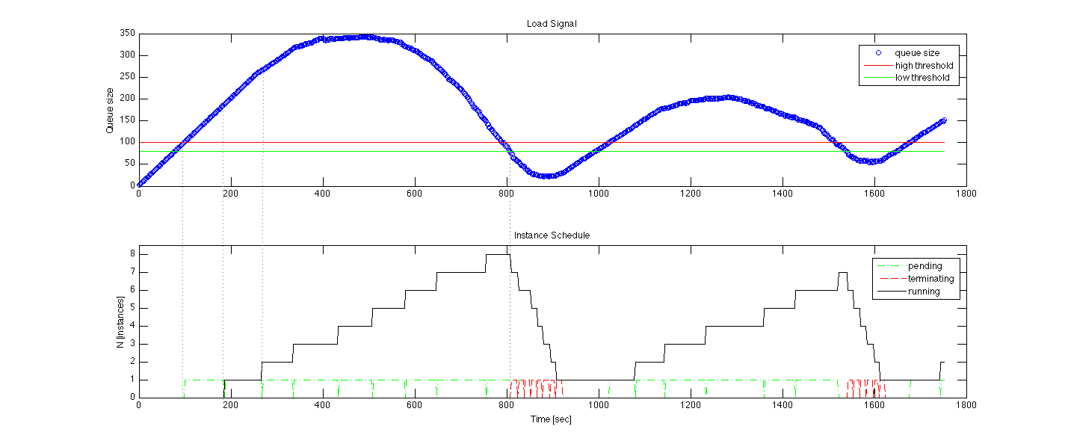
Elastic Scaling Tools: Towards “Bottomless Resources”
Early efforts:
2008: The ALICE proof-of-concept
2009: ElasticSite prototype
2009: OOI pilot
Challenge: a generic HA Service Model
React to sensor information
Queue: the workload sensor
Scale to demand
Across different cloud providers
Use contextualization to integrate machines into the network
Customizable
Routinely 100s of nodes on EC2
Coming out later this year
Paper: “Elastic Site”, CCGrid 2010

Slide 15
FutureGrid Case Studies

Slide 16
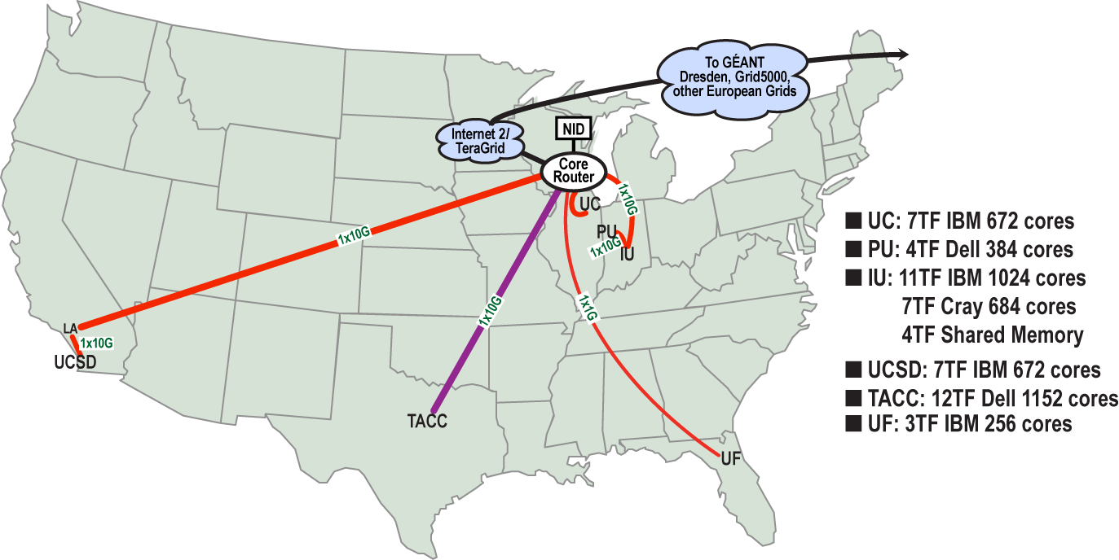
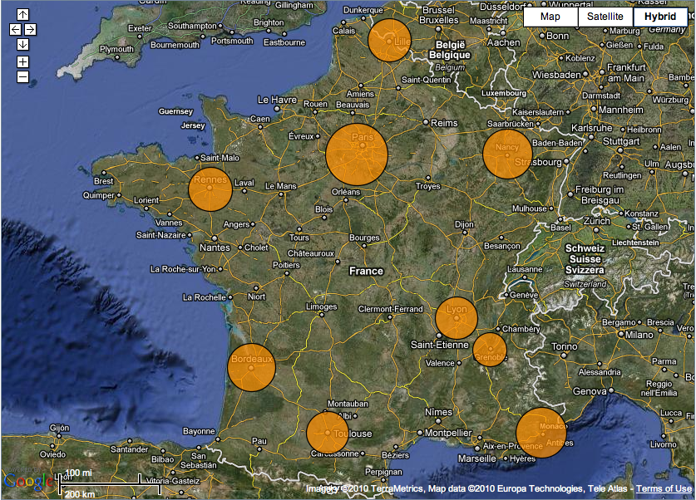
Sky Computing
Work by Pierre Riteau et al,
University of Rennes 1
Sky Computing = a Federation of Clouds
Approach:
Combine resources obtained in multiple Nimbus clouds in FutureGrid and Grid’ 5000
Combine Context Broker, ViNe, fast image deployment
Deployed a virtual cluster of over 1000 cores on Grid5000 and FutureGrid – largest ever of this type
Grid’5000 Large Scale Deployment Challenge award
Demonstrated at OGF 29 06/10
TeraGrid ’10 poster
More at: www.isgtw.org/?pid=1002832
“Sky Computing”
IEEE Internet Computing, September 2009

Slide 17
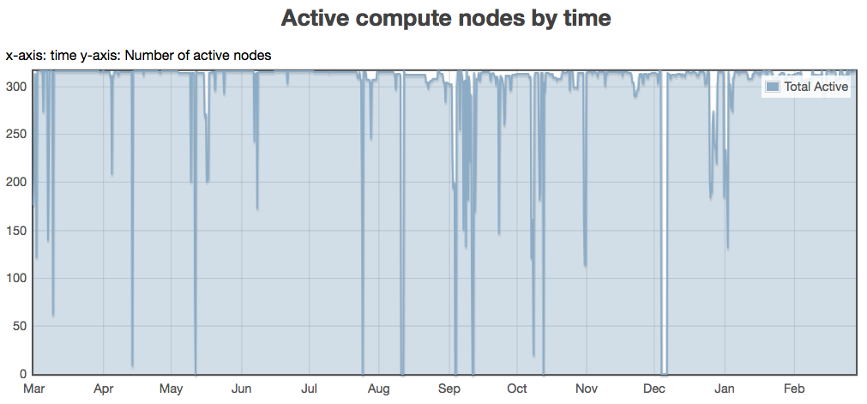
Backfill: Lower the Cost of Your Cloud
1 March 2010 through 28 February 2011
Challenge: utilization, catch-22 of on-demand computing
Solution: new instances
Backfill
Bottom line: up to 100% utilization
Who decides what backfill VMs run?
Spot pricing
Open Source community contribution
Preparing for running of production workloads on FG @ U Chicago
Nimbus release 2.7
Paper @ CCGrid 2011
94%
78%
62%
47%
31%
16%

Slide 18
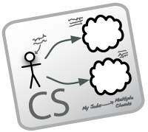
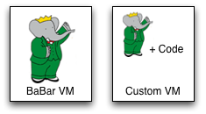
Work by the UVIC team
Canadian Efforts
BarBar Experiment at SLAC in Stanford, CA
Using clouds to simulating electron-positron collisions in their detector
Exploring virtualization as a vehicle for data preservation
Approach:
Appliance preparation and management
Distributed Nimbus clouds
Cloud Scheduler
Running production BaBar workloads

Slide 19
The Nimbus Team
Project lead: Kate Keahey, ANL&UC
Committers:
Tim Freeman - University of Chicago
Ian Gable - University of Victoria
David LaBissoniere - University of Chicago
John Bresnahan - Argonne National Laboratory
Patrick Armstrong - University of Victoria
Pierre Riteau - University of Rennes 1, IRISA
Github Contributors:
Tim Freeman, David LaBissoniere, John Bresnahan, Pierre Riteau, Alex Clemesha, Paulo Gomez, Patrick Armstrong, Matt Vliet, Ian Gable, Paul Marshall, Adam Bishop
And many others
See http://www.nimbusproject.org/about/people/

Slide 20
Parting Thoughts
Many challenges left in exploring infrastructure clouds
FutureGrid offers an instrument that allows you to explore them:
Multiple distributed clouds
The opportunity to experiment with cloud software
Paradigm exploration for domain sciences
Nimbus provides tools to explore them
Come and work with us on FutureGrid!

Slide 21
www.nimbusproject.com
Let’s make cloud computing for science happen.

