Slide 1
FutureGrid Computing Testbed as a Service
Geoffrey Fox
J. Fortes G. von Laszewski ….
gcf@indiana.edu
Informatics, Computing and Physics
Pervasive Technology Institute
Indiana University Bloomington

Slide 2
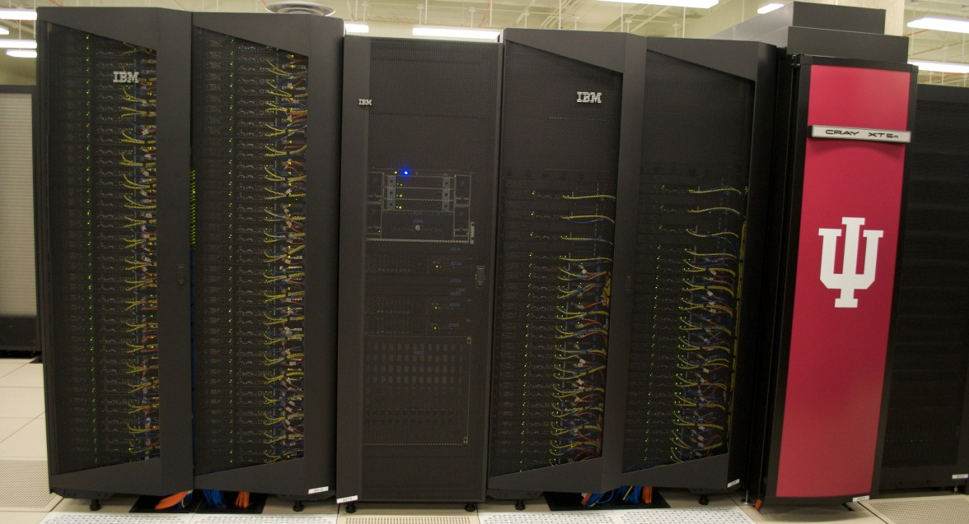
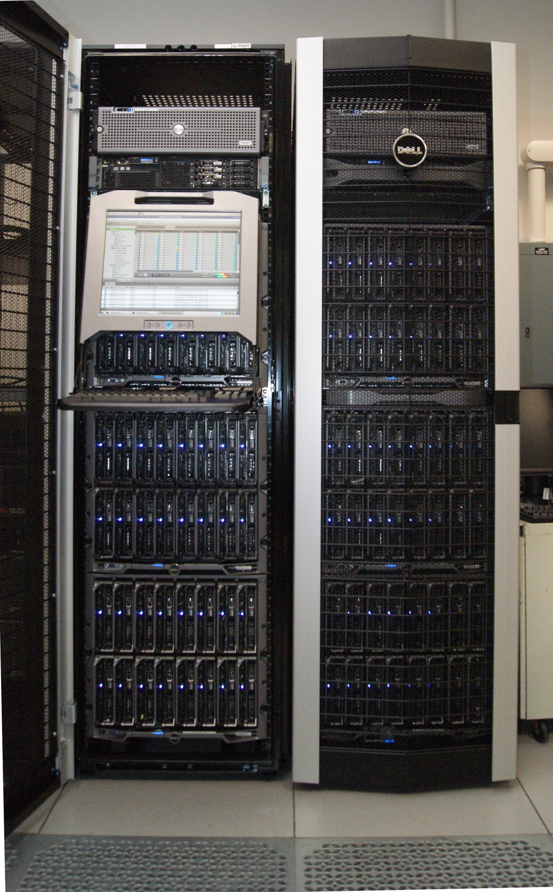
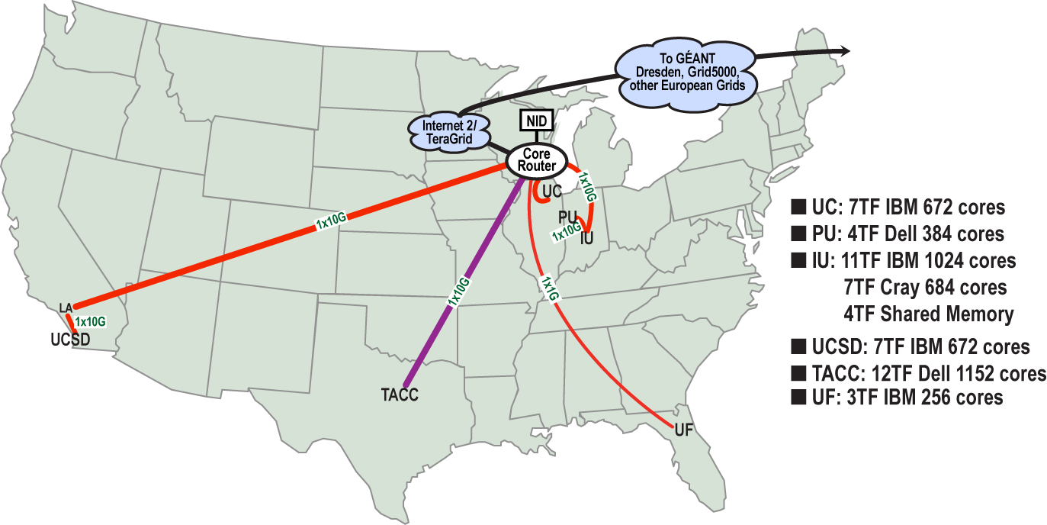
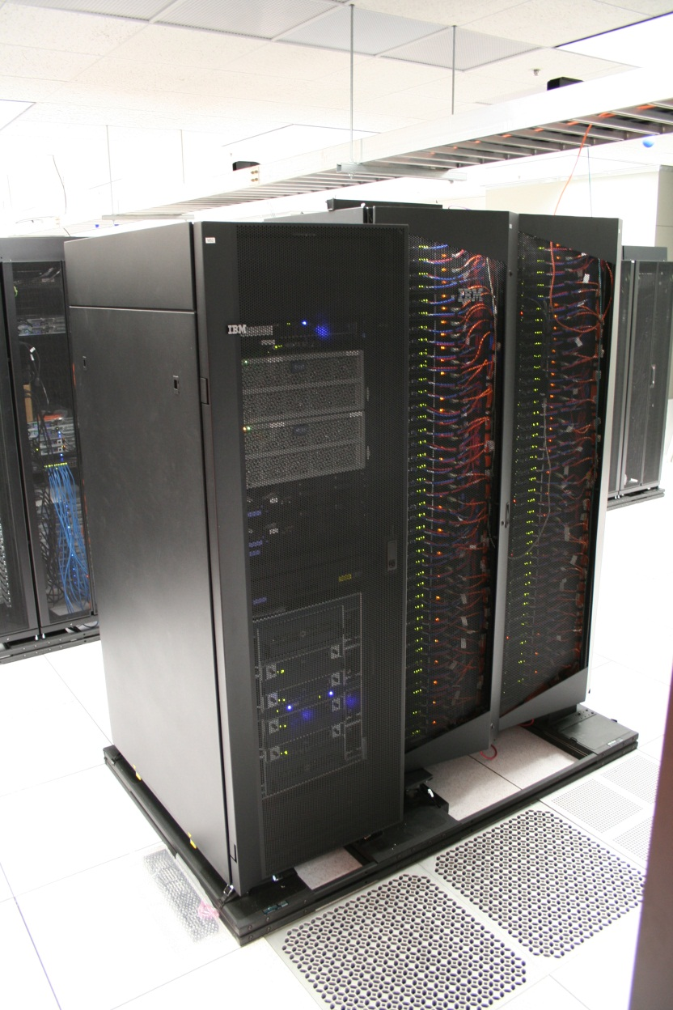
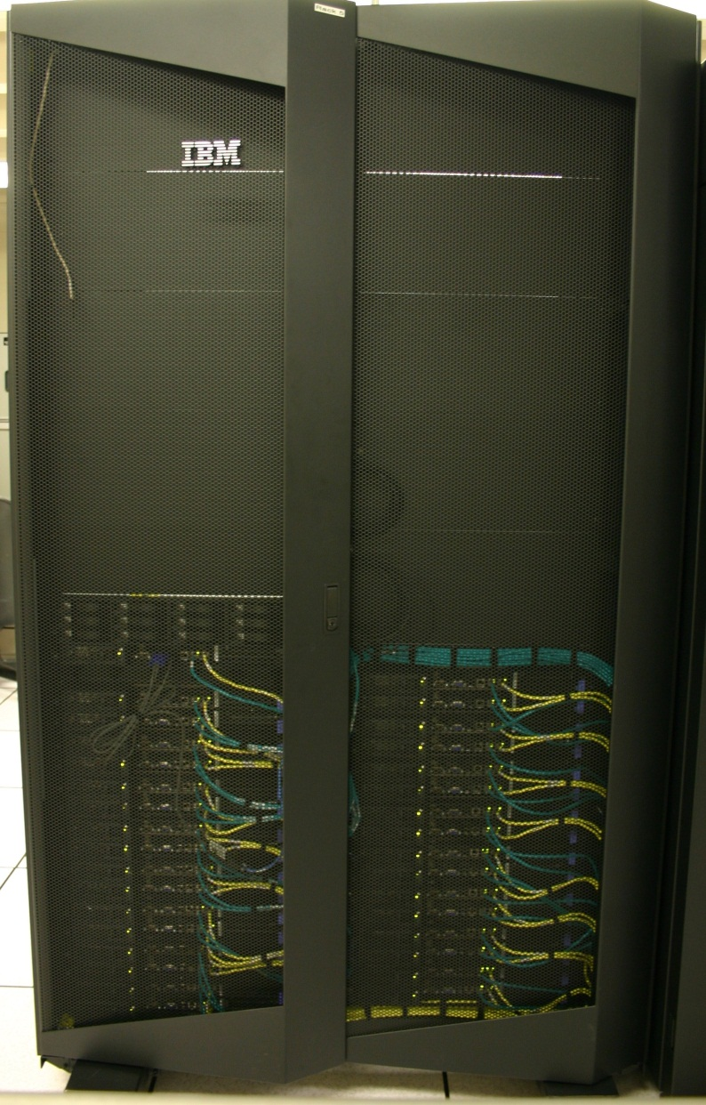
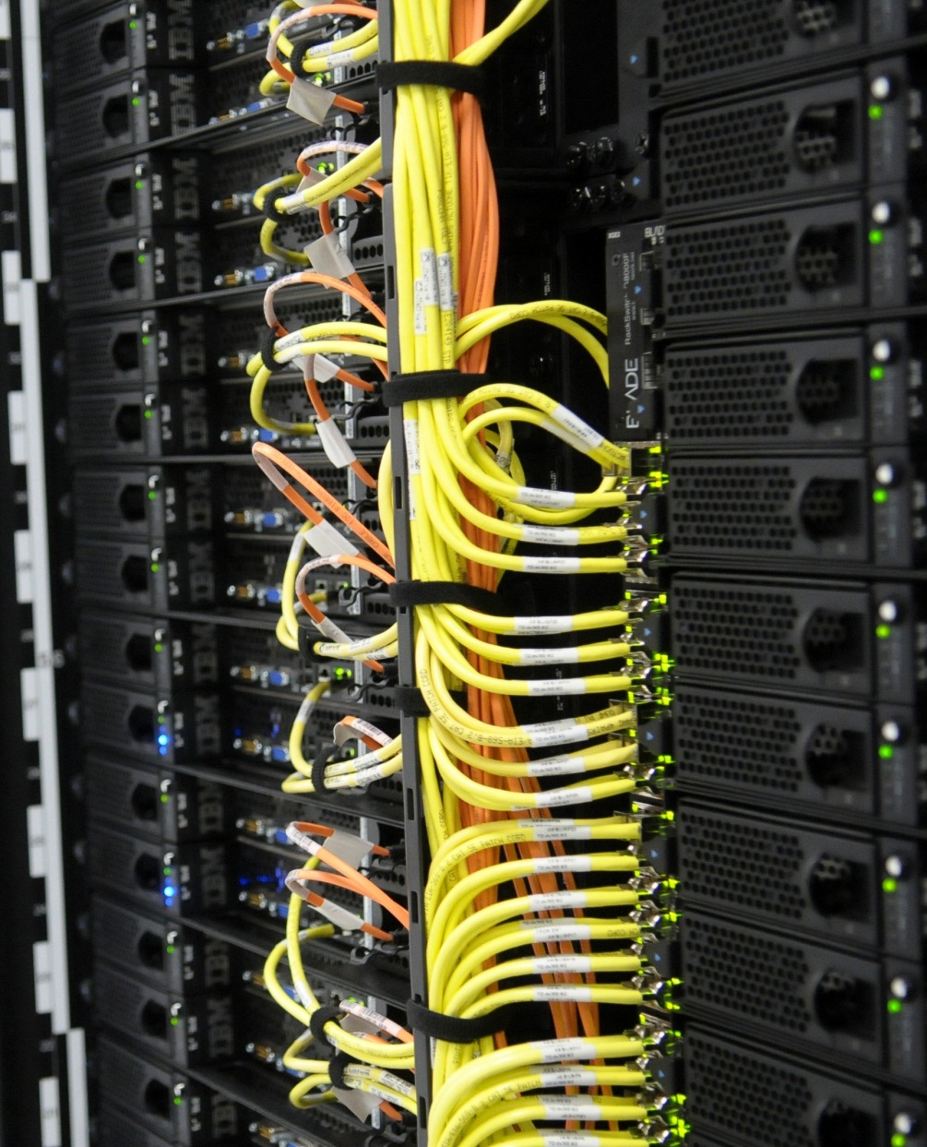
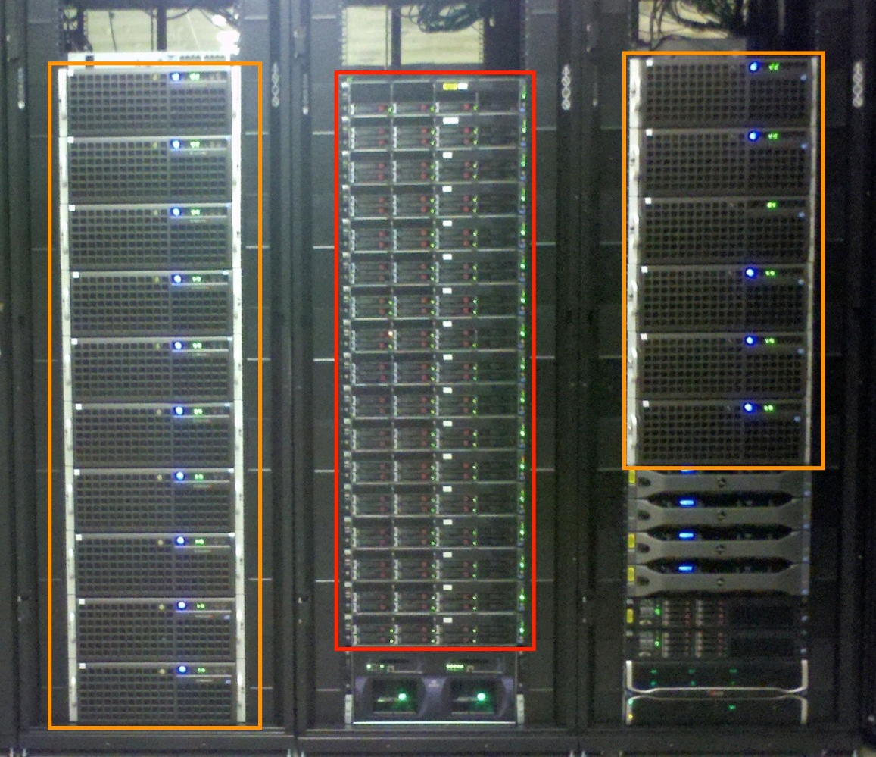
FutureGrid Computing Testbed as a Service
FutureGrid Computing Testbed as a Service
India (IBM) and Xray (Cray) (IU)
12TF Disk rich + GPU 512 cores
NID: Network Impairment Device
Private Public
FG Network
Bravo Delta (IU)
2
Sierra (SDSC)
Foxtrot (UF)
Alamo (TACC)
Hotel (Chicago)

Slide 3
FutureGrid offers
Computing Testbed as a Service
FutureGrid Uses
Testbed-aaS Tools
Provisioning
Image Management
IaaS Interoperability
IaaS tools
Expt management
Dynamic Network
Devops
Research
Computing
aaS
Custom Images
Courses
Consulting
Portals
Archival Storage
System e.g. SQL, GlobusOnline
Applications e.g. Amber, Blast
SaaS
4 FutureGrid Usages
Computer Science
Applications and understanding Science Clouds (Research Computing – aaS)
Technology Evaluation including XSEDE testing
Education and Training
Cloud e.g. MapReduce
HPC e.g. PETSc, SAGA
Computer Science e.g. Haskell
PaaS
Hypervisor
Bare Metal
Operating System
Virtual Clusters, Networks
IaaS

Slide 4
What to use in Clouds: Cloud PaaS
HDFS style file system to collocate data and computing
Queues to manage multiple tasks
Tables to track job information
MapReduce and Iterative MapReduce to support parallelism
Services for everything
Portals as User Interface
Appliances and Roles as customized images
Software tools like Google App Engine, memcached
Workflow to link multiple services (functions)
Data Parallel Languages like Pig; more successful than HPF?

Slide 5
What to use in Grids and Supercomputers? HPC (including Grid) PaaS
Services Portals and Workflow as in clouds
MPI and GPU/multicore threaded parallelism
GridFTP and high speed networking
Wonderful libraries supporting parallel linear algebra, particle evolution, partial differential equation solution
Globus, Condor, SAGA, Unicore, Genesis for Grids
Parallel I/O for high performance in an application
Wide area File System (e.g. Lustre) supporting file sharing
Scientific Visualization
Let’s unify Cloud and HPC PaaS and add Computer Science PaaS?

Slide 6
Computer Science PaaS
Tools to support Compiler Development
Performance tools at several levels
Components of Software Stacks
Experimental language Support
Messaging Middleware (Pub-Sub)
Semantic Web and Database tools
Simulators
System Development Environments
Open Source Software from Linux to Apache

Slide 7
Research Computing as a Service
Traditional Computer Center has a variety of capabilities supporting (scientific computing/scholarly research) users.
Could also call this Computational Science as a Service
IaaS, PaaS and SaaS are lower level parts of these capabilities but commercial clouds do not include
Developing roles/appliances for particular users
Supplying custom SaaS aimed at user communities
Community Portals
Integration across disparate resources for data and compute (i.e. grids)
Data transfer and network link services
Archival storage, preservation, visualization
Consulting on use of particular appliances and SaaS i.e. on particular software components
Debugging and other problem solving
Administrative issues such as (local) accounting
This allows us to develop a new model of a computer center where commercial companies operate base hardware/software
A combination of XSEDE, Internet2 and computer center supply 1) to 9)?

Slide 8
4 Use Types for FutureGrid TestbedaaS
223 approved projects (968 users) July 14 2012
USA, China, India, Pakistan, lots of European countries
Industry, Government, Academia
Training Education and Outreach (10%)
Semester and short events; interesting outreach to HBCU
Computer science and Middleware (59%)
Core CS and Cyberinfrastructure; Interoperability (2%) for Grids and Clouds; Open Grid Forum OGF Standards
Computer Systems Evaluation (29%)
XSEDE (TIS, TAS), OSG, EGI; Campuses
New Domain Science applications (26%)
Life science highlighted (14%), Non Life Science (12%)
Generalize to building Research Computing-aaS
Fractions are as of July 15 – add up to > 100%

Slide 9
Selected List of FutureGrid Services Offered
FutureGrid
IaaS
Nimbus
Cloud PaaS
Hadoop
Twister
HDFS
Swift Object Store
MPI
TestbedaaS
FG RAIN
Portal
Inca
Eucalyptus
OpenStack
ViNE
HPC PaaS
Ganglia
Devops
Exper. Manag./Pegasus
OpenMP
CUDA
Grid PaaS
Unicore
SAGA
Globus
Genesis II

Slide 10
Testbed as a Service
Experiment Management as a Service
Grids/HPC Platform as a Service
Research Computing as a Service
Computer Science as a Service
Infrastructure as a Service
Cloud Platform as a Service
Workflow, Script, Table, Queue
MPI, Libraries, GridFTP, Parallel IO, Wide area file system
Job Management Supports applications
Virtualization
Hypervisors
Virt. Networks
Portal
Hadoop
Iterative Mapreduce
Database
Compiler & Performance tools
Simulators
Messaging Middleware
Tools for Software Stack Engineering
Exp. Language support
Community Portal
Custom SaaS
Meshups: data and compute services
Analytic Services: Vizualization, …
Archival Services
Debugging
Administration
Supports Applications
The six paddles of a Testbed as a Service
Cultivating advanced Cyberinfrastructure Applications
G. C. Fox, G. von Laszewski

Slide 11
Expanding Resources in FutureGrid
We have a core set of resources but need to keep up to date and expand in size
Natural is to build large systems and support large experiments by federating hardware from several sources
Requirement is that partners in federation agree on and develop together TestbedaaS
Infrastructure includes networks, devices, edge (client) equipment

Slide 12
Core TestbedaaS Tools Architectural Overview
Notes:
This picture represents the architecture of our framework.
-we have devised a component for each one of the processes supporting the image life-cycle. This includes an
image generation component to create images following user requirements,
an image repository component to store, catalog and share images,
an image registration component for preparing, uploading and registering images into specific infrastructures such as HPC or different clouds. Once you have registered an image in a particular infrastructure, users can proceed to instantiate VMs or dynamic provision bare-metal machines with the image.
Users can access via a python API, a REST service, a convenient command line shell
------------------
One important feature in our design is how we are not simply storing an image but rather focusing on the way an image is created through abstract templating. Thus, it is possible at any time to regenerate an image based on the template describing the software stack and services for a given image. This enables us also to optimize the storage needs for users to manage many images. Instead of storing each image individually, we could just store the template or a pedigree of templates used to generate the images.
To aid storage reduction, our design includes data to assist in measuring usage and performance. This data can be used to purge rarely used images, while they can be recreated on- demand by leveraging the use of templating. Moreover, the use of abstract image templating will allow us to automatically generate images for a variety of hypervisors and hardware platforms on-demand. Autonomous services could be added to reduce the time needed to create images or deploy them in advance. Reusing images among groups of users and the introduction of a cache as part of the image generation will reduce the memory footprint or avoid the generation all together if an image with the same properties is already available.

Slide 13
Register Images on Cloud
Eucalyptus
OpenStack
Notes:
the figures use a stacked bar chart to depict the time spent in each phase of this process including (1) customization of the image, (2) retrieval of the image after customization, and (3) the upload and registration of the image to a cloud infrastructure.
We observe the time needed to customize the image (1) increases with the number of concurrent requests. This phase includes uncompressing the image to prepare the image to be uploaded and registered to the infrastructure. Therefore, when we process several images at the same time, this phase takes longer. To prevent resource starvation, we have introduced a parameter that limits the maximum number of request that are processed concurrently.
We observe that the time to register an image in OpenStack is higher than in Eucalyptus. This is based on two factors. First, in OpenStack, we need to include certain software to allow OpenStack to contextualize the VM (included in (1)). Second, the process to upload the image to the OpenStack cloud takes longer than in Eucalyptus as we can see in the yellow section. As part of this process, both frameworks compress and split the image in smaller tgz files that are uploaded to the IaaS server. The difference is that OpenStack uncompresses and changes the format of the image in the server side as part of this process, while Eucalyptus seems to maintain the original compressed version.
------------
Time needed to deploy an image in OpenStack is higher than in Eucalyptus
OpenStack we need to include certain software to allow OpenStack to contextualize the VM during the instantiation time
The process to upload the image to the OpenStack cloud takes longer than in Eucalyptus
OpenStack uncompress the image in the server side as part of this process, while Eucalyptus seem to maintain the compress version of the images
Occasionally OpenStack fails to upload some images when we perform several concurrent requests. These images get stuck in the untarring status and do not evolve to the available one. We suspect that it may be due to some problem with the messaging queue system of our OpenStack deployment, but we could not confirm that because the logs were not very helpful.

Slide 14
Register Image on HPC
Notes:
Finally, we show the results obtained from registering images in our HPC infrastructure utilizing Moab/xCAT. We distinguish the following phases (see Section IV-C) : (1) retrieve the image from the repository, (2) uncompress the image, (3) retrieve kernels and update the xCAT tables, and (4) package the image.
We observe that the overall process only takes about two minutes
The most time consuming parts are uncompress the image (orange part) and execute the xCAT packimage command
Creates a tar/cpio image that will be use to netboot bare-metal machines
-------------
The scalability of this service is limited because the packimage has to be executed in the machine where xCAT server is installed

Slide 15
Templated(Abstract) Dynamic Provisioning
Abstract Specification of image mapped to various HPC and Cloud environments
Essex replaces Cactus
Current Eucalyptus 3 commercial while version 2 Open Source

