Slide 1
FutureGrid
UAB Meeting
XSEDE13 San Diego
July 24 2013

Slide 2
Basic Status
FutureGrid has been running for 3 years
  322 projects; 1874 users
Funding available through September 30, 2014 with No Cost Extension which can be submitted in mid August (45 days prior to the formal expiration of the grant)
Participated in Computer Science activities (call for white papers and presentation to CISE director)
Participated in OCI solicitations
Pursuing GENI collaborations

Slide 3
Technology
OpenStack becoming best open source virtual machine management environment
  Also more reliable than previous versions of OpenStack and Eucalyptus
  Nimbus switch to OpenStack core with projects like Phantom
  In past Nimbus was essential as only reliable open source VM manager
XSEDE Integration has made major progress; 80% complete
These improvements/progress will allow much greater focus on TestbedaaS software
Solicitations motivated adding “On-ramp” capabilities; develop code on FutureGrid – Burst or Shift to other cloud or HPC systems (CloudMesh)

Slide 4
Assumptions
“Democratic” support of Clouds and HPC likely to be important
As a testbed, offer bare metal or clouds on a given node
Run HPC systems with similar tools to clouds so HPC bursting as well as Cloud bursting
Define images by templates that can be built for different HPC and cloud environments
Education integration important (MOOC’s)

Slide 5
Integrate MOOC Technology
We are building MOOC lessons to describe core FutureGrid Capabilities
  Come to 5pm OGF MOOC BOF
Will help especially educational uses
  28 Semester long classes: 563+ students
  Cloud Computing, Distributed Systems, Scientific Computing and Data Analytics
  3 one week summer schools: 390+ students
  Big Data, Cloudy View of Computing (for HBCU’s), Science Clouds
  7 one to three day workshop/tutorials: 238 students
Science Cloud Summer School available in MOOC format
First high level Software IP-over-P2P (IPOP)
Overview and Details of FutureGrid
How to get project, use HPC and use OpenStack

Slide 6
Online MOOC’s
Science Cloud MOOC repository
  http://iucloudsummerschool.appspot.com/preview
FutureGrid MOOC’s
  https://fgmoocs.appspot.com/explorer
A MOOC that will use FutureGrid for class laboratories (for advanced students in IU Online Data Science masters degree)
  https://x-informatics.appspot.com/course
MOOC Introduction to FutureGrid can be used by all classes and tutorials on FutureGrid
Currently use Google Course Builder: Google Apps + YouTube
  Built as collection of modular ~10 minute lessons

Slide 7
Recent FutureGrid
Software Efforts
Gregor von Laszewski, Geoffrey C. Fox
Indiana University

Slide 8
Selected List of Services Offered
IaaS
Nimbus
Cloud PaaS
Hadoop
Iterative MapReduce
HDFS
Hbase
Swift Object Store
MPI
TestbedaaS
Infrastructure: Inca, Ganglia
Eucalyptus
OpenStack
ViNE
HPCaaS
OpenMP
CUDA
GridaaS
Unicore
SAGA
Globus
Genesis
Provisioning: RAIN, CloudMesh
VMs: Phantom, CloudMesh
Experiments: Pegasus, Precip
Accounting: FG, XSEDE
FutureGrid

Slide 9
FutureGrid Testbed-aaS and User on-Ramp
Virtual Machine
Management
  Phantom
Provisioning Management
  Rain, cloudmesh
Experiment
Management
  Pegasus
  Precip
Information Services
  CloudMetrics
  Inca
Accounting
  FG Portal
  XSEDE Portal
Future Grid
TaaS
User On-Ramp
Amazon, Azure, FutureGrid, XSEDE,
OpenCirrus, ExoGeni, Other Science Clouds

Slide 10
Information Services I
Information Services
  Message-based Information System (SDSC, TACC)
    GLUE2 Inca, Ganglia.
    Candidate for XSEDE after FutureGrid test
  CloudMesh CloudMetrics
    Accounting integration (XSEDE)
    all events (logged)
    OpenStack, Eucalyptus, Nimbus
  Inca: service monitoring including history
    event sampling
  Others:
    Ganglia, Nagios

Slide 11
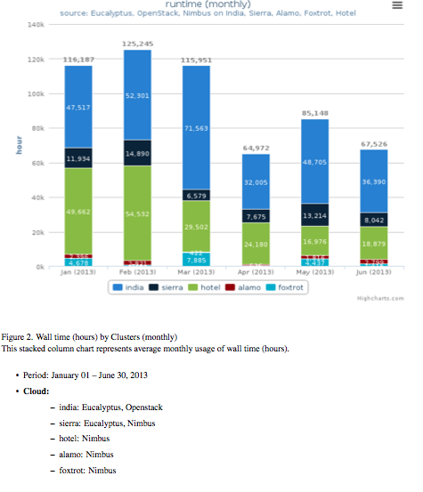
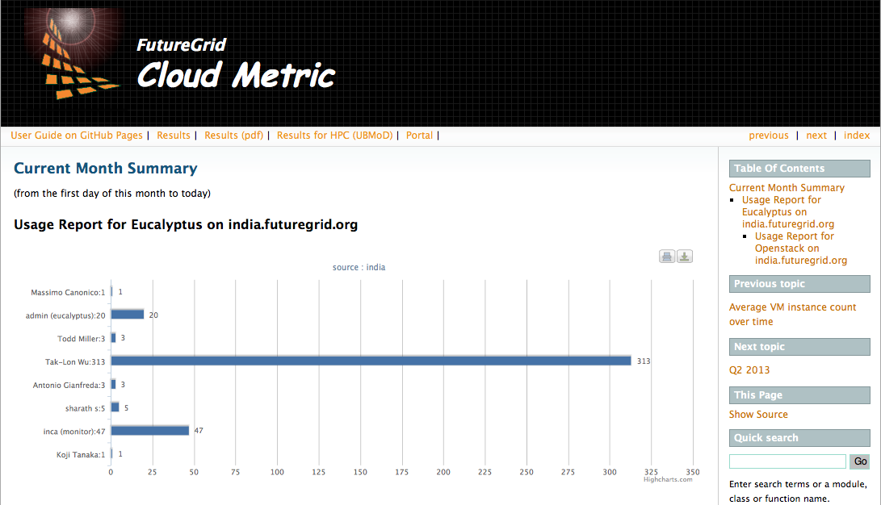
Information Services II
CloudMesh
CloudMetrics
  Report
  Portal
  CLI:
  cm> generate report
  API
  generate_report

Slide 12
XSEDE Integration
New Features
Changes
Project Request via XSEDE
  Initiated via XSEDE Portal
  Projects will be reviewed via Pops
  Accounts and projects will be created on FG
  FG summary metrics will be reported back to XSEDE
XSEDE:
  new pops testbeds object
  short lived projects
FG:
  FG simplified metrics for XSEDE. (FG has more Account information than XSEDE handles, Users with more need can goto FG portal, API, commandline tool)
  Ongoing: determination of Metric
    Fixed charge by day
    Wall clock time for vms used & managed
Planned Features
Explore TAS integration
Multiple Metrics
Multiple Resources

Slide 13
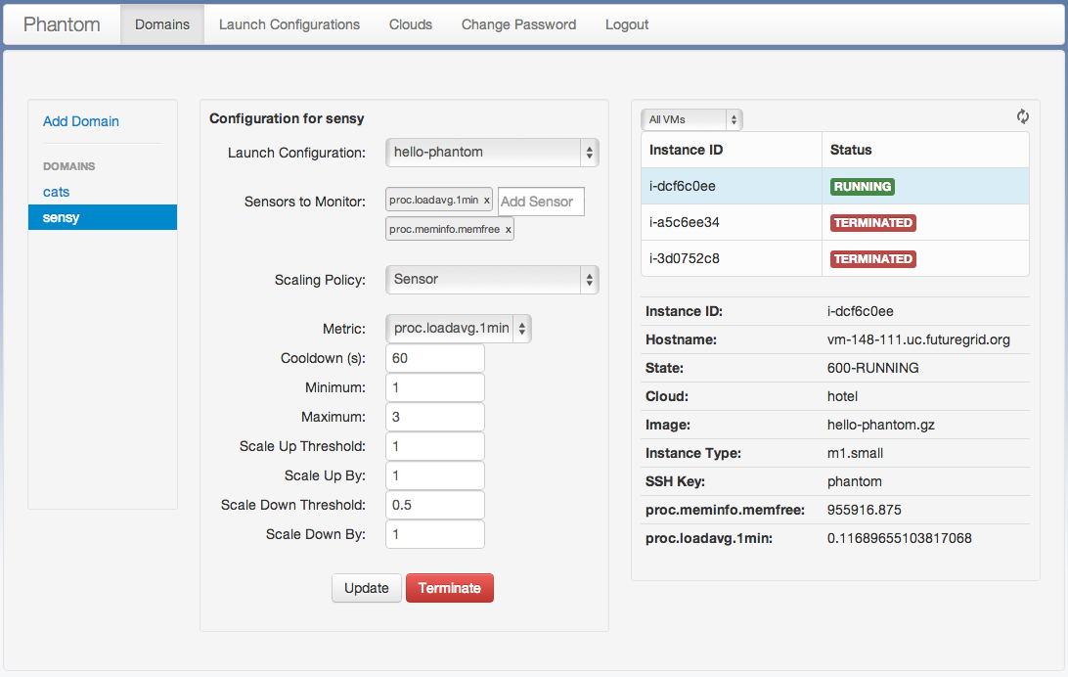
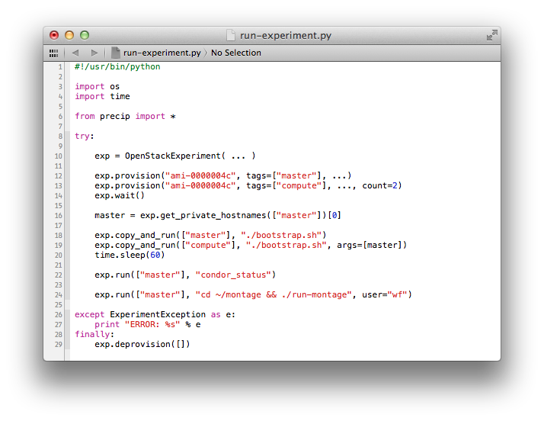
FG Partner Cloud Tools
Phantom
  Management of VMs
    Multiple clouds
    Fault tolerant
    On demand provisioning
    Sensors
    Euca2ools++
PRECIP
  Pegasus Repeatable Experiments for the Cloud in Python
  Extends VM management tools with
    Run shell script on VM
    Copy files to VM
    Managed via Condor

Slide 14
Dynamic Resourcing Capabilities underlying FutureGrid User-Ramp
Cloud/HPC Bursting
Resource(Cloud/HPC) Shifting or
Dynamic Resource Provisioning
Move workload (images/jobs) to other clouds (or HPC Clusters) in case your current resource gets over utilized.
Users do this
Providers do this
Schedulers do this
Add more resources to a cloud or HPC capability from resources that are not used or are underutilized.
Now doing this by hand
We are automatizing this
  PhD thesis
We want to integrate this with Cloud Bursting

Slide 15
CloudMesh
Requirements
Initial Release Capabilities
Support Shifting and Bursting
Support User-Ramp
Supports general commercial/academic cloud federation
Bare metal and Cloud (later) provisioning
Extensible architecture
Plugin mechanism
Security
Delivers API, services, command line, command shell that supports the tasks needed to conduct provisioning and shifting
Uniform API to multiple clouds via native protocol
  Important for scalability tests
  EC2 compatible tools and libraries are not enough (experience from FG)

Slide 16
CloudMesh Architecture
Notes:
Multiple components are part of cloudmesh. Cloudmesh is an umbrella for it. We are still debating about its name as we aslo could have used RAIN. But rain was initially just a small component and deals predominantly so far with templated image management

Slide 17
Rain
Current Features
Under Development
Manages images on VMs & Bare metal
  templated images
Uses low-level client libraries
  important for testing
Command shell
Moving of resources
  Eucalyptus, OpenStack, HPC
Provisioning via AMQP
Provisioning multiple clusters
  Provisioning Inventory for FG
  Provisioning Monitor
Provisioning command shell plugins
Provisioning Metrics

Slide 18
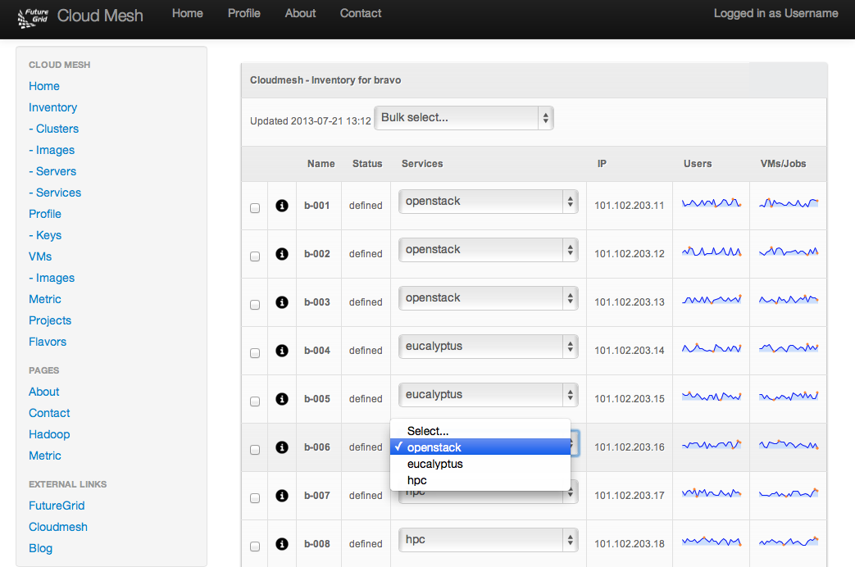
CloudMesh:
Example of Moving a Service

Slide 19
CloudMesh: Command Line Interface invoking dynamic provisioning
$ cm
FutureGrid - Cloud Mesh Shell
------------------------------------------------------
____ _ _ __ __ _
/ ___| | ___ _ _ __| | | \/ | ___ ___| |__
| | | |/ _ \| | | |/ _` | | |\/| |/ _ \/ __| '_ \
| |___| | (_) | |_| | (_| | | | | | __/\__ \ | | |
\____|_|\___/ \__,_|\__,_| |_| |_|\___||___/_| |_|
======================================================
cm> help
Documented commands (type help <topic>):
========================================
EOF dot2 graphviz inventory open project quit timer verbose
clear edit help keys pause py rst use version
cloud exec info man plugins q script var vm
cm>
Also REST interface
Python API
provision b-001 openstack

Slide 20
Next Steps: CloudMesh
CloudMesh Software
  First release end of August
  Deploy on FutureGrid
  Provide documentation
  Develop intelligent scheduler
    Ph.D. thesis
  Integrate with Chef
    Part of another thesis
Other bare-metal provisioners: OpenStack
Extend User On-Ramp features
Other frameworks can use CloudMesh
  e.g. Phantom, Precip

Slide 21
Acknowledgement
Sponsor:
  This material is based upon work supported in part by the National Science Foundation under Grant No. 0910812.
Citation:
  Fox, G., G. von Laszewski, et.al., “FutureGrid - a reconfigurable testbed for Cloud, HPC and Grid Computing”, Contemporary High Performance Computing: From Petascale toward Exascale, April, 2013. Editor J. Vetter. [pdf]
CloudMesh, Rain: Indiana Uinversity
Inca: SDSC
Precip: ISI
Phantom: UC

