Slide 1
Computing Research Testbeds as a Service: Supporting large scale Experiments and Testing
SC12 Birds of a Feather November 13 2012
José A.B. Fortes
Geoffrey Fox
Gregor von Laszewski
http://www.futuregrid.org

Slide 2
Some Existing Testbeds
Grid5000
Emulab (and PRObE Parallel Reconfigurable Observational Environment)
OpenCirrus
Planetlab
ExoGENI and ProtoGENI
FutureGrid
Production systems used in testing mode!
Production emphasizes stability; long jobs
Testbeds emphasize flexibility, interactivity and short(er) jobs

Slide 3
FutureGrid key Concepts
FutureGrid is an international testbed modeled on Grid5000
Supporting international Computer Science and Computational Science research in cloud, grid and parallel computing (HPC)
The FutureGrid testbed provides to its users:
A flexible development and testing platform for middleware and application users looking at interoperability, functionality, performance or evaluation
FutureGrid is user-customizable, accessed interactively and supports Grid, Cloud and HPC software with and without VM’s
A rich education and teaching platform for classes
See G. Fox, G. von Laszewski, J. Diaz, K. Keahey, J. Fortes, R. Figueiredo, S. Smallen, W. Smith, A. Grimshaw, FutureGrid - a reconfigurable testbed for Cloud, HPC and Grid Computing, Bookchapter – draft

Slide 4
FutureGrid Offers
Common Clouds:
OpenStack, Eucalyptus, Nimbus, (OpenNebula)
HPC
MPI, …
Dynamic Provisioning
Replace OS on a Node
RAIN
Place Templated Images on HPC, Eucalyptus, and OpenStack
Demonstrated Feasibility and Usefulness of Cloud-shifting
e.g. Assign resources (servers) to a cloud on demand
Demonstrated during the Cloud Summer School July 2012 at Indiana University on the cluster India

Slide 5
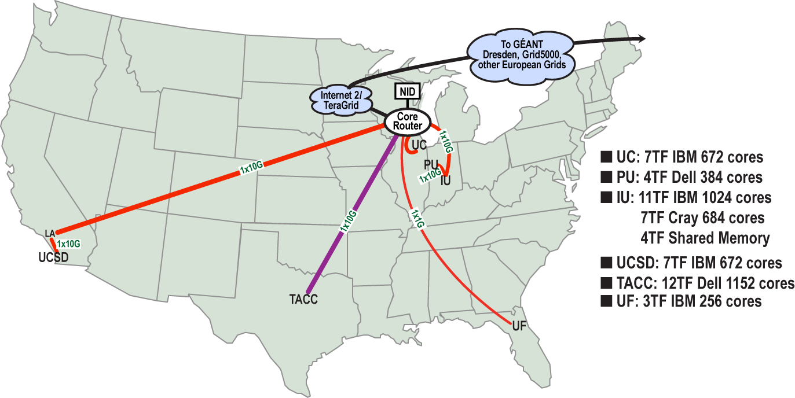
FutureGrid Grid supports Cloud Grid HPC Computing Testbed as a Service (aaS)
12TF Disk rich + GPU 512 cores
NID: Network Impairment Device
Private Public
FG Network
5

Slide 6
4 Use Types for FutureGrid TestbedaaS
275 approved projects (1400 users) November 13 2012
USA, China, India, Pakistan, lots of European countries
Industry, Government, Academia
Training Education and Outreach (10%)
Semester and short events; interesting outreach to HBCU
Computer science and Middleware (59%)
Core CS and Cyberinfrastructure; Interoperability (2%) for Grids and Clouds; Open Grid Forum OGF Standards
Computer Systems Evaluation (29%)
XSEDE (TIS, TAS), OSG, EGI; Campuses
New Domain Science applications (26%)
Life science highlighted (14%), Non Life Science (12%)
Generalize to building Research Computing-aaS
Fractions are as of July 15 2012 add to > 100%

Slide 7
Learning from FutureGrid
Architecture of TestbedaaS
Extend current IaaS dynamic provisioning to IaaS+NaaS
Generate a cross-continent distributed system on demand with
Desired O/S, hypervisor or not
Optimized networking
All software defined without systems admins
Form a group of interested researchers/developers
Need broader choice in hardware
Form an international collaboration
Use most appropriate solution
Commercial clouds could be best solution for some users

Slide 8
FutureGrid offers
Computing Testbed as a Service
FutureGrid Uses
Testbed-aaS Tools
Provisioning
Image Management
IaaS Interoperability
NaaS, IaaS tools
Expt management
Dynamic IaaS NaaS
Devops
CS Research Use e.g. test new compiler or storage model
Class Usages e.g. run GPU & multicore
Applications
Software
(Application
Or Usage) SaaS
Cloud e.g. MapReduce
HPC e.g. PETSc, SAGA
Computer Science e.g. Compiler tools, Sensor nets, Monitors
FutureGrid Usages
Computer Science
Applications and understanding Science Clouds
Technology Evaluation including XSEDE testing
Education & Training
Platform PaaS
Infra
structure
IaaS
Software Defined Computing (virtual Clusters)
Hypervisor, Bare Metal
Operating System
Network
NaaS
Software Defined Networks
OpenFlow GENI

Slide 9
Technical Architecture of TestbedaaS

