Slide 1
FutureGrid Services II
Using HPC Systems MapReduce & Eucalyptus on FutureGrid
FutureGrid Tutorial at PPAM 2011
Torun Poland
September 11 2011
Gregory G. Pike,
Andrew Younge,
Geoffrey Fox,
Gregor von Laszewski
http://futuregrid.org

Slide 2
A brief overview
  FutureGrid is a testbed
    Varied resources with varied capabilities
    Support for grid, cloud, HPC
    Continually evolving
    Sometimes breaks in strange and unusual ways
  FutureGrid as an experiment
    We’re learning as well
    Adapting the environment to meet user needs
http://futuregrid.org

Slide 3
Getting Started
  Getting an account
  Logging in
  Setting up your environment
  Writing a job script
  Looking at the job queue
  Why won’t my job run?
  Getting your job to run sooner
    http://portal.futuregrid.org/manual
    http://portal.futuregrid.org/tutorials
http://futuregrid.org

Slide 4
Getting an account
  Upload your ssh key to the portal, if you have not done that when you created the portal account
    Account -> Portal Account
      Edit the ssh key
      Include the public portion of your SSH key!
      Use a passphrase when generating the key!!!!!
  Request a FutureGrid HPC/Nimbus Account
    Account -> HPC & Nimbus
  This process may take up to 3 days.
    If it’s been longer than a week, send email
    We do not do any account management over weekends!
http://futuregrid.org

Slide 5
Generating an SSH key pair
  For Mac or Linux users
    ssh-keygen –t rsa
    Copy ~/.ssh/id_rsa.pub to the web form
  For Windows users, this is more difficult
    Download putty.exe and puttygen.exe
    Puttygen is used to generate an SSH key pair
      Run puttygen and click “Generate”
    The public portion of your key is in the box labeled “SSH key for pasting into OpenSSH authorized_keys file”
http://futuregrid.org
Notes:
-c comment

Slide 6
Logging in
  You must be logging in from a machine that has your SSH key
  Use the following command (on Linux/OSX):
    ssh username@india.futuregrid.org
  Substitute username with your FutureGrid account
http://futuregrid.org

Slide 7
Now you are logged in.
What is next?

Slide 8
Setting up your environment
  Modules is used to manage your $PATH and other environment variables
  A few common module commands
    module avail – lists all available modules
    module list – lists all loaded modules
    module load – adds a module to your environment
    module unload – removes a module from your environment
    module clear –removes all modules from your environment
http://futuregrid.org

Slide 9
Writing a job script
A job script has PBS directives followed by the commands to run your job
At least specify –l and –q options
The rest is a normal bash script, add whatever you want!
#!/bin/bash
#PBS -N testjob
#PBS -l nodes=1:ppn=8
#PBS –q batch
#PBS –M username@example.com
##PBS –o testjob.out
#PBS -j oe
#
sleep 60
hostname
echo $PBS_NODEFILE
cat $PBS_NODEFILE
sleep 60
http://futuregrid.org

Slide 10
Writing a job script
  Use the qsub command to submit your job
    qsub testjob.pbs
  Use the qstat command to check your job
  > qsub testjob.pbs
  25265.i136
  > qstat
  Job id Name User Time Use S Queue
  ---------- ------------ ----- -------- - ------
  25264.i136 sub27988.sub inca 00:00:00 C batch
  25265.i136 testjob gpike 0 R batch
http://futuregrid.org

Slide 11
Looking at the job queue
  Both qstat and showq can be used to show what’s running on the system
  The showq command gives nicer output
  The pbsnodes command will list all nodes and details about each node
  The checknode command will give extensive details about a particular node
  Run module load moab to add commands to path
http://futuregrid.org

Slide 12
Why won’t my job run?
  Two common reasons:
    The cluster is full and your job is waiting for other jobs to finish
    You asked for something that doesn’t exist
      More CPUs or nodes than exist
    The job manager is optimistic!
      If you ask for more resources than we have, the job manager will sometimes hold your job until we buy more hardware
http://futuregrid.org

Slide 13
Why won’t my job run?
  Use the checkjob command to see why your job will not run
  > checkjob 319285
  job 319285
  Name: testjob
  State: Idle
  Creds: user:gpike group:users class:batch qos:od
  WallTime: 00:00:00 of 4:00:00
  SubmitTime: Wed Dec 1 20:01:42
  (Time Queued Total: 00:03:47 Eligible: 00:03:26)
  Total Requested Tasks: 320
  Req[0] TaskCount: 320 Partition: ALL
  Partition List: ALL,s82,SHARED,msm
  Flags: RESTARTABLE
  Attr: checkpoint
  StartPriority: 3
  NOTE: job cannot run (insufficient available procs: 312 available)
http://futuregrid.org

Slide 14
Why won’t my job run?
  If you submitted a job that cannot run, use qdel to delete the job, fix your script, and resubmit the job
    qdel 319285
  If you think your job should run, leave it in the queue and send email
  It’s also possible that maintenance is coming up soon
http://futuregrid.org

Slide 15
Making your job run sooner
  In general, specify the minimal set of resources you need
    Use minimum number of nodes
    Use the job queue with the shortest max walltime
      qstat –Q –f
    Specify the minimum amount of time you need for the job
      qsub –l walltime=hh:mm:ss
http://futuregrid.org

Slide 16
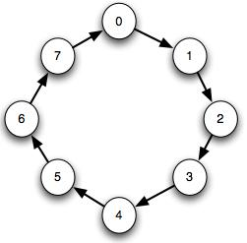
Example with MPI
Run through a simple example of an MPI job
  Ring algorithm passes messages along to each process as a chain or string
  Use Intel compiler and mpi to compile & run
  Hands on experience with PBS scripts

Slide 17
#PBS -N hello-mvapich-intel
#PBS -l nodes=4:ppn=8
#PBS -l walltime=00:02:00
#PBS -k oe
#PBS -j oe
EXE=$HOME/mpiring/mpiring
echo "Started on `/bin/hostname`"
echo
echo "PATH is [$PATH]"
echo
echo "Nodes chosen are:"
cat $PBS_NODEFILE
echo
module load intel intelmpi
mpdboot -n 4 -f $PBS_NODEFILE -v --remcons
mpiexec -n 32 $EXE
mpdallexit

Slide 18
Lets Run
> cp /share/project/mpiexample/mpiring.tar.gz .
> tar xfz mpiring.tar.gz
> cd mpiring
> module load intel intelmpi moab
Intel compiler suite version 11.1/072 loaded
Intel MPI version 4.0.0.028 loaded
moab version 5.4.0 loaded
> mpicc -o mpiring ./mpiring.c
> qsub mpiring.pbs
100506.i136
> cat ~/hello-mvapich-intel.o100506
...

Slide 19
MapReduce on FutureGrid
Shava Smallen, Andrew Younge, Geoffrey Fox

Slide 20
Why MapReduce?
Largest (in data processed) parallel computing platform today as runs information retrieval engines at Google, Yahoo and Bing.
Portable to Clouds and HPC systems
Has been shown to support much data analysis
It is “disk” (basic MapReduce) or “database” (DrayadLINQ) NOT “memory” oriented like MPI; supports “Data-enabled Science”
Fault Tolerant and Flexible
Interesting extensions like Pregel and Twister (Iterative MapReduce)
Spans Pleasingly Parallel, Simple Analysis (make histograms) to main stream parallel data analysis as in parallel linear algebra
  Not so good at solving PDE’s

Slide 21
Application Classification:
MapReduce and MPI
(a) Map Only
(b) Classic MapReduce
(c) Iterative MapReduce
(d) Loosely Synchronous
Input
Input
Iterations
Input
map
map
map
P_{ij}
reduce
reduce
Output
BLAST Analysis
Smith-Waterman Distances
Parametric sweeps
PolarGrid Matlab data analysis
High Energy Physics (HEP) Histograms
Distributed search
Distributed sorting
Information retrieval
Expectation maximization clustering e.g. Kmeans
Linear Algebra
Multimensional Scaling
Page Rank
Many MPI scientific applications such as solving differential equations and particle dynamics
Domain of MapReduce and Iterative Extensions
MPI

Slide 22
Microsoft Wants to Make It Easy for Academics to Analyze ‘Big Data’
July 18, 2011, 2:04 pm By Josh Fischman
http://chronicle.com/blogs/wiredcampus/microsoft-wants-to-make-it-easy-for-academics-to-analyze-big-data/32265
The enormous amount of data that scholars can generate now can easily overwhelm their desktops and university computing centers. Microsoft Corporation comes riding to the rescue with a new project called Daytona, unveiled at the Microsoft Research Faculty Summit on Monday. Essentially, it’s a tool—a free one—that connects these data to Microsoft’s giant data centers, and lets scholars run ready-made analytic programs on them. It puts the power of cloud computing at every scholar’s fingertips, says Tony Hey, corporate vice president of Microsoft Research Connections, as crunching “Big Data” becomes an essential part of research in health care, education, and the environment.
Researchers don’t need to know how to code for the cloud, for virtual machines, or to write their own software, Mr. Hey says. “What we do needs to be relevant to what academics want,” he says, and what they want is to spend time doing research and not writing computer programs. The idea grew out of academe, he adds, with roots in an open-source computing project led by Geoffrey Fox, a professor at Indiana University who directs the Digital Science Center there.
This is Iterative MapReduce (aka Twister) on Azure; portably runs on HPC at FutureGrid (with Excel front end)

Slide 23
MapReduce
Data Partitions
Map(Key, Value)
A hash function maps the results of the map tasks to reduce tasks
Reduce(Key, List<Value>)
Reduce Outputs
Implementations (Hadoop – Java; Dryad – Windows) support:
  Splitting of data with customized file systems
  Passing the output of map functions to reduce functions
  Sorting the inputs to the reduce function based on the intermediate keys
  Quality of service
20 petabytes per day (on an average of 400 machines) processed by Google using MapReduce September 2007

Slide 24
MapReduce: The Map Step
Input
key-value pairs
Intermediate
key-value pairs
k
v
map
k
v
k
v
map
k
v
k
v
…
…
k
v
k
v

Slide 25
The Map (Example)
inputs
tasks (M=3)
partitions (intermediate files) (R=2)
When in the course of human events it …
map
(when,1), (course,1) (human,1) (events,1) (best,1) …
(in,1) (the,1) (of,1) (it,1) (it,1) (was,1) (the,1) (of,1) …
It was the best of times and the worst of times…
Over the past five years, the authors and many…
map
(over,1), (past,1) (five,1) (years,1) (authors,1) (many,1) …
(the,1), (the,1) (and,1) …
This paper evaluates the suitability of the …
map
(this,1) (paper,1) (evaluates,1) (suitability,1) …
(the,1) (of,1) (the,1) …

Slide 26
MapReduce: The Reduce Step
Output
key-value pairs
Intermediate
key-value pairs
Key-value groups
reduce
k
v
k
v
v
v
k
v
reduce
k
v
k
v
v
k
v
group
k
v
…
…
…
k
v
k
v
k
v

Slide 27
The Reduce (Example)
partition (intermediate files) (R=2)
reduce task
(in,1) (the,1) (of,1) (it,1) (it,1) (was,1) (the,1) (of,1) …
sort
run-time function
(the,1), (the,1) (and,1) …
(the,1) (of,1) (the,1) …
(and, (1)) (in,(1)) (it, (1,1)) (the, (1,1,1,1,1,1))
(of, (1,1,1)) (was,(1))
reduce
(and,1) (in,1) (it, 2) (of, 3) (the,6) (was,1)
Note: only one of the two reduce tasks shown

Slide 28
Generalizing Information Retrieval
But you input anything from genome sequences to HEP events as well as documents
You can map them with an arbitrary program
You can reduce with an arbitrary reduction including all of those in MPI_(ALL)REDUCE
In Twister you can iterate this

Slide 29






MapReduce “File/Data Repository” Parallelism
Map = (data parallel) computation reading and writing data
Reduce = Collective/Consolidation phase e.g. forming multiple global sums as in histogram
Instruments
MPI or Iterative MapReduce
Map Reduce Map Reduce Map
Communication
Reduce
Portals
/Users
Disks
Map₁
Map₂
Map₃

Slide 30

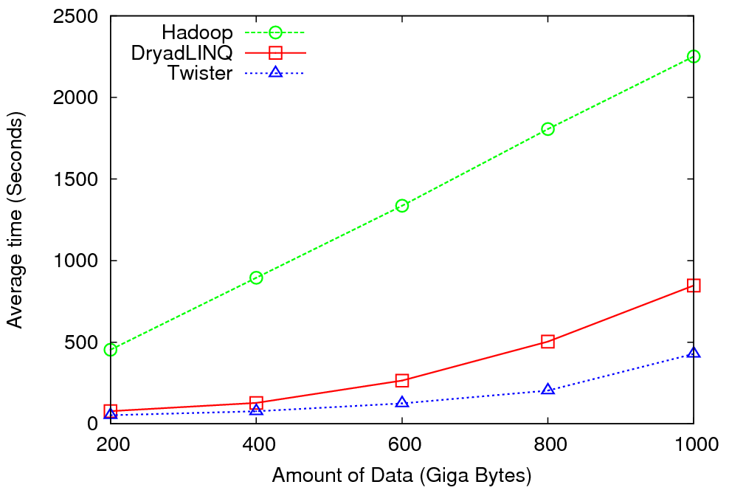
High Energy Physics Data Analysis
An application analyzing data from Large Hadron Collider
(1TB but 100 Petabytes eventually)
Input to a map task: <key, value>
key = Some Id value = HEP file Name
Output of a map task: <key, value>
key = random # (0<= num<= max reduce tasks)
value = Histogram as binary data
Input to a reduce task: <key, List<value>>
key = random # (0<= num<= max reduce tasks)
value = List of histogram as binary data
Output from a reduce task: value
value = Histogram file
Combine outputs from reduce tasks to form the final histogram

Slide 31
Cap3 Cost
Notes:
This is just the cost for the compute instances. In addition to this, there will be minor charges for the data storage for EMR & AzureMR. Also there will be additional minor charges for the queue service and table service for AzureMR.
Cost presented here are amortized for the actual time (time/3600 * num_instances * instance_price_per_hour), assuming the remaining time of the instance hour have been put to useful work.
Note: EMR & Hadoop-EC2 requires one extra node to act as the master node (included in the cost calculation)

Slide 32
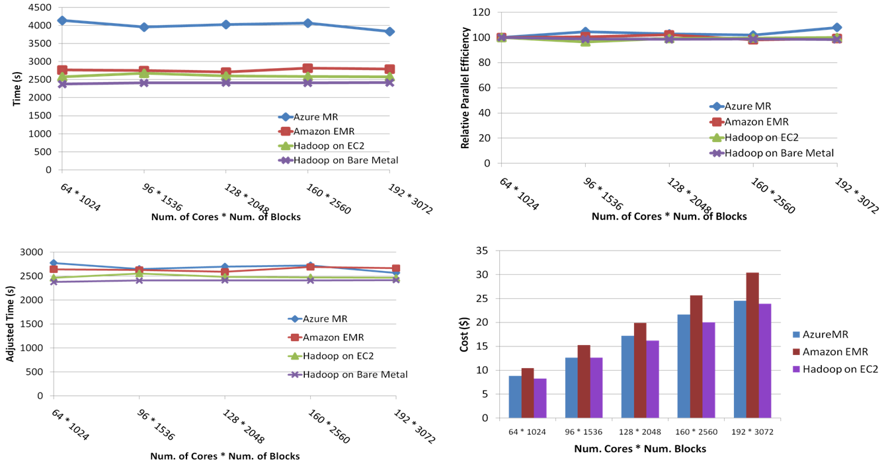
SWG Sequence Alignment Performance
Smith-Waterman-GOTOH to calculate all-pairs dissimilarity
Notes:
~123 million sequence alignments, for under 30$ with zero up front hardware cost,

Slide 33

Twister v0.9
March 15, 2011
  New Interfaces for Iterative MapReduce Programming
  http://www.iterativemapreduce.org/
SALSA Group
Bingjing Zhang, Yang Ruan, Tak-Lon Wu, Judy Qiu, Adam Hughes, Geoffrey Fox, Applying Twister to Scientific Applications, Proceedings of IEEE CloudCom 2010 Conference, Indianapolis, November 30-December 3, 2010
Twister4Azure released May 2011
http://salsahpc.indiana.edu/twister4azure/
MapReduceRoles4Azure available for some time at
http://salsahpc.indiana.edu/mapreduceroles4azure/

Slide 34

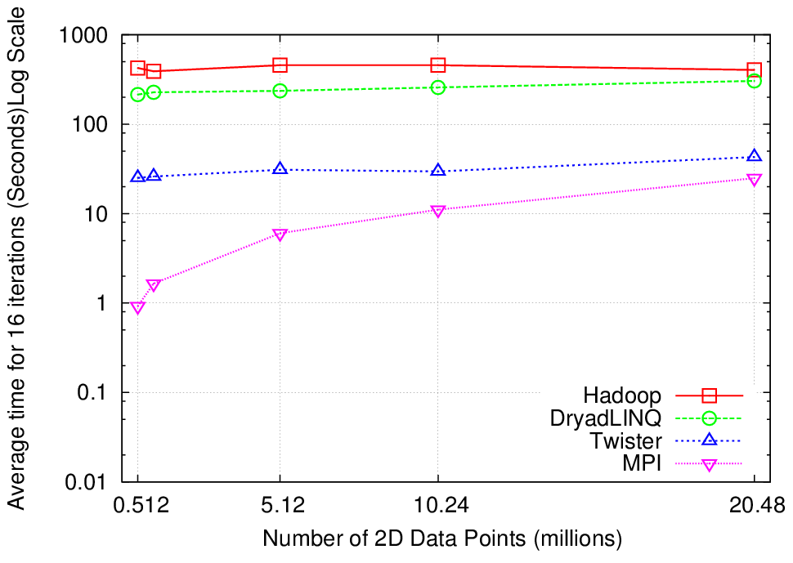
K-Means Clustering
Compute the distance to each data point from each cluster center and assign points to cluster centers
map
map
Time for 20 iterations
reduce
Compute new cluster
centers
User program
Compute new cluster centers
Iteratively refining operation
Typical MapReduce runtimes incur extremely high overheads
  New maps/reducers/vertices in every iteration
  File system based communication
Long running tasks and faster communication in Twister enables it to perform close to MPI

Slide 35


Twister
Pub/Sub Broker Network
Map Worker
M
Worker Nodes
R
Reduce Worker
Streaming based communication
Intermediate results are directly transferred from the map tasks to the reduce tasks – eliminates local files
Cacheable map/reduce tasks
  Static data remains in memory
Combine phase to combine reductions
User Program is the composer of MapReduce computations
Extends the MapReduce model to iterative computations
D
D
MR
Driver
User
Program
M
M
M
M
D
MRDeamon
R
R
R
R
Data Read/Write
Communication
Data Split
File System
Iterate
Static
data
Configure()
User Program
Map(Key, Value)
δ flow
Reduce (Key, List<Value>)
Combine (Key, List<Value>)
Different synchronization and intercommunication mechanisms used by the parallel runtimes
Close()

Slide 36

Performance of Pagerank using
ClueWeb Data (Time for 20 iterations)
using 32 nodes (256 CPU cores) of Crevasse

Slide 37
Iterative MapReduce for Azure
Merge Step
In-Memory Caching of static data
Cache aware hybrid scheduling using Queues as well as using a bulletin board (special table)

Slide 38




Performance –
Kmeans Clustering
Performance with/without
data caching
Speedup gained using data cache
Scaling speedup
Increasing number of iterations
Notes:
KMeans iterative MapReduce performance. 16 Azure Small instances, 6 iterations, 8 to 48 million 20-D data points.
Left: Performance with and without data caching.
Right: Speedup obtained from using the data cache
Left: Scaling speedup with increasing number of instances (Azure Small) & data for 10 iterations.
Right: Increasing number of iterations using 16 million data points with caching using 16 Azure Small instances.

Slide 39

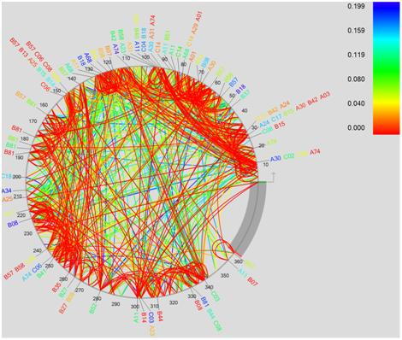
Performance Comparisons
BLAST Sequence Search
Smith Watermann
Sequence Alignment
Cap3 Sequence Assembly

Slide 40
Twister as Map Collective
Input
Iterations
User Program
map
Initial Collective Step
Network of Brokers
reduce
Final Collective Step
Network of Brokers

Slide 41
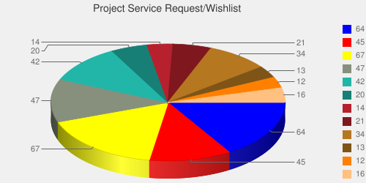
Usage Statistics from FutureGrid
Based on User input we focused on
  Nimbus (53%)
  Eucalyptus (51%)
  Hadoop (37%)
  HPC (36%)
Eucalyptus: 64(50.8%)
High Performance Computing Environment: 45(35.7%)
Nimbus: 67(53.2%)
Hadoop: 47(37.3%)
MapReduce: 42(33.3%)
Twister: 20(15.9%)
OpenNebula: 14(11.1%)
Genesis II: 21(16.7%)
Common TeraGrid Software Stack: 34(27%)
Unicore 6: 13(10.3%)
gLite: 12(9.5%)
OpenStack: 16(12.7%)

Slide 42


Hadoop on FutureGrid
Goal:
  Simplify running Hadoop jobs thru FutureGrid batch queue systems
  Allows user customized install of Hadoop
Status and Milestones
  Today
    myHadoop 0.2a released early this year, deployed to Sierra and India, tutorial available
  In future
    deploy to Alamo, Hotel, Xray (end of year 2)

Slide 43
Many FutureGrid uses of MapReduce demonstrated in various Tutorials
https://portal.futuregrid.org/tutorials
Running Hadoop as a batch job using MyHadoop
  Useful for coordinating many hadoop jobs through the HPC system and queues
Running Hadoop on Eucalyptus
  Running hadoop in a virtualized environment
Running Hadoop on the Grid Appliance
  Running haddop in a virtualized environment
  Benefit from easy setup
Eucalyptus and Twister on FG
  Those wanting to use the Twister Iterative MapReduce
Could organize workshops, seminars and/or increase online material.

Slide 44


















300+ Students learning about Twister & Hadoop
MapReduce technologies, supported by FutureGrid.
July 26-30, 2010 NCSA Summer School Workshop
http://salsahpc.indiana.edu/tutorial
Washington
University
University of
Minnesota
Michigan
State
Johns
Hopkins
Univ.Illinois
at Chicago
Iowa
Penn
State
IBM Almaden
Research Center
Notre
Dame
University of
California at
Los Angeles
Indiana
University
San Diego
Supercomputer
Center
University of
Texas at El Paso
University of
Arkansas
University
of Florida

Slide 45


ADMI Cloudy View on
Computing Workshop June 2011
Concept and Delivery by
Jerome Mitchell:
Undergraduate ECSU,
Masters Kansas, PhD (in progress)Indiana
Jerome took two courses from IU in this area Fall 2010 and Spring 2011 on FutureGrid
ADMI: Association of Computer and Information Science/Engineering Departments at Minority Institutions
10 Faculty and Graduate Students from ADMI Universities
Included bootcamp on Mapreduce illustrated with case studies of scientific applications on FutureGrid.
At the conclusion of the workshop, the participants indicated that they would incorporate cloud computing into their courses and/or research.

Slide 46
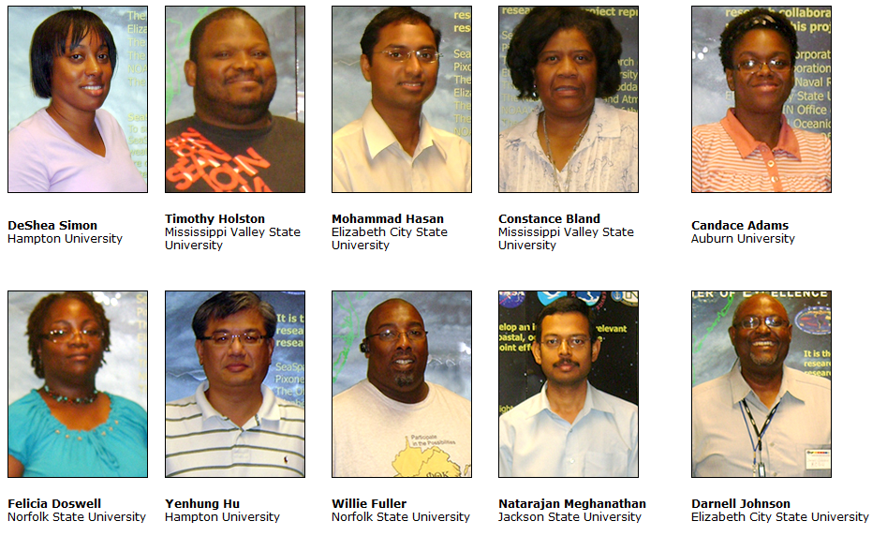
ADMI Cloudy View on Computing Workshop Participants

Slide 47


Hadoop
Hadoop provides an open source implementation of MapReduce and HDFS.
myHadoop provides a set of scripts to configure and run Hadoop within an HPC environment
  From San Diego Supercomputer Center
  Available on India, Sierra, and Alamo systems within FutureGrid

Slide 48
myHadoop
Log into to india & load mymadoop
user@host:$ ssh user@india.futuregrid.org
[user@i136 ~]$ module load myhadoop
myHadoop version 0.2a loaded
[user@i136 ~]$ echo $MY_HADOOP_HOME
/N/soft/myHadoop

Slide 49
myHadoop
Create a PBS Job
#PBS -q batch
#PBS -N hadoop_job
#PBS -l nodes=4:ppn=1
#PBS -o hadoop_run.out
#PBS -e hadoop_run.err
#PBS –V
module load java
#### Set this to the directory where Hadoop configs should be generated
#...
export HADOOP_CONF_DIR="${HOME}/myHadoop-config"

Slide 50
myHadoop
#### Start the Hadoop cluster
echo "Start all Hadoop daemons"
$HADOOP_HOME/bin/start-all.sh
#$HADOOP_HOME/bin/hadoop dfsadmin -safemode leave
#### Run your jobs here
echo "Run some test Hadoop jobs"
$HADOOP_HOME/bin/hadoop --config $HADOOP_CONF_DIR dfs -mkdir Data
$HADOOP_HOME/bin/hadoop --config $HADOOP_CONF_DIR dfs -copyFromLocal $MY_HADOOP_HOME/gutenberg Data
$HADOOP_HOME/bin/hadoop --config $HADOOP_CONF_DIR dfs -ls Data/gutenberg
$HADOOP_HOME/bin/hadoop --config $HADOOP_CONF_DIR jar $HADOOP_HOME/hadoop-0.20.2-examples.jar wordcount Data/gutenberg Outputs
$HADOOP_HOME/bin/hadoop --config $HADOOP_CONF_DIR dfs -ls Outputs
$HADOOP_HOME/bin/hadoop --config $HADOOP_CONF_DIR dfs -copyToLocal Outputs ${HOME}/Hadoop-Outputs

Slide 51
myHadoop
Submit a job
[user@i136 ~]$ qsub pbs-example.sh
125525.i136
[user@i136 ~]$ qstat -u user
i136:
Req'd Req'd Elap
Job ID Username Queue Jobname SessID NDS TSK Memory Time S Time
-------------------- -------- -------- ---------------- ------ ----- --- ------ ----- - -----
125525.i136 user batch hadoop_job -- 4 4 -- 04:00 Q --

Slide 52
myHadoop
Get results
[user@i136 ~]$ head Hadoop-Outputs/part-r-00000
"'After 1
"'My 1
"'Tis 2
"A 12
"About 2
"Ah! 2
"Ah!" 1
"Ah, 1
"All 2
"All! 1

Slide 53
Custom Hadoop
Can use another configuration of Hadoop…
### Run the myHadoop environment script to set the appropriate variables
#
# Note: ensure that the variables are set correctly in bin/setenv.sh
. /N/soft/myHadoop/bin/setenv.sh
export HADOOP_HOME=${HOME}/my-custom-hadoop

Slide 54
Eucalyptus on FutureGrid
Slide authors:
Archit Kulshrestha, Gregor von Laszewski, Andrew Younge
http://www.youtube.com/watch?v=Cp-YzYlwPUg
http://futuregrid.org

Slide 55
Before you can use Eucalyptus
  Please make sure you have a portal account
    https://portal.futuregrid.org
  Please make sure you are part of a valid FG project
    You can either create a new one or
    You can join an existing one with permission of the Lead
  Do not apply for an account before you have joined the project, your Eucalyptus account request will not be granted!

Slide 56

Eucalyptus
  Elastic Utility Computing Architecture Linking Your Programs To Useful Systems
    Eucalyptus is an open-source software platform that implements IaaS-style cloud computing using the existing Linux-based infrastructure
    IaaS Cloud Services providing atomic allocation for
      Set of VMs
      Set of Storage resources
      Networking
http://futuregrid.org

Slide 57
Open Source Eucalyptus
  Eucalyptus Features
      Amazon AWS Interface Compatibility
      Web-based interface for cloud configuration and credential management.
      Flexible Clustering and Availability Zones.
      Network Management, Security Groups, Traffic Isolation
        Elastic IPs, Group based firewalls etc.
      Cloud Semantics and Self-Service Capability
        Image registration and image attribute manipulation
      Bucket-Based Storage Abstraction (S3-Compatible)
      Block-Based Storage Abstraction (EBS-Compatible)
      Xen and KVM Hypervisor Support
Source: http://www.eucalyptus.com
http://futuregrid.org

Slide 58
Eucalyptus Testbed
  Eucalyptus is available to FutureGrid Users on the India and Sierra clusters.
  Users can make use of a maximum of 50 nodes on India. Each node supports up to 8 small VMs. Different Availability zones provide VMs with different compute and memory capacities.
AVAILABILITYZONE india 149.165.146.135
AVAILABILITYZONE |- vm types free / max cpu ram disk
AVAILABILITYZONE |- m1.small 0400 / 0400 1 512 5
AVAILABILITYZONE |- c1.medium 0400 / 0400 1 1024 7
AVAILABILITYZONE |- m1.large 0200 / 0200 2 6000 10
AVAILABILITYZONE |- m1.xlarge 0100 / 0100 2 12000 10
AVAILABILITYZONE |- c1.xlarge 0050 / 0050 8 20000 10
http://futuregrid.org

Slide 59
Eucalyptus Account Creation
  Use the Eucalyptus Web Interfaces at
  https://eucalyptus.india.futuregrid.org:8443/
  On the Login page click on Apply for account.
  On the next page that pops up fill out ALL the Mandatory AND optional fields of the form.
  Once complete click on signup and the Eucalyptus administrator will be notified of the account request.
  You will get an email once the account has been approved.
  Click on the link provided in the email to confirm and complete the account creation process.
http://futuregrid.org

Slide 60
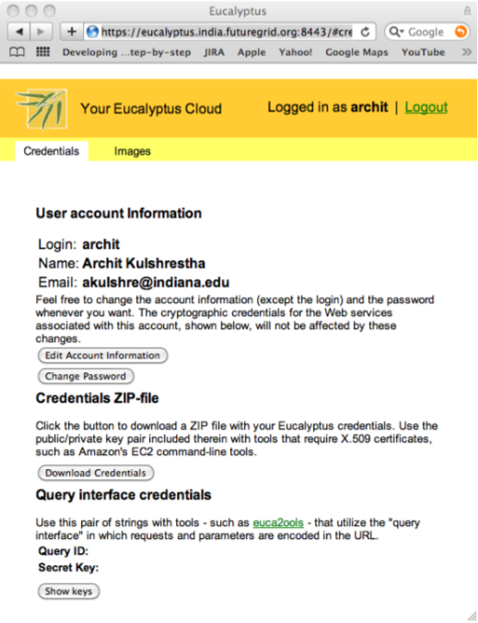

Obtaining Credentials
  Download your credentials as a zip file from the web interface for use with euca2ools.
  Save this file and extract it for local use or copy it to India/Sierra.
  On the command prompt change to the euca2-{username}-x509 folder which was just created.
    cd euca2-username-x509
  Source the eucarc file using the command source eucarc.
    source ./eucarc
http://futuregrid.org

Slide 61
Install/Load Euca2ools
  Euca2ools are the command line clients used to interact with Eucalyptus.
  If using your own platform Install euca2ools bundle from http://open.eucalyptus.com/downloads
    Instructions for various Linux platforms are available on the download page.
  On FutureGrid log on to India/Sierra and load the Euca2ools module.
  $ module load euca2ools
  euca2ools version 1.2 loaded
http://futuregrid.org

Slide 62
Euca2ools
  Testing your setup
    Use euca-describe-availability-zones to test the setup.
  List the existing images using euca-describe-images
  euca-describe-availability-zones
  AVAILABILITYZONE india 149.165.146.135
  $ euca-describe-images
  IMAGE emi-0B951139 centos53/centos.5-3.x86-64.img.manifest.xml admin available public x86_64 machine
  IMAGE emi-409D0D73 rhel55/rhel55.img.manifest.xml admin available public x86_64 machine
  …
http://futuregrid.org

Slide 63
Key management
  Create a keypair and add the public key to eucalyptus.
  Fix the permissions on the generated private key.
  $ euca-add-keypair userkey > userkey.pem
  $ chmod 0600 userkey.pem
  $ euca-describe-keypairs
  KEYPAIR userkey 0d:d8:7c:2c:bd:85:af:7e:ad:8d:09:b8:ff:b0:54:d5:8c:66:86:5d
http://futuregrid.org

Slide 64
Image Deployment
  Now we are ready to start a VM using one of the pre-existing images.
  We need the emi-id of the image that we wish to start. This was listed in the output of euca-describe-images command that we saw earlier.
    We use the euca-run-instances command to start the VM.
  $ euca-run-instances -k userkey -n 1 emi-0B951139 -t c1.medium
  RESERVATION r-4E730969 archit archit-default
  INSTANCE i-4FC40839 emi-0B951139 0.0.0.0 0.0.0.0 pending userkey 2010-07-20T20:35:47.015Z eki-78EF12D2 eri-5BB61255
http://futuregrid.org

Slide 65
Monitoring
  euca-describe-instances shows the status of the VMs.
  $ euca-describe-instances
  RESERVATION r-4E730969 archit default
  INSTANCE i-4FC40839 emi-0B951139 149.165.146.153 10.0.2.194 pending userkey 0 m1.small 2010-07-20T20:35:47.015Z india eki-78EF12D2 eri-5BB61255
  Shortly after…
  $ euca-describe-instances
  RESERVATION r-4E730969 archit default
  INSTANCE i-4FC40839 emi-0B951139 149.165.146.153 10.0.2.194 running userkey 0 m1.small 2010-07-20T20:35:47.015Z india eki-78EF12D2 eri-5BB61255
http://futuregrid.org

Slide 66
VM Access
  First we must create rules to allow access to the VM over ssh.
  euca-authorize -P tcp -p 22 -s 0.0.0.0/0 default
  The ssh private key that was generated earlier can now be used to login to the VM.
  ssh -i userkey.pem root@149.165.146.153
http://futuregrid.org

Slide 67
Image Deployment (1/3)
  We will use the example Fedora 10 image to test uploading images.
    Download the gzipped tar ball
  Uncompress and Untar the archive
  wget http://open.eucalyptus.com/sites/all/modules/pubdlcnt/pubdlcnt.php?file=http://www.eucalyptussoftware.com/downloads/eucalyptus-images/euca-fedora-10-x86_64.tar.gz&amp;nid=1210
  tar zxf euca-fedora-10-x86_64.tar.gz
http://futuregrid.org

Slide 68
Image Deployment (2/3)
  Next we bundle the image with a kernel and a ramdisk using the euca-bundle-image command.
    We will use the xen kernel already registered.
      euca-describe-images returns the kernel and ramdisk IDs that we need.
  $ euca-bundle-image -i euca-fedora-10-x86_64/fedora.10.x86-64.img --kernel eki-78EF12D2 --ramdisk eri-5BB61255
  Use the generated manifest file to upload the image to Walrus
  $ euca-upload-bundle -b fedora-image-bucket -m /tmp/fedora.10.x86-64.img.manifest.xml
http://futuregrid.org

Slide 69
Image Deployment (3/3)
  Register the image with Eucalyptus
  euca-register fedora-image-bucket/fedora.10.x86-64.img.manifest.xml
  This returns the image ID which can also be seen using euca-describe-images
  $ euca-describe-images
  IMAGE emi-FFC3154F fedora-image-bucket/fedora.10.x86-64.img.manifest.xml archit available public x86_64 machine eri-5BB61255 eki-78EF12D2
  IMAGE emi-0B951139 centos53/centos.5-3.x86-64.img.manifest.xml admin available public x86_64 machine ...
http://futuregrid.org

