Slide 1
Cosmic Issues and Analysis of External Comments on FutureGrid
TG11 Salt Lake City
July 18 2011
Geoffrey Fox
gcf@indiana.edu
http://www.infomall.org https://portal.futuregrid.org
Director, Digital Science Center, Pervasive Technology Institute
Associate Dean for Research and Graduate Studies, School of Informatics and Computing
Indiana University Bloomington

Slide 2
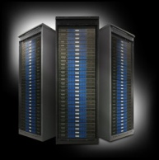
FutureGrid key Concepts
Rather than loading images onto VM’s, FutureGrid supports Cloud, Grid and Parallel computing environments by statically/dynamically provisioning software as needed onto “bare-metal” using Moab/xCAT
Image library for MPI, OpenMP, MapReduce (Hadoop, Dryad, Twister), gLite, Unicore, Genesis, Xen, ScaleMP (distributed Shared Memory), Nimbus, Eucalyptus, OpenNebula, OpenStack, KVM, Windows …..
Growth comes from users depositing novel images in library
FutureGrid has ~4000 (will grow to ~5000) distributed cores with a dedicated network and a Spirent XGEM network fault and delay generator
Image1
Image2
…
ImageN
Choose
Load
Run

Slide 3
FutureGrid Partners
Indiana University (Architecture, core software, Support)
San Diego Supercomputer Center at University of California San Diego (INCA, Monitoring)
University of Chicago/Argonne National Labs (Nimbus)
University of Florida (ViNE, Education and Outreach)
University of Southern California Information Sciences (Pegasus to manage experiments)
University of Tennessee Knoxville (Benchmarking)
University of Texas at Austin/Texas Advanced Computing Center (Portal)
University of Virginia (OGF, Advisory Board and allocation)
Center for Information Services and GWT-TUD from Technische Universtität Dresden. (VAMPIR)
Purdue University (potentially HTC Hardware)
Red institutions have FutureGrid hardware

Slide 4
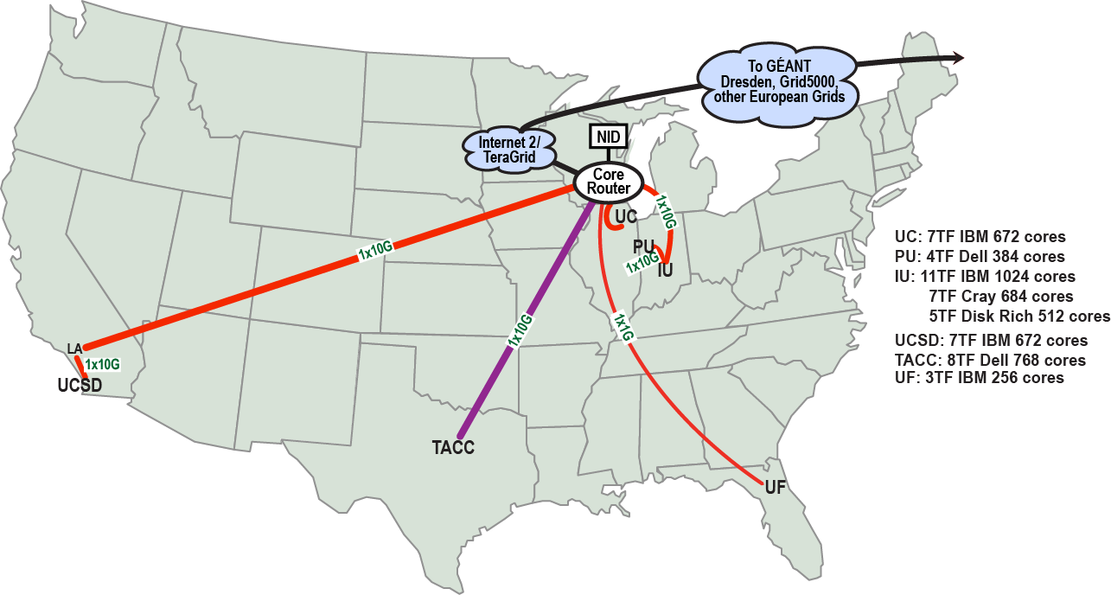
FutureGrid: a Grid/Cloud/HPC Testbed
NID: Network Impairment Device
Private Public
FG Network

Slide 5
Compute Hardware
Name | System type | # CPUs | # Cores | TFLOPS | Total RAM (GB) | Secondary Storage (TB) | Site | Status
india | IBM iDataPlex | 256 | 1024 | 11 | 3072 | 339 + 16 | IU | Operational
alamo | Dell PowerEdge | 192 | 768 | 8 | 1152 | 30 | TACC | Operational
hotel | IBM iDataPlex | 168 | 672 | 7 | 2016 | 120 | UC | Operational
sierra | IBM iDataPlex | 168 | 672 | 7 | 2688 | 96 | SDSC | Operational
xray | Cray XT5m | 168 | 672 | 6 | 1344 | 339 | IU | Operational
foxtrot | IBM iDataPlex | 64 | 256 | 2 | 768 | 24 | UF | Operational
Bravo* | Large Disk & memory | 32 | 128 | 1.5 | 3072 (192GB per node) | 144 (12 TB per Server) | IU | Early user Aug. 1 general
Delta* | Large Disk & memory With Tesla GPU’s | 16 16 GPU’s | 96 | ? 3 | 1536 (192GB per node) | 96 (12 TB per Server) | IU | ~Sept 15
 |  |  | TOTAL Cores 4288
* Teasers for next machine

Slide 6
FutureGrid Project Statistics
https://portal.futuregrid.org/projects
Total projects 122
Education 13
Computer Science 50
Domain Science NOT Life Science 21
Life Science 21
Interoperability 4
Technology Evaluation 35

Slide 7
Some FutureGrid Cosmic Issues
System fully operational with rich set of services and usage
FutureGrid poorly understood by all communities
FutureGrid can lead/help in many areas of innovative technologies and usage modes of growing importance
IaaS, PaaS, MapReduce, Data parallel file systems like HDFS
Interoperability, Testing and Evaluation coming from FutureGrid’s ability to support “any” environment
Can enrich EOT offerings – note ADMI Cloud workshop
Data intensive applications
Relation to XSEDE unclear
Implication of a lot of “small in compute-time metric” projects without significant user support
What should our next ~$450K machine be?

Slide 8
Develop a strategic plan to describe how the team will resolve the varying opinions among co-PIs regarding balance of computer science/other domain science applications.
FutureGrid will support computer science and domain science and in our re-budgeting this is shown by increase in HPC support at Texas and CS oriented user support at Indiana University.
Andrew Grimshaw has many Virginia domain scientists supported by CS. (they ran 12000 jobs on FutureGrid in 2 weeks ending July 11)
FutureGrid is still young and should support both CS and domain science and different approaches to domain science with or without CS direct involvement.
FG’s mission is to enable experimental work that advances
a) Innovation and scientific understanding of distributed computing and parallel computing paradigms
b) The engineering science of middleware that enables these paradigms
c) The use and drivers of these paradigms by important applications
d) The education of a new generation of students and workforce on the use of these paradigms and their applications
FG will strive to have a balanced portfolio of activities under the four points listed above, a precise percentage being hard (and undesirable) to pin down today. Instead, we will be community-driven and reach out for users that yield a balanced portfolio.

Slide 9
The panel recommends that the project develop a detailed plan outlining how decisions regarding major purchases and/or re-budgeting are being made.
Concerns next machine with value ~ $450K
We use the community input to decide on the upgrade strategy.
We define community broadly to include current and potential FG users, XSEDE, our advisory board etc. and inputs come from an explicit survey and input from tutorials at events such as CCGrid TG11 TrackIID workshop and future such events.
On the basis of community input, the FG Operations Committee make recommendations to the Executive Committee and the PI who ultimately makes the final purchase/re-budget decision.
Will bring online soon two new SMALL IU purchased machines to get feedback
Bravo 16 nodes, 192GB memory, 12 TB disk per node, Infiniband (Aug 1), 8 cores per node
Delta 8 nodes, 2 Tesla GPU’s, 192GB memory, 12 TB disk per node, Infiniband (waiting vendor evaluation), 12 cores per node

Slide 10
The panel recommends that the project team provide NSF with a written interaction plan and present this within 8 weeks of the award of the NSF solicitation 08-571 “TeraGrid Phase III: eXtreme Digital Resources for Science and Engineering.” This interaction plan should include mechanisms by which XD may leverage FG.
Co-PI’s Andrew Grimshaw and Warren Smith working technical interaction
Renato Figueiredo working EOT with Scott Lathrop
Volunteered to give talks in XSEDE EOT
User support (e.g. Campus Champions) seem an interesting opportunity
Geoffrey Fox works institutional issues
Put FutureGrid on XSEDE portal

Slide 11
The panel recommends that the project WBS carefully identify the enhancements to be carried out by FutureGrid to the tools provided by the partners.
PY2 funding (October 1 2010) approved recently. SoW’s will reinforce
All tools will provide user support
Work on tools is in response to FutureGrid requirements
Not on basic tool development
Details in Response

Slide 12
Recommendation 4 on Concern: Diversity of research topics explored using FutureGrid and breadth of community impact
The panel recommends that the FutureGrid team develop a desired target mix of applications and application domains and an outreach strategy for recruiting new users to meet those targets.
The panel recommends that the FutureGrid team reach well beyond its own set of frequent collaborators in the community engagement process.
The panel recommends that FutureGrid develop a publication plan, especially for joint papers by project personnel and users, and joint papers of CS and non-CS investigators.

Slide 13
Recommendation 5 on Concern: User Support
The panel recommends that supplemental resources be sought or reallocated to meet this need on a more sustainable basis. DONE
The panel recommends the addition of at least one non-systems/computer science researcher on the Advisory Board. DONE
The panel recommends that each functional area of the project (software, project management, management, etc.) develop a plan for end-user input into their decision process.
Will be done in next plan but software is user driven already
Recommendation 6: Hence, the panel recommends emphasizing efforts to attract all the listed classes of users in subsequent years by developing support and training materials for advanced research usage of FG facilities.
Its an emphasis but limited by funding

Slide 14
Comments on Usage and its Support
An important lesson from early use is that our projects require less compute resources but more user support than traditional machines.
Panel recommended asking for funding for user support but NSF declined plan with extra funding
Switched some software funding into user support
Support of specific tools from partners expert on them e.g. Nimbus, Pegasus, ViNE
Support of HPC from Texas
Additional 50% systems support

Slide 15
Components of User Support
Portal: Tutorials, Knowledgebase, Introductions, Forums, Ticket system
User facing FutureGrid Experts
Students and Staff assigned to new projects
Infrastructure facing Distributed Systems Management Group
Software/Tool facing expertise in software teams
Overall TEO team led by Renato Figueiredo for strategy, tutorials, appliances
Information donated by other users
“Advanced User Support at IU” aimed at HPC
XSEDE?

Slide 16
Components of User support
Funding for Ongoing support coordination and leadership position turned down by NSF

Slide 17
Last UAB Comments

Slide 18
Get the infrastructure running and responsive to external users DONE at some level. See portal for list of projects and capabilities. https://portal.futuregrid.org/manual/help-and-support is typical page for users.
Support users using it We do this at a modest level compatible with funding but believe we could do better with additional funding suggested by NSF panel review. We asked for funding for a staff position coordinating user support and outreach but this was not possible. Note we have harnessed help from FutureGrid user community through FutureGrid Expert concept, have developed multiple tutorials and all software groups contribute to user support. See separate response to NSF Panel for discussion of these points in detail. Note we are behind in areas like follow up on projects due to lack of high level user support.
Incrementally add new software capabilities based on user input This is current strategy. For example SAGA, OpenStack, PAPI, MPICH, MapReduce, Unicore, Genesis are being deployed on FutureGrid in response to requests. We also reduced Software funding and redirected to user and systems support.

Slide 19
Lack of focus of delivery on the project. We believe that project better focused than at last meeting.
A bunch of researchers talking about their projects. Addressed by redirecting some software staff positions to systems/user support. This comment partly reflected poor planning for last UAB in terms of presentations at wrong level. You can find last UAB and January 2011 NSF Panel presentations at https://portal.futuregrid.org/reports
Sounds a lot like a research development project not an infrastructure – more like a testbed for their project. Addressed by redirecting software work to systems/user support
Tension between operational delivery and research and development agendas of the participants Addressed as above.
Need technology neutrality. Not quite certain what this references. We do need to make some choices so as to be focused and our technology choices are aligned with user requests. NSF Panel commended our team approach

Slide 20
Reservations plus startup a vm and stop a vm See Software Presentation and plans
Just doing this was a challenge for Grid 5000
Some convenience vm’s Nimbus, Eucalyptus and OpenStack offer attractive convenient VM interfaces
Lack of commitment to a professionally managed testbed We don’t believe this is true
Where is the requirement traceability matrix, seems to be driven by the PI projects We don’t think it is driven by PI projects
No coherent organizing principle. See 4 principles given in response to recommendation 1a of NSF Panel. Note FutureGrid is different from past projects and had unexpected challenges (user support difficult due to many small project across range of technologies) and served rather different audience from previous TeraGrid activities.
Clearly articulate what capability you’re providing Done in classification of usage, catalog of projects being done and 4 mission principles mentioned above. See new brochure with sample projects in 5 categories

Slide 21
Prioritization – where is it? Note “Need to be a bit ambiguous while user base of FutureGrid still evolving”
Just two committees – science that defines use cases, technology on infrastructure. Committees largely replaced by teams. See new org chart
Architect may need more authority DONE in restructuring of systems and software as well defined teams
True technology neutrality and openness Don’t see that’s realistic. For example focus on Nimbus Hadoop and Pegasus helps users get a quality experience. Note comment above that richness of experience offered to users increases needed support. We are certainly open to new technologies
Should not be funding the development of any particular technology We fund enhancements of technology to address user comments; for example we do NOT fund general Genesis ViNE Nimbus or Pegasus or PAPI development. See answer to panel recommendation 3.
People time should be spent supporting users and the basics, development driven by users feedback AGREED

Slide 22
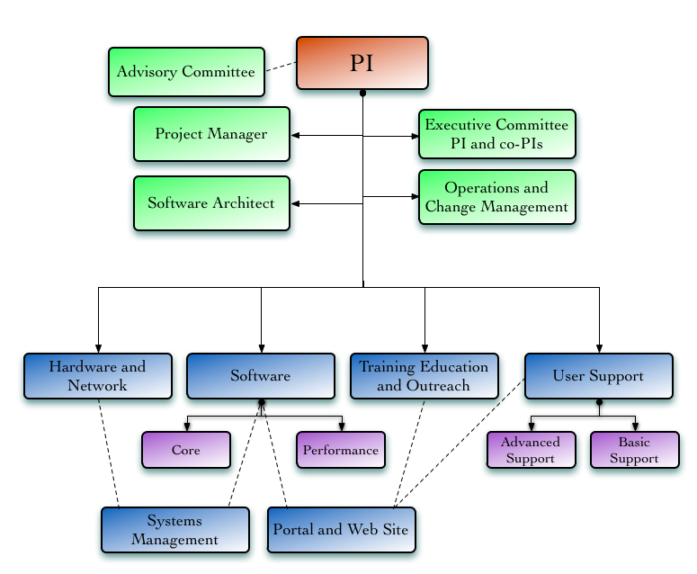
FutureGrid Organization

Slide 23
Get more users using now We now have 122 Projects available for everybody to review https://portal.futuregrid.org/projectssummary.
User focused metrics need to be developed, e.g., number of users, satisfaction, Number of projects and associated users tracked. The diversity and evolution of use (e.g. XSEDE interaction now starting) makes metrics non trivial. The user support position that was turned down by NSF was going to focus on this. We will definitely improve here
Run a school every year on how to use the infrastructure Currently our focus is conference tutorials. Other mechanisms are possible. For example we have a MapReduce BOF at TG11 as this programming model is well supported on FutureGrid and of growing interest (MapReduce popular at HPDC, CloudCom, SC11 etc.). Further see summer school on MapReduce hosted June 2011 on FutureGrid https://www.cresis.ku.edu/~jemitchell/cloud_workshop/admiws.html. 10 Minority Schools expressed interest/intent in including clouds in their curricula based on this.
Most important System Upgrade is not a new machine but additional disks. It was determined not to be cost effective to upgrade disks on current FutureGrid systems. We explore instead new nodes with 12 TB of disk and 192 GB memory on each. The first 16 nodes of this will be operational by the end of July.
How are you (FG) going to use this feedback if at all? We made drastic painful changes as a result of UAB input

