Slide 1
FutureGrid
Venus-C
June 2 2010
Geoffrey Fox
gcf@indiana.edu
http://www.infomall.org http://www.futuregrid.org
Director, Digital Science Center, Pervasive Technology Institute
Associate Dean for Research and Graduate Studies, School of Informatics and Computing
Indiana University Bloomington

Slide 2
FutureGrid Concepts
Support development of new applications and new middleware using Cloud, Grid and Parallel computing (Nimbus, Eucalyptus, Hadoop, Globus, Unicore, MPI, OpenMP. Linux, Windows …) looking at functionality, interoperability, performance, research and education
Put the “science” back in the computer science of grid/cloud computing by enabling replicable experiments
Open source software built around Moab/xCAT to support dynamic provisioning from Cloud to HPC environment, Linux to Windows ….. with monitoring, benchmarks and support of important existing middleware
June 2010 Initial users; September 2010 All hardware (except IU shared memory system) accepted and major use starts; October 2011 FutureGrid allocatable via TeraGrid process

Slide 3
FutureGrid Hardware
FutureGrid has dedicated network (except to TACC) and a network fault and delay generator
Can isolate experiments on request; IU runs Network for NLR/Internet2
(Many) additional partner machines will run FutureGrid software and be supported (but allocated in specialized ways)

Slide 4
FutureGrid Partners
Indiana University (Architecture, core software, Support)
Purdue University (HTC Hardware)
San Diego Supercomputer Center at University of California San Diego (INCA, Monitoring)
University of Chicago/Argonne National Labs (Nimbus)
University of Florida (ViNE, Education and Outreach)
University of Southern California Information Sciences (Pegasus to manage experiments)
University of Tennessee Knoxville (Benchmarking)
University of Texas at Austin/Texas Advanced Computing Center (Portal)
University of Virginia (OGF, Advisory Board and allocation)
Center for Information Services and GWT-TUD from Technische Universtität Dresden. (VAMPIR)
Blue institutions have FutureGrid hardware

Slide 5
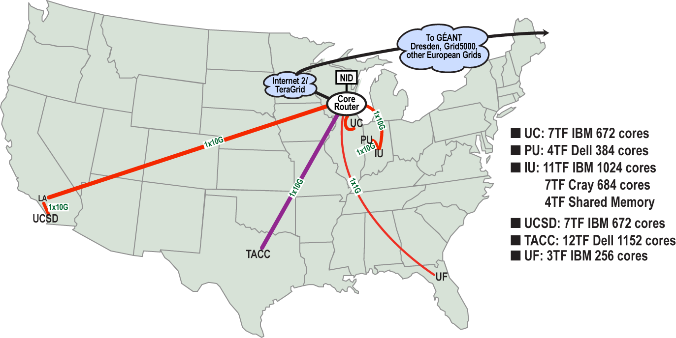
FutureGrid: a Grid Testbed
IU Cray operational, IU IBM (iDataPlex) completed stability test May 6
UCSD IBM operational, UF IBM stability test completes ~ June 7
Network, NID and PU HTC system operational
UC IBM stability test completes ~ June 5; TACC Dell awaiting installation (components delivered)
NID: Network Impairment Device
Private Public
FG Network

Slide 6
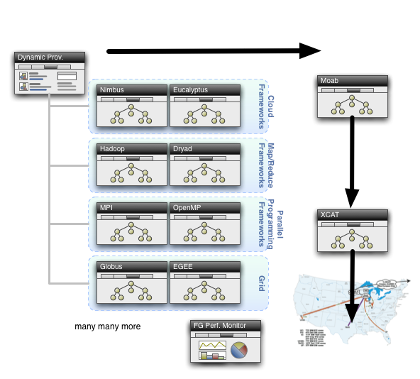
Dynamic Provisioning

Slide 7
Interactions with Venus-C
Running jobs on FutureGrid as well as Venus-C; compare performance; compare ease of use
Running Workflow linking processes on Azure and FutureGrid
Using MapReduce on Azure/FutureGrid
Comparing Azure Table with Hbase on Linux/Nimbus/Windows running on FutureGrid?
Make Venus-C framework target FutureGrid

Slide 8
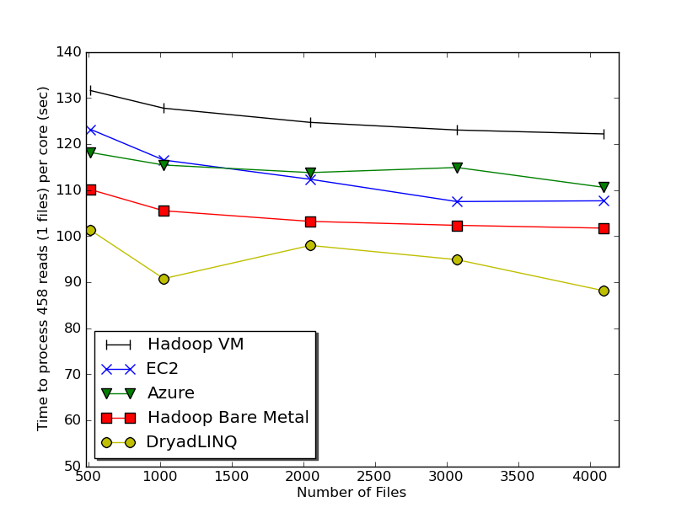
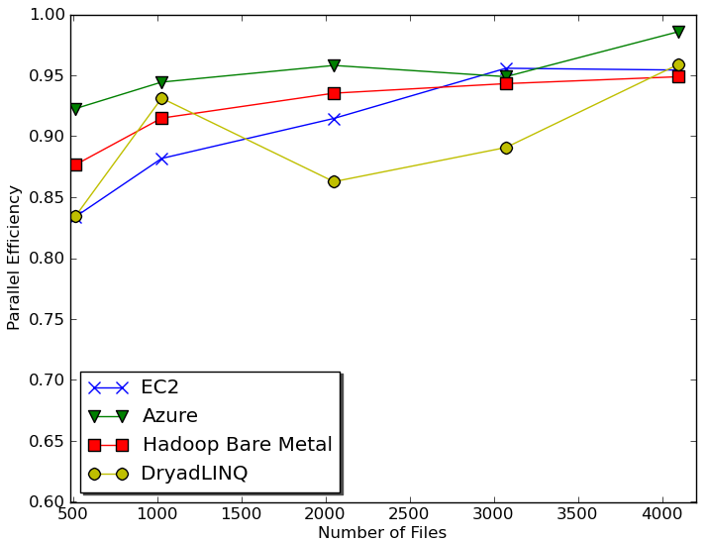
Sequence Assembly in the Clouds
Cap3 parallel efficiency
Cap3 – Per core per file (458 reads in each file) time to process sequences

Slide 9
Cost to assemble to process 4096 FASTA files
~ 1 GB / 1875968 reads (458 readsX4096)
Amazon AWS total :11.19 $
Compute 1 hour X 16 HCXL (0.68$ * 16) = 10.88 $
10000 SQS messages = 0.01 $
Storage per 1GB per month = 0.15 $
Data transfer out per 1 GB = 0.15 $
Azure total : 15.77 $
Compute 1 hour X 128 small (0.12 $ * 128) = 15.36 $
10000 Queue messages = 0.01 $
Storage per 1GB per month = 0.15 $
Data transfer in/out per 1 GB = 0.10 $ + 0.15 $
Tempest (amortized) : 9.43 $
24 core X 32 nodes, 48 GB per node
Assumptions : 70% utilization, write off over 3 years, include support

Slide 10
 | AWS/ Azure | Hadoop | DryadLINQ
Programming patterns | Independent job execution | MapReduce | DAG execution, MapReduce + Other patterns
Fault Tolerance | Task re-execution based on a time out | Re-execution of failed and slow tasks. | Re-execution of failed and slow tasks.
Data Storage | S3/Azure Storage. | HDFS parallel file system. | Local files
Environments | EC2/Azure, local compute resources | Linux cluster, Amazon Elastic MapReduce | Windows HPCS cluster
Ease of Programming | EC2 : ** Azure: *** | **** | ****
Ease of use | EC2 : *** Azure: ** | *** | ****
Scheduling & Load Balancing | Dynamic scheduling through a global queue, Good natural load balancing | Data locality, rack aware dynamic task scheduling through a global queue, Good natural load balancing | Data locality, network topology aware scheduling. Static task partitions at the node level, suboptimal load balancing
Notes:
Hi Professor,Yes. More * are better. This table was done mainly to compare EC2 & Azure with the Dryad & Hadoop based on a reviewer comment and it's bit subjective.
I gave similar ratings for the ease of programming of DryadLINQ & Hadoop. There is a jumpstart cost in learning DryadLINQ if somebody is not familiar with LINQ. But when he knows DryadLINQ, it's easier to program.
I also mention DryadLINQ is easier to use than Hadoop. What I meant by "ease of use" is the level of difficulty in managing the framework and to run the tasks. Given the availability of a Windows HPCS cluster, it's easier to install and run DryadLINQ than setting up a Hadoop cluster. But on the other hand with DryadLINQ users have to do the data distribution manually or through programatically, I don't think I'm capturing that in my rating.

Slide 11
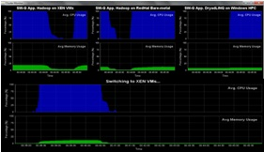
Dynamic Virtual Clusters
Dynamic Cluster Architecture
Monitoring & Control Infrastructure
Monitoring Infrastructure
Monitoring Interface
Pub/Sub Broker Network
SW-G Using Hadoop
SW-G Using Hadoop
SW-G Using DryadLINQ
Linux
Bare-system
Linux on Xen
Windows Server 2008 Bare-system
Virtual/Physical Clusters
Summarizer
XCAT Infrastructure
XCAT Infrastructure
Switcher
iDataplex Bare-metal Nodes
(32 nodes)
iDataplex Bare-metal Nodes
Switchable clusters on the same hardware (~5 minutes between different OS such as Linux+Xen to Windows+HPCS)
Support for virtual clusters
SW-G : Smith Waterman Gotoh Dissimilarity Computation as an pleasingly parallel problem suitable for MapReduce style application

