Slide 1
FutureGrid Overview
IMA University of Minneapolis
January 13 2010
Geoffrey Fox
gcf@indiana.edu
http://www.infomall.org https://portal.futuregrid.org
Director, Digital Science Center, Pervasive Technology Institute
Associate Dean for Research and Graduate Studies, School of Informatics and Computing
Indiana University Bloomington

Slide 2
FutureGrid key Concepts I
FutureGrid is an international testbed modeled on Grid5000
Supporting international Computer Science and Computational Science research in cloud, grid and parallel computing (HPC)
Industry and Academia
The FutureGrid testbed provides to its users:
A flexible development and testing platform for middleware and application users looking at interoperability, functionality, performance or evaluation
Each use of FutureGrid is an experiment that is reproducible
A rich education and teaching platform for advanced cyberinfrastructure (computer science) classes

Slide 3
FutureGrid key Concepts I
FutureGrid has a complementary focus to both the Open Science Grid and the other parts of TeraGrid.
FutureGrid is user-customizable, accessed interactively and supports Grid, Cloud and HPC software with and without virtualization.
FutureGrid is an experimental platform where computer science applications can explore many facets of distributed systems
and where domain sciences can explore various deployment scenarios and tuning parameters and in the future possibly migrate to the large-scale national Cyberinfrastructure.
FutureGrid supports Interoperability Testbeds – OGF really needed!
Note a lot of current use Education, Computer Science Systems and Biology/Bioinformatics

Slide 4
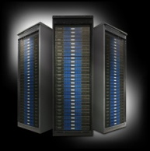
FutureGrid key Concepts III
Rather than loading images onto VM’s, FutureGrid supports Cloud, Grid and Parallel computing environments by dynamically provisioning software as needed onto “bare-metal” using Moab/xCAT
Image library for MPI, OpenMP, Hadoop, Dryad, gLite, Unicore, Globus, Xen, ScaleMP (distributed Shared Memory), Nimbus, Eucalyptus, OpenNebula, KVM, Windows …..
Growth comes from users depositing novel images in library
FutureGrid has ~4000 (will grow to ~5000) distributed cores with a dedicated network and a Spirent XGEM network fault and delay generator
Image1
Image2
…
ImageN
Choose
Load
Run

Slide 5
Dynamic Provisioning Results
Number of nodes
Time elapsed between requesting a job and the jobs reported start time on the provisioned node. The numbers here are an average of 2 sets of experiments.

Slide 6
FutureGrid Partners
Indiana University (Architecture, core software, Support)
Purdue University (HTC Hardware)
San Diego Supercomputer Center at University of California San Diego (INCA, Monitoring)
University of Chicago/Argonne National Labs (Nimbus)
University of Florida (ViNE, Education and Outreach)
University of Southern California Information Sciences (Pegasus to manage experiments)
University of Tennessee Knoxville (Benchmarking)
University of Texas at Austin/Texas Advanced Computing Center (Portal)
University of Virginia (OGF, Advisory Board and allocation)
Center for Information Services and GWT-TUD from Technische Universtität Dresden. (VAMPIR)
Red institutions have FutureGrid hardware

Slide 7
Compute Hardware
System type | # CPUs | # Cores | TFLOPS | Total RAM (GB) | Secondary Storage (TB) | Site | Status
IBM iDataPlex | 256 | 1024 | 11 | 3072 | 339* | IU | Operational
Dell PowerEdge | 192 | 768 | 8 | 1152 | 30 | TACC | Operational
IBM iDataPlex | 168 | 672 | 7 | 2016 | 120 | UC | Operational
IBM iDataPlex | 168 | 672 | 7 | 2688 | 96 | SDSC | Operational
Cray XT5m | 168 | 672 | 6 | 1344 | 339* | IU | Operational
IBM iDataPlex | 64 | 256 | 2 | 768 | On Order | UF | Operational
Large disk/memory system TBD | 128 | 512 | 5 | 7680 | 768 on nodes | IU | New System TBD
High Throughput Cluster | 192 | 384 | 4 | 192 |  | PU | Not yet integrated
Total | 1336 | 4960 | 50 | 18912 | 1353

Slide 8
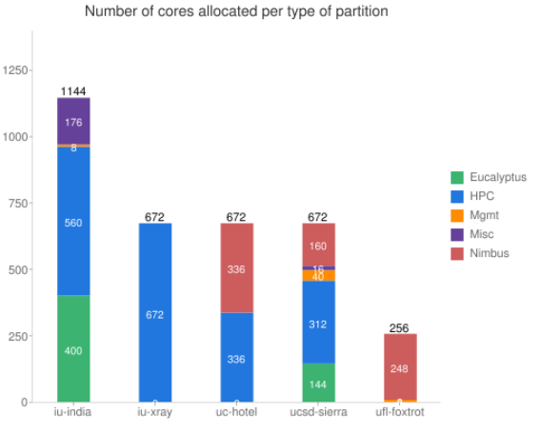
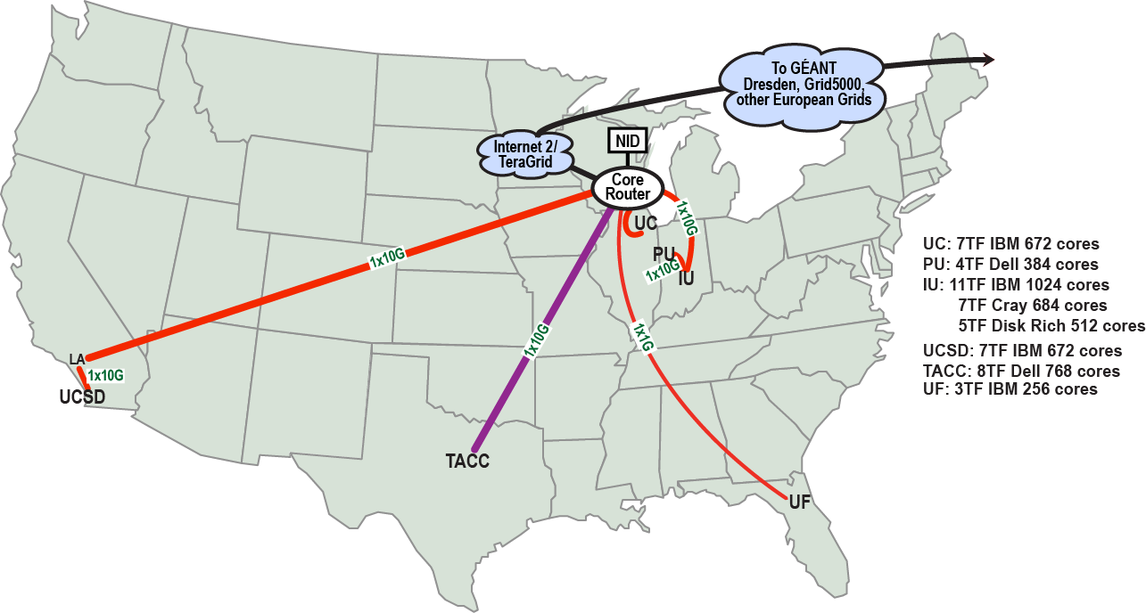
FutureGrid: a Grid/Cloud/HPC Testbed
NID: Network Impairment Device
Private Public
FG Network

Slide 9
Network & Internal Interconnects
FutureGrid has dedicated network (except to TACC) and a network fault and delay generator
Can isolate experiments on request; IU runs Network for NLR/Internet2
(Many) additional partner machines could run FutureGrid software and be supported (but allocated in specialized ways)
Machine | Name | Internal Network
IU Cray | xray | Cray 2D Torus SeaStar
IU iDataPlex | india | DDR IB, QLogic switch with Mellanox ConnectX adapters Blade Network Technologies & Force10 Ethernet switches
SDSC iDataPlex | sierra | DDR IB, Cisco switch with Mellanox ConnectX adapters Juniper Ethernet switches
UC iDataPlex | hotel | DDR IB, QLogic switch with Mellanox ConnectX adapters Blade Network Technologies & Juniper switches
UF iDataPlex | foxtrot | Gigabit Ethernet only (Blade Network Technologies; Force10 switches)
TACC Dell | alamo | QDR IB, Mellanox switches and adapters Dell Ethernet switches

Slide 10
Some Current FutureGrid projects I
Project | Institution | Details
Educational Projects
VSCSE Big Data | IU PTI, Michigan, NCSA and 10 sites | Over 200 students in week Long Virtual School of Computational Science and Engineering on Data Intensive Applications & Technologies
LSU Distributed Scientific Computing Class | LSU | 13 students use Eucalyptus and SAGA enhanced version of MapReduce
Topics on Systems: Cloud Computing CS Class | IU SOIC | 27 students in class using virtual machines, Twister, Hadoop and Dryad
Interoperability Projects
OGF Standards | Virginia, LSU, Poznan | Interoperability experiments between OGF standard Endpoints
Sky Computing | University of Rennes 1 | Over 1000 cores in 6 clusters across Grid’5000 & FutureGrid using ViNe and Nimbus to support Hadoop and BLAST demonstrated at OGF 29 June 2010

Slide 11
Some Current FutureGrid projects II
Application Projects
Combustion | Cummins | Performance Analysis of codes aimed at engine efficiency and pollution
ScaleMP for gene assembly | IU PTI and Biology | Investigate distributed shared memory over 16 nodes for SOAPdenovo assembly of Daphnia genomes
Cloud Technologies for Bioinformatics Applications | IU PTI | Performance analysis of pleasingly parallel/MapReduce applications on Linux, Windows, Hadoop, Dryad, Amazon, Azure with and without virtual machines
Computer Science Projects
Cumulus | Univ. of Chicago | Open Source Storage Cloud for Science based on Nimbus
Differentiated Leases for IaaS | University of Colorado | Deployment of always-on preemptible VMs to allow support of Condor based on demand volunteer computing
Application Energy Modeling | UCSD/SDSC | Fine-grained DC power measurements on HPC resources and power benchmark system
Evaluation and TeraGrid Support Projects
TeraGrid QA Test & Debugging | SDSC | Support TeraGrid software Quality Assurance working group
TeraGrid TAS/TIS | Buffalo/Texas | Support of XD Auditing and Insertion functions

Slide 12
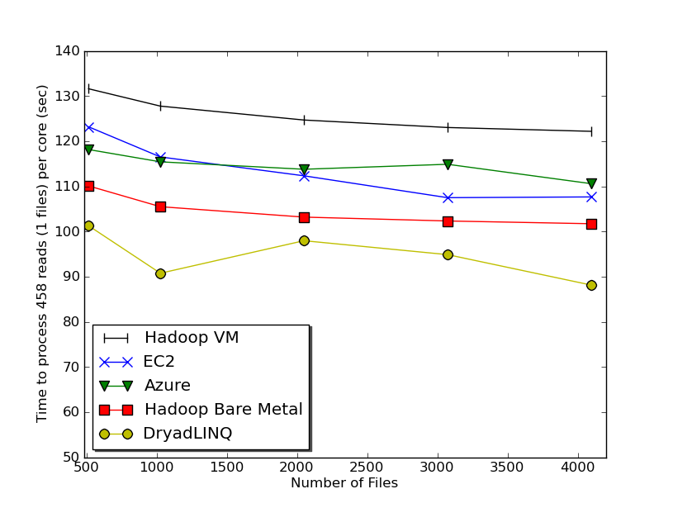
Typical FutureGrid Performance Study
Linux, Linux on VM, Windows, Azure, Amazon Bioinformatics

Slide 13
MapReduce
Data Partitions
Map(Key, Value)
A hash function maps the results of the map tasks to reduce tasks
Reduce(Key, List<Value>)
Reduce Outputs
Implementations (Hadoop – Java; Dryad – Windows) support:
Splitting of data
Passing the output of map functions to reduce functions
Sorting the inputs to the reduce function based on the intermediate keys
Quality of service

Slide 14
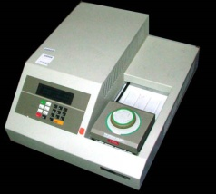
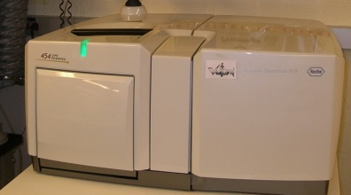
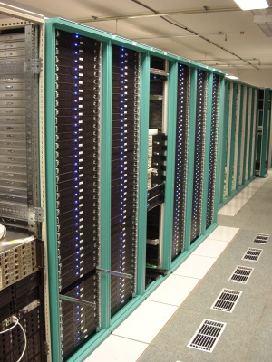
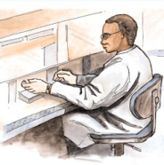
MapReduce “File/Data Repository” Parallelism
Map = (data parallel) computation reading and writing data
Reduce = Collective/Consolidation phase e.g. forming multiple global sums as in histogram
Instruments
Iterative MapReduce
Map Map Map Map
Reduce Reduce Reduce
Communication
Reduce
Portals /Users
Disks
Map₁
Map₂
Map₃

Slide 15
Applications & Different Interconnection Patterns
Map Only | Classic MapReduce | Iterative Reductions MapReduce++ | Loosely Synchronous
CAP3 Analysis Document conversion (PDF -> HTML) Brute force searches in cryptography Parametric sweeps | High Energy Physics (HEP) Histograms SWG gene alignment Distributed search Distributed sorting Information retrieval | Expectation maximization algorithms Clustering Linear Algebra | Many MPI scientific applications utilizing wide variety of communication constructs including local interactions
- CAP3 Gene Assembly - PolarGrid Matlab data analysis | - Information Retrieval - HEP Data Analysis - Calculation of Pairwise Distances for ALU Sequences | Kmeans Deterministic Annealing Clustering - Multidimensional Scaling MDS | - Solving Differential Equations and - particle dynamics with short range forces
Input
iterations
Input
Input
map
map
map
Pij
reduce
Output
reduce
Domain of MapReduce and Iterative Extensions
MPI

Slide 16
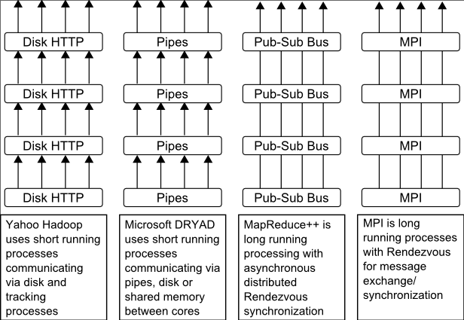
Twister
Pub/Sub Broker Network
Map Worker
M
Worker Nodes
R
Reduce Worker
Streaming based communication
Intermediate results are directly transferred from the map tasks to the reduce tasks – eliminates local files
Cacheable map/reduce tasks
Static data remains in memory
Combine phase to combine reductions
User Program is the composer of MapReduce computations
Extends the MapReduce model to iterative computations
D
D
MR
Driver
User
Program
M
M
M
M
D
MRDeamon
R
R
R
R
Data Read/Write
Communication
Data Split
File System
Iterate
Static
data
Configure()
User Program
Map(Key, Value)
δ flow
Reduce (Key, List<Value>)
Combine (Key, List<Value>)
Different synchronization and intercommunication mechanisms used by the parallel runtimes
Close()

Slide 17
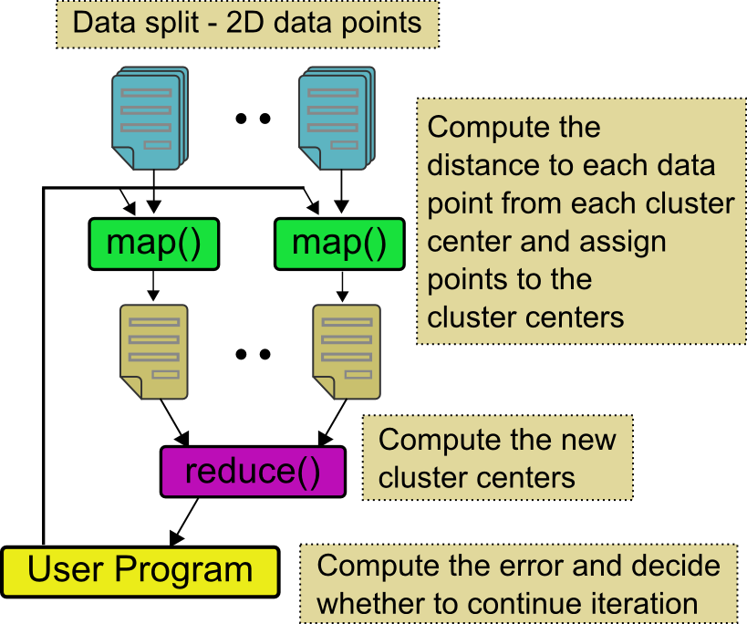
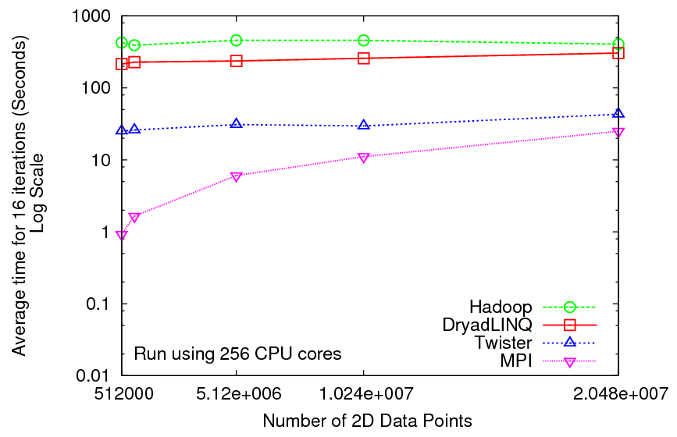
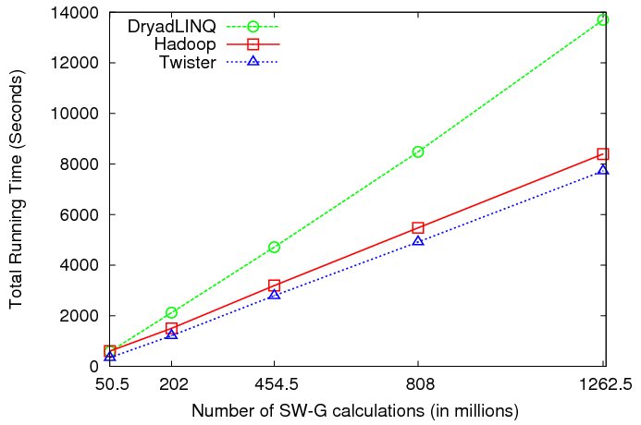
Iterative and non-Iterative Computations
K-means
Smith Waterman is a non iterative case and of course runs fine
Performance of K-Means

Slide 18
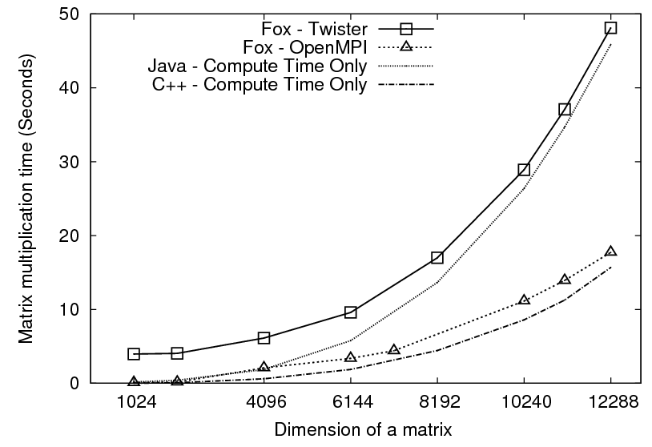
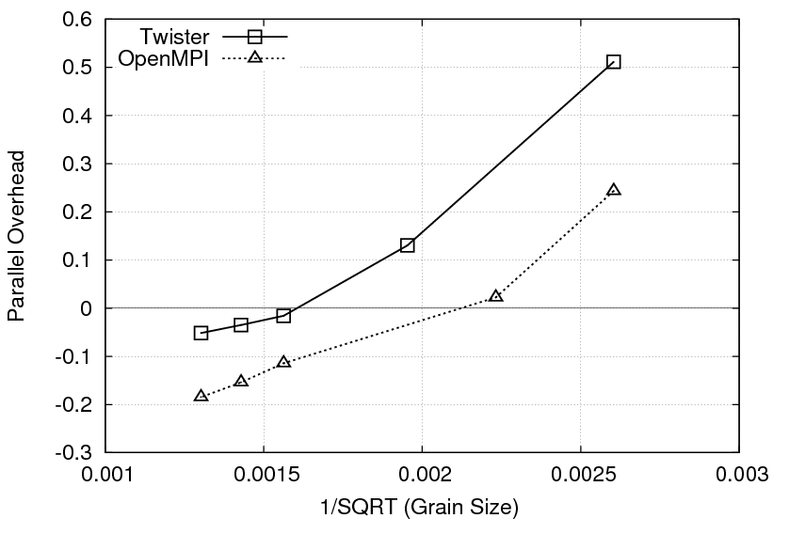
Performance of Matrix Multiplication
Matrix multiplication time against size of a matrix
Overhead against the 1/SQRT(Grain Size)
Considerable performance gap between Java and C++ (Note the estimated computation times)
For larger matrices both implementations show negative overheads
Stateful tasks enables these algorithms to be implemented using MapReduce
Exploring more algorithms of this nature would be an interesting future work

Slide 19
OGF’10 Demo from Rennes
SDSC
Rennes
Grid’5000 firewall
UF
Lille
UC
Sophia
ViNe provided the necessary inter-cloud connectivity to deploy CloudBLAST across 6 Nimbus sites, with a mix of public and private subnets.

Slide 20
Education & Outreach on FutureGrid
Build up tutorials on supported software
Support development of curricula requiring privileges and systems destruction capabilities that are hard to grant on conventional TeraGrid
Offer suite of appliances (customized VM based images) supporting online laboratories
Supporting ~200 students in Virtual Summer School on “Big Data” July 26-30 with set of certified images – first offering of FutureGrid 101 Class; TeraGrid ‘10 “Cloud technologies, data-intensive science and the TG”; CloudCom conference tutorials Nov 30-Dec 3 2010
Experimental class use fall semester at Indiana, Florida and LSU; follow up core distributed system class Spring at IU
Planning ADMI Summer School on Clouds and REU program

Slide 21
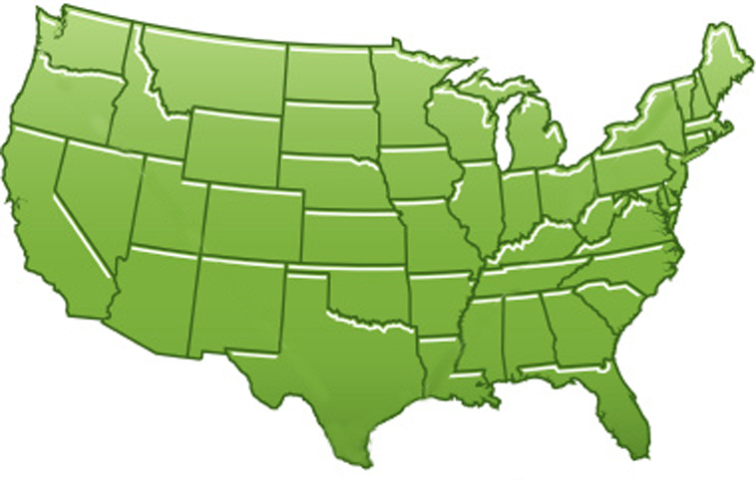
300+ Students learning about Twister & Hadoop
MapReduce technologies, supported by FutureGrid.
July 26-30, 2010 NCSA Summer School Workshop
http://salsahpc.indiana.edu/tutorial
Washington
University
University of
Minnesota
Michigan
State
Johns
Hopkins
Univ.Illinois
at Chicago
Iowa
Penn
State
IBM Almaden
Research Center
Notre
Dame
University of
California at
Los Angeles
Indiana
University
San Diego
Supercomputer
Center
University of
Texas at El Paso
University of
Arkansas
University
of Florida

Slide 22
FutureGrid Tutorials
Tutorial topic 3: Educational Virtual Appliances
Tutorial GA1: Introduction to the Grid Appliance
Tutorial GA2: Creating Grid Appliance Clusters
Tutorial GA3: Building an educational appliance from Ubuntu 10.04
Tutorial GA4: Deploying Grid Appliances using Nimbus
Tutorial GA5: Deploying Grid Appliances using Eucalyptus
Tutorial GA7: Customizing and registering Grid Appliance images using Eucalyptus
Tutorial MP1: MPI Virtual Clusters with the Grid Appliances and MPICH2
Tutorial topic 4: High Performance Computing
Tutorial VA1: Performance Analysis with Vampir
Tutorial VT1: Instrumentation and tracing with VampirTrace
Tutorial topic 1: Cloud Provisioning Platforms
Tutorial NM1: Using Nimbus on FutureGrid
Tutorial NM2: Nimbus One-click Cluster Guide
Tutorial GA6: Using the Grid Appliances to run FutureGrid Cloud Clients
Tutorial EU1: Using Eucalyptus on FutureGrid
Tutorial topic 2: Cloud Run-time Platforms
Tutorial HA1: Introduction to Hadoop using the Grid Appliance
Tutorial HA2: Running Hadoop on FG using Eucalyptus (.ppt)
Tutorial HA2: Running Hadoop on Eualyptus

Slide 23
Software Components
Portals including “Support” “use FutureGrid” “Outreach”
Monitoring – INCA, Power (GreenIT)
Experiment Manager: specify/workflow
Image Generation and Repository
Intercloud Networking ViNE
Virtual Clusters built with virtual networks
Performance library
Rain or Runtime Adaptable InsertioN Service: Schedule and Deploy images
Security (including use of isolated network), Authentication, Authorization,

Slide 24
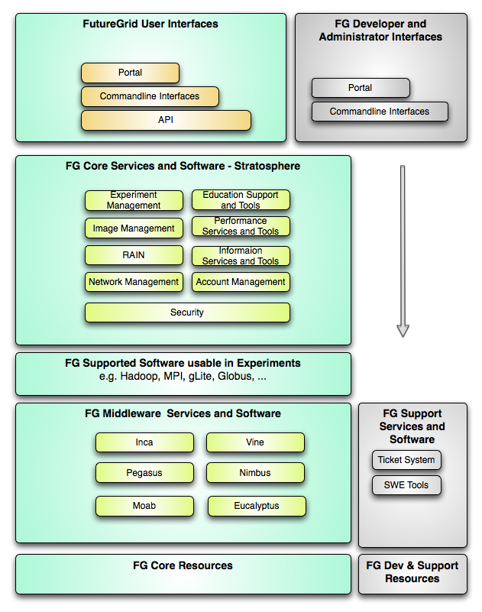
FutureGrid Layered Software Stack
User Supported Software usable in Experiments e.g. OpenNebula, Kepler, Other MPI, Bigtable

Slide 25
FutureGrid Viral Growth Model
Users apply for a project
Users improve/develop some software in project
This project leads to new images which are placed in FutureGrid repository
Project report and other web pages document use of new images
Images are used by other users
And so on ad infinitum ………

