Slide 1
Towards Green Aware Computing at Indiana University
Gregor von Laszewski
laszewski@gmail.com
Indiana University
Pervasive Technology Institute

Slide 2
What is Green IT?
Green IT also referred as Green computing is a study and practice of using computing resources in an efficient manner such that its impact on the environment is as less hazardous as possible.
least amount of hazardous materials are used
computing resources are used efficiently in terms of energy and to promote recyclability
http://en.wikipedia.org/wiki/Green_computing

Slide 3
Motivation
Cost:
A supercomputer with 360-Tflops with conventional processors requires 20 MW to operate, which is approximately equal to the sum of 22,000 US households power consumption
Servers consume 0.5 percent of the world’s total electricity usage
Energy usage will quadruple by 2020
The total estimated energy bill for data centers in 2010 is $11.5 billion
Reliability:
Every 10C increase of temperature leads to a doubling of the system failure rate
Environment:
A typical desktop computer consumes 200-300W of power
This results in emission of about 220Kg of CO2/annum
Data Centers produce 170 million metric tons of CO2 worldwide currently per year
670 million metric tons of CO2 are expected to be emitted by data centers worldwide annually by 2020
Utilization
32 percent of all servers are running at or below 3 percent peak and average utilizations, wasting energy spinning and cooling, and doing virtually no work.

Slide 4
A Typical Google Search
Google spends about 0.0003 kWh per search
1 kilo-watt-hour (kWh) of electricity = 7.12 x 10-4 metric tons CO2 = 0.712 kg or 712g of CO2
=> 213mg CO2 emitted
The number of Google searches worldwide amounts to 200-500 million per day.
total carbon emitted per day:
= 500 million x 0.000213 kg per search = 106500kg or 106.5 metric ton
Source: http://prsmruti.rediffiland.com/blogs/2009/01/19/How-much-cabondioxide-CO2-emitted.html
Notes:
ref:
http://www.globus.org/grid_software/security/voms.php – globus alliance ... basic definition
http://vdt.cs.wisc.edu/components/voms.html – virtual data toolkit (osg) – grid middleware
http://edg-wp2.web.cern.ch/edg-wp2/security/voms/voms.html – (datagrid)

Slide 5
Where is power used in Data Centers?
Data center uses large amount of electricity for 3 main components:
IT Equipment
Cooling
Power Delivery
Power Usage Effectiveness (PUE)
PUE = Total Facility Power/IT Equipment Power

Slide 6
Result
Evaluate Metrics carefully
A Datacenter with PUE close to 1 does not mean it produces the fewest CO2

Slide 7
So what can we do?

Slide 8
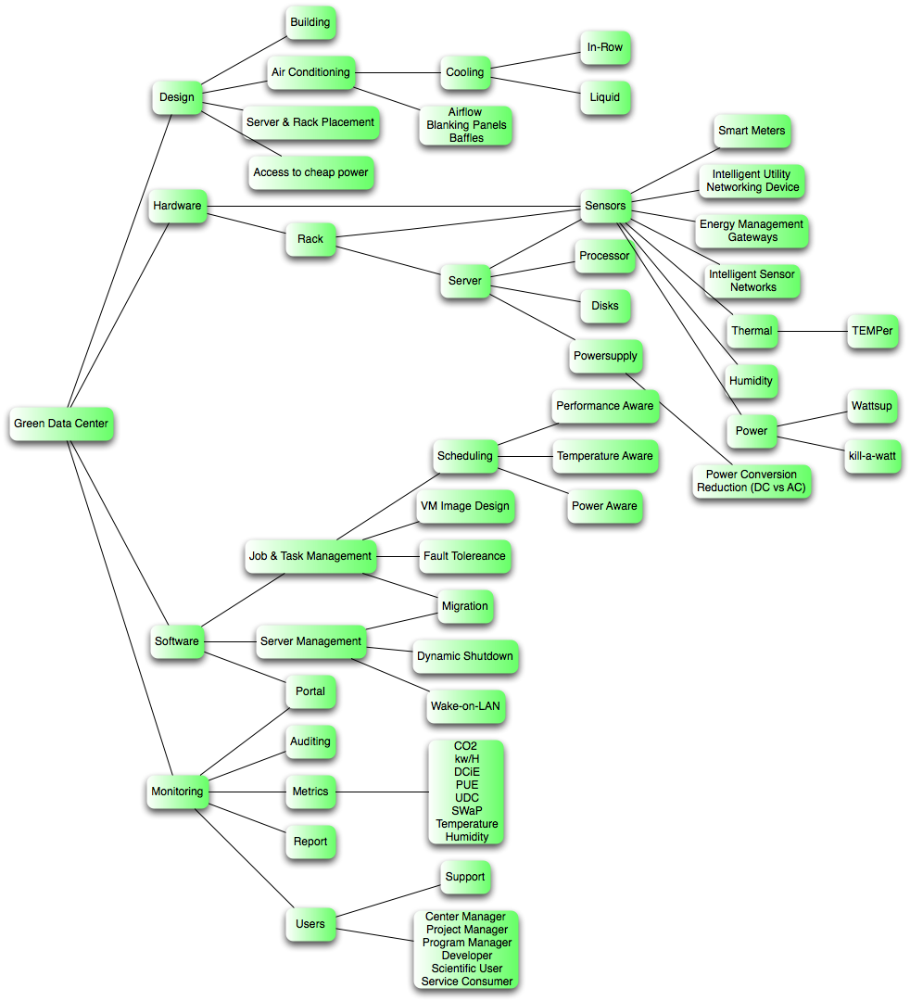
GreenIT Taxonomy
We are actively developing a Taxonomy
Helps assessing where to focus research activities
Will be resulting in
What to Monitor?
What Software?
Which Services?
What to Optimize?
At what cost ($,CO2,perf)?

Slide 9
Green Aware Computing
Hardware
Processor
Software
Behavior
Environment
Building
Disk
HVAC
Education
Shutdown
Migration
Rack design
GPGPU
GreenSaaS/SaaI
Policies
Scheduling
People
(Metrics)

Slide 10
Research methodology
Green Application
support environment
Performance metrics
Power consumption, CO2, …
Resource operation
Virtual machine migration
Smart cooling system operation
Server consolidation
& power management
“Green” infrastructure
Low power & high density computing resource
Virtualized infrastructure
“Green” service & middleware
Auditing & insertion system
Power aware task scheduling
Temperature aware workload placement
“Green” application support environment
SDKs and APIs for energy aware programming
Interfaces for “green” performance tuning
Green
service & middleware
Metrics
Operation
Green Infrastructure

Slide 11
END

