Slide 1
Challenges Facing Modeling and Simulation in HPC Environments Panel remarks
ECMS Multiconference HPCS 2008
Nicosia Cyprus
June 6 2008
Geoffrey Fox
Community Grids Laboratory, School of informatics Indiana University
gcf@indiana.edu, http://www.infomall.org
1
Notes:
1

Slide 2
Panel Charge
In the past years, high performance computing environments have been used to solve challenging scientific modeling and simulation applications. Now high performance computing (HPC) technology is becoming increasingly important as target platforms and has matured to the point of becoming a tool for impacting society at large in many major ways.
Panel members will present and discuss the main challenges facing HPC and simulation communities today and in the foreseen future. They will emphasize and possibly prioritize the importance of these problems and the difficulties of approaching them.
Furthermore, based on their experiences with different modeling and simulation applications using HPC technology (such as cluster and grid platforms), our panelists will point out the main trends and new technologies that will impact these challenges, and the factors that they believe will play major roles in pushing these challenges forward.

Slide 3
Key Trends I
HPC much healthier than M&S in USA
eScience supported by some sort of e-Infrastructure or Cyberinfrastructure is clearly critical and successful for international collaborative research
Grids show important prototypes supporting eScience
However need to make significant changes in approach
Community made “bet” that research systems would use commercial software built for “Enterprise Systems”
In fact Enterprise software struggled and the most important software came from the Internet Companies
Web 2.0 and Clouds
Amazon and Google; not IBM Microsoft Oracle and SAP
Need to change architecture and technologies
Need to change goals (hardest)

Slide 4
Key Trends II
Substantial change in hardware architecture with multicore chips
This will not impact “high end” users as clusters of multicore chips are just another parallel computer
Will need to rework MPI-based software infrastructure
As larger user base, high end user should see easier to use software
“General Users” will see big impact as non trivial to use multiple cores
Either need to parallelize applications and/or
View multicore as a “grid on a chip”
One simple “grid on a chip” use is pleasingly parallel “parameter searches”
No consensus as to “general parallel programming model”

Slide 5
Grid/Cloud Remarks
Current government initiatives in Europe, US and Asia are pouring resources into Grid projects which are possibly misguided
Unrealistic goals; doubtful that can link disparate grids (one per country or one per supercomputer center) together
Obsession with “open software” pours too much money into failed competition with industry
Wrong balance between research and infrastructure; research crippled and anyway not enough money to build infrastructure
Use Clouds/Web 2.0 architecture not Enterprise software
Green computing needs to be considered
Science should make more use of collaboration (virtual organizations) tools based on Web 2.0
Simplicity is key principle

Slide 6
Multicore Comments
MPI Community has a huge opportunity to help everybody by simplifying standard
Need to analyze barriers to broad use; not barriers for high end users
Multicore brings together many communities
High end users and their software developers
Scientists and scientific fields that up to now have not used parallel systems
Commodity software developers
How should this be done?
Good for discrete event simulation
Need to train students with good parallel algorithm background
Much easier to train to have good cloud background
Need to attract the Internet Generation to Computer Science where enrollments in US have dropped by a factor of two

Slide 7
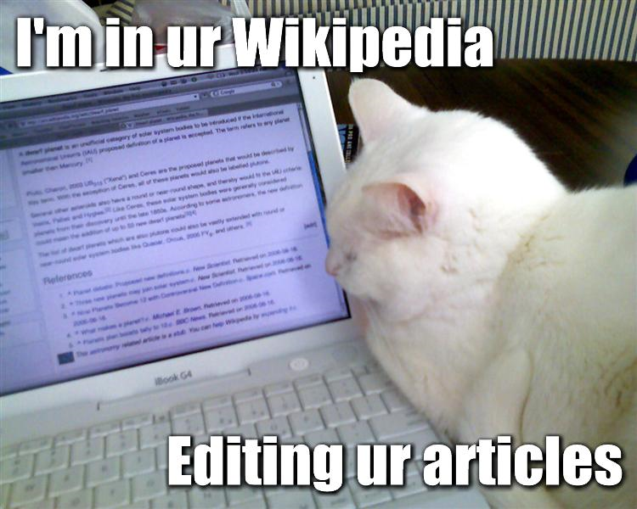
We need to communicate in the Net Gen language Lolcats

Slide 8
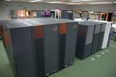
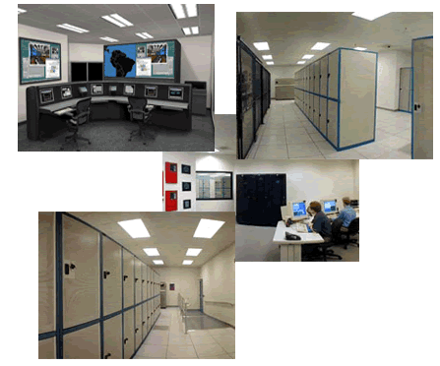
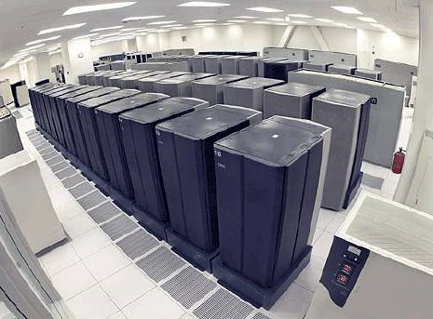
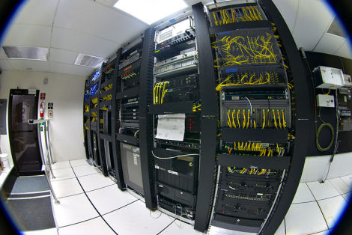
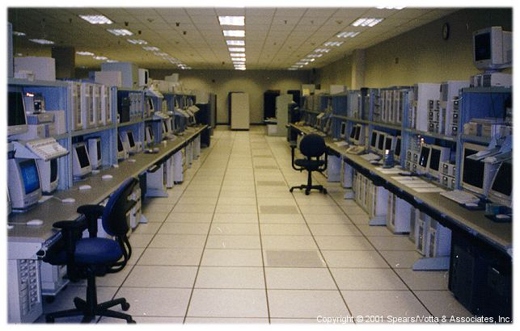
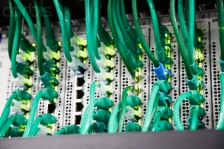
I’M IN UR CLOUD
Comment: +lawlz
INVISIBLE COMPLEXITY

