Slide 1
A Scalable Framework for the Collaborative Annotation of Live Data Streams
Thesis Proposal
Tao Huang
taohuang@cs.indiana.edu
Notes:
Good afternoon, professors,
What I am proposing is “A Scalable …. Streams”

Slide 2
Outline
Introduction
Motivation
Related System Survey
Research Issues
Milestones
Contributions
Notes:
There are six parts of my presentation listed here,
I am going to give a brief introduction first.

Slide 3
Introduction
Annotation Definitions
A commentary on an object that: (Cousins et al. 2000)
the annotator intends to be separable from the object itself
the reader interprets to be separable from the object itself
A marked-up comment made to information in a book, document, online record, video, software code or other information (Wikipedia)
Annotation is to link related metadata to the content data
Notes:
What is annotation?
There are two popular definitions,
One is a broad definition given by Steve Cousins in his paper defining the annotation to be a commentary…
The other one defines the annotation to be a marked-up comment made …..
In general, annotation is to link useful/related metadata to the content data so that it can be used to either supplement the meanings of the
Content or help in comprehending the content data.

Slide 4
Introduction-Ext.
Simple Annotation
Annotations of bibliographic entries
Reference management: Zotero
Genome Annotation: BioDAS.org
Video Annotation: IBM VideoAnnEx, Youtube annotation
Collaborative Annotation
Text Annotation: Wiki, Google Docs, Office Live workspace
Anchored Forums: Annotatiesysteem
Multimedia Annotation: ELAN, Vannotea, eSports and etc.
Notes:
Currently there are many existing annotation systems.
I categorize them into two major groups.
Simple annotation is an annotate and view process, the reader cannot communicate/collaborate with each other. They can
Search within the annotation database though

Slide 5
Problems & Issues
Limited support to annotations on real time data streams
Few annotation types
Complicated to be extended to support annotating new content data
Not interoperable with each other
No standard way to build annotation systems
Notes:
All these issues finally turn into important parts of my thesis motivation

Slide 6
Outline
Introduction
Motivation
Related System Survey
Research Issues
Milestones
Contributions

Slide 7
Motivation
Increased demands of collaborative annotation
Collaborative Researches on Massive Data
Live Traffic Monitoring/Controlling
Crisis Management
E-coaching/training
Requirements of annotating real time data streams
Need a simple annotation framework with well defined interfaces
Notes:
In both academic and industry
Massive Data that cannot be processed by a single person or group.
Emergencies that requires computer based aid to decision makers
Live stream data are being generated every second, some of them requires to be annotated on the fly so that
Decision makers make prompt response based on them and deliver their decision to the implementers.

Slide 8
Motivation-Ext.
Requirements of arbitrary types of annotation
Difficulties in interoperating with existing annotation systems
No unified format of annotation metadata
Needs to understand specific semantics within the metadata for each system
Some systems may not designed to support real time data streams

Slide 9
Outline
Introduction
Motivation
Related System Survey
Research Issues
Milestones
Contributions
Notes:
Before I start talking about research issues, I would like to give some general surveys on existing
Annotation systems. Since the topic of my thesis is to define a framework for annotating live data streams.
Most system I surveyed here are annotation system on Multimedia data.

Slide 10
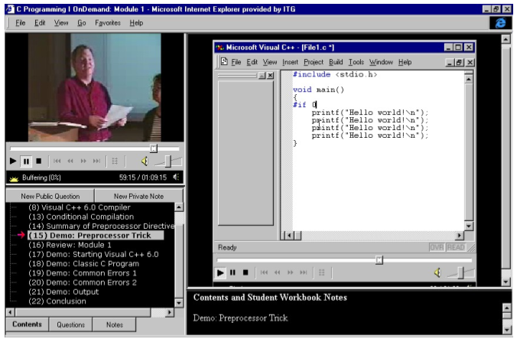
System Survey 1
MRAS: Microsoft Research Annotation System
Questions and Answers are anchored on multimedia content
Synchronous replays help later viewers with same questions benefit from the answers
Notes:
Microsoft research released its annotation system MRAS [11] in 2000, the system was designed to help Microsoft employees gain better training experience through asking questions on pre-recorded lecture videos. The questions are anchored on the multimedia content and answered by the instructors asynchronously. Since the questions can be synchronously replayed with the class content, students that have similar questions at the same time spot will benefit a lot from reading answers to the previous question. Collaboration is achieved through discussions on the questions and their answers. MRAS doesn’t support live video feeds and students who are watching the same video streams could not exchange their thoughts in the real time.

Slide 11
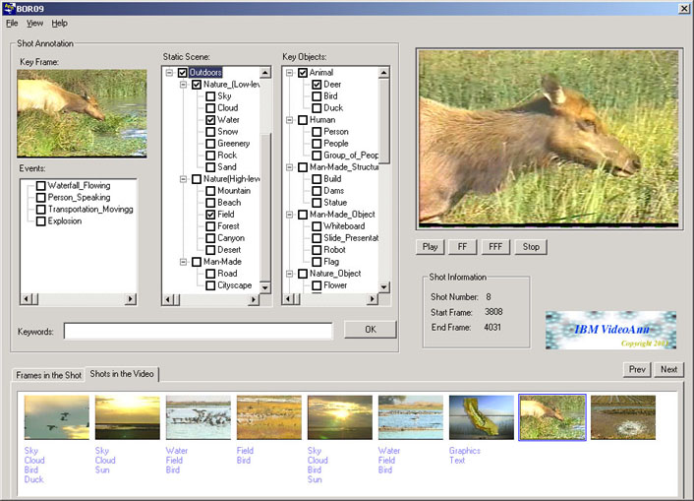
System survey 2
IBM VideoAnnEx
Mpeg7 based annotation
Support distribute annotation
Asynchronous communication and searching in annotation database
Notes:
IBM’s Mpeg-7 annotation tool – VideoAnnEx [12] was also released in 2000. It can parse Mpeg video files and segment them into small shot units. Each shot unit can be annotated with a description from three default categories: static scene, key object and event. All shot units are stored into a XML file as well as their descriptions/annotations following the Mpeg-7 standard. Users can search among the descriptions and replay the video shots alongside the description they are looking for. VideoAnnEx is a stand-alone annotation program that cannot accept live video feeds either, and it does not support sharing and manipulating video streams among distributed users. It can merely process Mpeg-1 and Mpeg-2 video files and the descriptions are limited to three pre-defined categories. It is difficult to extend the system without modifying the underlying source.

Slide 12
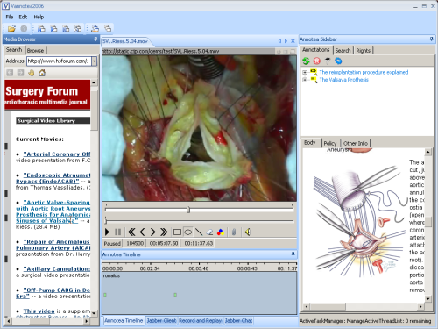
System Survey 3
Vannotea from University of Queensland
Similar to VideoAnnEx with more flexibility on annotation metadata
Based on RDF standard
Notes:
A group of researchers from University of Queensland invented Vannotea [13] to help facilitate collaborative video indexing, annotation and discussion of video contents in the distributed broadband environment. It supports most features that VideoAnnEx has and provides more flexibility on the metadata of video segments. Vannotea users are able to save, browse, retrieve and share both objective descriptions of the video files as well as subjective annotations on them. The videos files are still limited to Mpeg-2 format and users can only create text descriptions.

Slide 13
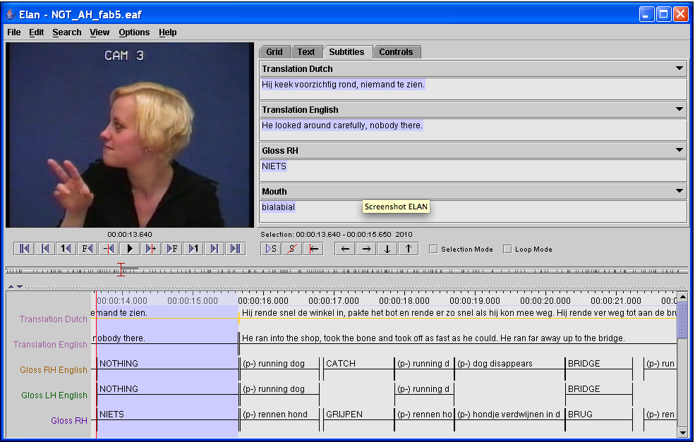
System Survey 4
ELAN
Text annotation on multimedia streams
Support annotations on multiple layers (tiers)
Tiers can be hierarchically interconnected
Notes:
ELAN is a professional tool for the creation of complex annotations on video and audio resources.
With ELAN a user can add an unlimited number of annotations to audio and/or video streams. An annotation can be a sentence, word or gloss, a comment, translation or a description of any feature observed in the media. Annotations can be created on multiple layers, called tiers. Tiers can be hierarchically interconnected. An annotation can either be time-aligned to the media or it can refer to other existing annotations. The textual content of annotations is always in Unicode and the transcription is stored in an XML format. ELAN provides several different views on the annotations, each view is connected and synchronized to the media playhead.
Up to 4 video files can be associated with an annotation document. Each video can be integrated in the main document window or displayed in its own resizable window. ELAN delegates media playback to an existing media framework, like Windows Media Player, QuickTime or JMF (Java Media Framework). As a result a wide variety of audio and video formats is supported and high performance media playback can be achieved.
ELAN is written in the Java programming language and the sources are available for non-commercial use. It runs on Windows, Mac OS X and Linux.

Slide 14
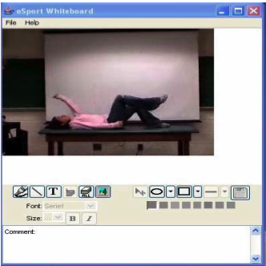
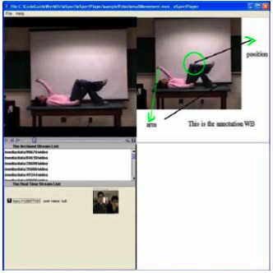
System Survey 5
eSports : Indiana University Community Grids Lab
Annotation from texts to images and video clips
Aimed at distance coaching
Notes:
eSports [14] developed by Community Grids Lab is another attempt to enable collaborative annotation on multimedia content over the distributed network, especially the grid-computing network. It enriched the annotation on multimedia contents from simple text to more diverse forms such as graphic shapes, audio/video clips. As its name indicates, eSports system aims to help sport coaches train their trainees remotely through vocal and graphic annotations on real time or archived video streams. Coaches can take snapshots of sample gestures in the video and comment on them to help students understand their classes. Annotations and video streams are archived using Naradabrokering storage service and can be replayed synchronously based on their timestamp property. Since the streams are stored as a series of Naradabrokering events rather than large video files, users can ask to replay any part of the stream without loading all related events. Live chat is also implemented to improve the real time communication in the system.

Slide 15
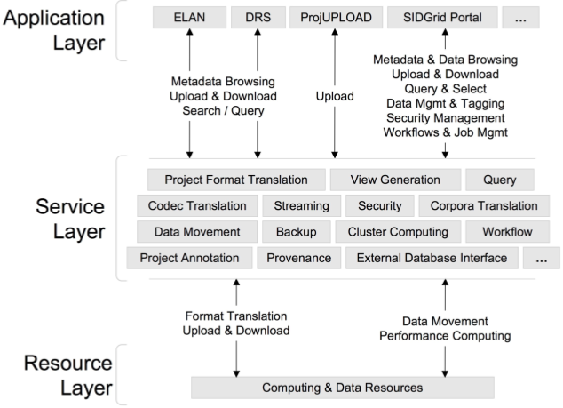
System Survey 6
SIDGrid
Infrastructure to enable transparent access to distributed, aligned, and annotated social informatics data
Notes:
The SIDGrid architecture provides a frame- work for distributed annotation, archiving, and analysis of the rapidly growing volume of multimodal data. The framework inte- grates three main components: an annota- tion and analysis client, a web-accessible data repository, and a portal to the dis- tributed processing capability of the Ter- aGrid. The architecture provides both a novel integration of annotation, analysis, and search for multimodal data and a pow- erful framework for web-based, distributed collaborative annotation and analysis.

Slide 16
Outline
Introduction
Motivation
Related System Survey
Research Issues
Milestones
Contributions

Slide 17
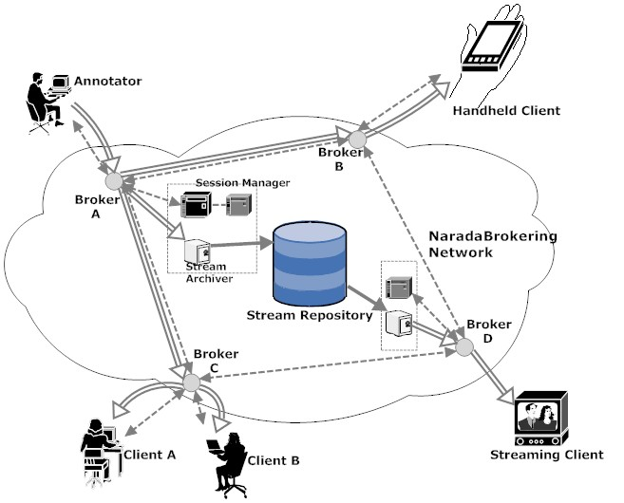
Issue 1: System Architecture
Client/Server
Peer to peer
Service Oriented Pub/sub
Notes:
Centralized Client/Server
Easy to control, maintain and update
Hard to scale, recover from server failure
Peer to peer
Easy to scale, tolerant to node failures
Hard to control
Service oriented in a pub/sub environment

Slide 18
Issue 2: Annotation format/Management
ITU-T Mpeg7 versus Semantic Web RDF
Mpeg7: Indexing, Searching, description of the content
RDF based: Statements about resources, knowledge can be built on top of it
Centralized storage versus Distributed Storage
Centralized: efficient, hard to recover from server crashes
Distributed : fault tolerant but may have latency issues
RDF + Distributed Storage
Notes:
Resource Description Framework

Slide 19
Issue 3: Annotation On Live Data Stream
Control/Monitor the status of Live Data Streams
Two modes of annotation (sync and async)
Simple Stream Processing Interface
Define behaviors of real time streams
Define basic annotating operations
Annotating annotations

Slide 20
Issue 4: Profiling and Evaluation
Profiling
Client Node: Synchronization test
Service Node: Resource usage of archiving service
Evaluation
Scalability
Robustness: Recovery time, failure detection

Slide 21
Outline
Introduction
Motivation
Related System Survey
Research Issues
Milestones
Contributions

Slide 22
Milestones
Annotation Client with well defined stream processing interfaces
Robust Session Management
Annotation Archiving Service
RDF based annotation description
Annotation Integration Service
Mobile Support

Slide 23
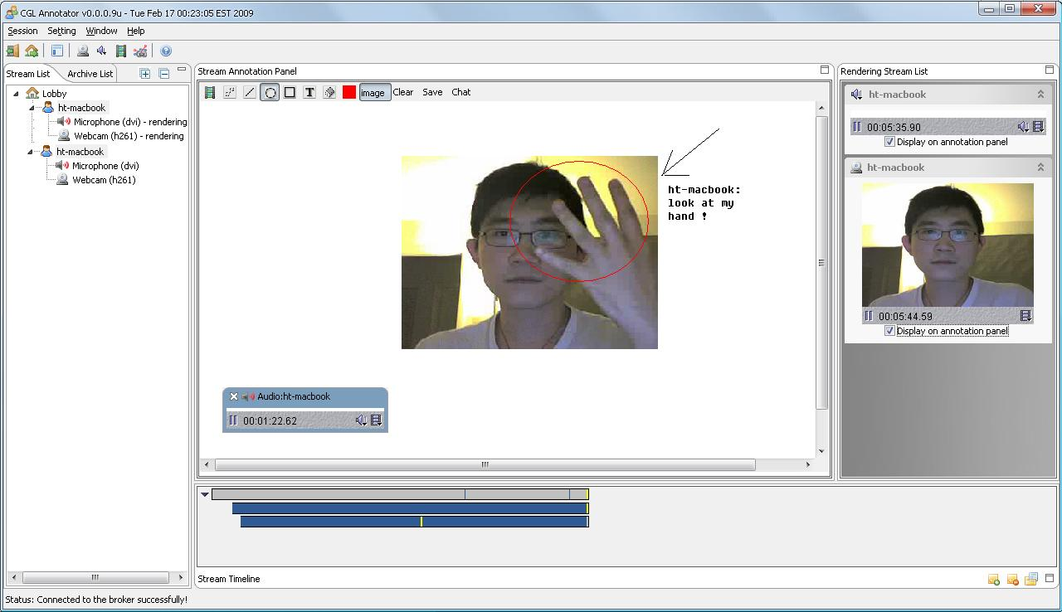
Annotation Client Interface

Slide 24
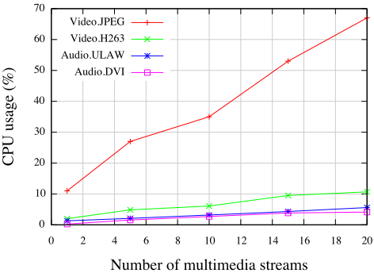
Preliminary Test 1

Slide 25
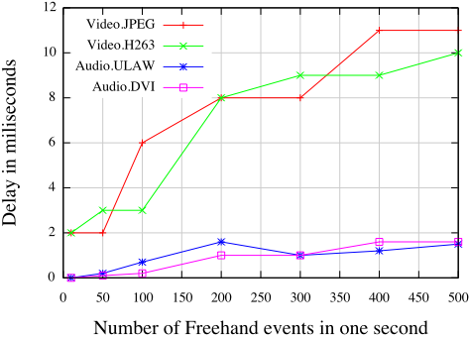
Preliminary Test 2

Slide 26
Outline
Introduction
Motivation
Related System Survey
Research Issues
Milestones
Contributions

Slide 27
Contributions
A scalable annotation framework of live data streams
A RDF based annotation metadata model
Simplify the efforts of collaborative annotation on real time streaming data
Well defined interface that supports adding arbitrary types of streaming data
Standard interface of stream annotation
Provide systematical profiling/evaluation methods for stream annotation systems

Slide 28
Thanks
Any questions ?

Slide 29
Reliable delivery of NB Events

Slide 30
Security in NB event delivery

Slide 31
Overheads of Reliable delivery

Slide 32
Overheads of secure delivery

Slide 33
System Architecture
Distributed annotation clients over the NaradaBrokering Network.
Session management with two recovery strategies
Distributed stream archiving and replaying
Easy to add support to handheld and streaming clients

Slide 34
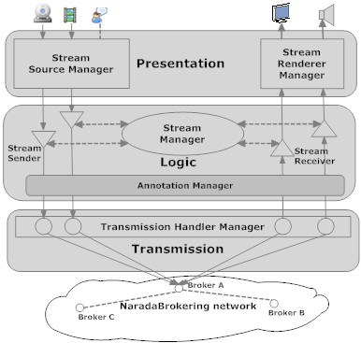
Decoupled Functions in Layers
Presentation layer
GUI, Stream Source/Renderer Managers
The Logic layer
Stream manager manages all active senders and receivers
Annotation manager associates and synchronizes content streams with annotation streams.
The Transmission
Creating and managing actual data transmission

Slide 35
Stream Processing Interfaces
Define the generic behaviors of real time data streams
Start, Stop, Pause, Resume and so on
Existing Stream Sources/Renderers
Audio/Video
Screen capture
File capture
Easy to write own source/renderer pairs

Slide 36
Demo Video
Click Me

