Slide 1
Harp: Collective Communication on Hadoop
Judy Qiu, Indiana University

Slide 2
Acknowledgement
Bingjing Zhang
Xiaoming Gao
Stephen Wu
Thilina Gunarathne
Yuan Young
Zhenghao Gu
Prof. Haixu Tang
Bioinformatics
Prof. David Crandall
Computer Vision
Prof. Filippo Menczer
Complex Networks and Systems
Prof. Madhav Marath
Network Science and HCI
Prof. Andrew Ng
Machine Learning
SALSA HPC Group
http://salsahpc.indiana.edu
School of Informatics and Computing
Indiana University

Slide 3
Machine Learning on Big Data
Extracting Knowledge with Data Analytics
Mahout on Hadoop
https://mahout.apache.org/
MLlib on Spark
http://spark.apache.org/mllib/
GraphLab Toolkits
http://graphlab.org/projects/toolkits.html
GraphLab Computer Vision Toolkit

Slide 4
Do we need 140 software packages?
The World of Big Data Tools
DAG Model
MapReduce Model
Graph Model
BSP/Collective Model
Hadoop
For Iterations/ Learning
MPI
HaLoop
Giraph
Twister
Hama
GraphLab
Spark
GraphX
Harp
Stratosphere
Dryad/ DryadLINQ
Reef
For Query
Pig/PigLatin
Hive
Drill
Tez
Shark
MRQL
For Streaming
S4
Storm
Samza
Spark Streaming

Slide 5
Programming Runtimes
Workflows, Swift, Falkon
Classic Cloud: Queues, Workers
PaaS:
Worker Roles
Hadoop MapReduce
Pig Latin,
Hive
Chapel, X10,
HPF
DAGMan, BOINC
MPI, PVM,
Achieve Higher Throughput
Perform Computations Efficiently
High-level programming models such as MapReduce adopt a data-centered design
Computation starts from data
Support moving computation to data
Shows promising results for data-intensive computing
( Google, Yahoo, Amazon, Microsoft …)
Challenges: traditional MapReduce and classical parallel runtimes cannot solve iterative algorithms efficiently
Hadoop: repeated data access to HDFS, no optimization to (in memory) data caching and (collective) intermediate data transfers
MPI: no natural support of fault tolerance; programming interface is complicated

Slide 6
Applications & Different Interconnection Patterns
(a) Map Only (Pleasingly Parallel) | (b) Classic MapReduce | (c) Iterative MapReduce | (d) Loosely Synchronous
- CAP3 Gene Analysis Smith-Waterman Distances - Document conversion (PDF -> HTML) - Brute force searches in cryptography - Parametric sweeps - PolarGrid MATLAB data analysis | - High Energy Physics (HEP) Histograms - Distributed search - Distributed sorting - Information retrieval - Calculation of Pairwise Distances for sequences (BLAST) | Expectation maximization algorithms Linear Algebra - Data mining, includes K-means clustering Deterministic Annealing Clustering - Multidimensional Scaling (MDS) - PageRank | Many MPI scientific applications utilizing wide variety of communication constructs, including local interactions - Solving Differential Equations and particle dynamics with short range forces
Input
Input
Input
iterations
map
map
map
Pij
reduce
reduce
Output
No Communication
Collective Communication
MPI
Domain of MapReduce and Iterative Extensions

Slide 7
Iterative MapReduce
Mapreduce is a Programming Model instantiating the paradigm of bringing computation to data
Iterative Mapreduce extends Mapreduce programming model and support iterative algorithms for Data Mining and Data Analysis
Is it possible to use the same computational tools on HPC and Cloud?
Enabling scientists to focus on science not programming distributed systems

Slide 8
Data Analysis Tools
MapReduce optimized for iterative computations
Twister: the speedy elephant
Abstractions
In-Memory
Cacheable map/reduce tasks
Data Flow
Iterative
Loop Invariant
Variable data
Thread
Lightweight
Local aggregation
Map-Collective
Communication patterns optimized for large intermediate data transfer
Portability
HPC (Java)
Azure Cloud (C#)
Supercomputer (C++, Java)

Slide 9
Programming Model for Iterative MapReduce
Loop Invariant Data
Loaded only once
Configure()
Cacheable map/reduce tasks
(in memory)
Variable data
Main Program
while(..)
{
runMapReduce(..)
}
Map(Key, Value)
Faster intermediate data transfer mechanism
Reduce (Key, List<Value>)
Combine(Map<Key,Value>)
Combiner operation to collect all reduce outputs
Distinction on loop invariant data and variable data (data flow vs. δ flow)
Cacheable map/reduce tasks (in-memory)
Combine operation

Slide 10
High Performance Data Movement
Broadcast Comparison: Twister vs. MPI vs. Spark
Tested on IU Polar Grid with 1 Gbps Ethernet connection
At least a factor of 120 on 125 nodes, compared with the simple broadcast algorithm
The new topology-aware chain broadcasting algorithm gives 20% better performance than best C/C++ MPI methods (four times faster than Java MPJ)
A factor of 5 improvement over non-optimized (for topology) pipeline-based method over 150 nodes.

Slide 11
Harp Map-Collective Communication Model
Hadoop Plugin (on Hadoop 1.2.1 and Hadoop 2.2.0)
Parallelism Model
Architecture
MapReduce Model
Map-Collective Model
MapReduce Applications
Map-Collective Applications
M
M
M
M
Application
M
M
M
M
MapReduce V2
Harp
Shuffle
Framework
R
R
Collective Communication
Resource Manager
YARN
We generalize the Map-Reduce concept to Map-Collective, noting that large collectives are a distinguishing feature of data intensive and data mining applications.

Slide 12
Hierarchical Data Abstraction and Collective Communication
Broadcast, Allgather, Allreduce, Regroup-(combine/reduce), Message-to-Vertex, Edge-to-Vertex
Table
Array Table <Array Type>
Edge
Table
Message Table
Vertex Table
KeyValue Table
Partition
Array Partition < Array Type >
Edge Partition
Message Partition
Vertex Partition
KeyValue Partition
Broadcast, Send
Long Array
Int Array
Double Array
Byte Array
Vertices, Edges, Messages
Key-Values
Basic Types
Array
Struct Object
Broadcast, Send, Gather
Commutable

Slide 13
K-means Clustering Parallel Efficiency
Shantenu Jha et al. A Tale of Two Data-Intensive Paradigms: Applications, Abstractions, and Architectures. 2014.

Slide 14
WDA-MDS Performance on Big Red II

Slide 15
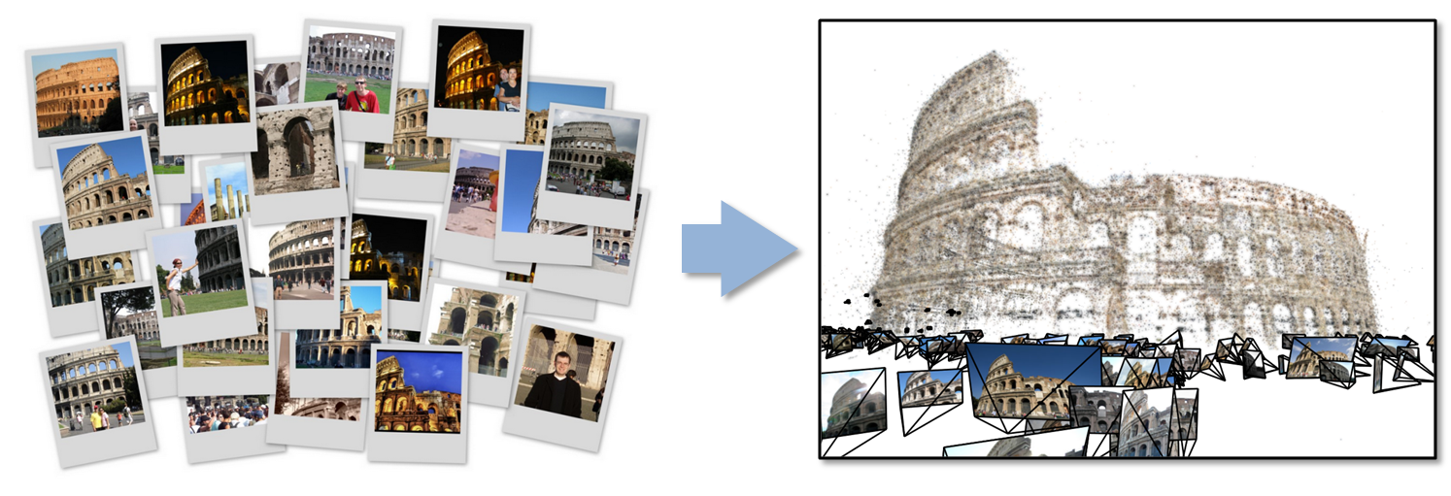
Data Intensive Kmeans Clustering
─ Image Classification: 7 million images; 512 features per image; 1 million clusters
10K Map tasks; 64G broadcasting data (1GB data transfer per Map task node);
20 TB intermediate data in shuffling.

Slide 16
Apache Open Source Project
Provides system authors with a centralized (pluggable) control flow
Embeds a user-defined system controller called the Job Driver
Event driven control
Package a variety of data-processing libraries (e.g., high-bandwidth shuffle, relational operators, low-latency group communication, etc.) in a reusable form.
To cover different models such as MapReduce, query, graph processing and stream data processing

Slide 17
Future Work
Research run times that will run Algorithms on a much larger scale
Provide Data Service on Clustering and MDS Algorithms

