Slide 1
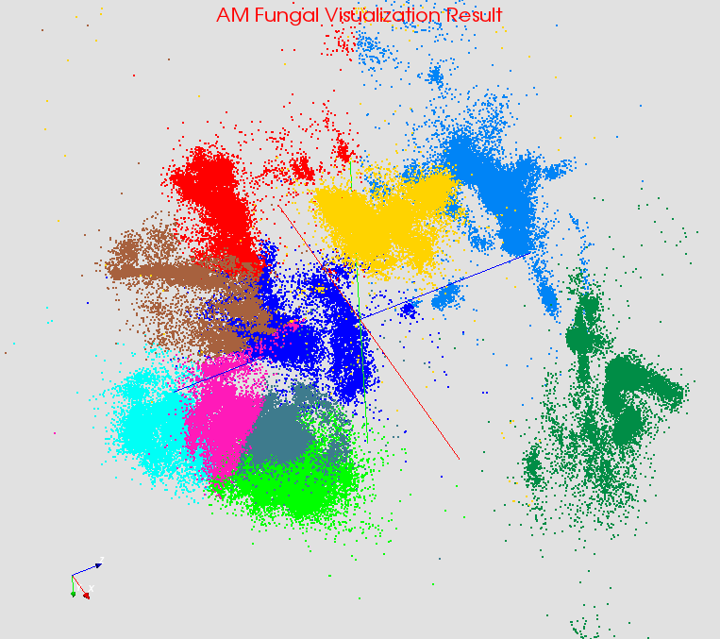

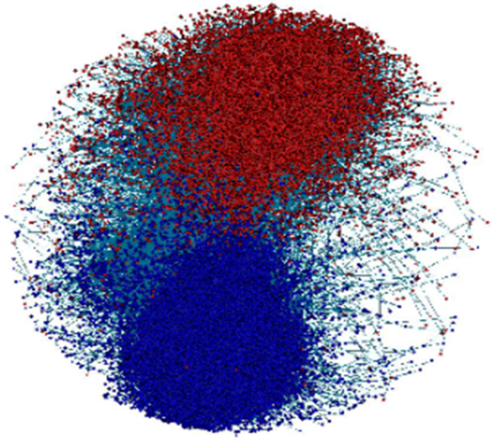

Large-Scale Data Analysis Applications
Judy Qiu, Indiana University
    Data analysis plays an important role in data-driven scientific discovery and commercial services. An interesting principle is that HPC ideas should integrate well with Apache (and other) open source big data technologies (ABDS). ABDS seems a winner as it has a clear vitality and innovation with a sustainable software model. Our current catalog has identified 200 software subsystems divided into 17 layers.
    Illustrating this principle, I have shown that previous standalone enhanced versions of MapReduce can be replaced by a Hadoop plug-in that offers both data abstractions useful for high performance iteration and communication using best available (MPI) approaches that are portable to HPC and Cloud.
    This iterative solver would enable robustness, scalability, productivity, and sustainability for applications including Computer Vision, Pathology, Information Visualization, Network Science, Remote sensing, Physical Simulation, as well as many commercial applications. This variety of applications should allow tests of memory architecture, vectorization and parallelization approach on the different Intel systems.
Classified OUT
IN
Bioinformatics
Computer Vision
Complex Networks
Deep Learning

Slide 2

Map-Collective Communication Model
  Hadoop Plugin (on Hadoop 1.2.1 and Hadoop 2.2.0)
Parallelism Model
Software Architecture
MapReduce Model
Map-Collective Model
MapReduce Applications
Map-Collective Applications
M
M
M
M
Application
M
M
M
M
MapReduce V2
Harp
Shuffle
Framework
R
R
Collective Communication
Resource Manager
YARN
REEF Architecture
  We generalize the Map-Reduce concept to Map-Collective, noting that large collectives (high performance data movement) are a distinguishing feature of data intensive and data mining applications.

Slide 3
Hierarchical Data Abstraction and Collective Communication
Broadcast, Allgather, Allreduce, Regroup-(combine/reduce), Message-to-Vertex, Edge-to-Vertex
Table
Array Table <Array Type>
Edge
Table
Message Table
Vertex Table
KeyValue Table
Partition
Array Partition
< Array Type >
Edge Partition
Message Partition
Vertex Partition
KeyValue Partition
Broadcast, Send
Long Array
Int Array
Double Array
Byte Array
Vertices, Edges, Messages
KeyValues
Basic Types
Array
Struct Object
Broadcast, Send, Gather
Commutable
    We create abstractions and connect to other communities so we can collaborate on common software building blocks.

