Slide 1
Implications of Clouds for Data Intensive Science with application to Biomedical Science
I400 Indiana University
March 10 2011
Geoffrey Fox
gcf@indiana.edu
http://www.infomall.org http://www.futuregrid.org
Director, Digital Science Center, Pervasive Technology Institute
Associate Dean for Research and Graduate Studies, School of Informatics and Computing
Indiana University Bloomington

Slide 2
Important Trends
Data Deluge in all fields of science
Multicore implies parallel computing important again
  Performance from extra cores – not extra clock speed
  GPU enhanced systems can give big power boost
Clouds – new commercially supported data center model replacing compute grids (and your general purpose computer center)
Light weight clients: Sensors, Smartphones and tablets accessing and supported by backend services in cloud
Commercial efforts moving much faster than academia in both innovation and deployment

Slide 3
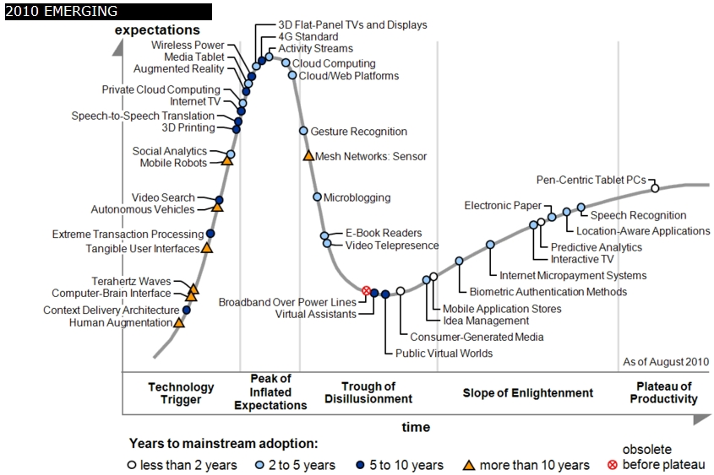
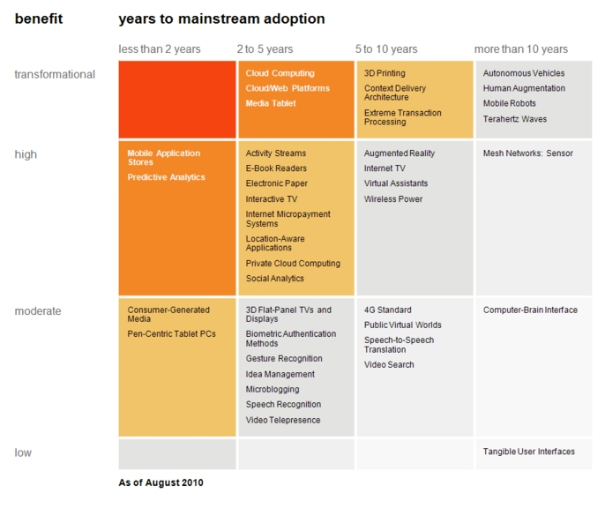

Transformational
High
Moderate
Low
Gartner 2009 Hype Curve
Clouds, Web2.0
Service Oriented Architectures
Cloud Computing
Cloud Web Platforms
Media Tablet

Slide 4



Data Centers Clouds &
Economies of Scale I
Range in size from “edge” facilities to megascale.
Economies of scale
  Approximate costs for a small size center (1K servers) and a larger, 50K server center.
2 Google warehouses of computers on the banks of the Columbia River, in The Dalles, Oregon
Such centers use 20MW-200MW
(Future) each with 150 watts per CPU
Save money from large size, positioning with cheap power and access with Internet
Technology | Cost in small-sized Data Center | Cost in Large Data Center | Ratio
Network | $95 per Mbps/ month | $13 per Mbps/ month | 7.1
Storage | $2.20 per GB/ month | $0.40 per GB/ month | 5.7
Administration | ~140 servers/ Administrator | >1000 Servers/ Administrator | 7.1
Each data center is
11.5 times
the size of a football field

Slide 5


Data Centers, Clouds
& Economies of Scale II
Builds giant data centers with 100,000’s of computers;
~ 200-1000 to a shipping container with Internet access
“Microsoft will cram between 150 and 220 shipping containers filled with data center gear into a new 500,000 square foot Chicago facility. This move marks the most significant, public use of the shipping container systems popularized by the likes of Sun Microsystems and Rackable Systems to date.”

Slide 6
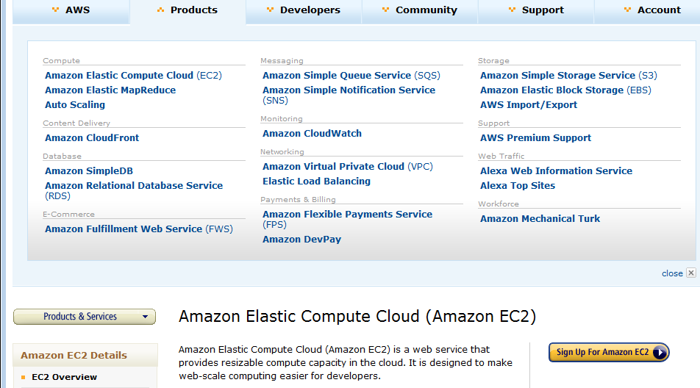
Amazon offers a lot!

Slide 7
















X as a Service
SaaS: Software as a Service imply software capabilities
(programs) have a service (messaging) interface
  Applying systematically reduces system complexity to being linear in number of components
  Access via messaging rather than by installing in /usr/bin
IaaS: Infrastructure as a Service or HaaS: Hardware as a Service – get your computer time with a credit card and with a Web interface
PaaS: Platform as a Service is IaaS plus core software capabilities on which you build SaaS
Cyberinfrastructure is “Research as a Service”
Other Services
Clients

Slide 8








Sensors as a Service
Cell phones are important sensor
Sensors as a Service
Sensor Processing as a Service (MapReduce)

Slide 9
Philosophy of
Clouds and Grids
Clouds are (by definition) commercially supported approach to large scale computing
  So we should expect Clouds to replace Compute Grids
  Current Grid technology involves “non-commercial” software solutions which are hard to evolve/sustain
  Maybe Clouds ~4% IT expenditure 2008 growing to 14% in 2012 (IDC Estimate)
Public Clouds are broadly accessible resources like Amazon and Microsoft Azure – powerful but not easy to customize and perhaps data trust/privacy issues
Private Clouds run similar software and mechanisms but on “your own computers” (not clear if still elastic)
  Platform features such as Queues, Tables, Databases currently limited
Services still are correct architecture with either REST (Web 2.0) or Web Services
Clusters are still critical concept for MPI or Cloud software

Slide 10
Grids MPI and Clouds
Grids are useful for managing distributed systems
  Pioneered service model for Science
  Developed importance of Workflow
  Performance issues – communication latency – intrinsic to distributed systems
  Can never run large differential equation based simulations or datamining
Clouds can execute any job class that was good for Grids plus
  More attractive due to platform plus elastic on-demand model
  MapReduce easier to use than MPI for appropriate parallel jobs
  Currently have performance limitations due to poor affinity (locality) for compute-compute (MPI) and Compute-data
  These limitations are not “inevitable” and should gradually improve as in July 13 Amazon Cluster announcement
  Will probably never be best for most sophisticated parallel differential equation based simulations
Classic Supercomputers (MPI Engines) run communication demanding differential equation based simulations
  MapReduce and Clouds replaces MPI for other problems
  Much more data processed today by MapReduce than MPI (Industry Informational Retrieval ~50 Petabytes per day)

Slide 11
Cloud Computing:
Infrastructure and Runtimes
Cloud infrastructure: outsourcing of servers, computing, data, file space, utility computing, etc.
  Handled through Web services that control virtual machine lifecycles.
Cloud runtimes or Platform: tools (for using clouds) to do data-parallel (and other) computations.
  Apache Hadoop, Google MapReduce, Microsoft Dryad, Bigtable, Chubby and others
  MapReduce designed for information retrieval but is excellent for a wide range of science data analysis applications
  Can also do much traditional parallel computing for data-mining if extended to support iterative operations
  MapReduce not usually on Virtual Machines

Slide 12
Simple Histograms
Histogram is set of bins in some observed variable and one calculates for each occurrence, bin in which variable lies
Particle Physics:
  Histogram mass of set of particles produced in collision where event satisfies conditions set by physicist
  Disks now are full of events which are scanned to see if condition satisfied and calculate bin in which mass lies – add into histogram
  Combine (add) histograms to form total
Compare …
Information Retrieval:
  Independently look at each compressed web page stored on disk to see if page (document) satisfies query
  Combine results and sort by Page Rank

Slide 13

Reduce Phase of Particle Physics
“Find the Higgs” using Dryad
Higgs in Monte Carlo
Combine Histograms produced by separate Root “Maps” (of event data to partial histograms) into a single Histogram delivered to Client

Slide 14
MapReduce
Data Partitions
Map(Key, Value)
A hash function maps the results of the map tasks to reduce tasks
Reduce(Key, List<Value>)
Reduce Outputs
Implementations (Hadoop – Java; Dryad – Windows) support:
  Splitting of data
  Passing the output of map functions to reduce functions
  Sorting the inputs to the reduce function based on the intermediate keys
  Quality of service

Slide 15






MapReduce “File/Data Repository” Parallelism
Map = (data parallel) computation reading and writing data
Reduce = Collective/Consolidation phase e.g. forming multiple global sums as in histogram
Instruments
Iterative MapReduce
Map Map Map Map
Reduce Reduce Reduce
Communication
Reduce
Portals
/Users
Disks
Map₁
Map₂
Map₃

Slide 16


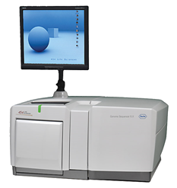
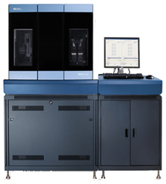
DNA Sequencing Pipeline
MapReduce
Pairwise
clustering
Sequence
alignment
Dissimilarity
Matrix
N(N-1)/2 values
Visualization
Plotviz
FASTA File
N Sequences
Blocking
block
Pairings
MPI
MDS
Read Alignment
Illumina/Solexa Roche/454 Life Sciences Applied Biosystems/SOLiD
Internet
Modern Commercial Gene Sequencers
This chart illustrate our research of a pipeline mode to provide services on demand (Software as a Service SaaS)
User submit their jobs to the pipeline. The components are services and so is the whole pipeline.

Slide 17
Alu and Metagenomics Workflow
“All pairs” problem
Data is a collection of N sequences. Need to calculate N² dissimilarities (distances) between sequnces (all pairs).
  These cannot be thought of as vectors because there are missing characters
  “Multiple Sequence Alignment” (creating vectors of characters) doesn’t seem to work if N larger than O(100), where 100’s of characters long.
Step 1: Can calculate N² dissimilarities (distances) between sequences
Step 2: Find families by clustering (using much better methods than Kmeans). As no vectors, use vector free O(N²) methods
Step 3: Map to 3D for visualization using Multidimensional Scaling (MDS) – also O(N²)
Results:
N = 50,000 runs in 10 hours (the complete pipeline above) on 768 cores
Discussions:
Need to address millions of sequences …..
Currently using a mix of MapReduce and MPI
Twister will do all steps as MDS, Clustering just need MPI Broadcast/Reduce

Slide 18

Alu Families
This visualizes results of Alu repeats from Chimpanzee and Human Genomes. Young families (green, yellow) are seen as tight clusters. This is projection of MDS dimension reduction to 3D of 35399 repeats – each with about 400 base pairs

Slide 19

Metagenomics
This visualizes results of dimension reduction to 3D of 30000 gene sequences from an environmental sample. The many different genes are classified by clustering algorithm and visualized by MDS dimension reduction

Slide 20

All-Pairs Using DryadLINQ
125 million distances
4 hours & 46 minutes
Calculate Pairwise Distances (Smith Waterman Gotoh)
Calculate pairwise distances for a collection of genes (used for clustering, MDS)
Fine grained tasks in MPI
Coarse grained tasks in DryadLINQ
Performed on 768 cores (Tempest Cluster)
Moretti, C., Bui, H., Hollingsworth, K., Rich, B., Flynn, P., & Thain, D. (2009). All-Pairs: An Abstraction for Data Intensive Computing on Campus Grids. IEEE Transactions on Parallel and Distributed Systems , 21, 21-36.

Slide 21
Hadoop VM Performance Degradation
Perf. Degradation = (T_{vm} – T_{baremetal})/T_{baremetal}
15.3% Degradation at largest data set size

Slide 22
Cap3 Cost
Notes:
This is just the cost for the compute instances. In addition to this, there will be minor charges for the data storage for EMR & AzureMR. Also there will be additional minor charges for the queue service and table service for AzureMR.
Cost presented here are amortized for the actual time (time/3600 * num_instances * instance_price_per_hour), assuming the remaining time of the instance hour have been put to useful work.
Note: EMR & Hadoop-EC2 requires one extra node to act as the master node (included in the cost calculation)

Slide 23
SWG Cost
Notes:
This is just the cost for the compute instances. In addition to this, there will be minor charges for the data storage for EMR & AzureMR. Also there will be additional minor charges for the queue service and table service for AzureMR.
Cost presented here are amortized for the actual time (time/3600 * num_instances * instance_price_per_hour), assuming the remaining time of the instance hour have been put to useful work.
Note: EMR & Hadoop-EC2 requires one extra node to act as the master node (included in the cost calculation)

Slide 24
Smith Waterman:
Daily Effect

Slide 25
High Performance Dimension Reduction and Visualization
Need is pervasive
  Large and high dimensional data are everywhere: biology, physics, Internet, …
  Visualization can help data analysis
Visualization of large datasets with high performance
  Map high-dimensional data into low dimensions (2D or 3D).
  Need Parallel programming for processing large data sets
  Developing high performance dimension reduction algorithms:
    MDS(Multi-dimensional Scaling), used earlier in DNA sequencing application
    GTM(Generative Topographic Mapping)
    DA-MDS(Deterministic Annealing MDS)
    DA-GTM(Deterministic Annealing GTM)
  Interactive visualization tool PlotViz
We are supporting drug discovery by browsing 60 million compounds in PubChem database with 166 features each
Notes:
With David Wild

Slide 26
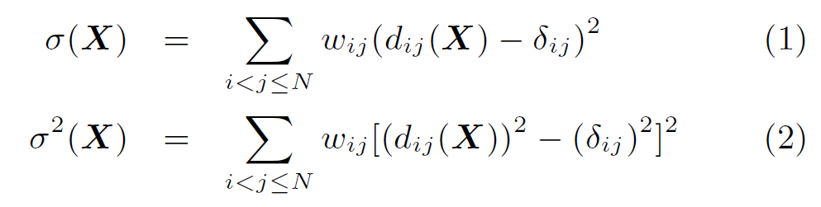

Dimension Reduction Algorithms
Multidimensional Scaling (MDS) [1]
  Given the proximity information among points.
  Optimization problem to find mapping in target dimension of the given data based on pairwise proximity information while minimize the objective function.
  Objective functions: STRESS (1) or SSTRESS (2)
  Only needs pairwise distances δ_{ij} between original points (typically not Euclidean)
  d_{ij}(X) is Euclidean distance between mapped (3D) points
Generative Topographic Mapping
(GTM) [2]
  Find optimal K-representations for the given data (in 3D), known as
  K-cluster problem (NP-hard)
  Original algorithm use EM method for optimization
  Deterministic Annealing algorithm can be used for finding a global solution
  Objective functions is to maximize log-likelihood:
[1] I. Borg and P. J. Groenen. Modern Multidimensional Scaling: Theory and Applications. Springer, New York, NY, U.S.A., 2005.
[2] C. Bishop, M. Svens´en, and C. Williams. GTM: The generative topographic mapping. Neural computation, 10(1):215–234, 1998.
Notes:
MDS implemented in C#; GTM in R and C/C++

Slide 27
GTM vs. MDS
GTM
MDS (SMACOF)
Purpose
Non-linear dimension reduction
Find an optimal configuration in a lower-dimension
Iterative optimization method
Objective
Function
Maximize Log-Likelihood
Minimize STRESS or SSTRESS
Complexity
O(KN) (K << N)
O(N²)
Optimization
Method
EM
Iterative Majorization (EM-like)
MDS also soluble by viewing as nonlinear χ² with iterative linear equation solver

Slide 28
Analysis of 60 Million PubChem Entries
With David Wild
60 million PubChem compounds with 166 features
  Drug discovery
  Bioassay
3D visualization for data exploration/mining
  Mapping by MDS(Multi-dimensional Scaling) and
  GTM(Generative Topographic Mapping)
  Interactive visualization tool PlotViz
  Discover hidden structures

Slide 29
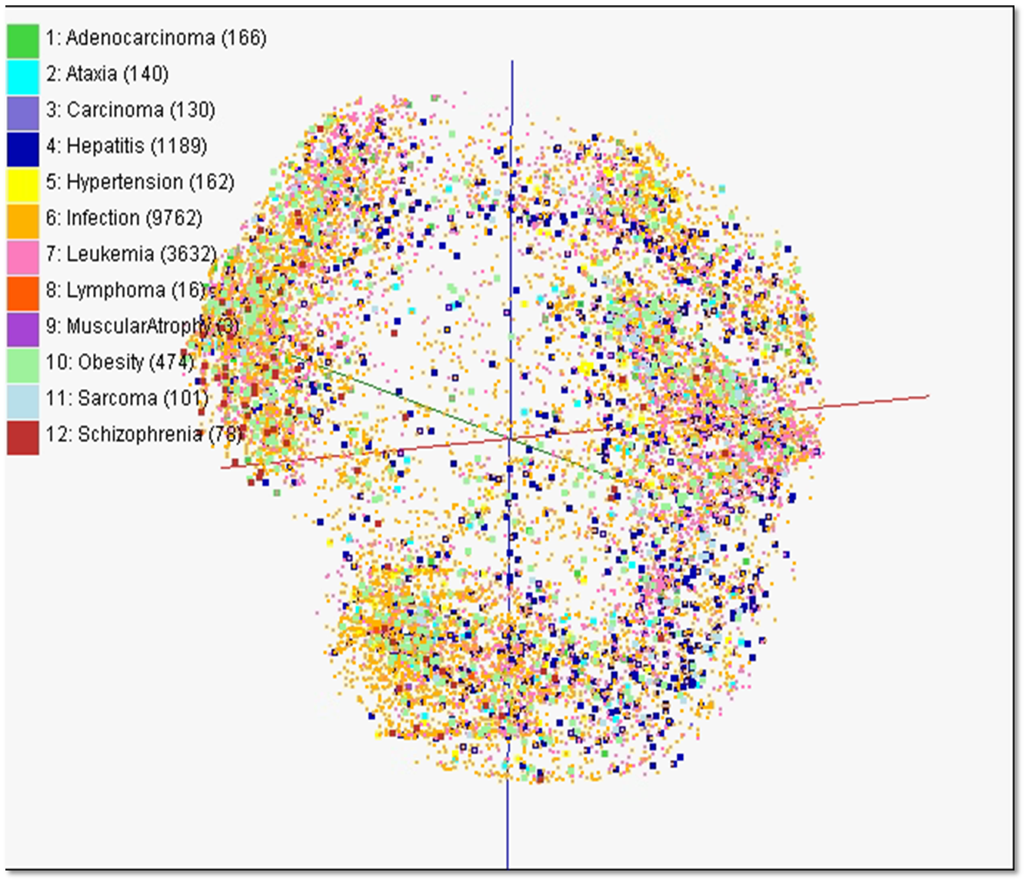

Slide 30
PlotViz
A tool for visualizing data points
  Dimension reduction by GTM and MDS
  Browse large and high-dimensional data
  Use many open (value-added) data
Parallel Visualization Algorithms
  GTM (Generative Topographic Mapping)
  MDS (Multi-dimensional Scaling)
  Interpolation extensions to GTM and MDS

Slide 31

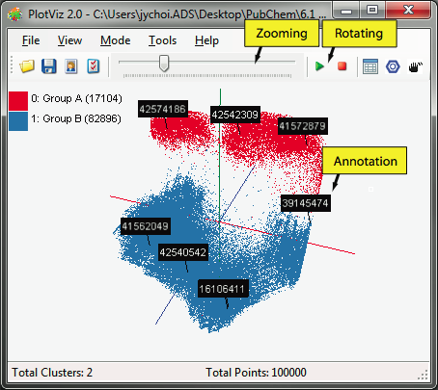

PlotViz System Overview
3-D Map File
SPARQL query
PlotViz
Meta data
Light-weight client
DrugBank
CTD
QSAR
Visualization Algorithms
PubChem
Chem2Bio2RDF
Parallel dimension reduction algorithms
Aggregated public databases

Slide 32
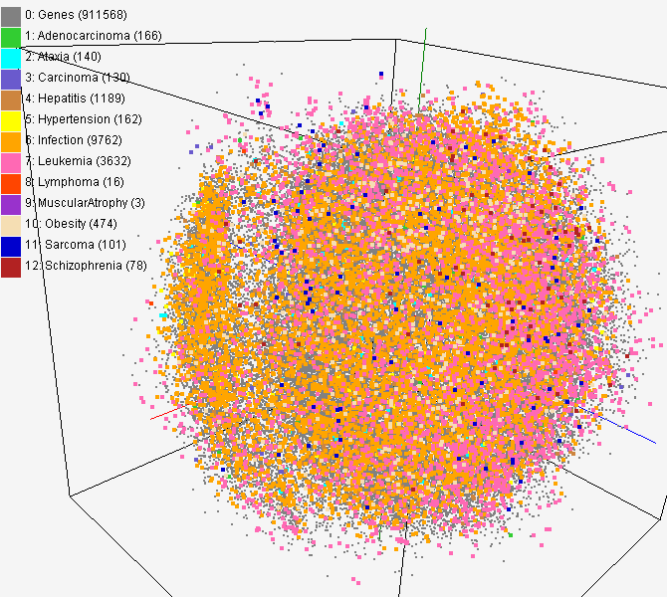
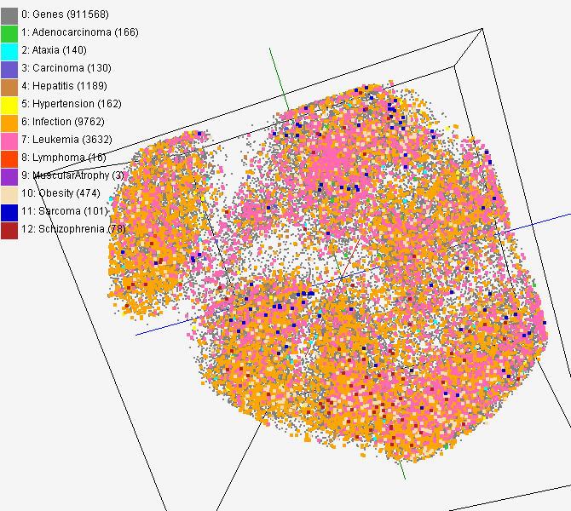
CTD data for gene-disease
PubChem data with CTD visualization by using MDS (left) and GTM (right)
About 930,000 chemical compounds are visualized as a point in 3D space, annotated by the related genes in Comparative Toxicogenomics Database (CTD)

Slide 33
Child Obesity Study
Discover environmental factors related with child obesity
About 137,000 Patient records with 8 health-related and 97 environmental factors has been analyzed
Health data
Environment data
Genetic Algorithm
BMI
Blood Pressure
Weight
Height
…
Greenness
Neighborhood
Population
Income
…
Canonical Correlation Analysis
Visualization

Slide 35
97-variable Environmental data
MDS
XYZ MDS Map
CCA
Correlation between MDS and U_{1st}
Variable Reduction PCA
1st Patient Canonical Variable (U_{1st})
k-variable Environmental data
CCA
1st Environment Canonical Variable (V_{1st})
GA
8-variable
Patient data
Most Significant
Properties

