Slide 1
Cyberinfrastructure for eScience and eBusiness from Clouds to Exascale
ICETE 2012 Joint Conference on e-Business and Telecommunications
Hotel Meliá Roma Aurelia Antica, Rome, Italy
July 27 2012
Geoffrey Fox
gcf@indiana.edu
Informatics, Computing and Physics
Indiana University Bloomington

Slide 2
Abstract
We analyze scientific computing into classes of applications and their suitability for different architectures covering both compute and data analysis cases and both high end and long tail (many small) users.
We identify where commodity systems (clouds) coming from eBusiness and eCommunity are appropriate and where specialized systems are needed. We cover both compute and data (storage) issues and propose an architecture for next generation Cyberinfrastructure and outline some of the research and education challenges.
We discuss FutureGrid project that is a testbed for these
ideas.

Slide 3
Topics Covered
Broad Overview: Data Deluge to Clouds
Clouds Grids and HPC
Internet of Things: Sensor Grids supported as pleasingly parallel applications on clouds
Analytics and Parallel Computing on Clouds and HPC
IaaS PaaS SaaS
Using Clouds
FutureGrid
Computing Testbed as a Service
Conclusions

Slide 4
Broad Overview:
Data Deluge to Clouds

Slide 5

Some Trends
  The Data Deluge is clear trend from Commercial (Amazon, e-commerce) , Community (Facebook, Search) and Scientific applications
  Light weight clients from smartphones, tablets to sensors
  Multicore reawakening parallel computing
  Exascale initiatives will continue drive to high end with a simulation orientation
  Clouds with cheaper, greener, easier to use IT for (some) applications
  New jobs associated with new curricula
    Clouds as a distributed system (classic CS courses)
    Data Analytics (Important theme in academia and industry)
    Network/Web Science

Slide 6
Some Data sizes
  ~40 10⁹ Web pages at ~300 kilobytes each = 10 Petabytes
  Youtube 48 hours video uploaded per minute;
    in 2 months in 2010, uploaded more than total NBC ABC CBS
    ~2.5 petabytes per year uploaded?
  LHC 15 petabytes per year
  Radiology 69 petabytes per year
  Square Kilometer Array Telescope will be 100 terabits/second
  Earth Observation becoming ~4 petabytes per year
  Earthquake Science – few terabytes total today
  PolarGrid – 100’s terabytes/year
  Exascale simulation data dumps – terabytes/second

Slide 7
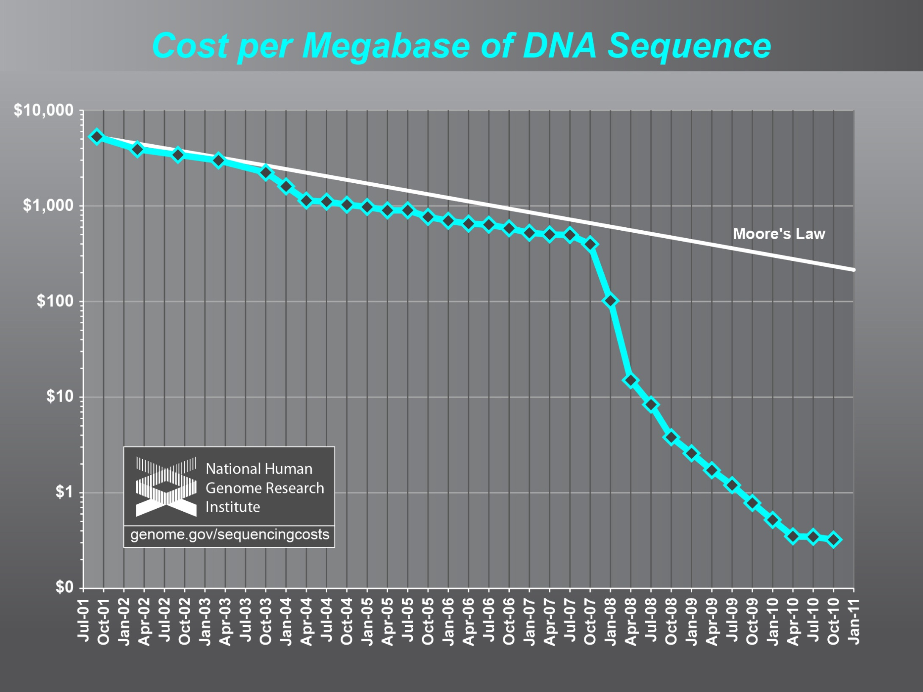
Why need cost effective
Computing!
Full Personal Genomics: 3 petabytes per day

Slide 8
Clouds Offer From different points of view
Features from NIST:
  On-demand service (elastic);
  Broad network access;
  Resource pooling;
  Flexible resource allocation;
  Measured service
Economies of scale in performance and electrical power (Green IT)
Powerful new software models
  Platform as a Service is not an alternative to Infrastructure as a Service – it is instead an incredible valued added
  Amazon is as much PaaS as Azure

Slide 9
The Google gmail example
http://www.google.com/green/pdfs/google-green-computing.pdf
Clouds win by efficient resource use and efficient data centers
Business Type | Number of users | # servers | IT Power per user | PUE (Power Usage effectiveness) | Total Power per user | Annual Energy per user
Small | 50 | 2 | 8W | 2.5 | 20W | 175 kWh
Medium | 500 | 2 | 1.8W | 1.8 | 3.2W | 28.4 kWh
Large | 10000 | 12 | 0.54W | 1.6 | 0.9W | 7.6 kWh
Gmail (Cloud) | ∞ | ∞ | < 0.22W | 1.16 | < 0.25W | < 2.2 kWh

Slide 10

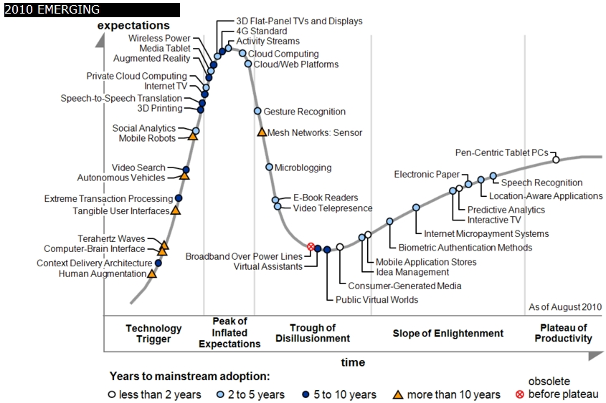
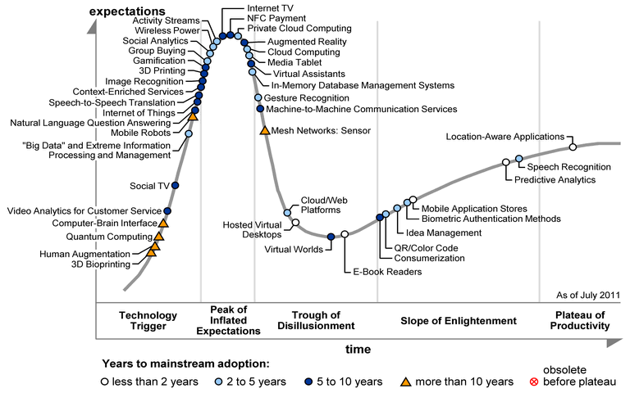
Gartner 2009 Hype Curve
Clouds, Web2.0, Green IT
Service Oriented Architectures

Slide 11

Jobs v. Countries

Slide 12
Clouds Grids and HPC

Slide 13
2 Aspects of Cloud Computing:
Infrastructure and Runtimes
Cloud infrastructure: outsourcing of servers, computing, data, file space, utility computing, etc..
Cloud runtimes or Platform: tools to do data-parallel (and other) computations. Valid on Clouds and traditional clusters
  Apache Hadoop, Google MapReduce, Microsoft Dryad, Bigtable, Chubby and others
  MapReduce designed for information retrieval but is excellent for a wide range of science data analysis applications
  Can also do much traditional parallel computing for data-mining if extended to support iterative operations
  Data Parallel File system as in HDFS and Bigtable

Slide 14
Science Computing Environments
Large Scale Supercomputers – Multicore nodes linked by high performance low latency network
  Increasingly with GPU enhancement
  Suitable for highly parallel simulations
High Throughput Systems such as European Grid Initiative EGI or Open Science Grid OSG typically aimed at pleasingly parallel jobs
  Can use “cycle stealing”
  Classic example is LHC data analysis
Grids federate resources as in EGI/OSG or enable convenient access to multiple backend systems including supercomputers
  Portals make access convenient and
  Workflow integrates multiple processes into a single job
Specialized visualization, shared memory parallelization etc. machines

Slide 15
Some Observations
Classic HPC machines as MPI engines offer highest possible performance on closely coupled problems
  Not going to change soon (maybe delivered by Amazon)
Clouds offer from different points of view
    On-demand service (elastic)
    Economies of scale from sharing
    Powerful new software models such as MapReduce, which have advantages over classic HPC environments
    Plenty of jobs making it attractive for students & curricula
    Security challenges
HPC problems running well on clouds have above advantages
Note 100% utilization of Supercomputers makes elasticity moot for capability (very large) jobs and makes capacity (many modest) use not be on-demand
Need Cloud-HPC Interoperability

Slide 16
Clouds and Grids/HPC
Synchronization/communication Performance
Grids > Clouds > Classic HPC Systems
Clouds naturally execute effectively Grid workloads but are less clear for closely coupled HPC applications
Service Oriented Architectures portals and workflow appear to work similarly in both grids and clouds
May be for immediate future, science supported by a mixture of
  Clouds – some practical differences between private and public clouds – size and software
  High Throughput Systems (moving to clouds as convenient)
  Grids for distributed data and access
  Supercomputers (“MPI Engines”) going to exascale

Slide 17
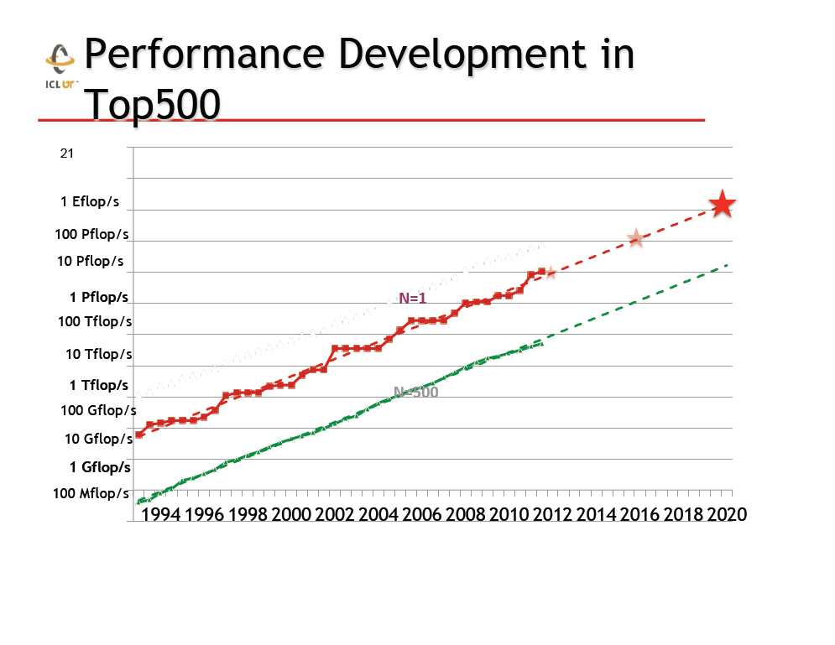
Exaflop
Exaflop machine TIGHTLY COUPLED
Clouds more powerful but LOOSELY COUPLED
From Jack Dongarra

Slide 18
What Applications work in Clouds
Pleasingly parallel applications of all sorts with roughly independent data or spawning independent simulations
  Long tail of science and integration of distributed sensors
Commercial and Science Data analytics that can use MapReduce (some of such apps) or its iterative variants (most other data analytics apps)
Which science applications are using clouds?
  Many demonstrations –Conferences, OOI, HEP ….
  Venus-C (Azure in Europe): 27 applications not using Scheduler, Workflow or MapReduce (except roll your own)
  50% of applications on FutureGrid are from Life Science but there is more computer science than total applications
  Locally Lilly corporation is major commercial cloud user (for drug discovery) but Biology department is not

Slide 19
Parallelism over Users and Usages
“Long tail of science” can be an important usage mode of clouds.
In some areas like particle physics and astronomy, i.e. “big science”, there are just a few major instruments generating now petascale data driving discovery in a coordinated fashion.
In other areas such as genomics and environmental science, there are many “individual” researchers with distributed collection and analysis of data whose total data and processing needs can match the size of big science.
Clouds can provide scaling convenient resources for this important aspect of science.
Can be map only use of MapReduce if different usages naturally linked e.g. exploring docking of multiple chemicals or alignment of multiple DNA sequences
  Collecting together or summarizing multiple “maps” is a simple Reduction

Slide 20
27 Venus-C Azure Applications
Chemistry (3)
• Lead Optimization in Drug Discovery
• Molecular Docking
Civil Protection (1)
• Fire Risk estimation and fire propagation
Biodiversity &
Biology (2)
• Biodiversity maps in marine species
• Gait simulation
Civil Eng. and Arch. (4)
• Structural Analysis
• Building information Management
• Energy Efficiency in Buildings
• Soil structure simulation
Physics (1)
• Simulation of Galaxies configuration
Earth Sciences (1)
• Seismic propagation
Mol, Cell. & Gen. Bio. (7)
• Genomic sequence analysis
• RNA prediction and analysis
• System Biology
• Loci Mapping
• Micro-arrays quality.
ICT (2)
• Logistics and vehicle routing
• Social networks analysis
Medicine (3)
• Intensive Care Units decision support.
• IM Radiotherapy planning.
• Brain Imaging
Mathematics (1)
• Computational Algebra
Mech, Naval & Aero. Eng. (2)
• Vessels monitoring
• Bevel gear manufacturing simulation

Slide 21
Internet of Things: Sensor Grids supported as pleasingly parallel applications on clouds

Slide 22
Internet of Things and the Cloud
It is projected that there will be 24 billion devices on the Internet by 2020. Most will be small sensors that send streams of information into the cloud where it will be processed and integrated with other streams and turned into knowledge that will help our lives in a multitude of small and big ways.
It is not unreasonable for us to believe that we will each have our own cloud-based personal agent that monitors all of the data about our life and anticipates our needs 24x7.
The cloud will become increasing important as a controller of and resource provider for the Internet of Things.
As well as today’s use for smart phone and gaming console support, “smart homes” and “ubiquitous cities” build on this vision and we could expect a growth in cloud supported/controlled robotics.
Natural parallelism over “things”

Slide 23
Internet of Things: Sensor Grids
A pleasingly parallel example on Clouds
A sensor (“Thing”) is any source or sink of time series
  In the thin client era, smart phones, Kindles, tablets, Kinects, web-cams are sensors
  Robots, distributed instruments such as environmental measures are sensors
  Web pages, Googledocs, Office 365, WebEx are sensors
  Ubiquitous Cities/Homes are full of sensors
They have IP address on Internet
Sensors – being intrinsically distributed are Grids
However natural implementation uses clouds to consolidate and control and collaborate with sensors
Sensors are typically “small” and have pleasingly parallel cloud implementations

Slide 24
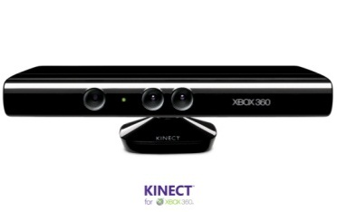








Sensors as a Service
Output Sensor
Sensors as a Service
Sensor Processing as a Service (could use
MapReduce)
A larger sensor ………
https://sites.google.com/site/opensourceiotcloud/ Open Source Sensor (IoT) Cloud

Slide 25
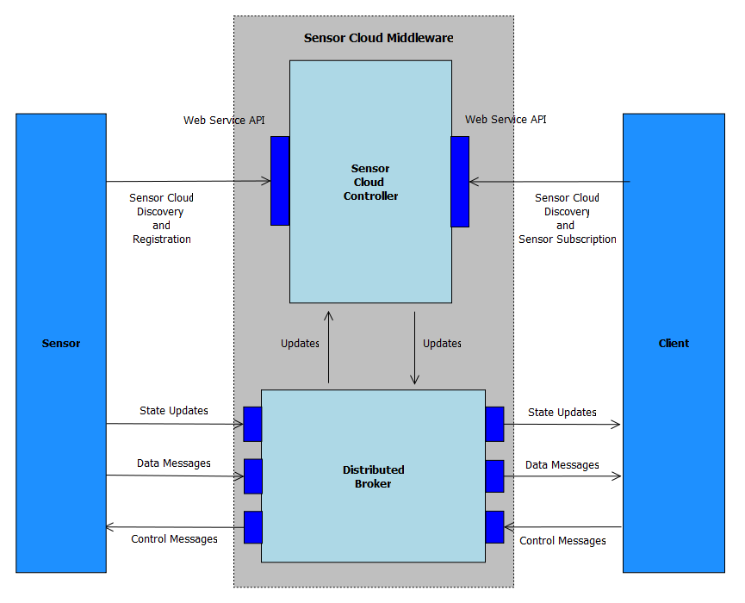
Sensor Cloud Architecture
Originally brokers were from NaradaBrokering
Replacing with ActiveMQ and Netty for streaming

Slide 26
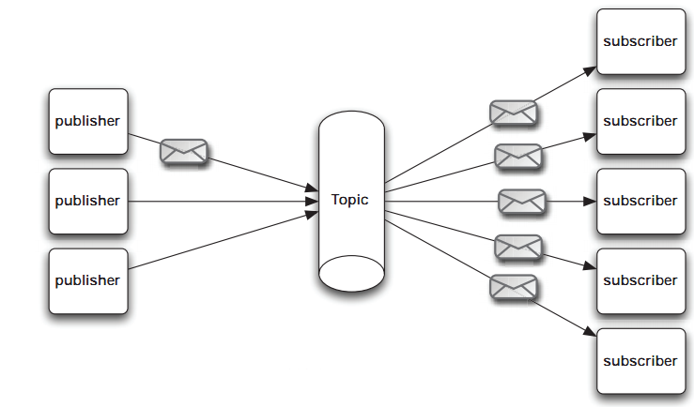
Pub/Sub Messaging
At the core Sensor Cloud is a pub/sub system
Publishers send data to topics with no information about potential subscribers
Subscribers subscribe to topics of interest and similarly have no knowledge of the publishers
URL: https://sites.google.com/site/opensourceiotcloud/
Notes:
The publish/subscribe (pub/sub) design pattern [5] describes a loosely-coupled architecture based message-oriented communication between distributed applications. In such an arrangement applications may fire-and-forget messages to a broker that manages the details of message delivery. This is an especially powerful benefit in heterogeneous environments, allowing clients to be written using different languages and even possibly different wire protocols. The pub/sub provider acts as the middle-man, allowing heterogeneous integration and interaction in an asynchronous (non-blocking) manner.
The pub/sub architecture uses destinations known as topics. Publishers address messages to a topic and subscribers register to receive messages from the topic. Publishers and subscribers are generally anonymous and may dynamically publish or subscribe to the content hierarchy. The system takes care of distributing the messages arriving from a topic's multiple publishers to its multiple subscribers. Topics retain messages only as long as it takes to distribute them to current subscribers. Figure 1 illustrates pub/sub messaging.
Message publication is inherently asynchronous in that no fundamental timing dependency exists between the production and the consumption of a message. Messages can be consumed in either of two ways:
Synchronously. A subscriber or a receiver explicitly fetches the message from the destination by calling the receive method. The receive method can block until a message arrives or can time out if a message does not arrive within a specified time limit.
Asynchronously. A client can register a message listener with a consumer. A message listener is similar to an event listener.

Slide 27
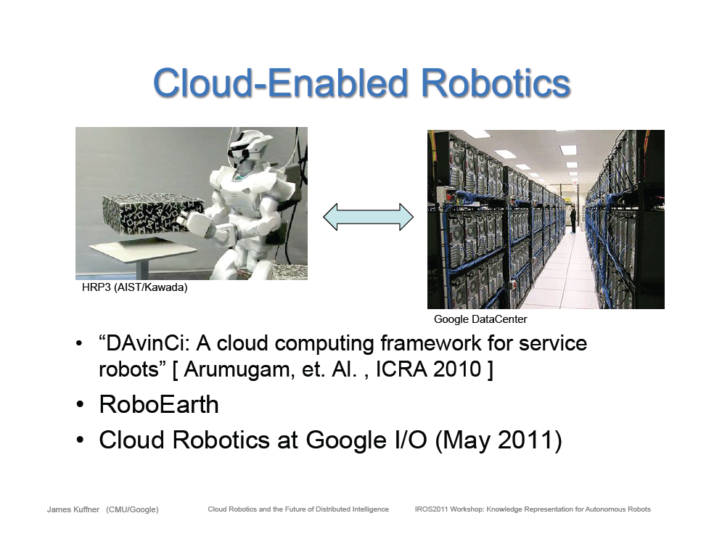

Slide 28
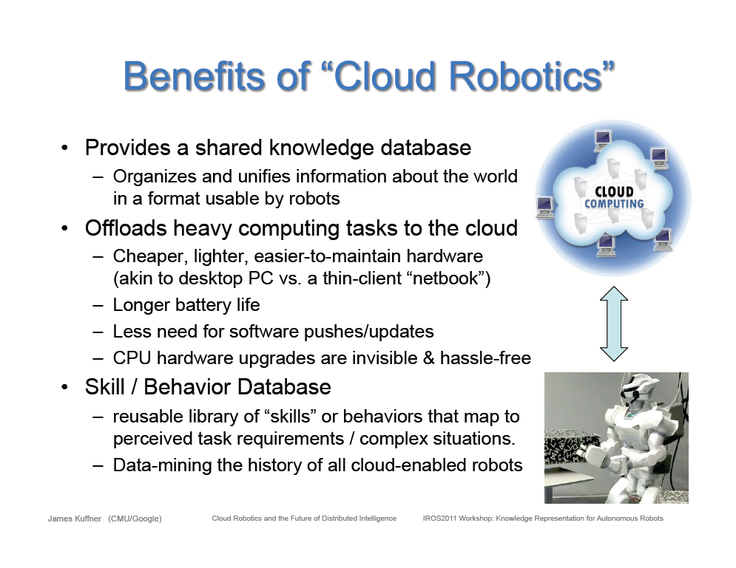

Slide 29
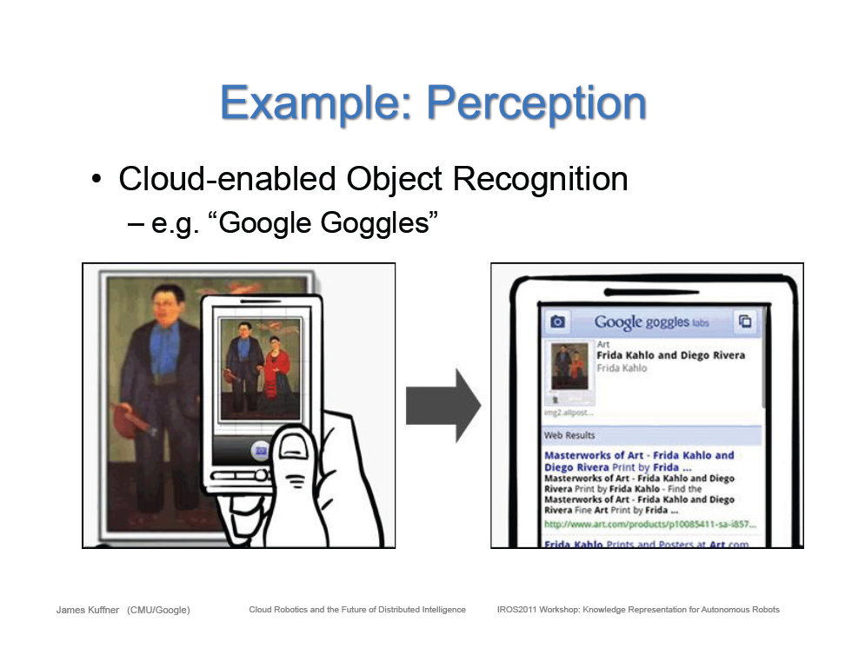

Slide 30
GPS Sensor: Multiple Brokers in Cloud

Slide 31
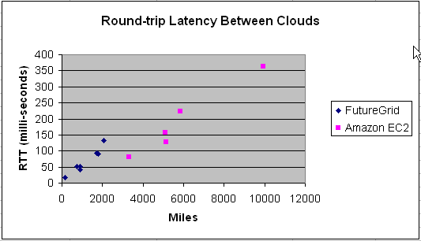
Web-scale and National-scale
Inter-Cloud Latency
Inter-cloud latency is proportional to distance between clouds.
Relevant especially for Robotics

Slide 32
Analytics and Parallel Computing on Clouds and HPC

Slide 33
Classic Parallel Computing
HPC: Typically SPMD (Single Program Multiple Data) “maps” typically processing particles or mesh points interspersed with multitude of low latency messages supported by specialized networks such as Infiniband and technologies like MPI
  Often run large capability jobs with 100K (going to 1.5M) cores on same job
  National DoE/NSF/NASA facilities run 100% utilization
  Fault fragile and cannot tolerate “outlier maps” taking longer than others
Clouds: MapReduce has asynchronous maps typically processing data points with results saved to disk. Final reduce phase integrates results from different maps
  Fault tolerant and does not require map synchronization
  Map only useful special case
HPC + Clouds: Iterative MapReduce caches results between “MapReduce” steps and supports SPMD parallel computing with large messages as seen in parallel kernels (linear algebra) in clustering and other data mining

Slide 34
4 Forms of MapReduce
(a) Map Only
(b) Classic MapReduce
(c) Iterative MapReduce
(d) Loosely Synchronous
Input
Input
Iterations
Input
map
map
map
P_{ij}
reduce
reduce
Output
BLAST Analysis
Parametric sweep
Pleasingly Parallel
High Energy Physics (HEP) Histograms
Distributed search
Expectation maximization Clustering e.g. Kmeans
Linear Algebra, Page Rank
Classic MPI
PDE Solvers and particle dynamics
Domain of MapReduce and Iterative Extensions
Science Clouds
MPI
Exascale

Slide 35
Commercial “Web 2.0” Cloud Applications
Internet search, Social networking, e-commerce, cloud storage
These are larger systems than used in HPC with huge levels of parallelism coming from
  Processing of lots of users or
  An intrinsically parallel Tweet or Web search
Classic MapReduce is suitable (although Page Rank component of search is parallel linear algebra)
Data Intensive
Do not need microsecond messaging latency

Slide 36
Data Intensive Applications
Applications tend to be new and so can consider emerging technologies such as clouds
Do not have lots of small messages but rather large reduction (aka Collective) operations
  New optimizations e.g. for huge messages
  e.g. Expectation Maximization (EM) dominated by broadcasts and reductions
Not clearly a single exascale job but rather many smaller (but not sequential) jobs e.g. to analyze groups of sequences
Algorithms not clearly robust enough to analyze lots of data
  Current standard algorithms such as those in R library not designed for big data
Our Experience
  Multidimensional Scaling MDS is iterative rectangular matrix-matrix multiplication controlled by EM
  Deterministically Annealed Pairwise Clustering as an EM example

Slide 37
Twister for Data Intensive
Iterative Applications
Generalize to arbitrary Collective
Broadcast
Compute
Communication
Reduce/ barrier
New Iteration
Smaller Loop-Variant Data
Larger Loop-Invariant Data
(Iterative) MapReduce structure with Map-Collective is framework
Twister runs on Linux or Azure
Twister4Azure is built on top of Azure tables, queues, storage
Notes:
Most of these applications consists of iterative computation and communication steps where single iterations can easily be specified as MapReduce computations.
Large input data sizes which are loop-invariant and can be reused across iterations.
Loop-variant results.. Orders of magnitude smaller…
While these can be performed using traditional MapReduce frameworks, Traditional is not efficient for these types of computations. MR leaves lot of room for improvements in terms of iterative applications.

Slide 38





Performance – Kmeans Clustering
Overhead between iterations
First iteration performs the initial data fetch
Twister4Azure
Task Execution Time Histogram
Number of Executing Map Task Histogram
Hadoop
Twister
Hadoop on bare metal scales worst
Twister4Azure(adjusted for C#/Java)
Strong Scaling with 128M Data Points
Weak Scaling
Qiu, Gunarathne
Performance with/without
data caching
Speedup gained using data cache
Scaling speedup
Increasing number of iterations

Slide 39
Data Intensive Futures?
Data analytics hugely important
Microsoft dropped Dryad and replaced with Hadoop
Amazon offers Hadoop and Google invented it
Hadoop doesn’t work well on iterative algorithms
Need a coordinated effort to build robust algorithms that scale well
Academic Business Collaboration?

Slide 40
Infrastructure as a Service
Platforms as a Service
Software as a Service

Slide 41
Infrastructure, Platforms, Software as a Service

Slide 42
What to use in Clouds: Cloud PaaS
Job Management
  Queues to manage multiple tasks
  Tables to track job information
  Workflow to link multiple services (functions)
Programming Model
  MapReduce and Iterative MapReduce to support parallelism
Data Management
  HDFS style file system to collocate data and computing
  Data Parallel Languages like Pig; more successful than HPF?
Interaction Management
  Services for everything
  Portals as User Interface
  Scripting for fast prototyping
  Appliances and Roles as customized images
New Generetion Software tools
  like Google App Engine, memcached

Slide 43
What to use in Grids and Supercomputers?
HPC (including Grid) PaaS
Job Management
  Queues, Services Portals and Workflow as in clouds
Programming Model
  MPI and GPU/multicore threaded parallelism
  Wonderful libraries supporting parallel linear algebra, particle evolution, partial differential equation solution
Data Management
  GridFTP and high speed networking
  Parallel I/O for high performance in an application
  Wide area File System (e.g. Lustre) supporting file sharing
Interaction Management and Tools
  Globus, Condor, SAGA, Unicore, Genesis for Grids
  Scientific Visualization
Let’s unify Cloud and HPC PaaS and add Computer Science PaaS?

Slide 44
Computer Science PaaS
Tools to support Compiler Development
Performance tools at several levels
Components of Software Stacks
Experimental language Support
Messaging Middleware (Pub-Sub)
Semantic Web and Database tools
Simulators
System Development Environments
Open Source Software from Linux to Apache

Slide 45
Using Clouds

Slide 46
How to use Clouds I
Build the application as a service. Because you are deploying one or more full virtual machines and because clouds are designed to host web services, you want your application to support multiple users or, at least, a sequence of multiple executions.
  If you are not using the application, scale down the number of servers and scale up with demand.
  Attempting to deploy 100 VMs to run a program that executes for 10 minutes is a waste of resources because the deployment may take more than 10 minutes.
  To minimize start up time one needs to have services running continuously ready to process the incoming demand.
Build on existing cloud deployments. For example use an existing MapReduce deployment such as Hadoop or existing Roles and Appliances (Images)

Slide 47
How to use Clouds II
Use PaaS if possible. For platform-as-a-service clouds like Azure use the tools that are provided such as queues, web and worker roles and blob, table and SQL storage.
  Note HPC systems don’t offer much in PaaS area
Design for failure. Applications that are services that run forever will experience failures. The cloud has mechanisms that automatically recover lost resources, but the application needs to be designed to be fault tolerant.
  In particular, environments like MapReduce (Hadoop, Daytona, Twister4Azure) will automatically recover many explicit failures and adopt scheduling strategies that recover performance "failures" from for example delayed tasks.
  One expects an increasing number of such Platform features to be offered by clouds and users will still need to program in a fashion that allows task failures but be rewarded by environments that transparently cope with these failures. (Need to build more such robust environments)

Slide 48
How to use Clouds III
Use as a Service where possible. Capabilities such as SQLaaS (database as a service or a database appliance) provide a friendlier approach than the traditional non-cloud approach exemplified by installing MySQL on the local disk.
  Suggest that many prepackaged aaS capabilities such as Workflow as a Service for eScience will be developed and simplify the development of sophisticated applications.
Moving Data is a challenge. The general rule is that one should move computation to the data, but if the only computational resource available is a the cloud, you are stuck if the data is not also there.
  Persuade Cloud Vendor to host your data free in cloud
  Persuade Internet2 to provide good link to Cloud
  Decide on Object Store v. HDFS style (or v. Lustre WAFS on HPC)

Slide 49
aaS versus Roles/Appliances
If you package a capability X as XaaS, it runs on a separate VM and you interact with messages
  SQLaaS offers databases via messages similar to old JDBC model
If you build a role or appliance with X, then X built into VM and you just need to add your own code and run
  Generic worker role in Venus-C (Azure) builds in I/O and scheduling
Lets take all capabilities – MPI, MapReduce, Workflow .. – and offer as roles or aaS (or both)
Perhaps workflow has a controller aaS with graphical design tool while runtime packaged in a role?
Need to think through packaging of parallelism

Slide 50
Private Clouds
Define as non commercial cloud used to support science
What does it take to make private cloud platforms competitive with commercial systems?
Plenty of work at VM management level with Eucalyptus, Nimbus, OpenNebula, OpenStack
  Only now maturing
  Nimbus and OpenNebula pretty solid but not widely adopted in USA
  OpenStack and Eucalyptus recent major improvements
Open source PaaS tools like Hadoop, Hbase, Cassandra, Zookeeper but not integrated into platform
Need dynamic resource management in a “not really elastic” environment as limited size
Federation of distributed components (as in grids) to make a decent size system

Slide 51
Architecture of Data Repositories?
Traditionally governments set up repositories for data associated with particular missions
  For example EOSDIS (Earth Observation), GenBank (Genomics), NSIDC (Polar science), IPAC (Infrared astronomy)
  LHC/OSG computing grids for particle physics
This is complicated by volume of data deluge, distributed instruments as in gene sequencers (maybe centralize?) and need for intense computing like Blast
  i.e. repositories need lots of computing?

Slide 52
Clouds as Support for Data Repositories?
The data deluge needs cost effective computing
  Clouds are by definition cheapest
  Need data and computing co-located
Shared resources essential (to be cost effective and large)
  Can’t have every scientists downloading petabytes to personal cluster
Need to reconcile distributed (initial source of ) data with shared analysis
  Can move data to (discipline specific) clouds
  How do you deal with multi-disciplinary studies
Data repositories of future will have cheap data and elastic cloud analysis support?
  Hosted free if data can be used commercially?

Slide 53
FutureGrid

Slide 54
FutureGrid key Concepts I
FutureGrid is an international testbed modeled on Grid5000
  July 15 2012: 223 Projects, ~968 users
Supporting international Computer Science and Computational Science research in cloud, grid and parallel computing (HPC)
The FutureGrid testbed provides to its users:
  A flexible development and testing platform for middleware and application users looking at interoperability, functionality, performance or evaluation
  FutureGrid is user-customizable, accessed interactively and supports Grid, Cloud and HPC software with and without VM’s
  A rich education and teaching platform for classes
See G. Fox, G. von Laszewski, J. Diaz, K. Keahey, J. Fortes, R. Figueiredo, S. Smallen, W. Smith, A. Grimshaw, FutureGrid - a reconfigurable testbed for Cloud, HPC and Grid Computing, Bookchapter – draft

Slide 55

FutureGrid key Concepts II
Rather than loading images onto VM’s, FutureGrid supports Cloud, Grid and Parallel computing environments by provisioning software as needed onto “bare-metal” using Moab/xCAT (need to generalize)
  Image library for MPI, OpenMP, MapReduce (Hadoop, (Dryad), Twister), gLite, Unicore, Globus, Xen, ScaleMP (distributed Shared Memory), Nimbus, Eucalyptus, OpenNebula, KVM, Windows …..
  Either statically or dynamically
Growth comes from users depositing novel images in library
FutureGrid has ~4400 distributed cores with a dedicated network and a Spirent XGEM network fault and delay generator
Image1
Image2
…
ImageN
Choose
Load
Run

Slide 56

FutureGrid Grid supports Cloud Grid HPC Computing Testbed as a Service (aaS)
12TF Disk rich + GPU 512 cores
NID: Network Impairment Device
Private
Public
FG Network
56

Slide 57
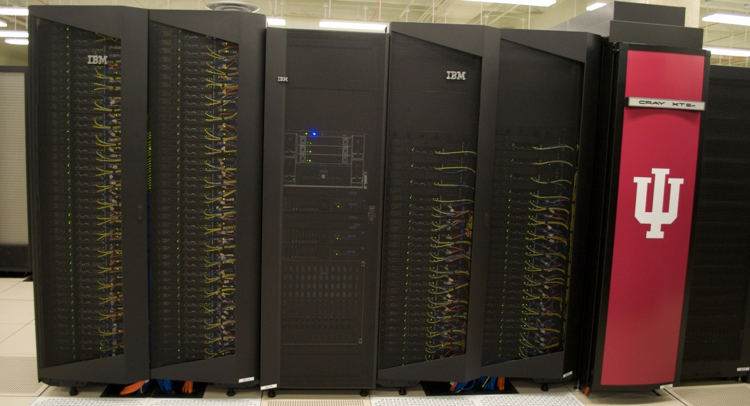
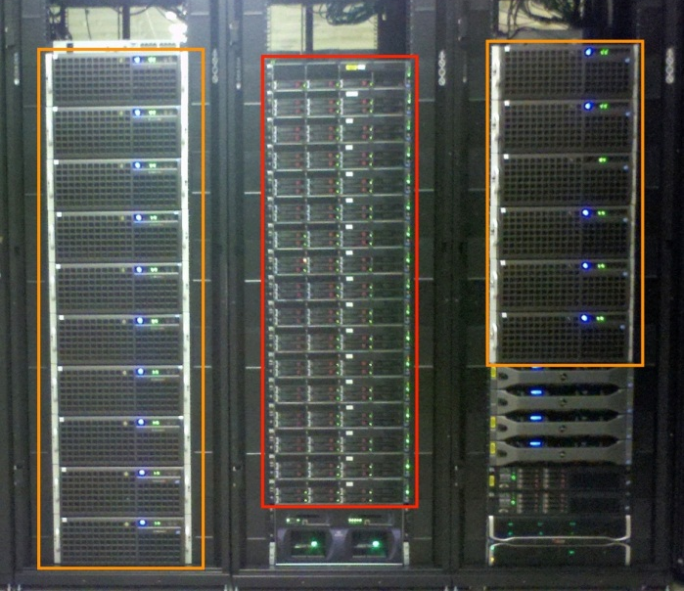
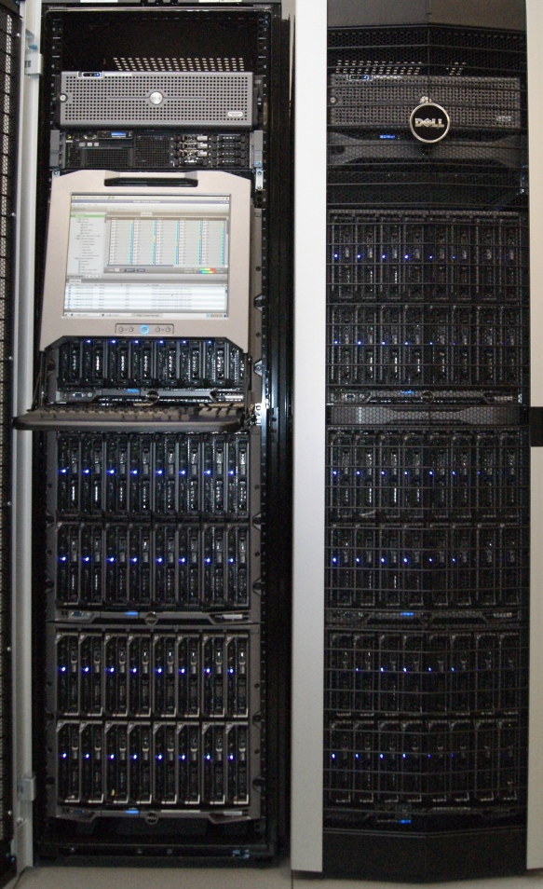
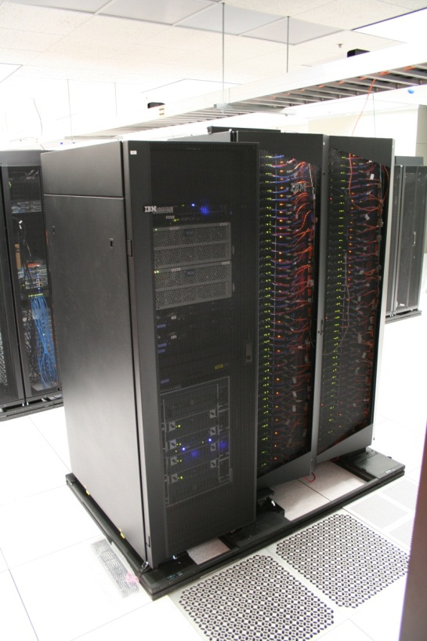
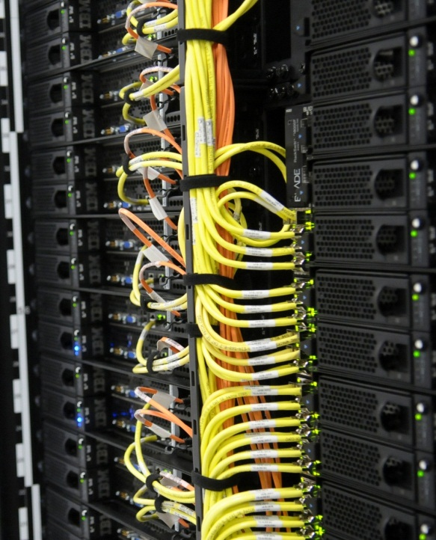
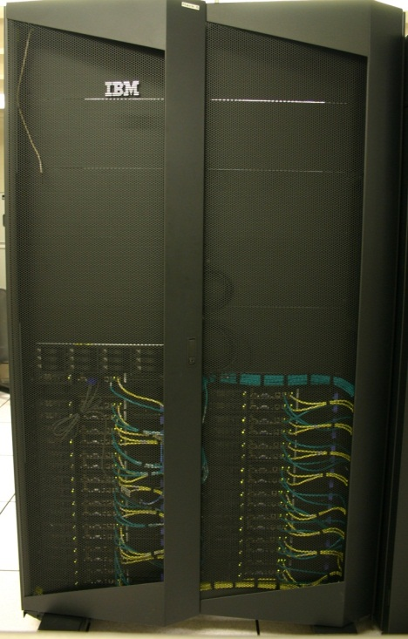
FutureGrid Distributed Testbed-aaS
Bravo Delta (IU)
India (IBM) and Xray (Cray) (IU)
Hotel (Chicago)
Foxtrot (UF)
Sierra (SDSC)
Alamo (TACC)

Slide 58
Compute Hardware
Name | System type | # CPUs | # Cores | TFLOPS | Total RAM (GB) | Secondary Storage (TB) | Site | Status
india | IBM iDataPlex | 256 | 1024 | 11 | 3072 | 180 | IU | Operational
alamo | Dell PowerEdge | 192 | 768 | 8 | 1152 | 30 | TACC | Operational
hotel | IBM iDataPlex | 168 | 672 | 7 | 2016 | 120 | UC | Operational
sierra | IBM iDataPlex | 168 | 672 | 7 | 2688 | 96 | SDSC | Operational
xray | Cray XT5m | 168 | 672 | 6 | 1344 | 180 | IU | Operational
foxtrot | IBM iDataPlex | 64 | 256 | 2 | 768 | 24 | UF | Operational
Bravo | Large Disk & memory | 32 | 128 | 1.5 | 3072 (192GB per node) | 192 (12 TB per Server) | IU | Operational
Delta | Large Disk & memory With Tesla GPU’s | 32 CPU 32 GPU’s | 192+ 14336 GPU | ? 9 | 1536 (192GB per node) | 192 (12 TB per Server) | IU | Operational
 |  |  | TOTAL Cores 4384

Slide 59
FutureGrid Partners
Indiana University (Architecture, core software, Support)
San Diego Supercomputer Center at University of California San Diego (INCA, Monitoring)
University of Chicago/Argonne National Labs (Nimbus)
University of Florida (ViNE, Education and Outreach)
University of Southern California Information Sciences (Pegasus to manage experiments)
University of Tennessee Knoxville (Benchmarking)
University of Texas at Austin/Texas Advanced Computing Center (Portal)
University of Virginia (OGF, XSEDE Software stack)
Center for Information Services and GWT-TUD from Technische Universtität Dresden. (VAMPIR)
Red institutions have FutureGrid hardware

Slide 60
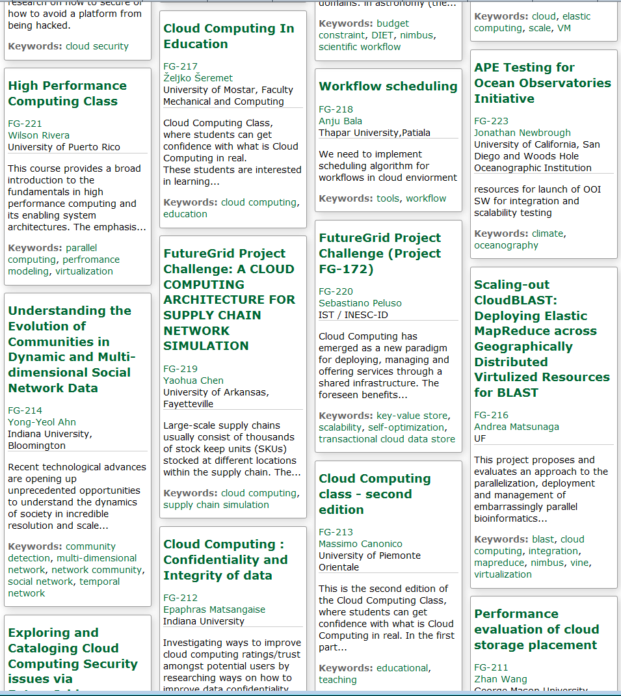
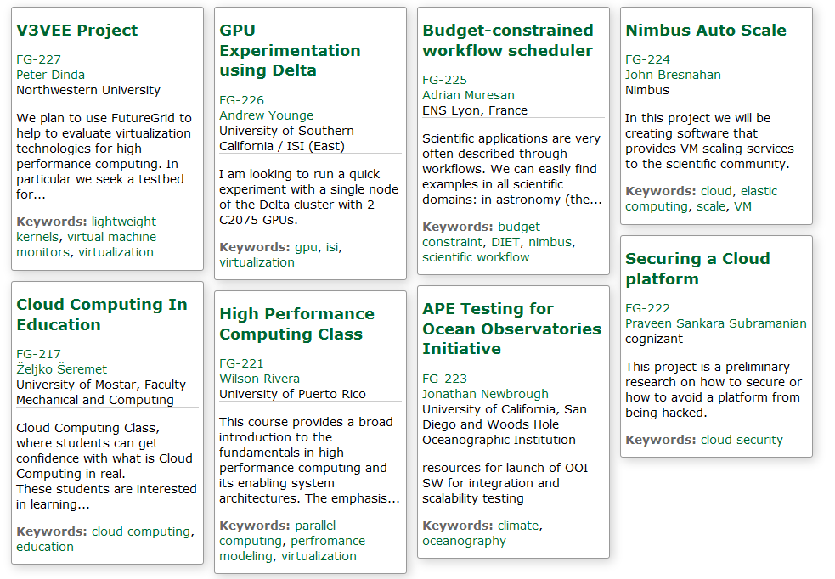
Recent Projects
Have Competitions
Last one just finished
Grand Prize
Trip to SC12
Next Competition
Beginning of August
For our Science Cloud Summer School

Slide 61
4 Use Types for FutureGrid TestbedaaS
223 approved projects (968 users) July 14 2012
  USA, China, India, Pakistan, lots of European countries
  Industry, Government, Academia
Training Education and Outreach (10%)
  Semester and short events; interesting outreach to HBCU
Computer science and Middleware (59%)
  Core CS and Cyberinfrastructure; Interoperability (2%) for Grids and Clouds; Open Grid Forum OGF Standards
Computer Systems Evaluation (29%)
  XSEDE (TIS, TAS), OSG, EGI; Campuses
New Domain Science applications (26%)
  Life science highlighted (14%), Non Life Science (12%)
  Generalize to building Research Computing-aaS
Fractions are as of July 15 2012 add to > 100%

Slide 62
FutureGrid TestbedaaS Supports Education and Training
Jerome Mitchell HBCU Cloud View of Computing workshop June 2011
Cloud Summer School July 30—August 3 2012 with 10 HBCU attendees
Mitchell and Younge building “Cloud Computing Handbook” loosely based on my book with Hwang and Dongarra
Several classes around the world each semester
Possible Interaction with (200 team) Student Competition in China organized by Beihang Univ.

Slide 63
FutureGrid TestbedaaS Supports Computer Science
Core Computer Science FG-172 Cloud-TM from Portugal: on distributed concurrency control (software transactional memory): "When Scalability Meets Consistency: Genuine Multiversion Update Serializable Partial Data Replication,“ 32nd International Conference on Distributed Computing Systems (ICDCS'12) (top conference) used 40 nodes of FutureGrid
Core Cyberinfrastructure FG-42,45 LSU/Rutgers: SAGA Pilot Job P* abstraction and applications. SAGA/BigJob use on clouds
Core Cyberinfrastructure FG-130: Optimizing Scientific Workflows on Clouds. Scheduling Pegasus on distributed systems with overhead measured and reduced. Used Eucalyptus on FutureGrid

Slide 64
Selected List of FutureGrid
Services Offered
FutureGrid
IaaS
Nimbus
Cloud PaaS
Hadoop
Twister
HDFS
Swift Object Store
MPI
TestbedaaS
FG RAIN
Portal
Inca
Eucalyptus
OpenStack
ViNE
HPC PaaS
Ganglia
Devops
Exper. Manag./Pegasus
OpenMP
CUDA
Grid PaaS
Unicore
SAGA
Globus
Genesis II

Slide 65
Distribution of FutureGrid Technologies and Areas
220 Projects

Slide 66
Computing
Testbed as a Service

Slide 67
FutureGrid offers
Computing Testbed as a Service
FutureGrid Uses
Testbed-aaS Tools
Provisioning
Image Management
IaaS Interoperability
IaaS tools
Expt management
Dynamic Network
Devops
Research
Computing
aaS
Custom Images
Courses
Consulting
Portals
Archival Storage
System e.g. SQL, GlobusOnline
Applications e.g. Amber, Blast
SaaS
FutureGrid Usages
Computer Science
Applications and understanding Science Clouds
Technology Evaluation including XSEDE testing
Education and Training
Cloud e.g. MapReduce
HPC e.g. PETSc, SAGA
Computer Science e.g. Languages, Sensor nets
PaaS
Hypervisor
Bare Metal
Operating System
Virtual Clusters, Networks
IaaS

Slide 68
Research Computing as a Service
Traditional Computer Center has a variety of capabilities supporting (scientific computing/scholarly research) users.
  Could also call this Computational Science as a Service
IaaS, PaaS and SaaS are lower level parts of these capabilities but commercial clouds do not include
  Developing roles/appliances for particular users
  Supplying custom SaaS aimed at user communities
  Community Portals
  Integration across disparate resources for data and compute (i.e. grids)
  Data transfer and network link services
  Archival storage, preservation, visualization
  Consulting on use of particular appliances and SaaS i.e. on particular software components
  Debugging and other problem solving
  Administrative issues such as (local) accounting
This allows us to develop a new model of a computer center where commercial companies operate base hardware/software
A combination of XSEDE, Internet2 and computer center supply 1) to 9)?

Slide 69
RAINing on FutureGrid
http://futuregrid.org

Slide 70
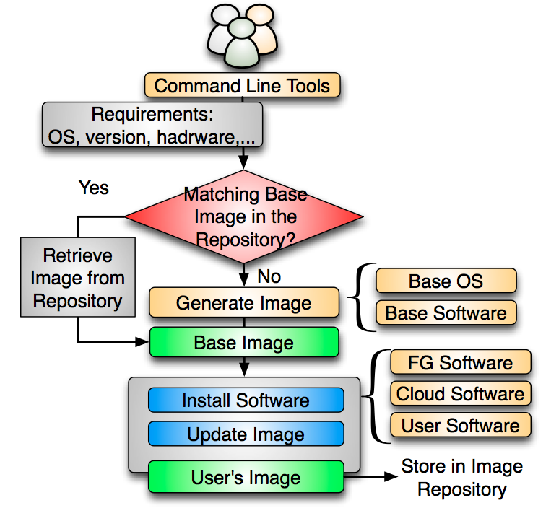
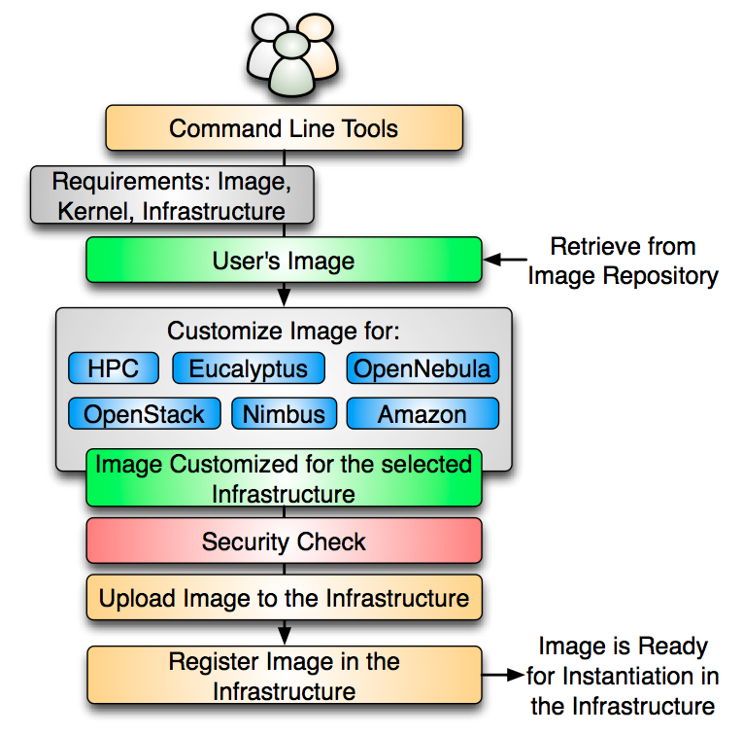
VM Image Management

Slide 71
Create Image from Scratch
CentOS
Takes Up to 69%
Ubuntu
Takes Up to 83%
Notes:
the figures use a stacked bar chart to depict the time spent in each phase of this process including . This (1) boot the VM, (2) generate the image and install user’s software, (3) compress the image, and (4) upload the image to the repository.
we observe the virtualization layer (blue section) introduces significant overhead in the process, which is higher in the case of centos. Next, the orange section represent the time to generate and install the user’s software. Here, generating the image from scratch is the most time consuming part. This is up to 69% for Centos and up to 83% in the case of Ubuntu.
For this reason, we considered to manage base images that can be used to save time during the image creation process.

Slide 72
Create Image from Base Image
Reduces 55-67%
CentOS
Ubuntu
Reduces 62-80%
Notes:
Here, we show the results of creating images using a base image stored in the image repository. So, first, we retrieve the base image and uncompress it, then we install the software required by the user and finally we compress the image and upload to the repository.
By using a base image, the time spent in the creation process is reduced dramatically. In particular, we have reduced the overall time of this process up to an 80% in the case of 1 ubuntu image.
There are two reasons: there is no need to create the base image every time, and we do not need to use the virtualization layer since the base image already has the desired OS and only needs to be upgraded with the software requested by the user.
-------------
This means that the time to create an image has been reduced from six minutes to less than two minutes for a single request. For the worst case, we reduced the time from 16 minutes to less than nine minutes, where we used one processors handling eight concurrent requests.

Slide 73
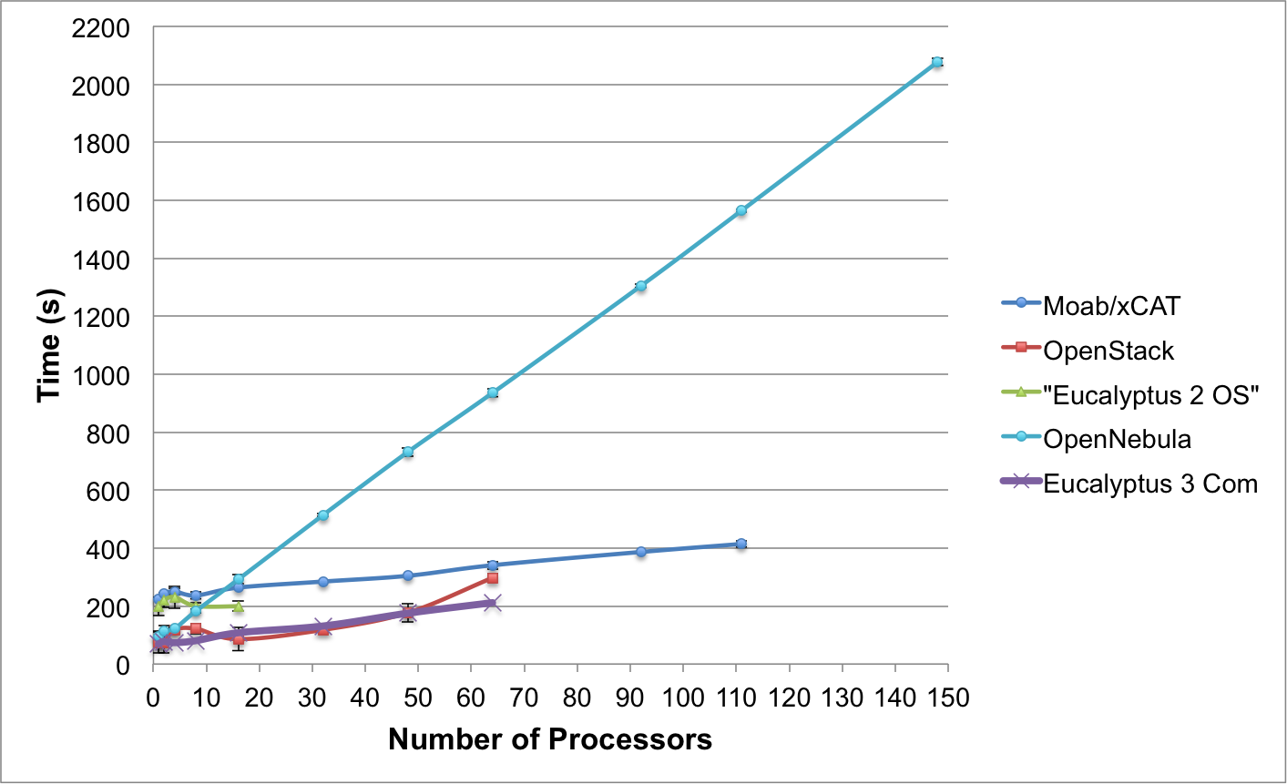
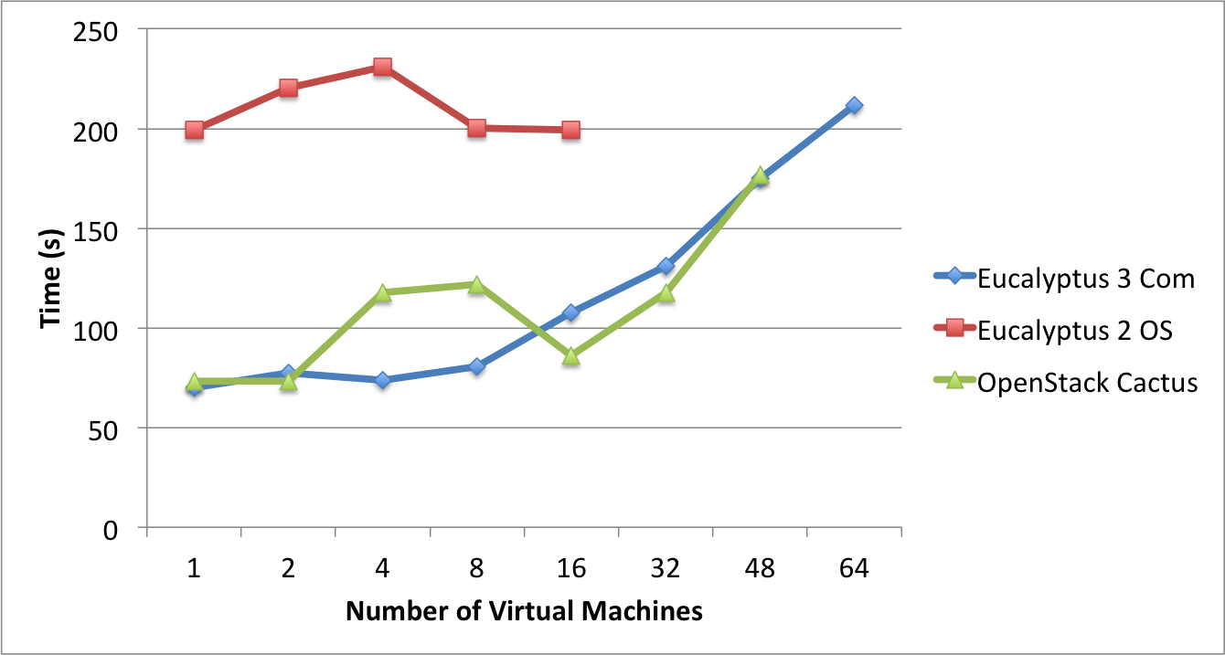
Templated(Abstract) Dynamic Provisioning
Abstract Specification of image mapped to various HPC and Cloud environments
OpenNebula
Parallel provisioning now supported
Moab/xCAT HPC – high as need reboot before use
Essex replaces Cactus
Current Eucalyptus 3 commercial while version 2 Open Source

Slide 74
Expanding Resources in FutureGrid
We have a core set of resources but need to keep up to date and expand in size
Natural is to build large systems and support large experiments by federating hardware from several sources
  Requirement is that partners in federation agree on and develop together TestbedaaS
Infrastructure includes networks, devices, edge (client) equipment

Slide 75
Conclusion

Slide 76
Using Clouds in a Nutshell
High Throughput Computing; pleasingly parallel; grid applications
Multiple users (long tail of science) and usages (parameter searches)
Internet of Things (Sensor nets) as in cloud support of smart phones
(Iterative) MapReduce including “most” data analysis
Exploiting elasticity and platforms (HDFS, Object Stores, Queues ..)
Use worker roles, services, portals (gateways) and workflow
Good Strategies:
  Build the application as a service;
  Build on existing cloud deployments such as Hadoop;
  Use PaaS if possible;
  Design for failure;
  Use as a Service (e.g. SQLaaS) where possible;
  Address Challenge of Moving Data

Slide 77
Cosmic Comments I
Does Cloud + MPI Engine for computing + grids for data cover all?
  Will current high throughput computing and cloud concepts merge?
Need interoperable data analytics libraries for HPC and Clouds that address new robustness and scaling challenges of big data
  Business and Academia should collaborate
Can we characterize data analytics applications?
  I said modest size and kernels need reduction operations and are often full matrix linear algebra (true?)
Does a “modest-size private science cloud” make sense
  Too small to be elastic?
Should governments fund use of commercial clouds (or build their own)
  Are privacy issues motivating private clouds really valid?

Slide 78
Cosmic Comments II
Recent private cloud infrastructure (Eucalyptus 3, OpenStack Essex in USA) much improved
  Nimbus, OpenNebula still good
But are they really competitive with commercial cloud fabric runtime?
Should we integrate Cloud Platforms with other Platforms?
Is Research Computing as a Service interesting?
  Many related commercial offerings e.g. MapReduce value added vendors
More employment opportunities in clouds than HPC and Grids; so cloud related activities popular with students
Science Cloud Summer School July 30-August 3
  Part of virtual summer school in computational science and engineering and expect over 200 participants spread over 10 sites

