Slide 1
Panel on Recent Advances in the Security of Telecommunication and Network Systems
ICETE 2012 Joint Conference on e-Business and Telecommunications
Hotel Meliá Roma Aurelia Antica, Rome, Italy
July 24 2012
Geoffrey Fox
gcf@indiana.edu
Informatics, Computing and Physics
Pervasive Technology Institute
Indiana University Bloomington

Slide 2
Biomedical Cloud Issues
Operating cost of a large shared (public) cloud ~20% that of traditional cluster
Gene sequencing cost decreasing much faster than Moore’s law
Biomedical computing does not need low latency (microsecond) synchronization of HPC Cluster
Amazon a factor of 6 less effective on HPC workloads than state of art HPC cluster
i.e. Clouds work for biomedical applications if we can make convenient and address privacy and trust
Deduce natural infrastructure for biomedical data analysis is cloud plus (iterative) MapReduce
Software as a Service likely to be dominant usage model
Paid by “credit card” whether commercial, government or academic
“standard” services like BLAST plus services with your software

Slide 3
Full Personal Genomics: 3 petabytes per day

Slide 4
Security, Privacy, Trust
Virtualization and sharing of a large data center creates risks from sharing of
Computing
Data
Networks
Of course sharing creates cost effectiveness of clouds
Three possible approaches to privacy in cloud
Run sensitive applications on a private cloud
Use a hybrid public/private cloud
Establish a Secure partition/Establish secure mechanisms on a Public Cloud
Trust is an essential point
What do users and providers believe in?
More important than actual risk

Slide 5
Security and Privacy in Cloud Computing
Clouds get much of cost effectiveness from shared facility with corresponding privacy issues although clearly can separate users to some extent at cost to elasticity
In health area interesting anonymization and hybrid algorithms (small privacy sensitive and large insensitive) but difficult trust and policy issues
Can we explain to lawyers; it’s a policy/trust not technical issue
Genomics and personal medicine critical challenges
Probably commercial clouds run more professionally than many “private installations” and less “human error”
Many corporations seem to be using in spite of security/privacy concerns
Locally Lilly corporation uses Amazon for drug discovery; Biology and chemistry departments don’t

Slide 6
Trustworthy Cloud Computing
Public Clouds are elastic (can be scaled up and down) as large and shared
Sharing implies privacy and security concerns; need to learn how to use shared facilities
Private clouds are not easy to make elastic or cost effective (as too small)
Need to support public (aka shared) and private clouds
“Amazon is 100X more secure than your infrastructure” (Bio-IT Boston April 2011)
But how do we establish this trust?
“Amazon is more or less useless as NIH will only let us run 20% of our genomic data on it so not worth the effort to port software to cloud” (Bio-IT Boston)
Need to establish trust

Slide 7
Trustworthy Cloud Approaches
Rich access control with roles and sensitivity to combined datasets
Anonymization & Differential Privacy – defend against sophisticated datamining and establish trust that it can
Secure environments (systems) such as Amazon Virtual Private Cloud – defend against sophisticated attacks and establish trust that it can
Application specific approaches such as database privacy
Hierarchical algorithms where sensitive computations need modest computing on non-shared resources
Iterative MapReduce can be built on classic pub-sub communication software with known security approaches

Slide 8
Hybrid Clouds
“small” Private Cloud
Public Cloud
Some issues:
Can algorithm isolate “sensitive” computation to a small private cloud
Is private—public bandwidth sufficient?
Is whole system elastic?

Slide 9
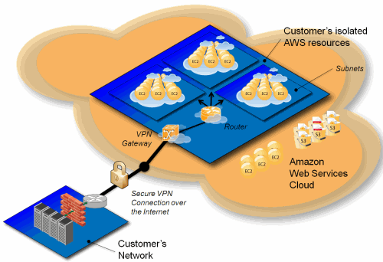
Amazon Virtual Private Cloud
Can Amazon implement elastic VPC’s that really separate storage, computing and networkking
Do you trust barriers Amazon implemented in public cloud

