Slide 1
Grids and Clouds for Cyberinfrastructure
IIT June 25 2010
Geoffrey Fox
gcf@indiana.edu
http://www.infomall.org http://www.futuregrid.org
Director, Digital Science Center, Pervasive Technology Institute
Associate Dean for Research and Graduate Studies, School of Informatics and Computing
Indiana University Bloomington

Slide 2
Important Trends
Data Deluge in all fields of science
Also throughout life e.g. web!
Multicore implies parallel computing important again
Performance from extra cores – not extra clock speed
Clouds – new commercially supported data center model replacing compute grids
Light weight clients: Smartphones and tablets

Slide 3
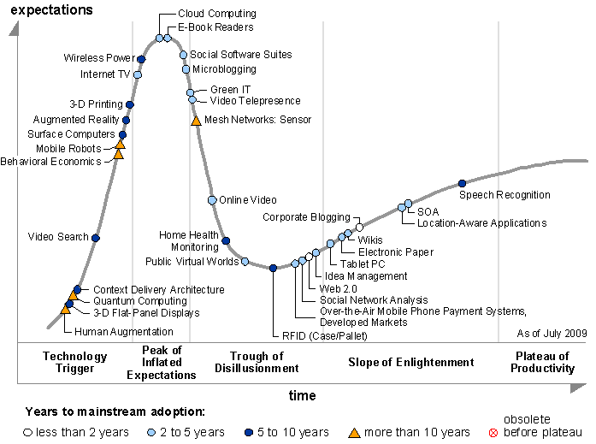
Gartner 2009 Hype Curve
Clouds, Web2.0
Service Oriented Architectures

Slide 4
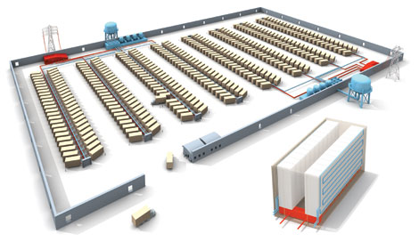
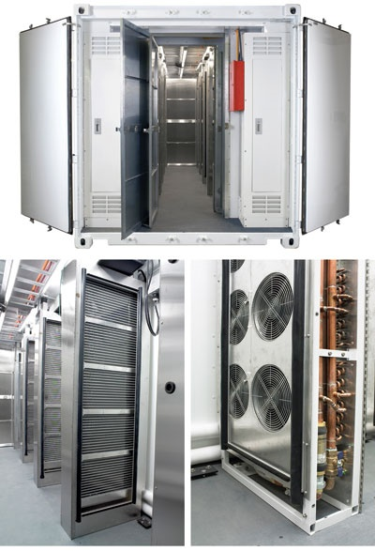
Clouds as Cost Effective Data Centers
Builds giant data centers with 100,000’s of computers; ~ 200 -1000 to a shipping container with Internet access
“Microsoft will cram between 150 and 220 shipping containers filled with data center gear into a new 500,000 square foot Chicago facility. This move marks the most significant, public use of the shipping container systems popularized by the likes of Sun Microsystems and Rackable Systems to date.”

Slide 5
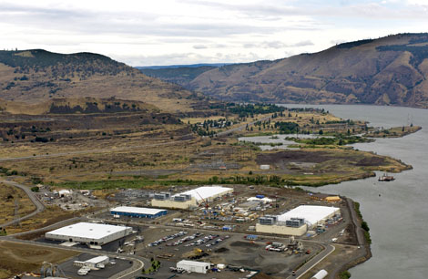
Clouds hide Complexity
SaaS: Software as a Service
IaaS: Infrastructure as a Service or HaaS: Hardware as a Service – get your computer time with a credit card and with a Web interaface
PaaS: Platform as a Service is IaaS plus core software capabilities on which you build SaaS
Cyberinfrastructure is “Research as a Service”
SensaaS is Sensors (Instruments) as a Service
2 Google warehouses of computers on the banks of the Columbia River, in The Dalles, Oregon
Such centers use 20MW-200MW
(Future) each
150 watts per CPU
Save money from large size, positioning with cheap power and access with Internet

Slide 6
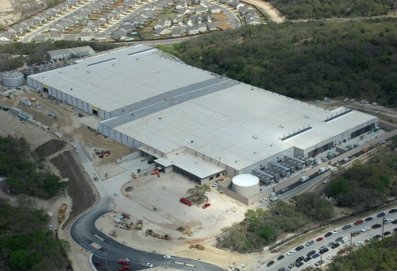
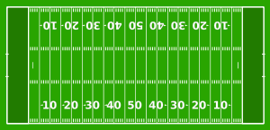
The Data Center Landscape
Range in size from “edge” facilities to megascale.
Economies of scale
Approximate costs for a small size center (1K servers) and a larger, 50K server center.
Technology | Cost in small-sized Data Center | Cost in Large Data Center | Ratio
Network | $95 per Mbps/ month | $13 per Mbps/ month | 7.1
Storage | $2.20 per GB/ month | $0.40 per GB/ month | 5.7
Administration | ~140 servers/ Administrator | >1000 Servers/ Administrator | 7.1
Each data center is
11.5 times
the size of a football field

Slide 7
Clouds hide Complexity
Cyberinfrastructure
Is “Research as a Service”
SaaS: Software as a Service
(e.g. CFD or Search documents/web are services)
PaaS: Platform as a Service
IaaS plus core software capabilities on which you build SaaS
(e.g. Azure is a PaaS; MapReduce is a Platform)
IaaS (HaaS): Infrastructure as a Service
(get computer time with a credit card and with a Web interface like EC2)

Slide 8
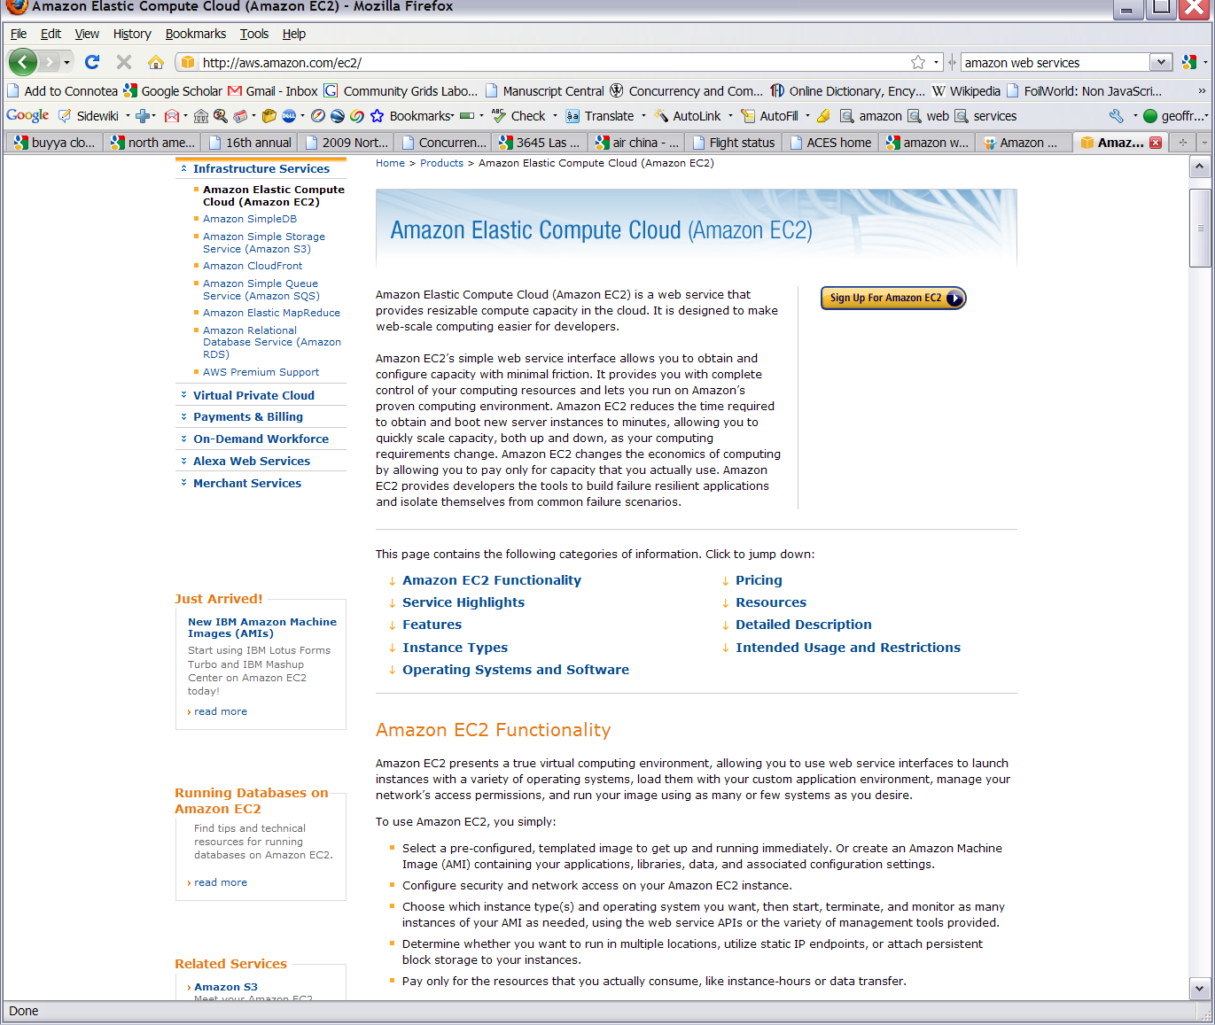
Commercial Cloud
Software

Slide 9
Philosophy of Clouds and Grids
Clouds are (by definition) commercially supported approach to large scale computing
So we should expect Clouds to replace Compute Grids
Current Grid technology involves “non-commercial” software solutions which are hard to evolve/sustain
Maybe Clouds ~4% IT expenditure 2008 growing to 14% in 2012 (IDC Estimate)
Public Clouds are broadly accessible resources like Amazon and Microsoft Azure – powerful but not easy to customize and perhaps data trust/privacy issues
Private Clouds run similar software and mechanisms but on “your own computers” (not clear if still elastic)
Platform features such as Queues, Tables, Databases limited
Services still are correct architecture with either REST (Web 2.0) or Web Services
Clusters still critical concept

Slide 10
Cloud Computing: Infrastructure and Runtimes
Cloud infrastructure: outsourcing of servers, computing, data, file space, utility computing, etc.
Handled through Web services that control virtual machine lifecycles.
Cloud runtimes or Platform: tools (for using clouds) to do data-parallel (and other) computations.
Apache Hadoop, Google MapReduce, Microsoft Dryad, Bigtable, Chubby and others
MapReduce designed for information retrieval but is excellent for a wide range of science data analysis applications
Can also do much traditional parallel computing for data-mining if extended to support iterative operations
MapReduce not usually on Virtual Machines

Slide 11
Authentication and Authorization: Provide single sign in to both FutureGrid and Commercial Clouds linked by workflow
Workflow: Support workflows that link job components between FutureGrid and Commercial Clouds. Trident from Microsoft Research is initial candidate
Data Transport: Transport data between job components on FutureGrid and Commercial Clouds respecting custom storage patterns
Program Library: Store Images and other Program material (basic FutureGrid facility)
Blob: Basic storage concept similar to Azure Blob or Amazon S3
DPFS Data Parallel File System: Support of file systems like Google (MapReduce), HDFS (Hadoop) or Cosmos (dryad) with compute-data affinity optimized for data processing
Table: Support of Table Data structures modeled on Apache Hbase or Amazon SimpleDB/Azure Table
SQL: Relational Database
Queues: Publish Subscribe based queuing system
Worker Role: This concept is implicitly used in both Amazon and TeraGrid but was first introduced as a high level construct by Azure
MapReduce: Support MapReduce Programming model including Hadoop on Linux, Dryad on Windows HPCS and Twister on Windows and Linux
Software as a Service: This concept is shared between Clouds and Grids and can be supported without special attention
Web Role: This is used in Azure to describe important link to user and can be supported in FutureGrid with a Portal framework

Slide 12
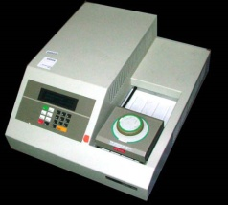
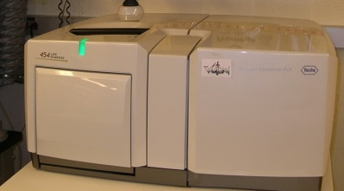
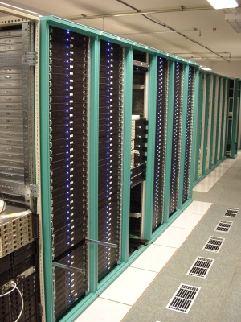
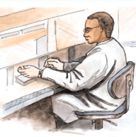
MapReduce “File/Data Repository” Parallelism
Map = (data parallel) computation reading and writing data
Reduce = Collective/Consolidation phase e.g. forming multiple global sums as in histogram
Instruments
Iterative MapReduce
Map Map Map Map
Reduce Reduce Reduce
Communication
Reduce
Portals /Users
Disks
Map₁
Map₂
Map₃

Slide 13
Grids and Clouds + and -
Grids are useful for managing distributed systems
Pioneered service model for Science
Developed importance of Workflow
Performance issues – communication latency – intrinsic to distributed systems
Clouds can execute any job class that was good for Grids plus
More attractive due to platform plus elasticity
Currently have performance limitations due to poor affinity (locality) for compute-compute (MPI) and Compute-data
These limitations are not “inevitable” and should gradually improve

Slide 14
MapReduce
Data Partitions
Map(Key, Value)
A hash function maps the results of the map tasks to reduce tasks
Reduce(Key, List<Value>)
Reduce Outputs
Implementations support:
Splitting of data
Passing the output of map functions to reduce functions
Sorting the inputs to the reduce function based on the intermediate keys
Quality of service

Slide 15
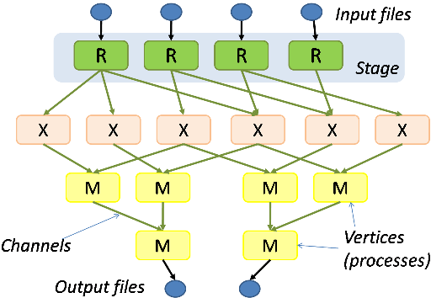
Hadoop & Dryad
Apache Hadoop
Microsoft Dryad
Master Node
Data/Compute Nodes
Job
Tracker
M
M
M
M
R
R
R
R
Name
Node
Data blocks
1
2
2
4
HDFS
3
3
Apache Implementation of Google’s MapReduce
Uses Hadoop Distributed File System (HDFS) manage data
Map/Reduce tasks are scheduled based on data locality in HDFS
Hadoop handles:
Job Creation
Resource management
Fault tolerance & re-execution of failed map/reduce tasks
The computation is structured as a directed acyclic graph (DAG)
Superset of MapReduce
Vertices – computation tasks
Edges – Communication channels
Dryad process the DAG executing vertices on compute clusters
Dryad handles:
Job creation, Resource management
Fault tolerance & re-execution of vertices

Slide 16
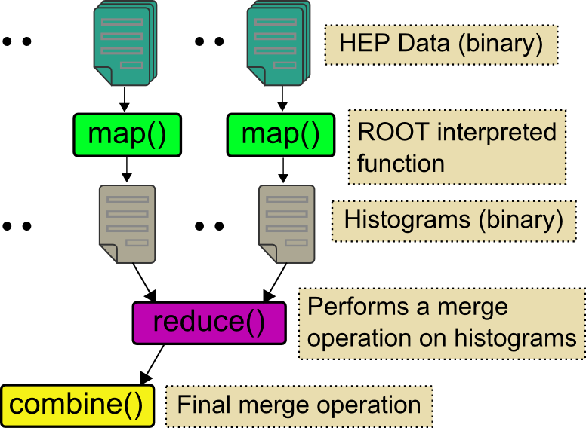
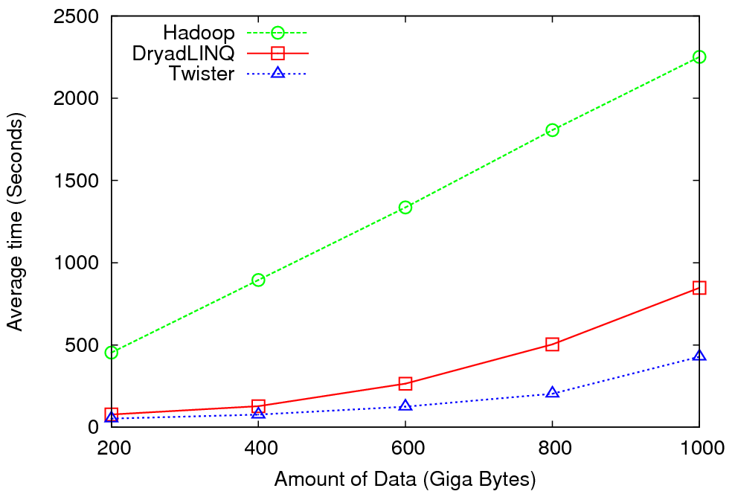
High Energy Physics Data Analysis
An application analyzing data from Large Hadron Collider (1TB but 100 Petabytes eventually)
Input to a map task: <key, value>
key = Some Id value = HEP file Name
Output of a map task: <key, value>
key = random # (0<= num<= max reduce tasks)
value = Histogram as binary data
Input to a reduce task: <key, List<value>>
key = random # (0<= num<= max reduce tasks)
value = List of histogram as binary data
Output from a reduce task: value
value = Histogram file
Combine outputs from reduce tasks to form the final histogram

Slide 17
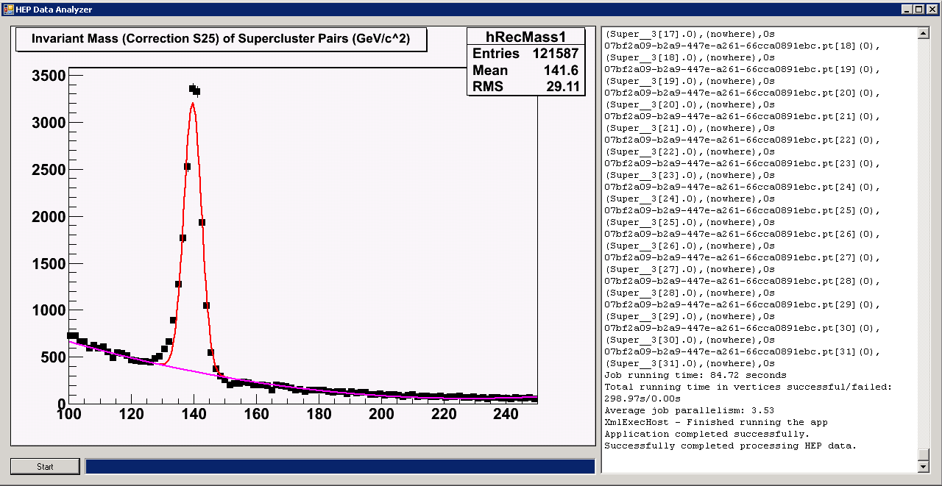
Reduce Phase of Particle Physics “Find the Higgs” using Dryad
Higgs in Monte Carlo
Combine Histograms produced by separate Root “Maps” (of event data to partial histograms) into a single Histogram delivered to Client

Slide 18
Broad Architecture Components
Traditional Supercomputers (TeraGrid and DEISA) for large scale parallel computing – mainly simulations
Likely to offer major GPU enhanced systems
Traditional Grids for handling distributed data – especially instruments and sensors
Clouds for “high throughput computing” including much data analysis and emerging areas such as Life Sciences using loosely coupled parallel computations
May offer small clusters for MPI style jobs
Certainly offer MapReduce
Integrating these needs new work on distributed file systems and high quality data transfer service
Link Lustre WAN, Amazon/Google/Hadoop/Dryad File System
Offer Bigtable (distributed scalable Excel)

Slide 19
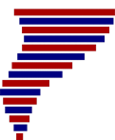
Application Classes
Old classification of Parallel software/hardware
in terms of 5 (becoming 6) “Application architecture” Structures)
1 | Synchronous | Lockstep Operation as in SIMD architectures
2 | Loosely Synchronous | Iterative Compute-Communication stages with independent compute (map) operations for each CPU. Heart of most MPI jobs | MPP
3 | Asynchronous | Computer Chess; Combinatorial Search often supported by dynamic threads | MPP
4 | Pleasingly Parallel | Each component independent – in 1988, Fox estimated at 20% of total number of applications | Grids
5 | Metaproblems | Coarse grain (asynchronous) combinations of classes 1)-4). The preserve of workflow. | Grids
6 | MapReduce++ | It describes file(database) to file(database) operations which has subcategories including. Pleasingly Parallel Map Only Map followed by reductions Iterative “Map followed by reductions” – Extension of Current Technologies that supports much linear algebra and datamining | Clouds Hadoop/ Dryad Twister
Notes:
CGL-MapReduce is an example of MapReduce++ -- supports MapReduce model with iteration (data stays in memory and communication via streams not files)

Slide 20
Applications & Different Interconnection Patterns
Map Only | Classic MapReduce | Iterative Reductions MapReduce++ | Loosely Synchronous
CAP3 Analysis Document conversion (PDF -> HTML) Brute force searches in cryptography Parametric sweeps | High Energy Physics (HEP) Histograms SWG gene alignment Distributed search Distributed sorting Information retrieval | Expectation maximization algorithms Clustering Linear Algebra | Many MPI scientific applications utilizing wide variety of communication constructs including local interactions
- CAP3 Gene Assembly - PolarGrid Matlab data analysis | - Information Retrieval - HEP Data Analysis - Calculation of Pairwise Distances for ALU Sequences | Kmeans Deterministic Annealing Clustering - Multidimensional Scaling MDS | - Solving Differential Equations and - particle dynamics with short range forces
Input
iterations
Input
Input
map
map
map
Pij
reduce
Output
reduce
Domain of MapReduce and Iterative Extensions
MPI

Slide 21
Fault Tolerance and MapReduce
MPI does “maps” followed by “communication” including “reduce” but does this iteratively
There must (for most communication patterns of interest) be a strict synchronization at end of each communication phase
Thus if a process fails then everything grinds to a halt
In MapReduce, all Map processes and all reduce processes are independent and stateless and read and write to disks
As 1 or 2 (reduce+map) iterations, no difficult synchronization issues
Thus failures can easily be recovered by rerunning process without other jobs hanging around waiting
Re-examine MPI fault tolerance in light of MapReduce
Twister will interpolate between MPI and MapReduce

Slide 22
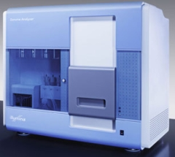
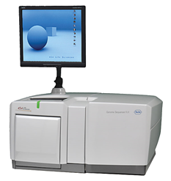
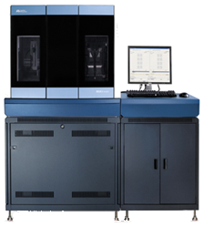
DNA Sequencing Pipeline
MapReduce
Pairwise
clustering
Sequence
alignment
Dissimilarity
Matrix
N(N-1)/2 values
Visualization
Plotviz
FASTA File N Sequences
Blocking
block
Pairings
MPI
MDS
Read Alignment
Illumina/Solexa Roche/454 Life Sciences Applied Biosystems/SOLiD
Internet
Modern Commercial Gene Sequencers
This chart illustrate our research of a pipeline mode to provide services on demand (Software as a Service SaaS)
User submit their jobs to the pipeline. The components are services and so is the whole pipeline.

Slide 23
Alu and Metagenomics Workflow
“All pairs” problem
Data is a collection of N sequences. Need to calculate N² dissimilarities (distances) between sequnces (all pairs).
These cannot be thought of as vectors because there are missing characters
“Multiple Sequence Alignment” (creating vectors of characters) doesn’t seem to work if N larger than O(100), where 100’s of characters long.
Step 1: Can calculate N² dissimilarities (distances) between sequences
Step 2: Find families by clustering (using much better methods than Kmeans). As no vectors, use vector free O(N²) methods
Step 3: Map to 3D for visualization using Multidimensional Scaling (MDS) – also O(N²)
Results:
N = 50,000 runs in 10 hours (the complete pipeline above) on 768 cores
Discussions:
Need to address millions of sequences …..
Currently using a mix of MapReduce and MPI
Twister will do all steps as MDS, Clustering just need MPI Broadcast/Reduce

Slide 24
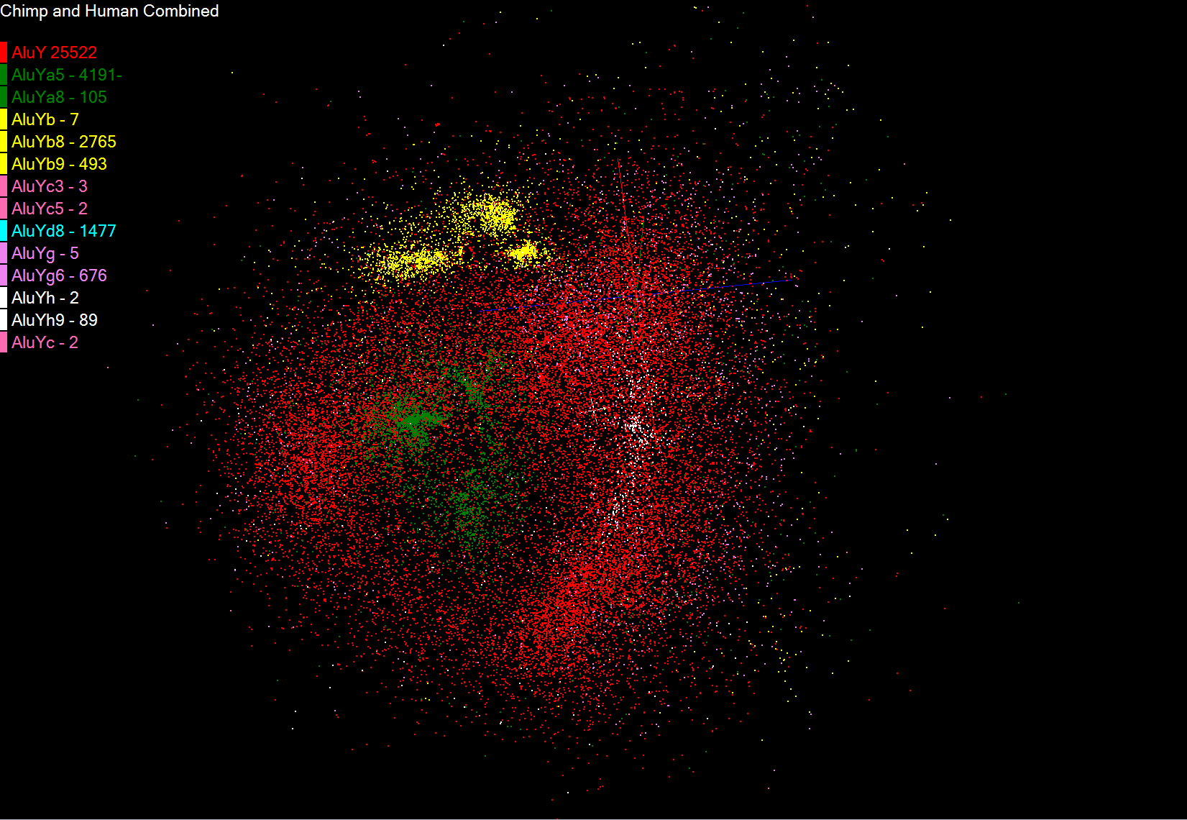
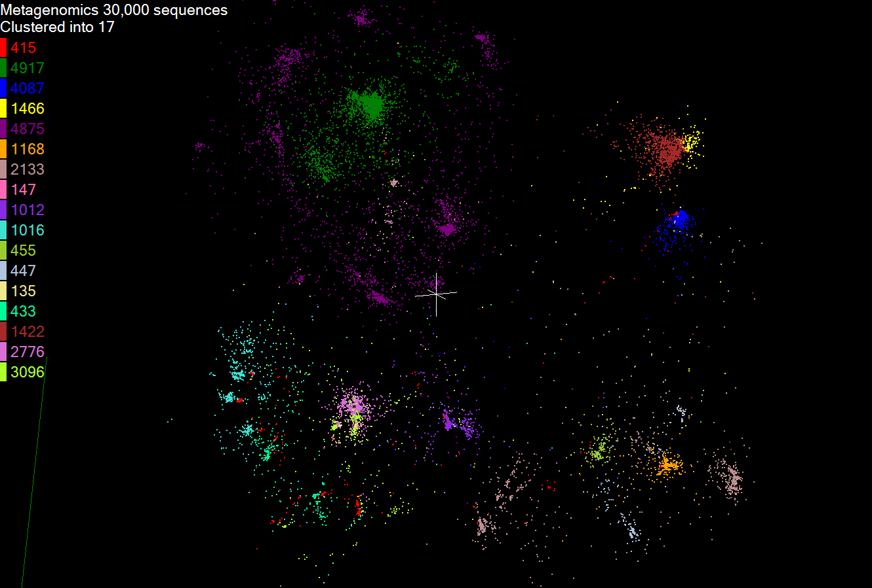
Biology MDS and Clustering Results
Alu Families
This visualizes results of Alu repeats from Chimpanzee and Human Genomes. Young families (green, yellow) are seen as tight clusters. This is projection of MDS dimension reduction to 3D of 35399 repeats – each with about 400 base pairs
Metagenomics
This visualizes results of dimension reduction to 3D of 30000 gene sequences from an environmental sample. The many different genes are classified by clustering algorithm and visualized by MDS dimension reduction

Slide 25
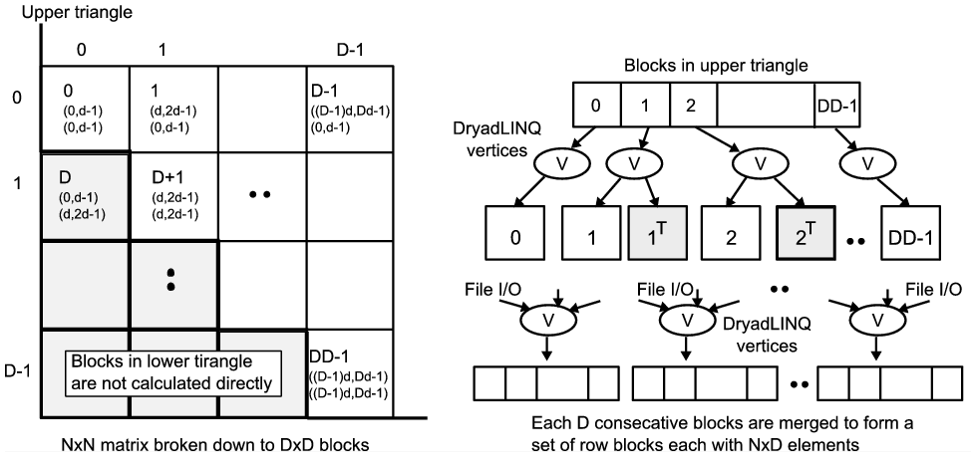
All-Pairs Using DryadLINQ
125 million distances
4 hours & 46 minutes
Calculate Pairwise Distances (Smith Waterman Gotoh)
Calculate pairwise distances for a collection of genes (used for clustering, MDS)
Fine grained tasks in MPI
Coarse grained tasks in DryadLINQ
Performed on 768 cores (Tempest Cluster)
Moretti, C., Bui, H., Hollingsworth, K., Rich, B., Flynn, P., & Thain, D. (2009). All-Pairs: An Abstraction for Data Intensive Computing on Campus Grids. IEEE Transactions on Parallel and Distributed Systems , 21, 21-36.

Slide 26
Hadoop/Dryad Comparison Inhomogeneous Data I
Inhomogeneity of data does not have a significant effect when the sequence lengths are randomly distributed
Dryad with Windows HPCS compared to Hadoop with Linux RHEL on Idataplex (32 nodes)

Slide 27
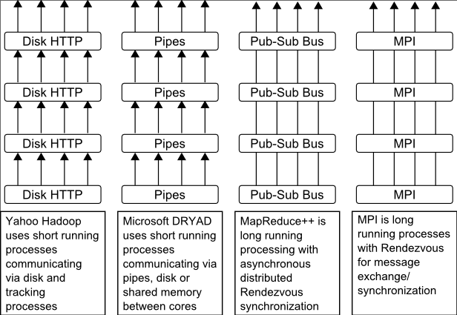
Twister(MapReduce++)
Pub/Sub Broker Network
Map Worker
M
Streaming based communication
Intermediate results are directly transferred from the map tasks to the reduce tasks – eliminates local files
Cacheable map/reduce tasks
Static data remains in memory
Combine phase to combine reductions
User Program is the composer of MapReduce computations
Extends the MapReduce model to iterative computations
Worker Nodes
R
Reduce Worker
D
D
MR
Driver
User
Program
M
M
M
M
D
MRDeamon
R
R
R
R
Data Read/Write
Communication
Data Split
File System
Iterate
Static
data
Configure()
User Program
Map(Key, Value)
δ flow
Reduce (Key, List<Value>)
Combine (Key, List<Value>)
Different synchronization and intercommunication mechanisms used by the parallel runtimes
Close()

Slide 28
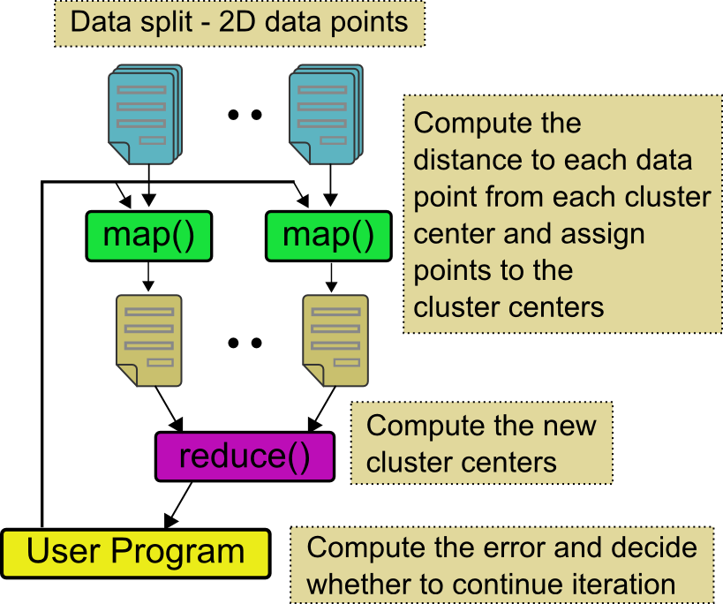
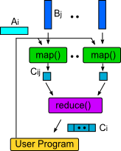
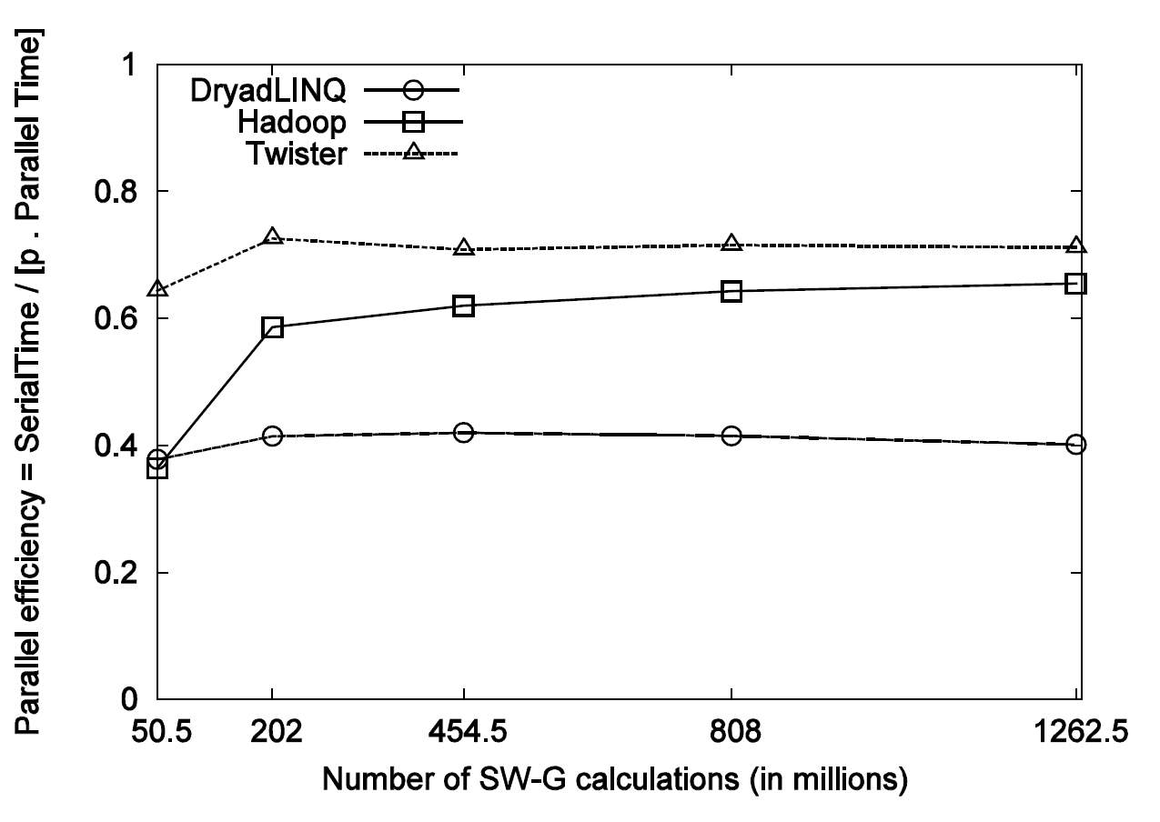
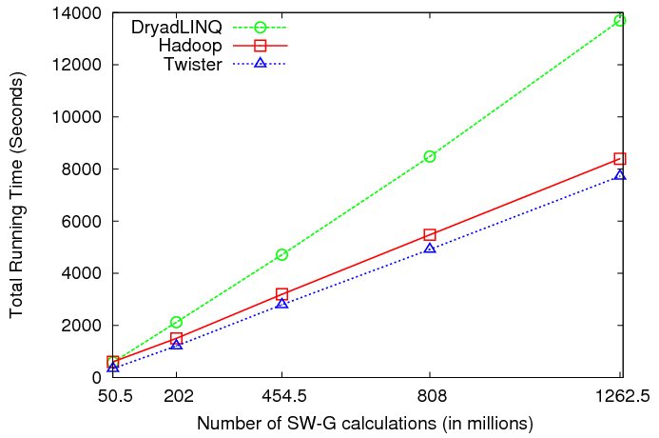
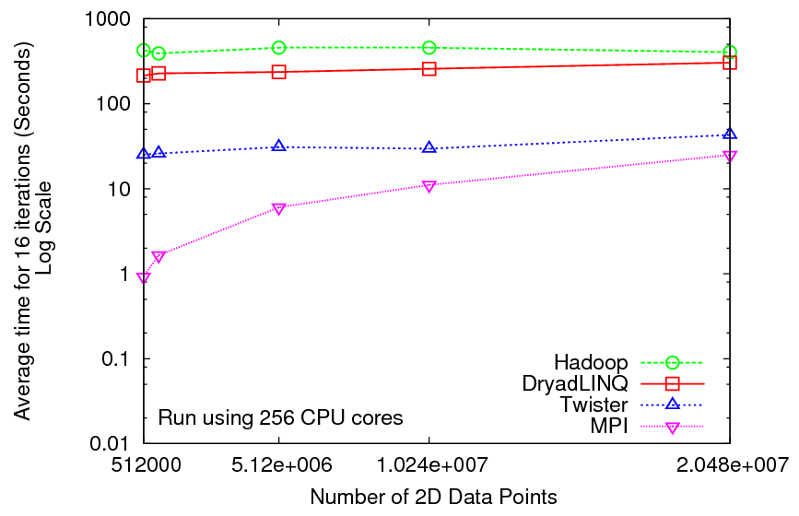
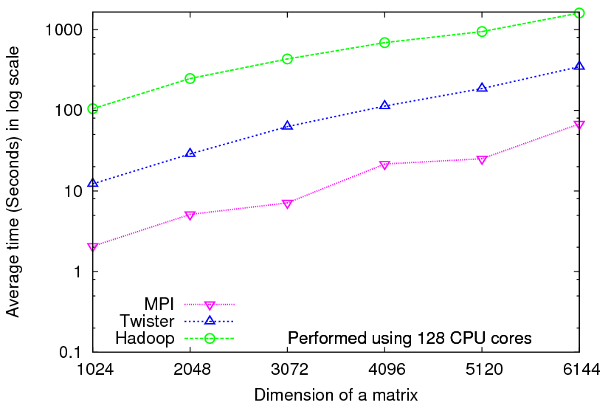
Iterative Computations
K-means
Matrix Multiplication
Smith Waterman
Performance of K-Means
Performance Matrix Multiplication

Slide 29
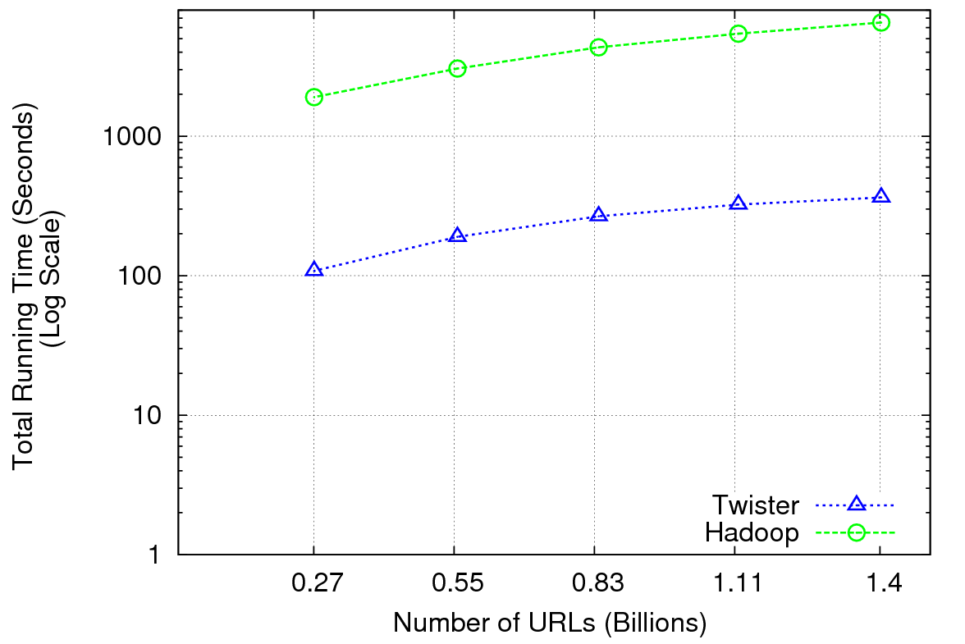
Performance of Pagerank using ClueWeb Data (Time for 20 iterations) using 32 nodes (256 CPU cores) of Crevasse

Slide 30
TwisterMPIReduce
PairwiseClustering MPI
Multi Dimensional Scaling MPI
Generative Topographic Mapping MPI
Other …
TwisterMPIReduce
Azure Twister (C# C++)
Java Twister
Microsoft Azure
FutureGrid
Local Cluster
Amazon EC2
Runtime package supporting subset of MPI mapped to Twister
Set-up, Barrier, Broadcast, Reduce

Slide 31
2916 iterations
(384 CPUcores)
968 iterations
(384 CPUcores)
343 iterations
(768 CPU cores)

Slide 32
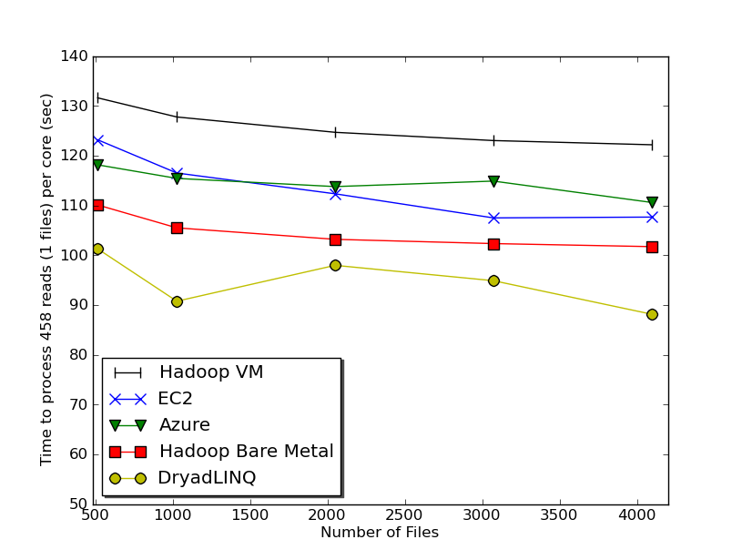
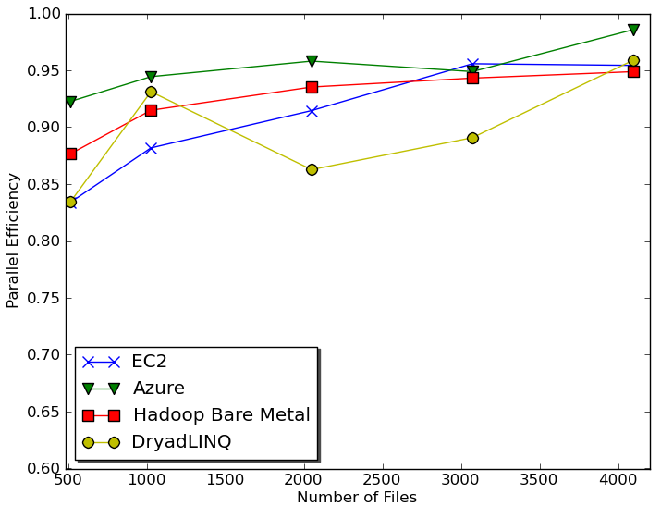
Sequence Assembly in the Clouds
Cap3 parallel efficiency
Cap3 – Per core per file (458 reads in each file) time to process sequences

Slide 33
Cap3 Performance with different EC2 Instance Types
Notes:
Instance Type CPU Cores Memory Local Disk Space Cost per hour
Small 1 1.7 GB 250 GB 0.12$
Medium 2 3.5 GB 500 GB 0.24$
Large 4 7 GB 1000 GB 0.48$
Extra Large 8 15 GB 2000 GB 0.96$

Slide 34
Cost to assemble 4096 FASTA files
~ 1 GB / 1875968 reads (458 readsX4096)
Amazon AWS total :11.19 $
Compute 1 hour X 16 HCXL (0.68$ * 16) = 10.88 $
10000 SQS messages = 0.01 $
Storage per 1GB per month = 0.15 $
Data transfer out per 1 GB = 0.15 $
Azure total : 15.77 $
Compute 1 hour X 128 small (0.12 $ * 128) = 15.36 $
10000 Queue messages = 0.01 $
Storage per 1GB per month = 0.15 $
Data transfer in/out per 1 GB = 0.10 $ + 0.15 $
Tempest (amortized) : 9.43 $
24 core X 32 nodes, 48 GB per node
Assumptions : 70% utilization, write off over 3 years, include support

Slide 35
 | AWS/ Azure | Hadoop | DryadLINQ
Programming patterns | Independent job execution | MapReduce | DAG execution, MapReduce + Other patterns
Fault Tolerance | Task re-execution based on a time out | Re-execution of failed and slow tasks. | Re-execution of failed and slow tasks.
Data Storage | S3/Azure Storage. | HDFS parallel file system. | Local files
Environments | EC2/Azure, local compute resources | Linux cluster, Amazon Elastic MapReduce | Windows HPCS cluster
Ease of Programming | EC2 : ** Azure: *** | **** | ****
Ease of use | EC2 : *** Azure: ** | *** | ****
Scheduling & Load Balancing | Dynamic scheduling through a global queue, Good natural load balancing | Data locality, rack aware dynamic task scheduling through a global queue, Good natural load balancing | Data locality, network topology aware scheduling. Static task partitions at the node level, suboptimal load balancing

Slide 36
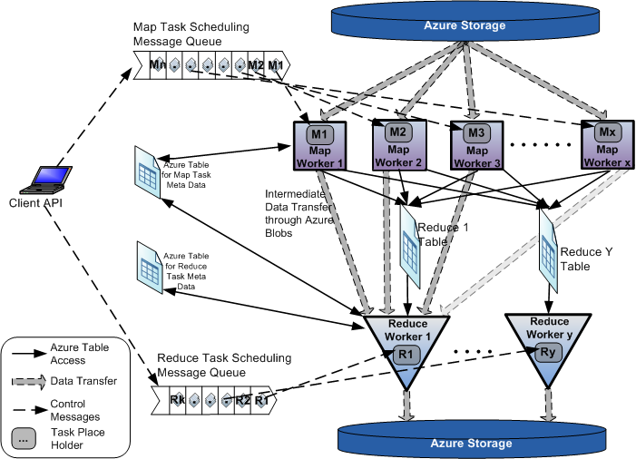
AzureMapReduce

Slide 37
Early Results with AzureMapreduce
Compare
Hadoop - 4.44 ms Hadoop VM - 5.59 ms DryadLINQ - 5.45 ms Windows MPI - 5.55 ms

Slide 38
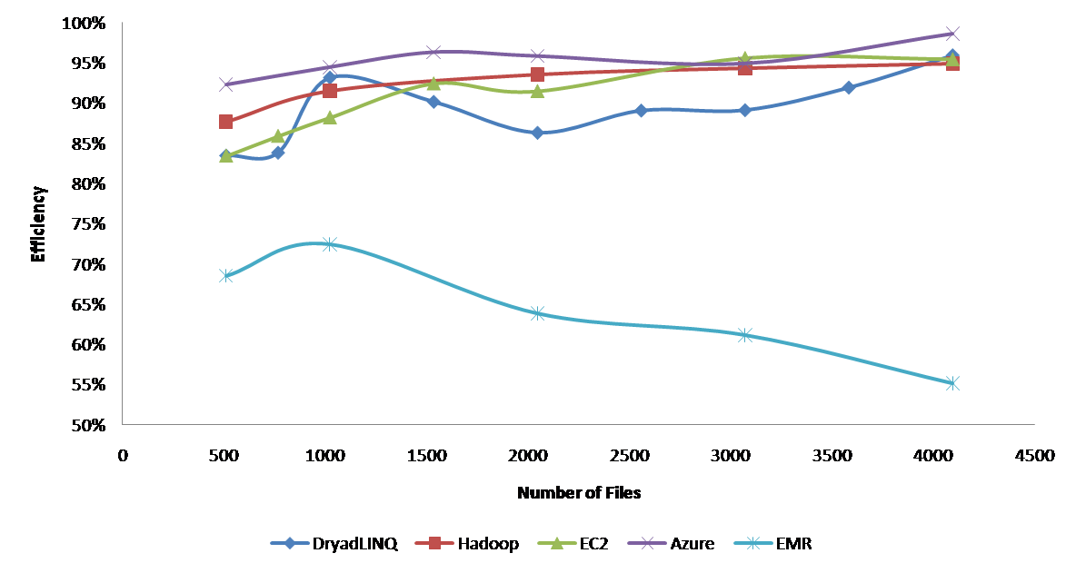
Currently we cant make Amazon Elastic MapReduce run well
Hadoop runs well on Xen FutureGrid Virtual Machines

Slide 39
Some Issues with AzureTwister and AzureMapReduce
Transporting data to Azure: Blobs (HTTP), Drives (GridFTP etc.), Fedex disks
Intermediate data Transfer: Blobs (current choice) versus Drives (should be faster but don’t seem to be)
Azure Table v Azure SQL: Handle all metadata
Messaging Queues: Use real publish-subscribe system in place of Azure Queues
Azure Affinity Groups: Could allow better data-compute and compute-compute affinity

Slide 40
 | Google MapReduce | Apache Hadoop | Microsoft Dryad | Twister | Azure Twister
Programming Model | 98 | MapReduce | DAG execution, Extensible to MapReduce and other patterns | Iterative MapReduce | MapReduce-- will extend to Iterative MapReduce
Data Handling | GFS (Google File System) | HDFS (Hadoop Distributed File System) | Shared Directories & local disks | Local disks and data management tools | Azure Blob Storage
Scheduling | Data Locality | Data Locality; Rack aware, Dynamic task scheduling through global queue | Data locality; Network topology based run time graph optimizations; Static task partitions | Data Locality; Static task partitions | Dynamic task scheduling through global queue
Failure Handling | Re-execution of failed tasks; Duplicate execution of slow tasks | Re-execution of failed tasks; Duplicate execution of slow tasks | Re-execution of failed tasks; Duplicate execution of slow tasks | Re-execution of Iterations | Re-execution of failed tasks; Duplicate execution of slow tasks
High Level Language Support | Sawzall | Pig Latin | DryadLINQ | Pregel has related features | N/A
Environment | Linux Cluster. | Linux Clusters, Amazon Elastic Map Reduce on EC2 | Windows HPCS cluster | Linux Cluster EC2 | Window Azure Compute, Windows Azure Local Development Fabric
Intermediate data transfer | File | File, Http | File, TCP pipes, shared-memory FIFOs | Publish/Subscribe messaging | Files, TCP

Slide 41
Algorithms and Clouds I
Clouds are suitable for “Loosely coupled” data parallel applications
Quantify “loosely coupled” and define appropriate programming model
“Map Only” (really pleasingly parallel) certainly run well on clouds (subject to data affinity) with many programming paradigms
Parallel FFT and adaptive mesh PDA solver probably pretty bad on clouds but suitable for classic MPI engines
MapReduce and Twister are candidates for “appropriate programming model”
1 or 2 iterations (MapReduce) and Iterative with large messages (Twister) are “loosely coupled” applications
How important is compute-data affinity and concepts like HDFS

Slide 42
Algorithms and Clouds II
Platforms: exploit Tables as in SHARD (Scalable, High-Performance, Robust and Distributed) Triple Store based on Hadoop
What are needed features of tables
Platforms: exploit MapReduce and its generalizations: are there other extensions that preserve its robust and dynamic structure
How important is the loose coupling of MapReduce
Are there other paradigms supporting important application classes
What are other platform features are useful
Are “academic” private clouds interesting as they (currently) only have a few of Platform features of commercial clouds?
Long history of search for latency tolerant algorithms for memory hierarchies
Are there successes? Are they useful in clouds?
In Twister, only support large complex messages
What algorithms only need TwisterMPIReduce

Slide 43
Algorithms and Clouds III
Can cloud deployment algorithms be devised to support compute-compute and compute-data affinity
What platform primitives are needed by datamining?
Clearer for partial differential equation solution?
Note clouds have greater impact on programming paradigms than Grids
Workflow came from Grids and will remain important
Workflow is coupling coarse grain functionally distinct components together while MapReduce is data parallel scalable parallelism
Finding subsets of MPI and algorithms that can use them probably more important than making MPI more complicated
Note MapReduce can use multicore directly – don’t need hybrid MPI OpenMP Programming models

Slide 44
The term SALSA or Service Aggregated Linked Sequential Activities, is derived from Hoare’s Concurrent Sequential Processes (CSP)
SALSA Group
http://salsahpc.indiana.edu
Group Leader: Judy Qiu
Staff : Adam Hughes
CS PhD: Jaliya Ekanayake, Thilina Gunarathne, Jong Youl Choi, Seung-Hee Bae,
Yang Ruan, Hui Li, Bingjing Zhang, Saliya Ekanayake,
CS Masters: Stephen Wu
Undergraduates: Zachary Adda, Jeremy Kasting, William Bowman
http://salsahpc.indiana.edu/content/cloud-materials Cloud Tutorial Material
Notes:
describes our approach to multicore computing where we used services as modules to capture key functionalities implemented with multicore threading.
This will be expanded as a proposed approach to parallel computing where one produces libraries of parallelized components and combines them with a generalized service integration (workflow) model

