Slide 1
Deterministic Annealing: Oct Trees and High Dimension (followed by FutureGrid)
IMA
January 13 2010
Geoffrey Fox
gcf@indiana.edu
http://www.infomall.org http://www.futuregrid.org
Director, Digital Science Center, Pervasive Technology Institute
Associate Dean for Research and Graduate Studies, School of Informatics and Computing
Indiana University Bloomington

Slide 2
In 1985 …..
Martin Schultz invited me to IMA
Fox, G. C, ``A Graphical Approach to Load Balancing and Sparse Matrix Vector Multiplication on the Hypercube'', CALT-68-1406, July 22, 1986. The Proceedings for the Workshop on Numerical Algorithms for Modern Parallel Computer Architectures, held at the IMA in November 1985, published as Volume 13 in the IMA Volumes in Mathematics and Its Applications, Numerical Algorithms for Modern Parallel Computer Architectures, (Springer-Verlag), New York, Caltech report C3P-327b.
Oct Trees for Load Balancing ……
Then I was a sort of physicist ……

Slide 3
Global Optimization
Deterministic annealing (DA) is one of better approaches to global optimization
Removes local minima
Addresses overfitting
Clustering
Vectors: Rose (Gurewitz and Fox)
No Vectors: Hofmann and Buhmann (Just use pairwise distances)
Dimension Reduction for visualization and analysis
Vectors: GTM
No vectors: MDS (Just use pairwise distances)
Can apply to (but little practical work)
Gaussian Mixture Models
Latent Dirichlet Allocation (typical informational retrieval/global inference)

Slide 4
Two Ideas
Deterministic annealing (mean field) is better than many well-used global optimization problems
The No-vector problems are O(N²) as in many Bioinformatics Alignment /Assembly problems
Interpolation
O(N) or O(NlogN) methods as in “Fast Multipole and Oct Tree methods”
Map high dimensional data to 3D and use classic methods to speed up O(N²) 3D problems

Slide 5
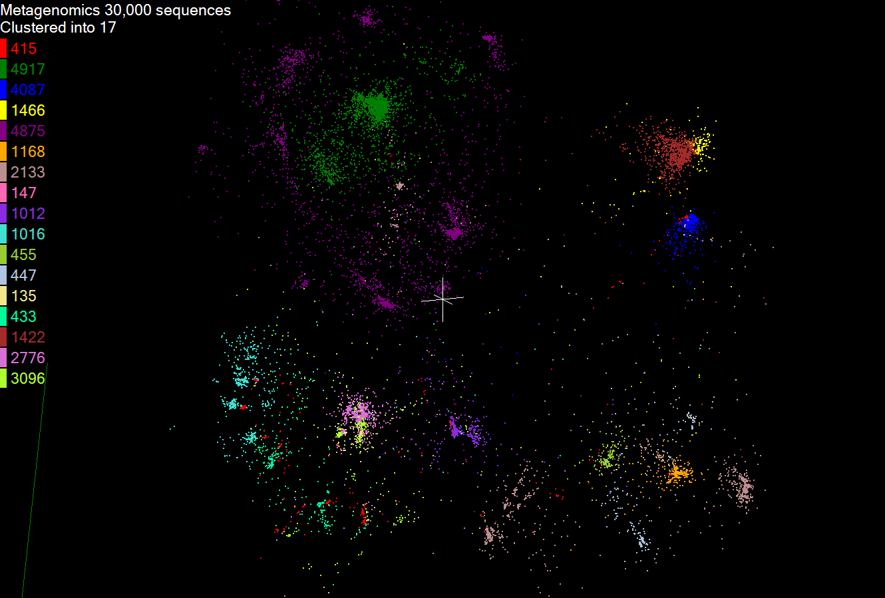
Metagenomics
This visualizes results of dimension reduction to 3D of 30000 gene sequences from an environmental sample. The many different genes are classified by clustering algorithm and visualized by MDS dimension reduction

Slide 6
General Deterministic Annealing Formula
N data points E(x) in D dimensions space and minimize F by EM
Deterministic Annealing Clustering (DAC)
F is Free Energy
EM is well known expectation maximization method
p(x) with Σ p(x) =1
T is annealing temperature varied down from ∞ with final value of 1
Determine cluster center Y(k) by EM method
K (number of clusters) starts at 1 and is incremented by algorithm

Slide 7
Deterministic Annealing I
Gibbs Distribution at Temperature T P(χ) = exp( - H(χ)/T) / ∫ dχ exp( - H(χ)/T)
Or P(χ) = exp( - H(χ)/T + F/T )
Minimize Free Energy F = < H - T S(P) > = ∫ dχ {P(χ)H + T P(χ) lnP(χ)}
Where χ are (a subset of) parameters to be minimized
Simulated annealing corresponds to doing these integrals by Monte Carlo
Deterministic annealing corresponds to doing integrals analytically and is naturally much faster
In each case temperature is lowered slowly – say by a factor 0.99 at each iteration

Slide 8
Deterministic Annealing
F({y}, T)
Solve Linear Equations for each temperature
Nonlinearity effects mitigated by initializing with solution at previous higher temperature
Configuration {y}
Minimum evolving as temperature decreases
Movement at fixed temperature going to local minima if not initialized “correctly

Slide 9
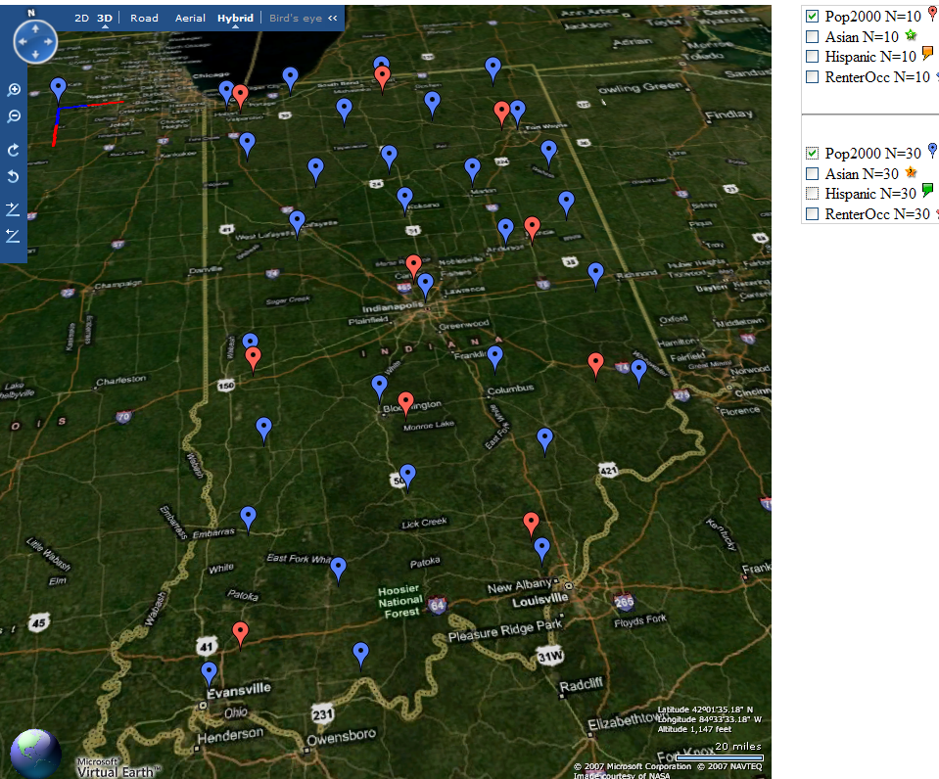
Deterministic Annealing Clustering of Indiana Census Data
Decrease temperature (distance scale) to discover more clusters
Distance Scale Temperature^{0.5}
Red is coarse resolution with 10 clusters
Blue is finer resolution with 30 clusters
Clusters find cities in Indiana
Distance Scale is √Temperature

Slide 10
Deterministic Annealing II
For some cases such as vector clustering and Gaussian Mixture Models one can do integrals by hand but usually will be impossible
So introduce Hamiltonian H₀(χ, ε) which by choice of ε can be made similar to H(χ) and which has tractable integrals
P₀(χ) = exp( - H₀(χ)/T + F₀/T ) approximate Gibbs
F_{R} (P₀) = < H_{R} - T S₀(P₀) >|₀ = < H_{R} – H₀> |₀ + F₀(P₀)
Where <…>|₀ denotes ∫ dχ P_{o}(χ)
Easy to show that real Free Energy F_{A} (P_{A}) ≤ F_{R} (P₀)
In many problems, decreasing temperature is classic multiscale – finer resolution (T is “just” distance scale)
Related to variational inference

Slide 11
Implementation of DA I
Expectation step E is find ε minimizing F_{R} (P₀) and
Follow with M step setting χ = <χ> |₀ = ∫ dχ χ P_{o}(χ) and if one does not anneal over all parameters and one follows with a traditional minimization of remaining parameters
In clustering, one then looks at second derivative matrix of F_{R} (P₀) wrt ε and as temperature is lowered this develops negative eigenvalue corresponding to instability
This is a phase transition and one splits cluster into two and continues EM iteration
One starts with just one cluster

Slide 12
Rose, K., Gurewitz, E., and Fox, G. C. ``Statistical mechanics and phase transitions in clustering,'' Physical Review Letters, 65(8):945-948, August 1990.
My #5 most cited article

Slide 13
Implementation II
Clustering variables are M_{i}(k) where this is probability point i belongs to cluster k
In Clustering, take H₀ = ∑_{i=1}^{N} ∑_{k=1}^{K} M_{i}(k) ε_{i}(k)
<M_{i}(k)> = exp( -ε_{i}(k)/T ) / ∑_{k=1}^{K} exp( -ε_{i}(k)/T )
Central clustering has ε_{i}(k) = (X(i)- Y(k))² and ε_{i}(k) determined by Expectation step in pairwise clustering
H_{Central} = ∑_{i=1}^{N} ∑_{k=1}^{K} M_{i}(k) (X(i)- Y(k))²
H_{central} and H₀ are identical
Centers Y(k) are determined in M step
Pairwise Clustering given by nonlinear form
H_{PC} = 0.5 ∑_{i=1}^{N} ∑_{j=1}^{N} δ(i, j) ∑_{k=1}^{K} M_{i}(k) M_{j}(k) / C(k)
with C(k) = ∑_{i=1}^{N} M_{i}(k) as number of points in Cluster k
And now H₀ and H_{PC} are different

Slide 14
Multidimensional Scaling MDS
Map points in high dimension to lower dimensions
Many such dimension reduction algorithm (PCA Principal component analysis easiest); simplest but perhaps best is MDS
Minimize Stress σ(X) = Σ_{i<j=1}^{n} weight(i,j) (δ_{ij} - d(X_{i} , X_{j}))²
δ_{ij} are input dissimilarities and d(X_{i} , X_{j}) the Euclidean distance squared in embedding space (3D usually)
SMACOF or Scaling by minimizing a complicated function is clever steepest descent (expectation maximization EM) algorithm
Computational complexity goes like N². Reduced Dimension
There is Deterministic annealed version of it
Could just view as non linear χ² problem (Tapia et al. Rice)
All will/do parallelize with high efficiency

Slide 15
Implementation III
One tractable form was linear Hamiltonians
Another is Gaussian H₀ = Σ_{i=1}^{n} (X(i) - μ(i))² / 2
Where X(i) are vectors to be determined as in formula for Multidimensional scaling
H_{MDS} = Σ_{i< j=1}^{n} weight(i,j) (δ(i, j) - d(X(i) , X(j) ))²
Where δ(i, j) are observed dissimilarities and we want to represent as Euclidean distance between points X(i) and X(j) (H_{MDS} is quartic or involves square roots)
The E step is minimize Σ_{i< j=1}^{n} weight(i,j) (δ(i, j) – constant.T - (μ(i) - μ(j))² )²
with solution μ(i) = 0 at large T
Points pop out from origin as Temperature lowered

Slide 16
High Performance Dimension Reduction and Visualization
Need is pervasive
Large and high dimensional data are everywhere: biology, physics, Internet, …
Visualization can help data analysis
Visualization of large datasets with high performance
Map high-dimensional data into low dimensions (2D or 3D).
Need Parallel programming for processing large data sets
Developing high performance dimension reduction algorithms:
MDS(Multi-dimensional Scaling), used earlier in DNA sequencing application
GTM(Generative Topographic Mapping)
DA-MDS(Deterministic Annealing MDS)
DA-GTM(Deterministic Annealing GTM)
Interactive visualization tool PlotViz
We are supporting drug discovery by browsing 60 million compounds in PubChem database with 166 features each
Notes:
With David Wild

Slide 17
Dimension Reduction Algorithms
Multidimensional Scaling (MDS) [1]
Given the proximity information among points.
Optimization problem to find mapping in target dimension of the given data based on pairwise proximity information while minimize the objective function.
Objective functions: STRESS (1) or SSTRESS (2)
Only needs pairwise distances δ_{ij} between original points (typically not Euclidean)
d_{ij}(X) is Euclidean distance between mapped (3D) points
Generative Topographic Mapping (GTM) [2]
Find optimal K-representations for the given data (in 3D), known as K-cluster problem (NP-hard)
Original algorithm use EM method for optimization
Deterministic Annealing algorithm can be used for finding a global solution
Objective functions is to maximize log-likelihood:
[1] I. Borg and P. J. Groenen. Modern Multidimensional Scaling: Theory and Applications. Springer, New York, NY, U.S.A., 2005.
[2] C. Bishop, M. Svens´en, and C. Williams. GTM: The generative topographic mapping. Neural computation, 10(1):215–234, 1998.
Notes:
MDS implemented in C#; GTM in R and C/C++

Slide 18
GTM vs. MDS
GTM
MDS (SMACOF)
Purpose
Non-linear dimension reduction
Find an optimal configuration in a lower-dimension
Iterative optimization method
Objective Function
Maximize Log-Likelihood
Minimize STRESS or SSTRESS
Complexity
O(KN) (K << N)
O(N²)
Optimization
Method
EM
Iterative Majorization (EM-like)
MDS also soluble by viewing as nonlinear χ² with iterative linear equation solver

Slide 20
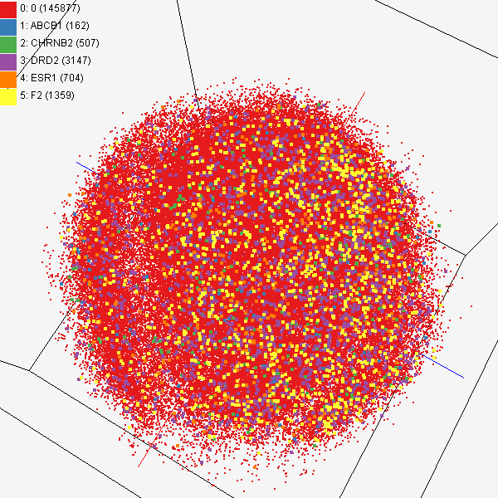
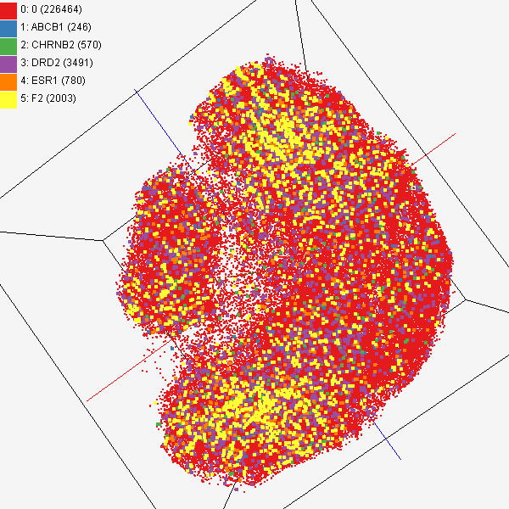
MDS and GTM Comparison
Chemical compounds shown in literatures, visualized by MDS (left) and GTM (right)
Visualized 234,000 chemical compounds which may be related with a set of 5 genes of interest (ABCB1, CHRNB2, DRD2, ESR1, and F2) based on the dataset collected from major journal literatures which is also stored in Chem2Bio2RDF system.

Slide 21
Interpolation Method
MDS and GTM are highly memory and time consuming process for large dataset such as millions of data points
MDS requires O(N²) and GTM does O(KN) (N is the number of data points and K is the number of latent variables)
Training only for sampled data and interpolating for out-of-sample set can improve performance
Interpolation is a pleasingly parallel application suitable for MapReduce and Clouds
n in-sample
Training
Trained data
N-n
out-of-sample
Interpolated
MDS/GTM map
Interpolation
Total N data

Slide 22
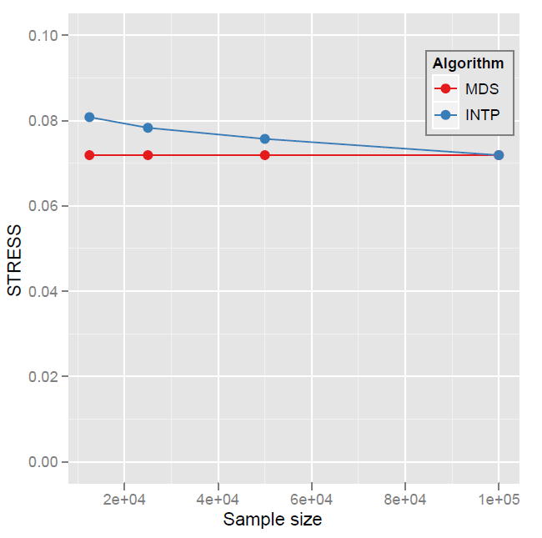
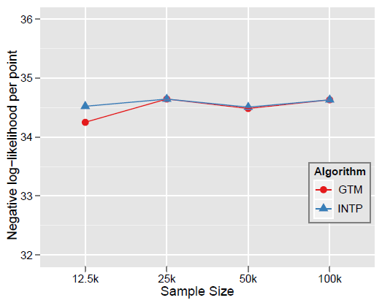
Quality Comparison (O(N²) Full vs. Interpolation)
MDS
GTM
Quality comparison between Interpolated result upto 100k based on the sample data (12.5k, 25k, and 50k) and original MDS result w/ 100k.
STRESS:
w_{ij} = 1 / ∑δ_{ij}²
16 nodes
Interpolation result (blue) is getting close to the original (red) result as sample size is increasing.
Time = C(250 n² + nN_{I}) where sample size n and N_{I} points interpolated
Notes:
12.5K 25K 50K 100K Run on 16 nodes of Tempest
Note that we gain performance of over a factor of 100 for this data size. It would be more for larger data set.

Slide 23
Mapping Quality (metagenomics)
N x N dissimilarity matix
30,000 sequences
Run w/ Parallel SMACOF
DA-exp95 improves
12.6/10.4% of SMACOF
DA-SMACOF Outperforms SMACOF and MDS-DistSmooth in
Quality by better STRESS value.
Reliability by consistent result (less sensitive to initial conf).

Slide 24
MDS v DA-MDS Runtime Comparison
DA uses compatible runtimes, 1.12 ~ 4.2 times longer than SMACOF and 1.3 ~ 9.1 times shorter than DistSmooth (DS).

Slide 25
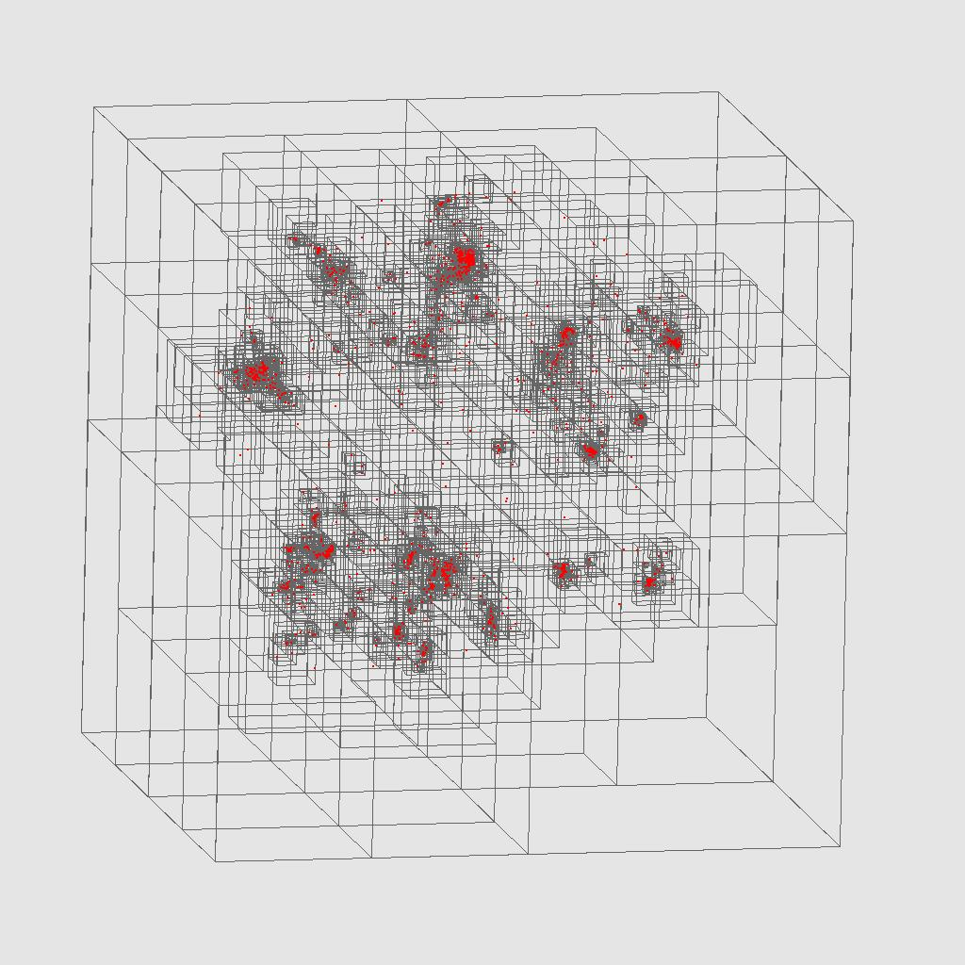
Oct Tree for Metagenomics

Slide 26
Scalable MDS
Use MDS on a subset of data (100,000 takes a few hours on 768 cores)
Form oct-tree (currently open Barnes Hut code)
Find centers of each box (slightly non trivial if use high dimension distances)
Each further point interpolate to some level of tree using high dimension distance
Interpolate using subset in “best box”

Slide 27
Scalable Clustering
Simplest is an hierarchical method – cluster within boxes of tractable size
Note clustering is ~ same speed as distance computation – both O(N_{box}²)
More innovative is nearer to classic fast multipole/Barnes Hut
Cluster boxes not points

Slide 28
FutureGrid key Concepts I
FutureGrid is an international testbed modeled on Grid5000
Supporting international Computer Science and Computational Science research in cloud, grid and parallel computing (HPC)
Industry and Academia
The FutureGrid testbed provides to its users:
A flexible development and testing platform for middleware and application users looking at interoperability, functionality, performance or evaluation
Each use of FutureGrid is an experiment that is reproducible
A rich education and teaching platform for advanced cyberinfrastructure (computer science) classes

Slide 29
FutureGrid key Concepts I
FutureGrid has a complementary focus to both the Open Science Grid and the other parts of TeraGrid.
FutureGrid is user-customizable, accessed interactively and supports Grid, Cloud and HPC software with and without virtualization.
FutureGrid is an experimental platform where computer science applications can explore many facets of distributed systems
and where domain sciences can explore various deployment scenarios and tuning parameters and in the future possibly migrate to the large-scale national Cyberinfrastructure.
FutureGrid supports Interoperability Testbeds – OGF really needed!
Note a lot of current use Education, Computer Science Systems and Biology/Bioinformatics

Slide 30
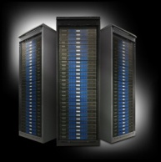
FutureGrid key Concepts III
Rather than loading images onto VM’s, FutureGrid supports Cloud, Grid and Parallel computing environments by dynamically provisioning software as needed onto “bare-metal” using Moab/xCAT
Image library for MPI, OpenMP, Hadoop, Dryad, gLite, Unicore, Globus, Xen, ScaleMP (distributed Shared Memory), Nimbus, Eucalyptus, OpenNebula, KVM, Windows …..
Growth comes from users depositing novel images in library
FutureGrid has ~4000 (will grow to ~5000) distributed cores with a dedicated network and a Spirent XGEM network fault and delay generator
Image1
Image2
…
ImageN
Choose
Load
Run

Slide 31
Dynamic Provisioning Results
Number of nodes
Time elapsed between requesting a job and the jobs reported start time on the provisioned node. The numbers here are an average of 2 sets of experiments.

Slide 32
FutureGrid Partners
Indiana University (Architecture, core software, Support)
Purdue University (HTC Hardware)
San Diego Supercomputer Center at University of California San Diego (INCA, Monitoring)
University of Chicago/Argonne National Labs (Nimbus)
University of Florida (ViNE, Education and Outreach)
University of Southern California Information Sciences (Pegasus to manage experiments)
University of Tennessee Knoxville (Benchmarking)
University of Texas at Austin/Texas Advanced Computing Center (Portal)
University of Virginia (OGF, Advisory Board and allocation)
Center for Information Services and GWT-TUD from Technische Universtität Dresden. (VAMPIR)
Red institutions have FutureGrid hardware

Slide 33
Compute Hardware
System type | # CPUs | # Cores | TFLOPS | Total RAM (GB) | Secondary Storage (TB) | Site | Status
IBM iDataPlex | 256 | 1024 | 11 | 3072 | 339* | IU | Operational
Dell PowerEdge | 192 | 768 | 8 | 1152 | 30 | TACC | Operational
IBM iDataPlex | 168 | 672 | 7 | 2016 | 120 | UC | Operational
IBM iDataPlex | 168 | 672 | 7 | 2688 | 96 | SDSC | Operational
Cray XT5m | 168 | 672 | 6 | 1344 | 339* | IU | Operational
IBM iDataPlex | 64 | 256 | 2 | 768 | On Order | UF | Operational
Large disk/memory system TBD | 128 | 512 | 5 | 7680 | 768 on nodes | IU | New System TBD
High Throughput Cluster | 192 | 384 | 4 | 192 |  | PU | Not yet integrated
Total | 1336 | 4960 | 50 | 18912 | 1353

Slide 34
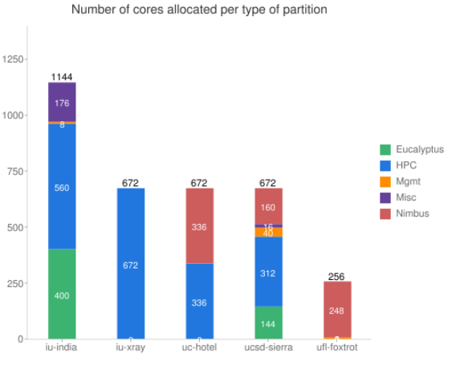
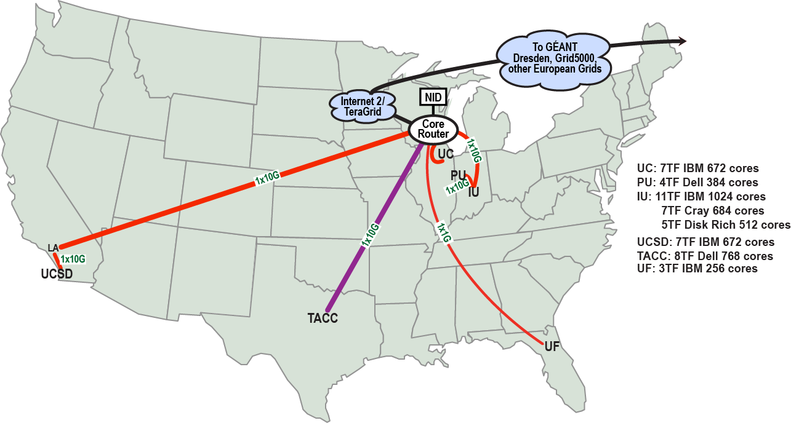
FutureGrid: a Grid/Cloud/HPC Testbed
NID: Network Impairment Device
Private Public
FG Network

Slide 35
Network & Internal Interconnects
FutureGrid has dedicated network (except to TACC) and a network fault and delay generator
Can isolate experiments on request; IU runs Network for NLR/Internet2
(Many) additional partner machines could run FutureGrid software and be supported (but allocated in specialized ways)
Machine | Name | Internal Network
IU Cray | xray | Cray 2D Torus SeaStar
IU iDataPlex | india | DDR IB, QLogic switch with Mellanox ConnectX adapters Blade Network Technologies & Force10 Ethernet switches
SDSC iDataPlex | sierra | DDR IB, Cisco switch with Mellanox ConnectX adapters Juniper Ethernet switches
UC iDataPlex | hotel | DDR IB, QLogic switch with Mellanox ConnectX adapters Blade Network Technologies & Juniper switches
UF iDataPlex | foxtrot | Gigabit Ethernet only (Blade Network Technologies; Force10 switches)
TACC Dell | alamo | QDR IB, Mellanox switches and adapters Dell Ethernet switches

Slide 36
Some Current FutureGrid projects I
Project | Institution | Details
Educational Projects
VSCSE Big Data | IU PTI, Michigan, NCSA and 10 sites | Over 200 students in week Long Virtual School of Computational Science and Engineering on Data Intensive Applications & Technologies
LSU Distributed Scientific Computing Class | LSU | 13 students use Eucalyptus and SAGA enhanced version of MapReduce
Topics on Systems: Cloud Computing CS Class | IU SOIC | 27 students in class using virtual machines, Twister, Hadoop and Dryad
Interoperability Projects
OGF Standards | Virginia, LSU, Poznan | Interoperability experiments between OGF standard Endpoints
Sky Computing | University of Rennes 1 | Over 1000 cores in 6 clusters across Grid’5000 & FutureGrid using ViNe and Nimbus to support Hadoop and BLAST demonstrated at OGF 29 June 2010

Slide 37
Some Current FutureGrid projects II
Application Projects
Combustion | Cummins | Performance Analysis of codes aimed at engine efficiency and pollution
ScaleMP for gene assembly | IU PTI and Biology | Investigate distributed shared memory over 16 nodes for SOAPdenovo assembly of Daphnia genomes
Cloud Technologies for Bioinformatics Applications | IU PTI | Performance analysis of pleasingly parallel/MapReduce applications on Linux, Windows, Hadoop, Dryad, Amazon, Azure with and without virtual machines
Computer Science Projects
Cumulus | Univ. of Chicago | Open Source Storage Cloud for Science based on Nimbus
Differentiated Leases for IaaS | University of Colorado | Deployment of always-on preemptible VMs to allow support of Condor based on demand volunteer computing
Application Energy Modeling | UCSD/SDSC | Fine-grained DC power measurements on HPC resources and power benchmark system
Evaluation and TeraGrid Support Projects
TeraGrid QA Test & Debugging | SDSC | Support TeraGrid software Quality Assurance working group
TeraGrid TAS/TIS | Buffalo/Texas | Support of XD Auditing and Insertion functions

Slide 38
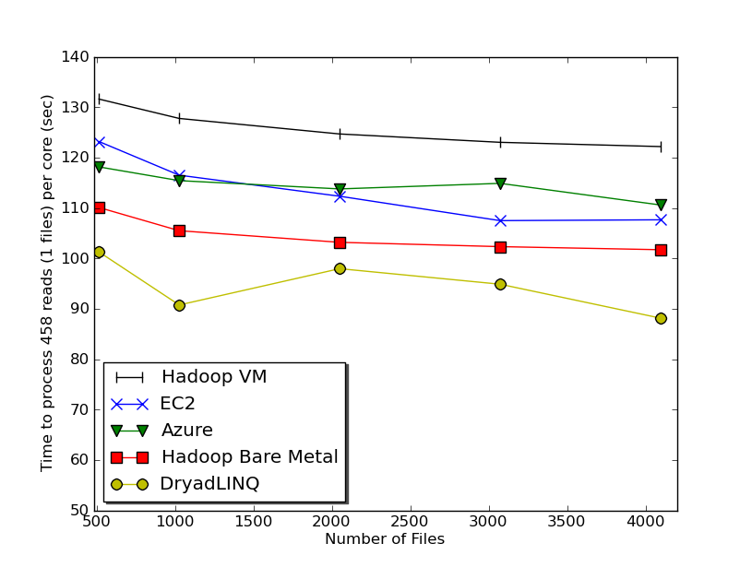
Typical FutureGrid Performance Study
Linux, Linux on VM, Windows, Azure, Amazon Bioinformatics

Slide 39
MapReduce
Data Partitions
Map(Key, Value)
A hash function maps the results of the map tasks to reduce tasks
Reduce(Key, List<Value>)
Reduce Outputs
Implementations (Hadoop – Java; Dryad – Windows) support:
Splitting of data
Passing the output of map functions to reduce functions
Sorting the inputs to the reduce function based on the intermediate keys
Quality of service

Slide 40
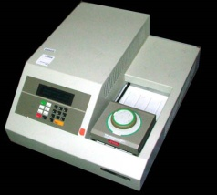
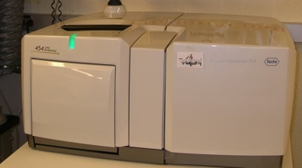
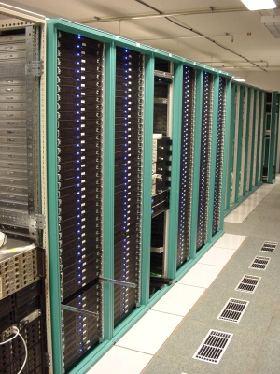
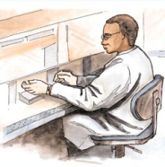
MapReduce “File/Data Repository” Parallelism
Map = (data parallel) computation reading and writing data
Reduce = Collective/Consolidation phase e.g. forming multiple global sums as in histogram
Instruments
Iterative MapReduce
Map Map Map Map
Reduce Reduce Reduce
Communication
Reduce
Portals /Users
Disks
Map₁
Map₂
Map₃

Slide 41
Applications & Different Interconnection Patterns
Map Only | Classic MapReduce | Iterative Reductions MapReduce++ | Loosely Synchronous
CAP3 Analysis Document conversion (PDF -> HTML) Brute force searches in cryptography Parametric sweeps | High Energy Physics (HEP) Histograms SWG gene alignment Distributed search Distributed sorting Information retrieval | Expectation maximization algorithms Clustering Linear Algebra | Many MPI scientific applications utilizing wide variety of communication constructs including local interactions
- CAP3 Gene Assembly - PolarGrid Matlab data analysis | - Information Retrieval - HEP Data Analysis - Calculation of Pairwise Distances for ALU Sequences | Kmeans Deterministic Annealing Clustering - Multidimensional Scaling MDS | - Solving Differential Equations and - particle dynamics with short range forces
Input
iterations
Input
Input
map
map
map
Pij
reduce
Output
reduce
Domain of MapReduce and Iterative Extensions
MPI

Slide 42
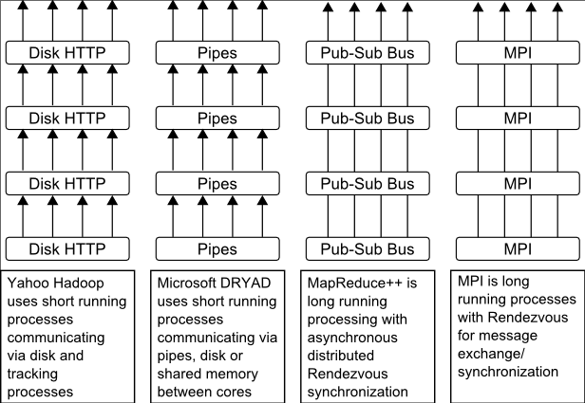
Twister
Pub/Sub Broker Network
Map Worker
M
Worker Nodes
R
Reduce Worker
Streaming based communication
Intermediate results are directly transferred from the map tasks to the reduce tasks – eliminates local files
Cacheable map/reduce tasks
Static data remains in memory
Combine phase to combine reductions
User Program is the composer of MapReduce computations
Extends the MapReduce model to iterative computations
D
D
MR
Driver
User
Program
M
M
M
M
D
MRDeamon
R
R
R
R
Data Read/Write
Communication
Data Split
File System
Iterate
Static
data
Configure()
User Program
Map(Key, Value)
δ flow
Reduce (Key, List<Value>)
Combine (Key, List<Value>)
Different synchronization and intercommunication mechanisms used by the parallel runtimes
Close()

Slide 43
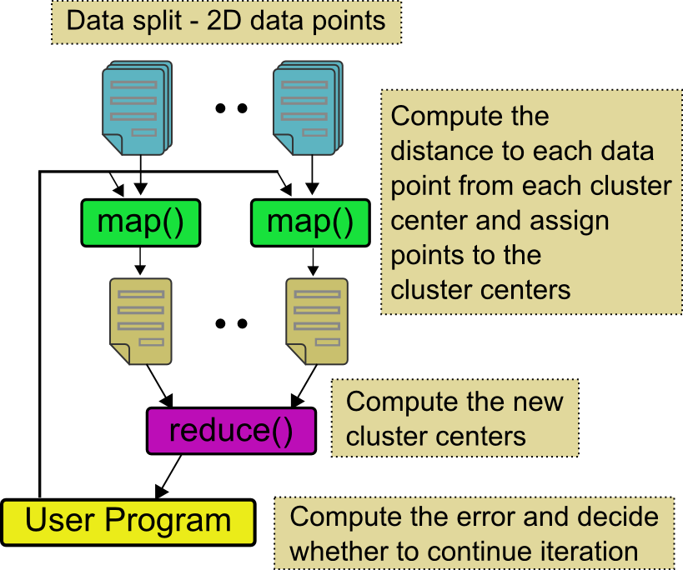
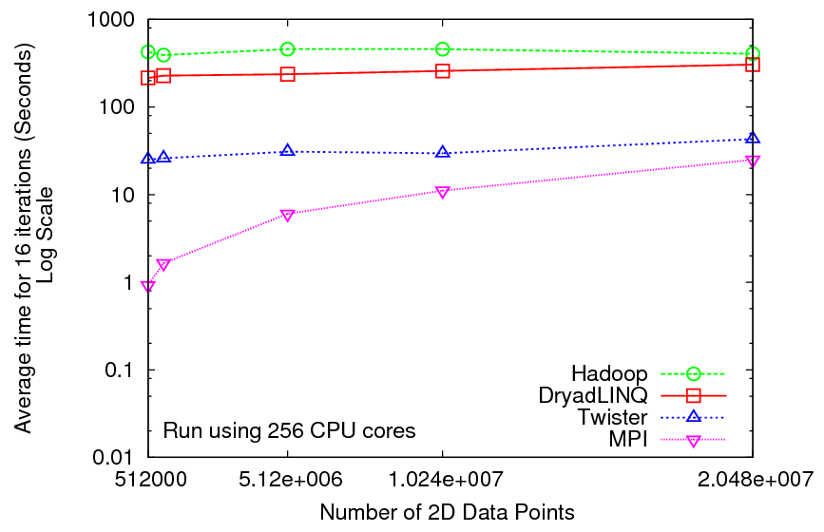
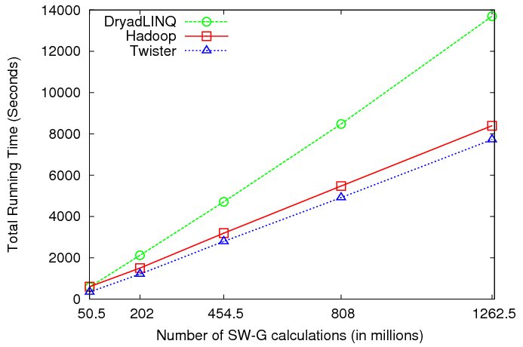
Iterative and non-Iterative Computations
K-means
Smith Waterman is a non iterative case and of course runs fine
Performance of K-Means

Slide 44
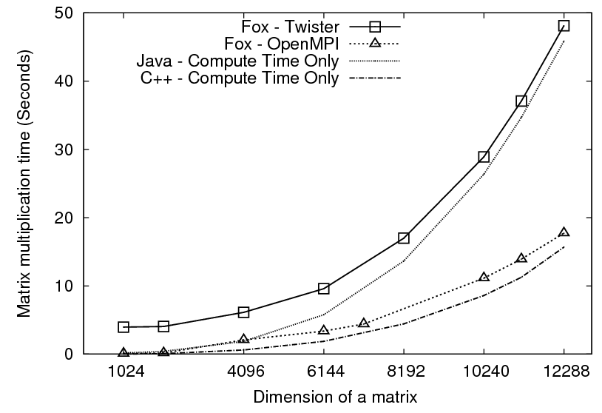
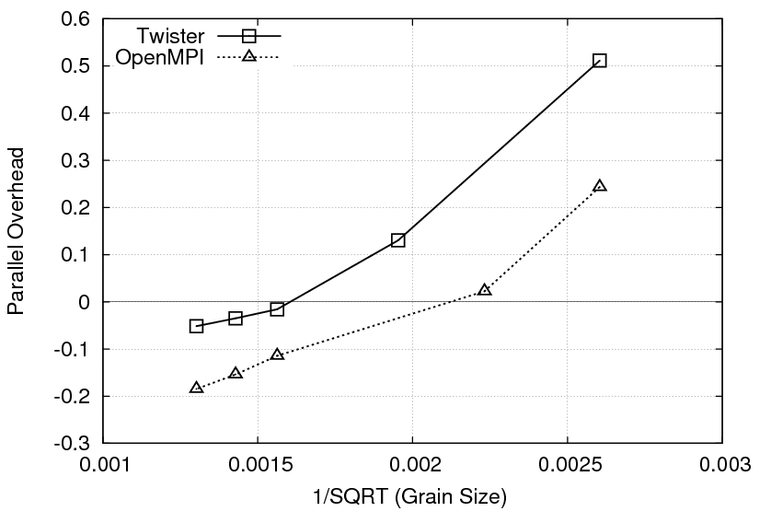
Performance of Matrix Multiplication
Matrix multiplication time against size of a matrix
Overhead against the 1/SQRT(Grain Size)
Considerable performance gap between Java and C++ (Note the estimated computation times)
For larger matrices both implementations show negative overheads
Stateful tasks enables these algorithms to be implemented using MapReduce
Exploring more algorithms of this nature would be an interesting future work

Slide 45
OGF’10 Demo from Rennes
SDSC
Rennes
Grid’5000 firewall
UF
Lille
UC
Sophia
ViNe provided the necessary inter-cloud connectivity to deploy CloudBLAST across 6 Nimbus sites, with a mix of public and private subnets.

Slide 46
Education & Outreach on FutureGrid
Build up tutorials on supported software
Support development of curricula requiring privileges and systems destruction capabilities that are hard to grant on conventional TeraGrid
Offer suite of appliances (customized VM based images) supporting online laboratories
Supporting ~200 students in Virtual Summer School on “Big Data” July 26-30 with set of certified images – first offering of FutureGrid 101 Class; TeraGrid ‘10 “Cloud technologies, data-intensive science and the TG”; CloudCom conference tutorials Nov 30-Dec 3 2010
Experimental class use fall semester at Indiana, Florida and LSU; follow up core distributed system class Spring at IU
Planning ADMI Summer School on Clouds and REU program

Slide 47
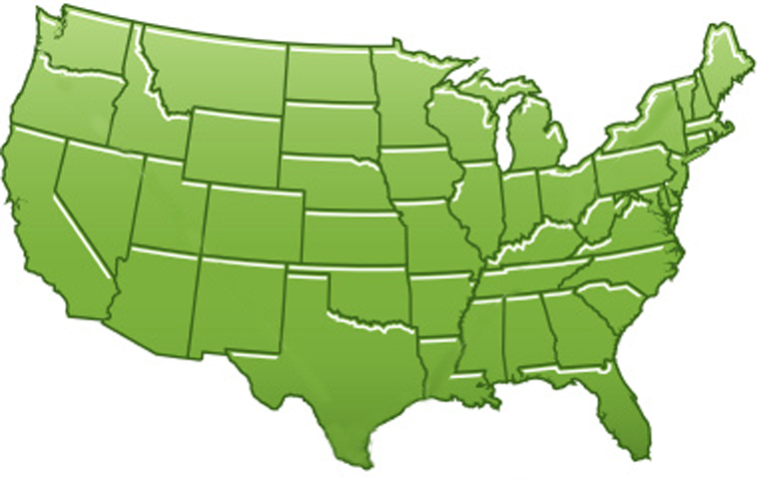
300+ Students learning about Twister & Hadoop
MapReduce technologies, supported by FutureGrid.
July 26-30, 2010 NCSA Summer School Workshop
http://salsahpc.indiana.edu/tutorial
Washington
University
University of
Minnesota
Michigan
State
Johns
Hopkins
Univ.Illinois
at Chicago
Iowa
Penn
State
IBM Almaden
Research Center
Notre
Dame
University of
California at
Los Angeles
Indiana
University
San Diego
Supercomputer
Center
University of
Texas at El Paso
University of
Arkansas
University
of Florida

Slide 48
FutureGrid Tutorials
Tutorial topic 3: Educational Virtual Appliances
Tutorial GA1: Introduction to the Grid Appliance
Tutorial GA2: Creating Grid Appliance Clusters
Tutorial GA3: Building an educational appliance from Ubuntu 10.04
Tutorial GA4: Deploying Grid Appliances using Nimbus
Tutorial GA5: Deploying Grid Appliances using Eucalyptus
Tutorial GA7: Customizing and registering Grid Appliance images using Eucalyptus
Tutorial MP1: MPI Virtual Clusters with the Grid Appliances and MPICH2
Tutorial topic 4: High Performance Computing
Tutorial VA1: Performance Analysis with Vampir
Tutorial VT1: Instrumentation and tracing with VampirTrace
Tutorial topic 1: Cloud Provisioning Platforms
Tutorial NM1: Using Nimbus on FutureGrid
Tutorial NM2: Nimbus One-click Cluster Guide
Tutorial GA6: Using the Grid Appliances to run FutureGrid Cloud Clients
Tutorial EU1: Using Eucalyptus on FutureGrid
Tutorial topic 2: Cloud Run-time Platforms
Tutorial HA1: Introduction to Hadoop using the Grid Appliance
Tutorial HA2: Running Hadoop on FG using Eucalyptus (.ppt)
Tutorial HA2: Running Hadoop on Eualyptus

Slide 49
Software Components
Portals including “Support” “use FutureGrid” “Outreach”
Monitoring – INCA, Power (GreenIT)
Experiment Manager: specify/workflow
Image Generation and Repository
Intercloud Networking ViNE
Virtual Clusters built with virtual networks
Performance library
Rain or Runtime Adaptable InsertioN Service: Schedule and Deploy images
Security (including use of isolated network), Authentication, Authorization,

Slide 50
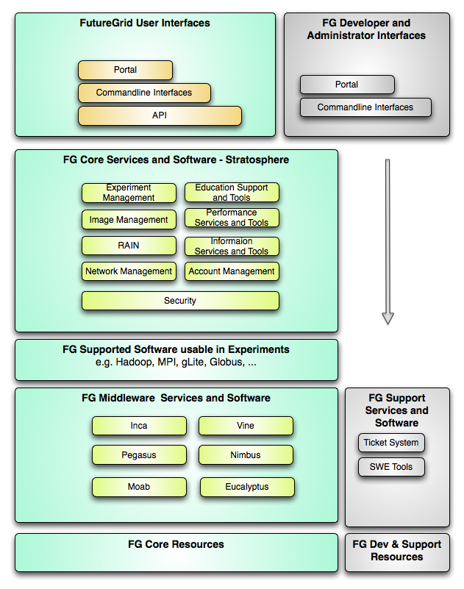
FutureGrid Layered Software Stack
User Supported Software usable in Experiments e.g. OpenNebula, Kepler, Other MPI, Bigtable

Slide 51
FutureGrid Viral Growth Model
Users apply for a project
Users improve/develop some software in project
This project leads to new images which are placed in FutureGrid repository
Project report and other web pages document use of new images
Images are used by other users
And so on ad infinitum ………

