Slide 1
Computing Testbeds as a Service or ? as an Instrument
July 21 2012
INCISE 2 Workshop Snowbird
Geoffrey Fox
gcf@indiana.edu
Informatics, Computing and Physics
Pervasive Technology Institute
Indiana University Bloomington

Slide 2
PolarGrid MRI
CNS0723054 MRI: Acquisition of PolarGrid: Cyberinfrastructure for Polar Science
Collaboration with Kansas CReSIS Science and Technology Center for Remote Sensing of Ice Sheets (world’s best radar to probe ice/snow structure)
Elizabeth City State University
Multiple expeditions each year with nearing a petabyte of data total
Field and Offline Analysis
Outreach with ADMI (Association of Computer and Information Science/Engineering Departments at Minority Institutions) led by ECSU Linda Hayden
High level Radar Analysis Algorithms/Software
Led to several later successful projects/proposals exploiting PolarGrid Instrument

Slide 3
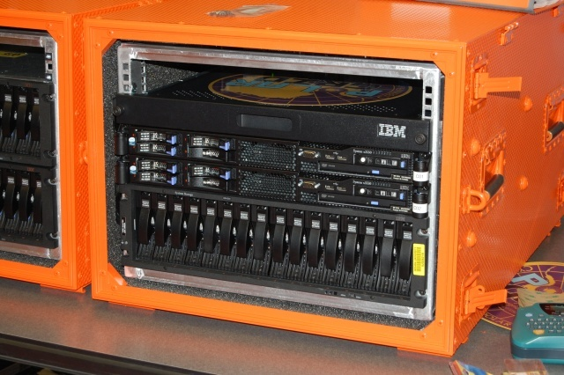
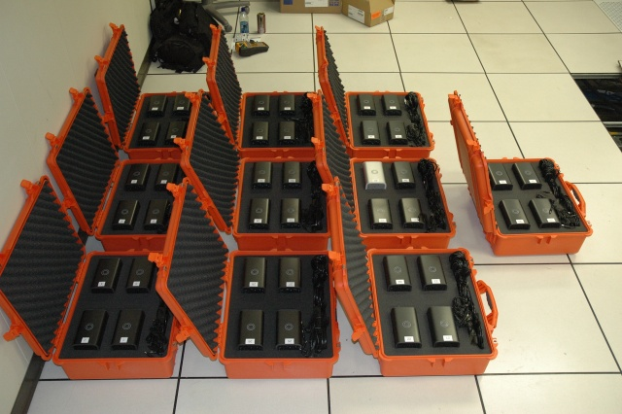
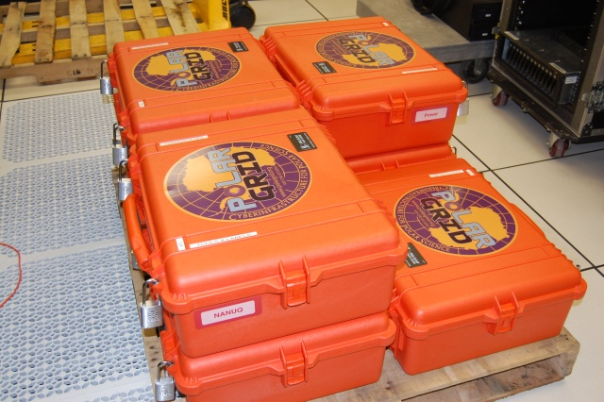
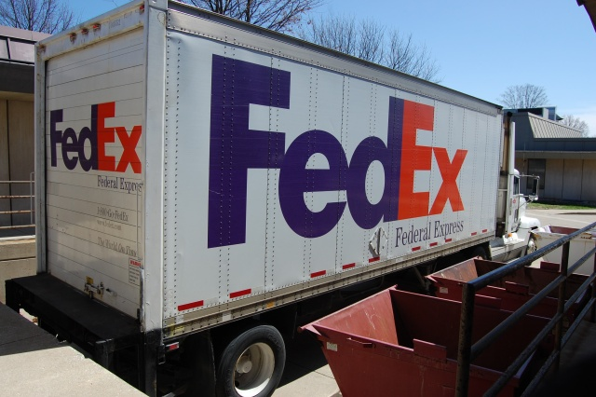
PolarGrid goes to Greenland

Slide 4
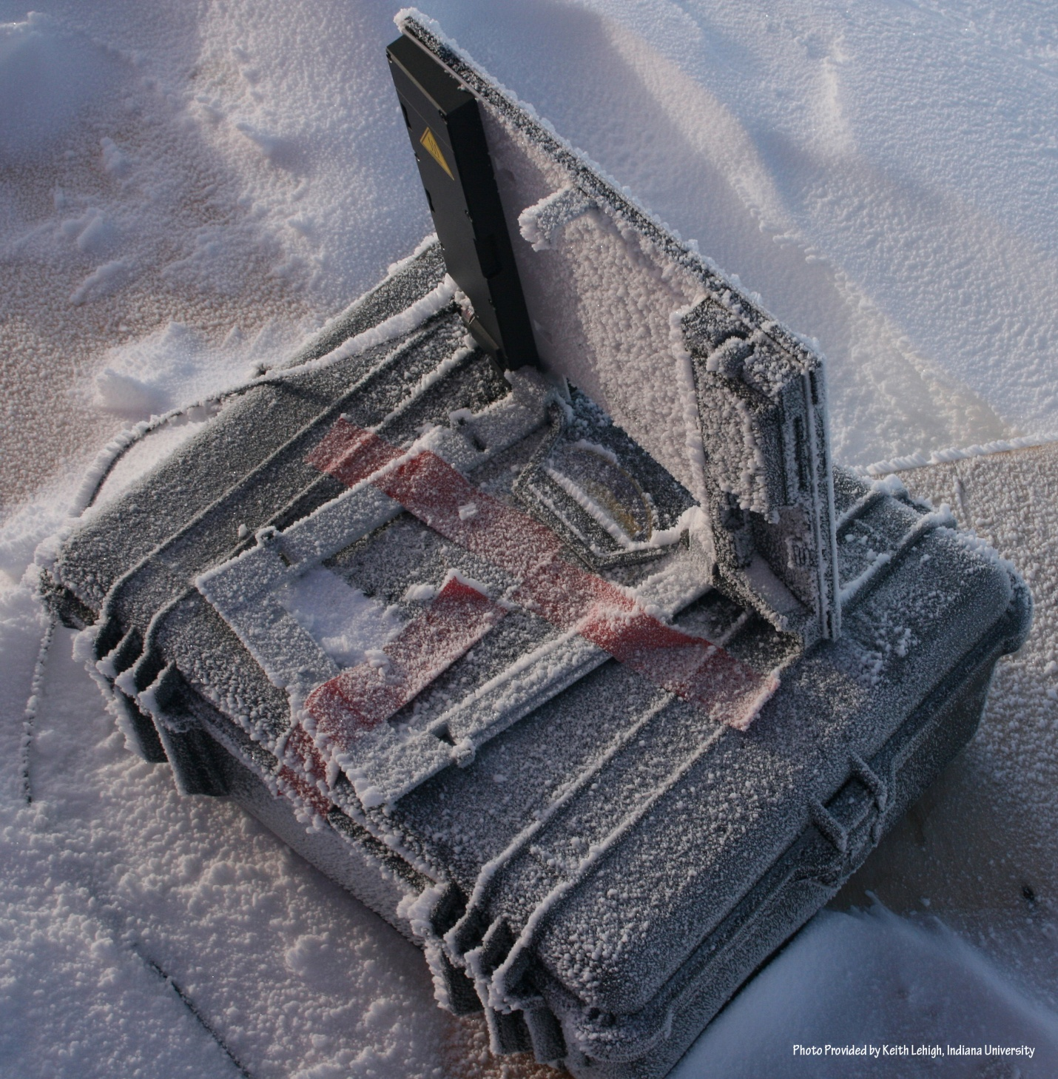
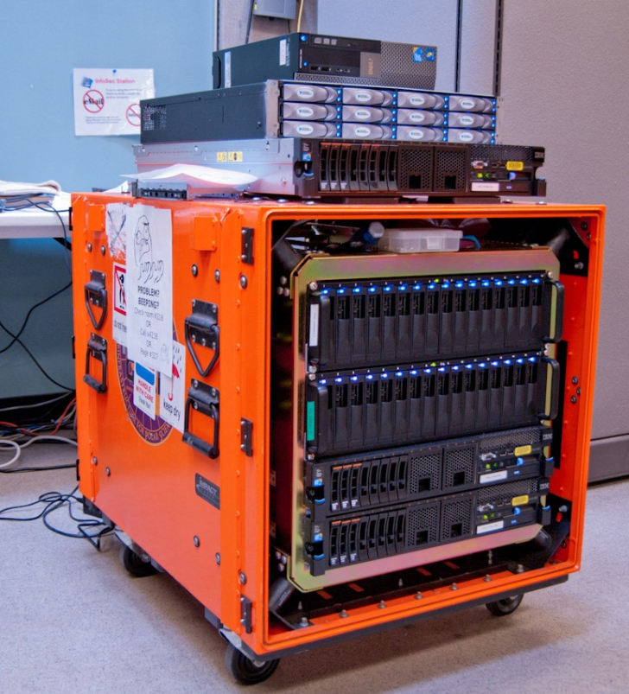
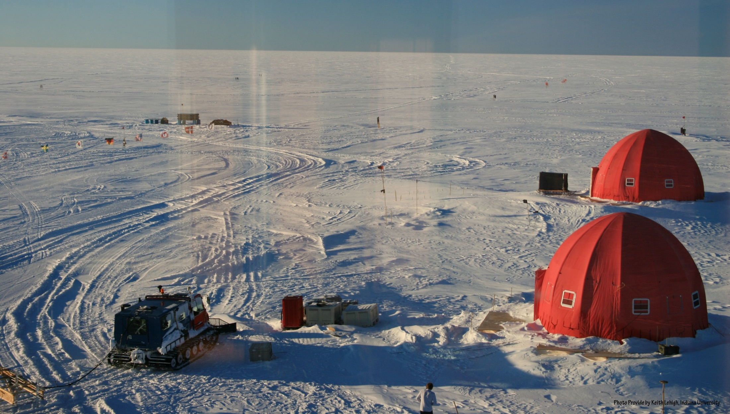
In the Field

Slide 5
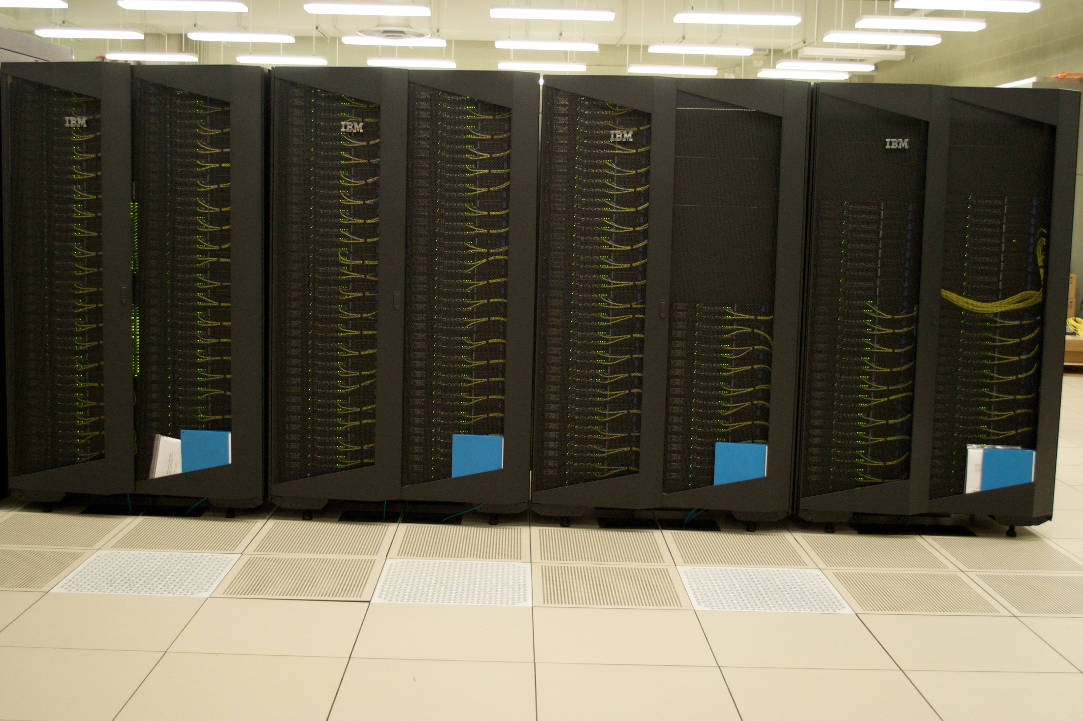
Offline Data Analysis on Polar Quarry

Slide 6
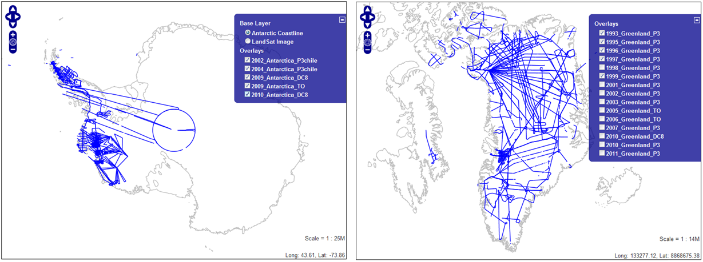
Building High Level Tools
Automatic Layer Determination developed by David Crandall added to collaboration from the faculty at Indiana University
Hidden Markov Method based Layer Finding Algorithm.
automatic layer finding algorithm
manual method
Data Browser

Slide 7
Some Lessons
MRI only supported Instrument and its operation
Need to couple with other projects to enable use
Flourishing work on GPU’s for low power field equipment to scalable Rad
Good coupling of important science, computer science, infrastructure and outreach to MSI’s
Apply for REU supplements!

Slide 8
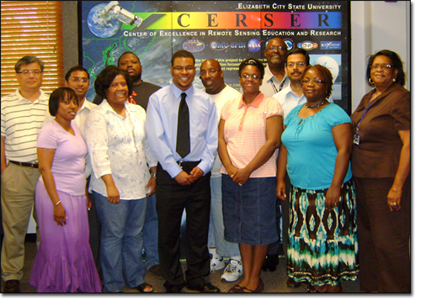
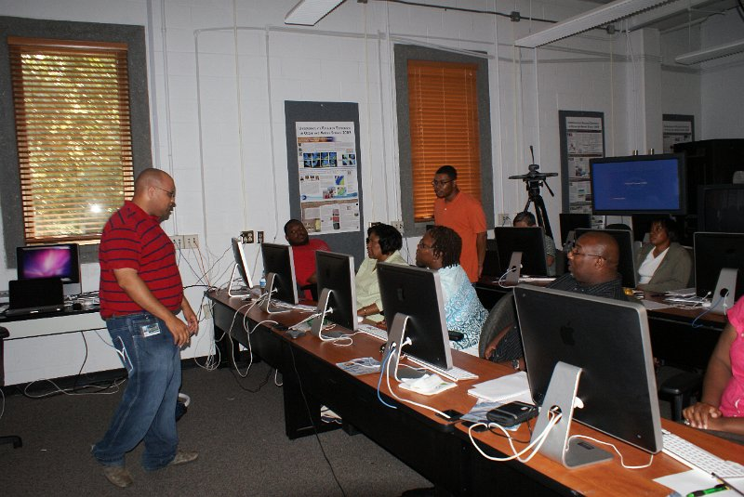
ECSU Workshop 2011 with Jerome Mitchell and Linda Hayden
PolarGrid laboratory at ECSU accessing FutureGrid

Slide 9
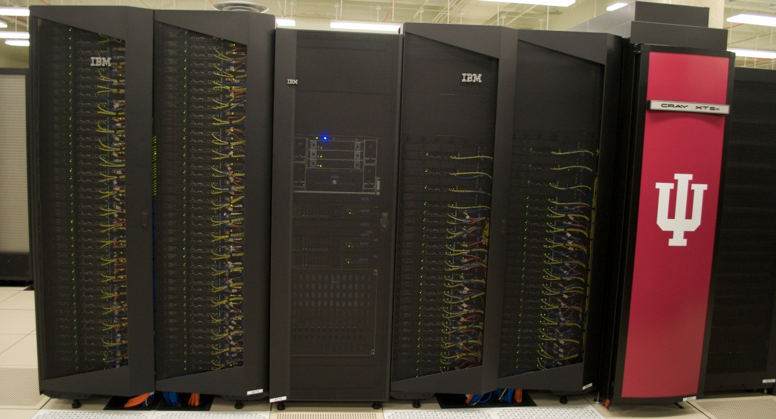
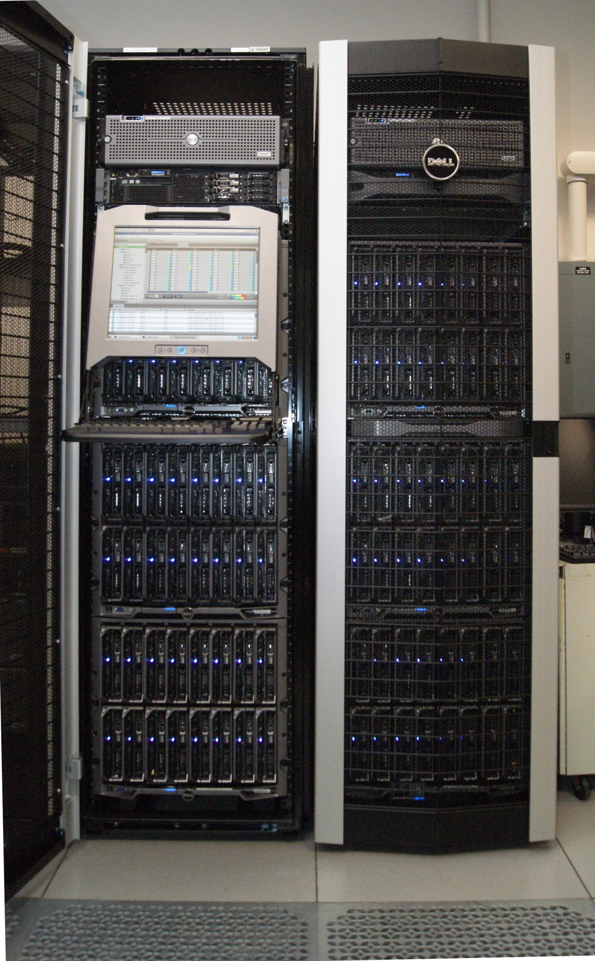
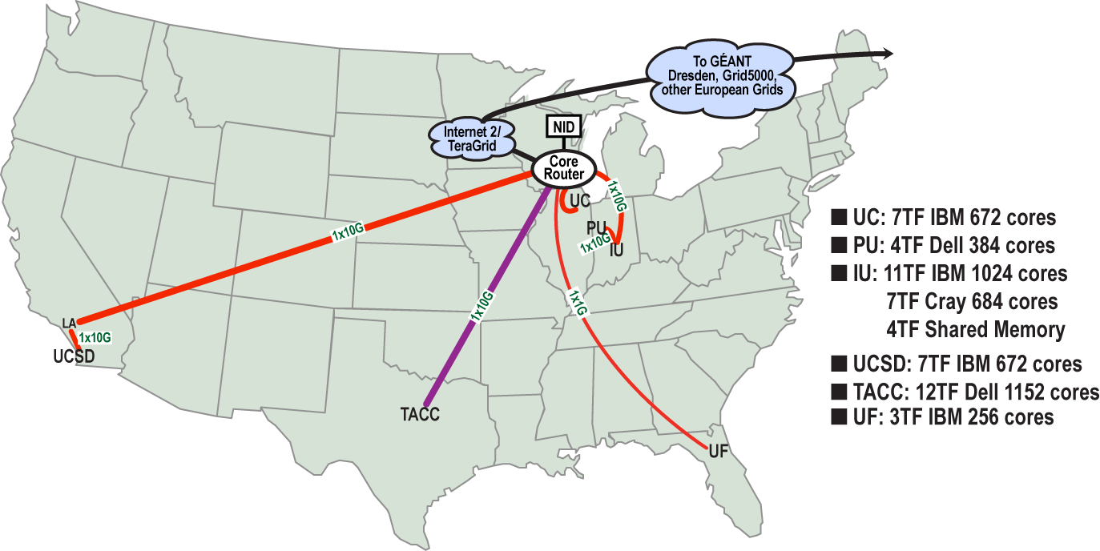
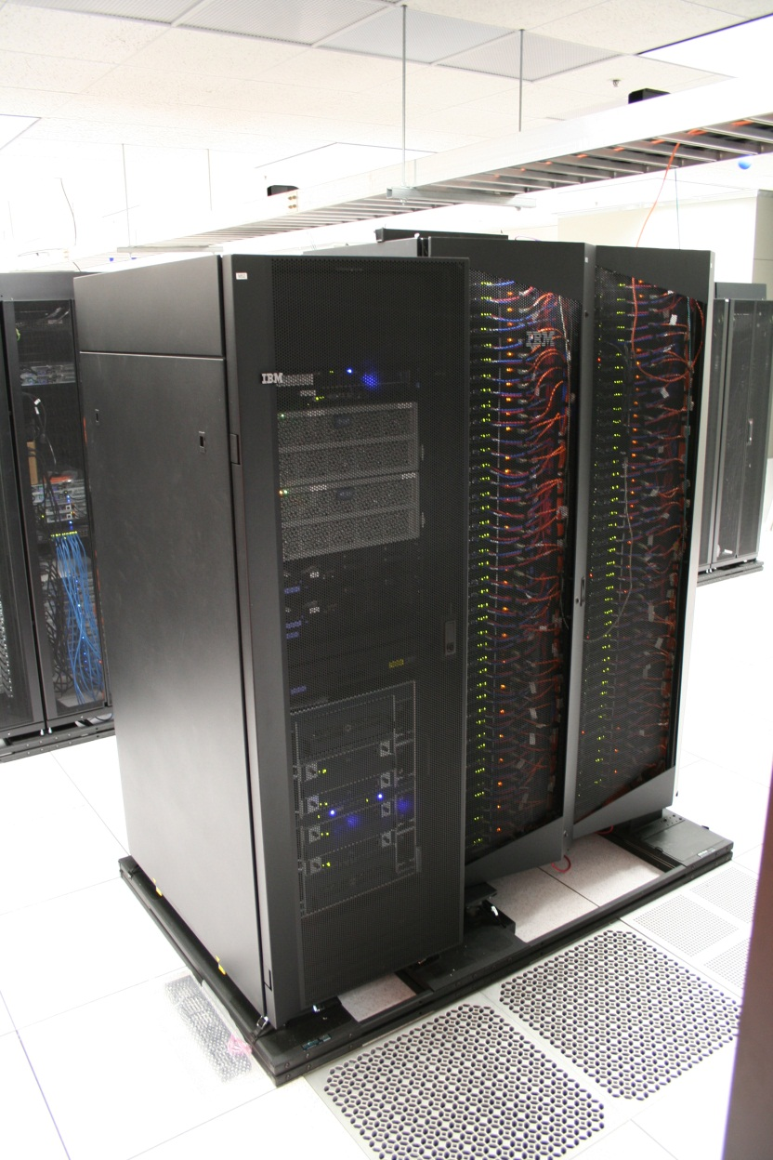
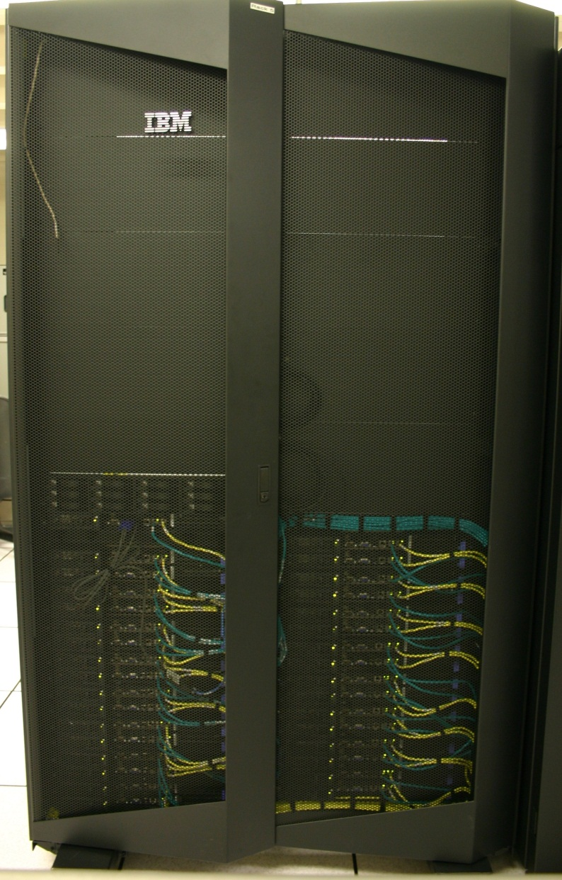
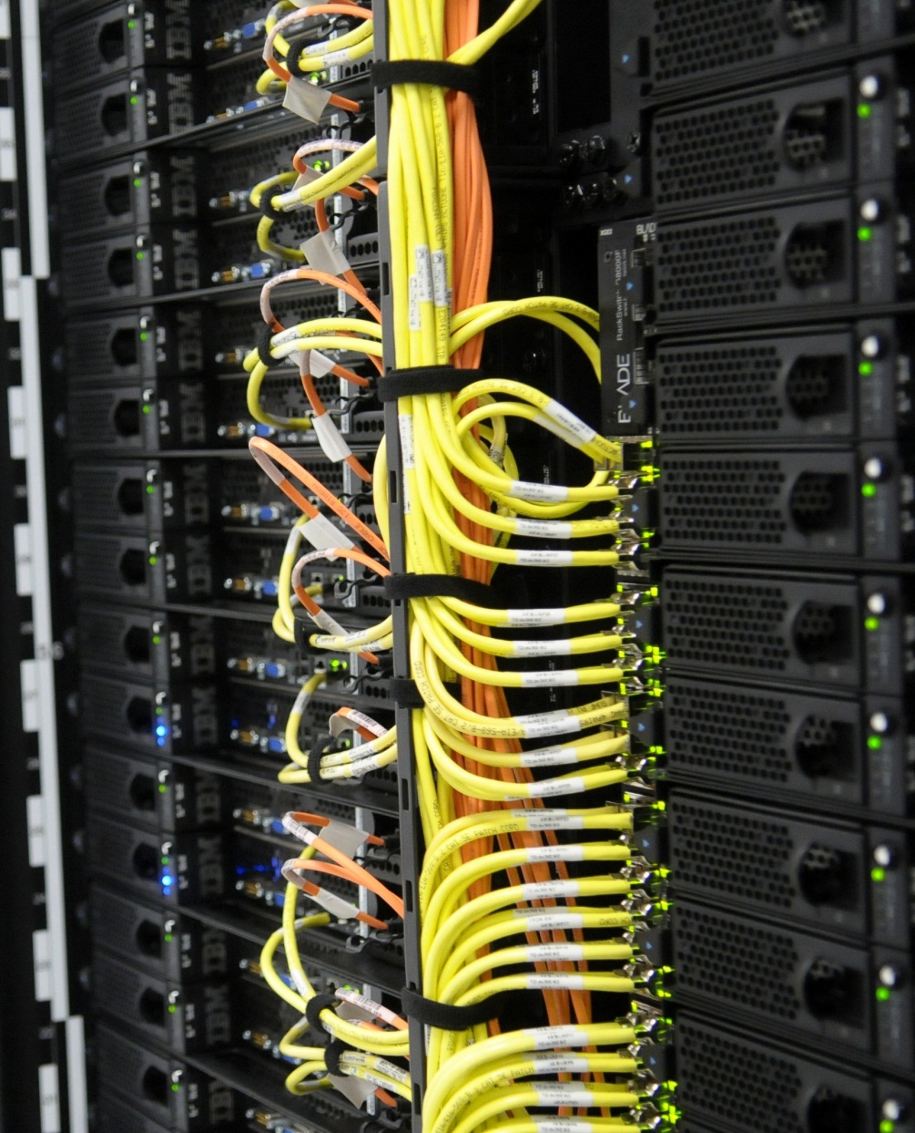
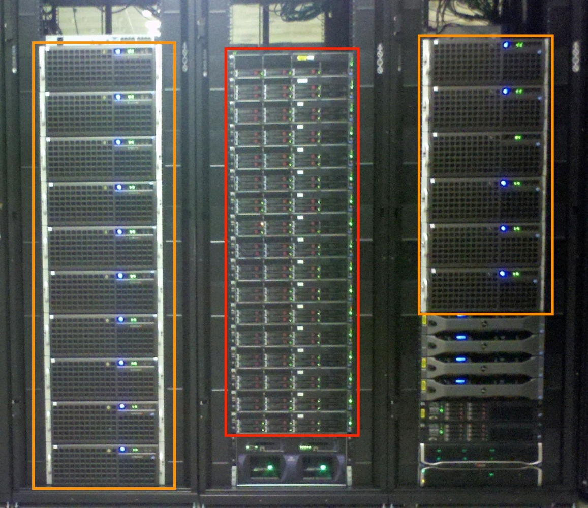
FutureGrid Computing Testbed as a Service
FutureGrid Computing Testbed as a Service
India (IBM) and Xray (Cray) (IU)
12TF Disk rich + GPU 512 cores
NID: Network Impairment Device
Private Public
FG Network
Bravo Delta (IU)
9
Sierra (SDSC)
Foxtrot (UF)
Alamo (TACC)
Hotel (Chicago)

Slide 10
Computer Science needs dynamic instantiation at all levels of stack
Applications develop SaaS services on top of PaaS middleware
Computing Testbed as a Service
Research
Computing
aaS
Custom Images
Courses
Consulting
Portals
Archival Storage
System e.g. SQL, GlobusOnline
Applications e.g. Amber, Blast
SaaS
Cloud e.g. MapReduce
HPC e.g. PETSc, SAGA
Computer Science e.g. Haskell
PaaS
Testbed-aaS Tools
Provisioning
Image Management
IaaS Interoperability
IaaS tools
Expt management
Dynamic Network
Devops
Hypervisor
Bare Metal
Operating System
Virtual Clusters, Networks
IaaS

Slide 11
What to use in Clouds: Cloud PaaS
HDFS style file system to collocate data and computing
Queues to manage multiple tasks
Tables to track job information
MapReduce and Iterative MapReduce to support parallelism
Services for everything
Portals as User Interface
Appliances and Roles as customized images
Software tools like Google App Engine, memcached
Workflow to link multiple services (functions)
Data Parallel Languages like Pig; more successful than HPF?

Slide 12
What to use in Grids and Supercomputers? HPC (including Grid) PaaS
Services Portals and Workflow as in clouds
MPI and GPU/multicore threaded parallelism
GridFTP and high speed networking
Wonderful libraries supporting parallel linear algebra, particle evolution, partial differential equation solution
Globus, Condor, SAGA, Unicore, Genesis for Grids
Parallel I/O for high performance in an application
Wide area File System (e.g. Lustre) supporting file sharing
Scientific Visualization
Let’s unify Cloud and HPC PaaS and add Computer Science PaaS?

Slide 13
Computer Science PaaS
Tools to support Compiler Development
Performance tools at several levels
Components of Software Stacks
Experimental language Support
Messaging Middleware (Pub-Sub)
Semantic Web and Database tools
Simulators
System Development Environments
Open Source Software from Linux to Apache

Slide 14
Research Computing as a Service
Traditional Computer Center has a variety of capabilities supporting (scientific computing/scholarly research) users.
Could also call this Computational Science as a Service
IaaS, PaaS and SaaS are lower level parts of these capabilities but commercial clouds do not include
Developing roles/appliances for particular users
Supplying custom SaaS aimed at user communities
Community Portals
Integration across disparate resources for data and compute (i.e. grids)
Data transfer and network link services
Archival storage, preservation, visualization
Consulting on use of particular appliances and SaaS i.e. on particular software components
Debugging and other problem solving
Administrative issues such as (local) accounting
This allows us to develop a new model of a computer center where commercial companies operate base hardware/software
A combination of XSEDE, Internet2 and computer center supply 1) to 9)?

Slide 15
aaS versus Roles/Appliances
If you package a capability X as XaaS, it runs on a separate VM and you interact with messages
SQLaaS offers databases via messages similar to old JDBC model
If you build a role or appliance with X, then X built into VM and you just need to add your own code and run
Venus-C Generic worker role builds in I/O and scheduling
Lets take all capabilities – MPI, MapReduce, Workflow .. – and offer as roles or aaS (or both)
Perhaps workflow has a controller aaS with graphical design tool while runtime packaged in a role?
Need to think through packaging of parallelism

Slide 16
27 Venus-C Azure Applications chosen from ~70
Chemistry (3)
• Lead Optimization in Drug Discovery
• Molecular Docking
Civil Protection (1)
• Fire Risk estimation and fire propagation
Biodiversity &
Biology (2)
• Biodiversity maps in marine species
• Gait simulation
Civil Eng. and Arch. (4)
• Structural Analysis
• Building information Management
• Energy Efficiency in Buildings
• Soil structure simulation
Physics (1)
• Simulation of Galaxies configuration
Earth Sciences (1)
• Seismic propagation
Mol, Cell. & Gen. Bio. (7)
• Genomic sequence analysis
• RNA prediction and analysis
• System Biology
• Loci Mapping
• Micro-arrays quality.
ICT (2)
• Logistics and vehicle routing
• Social networks analysis
Medicine (3)
• Intensive Care Units decision support.
• IM Radiotherapy planning.
• Brain Imaging
Mathematics (1)
• Computational Algebra
Mech, Naval & Aero. Eng. (2)
• Vessels monitoring
• Bevel gear manufacturing simulation

Slide 17
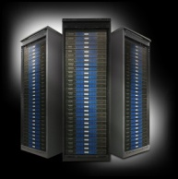
FutureGrid and TestbedaaS
FutureGrid is an international testbed modeled on Grid5000
July 15 2012: 223 Projects, ~968 users
Supporting international Computer Science and Computational Science research in cloud, grid and parallel computing (HPC)
The FutureGrid uses TestbedaaS to make a flexible environment supporting interoperability, functionality, performance and evaluation
Static and Dynamic Provisioning
See G. Fox, G. von Laszewski, J. Diaz, K. Keahey, J. Fortes, R. Figueiredo, S. Smallen, W. Smith, A. Grimshaw, FutureGrid - a reconfigurable testbed for Cloud, HPC and Grid Computing, Bookchapter – draft
Image1
Image2
…
ImageN
Choose
Load
Run

Slide 18
5 Use Types for FutureGrid TestbedaaS
223 approved projects (968 users) July 14 2012
USA, China, India, Pakistan, lots of European countries
Industry, Government, Academia
Training Education and Outreach (10%)
Semester and short events; interesting outreach to HBCU
Computer science (57%)
Core CS + Cyberinfrastructure
Computer Systems Evaluation (29%)
XSEDE (TIS, TAS), OSG, EGI
Interoperability test-beds (2%)
Grids and Clouds; Open Grid Forum OGF Standards
New Domain Science applications (26%)
Life science highlighted (14%), Non Life Science (12%)
Generalize to building Research Computing-aaS
Fractions are as of July 15 – add up to > 100%

Slide 19
FutureGrid TestbedaaS Supports Education and Training
Jerome Mitchell HBCU Cloud View of Computing workshop June 2011
Cloud Summer School July 30—August 3 2012 with 10 HBCU attendees
Mitchell and Younge building “Cloud Computing Handbook” loosely based on my book with Hwang and Dongarra
Several classes around the world each semester
Possible Interaction with (200 team) Student Competition in China organized by Beihang Univ.

Slide 20
FutureGrid TestbedaaS Supports Computer Science
Core Computer Science FG-172 Cloud-TM from Portugal: on distributed concurrency control (software transactional memory): "When Scalability Meets Consistency: Genuine Multiversion Update Serializable Partial Data Replication,“ 32nd International Conference on Distributed Computing Systems (ICDCS'12) (top conference) used 40 nodes of FutureGrid
Core Cyberinfrastructure FG-42,45 LSU/Rutgers: SAGA Pilot Job P* abstraction and applications. SAGA/BigJob use on clouds
Core Cyberinfrastructure FG-130: Optimizing Scientific Workflows on Clouds. Scheduling Pegasus on distributed systems with overhead measured and reduced. Used Eucalyptus on FutureGrid

Slide 21
Selected List of Services Offered
FutureGrid
IaaS
Nimbus
Cloud PaaS
Hadoop
Twister
HDFS
Swift Object Store
MPI
TestbedaaS
FG RAIN
Portal
Inca
Eucalyptus
OpenStack
ViNE
HPCaaS
Ganglia
Devops
Exper. Manag./Pegasus
OpenMP
CUDA
GridaaS
Unicore
SAGA
Globus
Genesis II

Slide 22
Building Infrastructure
Computing Testbed aaS enables infrastructure to dynamically support Computer Science (systems experimentation) aaS
Natural is to build large systems and support large experiments by federating hardware from several sources
Requirement is that partners in federation agree on and develop together TestbedaaS
Infrastructure includes networks, devices, field equipment as in PolarGrid

Slide 23
Architectural Overview
Notes:
This picture represents the architecture of our framework.
-we have devised a component for each one of the processes supporting the image life-cycle. This includes an
image generation component to create images following user requirements,
an image repository component to store, catalog and share images,
an image registration component for preparing, uploading and registering images into specific infrastructures such as HPC or different clouds. Once you have registered an image in a particular infrastructure, users can proceed to instantiate VMs or dynamic provision bare-metal machines with the image.
Users can access via a python API, a REST service, a convenient command line shell
------------------
One important feature in our design is how we are not simply storing an image but rather focusing on the way an image is created through abstract templating. Thus, it is possible at any time to regenerate an image based on the template describing the software stack and services for a given image. This enables us also to optimize the storage needs for users to manage many images. Instead of storing each image individually, we could just store the template or a pedigree of templates used to generate the images.
To aid storage reduction, our design includes data to assist in measuring usage and performance. This data can be used to purge rarely used images, while they can be recreated on- demand by leveraging the use of templating. Moreover, the use of abstract image templating will allow us to automatically generate images for a variety of hypervisors and hardware platforms on-demand. Autonomous services could be added to reduce the time needed to create images or deploy them in advance. Reusing images among groups of users and the introduction of a cache as part of the image generation will reduce the memory footprint or avoid the generation all together if an image with the same properties is already available.

Slide 24
Image Metadata
User Metadata
Field Name | Description
imgId | Image’s unique identifier
owner | owner
os | Operating system
description | Description of the image
tag | Image’s keywords
vmType | Virtual machine type
imgType | Aim of the image
permission | Access permission
imgStatus | Status of the image
createdDate | Upload date
lastAccess | Last time the image was accessed
accessCount | # times the image has been accessed
size | Size of the image
Field Name | Description
userId | User’s unique identifier
fsCap | Disk max usage (quota)
fsUsed | Disk space used
lastLogin | Last time user used the framework
status | Active, pending, disable
role | Admin, User
ownedimg | # of owned images
Notes:
These tables collects the metadata associated with images and users. This includes information about properties of the images, the access permission by users and the usage.
--------
Access permissions allow the image owner to determine who has access to the image. The simplest types of sharing include private to owner, shared with the public or shared with a set of people defined by a group/project. Usage information is available as part of the metadata to allow information about usage to be recorded. This includes how many times an image was accessed and by whom.

Slide 25
Register Images on Cloud
Eucalyptus
OpenStack
Notes:
the figures use a stacked bar chart to depict the time spent in each phase of this process including (1) customization of the image, (2) retrieval of the image after customization, and (3) the upload and registration of the image to a cloud infrastructure.
We observe the time needed to customize the image (1) increases with the number of concurrent requests. This phase includes uncompressing the image to prepare the image to be uploaded and registered to the infrastructure. Therefore, when we process several images at the same time, this phase takes longer. To prevent resource starvation, we have introduced a parameter that limits the maximum number of request that are processed concurrently.
We observe that the time to register an image in OpenStack is higher than in Eucalyptus. This is based on two factors. First, in OpenStack, we need to include certain software to allow OpenStack to contextualize the VM (included in (1)). Second, the process to upload the image to the OpenStack cloud takes longer than in Eucalyptus as we can see in the yellow section. As part of this process, both frameworks compress and split the image in smaller tgz files that are uploaded to the IaaS server. The difference is that OpenStack uncompresses and changes the format of the image in the server side as part of this process, while Eucalyptus seems to maintain the original compressed version.
------------
Time needed to deploy an image in OpenStack is higher than in Eucalyptus
OpenStack we need to include certain software to allow OpenStack to contextualize the VM during the instantiation time
The process to upload the image to the OpenStack cloud takes longer than in Eucalyptus
OpenStack uncompress the image in the server side as part of this process, while Eucalyptus seem to maintain the compress version of the images
Occasionally OpenStack fails to upload some images when we perform several concurrent requests. These images get stuck in the untarring status and do not evolve to the available one. We suspect that it may be due to some problem with the messaging queue system of our OpenStack deployment, but we could not confirm that because the logs were not very helpful.

Slide 26
Register Image on HPC
Notes:
Finally, we show the results obtained from registering images in our HPC infrastructure utilizing Moab/xCAT. We distinguish the following phases (see Section IV-C) : (1) retrieve the image from the repository, (2) uncompress the image, (3) retrieve kernels and update the xCAT tables, and (4) package the image.
We observe that the overall process only takes about two minutes
The most time consuming parts are uncompress the image (orange part) and execute the xCAT packimage command
Creates a tar/cpio image that will be use to netboot bare-metal machines
-------------
The scalability of this service is limited because the packimage has to be executed in the machine where xCAT server is installed

Slide 27
Templated(Abstract) Dynamic Provisioning
Abstract Specification of image mapped to various HPC and Cloud environments
Essex replaces Cactus
Current Eucalyptus 3 commercial while version 2 Open Source

