Slide 1
Cloud Technologies and Data Intensive Applications
INGRID 2010 Workshop Poznan Poland
May 13 2010
http://www.ingrid.cnit.it/
Geoffrey Fox
gcf@indiana.edu
http://www.infomall.org http://www.futuregrid.org
Director, Digital Science Center, Pervasive Technology Institute
Associate Dean for Research and Graduate Studies, School of Informatics and Computing
Indiana University Bloomington

Slide 2
Important Trends
Data Deluge in all fields of science
  Also throughout life e.g. web!
Multicore implies parallel computing important again
  Performance from extra cores – not extra clock speed
Clouds – new commercially supported data center model replacing compute grids

Slide 3

Gartner 2009 Hype Curve
Clouds, Web2.0
Service Oriented Architectures

Slide 4


Clouds as Cost Effective Data Centers
Builds giant data centers with 100,000’s of computers; ~ 200
-1000 to a shipping container with Internet access
“Microsoft will cram between 150 and 220 shipping containers filled with data center gear into a new 500,000 square foot Chicago facility. This move marks the most significant, public use of the shipping container systems popularized by the likes of Sun Microsystems and Rackable Systems to date.”

Slide 5

Clouds hide Complexity
SaaS: Software as a Service
IaaS: Infrastructure as a Service or HaaS: Hardware as a Service – get your computer time with a credit card and with a Web interaface
PaaS: Platform as a Service is IaaS plus core software capabilities on which you build SaaS
Cyberinfrastructure is “Research as a Service”
SensaaS is Sensors (Instruments) as a Service
2 Google warehouses of computers on the banks of the Columbia River, in The Dalles, Oregon
Such centers use 20MW-200MW
(Future) each
150 watts per core
Save money from large size, positioning with cheap power and access with Internet

Slide 6


The Data Center Landscape
Range in size from “edge” facilities to megascale.
Economies of scale
  Approximate costs for a small size center (1K servers) and a larger, 50K server center.
Technology | Cost in small-sized Data Center | Cost in Large Data Center | Ratio
Network | $95 per Mbps/ month | $13 per Mbps/ month | 7.1
Storage | $2.20 per GB/ month | $0.40 per GB/ month | 5.7
Administration | ~140 servers/ Administrator | >1000 Servers/ Administrator | 7.1
Each data center is
11.5 times
the size of a football field

Slide 7
Clouds hide Complexity
Cyberinfrastructure
Is “Research as a Service”
SaaS: Software as a Service
(e.g. CFD or Search documents/web are services)
PaaS: Platform as a Service
IaaS plus core software capabilities on which you build SaaS
(e.g. Azure is a PaaS; MapReduce is a Platform)
IaaS (HaaS): Infrastructure as a Service
(get computer time with a credit card and with a Web interface like EC2)

Slide 8

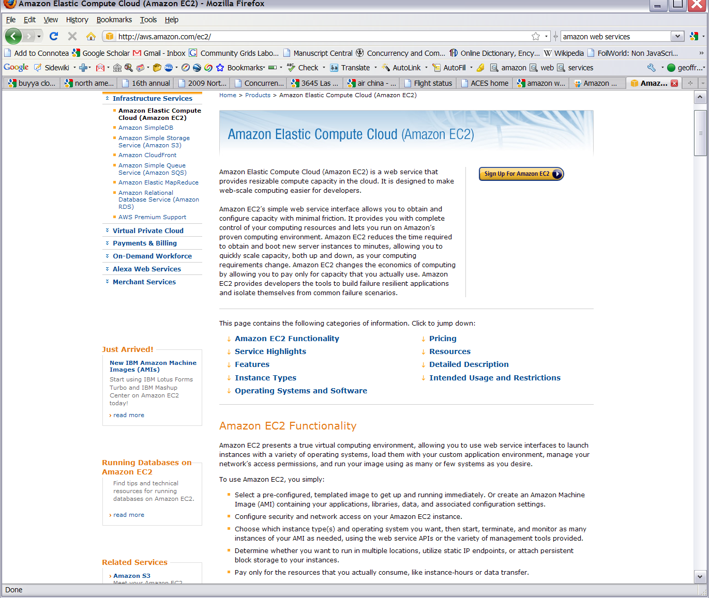






Commercial Cloud
Software

Slide 9
Philosophy of Clouds and Grids
Clouds are (by definition) commercially supported approach to large scale computing
  So we should expect Clouds to replace Compute Grids
  Current Grid technology involves “non-commercial” software solutions which are hard to evolve/sustain
  Maybe Clouds ~4% IT expenditure 2008 growing to 14% in 2012 (IDC Estimate)
Public Clouds are broadly accessible resources like Amazon and Microsoft Azure – powerful but not easy to customize and perhaps data trust/privacy issues
Private Clouds run similar software and mechanisms but on “your own computers” (not clear if still elastic)
Services still are correct architecture with either REST (Web 2.0) or Web Services
Clusters still critical concept

Slide 11






MapReduce “File/Data Repository” Parallelism
Map = (data parallel) computation reading and writing data
Reduce = Collective/Consolidation phase e.g. forming multiple global sums as in histogram
Instruments
Iterative MapReduce
Map Map Map Map
Reduce Reduce Reduce
Communication
Reduce
Portals
/Users
Disks
Map₁
Map₂
Map₃

Slide 12
Cloud Computing: Infrastructure and Runtimes
Cloud infrastructure: outsourcing of servers, computing, data, file space, utility computing, etc.
  Handled through Web services that control virtual machine lifecycles.
Cloud runtimes: tools (for using clouds) to do data-parallel computations.
  Apache Hadoop, Google MapReduce, Microsoft Dryad, Bigtable, Chubby and others
  MapReduce designed for information retrieval but is excellent for a wide range of science data analysis applications
  Can also do much traditional parallel computing for data-mining if extended to support iterative operations
  Not usually on Virtual Machines

Slide 13
MapReduce
Data Partitions
Map(Key, Value)
A hash function maps the results of the map tasks to reduce tasks
Reduce(Key, List<Value>)
Reduce Outputs
Implementations support:
  Splitting of data
  Passing the output of map functions to reduce functions
  Sorting the inputs to the reduce function based on the intermediate keys
  Quality of service

Slide 14
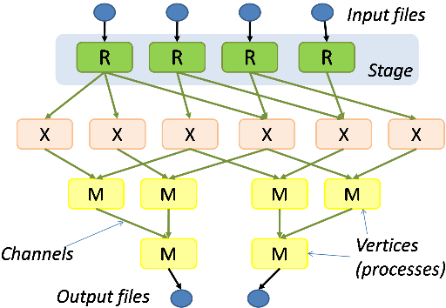
Hadoop & Dryad
Apache Hadoop
Microsoft Dryad
Master Node
Data/Compute Nodes
Job
Tracker
M
M
M
M
R
R
R
R
Name
Node
Data blocks
1
2
2
4
HDFS
3
3
Apache Implementation of Google’s MapReduce
Uses Hadoop Distributed File System (HDFS) manage data
Map/Reduce tasks are scheduled based on data locality in HDFS
Hadoop handles:
  Job Creation
  Resource management
  Fault tolerance & re-execution of failed map/reduce tasks
The computation is structured as a directed acyclic graph (DAG)
  Superset of MapReduce
Vertices – computation tasks
Edges – Communication channels
Dryad process the DAG executing vertices on compute clusters
Dryad handles:
  Job creation, Resource management
  Fault tolerance & re-execution of vertices

Slide 15

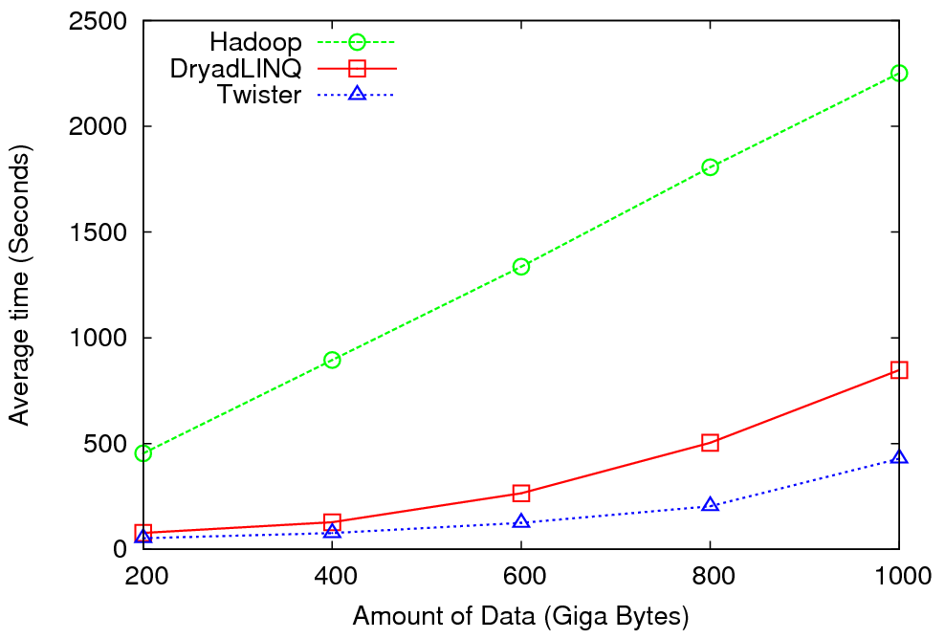
High Energy Physics Data Analysis
An application analyzing data from Large Hadron Collider (1TB but 100 Petabytes eventually)
Input to a map task: <key, value>
key = Some Id value = HEP file Name
Output of a map task: <key, value>
key = random # (0<= num<= max reduce tasks)
value = Histogram as binary data
Input to a reduce task: <key, List<value>>
key = random # (0<= num<= max reduce tasks)
value = List of histogram as binary data
Output from a reduce task: value
value = Histogram file
Combine outputs from reduce tasks to form the final histogram

Slide 16

Reduce Phase of Particle Physics
“Find the Higgs” using Dryad
Higgs in Monte Carlo
Combine Histograms produced by separate Root “Maps” (of event data to partial histograms) into a single Histogram delivered to Client

Slide 17
Fault Tolerance and MapReduce
MPI does “maps” followed by “communication” including “reduce” but does this iteratively
There must (for most communication patterns of interest) be a strict synchronization at end of each communication phase
  Thus if a process fails then everything grinds to a halt
In MapReduce, all Map processes and all reduce processes are independent and stateless and read and write to disks
Thus failures can easily be recovered by rerunning process without other jobs hanging around waiting

Slide 18


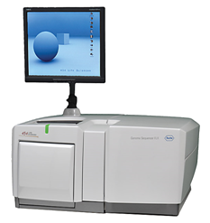
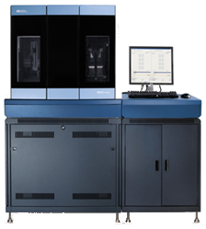
DNA Sequencing Pipeline
MapReduce
Pairwise
clustering
Sequence
alignment
Dissimilarity
Matrix
N(N-1)/2 values
Visualization
Plotviz
FASTA File
N Sequences
Blocking
block
Pairings
MPI
MDS
Read Alignment
Illumina/Solexa Roche/454 Life Sciences Applied Biosystems/SOLiD
Internet
Modern Commercial Gene Sequencers
This chart illustrate our research of a pipeline mode to provide services on demand (Software as a Service SaaS)
User submit their jobs to the pipeline. The components are services and so is the whole pipeline.

Slide 19
Alu and Metagenomics Workflow
“All pairs” problem
Data is a collection of N sequences. Need to calculate N² dissimilarities (distances) between sequnces (all pairs).
  These cannot be thought of as vectors because there are missing characters
  “Multiple Sequence Alignment” (creating vectors of characters) doesn’t seem to work if N larger than O(100), where 100’s of characters long.
Step 1: Can calculate N² dissimilarities (distances) between sequences
Step 2: Find families by clustering (using much better methods than Kmeans). As no vectors, use vector free O(N²) methods
Step 3: Map to 3D for visualization using Multidimensional Scaling (MDS) – also O(N²)
Results:
N = 50,000 runs in 10 hours (the complete pipeline above) on 768 cores
Discussions:
Need to address millions of sequences …..
Currently using a mix of MapReduce and MPI
Twister will do all steps as MDS, Clustering just need MPI Broadcast/Reduce

Slide 20


Biology MDS and Clustering Results
Alu Families
This visualizes results of Alu repeats from Chimpanzee and Human Genomes. Young families (green, yellow) are seen as tight clusters. This is projection of MDS dimension reduction to 3D of 35399 repeats – each with about 400 base pairs
Metagenomics
This visualizes results of dimension reduction to 3D of 30000 gene sequences from an environmental sample. The many different genes are classified by clustering algorithm and visualized by MDS dimension reduction

Slide 21

All-Pairs Using DryadLINQ
125 million distances
4 hours & 46 minutes
Calculate Pairwise Distances (Smith Waterman Gotoh)
Calculate pairwise distances for a collection of genes (used for clustering, MDS)
Fine grained tasks in MPI
Coarse grained tasks in DryadLINQ
Performed on 768 cores (Tempest Cluster)
Moretti, C., Bui, H., Hollingsworth, K., Rich, B., Flynn, P., & Thain, D. (2009). All-Pairs: An Abstraction for Data Intensive Computing on Campus Grids. IEEE Transactions on Parallel and Distributed Systems , 21, 21-36.

Slide 22
Hadoop/Dryad Comparison
Inhomogeneous Data I
Inhomogeneity of data does not have a significant effect when the sequence lengths are randomly distributed
Dryad with Windows HPCS compared to Hadoop with Linux RHEL on Idataplex (32 nodes)

Slide 23
Hadoop/Dryad Comparison
Inhomogeneous Data II
This shows the natural load balancing of Hadoop MR dynamic task assignment using a global pipe line in contrast to the DryadLinq static assignment
Dryad with Windows HPCS compared to Hadoop with Linux RHEL on Idataplex (32 nodes)

Slide 24
Hadoop VM Performance Degradation
Perf. Degradation = (T_{vm} – T_{baremetal})/T_{baremetal}
15.3% Degradation at largest data set size

Slide 25

Application Classes
Old classification of Parallel software/hardware
in terms of 5 (becoming 6) “Application architecture” Structures)
1 | Synchronous | Lockstep Operation as in SIMD architectures
2 | Loosely Synchronous | Iterative Compute-Communication stages with independent compute (map) operations for each CPU. Heart of most MPI jobs | MPP
3 | Asynchronous | Computer Chess; Combinatorial Search often supported by dynamic threads | MPP
4 | Pleasingly Parallel | Each component independent – in 1988, Fox estimated at 20% of total number of applications | Grids
5 | Metaproblems | Coarse grain (asynchronous) combinations of classes 1)-4). The preserve of workflow. | Grids
6 | MapReduce++ | It describes file(database) to file(database) operations which has subcategories including. Pleasingly Parallel Map Only Map followed by reductions Iterative “Map followed by reductions” – Extension of Current Technologies that supports much linear algebra and datamining | Clouds Hadoop/ Dryad Twister
Notes:
CGL-MapReduce is an example of MapReduce++ -- supports MapReduce model with iteration (data stays in memory and communication via streams not files)

Slide 26
Applications & Different Interconnection Patterns
Map Only | Classic MapReduce | Iterative Reductions MapReduce++ | Loosely Synchronous
CAP3 Analysis Document conversion (PDF -> HTML) Brute force searches in cryptography Parametric sweeps | High Energy Physics (HEP) Histograms SWG gene alignment Distributed search Distributed sorting Information retrieval | Expectation maximization algorithms Clustering Linear Algebra | Many MPI scientific applications utilizing wide variety of communication constructs including local interactions
- CAP3 Gene Assembly - PolarGrid Matlab data analysis | - Information Retrieval - HEP Data Analysis - Calculation of Pairwise Distances for ALU Sequences | Kmeans Deterministic Annealing Clustering - Multidimensional Scaling MDS | - Solving Differential Equations and - particle dynamics with short range forces
Input
iterations
Input
Input
map
map
map
Pij
reduce
Output
reduce
Domain of MapReduce and Iterative Extensions
MPI

Slide 27

Twister(MapReduce++)
Pub/Sub Broker Network
Map Worker
M
Streaming based communication
Intermediate results are directly transferred from the map tasks to the reduce tasks – eliminates local files
Cacheable map/reduce tasks
  Static data remains in memory
Combine phase to combine reductions
User Program is the composer of MapReduce computations
Extends the MapReduce model to iterative computations
Worker Nodes
R
Reduce Worker
D
D
MR
Driver
User
Program
M
M
M
M
D
MRDeamon
R
R
R
R
Data Read/Write
Communication
Data Split
File System
Iterate
Static
data
Configure()
User Program
Map(Key, Value)
δ flow
Reduce (Key, List<Value>)
Combine (Key, List<Value>)
Different synchronization and intercommunication mechanisms used by the parallel runtimes
Close()

Slide 28


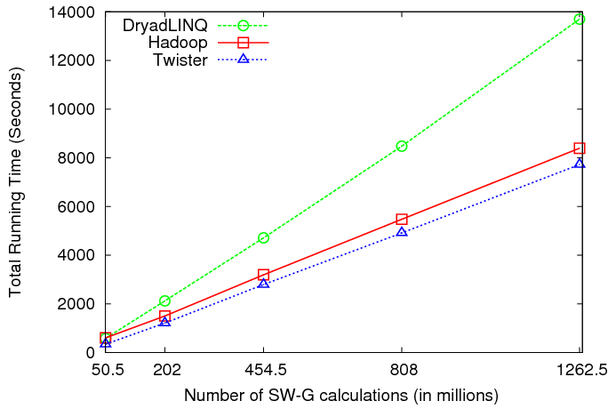
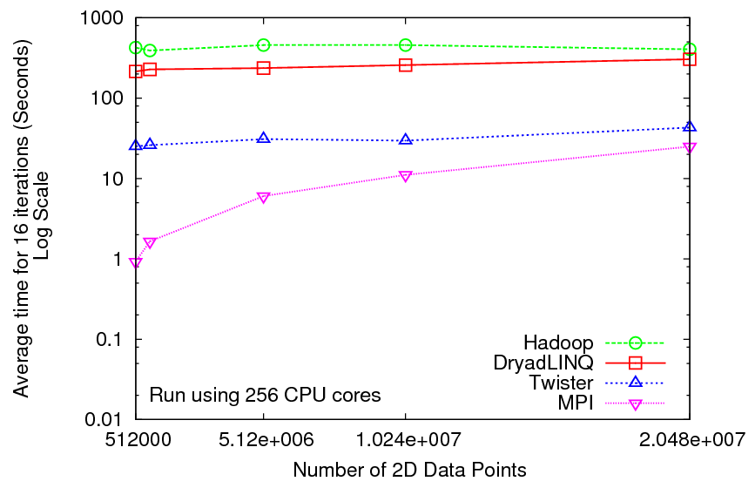
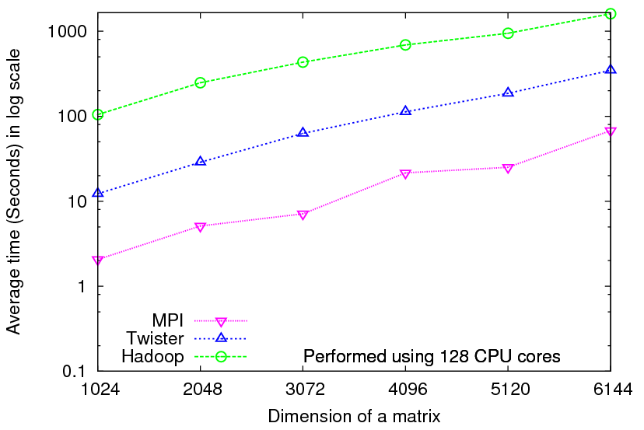
Iterative Computations
K-means
Matrix Multiplication
Smith Waterman
Performance of K-Means
Performance Matrix Multiplication

Slide 30
2916 iterations
(384 CPUcores)
968 iterations
(384 CPUcores)
343 iterations
(768 CPU cores)

Slide 33
 | AWS/ Azure | Hadoop | DryadLINQ
Programming patterns | Independent job execution | MapReduce | DAG execution, MapReduce + Other patterns
Fault Tolerance | Task re-execution based on a time out | Re-execution of failed and slow tasks. | Re-execution of failed and slow tasks.
Data Storage | S3/Azure Storage. | HDFS parallel file system. | Local files
Environments | EC2/Azure, local compute resources | Linux cluster, Amazon Elastic MapReduce | Windows HPCS cluster
Ease of Programming | EC2 : ** Azure: *** | **** | ****
Ease of use | EC2 : *** Azure: ** | *** | ****
Scheduling & Load Balancing | Dynamic scheduling through a global queue, Good natural load balancing | Data locality, rack aware dynamic task scheduling through a global queue, Good natural load balancing | Data locality, network topology aware scheduling. Static task partitions at the node level, suboptimal load balancing

Slide 34


Applications using Dryad & DryadLINQ
CAP3 - Expressed Sequence Tag assembly to re-construct full-length mRNA
Input files (FASTA)
DryadLINQ
CAP3
CAP3
CAP3
Output files
Perform using DryadLINQ and Apache Hadoop implementations
Single “Select” operation in DryadLINQ
“Map only” operation in Hadoop
X. Huang, A. Madan, “CAP3: A DNA Sequence Assembly Program,” Genome Research, vol. 9, no. 9, pp. 868-877, 1999.

Slide 35
Architecture of EC2 and Azure Cloud for Cap3
HDFS
Input Data Set
Data File
exe
exe
Map()
Map()
Executable
Optional
Reduce
Phase
Reduce
HDFS
Results

Slide 36
Cap3 Performance with different EC2 Instance Types
Notes:
Instance Type CPU Cores Memory Local Disk Space Cost per hour
Small 1 1.7 GB 250 GB 0.12$
Medium 2 3.5 GB 500 GB 0.24$
Large 4 7 GB 1000 GB 0.48$
Extra Large 8 15 GB 2000 GB 0.96$

Slide 37


Sequence Assembly in the Clouds
Cap3 parallel efficiency
Cap3 – Per core per file (458 reads in each file) time to process sequences

Slide 38
Cost to assemble to process 4096 FASTA files
~ 1 GB / 1875968 reads (458 readsX4096)
Amazon AWS total :11.19 $
    Compute 1 hour X 16 HCXL (0.68$ * 16) = 10.88 $
    10000 SQS messages = 0.01 $
    Storage per 1GB per month = 0.15 $
    Data transfer out per 1 GB = 0.15 $
Azure total : 15.77 $
    Compute 1 hour X 128 small (0.12 $ * 128) = 15.36 $
    10000 Queue messages = 0.01 $
    Storage per 1GB per month = 0.15 $
    Data transfer in/out per 1 GB = 0.10 $ + 0.15 $
Tempest (amortized) : 9.43 $
  24 core X 32 nodes, 48 GB per node
  Assumptions : 70% utilization, write off over 3 years, include support

Slide 39
FutureGrid Concepts
Support development of new applications and new middleware using Cloud, Grid and Parallel computing (Nimbus, Eucalyptus, Hadoop, Globus, Unicore, MPI, OpenMP. Linux, Windows …) looking at functionality, interoperability, performance
Put the “science” back in the computer science of grid computing by enabling replicable experiments
Open source software built around Moab/xCAT to support dynamic provisioning from Cloud to HPC environment, Linux to Windows ….. with monitoring, benchmarks and support of important existing middleware
June 2010 Initial users; September 2010 All hardware (except IU shared memory system) accepted and major use starts; October 2011 FutureGrid allocatable via TeraGrid process

Slide 40

FutureGrid: a Grid Testbed
IU Cray operational, IU IBM (iDataPlex) completed stability test May 6
UCSD IBM operational, UF IBM stability test completes ~ May 12
Network, NID and PU HTC system operational
UC IBM stability test completes ~ May 27; TACC Dell awaiting delivery of components
NID: Network Impairment Device
Private
Public
FG Network

Slide 41
FutureGrid Partners
Indiana University (Architecture, core software, Support)
Purdue University (HTC Hardware)
San Diego Supercomputer Center at University of California San Diego (INCA, Monitoring)
University of Chicago/Argonne National Labs (Nimbus)
University of Florida (ViNE, Education and Outreach)
University of Southern California Information Sciences (Pegasus to manage experiments)
University of Tennessee Knoxville (Benchmarking)
University of Texas at Austin/Texas Advanced Computing Center (Portal)
University of Virginia (OGF, Advisory Board and allocation)
Center for Information Services and GWT-TUD from Technische Universtität Dresden. (VAMPIR)
Blue institutions have FutureGrid hardware

Slide 42
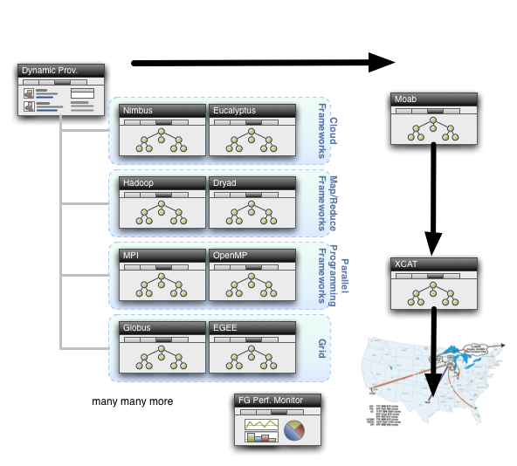
Dynamic Provisioning

Slide 43
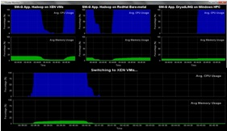
Dynamic Virtual Clusters
Dynamic Cluster Architecture
Monitoring & Control Infrastructure
Monitoring Infrastructure
Monitoring Interface
Pub/Sub Broker Network
SW-G Using Hadoop
SW-G Using Hadoop
SW-G Using DryadLINQ
Linux
Bare-system
Linux on Xen
Windows Server 2008 Bare-system
Virtual/Physical Clusters
Summarizer
XCAT Infrastructure
XCAT Infrastructure
Switcher
iDataplex Bare-metal Nodes
(32 nodes)
iDataplex Bare-metal Nodes
Switchable clusters on the same hardware (~5 minutes between different OS such as Linux+Xen to Windows+HPCS)
Support for virtual clusters
SW-G : Smith Waterman Gotoh Dissimilarity Computation as an pleasingly parallel problem suitable for MapReduce style application

Slide 45
Clouds MapReduce and eScience I
Clouds are the largest scale computer centers ever constructed and so they have the capacity to be important to large scale science problems as well as those at small scale.
Clouds exploit the economies of this scale and so can be expected to be a cost effective approach to computing. Their architecture explicitly addresses the important fault tolerance issue.
Clouds are commercially supported and so one can expect reasonably robust software without the sustainability difficulties seen from the academic software systems critical to much current Cyberinfrastructure.
There are 3 major vendors of clouds (Amazon, Google, Microsoft) and many other infrastructure and software cloud technology vendors including Eucalyptus Systems that spun off UC Santa Barbara HPC research. This competition should ensure that clouds should develop in a healthy innovative fashion. Further attention is already being given to cloud standards
There are many Cloud research projects, conferences (Indianapolis December 2010) and other activities with research cloud infrastructure efforts including Nimbus, OpenNebula, Sector/Sphere and Eucalyptus.

Slide 46
Clouds MapReduce and eScience II
There are a growing number of academic and science cloud systems supporting users through NSF Programs for Google/IBM and Microsoft Azure systems. In NSF, FutureGrid will offer a Cloud testbed and Magellan is a major DoE experimental cloud system. The EU framework 7 project VENUS-C is just starting.
Clouds offer "on-demand" and interactive computing that is more attractive than batch systems to many users.
MapReduce attractive data intensive computing model supporting many data intensive applications
BUT
The centralized computing model for clouds runs counter to the concept of "bringing the computing to the data" and bringing the "data to a commercial cloud facility" may be slow and expensive.
There are many security, legal and privacy issues that often mimic those Internet which are especially problematic in areas such health informatics and where proprietary information could be exposed.
The virtualized networking currently used in the virtual machines in today’s commercial clouds and jitter from complex operating system functions increases synchronization/communication costs.
  This is especially serious in large scale parallel computing and leads to significant overheads in many MPI applications. Indeed the usual (and attractive) fault tolerance model for clouds runs counter to the tight synchronization needed in most MPI applications.

Slide 47
Broad Architecture Components
Traditional Supercomputers (TeraGrid and DEISA) for large scale parallel computing – mainly simulations
  Likely to offer major GPU enhanced systems
Traditional Grids for handling distributed data – especially instruments and sensors
Clouds for “high throughput computing” including much data analysis and emerging areas such as Life Sciences using loosely coupled parallel computations
  May offer small clusters for MPI style jobs
  Certainly offer MapReduce
Integrating these needs new work on distributed file systems and high quality data transfer service
  Link Lustre WAN, Amazon/Google/Hadoop/Dryad File System
  Offer Bigtable (distributed scalable Excel)

Slide 48
The term SALSA or Service Aggregated Linked Sequential Activities, is derived from Hoare’s Concurrent Sequential Processes (CSP)
SALSA Group
http://salsahpc.indiana.edu
Group Leader: Judy Qiu
Staff : Adam Hughes
CS PhD: Jaliya Ekanayake, Thilina Gunarathne, Jong Youl Choi, Seung-Hee Bae,
Yang Ruan, Hui Li, Bingjing Zhang, Saliya Ekanayake,
CS Masters: Stephen Wu
Undergraduates: Zachary Adda, Jeremy Kasting, William Bowman
http://salsahpc.indiana.edu/content/cloud-materials Cloud Tutorial Material
Notes:
describes our approach to multicore computing where we used services as modules to capture key functionalities implemented with multicore threading.
This will be expanded as a proposed approach to parallel computing where one produces libraries of parallelized components and combines them with a generalized service integration (workflow) model

