Slide 1
Data Science Research and Education with Bioinformatics Applications
IUPUI
October 23 2014
Geoffrey Fox
gcf@indiana.edu
http://www.infomall.org
School of Informatics and Computing
Digital Science Center
Indiana University Bloomington

Slide 2
Abstract
We describe the Data Science Education program at Bloomington and speculate on broadening it across campus and to IUPUI with perhaps a biomedical specialization.
Then I discuss big data research in the Digital Science Center with application to bioinformatics.
We describe parallel algorithms and software models that are designed to run on clouds and HPC systems.
The HPC-ABDS (Apache Big Data Software Stack) is designed to re-use technologies from open source cloud activities and High Performance Computing.
Algorithms include clustering, visualization and phylogenetic trees.

Slide 3
Data Science Curriculum at Indiana University
Faculty in Data Science is “virtual department”
4 course Certificate: purely online, started January 2014
10 course Masters: online/residential, starting January 2015

Slide 4

McKinsey Institute on Big Data Jobs
There will be a shortage of talent necessary for organizations to take advantage of big data. By 2018, the United States alone could face a shortage of 140,000 to 190,000 people with deep analytical skills as well as 1.5 million managers and analysts with the know-how to use the analysis of big data to make effective decisions.
Perhaps Informatics/ILS aimed at 1.5 million jobs. Computer Science covers the 140,000 to 190,000
http://www.mckinsey.com/mgi/publications/big_data/index.asp.

Slide 5
What is Data Science?
The next slide gives a definition arrived by a NIST study group fall 2013.
The previous slide says there are several jobs but that’s not enough! Is this a field – what is it and what is its core?
  The emergence of the 4th or data driven paradigm of science illustrates significance - http://research.microsoft.com/en-us/collaboration/fourthparadigm/
  Discovery is guided by data rather than by a model
  The End of (traditional) science http://www.wired.com/wired/issue/16-07 is famous here
Another example is recommender systems in Netflix, e-commerce etc.
  Here data (user ratings of movies or products) allows an empirical prediction of what users like
  Here we define points in spaces (of users or products), cluster them etc. – all conclusions coming from data

Slide 6
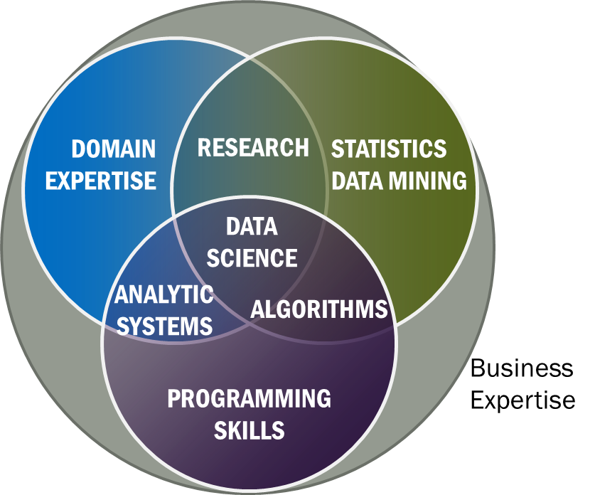
Data Science Definition from NIST Public Working Group
Data Science is the extraction of actionable knowledge directly from data through a process of discovery, hypothesis, and analytical hypothesis analysis.
A Data Scientist is a practitioner who has sufficient knowledge of the overlapping regimes of expertise in business needs, domain knowledge, analytical skills and programming expertise to manage the end-to-end scientific method process through each stage in the big data lifecycle.
See Big Data Definitions in http://bigdatawg.nist.gov/V1_output_docs.php
Notes:
Big Data refers to digital data volume, velocity and/or variety whose management requires scalability across coupled horizontal resources
Data Science is the extraction of actionable knowledge directly from data through a process of discovery, hypothesis, and analytical hypothesis analysis.
A Data Scientist is a practitioner who has sufficient knowledge of the overlapping regimes of expertise in business needs, domain knowledge, analytical skills and programming expertise to manage the end-to-end scientific method process through each stage in the big data lifecycle.

Slide 7
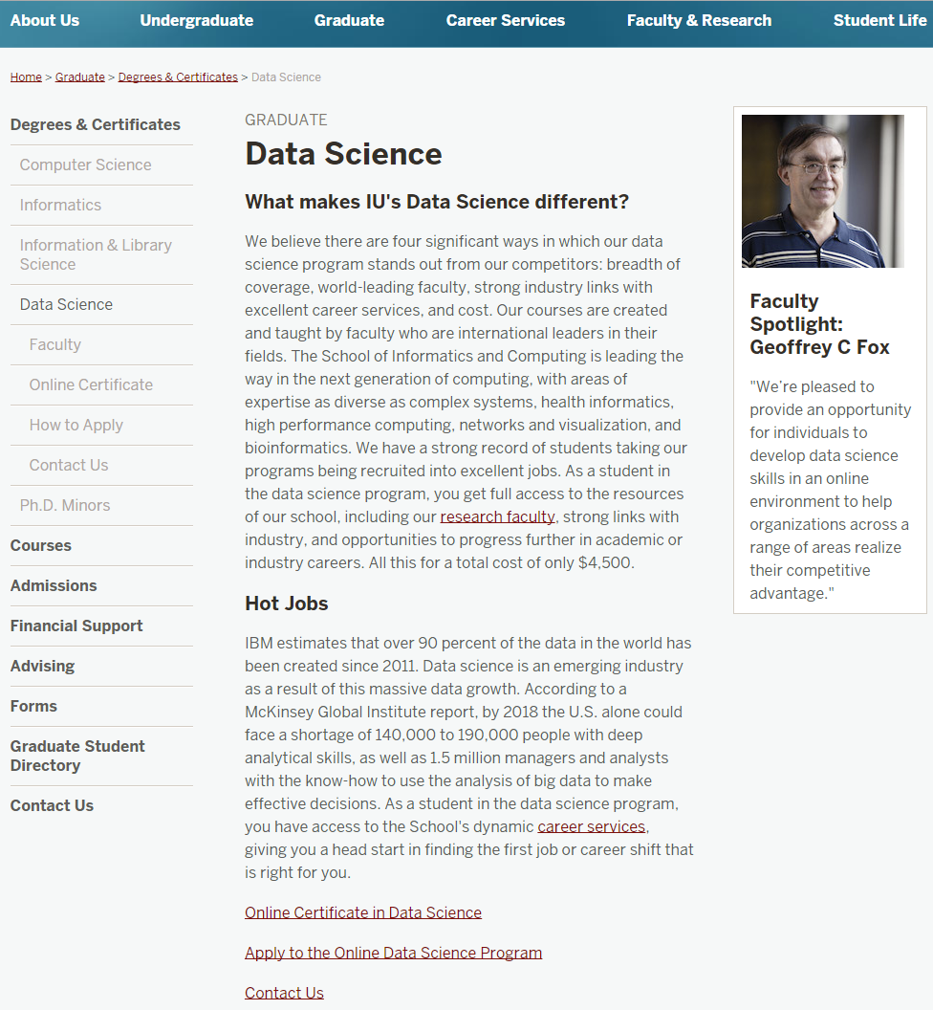
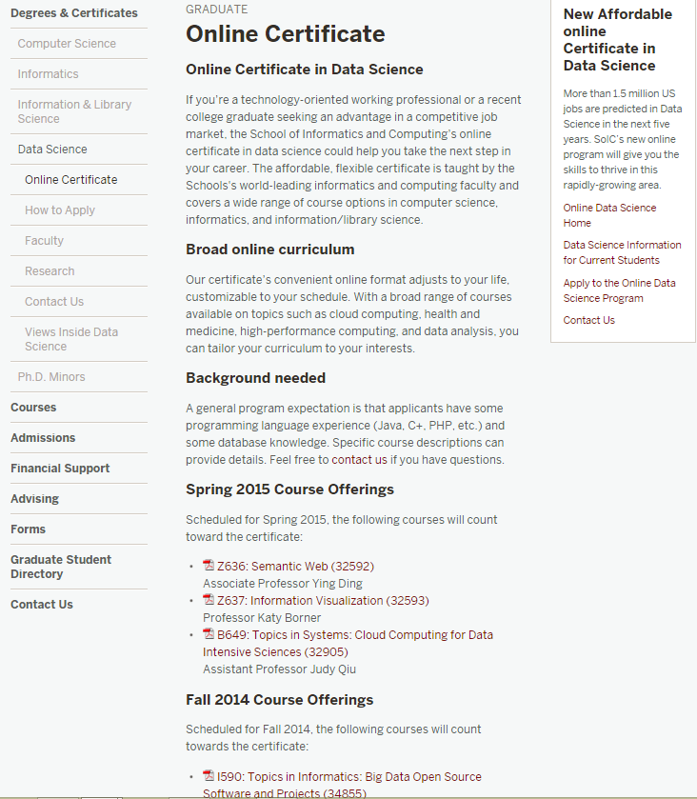
Indiana University Data Science Site

Slide 8
IU Data Science Masters Features
Fully approved by University and State October 14 2014
Blended online and residential (any combination)
  Online offered at Residential rates (~$1100 per course)
Informatics, Computer Science, Information and Library Science in School of Informatics and Computing and the Department of Statistics, College of Arts and Science, IUB
30 credits (10 conventional courses)
Basic (general) Masters degree plus tracks
  Currently only track is “Computational and Analytic Data Science ”
  Other tracks expected such as m
A purely online 4-course Certificate in Data Science has been running since January 2014 (Technical and Decision Maker paths) with 75 students total in 2 semesters
A Ph.D. Minor in Data Science has been proposed.
Managed by Faculty in Data Science: expand to full IUB campus and perhaps IUPUI?

Slide 9
Indiana University Data Science Certificate
We currently have 75 students admitted into the Data Science Certificate program (from 81 applications)
36 students admitted in Spring 2014; 17 of these have signed up for fall classes
39 students admitted in Fall 2014
We expected rather more applicants
Two paths for information only (also used in Masters)
  Decision Maker (little software) ~= McKinsey “managers and analysts”
  Technical ~= McKinsey “people with deep analytical skills”
Total tuition costs for the twelve credit hours for this certificate is approximately $4,500. (Factor of three lower than out of state $14,198 and ~ in-state rate $4,603)

Slide 10
Basic Masters Course Requirements
One course from two of three technology areas
  I. Data analysis and statistics
  II. Data lifecycle (includes “handling of research data”)
  III. Data management and infrastructure
One course from (big data) application course cluster
Other courses chosen from list maintained by Data Science Program curriculum committee (or outside this with permission of advisor/ Curriculum Committee)
Capstone project optional
All students assigned an advisor who approves course choice.
Due to variation in preparation will label courses
  Decision Maker
  Technical
Corresponding to two categories in McKinsey report – note Decision Maker had an order of magnitude more job openings expected

Slide 11
Computational and Analytic Data Science track
For this track, data science courses have been reorganized into categories reflecting the topics important for students wanting to prepare for computational and analytic data science careers for which a strong computer science background is necessary. Consequently, students in this track must complete additional requirements,
1) A student has to take at least 3 courses (9 credits) from Category 1 Core Courses. Among them, B503 Analysis of Algorithms is required and the student should take at least 2 courses from the following 3:
  B561 Advanced Database Concepts,
  [STAT] S520 Introduction to Statistics OR (New Course) Probabilistic Reasoning
  B555 Machine Learning OR I590 Applied Machine Learning
2) A student must take at least 2 courses from Category 2 Data Systems, AND, at least 2 courses from Category 3 Data Analysis. Courses taken in Category 1 can be double counted if they are also listed in Category 2 or Category 3.
3) A student must take at least 3 courses from Category 2 Data Systems, OR, at least 3 courses from Category 3 Data Analysis. Again, courses taken in Category 1 can be double counted if they are also listed in Category 2 or Category 3. One of these courses must be an application domain course

Slide 12
Admissions
Decided by Data Science Program Curriculum Committee
Need some computer programming experience (either through coursework or experience), and a mathematical background and knowledge of statistics will be useful
Tracks can impose stronger requirements
3.0 Undergraduate GPA
A 500 word personal statement
GRE scores are required for all applicants.
3 letters of recommendation

Slide 13
Comparing Google Course Builder (GCB) and Microsoft Office Mix

Slide 14
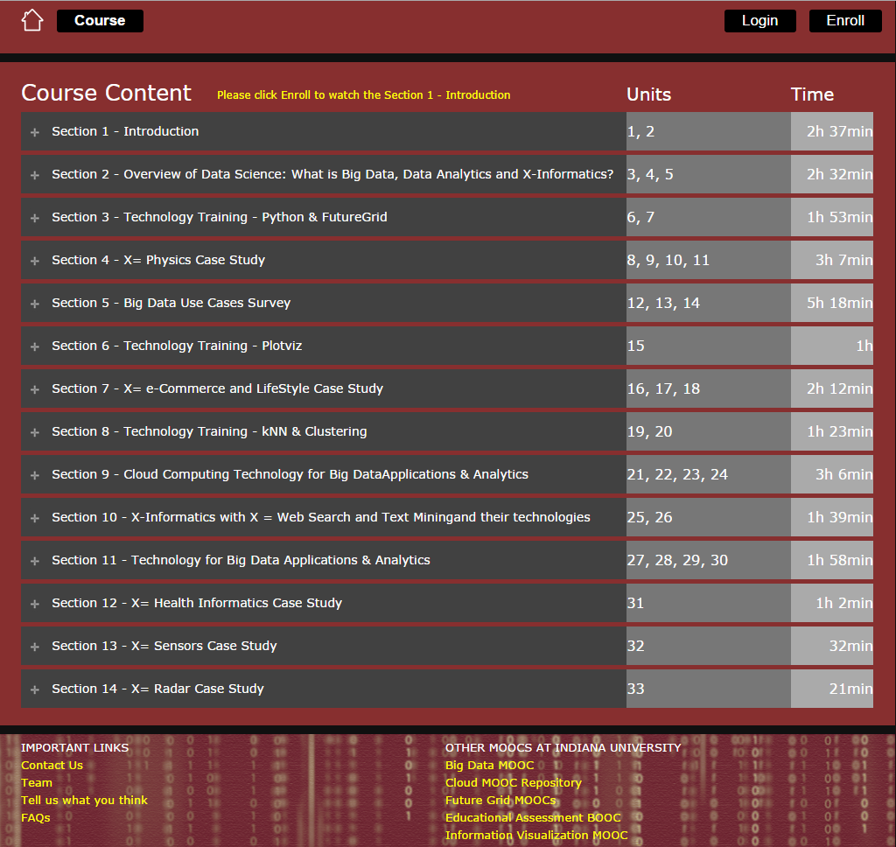
Big Data Applications and Analytics
All Units and Sections

Slide 15
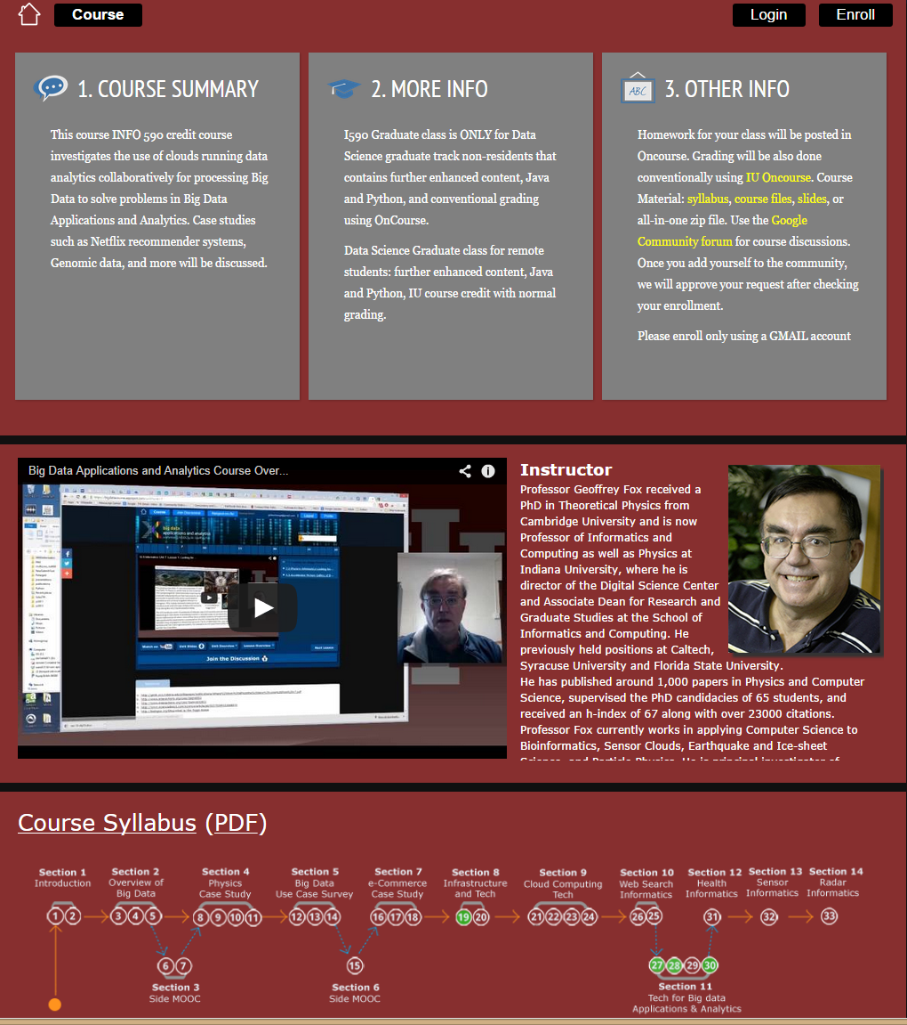
Big Data Applications and Analytics
General Information on Home Page

Slide 16
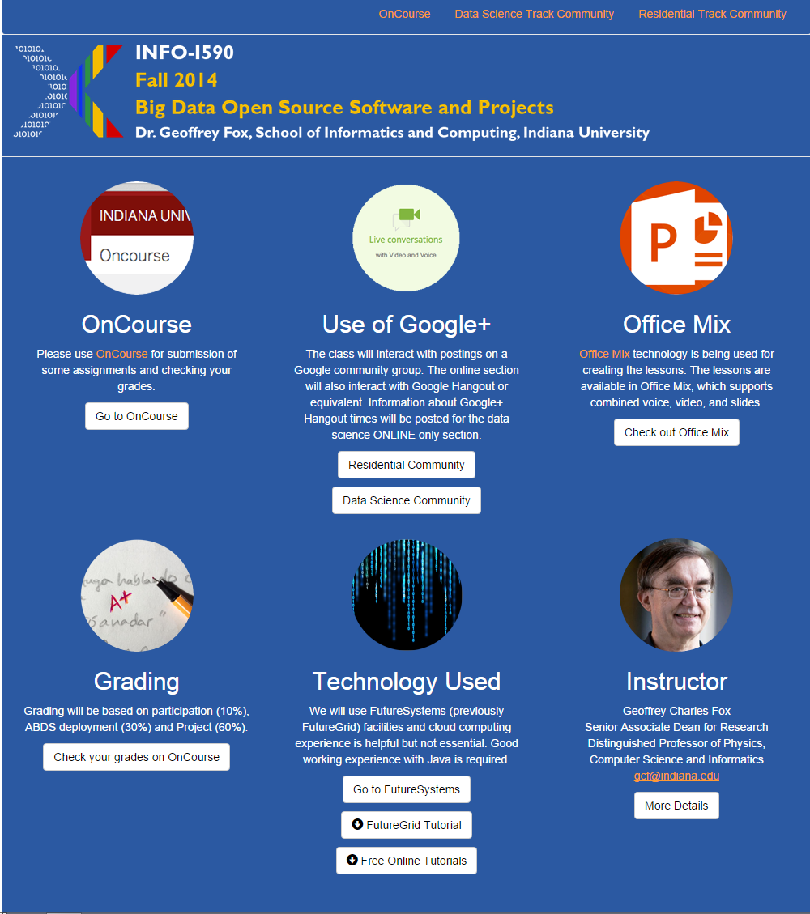
Office Mix Site
General Material
Create video in PowerPoint with laptop web cam
Exported to Microsoft Video Streaming Site

Slide 17
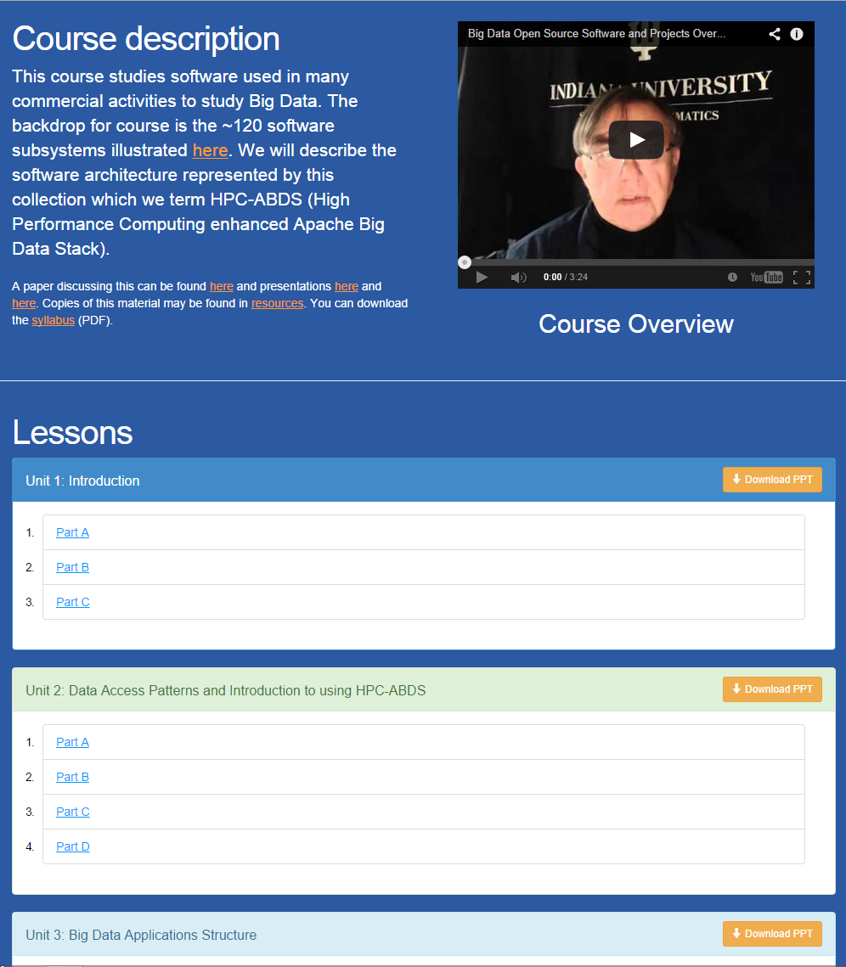
Office Mix Site
Lectures
Made as ~15 minute lessons linked here
Metadata on Microsoft Site

Slide 18
Potpourri of Online Technologies
Canvas (Indiana University Default): Best for interface with IU grading and records
Google Course Builder: Best for management and integration of components
Ad hoc web pages: alternative easy to build integration
Mix: Best faculty preparation interface
Adobe Presenter/Camtasia: More powerful video preparation that support subtitles but not clearly needed
Google Community: Good social interaction support
YouTube: Best user interface for videos
Hangout: Best for instructor-students online interactions (one instructor to 9 students with live feed). Hangout on air mixes live and streaming (30 second delay from archived YouTube) and more participants

Slide 19
Digital Science Center

Slide 20
DSC Computing Systems
Working with SDSC on NSF XSEDE Comet System (Haswell)
Purchasing 128 node Haswell based system (Juliet)
  128-256 GB memory per node
  Substantial conventional disk per node (8TB) plus SSD
  Infiniband SR-IOV
  Lustre access to UITS facilities
Older machines
  India (128 nodes, 1024 cores), Bravo (16 nodes, 128 cores), Delta(16 nodes, 192 cores), Echo(16 nodes, 192 cores), Tempest (32 nodes, 768 cores) with large memory, large disk and GPU
  Cray XT5m with 672 cores
Optimized for Cloud research and Data analytics exploring storage models, algorithms
Bare-metal v. Openstack virtual clusters
Extensively used in Education
University has Supercomputer BR II for simulations

Slide 21
Cloudmesh Software Defined System Toolkit
Cloudmesh Open source http://cloudmesh.github.io/ supporting
  The ability to federate a number of resources from academia and industry. This includes existing FutureSystems infrastructure, Amazon Web Services, Azure, HP Cloud, Karlsruhe using several IaaS frameworks
  IPython-based workflow as an interoperable onramp
Supports reproducible computing environments
Uses internally Libcloud and Cobbler
Celery Task/Query manager (AMQP - RabbitMQ)
MongoDB
Notes:
Due to its integrated services Cloudmesh provides the ability to be an onramp for other clouds.
It provides information services to various system level sensors to give access to sensor and utilization data. Internally, it can be used to optimize the system usage.
The provisioning experience from FutureGrid has taught us that we need to provide
the creation of new clouds (rain)
the repartitioning of resources between services (cloud shifting)
and the integration of external cloud resources in case of over provisioning (cloud bursting)
As we deal with many IaaS frameworks, we need an abstraction layer on top of the IaaS framework.
Experiment management is conducted with workflows controlled in shells, Python/iPython, as well as systems such as OpenStack's Heat.
Accounting is supported through additional services such as user management and charge rate management.
Not all features are yet implemented. Figure shows the main functionality that we target at this time to implement.

Slide 22
Two NSF Data Science Projects
3 yr. XPS: FULL: DSD: Collaborative Research: Rapid Prototyping HPC Environment for Deep Learning IU, Tennessee (Dongarra), Stanford (Ng)
“Rapid Python Deep Learning Infrastructure” (RaPyDLI) Builds optimized Multicore/GPU/Xeon Phi kernels (best exascale dataflow) with Python front end for general deep learning problems with ImageNet exemplar. Leverage Caffe from UCB.
5 yr. Datanet: CIF21 DIBBs: Middleware and High Performance Analytics Libraries for Scalable Data Science IU, Rutgers (Jha), Virginia Tech (Marathe), Kansas (CReSIS), Emory (Wang), Arizona(Cheatham), Utah(Beckstein)
HPC-ABDS: Cloud-HPC interoperable software performance of HPC (High Performance Computing) and the rich functionality of the commodity Apache Big Data Stack.
SPIDAL (Scalable Parallel Interoperable Data Analytics Library): Scalable Analytics for Biomolecular Simulations, Network and Computational Social Science, Epidemiology, Computer Vision, Spatial Geographical Information Systems, Remote Sensing for Polar Science and Pathology Informatics.

Slide 23
Machine Learning in Network Science, Imaging in Computer Vision, Pathology, Polar Science, Biomolecular Simulations
Algorithm | Applications | Features | Status | Parallelism
Graph Analytics
Community detection | Social networks, webgraph | Graph . | P-DM | GML-GrC
Subgraph/motif finding | Webgraph, biological/social networks |  | P-DM | GML-GrB
Finding diameter | Social networks, webgraph |  | P-DM | GML-GrB
Clustering coefficient | Social networks |  | P-DM | GML-GrC
Page rank | Webgraph |  | P-DM | GML-GrC
Maximal cliques | Social networks, webgraph |  | P-DM | GML-GrB
Connected component | Social networks, webgraph |  | P-DM | GML-GrB
Betweenness centrality | Social networks | Graph, Non-metric, static | P-Shm | GML-GRA
Shortest path | Social networks, webgraph |  | P-Shm
Spatial Queries and Analytics
Spatial relationship based queries | GIS/social networks/pathology informatics | Geometric | P-DM | PP
Distance based queries |  |  | P-DM | PP
Spatial clustering |  |  | Seq | GML
Spatial modeling |  |  | Seq | PP
GML Global (parallel) ML
GrA Static GrB Runtime partitioning

Slide 24
Some specialized data analytics in SPIDAL
Algorithm | Applications | Features | Status | Parallelism
Core Image Processing
Image preprocessing | Computer vision/pathology informatics | Metric Space Point Sets, Neighborhood sets & Image features | P-DM | PP
Object detection & segmentation |  |  | P-DM | PP
Image/object feature computation |  |  | P-DM | PP
3D image registration |  |  | Seq | PP
Object matching |  | Geometric | Todo | PP
3D feature extraction |  |  | Todo | PP
Deep Learning
Learning Network, Stochastic Gradient Descent | Image Understanding, Language Translation, Voice Recognition, Car driving | Connections in artificial neural net | P-DM | GML
aa
PP Pleasingly Parallel (Local ML)
Seq Sequential Available
GRA Good distributed algorithm needed
Todo No prototype Available
P-DM Distributed memory Available
P-Shm Shared memory Available

Slide 25
Some Core Machine Learning Building Blocks
Algorithm | Applications | Features | Status | //ism
DA Vector Clustering | Accurate Clusters | Vectors | P-DM | GML
DA Non metric Clustering | Accurate Clusters, Biology, Web | Non metric, O(N²) | P-DM | GML
Kmeans; Basic, Fuzzy and Elkan | Fast Clustering | Vectors | P-DM | GML
Levenberg-Marquardt Optimization | Non-linear Gauss-Newton, use in MDS | Least Squares | P-DM | GML
SMACOF Dimension Reduction | DA- MDS with general weights | Least Squares, O(N²) | P-DM | GML
Vector Dimension Reduction | DA-GTM and Others | Vectors | P-DM | GML
TFIDF Search | Find nearest neighbors in document corpus | Bag of “words” (image features) | P-DM | PP
All-pairs similarity search | Find pairs of documents with TFIDF distance below a threshold
 |  |  | Todo | GML
Support Vector Machine SVM | Learn and Classify | Vectors | Seq | GML
Random Forest | Learn and Classify | Vectors | P-DM | PP
Gibbs sampling (MCMC) | Solve global inference problems | Graph | Todo | GML
Latent Dirichlet Allocation LDA with Gibbs sampling or Var. Bayes | Topic models (Latent factors) | Bag of “words” | P-DM | GML
Singular Value Decomposition SVD | Dimension Reduction and PCA | Vectors | Seq | GML
Hidden Markov Models (HMM) | Global inference on sequence models | Vectors | Seq | PP & GML

Slide 26
HPC-ABDS
Integrating High Performance Computing with Apache Big Data Stack
Shantenu Jha, Judy Qiu, Andre Luckow

Slide 28
HPC-ABDS Layers
Message Protocols
Distributed Coordination:
Security & Privacy:
Monitoring:
IaaS Management from HPC to hypervisors:
DevOps:
Interoperability:
File systems:
Cluster Resource Management:
Data Transport:
SQL / NoSQL / File management:
In-memory databases&caches / Object-relational mapping / Extraction Tools
Inter process communication Collectives, point-to-point, publish-subscribe
Basic Programming model and runtime, SPMD, Streaming, MapReduce, MPI:
High level Programming:
Application and Analytics:
Workflow-Orchestration:
Here are 17 functionalities.
4 Cross cutting at top
13 in order of layered diagram starting at bottom

Slide 29
Maybe a Big Data Initiative would include
We don’t need 200 software packages so can choose e.g.
Workflow: Python or Kepler or Apache Crunch
Data Analytics: Mahout, R, ImageJ, Scalapack
High level Programming: Hive, Pig
Parallel Programming model: Hadoop, Spark, Giraph (Twister4Azure, Harp), MPI; Storm, Kapfka or RabbitMQ (Sensors)
In-memory: Memcached
Data Management: Hbase, MongoDB, MySQL or Derby
Distributed Coordination: Zookeeper
Cluster Management: Yarn, Slurm
File Systems: HDFS, Lustre
DevOps: Cloudmesh, Chef, Puppet, Docker, Cobbler
IaaS: Amazon, Azure, OpenStack, Libcloud
Monitoring: Inca, Ganglia, Nagios

Slide 30
Harp Design
Parallelism Model
Architecture
MapReduce Model
Map-Collective or Map-Communication Model
M
M
M
M
MapReduce Applications
Map-Collective
or Map-Communication Applications
M
M
M
M
Application
Shuffle
Harp
Optimal Communication
MapReduce V2
R
R
Framework
Resource Manager
YARN

Slide 31
Features of Harp Hadoop Plugin
Hadoop Plugin (on Hadoop 1.2.1 and Hadoop 2.2.0)
Hierarchical data abstraction on arrays, key-values and graphs for easy programming expressiveness.
Collective communication model to support various communication operations on the data abstractions (will extend to Point to Point)
Caching with buffer management for memory allocation required from computation and communication
BSP style parallelism
Fault tolerance with checkpointing

Slide 32
WDA SMACOF MDS (Multidimensional Scaling) using Harp on IU Big Red 2
Parallel Efficiency: on 100-300K sequences
Best available MDS (much better than that in R)
Java
Harp (Hadoop plugin)
Cores =32 #nodes
Conjugate Gradient (dominant time) and Matrix Multiplication

Slide 33
Increasing Communication
Identical Computation
Mahout and Hadoop MR – Slow due to MapReduce
Python slow as Scripting; MPI fastest
Spark Iterative MapReduce, non optimal communication
Harp Hadoop plug in with ~MPI collectives

Slide 34
Deterministic Annealing
Algorithms

Slide 35

Some Motivation
Big Data requires high performance – achieve with parallel computing
Big Data sometimes requires robust algorithms as more opportunity to make mistakes
Deterministic annealing (DA) is one of better approaches to robust optimization
  Started as “Elastic Net” by Durbin for Travelling Salesman Problem TSP
  Tends to remove local optima
  Addresses overfitting
  Much Faster than simulated annealing
Physics systems find true lowest energy state if you anneal i.e. you equilibrate at each temperature as you cool
Uses mean field approximation, which is also used in “Variational Bayes” and “Variational inference”

Slide 36
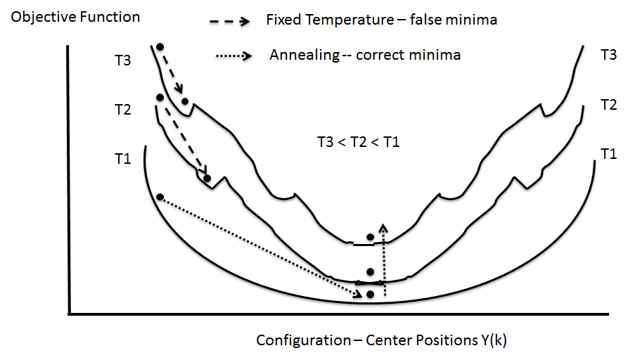
(Deterministic) Annealing
Find minimum at high temperature when trivial
Small change avoiding local minima as lower temperature
Typically gets better answers than standard libraries- R and Mahout
And can be parallelized and put on GPU’s etc.

Slide 37
General Features of DA
In many problems, decreasing temperature is classic multiscale – finer resolution (√T is “just” distance scale)
In clustering √T is distance in space of points (and centroids), for MDS scale in mapped Euclidean space
T = ∞, all points are in same place – the center of universe
For MDS all Euclidean points are at center and distances are zero. For clustering, there is one cluster
As Temperature lowered there are phase transitions in clustering cases where clusters split
  Algorithm determines whether split needed as second derivative matrix singular
Note DA has similar features to hierarchical methods and you do not have to specify a number of clusters; you need to specify a final distance scale

Slide 38
Basic Deterministic Annealing
H(χ) is objective function to be minimized as a function of parameters χ (as in Stress formula given earlier for MDS)
Gibbs Distribution at Temperature T
P(χ) = exp( - H(χ)/T) / ∫ dχ exp( - H(χ)/T)
Or P(χ) = exp( - H(χ)/T + F/T )
Replace H(χ) by a smoothed version; the Free Energy combining Objective Function and Entropy
F = < H - T S(P) > = ∫ dχ {P(χ)H + T P(χ) lnP(χ)}
Simulated annealing performs these integrals by Monte Carlo
Deterministic annealing corresponds to doing integrals analytically (by mean field approximation) and is much much faster
In each case temperature is lowered slowly – say by a factor 0.95 to 0.9999 at each iteration

Slide 39
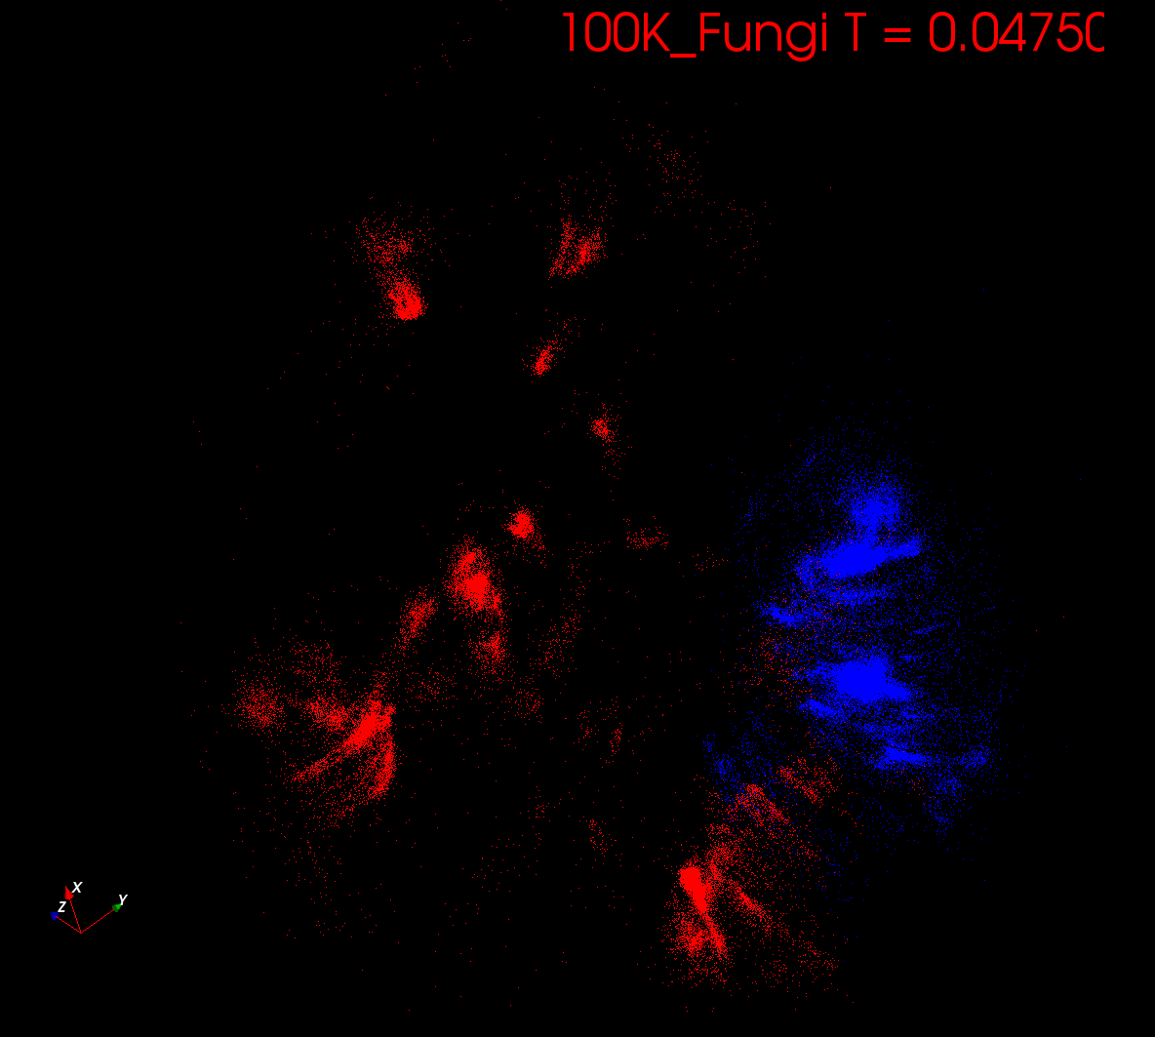
Start at T= “∞” with 1 Cluster
Decrease T, Clusters emerge at instabilities

Slide 40
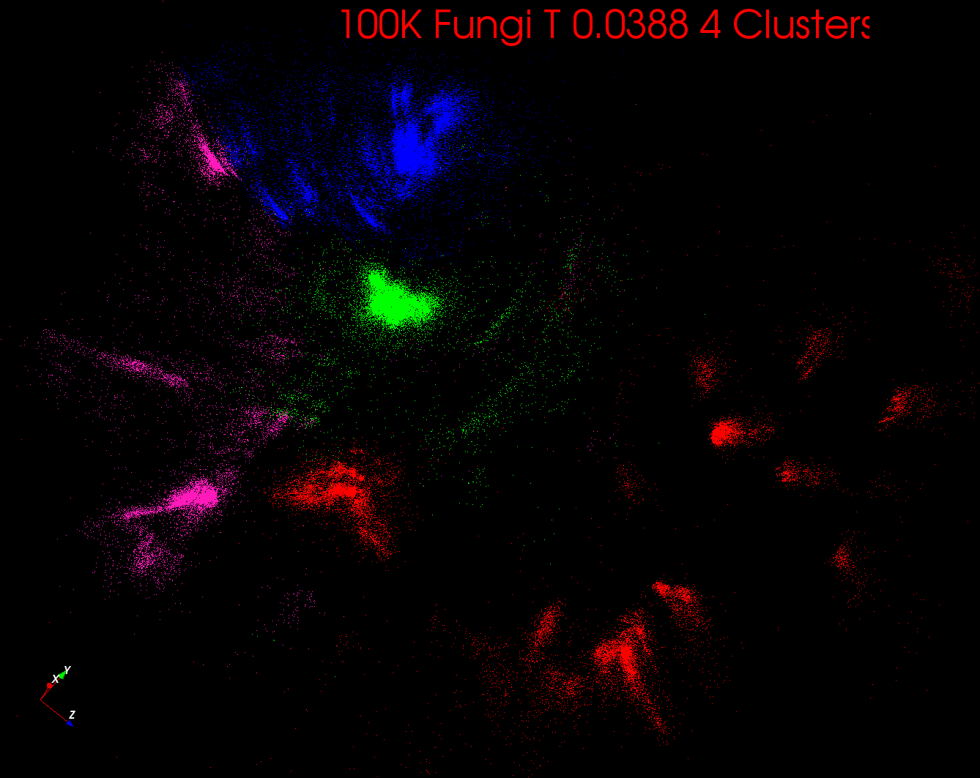

Slide 41
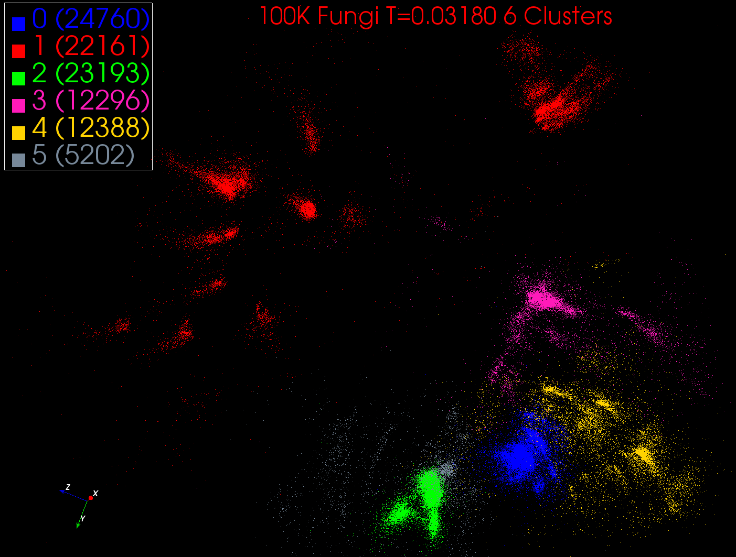

Slide 42
Some Uses of Deterministic Annealing
Clustering
  Vectors: Rose (Gurewitz and Fox)
  Clusters with fixed sizes and no tails (Proteomics team at Broad)
  No Vectors: Hofmann and Buhmann (Just use pairwise distances)
Dimension Reduction for visualization and analysis
  Vectors: GTM Generative Topographic Mapping
  No vectors SMACOF: Multidimensional Scaling) MDS (Just use pairwise distances)
Can apply to HMM & general mixture models (less study)
  Gaussian Mixture Models
  Probabilistic Latent Semantic Analysis with Deterministic Annealing DA-PLSA as alternative to Latent Dirichlet Allocation for finding “hidden factors”

Slide 43
Examples of current Digital Science Center algorithms
Proteomics

Slide 44
Some Clustering Problems in DSC
Analysis of Mass Spectrometry data to find peptides by clustering peaks (Broad Institute)
  ~0.5 million points in 2 dimensions (one experiment) -- ~ 50,000 clusters summed over charges
Metagenomics – 0.5 million (increasing rapidly) points NOT in a vector space – hundreds of clusters per sample
Pathology Images >50 Dimensions
Social image analysis is in a highish dimension vector space
  10-50 million images; 1000 features per image; million clusters
Finding communities from network graphs coming from Social media contacts etc.
  No vector space; can be huge in all ways

Slide 45
Background on LC-MS
Remarks of collaborators – Broad Institute
Abundance of peaks in “label-free” LC-MS enables large-scale comparison of peptides among groups of samples.
In fact when a group of samples in a cohort is analyzed together, not only is it possible to “align” robustly or cluster the corresponding peaks across samples, but it is also possible to search for patterns or fingerprints of disease states which may not be detectable in individual samples.
This property of the data lends itself naturally to big data analytics for biomarker discovery and is especially useful for population-level studies with large cohorts, as in the case of infectious diseases and epidemics.
With increasingly large-scale studies, the need for fast yet precise cohort-wide clustering of large numbers of peaks assumes technical importance.
In particular, a scalable parallel implementation of a cohort-wide peak clustering algorithm for LC-MS-based proteomic data can prove to be a critically important tool in clinical pipelines for responding to global epidemics of infectious diseases like tuberculosis, influenza, etc.

Slide 46
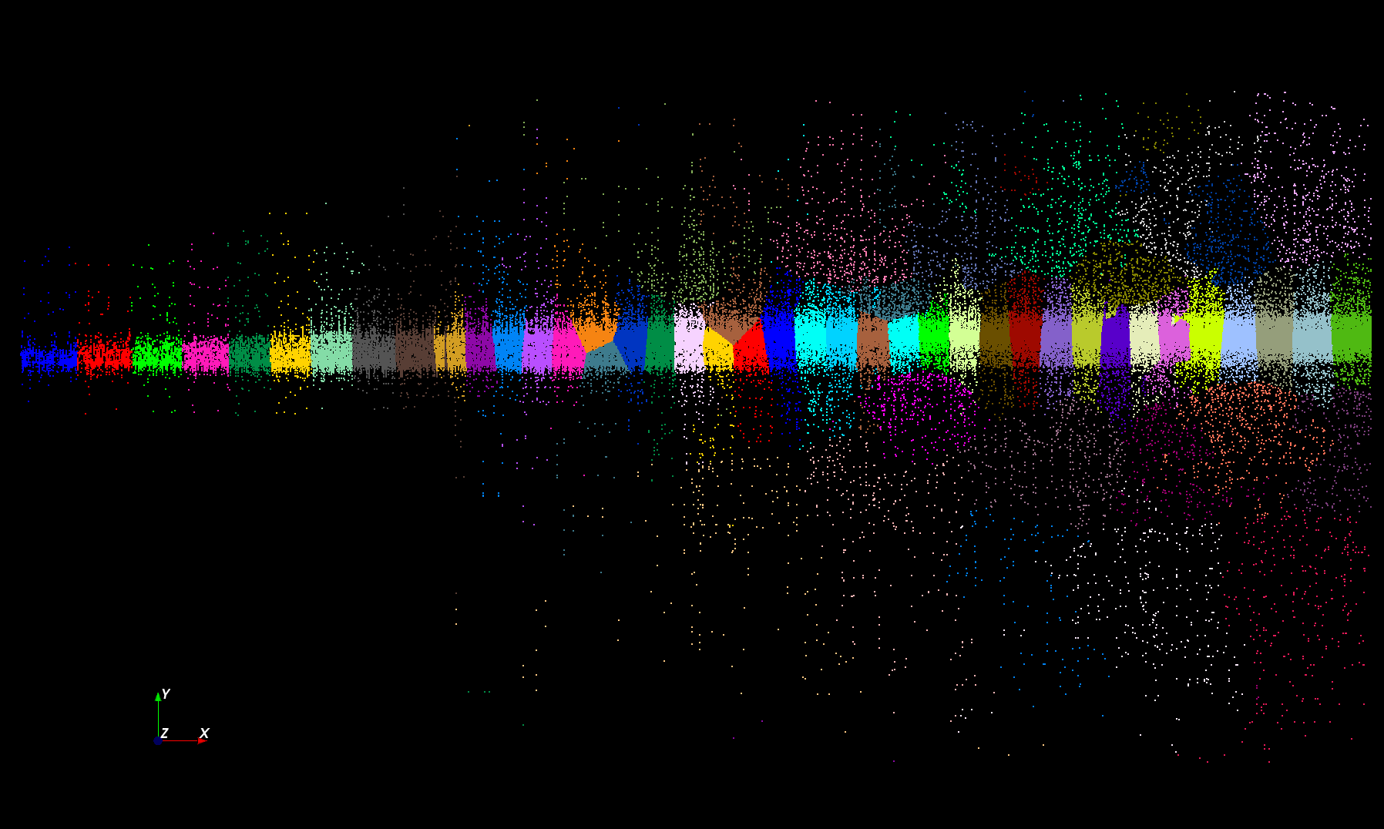
Proteomics 2D DA Clustering T= 25000 with 60 Clusters (will be 30,000 at T=0.025)

Slide 47
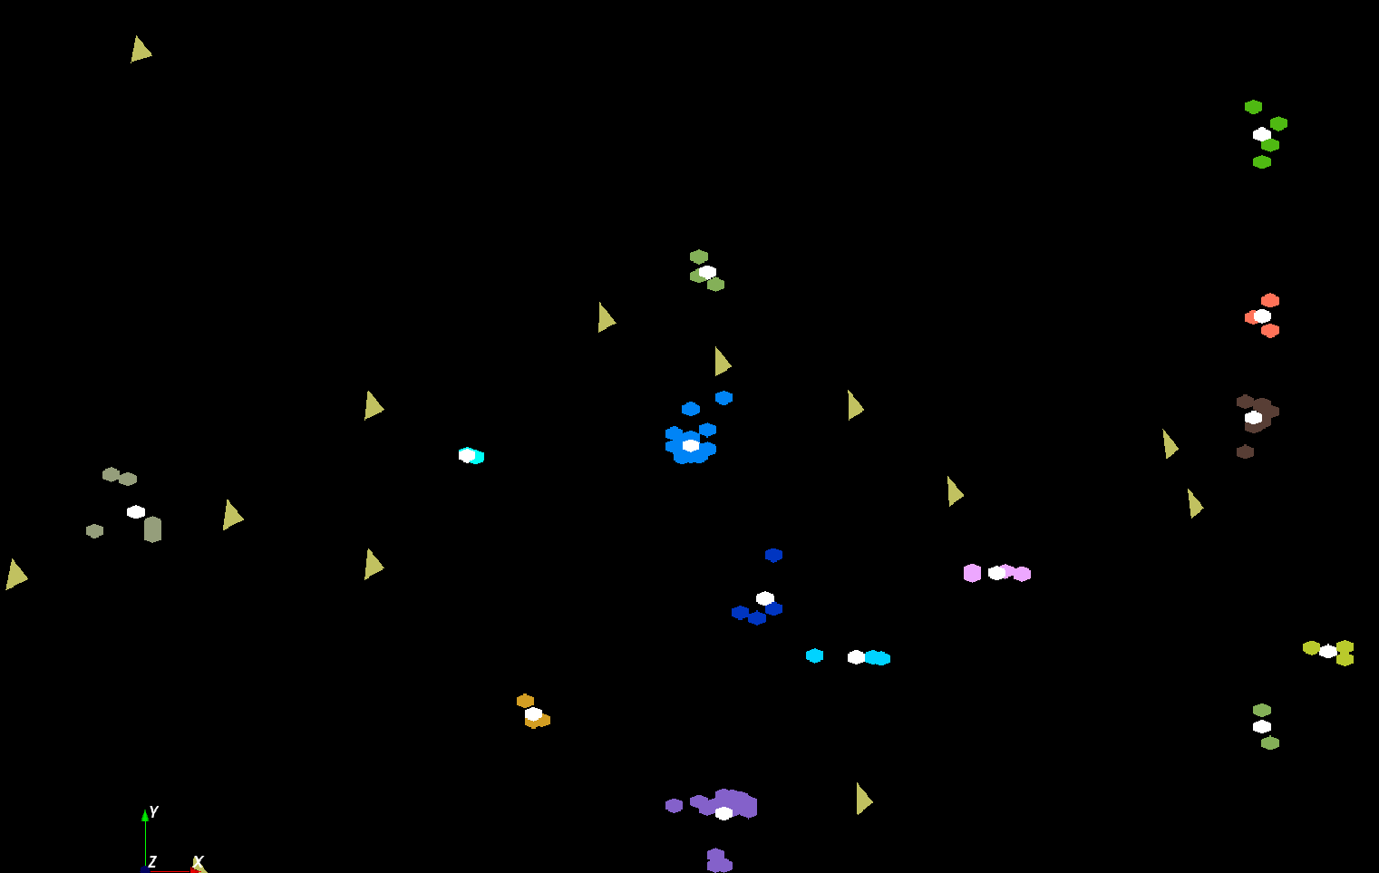
The brownish triangles are sponge peaks outside any cluster.
The colored hexagons are peaks inside clusters with the white hexagons being determined cluster center
Fragment of 30,000 Clusters
241605 Points

Slide 48
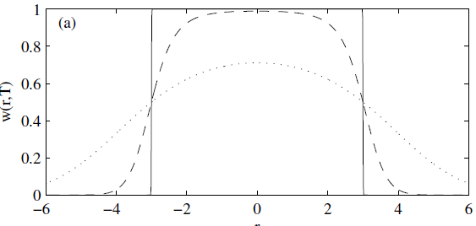
Trimmed Clustering
Clustering with position-specific constraints on variance: Applying redescending M-estimators to label-free LC-MS data analysis (Rudolf Frühwirth , D R Mani and Saumyadipta Pyne) BMC Bioinformatics 2011, 12:358
H_{TCC} = ∑_{k=0}^{K} ∑_{i=1}^{N} M_{i}(k) f(i,k)
  f(i,k) = (X(i) - Y(k))²/2σ(k)² k > 0
  f(i,0) = c² / 2 k = 0
The 0’th cluster captures (at zero temperature) all points outside clusters (background)
Clusters are trimmed
(X(i) - Y(k))²/2σ(k)² < c² / 2
Relevant when well
defined errors
T = 1
T ~ 0
T = 5
Distance from cluster center

Slide 49
Cluster Count v. Temperature for 2 Runs
All start with one cluster at far left
T=1 special as measurement errors divided out
DA2D counts clusters with 1 member as clusters. DAVS(2) does not

Slide 50
Speedups for several runs on Tempest from 8-way through 384 way MPI parallelism with one thread per process. We look at different choices for MPI processes which are either inside nodes or on separate nodes

Slide 51
Genomics

Slide 52
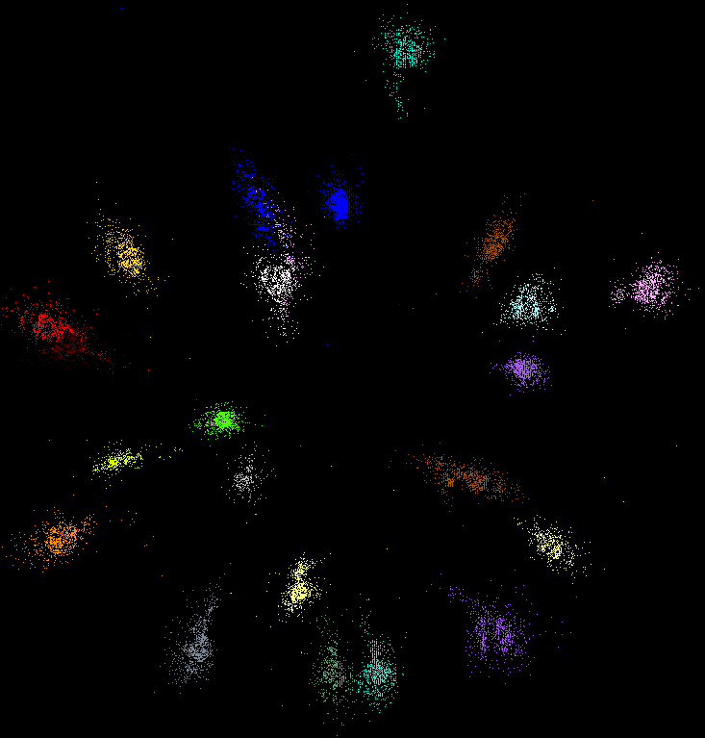
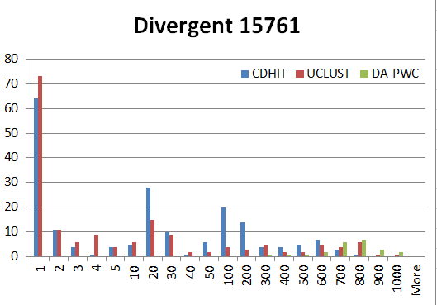
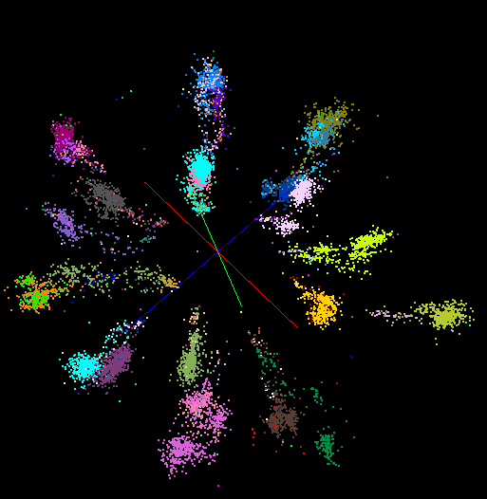
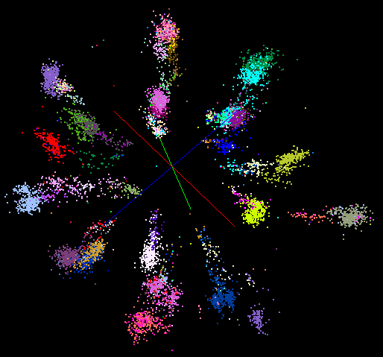
“Divergent” Data Sample
23 True Sequences
DA-PWC
UClust
CDhit
Divergent Data Set UClust (Cuts 0.65 to 0.95)
DAPWC 0.65 0.75 0.85 0.95
Total # of clusters 23 4 10 36 91
Total # of clusters uniquely identified 23 0 0 13 16
(i.e. one original cluster goes to 1 uclust cluster )
Total # of shared clusters with significant sharing 0 4 10 5 0
(one uclust cluster goes to > 1 real cluster)
Total # of uclust clusters that are just part of a real cluster 0 4 10 17(11) 72(62)
(numbers in brackets only have one member)
Total # of real clusters that are 1 uclust cluster 0 14 9 5 0
but uclust cluster is spread over multiple real clusters
Total # of real clusters that have 0 9 14 5 7
significant contribution from > 1 uclust cluster

Slide 53
Parallel Efficiency

Slide 54
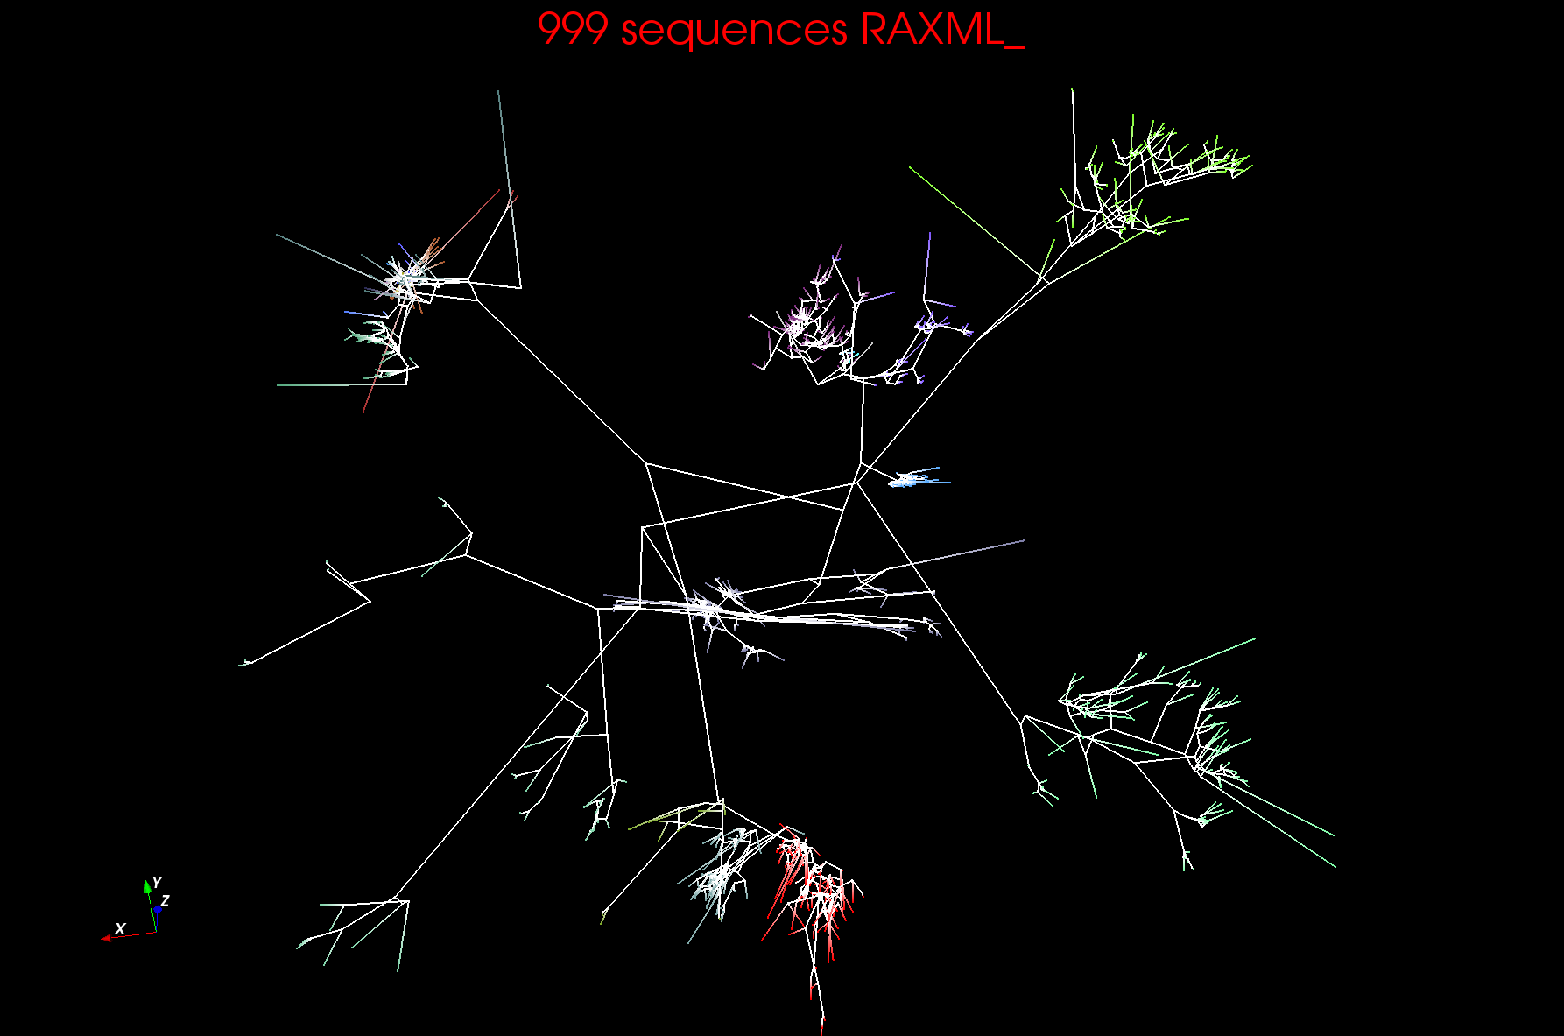
999 Fungi Sequences 3D Phylogenetic Tree

Slide 55
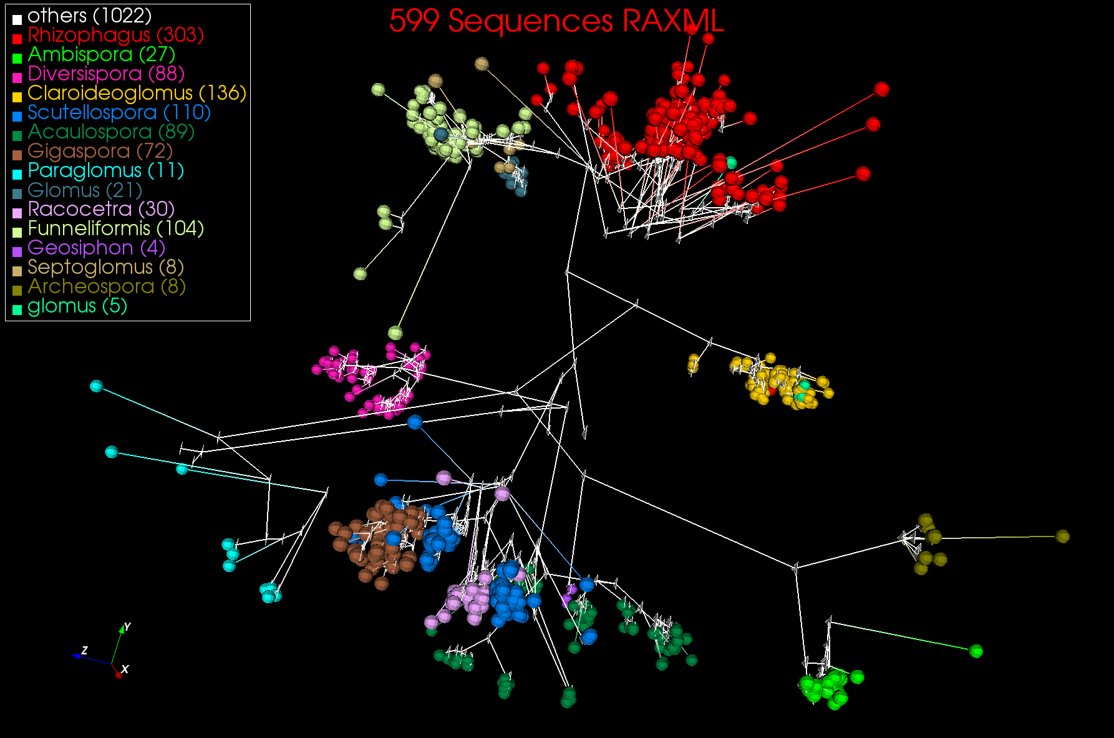
599 Fungi Sequences 3D Phylogenetic Tree

Slide 56
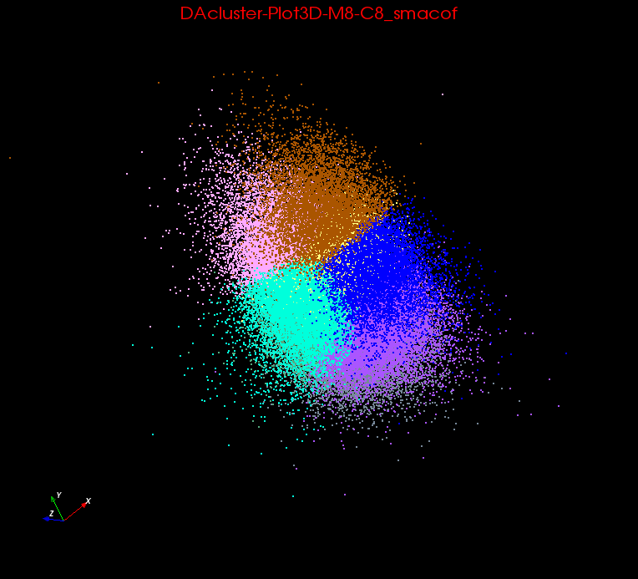
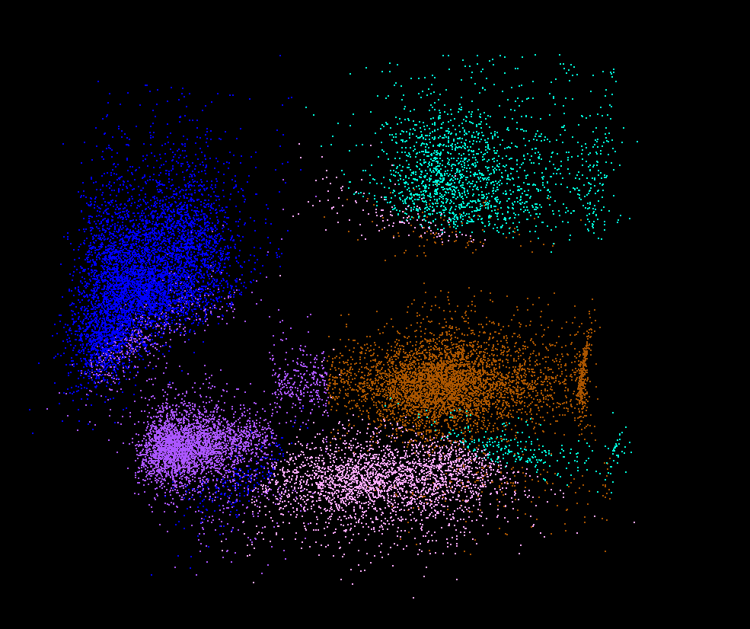
Clusters v. Regions
Lymphocytes 4D
Pathology 54D
In Lymphocytes clusters are distinct
In Pathology, clusters divide space into regions and sophisticated methods like deterministic annealing are probably unnecessary

Slide 57

Protein Universe Browser for COG Sequences with a few illustrative biologically identified clusters

Slide 58
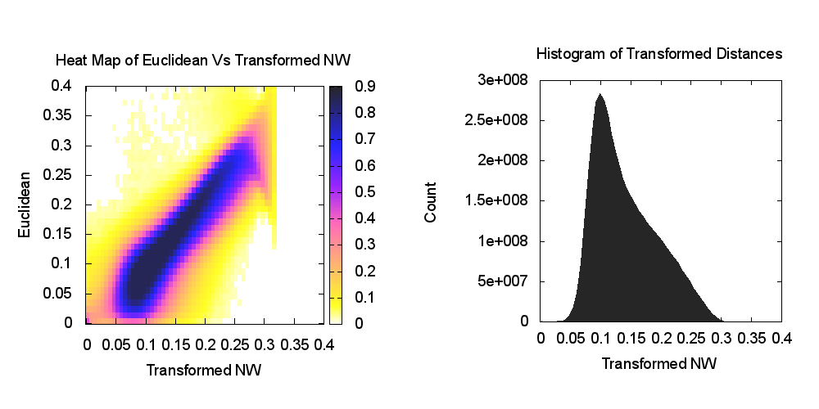
Heatmap of biology distance (Needleman-Wunsch) vs 3D Euclidean Distances
If d a distance, so is f(d) for any monotonic f. Optimize choice of f

Slide 59
Summary

Slide 60
Remarks on Parallelism I
Most use parallelism over items in data set
  Entities to cluster or map to Euclidean space
Except deep learning (for image data sets)which has parallelism over pixel plane in neurons not over items in training set
  as need to look at small numbers of data items at a time in Stochastic Gradient Descent SGD
  Need experiments to really test SGD – as no easy to use parallel implementations tests at scale NOT done
  Maybe got where they are as most work sequential
Maximum Likelihood or χ² both lead to structure like
Minimize sum ∑_{items=1}^{N} (Positive nonlinear function of unknown parameters for item i)
All solved iteratively with (clever) first or second order approximation to shift in objective function
  Sometimes steepest descent direction; sometimes Newton
  11 billion deep learning parameters; Newton impossible
  Have classic Expectation Maximization structure
  Steepest descent shift is sum over shift calculated from each point
SGD – take randomly a few hundred of items in data set and calculate shifts over these and move a tiny distance
  Classic method – take all (millions) of items in data set and move full distance

Slide 61
Remarks on Parallelism II
Need to cover non vector semimetric and vector spaces for clustering and dimension reduction (N points in space)
MDS Minimizes Stress
σ(X) = Σ_{i<j=1}^{N} weight(i,j) (δ(i, j) - d(X_{i} , X_{j}))²
Semimetric spaces just have pairwise distances defined between points in space δ(i, j)
Vector spaces have Euclidean distance and scalar products
  Algorithms can be O(N) and these are best for clustering but for MDS O(N) methods may not be best as obvious objective function O(N²)
  Important new algorithms needed to define O(N) versions of current O(N²) – “must” work intuitively and shown in principle
Note matrix solvers all use conjugate gradient – converges in 5-100 iterations – a big gain for matrix with a million rows. This removes factor of N in time complexity
Ratio of #clusters to #points important; new ideas if ratio >~ 0.1

Slide 62
Algorithm Challenges
See NRC Massive Data Analysis report
O(N) algorithms for O(N²) problems
Parallelizing Stochastic Gradient Descent
Streaming data algorithms – balance and interplay between batch methods (most time consuming) and interpolative streaming methods
Graph algorithms
Machine Learning Community uses parameter servers; Parallel Computing (MPI) would not recommend this?
  Is classic distributed model for “parameter service” better?
Apply best of parallel computing – communication and load balancing – to Giraph/Hadoop/Spark
Are data analytics sparse?; many cases are full matrices
BTW Need Java Grande – Some C++ but Java most popular in ABDS, with Python, Erlang, Go, Scala (compiles to JVM) …..

Slide 63
Lessons / Insights
Data Science is a promising new degree option – nationwide and at Indiana University
Global Machine Learning or (Exascale Global Optimization) particularly challenging
Develop SPIDAL (Scalable Parallel Interoperable Data Analytics Library)
Enhanced Apache Big Data Stack HPC-ABDS has ~200 members with HPC opportunities at Resource management, Storage/Data, Streaming, Programming, monitoring, workflow layers.
  Integrate (don’t compete) HPC with “Commodity Big data
Parallel Multidimensional Scaling can generate neat Phylogenetic Trees and 3D sequence browsers
Robust Clustering in 2D (LC-MS) and for general sequences
  Better to use set of SWG or NW distances than to use Multiple Sequence Alignment

