Slide 1
Collaborating on the DMDI
Digital manufacturing and Design Innovation
IUPUI
October 23 2014
Geoffrey Fox
gcf@indiana.edu
http://www.infomall.org
School of Informatics and Computing
Digital Science Center
Indiana University Bloomington

Slide 2
School of Informatics and Computing at Indiana University

Slide 3

Background of the School
The School of Informatics was established in 2000 as first of
its kind in the United States.
Computer Science was established in 1971 and became part
of the school in 2005.
Library and Information Science
was established in 1951 and
became part of the school
in 2013.
Now named the School of
Informatics and Computing.

Slide 4
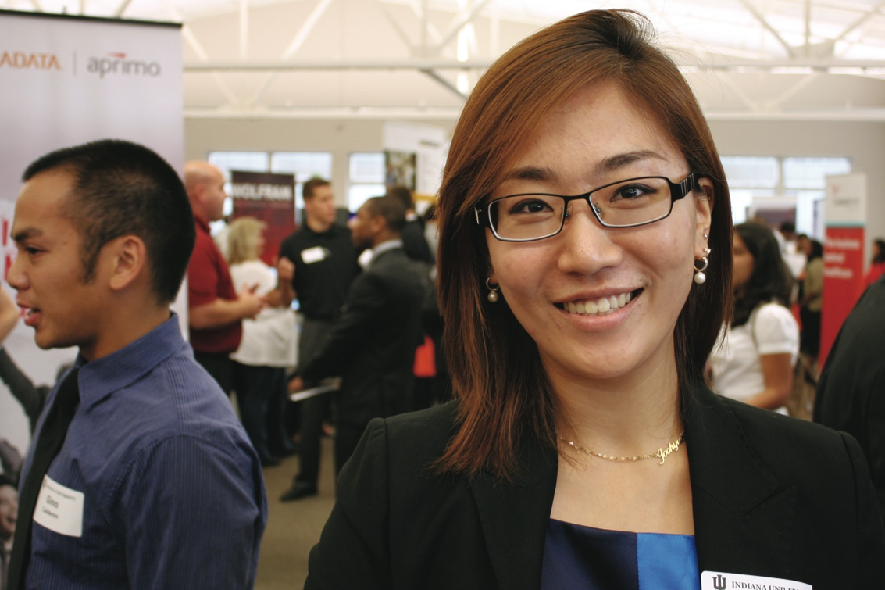
What Is Our School About?
The broad range of computing and information technology: science, a broad range of applications and human and
societal implications.
United by a focus on
information and technology,
our extensive programs
include:
  Computer Science
  Informatics
  Information Science
  Library Science
  Data Science (starting)

Slide 5
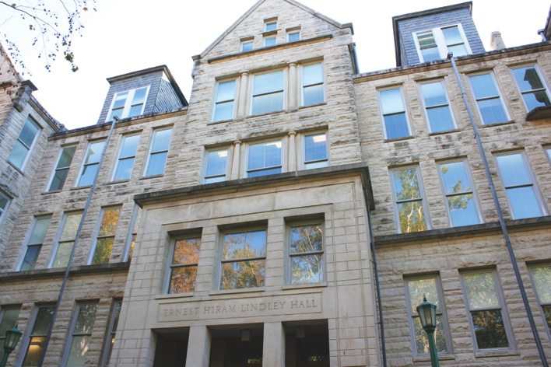
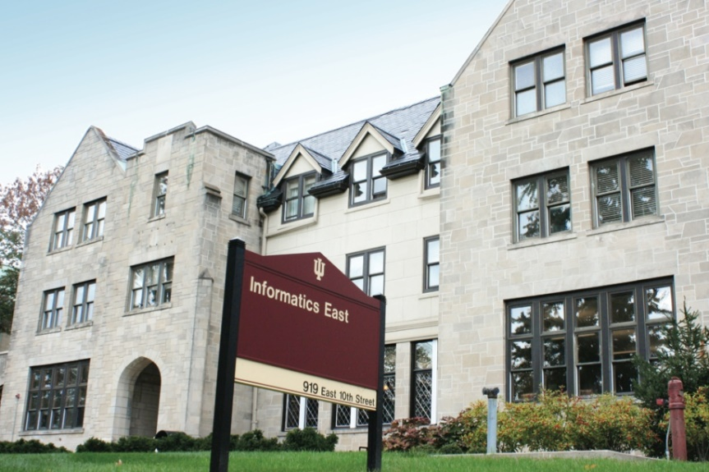
Size of School
(2013-2014)
Undergraduates mainly Informatics;
Graduates mainly Computer Science
Faculty 97
  (85 tenure track)
Students
Undergraduate 1,191
Master’s 644
Ph.D. 263
Female Undergraduates 21%
(⬆68% since 2007)
Female Graduate Students 28%
(⬆4% since 2007)

Slide 6

DMDI
Digital manufacturing and Design Innovation Institute

Slide 7
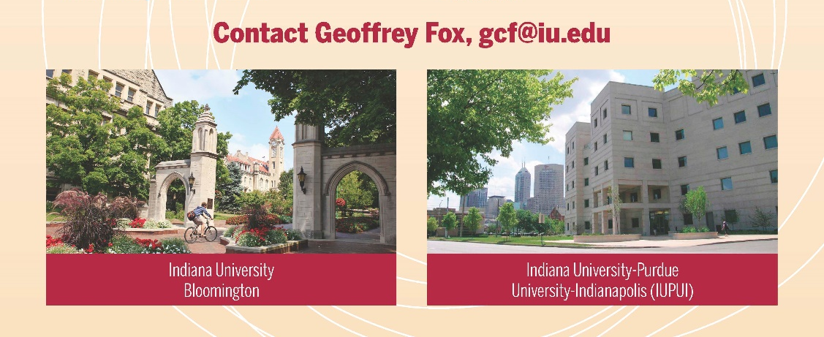
DMDI Opportunities for IUPUI
IUB (SOIC) Industry Collaboration
http://digitallab.iu.edu/

Slide 8
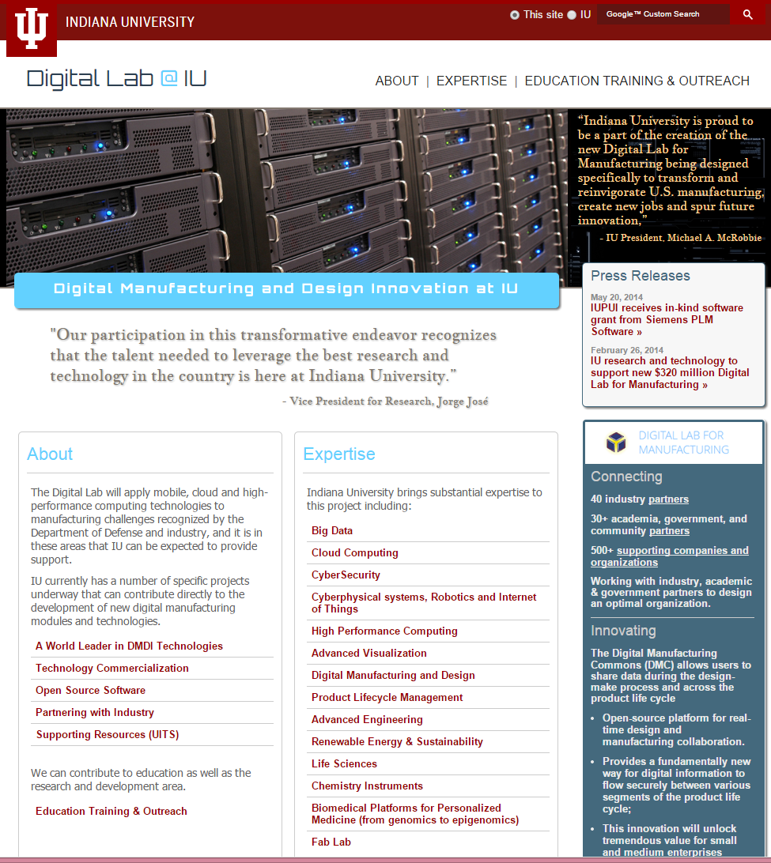

Slide 9

Project Interests:

Slide 10
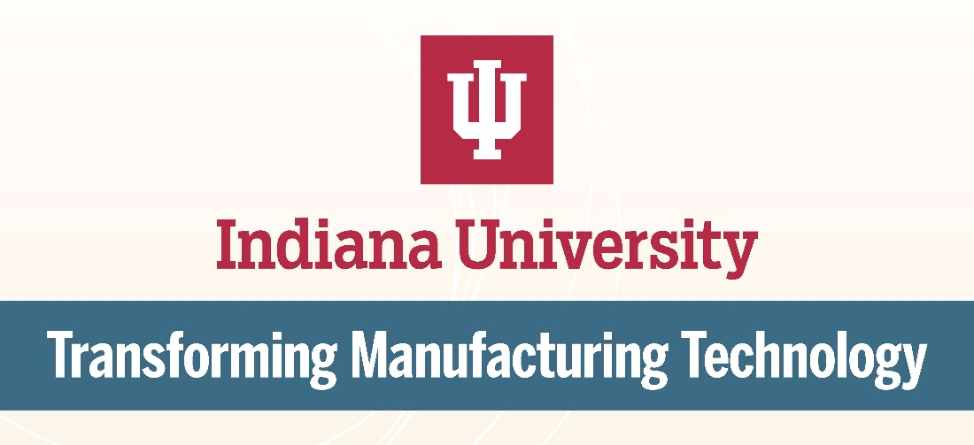
Organization
Name:
Organization Description:
School of Informatics and Computing
School of Engineering and Technology
IT Services (Research Technologies)
Types of Partners Sought: Those needing our cross cutting skills and facilities (HPC, Cloud, Internet of Things, Security, Data Science, MOOC or online education) and manufacturing capabilities such as PLM and Life Science instruments

Slide 11
Big Data Capabilities
It is likely that a key feature of digital manufacturing will be both new data and new ways of analyzing and integrating data.
This holistic data analysis will include the pervasive sensors in the manufacturing process, the sensors in the manufactured items, relevant online interactions (as in forums and other places where manufacturing and products discussed), and reports and articles on manufacturing.
Indiana University has great expertise both in the needed data architectures (Hbase, MapReduce, core data analytics, etc.), management (including provenance), and in associated text mining and social network analysis.
We are a major contributor to current NIST Big Data Program and part of leadership team for the International Research Data Alliance RDA.
In detail our research covers HPC graph analysis, Bioinformatics algorithms, large scale image processing, probabilistic relational learning, clustering, dimension reduction, and social network analysis.
IU has substantial experience with data analytics, including within the School of Informatics and Computing and in the Statistics department in the College of Arts and Sciences.
This is built around large datasets from several units of IU including the IU School of Medicine, the Regenstrief Institute, and Biology department (electronic medical records, genomics, proteomics), Physics department (Accelerator data analysis include Higgs boson related work from LHC), Social networks, Digital Libraries and a broad range of social science projects.
Our Data Science Initiative runs across Statistics and the Information & Library Science, Computer Science and Informatics programs as well as the Statistics department.

Slide 12
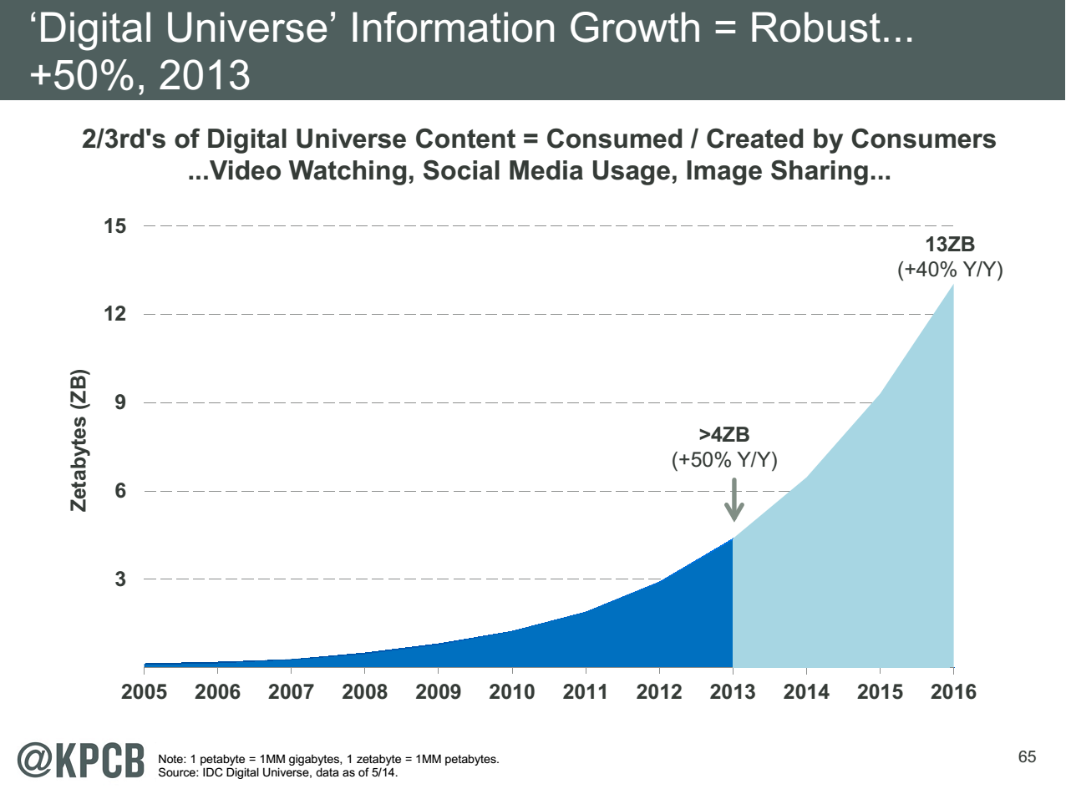
My Research focus is Science Big Data but note
Note largest science ~100 petabytes = 0.000025 total
Note 7 ZB (7. 10²¹) is about a
terabyte (10¹²) for each person in world
http://www.kpcb.com/internet-trends

Slide 13
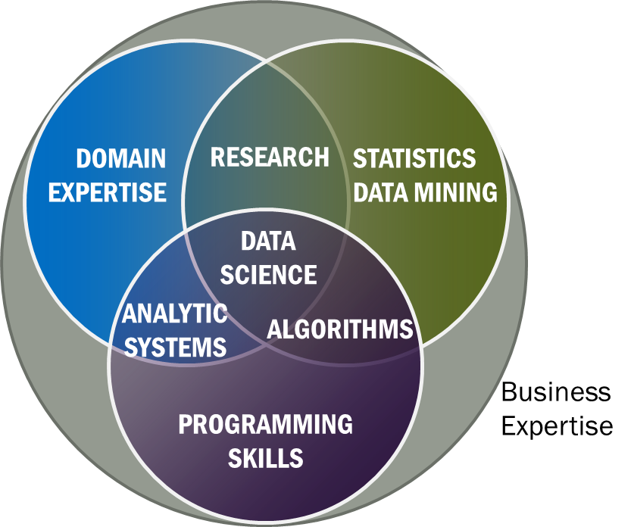
Data Science Definition from NIST Public Working Group
Data Science is the extraction of actionable knowledge directly from data through a process of discovery, hypothesis, and analytical hypothesis analysis.
A Data Scientist is a practitioner who has sufficient knowledge of the overlapping regimes of expertise in business needs, domain knowledge, analytical skills and programming expertise to manage the end-to-end scientific method process through each stage in the big data lifecycle.
See Big Data Definitions in http://bigdatawg.nist.gov/V1_output_docs.php
Notes:
Big Data refers to digital data volume, velocity and/or variety whose management requires scalability across coupled horizontal resources
Data Science is the extraction of actionable knowledge directly from data through a process of discovery, hypothesis, and analytical hypothesis analysis.
A Data Scientist is a practitioner who has sufficient knowledge of the overlapping regimes of expertise in business needs, domain knowledge, analytical skills and programming expertise to manage the end-to-end scientific method process through each stage in the big data lifecycle.

Slide 14

McKinsey Institute on Big Data Jobs
There will be a shortage of talent necessary for organizations to take advantage of big data. By 2018, the United States alone could face a shortage of 140,000 to 190,000 people with deep analytical skills as well as 1.5 million managers and analysts with the know-how to use the analysis of big data to make effective decisions.
Perhaps Informatics/ILS aimed at 1.5 million jobs. Computer Science covers the 140,000 to 190,000
http://www.mckinsey.com/mgi/publications/big_data/index.asp.

Slide 15
IU Data Science Masters Features
Fully approved by University and State October 14 2014
Blended online and residential (any combination)
  Online offered at Residential rates (~$1100 per course)
Informatics, Computer Science, Information and Library Science in School of Informatics and Computing and the Department of Statistics, College of Arts and Science, IUB
30 credits (10 conventional courses)
Basic (general) Masters degree plus tracks
  Currently only track is “Computational and Analytic Data Science ”
  Other tracks expected such as m
A purely online 4-course Certificate in Data Science has been running since January 2014 (Technical and Decision Maker paths) with 75 students total in 2 semesters
A Ph.D. Minor in Data Science has been proposed.
Managed by Faculty in Data Science: expand to full IUB campus and perhaps IUPUI?

Slide 16
Two NSF Data Science Projects
3 yr. XPS: FULL: DSD: Collaborative Research: Rapid Prototyping HPC Environment for Deep Learning IU, Tennessee (Dongarra), Stanford (Ng)
“Rapid Python Deep Learning Infrastructure” (RaPyDLI) Builds optimized Multicore/GPU/Xeon Phi kernels (best exascale dataflow) with Python front end for general deep learning problems with ImageNet exemplar. Leverage Caffe from UCB.
5 yr. Datanet: CIF21 DIBBs: Middleware and High Performance Analytics Libraries for Scalable Data Science IU, Rutgers (Jha), Virginia Tech (Marathe), Kansas (CReSIS), Emory (Wang), Arizona(Cheatham), Utah(Beckstein)
HPC-ABDS: Cloud-HPC interoperable software performance of HPC (High Performance Computing) and the rich functionality of the commodity Apache Big Data Stack.
SPIDAL (Scalable Parallel Interoperable Data Analytics Library): Scalable Analytics for Biomolecular Simulations, Network and Computational Social Science, Epidemiology, Computer Vision, Spatial Geographical Information Systems, Remote Sensing for Polar Science and Pathology Informatics.
I work on interface of computing and applications

Slide 17
Cloud Computing
Many digital manufacturing services will be hosted on cloud infrastructure, and here Indiana University has unrivalled expertise both terms of research and deployment.
Our research covers Infrastructure (virtual machines), software (especially MapReduce), and applications. The deployment experience comes from our leadership of FutureGrid, which is the XSEDE (led by UIUC) testbed with a strong focus on clouds.
We can also bring collaborations with major commercial clouds like Amazon, Google and Microsoft.
Our expertise would include architecture and design of ‘Advanced Manufacturing Enterprise’ systems.
We have a large Private Cloud (Running OpenStack)

Slide 18
DSC Computing Systems
Working with SDSC on NSF XSEDE Comet System (Intel Haswell)
Purchasing 128 node Haswell based system (Juliet)
  128 GB memory per node
  Substantial conventional disk per node (8TB) plus SSD
  Infiniband SR-IOV
  Lustre access to UITS facilities
Older machines
  India (128 nodes, 1024 cores), Bravo (16 nodes, 128 cores), Delta(16 nodes, 192 cores), Echo(16 nodes, 192 cores), Tempest (32 nodes, 768 cores) with large memory, large disk and GPU
  Cray XT5m with 672 cores
Optimized for Cloud research and Data analytics exploring storage models, algorithms
Bare-metal v. Openstack virtual clusters
Extensively used in Education
University has Supercomputer BR II for simulations

Slide 19
High Performance (Parallel) Computing
DMDI identifies HPC or Advanced Analysis as a key enabler. Indiana University can play an important role here where we have top faculty researchers in exascale software and have recently installed a petaflop supercomputer (Big Red 2) for university use.
IU has a strong history in delivering HPC services and HPC consulting to the national research community – with more than a decade of experience in NSF-funded national service and facilities operations.
In SOIC, CREST center is world leader in large scale (exascale)
  Execution Models
  Runtime Systems
  Graph Processing
  Programming languages, compilers, interfaces, and libraries
  Computer systems Architecture (Power/Energy, Fault Tolerance, and Networking)
  Extreme Scale Applications and Visualization

Slide 20
Cyberphysical systems, Robotics and Internet of Things
Sensor Nets will underpin ‘Intelligent Machines’ and there will be pervasive sensors in both the manufacturing process and manufactured items (note General Electric says it gathers more data from its engines in flight than Twitter).
Modern sensors architectures have a cloud-fog-device architecture with all sensors back-ended by clouds in a hierarchical fashion, with clouds used as computational and data support except when low latency (fraction of a second) needed when a local cloud like infrastructure (the fog) is used in some cases.
IU has developed a sensor cloud for air force applications and we can build on this for the digital laboratory. We also have a robotics group with expertise in planning. We are also strong on relevant algorithms such as image analysis.
Finally we expect that software defined networks will be important in manufacturing systems as we have dynamic collections of sensors whose connectivity is often changing. IU has expertise here both in SOIC and the UITS infrastructure group.

Slide 21
Cybersecurity
Indiana University has outstanding Cybersecurity expertise on needed system security, which spans sensors to clouds. We also have top-class research in related privacy and policy issues.
IUB School of Informatics and Computing offers a Masters and PhD program in Security Informatics. Its research covers:
  The intersection of security and society and economics;
  Security and privacy in peer-to-peer and social networks, network security, mobile computing security, usable security, accountable anonymity, anonymizing networks, and applied cryptography;
  Internet fraud infrastructures, computer networks security, cyber-fraud and censorship;
  Developing security protocols and mechanisms for wired and wireless infrastructures;
  Cryptography & secure computation, probabilistic constructions and combinatorics, complexity theory, randomized & approximation algorithms, distributed computing; and
  Privacy protection in Human Genome research, cloud and web security, software and system security.
The Center for Applied Cybersecurity Research works to enhance the security and integrity of information systems, technologies, and content by facilitating research and education informed by, and integrated with, the practice of information assurance.
Indiana University is the national operator of the REN-ISAC and the GlobalNOC, and as such has extraordinary relationships and expertise for any timely Cybersecurity intelligence that could affect IU’s and the national Research and Education Networks.
  The REN-ISAC mission is to aid and promote Cybersecurity operational protection and response within the research and higher education (R&E) communities.

Slide 22
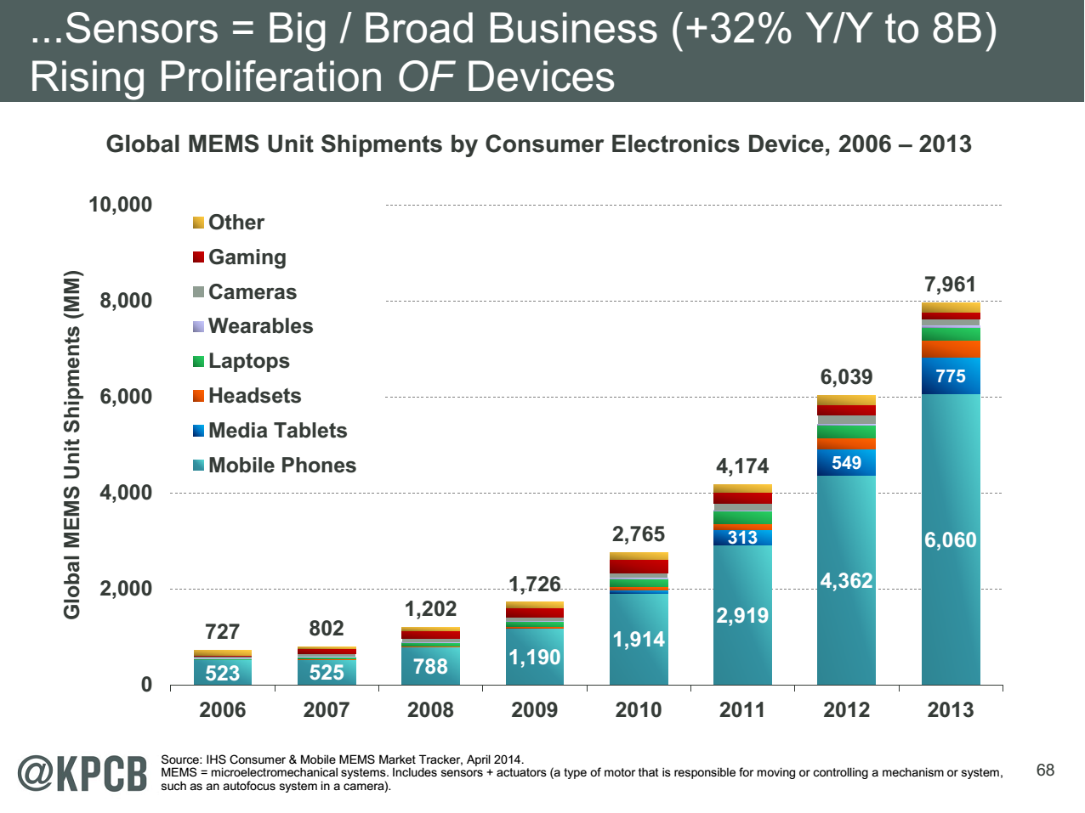
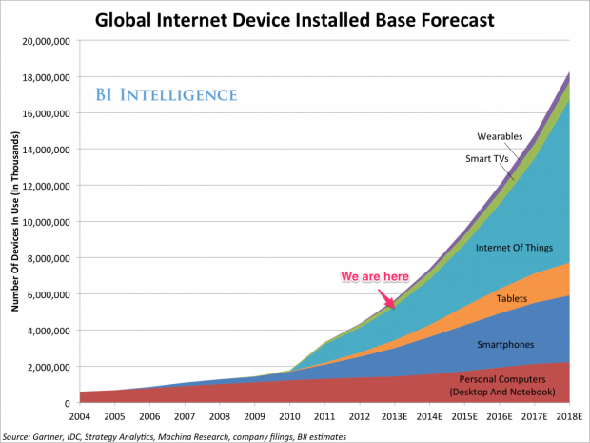
http://www.kpcb.com/internet-trends

Slide 23
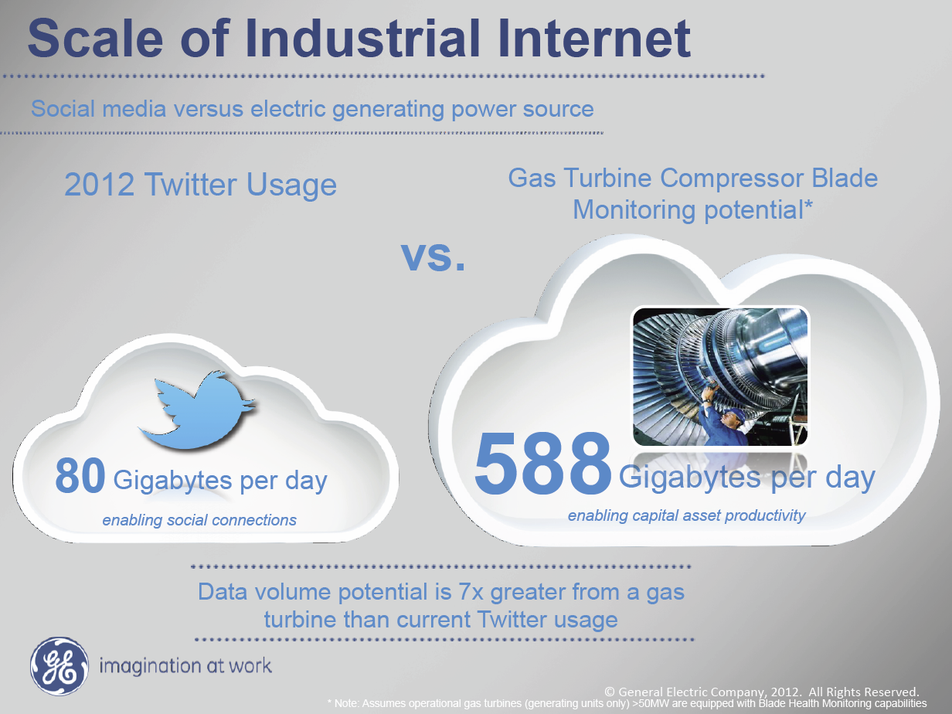
Ruh VP Software GE http://fisheritcenter.haas.berkeley.edu/Big_Data/index.html

Slide 24
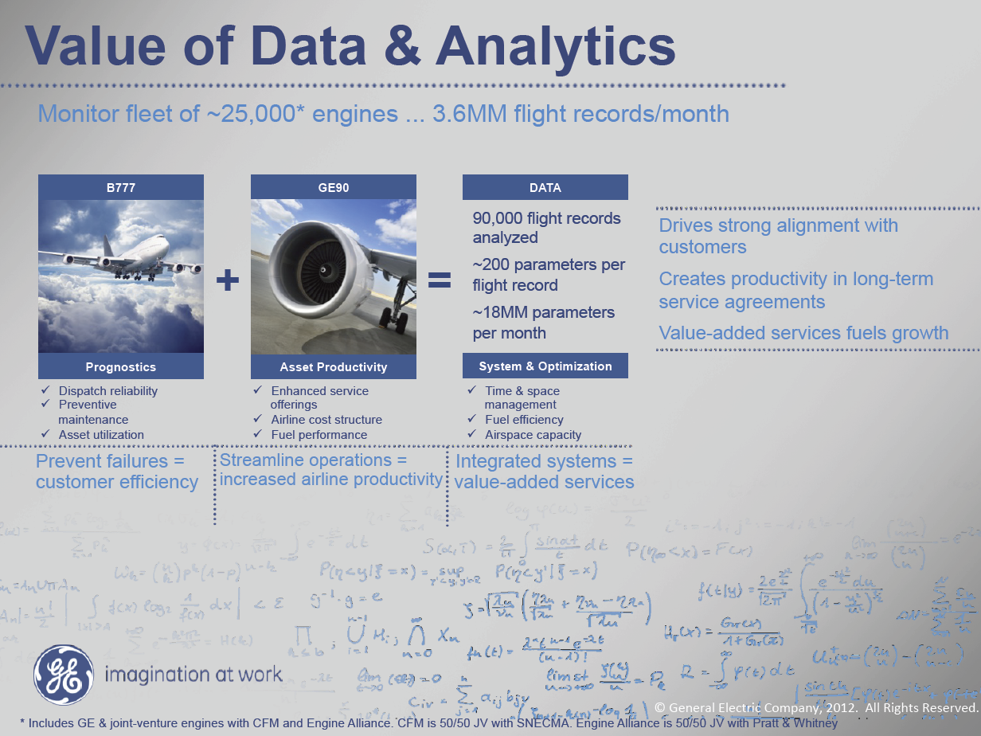
MM = Million
Ruh VP Software GE http://fisheritcenter.haas.berkeley.edu/Big_Data/index.html

Slide 25
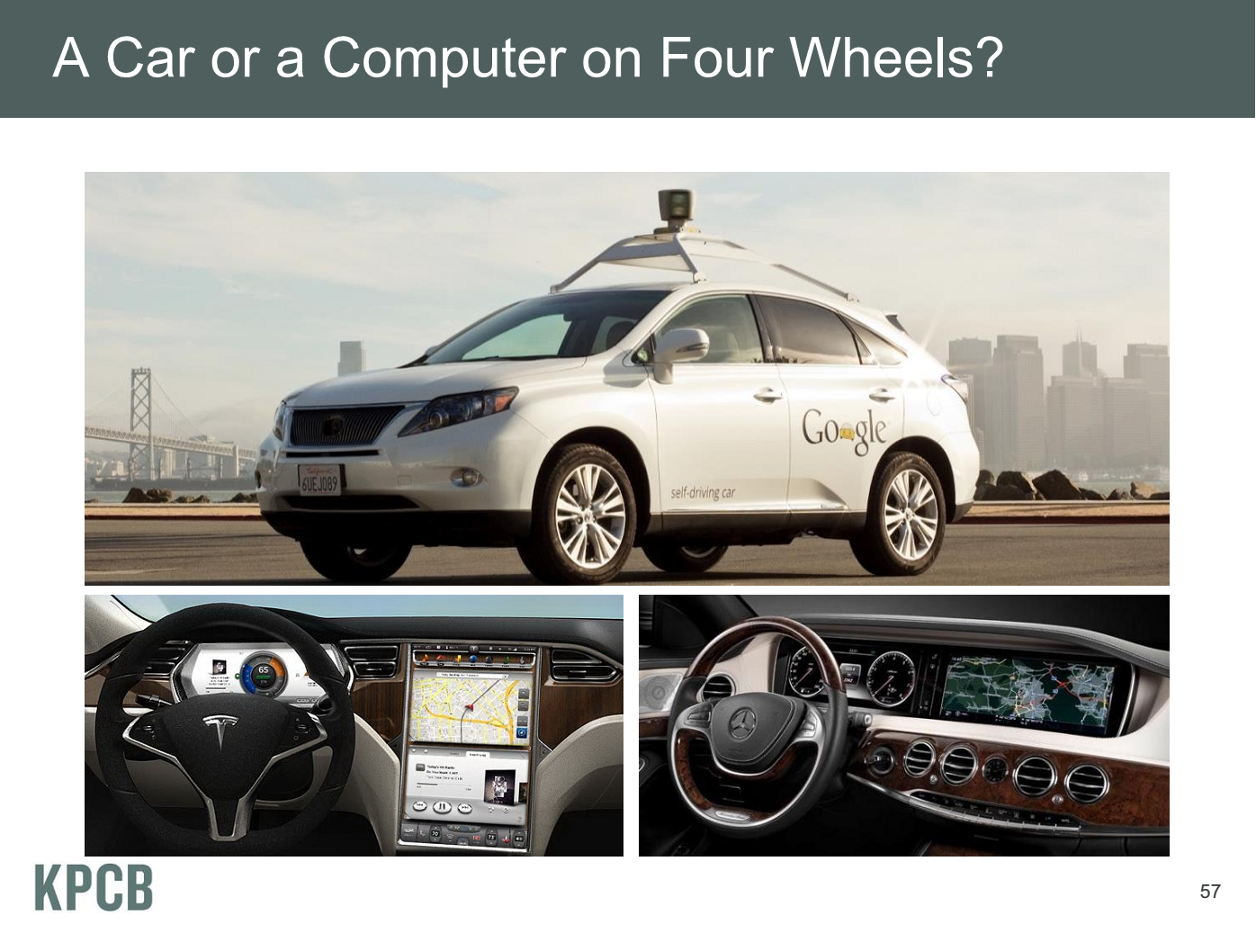
Meeker/Wu May 29 2013 Internet Trends D11 Conference

Slide 26
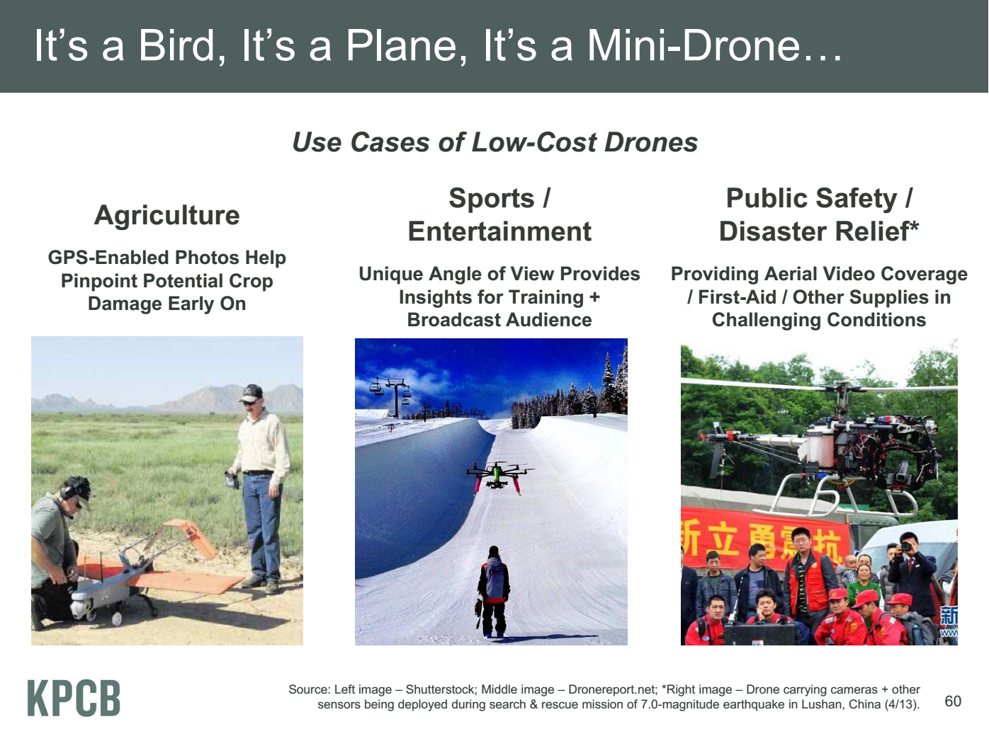
Meeker/Wu May 29 2013 Internet Trends D11 Conference

Slide 27

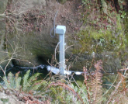
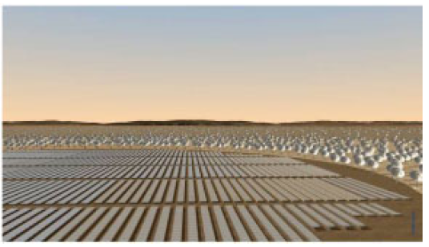
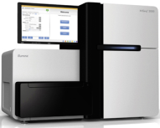
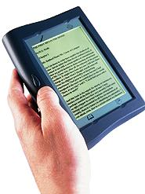





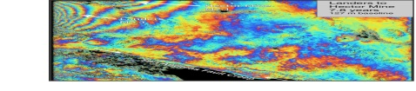
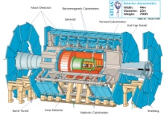
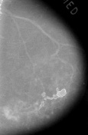



Raw Data → Data → Information → Knowledge → Wisdom → Decisions
Another
Grid
SS
SS
SS
SS
SS
SS
SS
Filter
Cloud
Discovery
Cloud
Portal
Filter
Cloud
Fusion for Discovery/Decisions
SS
Filter
Cloud
Another
Service
SS
Filter
Cloud
Filter
Cloud
Filter
Cloud
Discovery
Cloud
SS
SS
SS: Sensor or Data
Interchange
Service
Workflow through multiple filter/discovery clouds
Filter
Cloud
Filter
Cloud
Filter
Cloud
Filter
Cloud
SS
Another
Cloud
SS
SS
SS
SS
SS
SS
SS
SS
SS
SS
SS
SS
SS
Compute
Cloud
Storage
Cloud
Distributed
Grid
Hadoop Cluster
Database

Slide 28
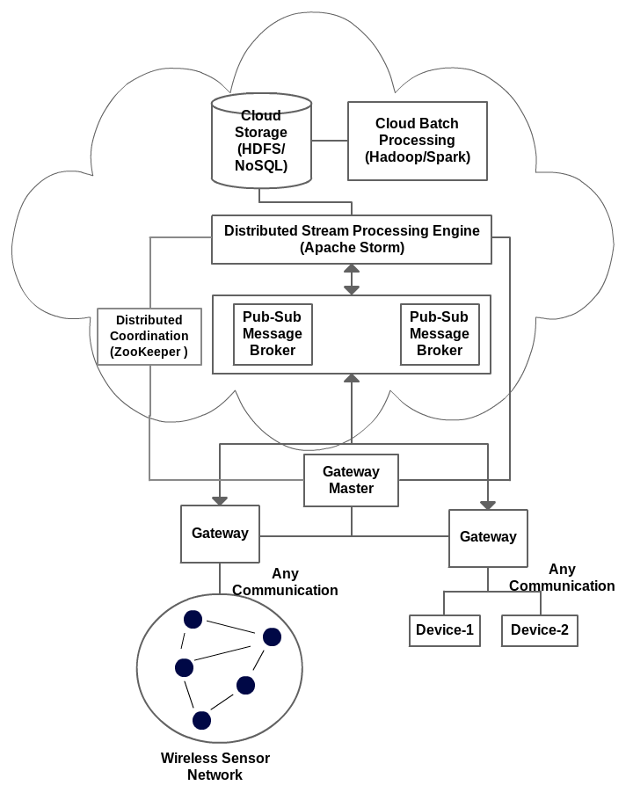
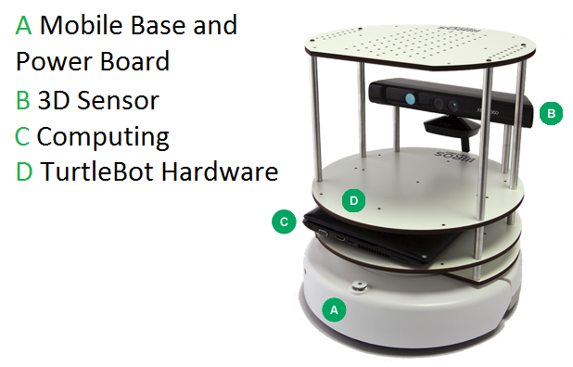
IOTCloud
Device → Pub-Sub→Storm → Datastore → Data Analysis
Apache Storm provides scalable distributed system for processing data streams coming from devices in real time.
For example Storm layer can decide to store the data in cloud storage for further analysis or to send control data back to the devices
Evaluating Pub-Sub Systems ActiveMQ, RabbitMQ, Kafka, Kestrel
Turtlebot and Kinect

Slide 29
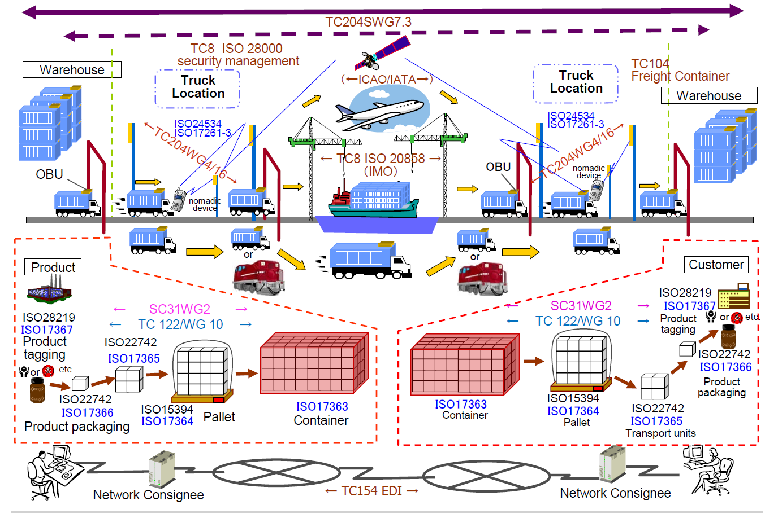
Cargo Shipping Architecture from NIST Study
Industry Standards
Continuous Tracking

Slide 30
Chemistry and Biomedical Instruments
Building new instruments
Manufacturing of chemical compounds
Building personalized medicine platforms as a system of sensors

Slide 31
Education and MOOC’s

Slide 32
Background on MOOC’s
MOOC’s are a “disruptive force” in the educational environment
  Coursera, Udacity, Khan Academy and many others
MOOC’s have courses and technologies
Google Course Builder and OpenEdX are open source MOOC technologies
Blackboard, Canvas and others are learning management systems with (some) MOOC support
The MOOC version of my Big Data Applications and Analytics course has ~2000 students enrolled.
Coursera Offerings are much larger enrollment

Slide 33
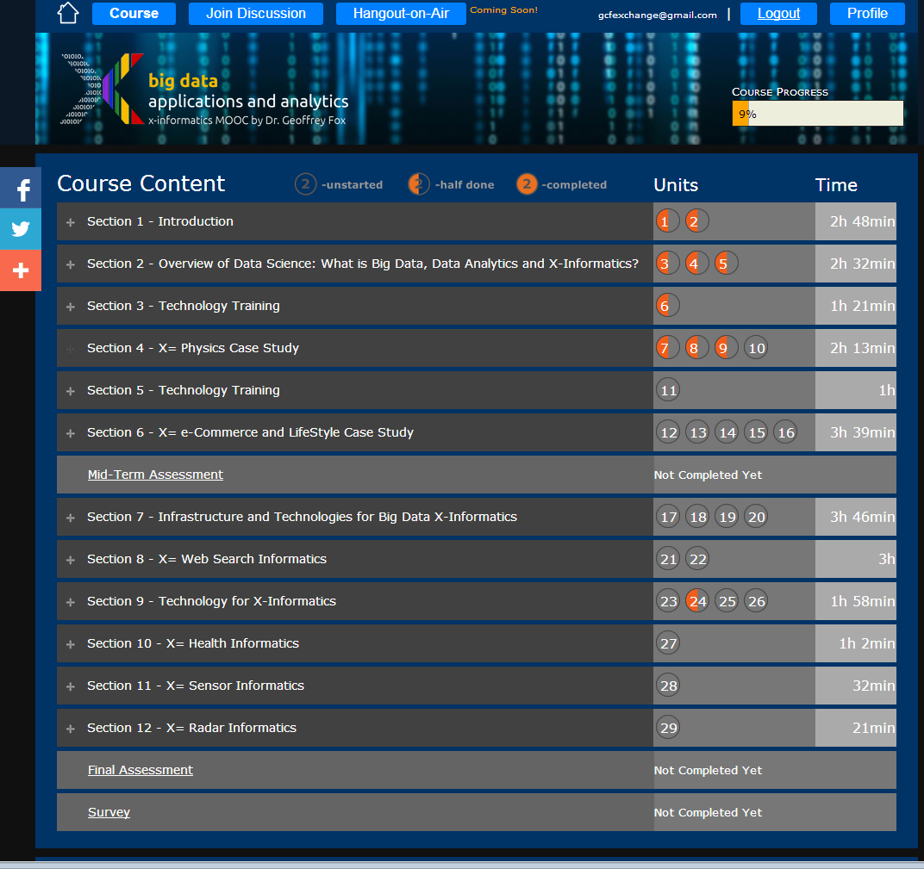
Example
Google
Course Builder
MOOC
4 levels
Course
Section (12)
Units(29)
Lessons(~150)
Units are ~ traditional lecture
Lessons are ~10 minute segments
http://x-informatics.appspot.com/course

Slide 34
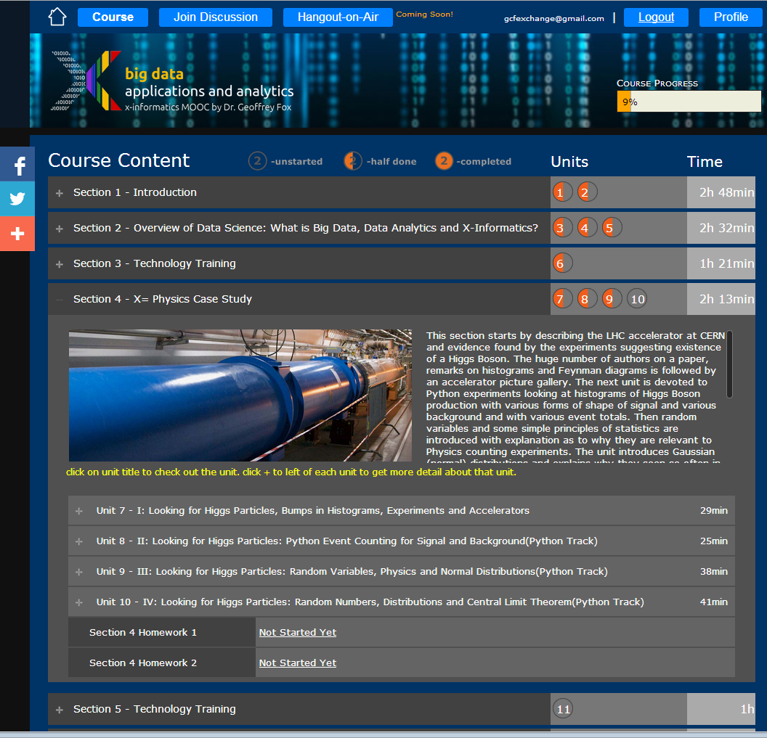
Example
Google
Course Builder
MOOC
The Physics Section expands to 4 units and 2 Homeworks
Unit 9 expands to 5 lessons
Lessons played on Youtube
“talking head video + PowerPoint”
http://x-informatics.appspot.com/course

Slide 35
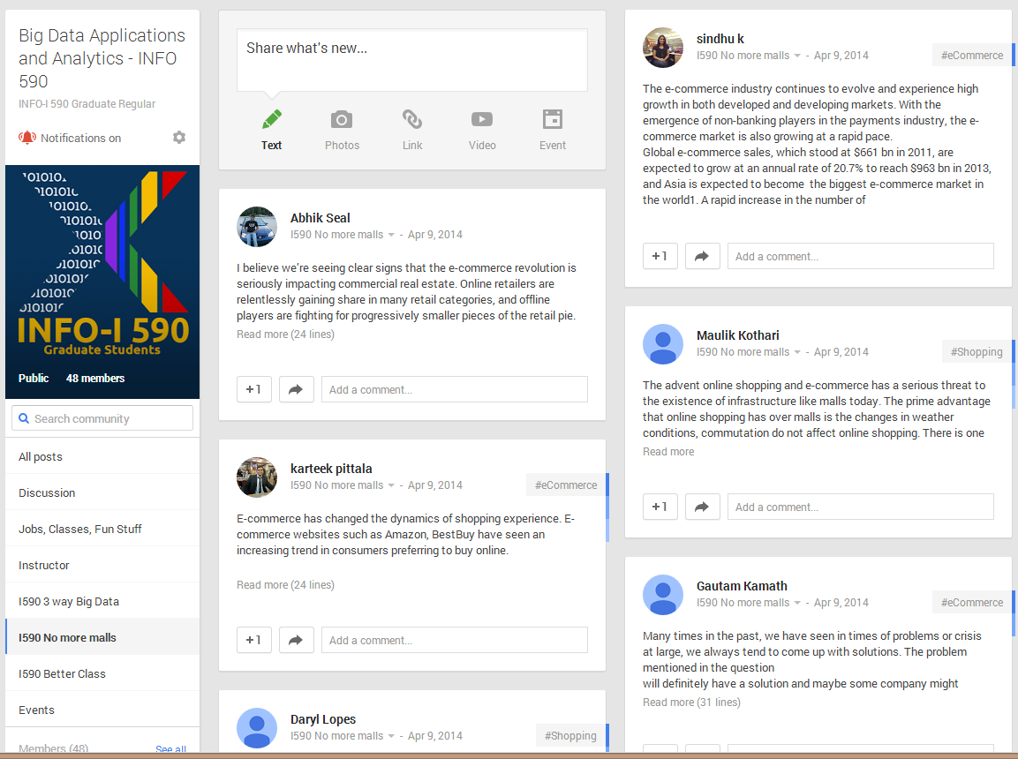
The community group for one of classes and one forum (“No more malls”)

Slide 36
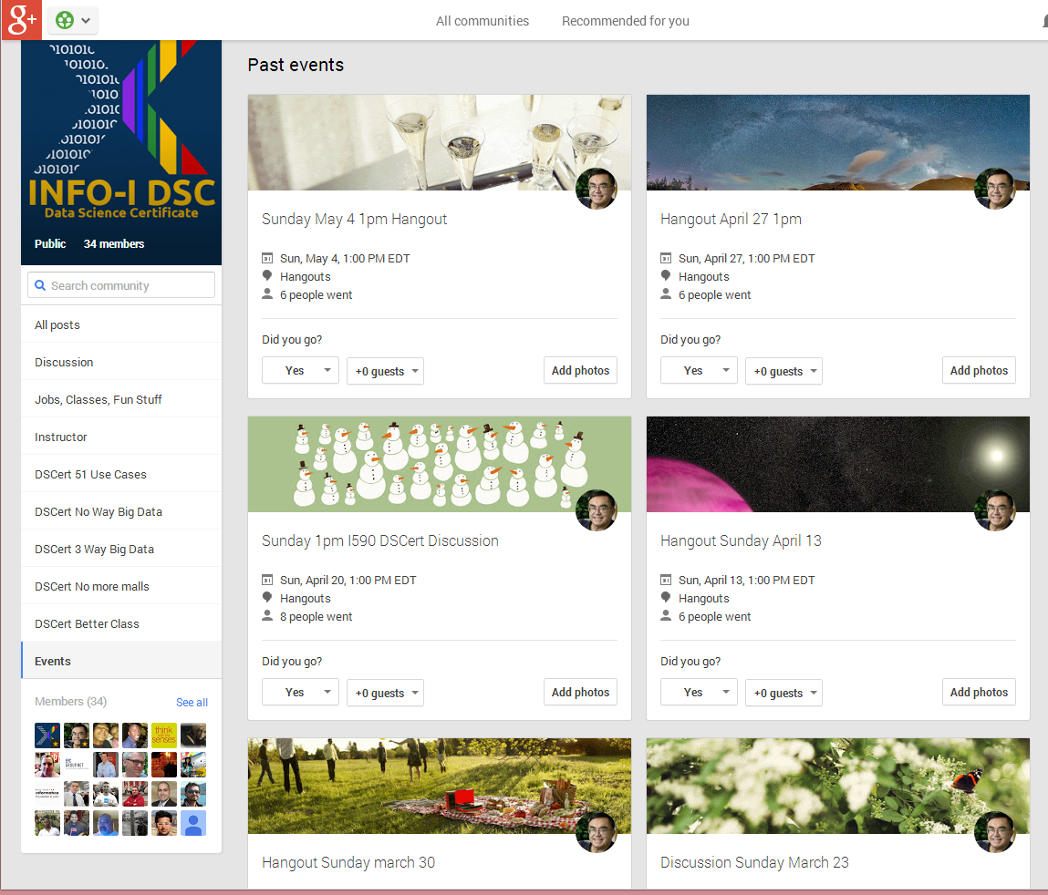
Community Events for Online Data Science Certificate Course

Slide 37
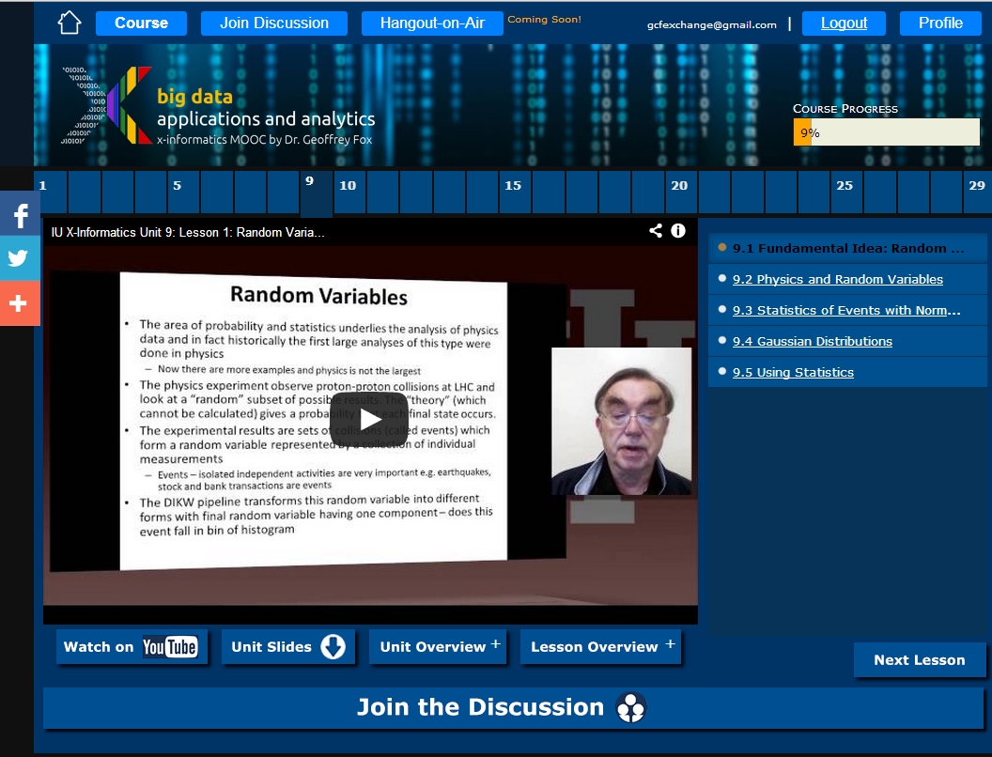

Slide 38
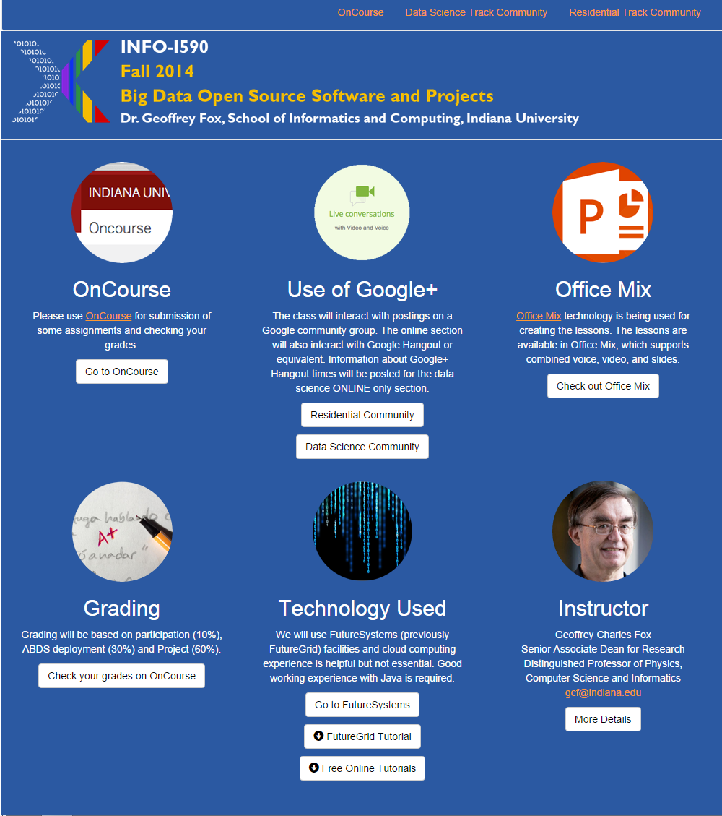
Office Mix Site
General Material
Create video in PowerPoint with laptop web cam
Exported to Microsoft Video Streaming Site

Slide 39
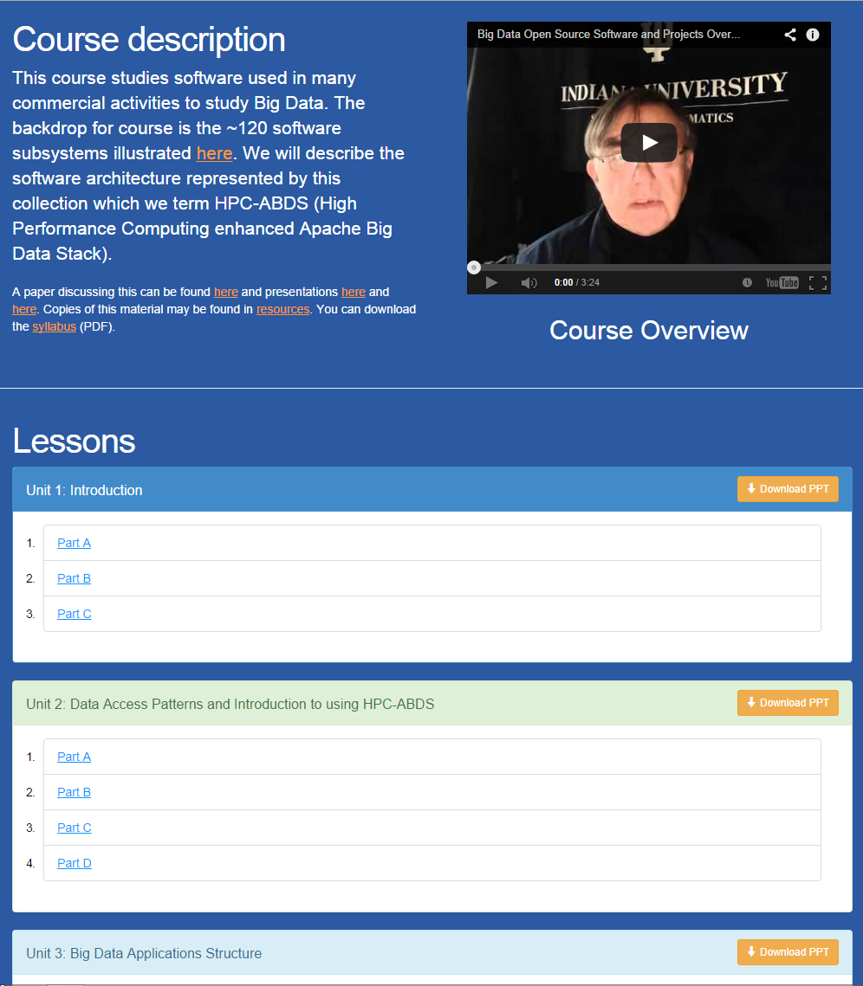
Office Mix Site
Lectures
Made as ~15 minute lessons linked here
Metadata on Microsoft Site

Slide 40
Potpourri of Online Technologies
Canvas (Indiana University Default): Best for interface with IU grading and records
Google Course Builder: Best for management and integration of components
Ad hoc web pages: alternative easy to build integration
Mix: Best faculty preparation interface
Adobe Presenter/Camtasia: More powerful video preparation that support subtitles but not clearly needed
Google Community: Good social interaction support
YouTube: Best user interface for videos
Hangout: Best for instructor-students online interactions (one instructor to 9 students with live feed). Hangout on air mixes live and streaming (30 second delay from archived YouTube) and more participants

