Slide 1
InSAR Data and GeoServer
IU QuakeSim Team
October 26, 2011

Slide 2
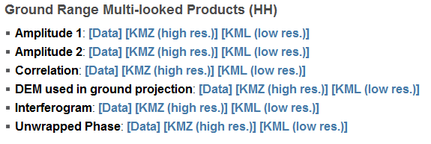
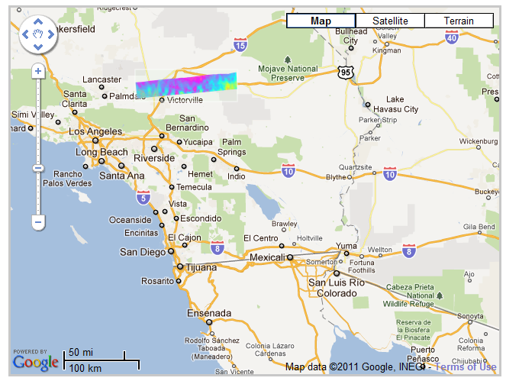
QuakeTables InSAR Data Distribution
File-based distribution:
data is stored as the pure binary file with no header
Image information and meta-data are stored in annotation file

Slide 3
QuakeTables InSAR Data Distribution
Current file format is not supported by most of GIS packages. It is difficult to use web GIS tools with InSAR data.
InSAR data is large (GB level per image), it is difficult to build web-service in the distributed environment.
QuakeTables can be used to find and download images and metadata but we also need tools to perform standard GIS operations on subsets of data on the server itself.

Slide 4
Motivations for GeoServer Solution
Data distribution service: produce more standards-compliant GIS products
Software as a Service: make InSAR processing software more accessible to general users
Infrastructure as a Service: provide system sustainability and reusability for other projects like E-DECIDER

Slide 5
GeoServer
GeoServer (http://geoserver.org) is an open source software server written in Java that allows users to share and edit geospatial data. Designed for interoperability, it publishes data from any major spatial data source using open standards.
It is widely used in cloud-based GIS system
It is a free alternative for more expensive ESRI ArcGIS server

Slide 6
InSAR GeoServer Distribution
Cloud Service
User Access
GeoServer
Web Service Interface
WMS
WCS
WPS
Google Map/Google Earth
GIS Software: ArcGIS etc.
Matlab/Mathematica
Cloud Storage Service
InSAR Processing Tools
Mobile Platforms

Slide 7
WMS and WCS Service
The Web Map Service (WMS) standard for generating maps on the web for both vector and raster data. It also supports the meta-data query by location.
The Web Coverage Service (WCS) provides a standard interface for how to request the raster source (raw images) of a geospatial image.

Slide 8
Import InSAR Data to GeoServer
Automatically processing:
Generate header file from .ann
Convert simple binary to GeoTiff
Build image overview
Register GeoTiff image with GeoServer

Slide 9
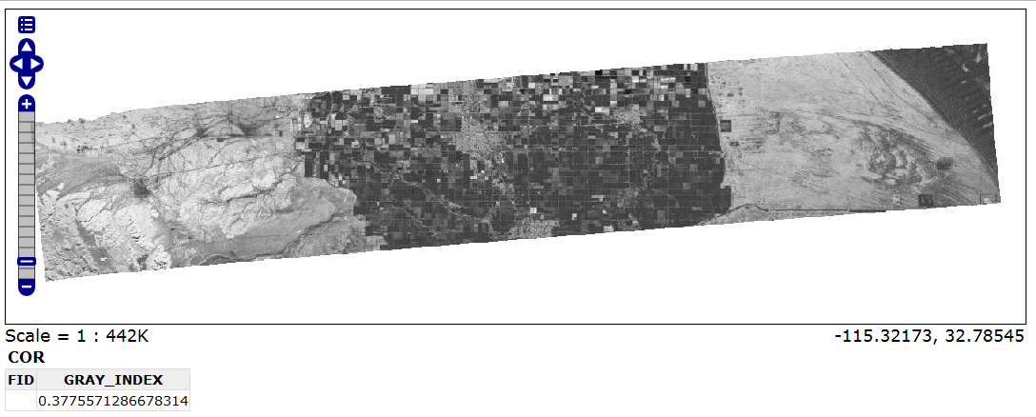
GeoServer Access Example

Slide 10
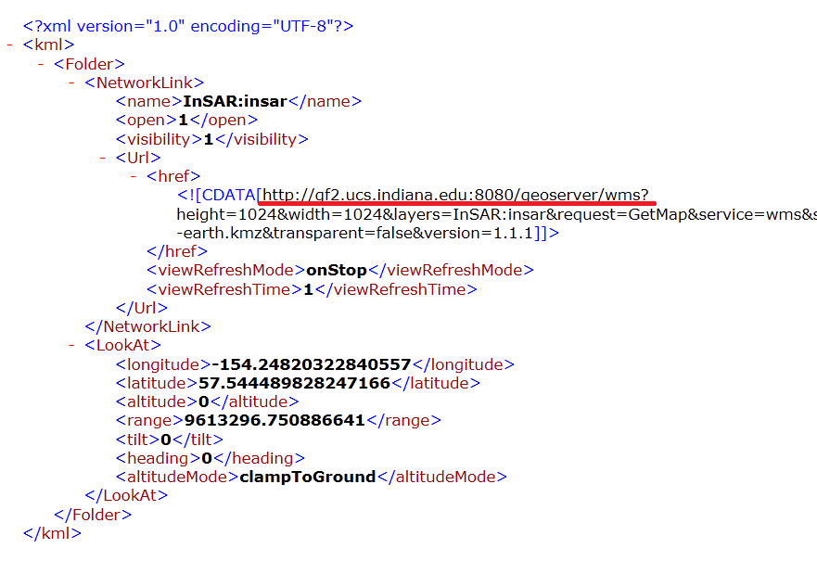
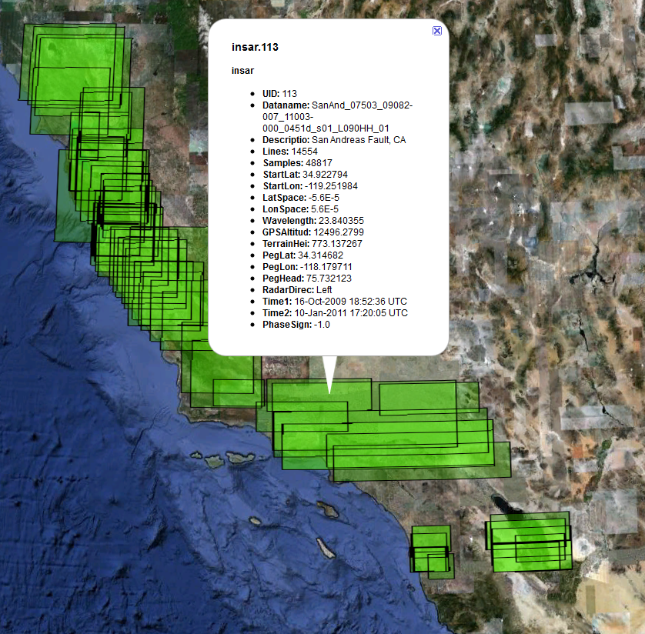
GeoServer Access Example

Slide 11
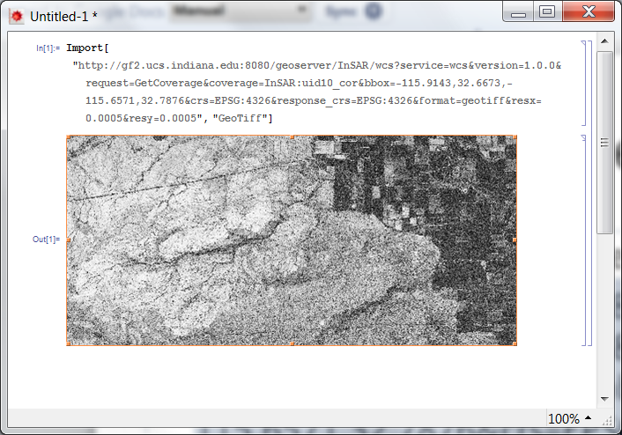
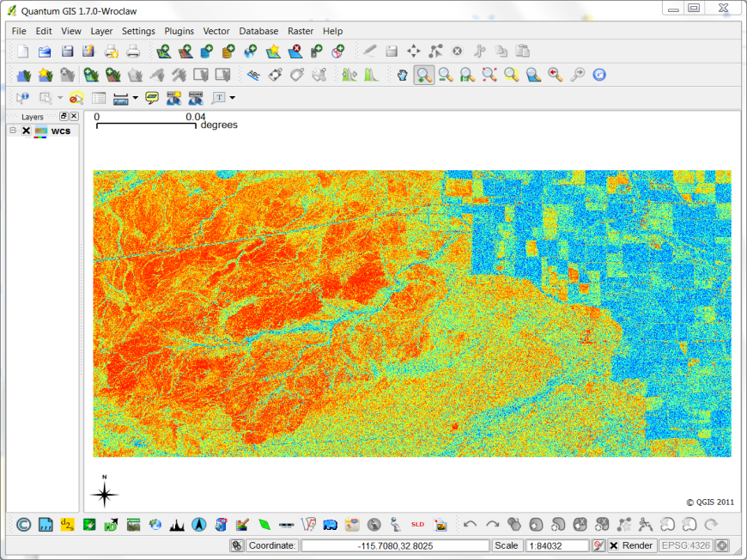
WCS Image-on-Demand Example
Parameters: image name, region, resolution
http://gf2.ucs.indiana.edu:8080/geoserver/InSAR/wcs?service=wcs&version=1.0.0&request=GetCoverage&coverage=InSAR:uid10_cor&bbox=-115.9143,32.6673,-115.6571,32.7876&crs=EPSG:4326&response_crs=EPSG:4326&format=geotiff&resx=0.0005&resy=0.0005

