Slide 1
Supporting Large-scale Social Media Data Analyses with Customizable Indexing Techniques on NoSQL Databases

Slide 2
Motivation - characteristics of social media data analysis
Large data size:
- TBs/PBs of historical data, 10s of millions of streaming social updates per day
- Fine-grained social update records, mostly written-once-read-many
Focus on data subsets about specific social events/activities
- Require efficient queries about social events
Workflows contain algorithms of different computation/communication patterns:
- Require dynamic adoption of different processing frameworks: Hadoop, Harp, Giraph, etc.

Slide 3
Motivation – addressing the requirements
NoSQL databases as possible storage solution:
- Scalable storage and access speed for fine-grained data records
- Varied level of indexing support
- Index structures not customizable enough for queries in different applications
Our contribution:
- A general customizable indexing framework on NoSQL databases
- Extended analysis stack based on YARN
- Queries and post-query analysis algorithms as building blocks for workflows
- Usage of customized index structures in both queries and analysis algorithms

Slide 4
Customizable indexing framework over NoSQL databases
Abstract index structure
- A sorted list of index keys.
- Each key associated with multiple entries sorted by unique entry IDs.
- Each entry contains multiple additional fields.
- Index configuration file defines what to contain in keys and entries
<index-config>
<source-set>tweets</source-set>
<source-field>text</source-field>
<source-field-type>full-text</source-field-type>
<index-name>textIndex</index-name>
<index-entry-id>{source-record}.id</index-entry-id>
<index-entry-field>{source-record}.created_at</index-entry-field>
</index-config>
<index-config>
<source-set>users</source-set>
<index-name>snameIndex</index-name>
<indexer-class>iu.pti.hbaseapp.truthy.UserSnameIndexer</indexer-class>
</index-config>
key1
34077
Entry ID
Entry ID
2012-06-02
Field2
Field1
Field2
Field1
Field2
key2
34077
Entry ID
2012-06-02
Field2
Field1
Field2
key3
Entry ID
Entry ID
Entry ID
Field1
Field2
Field1
Field2
Field1
Field2
key4
Entry ID
Field1
Field2
…

Slide 5
Demonstration of Customizability
Sorted single dimensional index
Multi-dimensional index
2012-06-02
34077
34077
43125
2012-06-02
2012-06-03
45327
25233
44331
tweet id
2012-06-02
time
…
…
Inverted index for text retrieval applications
Multi-dimensional index involving both text and non-text fields
enjoy
34077
doc id
doc id
#occupy
34077
tweet id
tweet id
1
frequency
frequency
2012-06-02
time
time
great
34077
doc id
#oscar
34077
tweet id
1
frequency
2012-06-02
time
…
…
Suitable for social queries about hashtags etc. with time constraints
Other possible extensions: multi-key index similar to MongoDB, geospatial indexes using geohashes as keys

Slide 6
Implementation on HBase
Mapping between abstract structure and NoSQL storage units:
Text Index Table
Text Index
entries
enjoy
34077
Entry ID
Entry ID
2012-06-02
Field2
Field1
Field2
Field1
Field2
enjoy
34077
Entry ID
Entry ID
2012-06-02
Filed2
Field1
Filed2
Field1
Filed2
great
34077
Entry ID
2012-06-02
Field2
Field1
Field2
34077
Entry ID
great
2012-06-02
Filed2
Field1
Filed2
HBase designed for real-time updates of single column values – efficient access of individual index entries
Data storage with HDFS – reliable and scalable index data storage
Region split and dynamic load balancing – scalable index read/write speed
Data stored under the hierarchical order of <rowkey, column name, timestamp> - efficient range scan of index keys and entry IDs

Slide 7
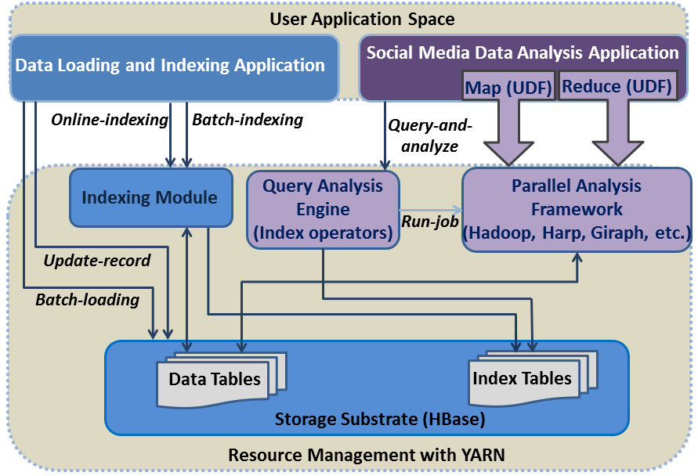
Analysis stack based on YARN
Building blocks:
- Parallel query evaluation using Hadoop MapReduce
- Related hashtag mining algorithm using Hadoop MapReduce:
- Meme daily meme frequency using MapReduce over index tables
- Parallel force-directed graph layout algorithm using Twister (Harp) iterative MapReduce
$$σ(S,T)=\frac{|S∩T|}{|S∪T|}$$

Slide 8
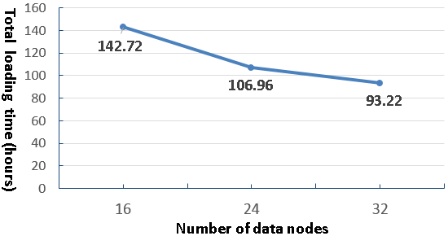
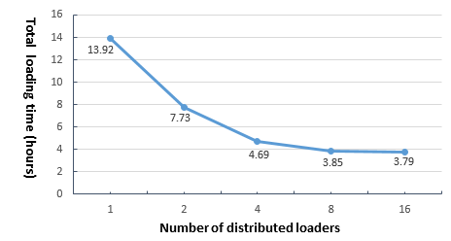
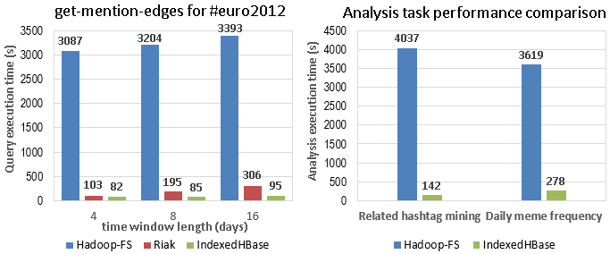
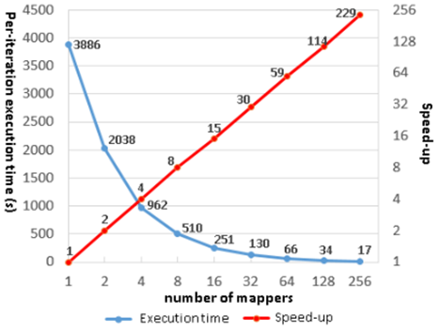
Evaluation with Truthy Applications
Scalable indexing:
Two months’ data loading for varied cluster size
One day’s data loading for fixed cluster size at 8
Queries and analysis algorithms:
Scalability of iterative graph layout algorithm on Twister

