Slide 1
Community Grids Laboratory Digital Science Center Pervasive Technology Institute
Student Visits
August 26 2009
Geoffrey Fox
gcf@indiana.edu www.infomall.org

Slide 2
e-moreorlessanything
‘ e-Science is about global collaboration in key areas of science, and the next generation of infrastructure that will enable it.’ from inventor of term John Taylor Director General of Research Councils UK, Office of Science and Technology
e-Science is about developing tools and technologies that allow scientists to do ‘faster, better or different’ research
Similarly e-Business captures the emerging view of corporations as dynamic virtual organizations linking employees, customers and stakeholders across the world.
This generalizes to e-moreorlessanything including e-PolarGrid, e-Bioinformatics, e-HavingFun and e-Education
A deluge of data of unprecedented and inevitable size must be managed and understood.
People (virtual organizations), computers, data (including sensors and instruments) must be linked via hardware and software networks
2
Notes:
2

Slide 3
What is Cyberinfrastructure
Cyberinfrastructure is (from NSF) infrastructure that supports distributed research and learning (e-Science, e-Research, e-Education)
Links data, people, computers
Exploits Internet technology (Web2.0 and Clouds) adding (via Grid technology) management, security, supercomputers etc.
It has two aspects: parallel – low latency (microseconds) between nodes and distributed – highish latency (milliseconds) between nodes
Parallel needed to get high performance on individual large simulations, data analysis etc.; must decompose problem
Distributed aspect integrates already distinct components – especially natural for data (as in biology databases etc.)
3
Notes:
3

Slide 4
Relevance of Web 2.0 to Academia
Web 2.0 can help e-Research in many ways
Its tools (web sites) can enhance scientific collaboration, i.e. effectively support virtual organizations, in different ways from grids
The popularity of Web 2.0 can provide high quality technologies and software that (due to large commercial investment) can be very useful in e-Research and preferable to complex Grid or Web Service solutions
The usability and participatory nature of Web 2.0 can bring science and its informatics to a broader audience
Cyberinfrastructure is research analogue of major commercial initiatives e.g. to important job opportunities for students!
Web 2.0 is major commercial use of computers and “Google/Amazon” farms spurred cloud computing
Same computer answering your Google query can do bioinformatics
Can be accessed from a web page with a credit card i.e. as a Service

Slide 5
Clouds v Grids Philosophy
Clouds are (by definition) commercially supported approach to large scale computing
So we should expect Clouds to replace Compute Grids
Current Grid technology involves “non-commercial” software solutions which are hard to evolve/sustain
Grid approaches to distributed data and sensors still valid
Informational Retrieval is major data intensive commercial application so we can expect technologies from this field (Dryad, Hadoop) to be relevant for related scientific (File/Data parallel) applications
Technologies still immature but can be expected to rapidly become mainstream
Data becoming more and more important in all fields including Science

Slide 6
Activities in CGL/DSC
Project Leaders
Gregor von Lazewski (mainly FutureGrid, GreenIT, GPU)
Marlon Pierce (mainly Grids, Portals, Web2.0, PolarGrid, QuakeSim)
Judy Qiu (mainly Multicore, Data Intensive Computing, Data mining)
Highlighted Facilities
32 nodes each with 24 cores – Tempest 768 core cluster
Cloud Testbed running Nimbus and Eucalyptus
Collaborations
UITS to get good facilities and explore implications of new technologies for computing Infrastructure
Need applications to test and motivate new technologies: Bioinformatics; Cheminformatics; Health-informatics, Polar Science; Earthquake Science; Particle Physics ; Geographic Information systems and Sensor Nets

Slide 7
FutureGrid
FutureGrid is expected to start next month and will use modern virtual machine technology to build test environments for new distributed applications with 8 distributed systems.
Partners in the FutureGrid project include: Purdue University, University of California San Diego, University of Chicago/Argonne National Labs, University of Florida, University of Southern California Information Sciences Institute, University of Texas Austin/Texas Advanced Computing Center, University of Tennessee Knoxville, University of Virginia, and the Center for Information Services and High Performance Computing at the Technische Universitaet Dresden, Germany.
It could define the next generation of scientific computing environments
http://cyberaide.org/contact is Gregor’s current web page

Slide 8
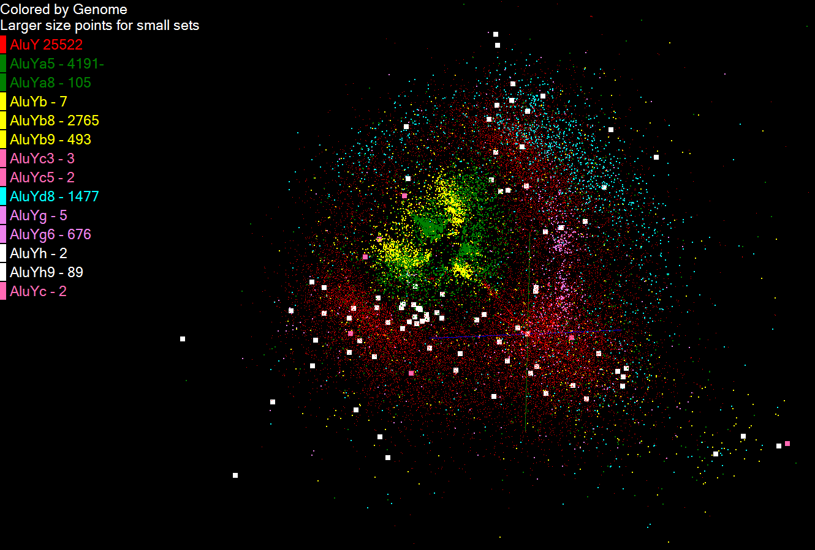
Multicore and Cloud Technologies to support Data Intensive applications
Using Dryad (Microsoft) and MPI to study structure of Gene Sequences on Tempest Cluster
See http://www. infomall.org/ salsa for Judy’s projects

Slide 9
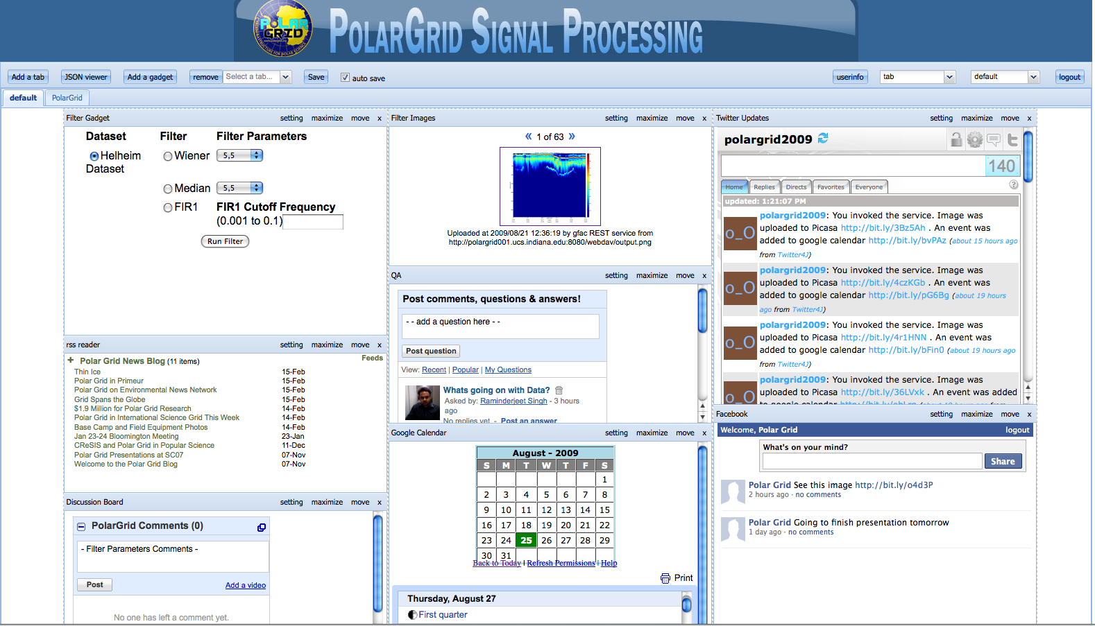
OGCE Project: Open Social Gadget
Containers and Mash Ups for Scientific Communities (Raminder Singh and Gerald Guo).

Slide 10
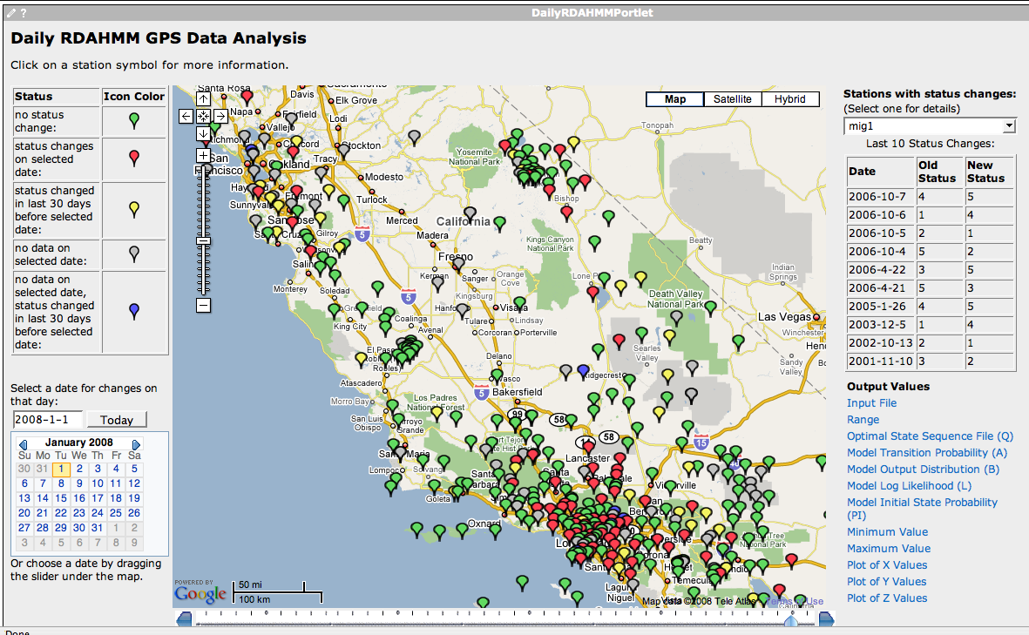
Daily RDAHMM Updates
QuakeSim: Daily analysis and event classification of GPS data from REASoN’s GRWS (Xiaoming Gao)

Slide 11
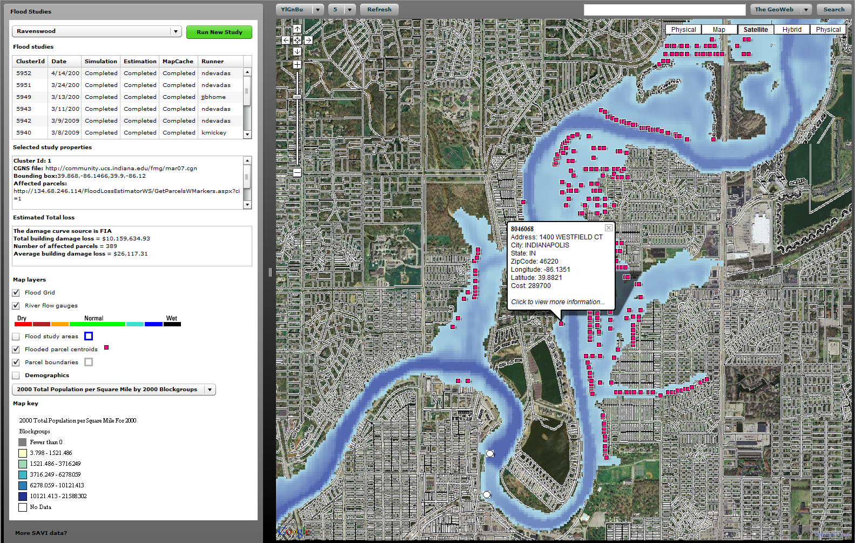
FloodGrid and Swarm: Integrating GIS, Workflows, and Grid Job Management (Marie Ma and Jun Wang)

