Slide 1
Introduction to Clouds and the VSCSE Summer School on Science Clouds
Science Cloud Summer School
VSCSE@Indiana University
July 30 2012
Geoffrey Fox
gcf@indiana.edu
Informatics, Computing and Physics
Pervasive Technology Institute
Indiana University Bloomington

Slide 2
Web Resources
Science Cloud Summer School 2012 website:
http://sciencecloudsummer2012.tumblr.com/
Science Cloud Summer School schedule:
http://sciencecloudsummer2012.tumblr.com/schedule
FG-241 Science Cloud Summer School 2012 project page:
https://portal.futuregrid.org/projects/241
Instructions for obtaining FutureGrid accounts for Science Cloud Summer School 2012:
https://portal.futuregrid.org/projects/241/register
Science Cloud Summer School 2012 Forum:
https://portal.futuregrid.org/forums/fg-class-and-tutorial-forums/summer-school-2012
Twitter hashtag: #ScienceCloudSummer

Slide 3
Many Thanks to
Funding Organizations: NSF, Lilly Foundation
VSCSE: Sharon Glotzer, Eric Hofer, Scott Lathrop, Meagan Lefebvre
Video Infrastructure: Mike Miller (NCSA), Chris Eller, Jeff Rogers
Organizers and AI’s at 10 sites
Speakers acknowledged as they are announced
IU Hospitality: Mary Nell Shiflet
Staff at FutureGrid: John Bresnahan, Ti Leggett, David Gignac, Gary Miksik, Barbara Ann O'Leary, Javier Diaz Montes, Sharif Islam, Koji Tanaka, Fugang Wang, Gregor von Laszewski
Many dedicated students

Slide 4
Topics Covered in Summer School
Several Applications with 3 talks on Life Sciences and talks on experiences with HPC on the cloud and use of specific technologies in particular applications
Virtual Machine management: Nimbus, Eucalyptus, OpenStack
Amazon and Azure commercial clouds
Combining/Federating clouds and bursting from one to another
Virtual Networks and Virtual Clusters
Appliances or Images – the building block of Cloud applications
Building Services and composing them with Workflow
Running loosely coupled collections of jobs
Parallel Computing on Clouds or HPC with MapReduce
Novel Data models: NOSQL, Data parallel file systems (HDFS), Object stores, Queues and Tables
Key cross cutting technologies: Security, Networks and Use of GPU’s

Slide 5
Sections in Talk
Broad Overview: Data Deluge to Clouds
Clouds Grids and HPC
Analytics and Parallel Computing on Clouds and HPC
IaaS PaaS SaaS
Using Clouds
The Summer School
Summary: Clouds and Summer School in a Nutshell

Slide 6
Broad Overview:
Data Deluge to Clouds

Slide 7

Some Trends
  The Data Deluge is clear trend from Commercial (Amazon, e-commerce) , Community (Facebook, Search) and Scientific applications
  Light weight clients from smartphones, tablets to sensors
  Multicore reawakening parallel computing
  Exascale initiatives will continue drive to high end with a simulation orientation
  Clouds with cheaper, greener, easier to use IT for (some) applications
  New jobs associated with new curricula
    Clouds as a distributed system (classic CS courses)
    Data Analytics (Important theme in academia and industry)
    Network/Web Science

Slide 8
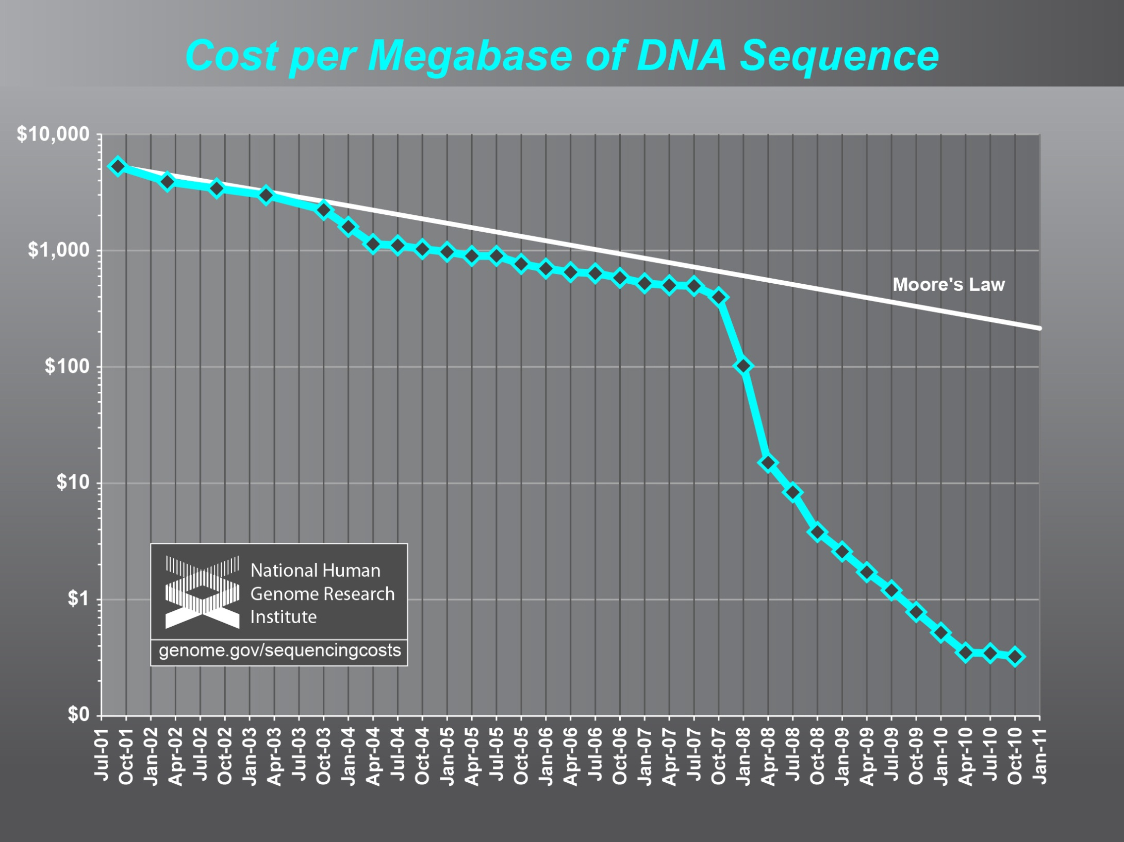
Why need cost effective
Computing!
Full Personal Genomics: 3 petabytes per day

Slide 9
Some Data sizes
  ~40 10⁹ Web pages at ~300 kilobytes each = 10 Petabytes
  Youtube 48 hours video uploaded per minute;
    in 2 months in 2010, uploaded more than total NBC ABC CBS
    ~2.5 petabytes per year uploaded?
  LHC (Large Hadron Collider) 15 petabytes per year
  Radiology 69 petabytes per year
  Square Kilometer Array Telescope will be 100 terabits/second
  Earth Observation becoming ~4 petabytes per year
  Earthquake Science – few terabytes total today
  PolarGrid – 100’s terabytes/year icesheet radar
  Exascale simulation data dumps – terabytes/second (30 exabytes per year)

Slide 10
Clouds Offer From different points of view
Features from NIST:
  On-demand service (elastic);
  Broad network access;
  Resource pooling;
  Flexible resource allocation;
  Measured service
Economies of scale in performance and electrical power (Green IT)
Powerful new software models
  Platform as a Service is not an alternative to Infrastructure as a Service – it is instead an incredible valued added

Slide 11
The Google gmail example
http://www.google.com/green/pdfs/google-green-computing.pdf
Clouds win by efficient resource use and efficient data centers
Business Type | Number of users | # servers | IT Power per user | PUE (Power Usage effectiveness) | Total Power per user | Annual Energy per user
Small | 50 | 2 | 8W | 2.5 | 20W | 175 kWh
Medium | 500 | 2 | 1.8W | 1.8 | 3.2W | 28.4 kWh
Large | 10000 | 12 | 0.54W | 1.6 | 0.9W | 7.6 kWh
Gmail (Cloud) | ∞ | ∞ | < 0.22W | 1.16 | < 0.25W | < 2.2 kWh

Slide 12

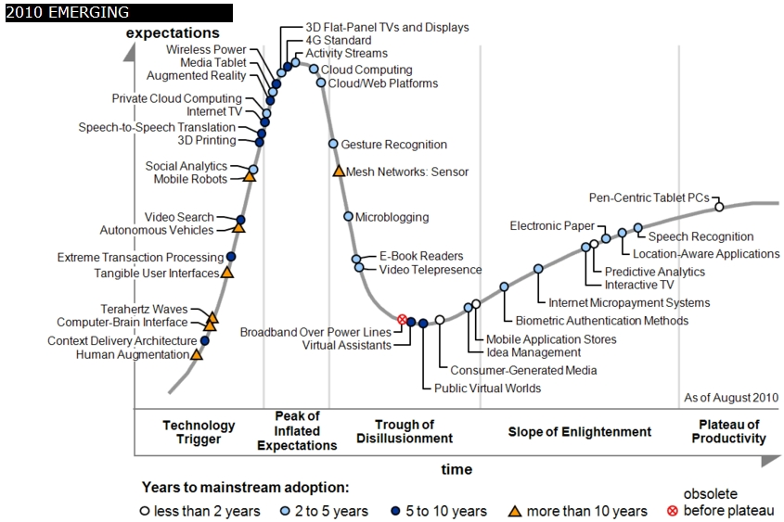
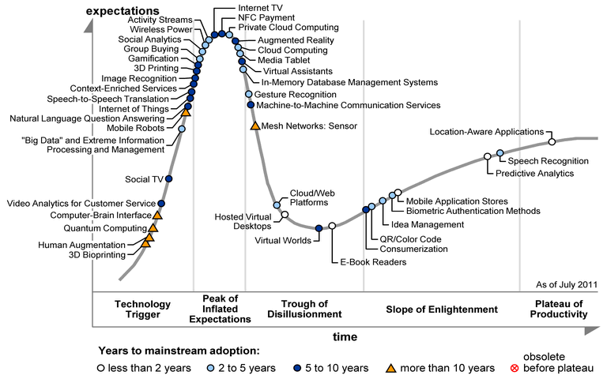
Gartner 2009 Hype Curve
Clouds, Web2.0, Green IT
Service Oriented Architectures

Slide 13

Cloud Jobs v. Countries

Slide 14


Clouds as Cost Effective Data Centers
Clouds can be considered as just the best biggest data centers
Right is 2 Google warehouses of computers on the banks of the Columbia River, in The Dalles, Oregon
Left is shipping container (each with 200-1000 servers) model used in Microsoft Chicago data center holding 150-220
Data Center Part | Cost in small-sized Data Center | Cost in Large Data Center | Ratio
Network | $95 per Mbps/ month | $13 per Mbps/ month | 7.1
Storage | $2.20 per GB/ month | $0.40 per GB/ month | 5.7
Administration | ~140 servers/ Administrator | >1000 Servers/ Administrator | 7.1

Slide 15
Some Sizes in 2010
http://www.mediafire.com/file/zzqna34282frr2f/koomeydatacenterelectuse2011finalversion.pdf
30 million servers worldwide
Google had 900,000 servers (3% total world wide)
Google total power ~200 Megawatts
  < 1% of total power used in data centers (Google more efficient than average – Clouds are Green!)
  ~ 0.01% of total power used on anything world wide
Maybe total clouds are 20% total world server count (a growing fraction)

Slide 16
Some Sizes Cloud v HPC
Top Supercomputer Sequoia Blue Gene Q at LLNL
  16.32 Petaflop/s on the Linpack benchmark using 98,304 CPU compute chips with 1.6 million processor cores and 1.6 Petabyte of memory in 96 racks covering an area of about 3,000 square feet
  7.9 Megawatts power
Largest (cloud) computing data centers
  100,000 servers at ~200 watts per CPU chip
  Up to 30 Megawatts power
So largest supercomputer is around 1-2% performance of total cloud computing systems assuming Google ~20% total

Slide 17
Clouds Grids and HPC

Slide 18
2 Aspects of Cloud Computing:
Infrastructure and Runtimes
Cloud infrastructure: outsourcing of servers, computing, data, file space, utility computing, etc..
Cloud runtimes or Platform: tools to do data-parallel (and other) computations. Valid on Clouds and traditional clusters
  Apache Hadoop, Google MapReduce, Microsoft Dryad, Bigtable, Chubby and others
  MapReduce designed for information retrieval but is excellent for a wide range of science data analysis applications
  Can also do much traditional parallel computing for data-mining if extended to support iterative operations
  Data Parallel File system as in HDFS and Bigtable

Slide 19
Science Computing Environments
Large Scale Supercomputers – Multicore nodes linked by high performance low latency network
  Increasingly with GPU enhancement
  Suitable for highly parallel simulations
High Throughput Systems such as European Grid Initiative EGI or Open Science Grid OSG typically aimed at pleasingly parallel jobs
  Can use “cycle stealing”
  Classic example is LHC data analysis
Grids federate resources as in EGI/OSG or enable convenient access to multiple backend systems including supercomputers
  Portals make access convenient and
  Workflow integrates multiple processes into a single job
Specialized visualization, shared memory parallelization etc. machines

Slide 20
Clouds HPC and Grids
Synchronization/communication Performance
Grids > Clouds > Classic HPC Systems
Clouds naturally execute effectively Grid workloads but are less clear for closely coupled HPC applications
Classic HPC machines as MPI engines offer highest possible performance on closely coupled problems
    Likely to remain in spite of Amazon cluster offering
Service Oriented Architectures portals and workflow appear to work similarly in both grids and clouds
May be for immediate future, science supported by a mixture of
  Clouds – some practical differences between private and public clouds – size and software
  High Throughput Systems (moving to clouds as convenient)
  Grids for distributed data and access
  Supercomputers (“MPI Engines”) going to exascale

Slide 21
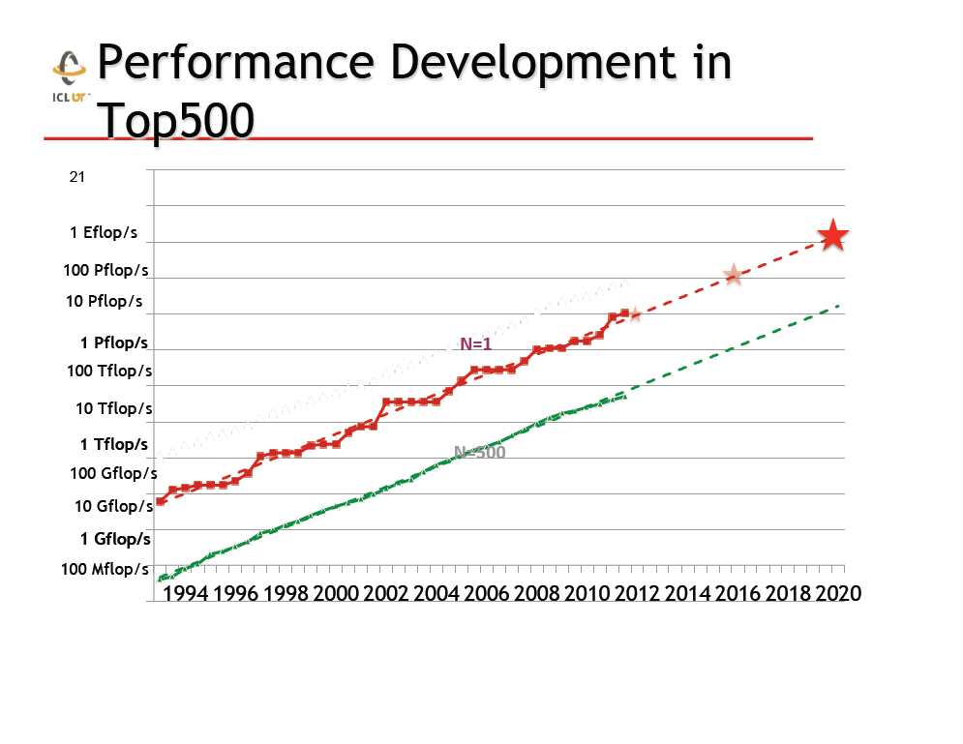
Exaflop
Exaflop machine TIGHTLY COUPLED
Clouds more powerful but LOOSELY COUPLED
From Jack Dongarra

Slide 22
What Applications work in Clouds
Pleasingly parallel applications of all sorts with roughly independent data or spawning independent simulations
  Long tail of science and integration of distributed sensors
Commercial and Science Data analytics that can use MapReduce (some of such apps) or its iterative variants (most other data analytics apps)
Which science applications are using clouds?
  Many demonstrations described in Conference papers
  Venus-C (Azure in Europe): 27 applications not using Scheduler, Workflow or MapReduce (except roll your own)
  50% of applications on FutureGrid are from Life Science
  Locally Lilly corporation is commercial cloud user (for drug discovery)
  This afternoon, Keahey will describe Nimbus applications in bioinformatics, high energy physics, nuclear physics, astronomy and ocean sciences

Slide 23
27 Venus-C Azure Applications
Chemistry (3)
• Lead Optimization in Drug Discovery
• Molecular Docking
Civil Protection (1)
• Fire Risk estimation and fire propagation
Biodiversity &
Biology (2)
• Biodiversity maps in marine species
• Gait simulation
Civil Eng. and Arch. (4)
• Structural Analysis
• Building information Management
• Energy Efficiency in Buildings
• Soil structure simulation
Physics (1)
• Simulation of Galaxies configuration
Earth Sciences (1)
• Seismic propagation
Mol, Cell. & Gen. Bio. (7)
• Genomic sequence analysis
• RNA prediction and analysis
• System Biology
• Loci Mapping
• Micro-arrays quality.
ICT (2)
• Logistics and vehicle routing
• Social networks analysis
Medicine (3)
• Intensive Care Units decision support.
• IM Radiotherapy planning.
• Brain Imaging
Mathematics (1)
• Computational Algebra
Mech, Naval & Aero. Eng. (2)
• Vessels monitoring
• Bevel gear manufacturing simulation

Slide 24
Parallelism over Users and Usages
“Long tail of science” can be an important usage mode of clouds.
In some areas like particle physics and astronomy, i.e. “big science”, there are just a few major instruments generating now petascale data driving discovery in a coordinated fashion.
In other areas such as genomics and environmental science, there are many “individual” researchers with distributed collection and analysis of data whose total data and processing needs can match the size of big science.
Clouds can provide scaling convenient resources for this important aspect of science.
Can be map only use of MapReduce if different usages naturally linked e.g. exploring docking of multiple chemicals or alignment of multiple DNA sequences
  Collecting together or summarizing multiple “maps” is a simple Reduction

Slide 25
Internet of Things and the Cloud
It is projected that there will be 24 billion devices on the Internet by 2020. Most will be small sensors that send streams of information into the cloud where it will be processed and integrated with other streams and turned into knowledge that will help our lives in a multitude of small and big ways.
The cloud will become increasing important as a controller of and resource provider for the Internet of Things.
As well as today’s use for smart phone and gaming console support, “smart homes” and “ubiquitous cities” build on this vision and we could expect a growth in cloud supported/controlled robotics.
Some of these “things” will be supporting science
Natural parallelism over “things”
“Things” are distributed and so form a Grid

Slide 26
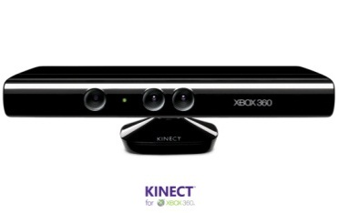








Sensors (Things) as a Service
Output Sensor
Sensors as a Service
Sensor Processing as a Service (could use
MapReduce)
A larger sensor ………
https://sites.google.com/site/opensourceiotcloud/ Open Source Sensor (IoT) Cloud

Slide 27
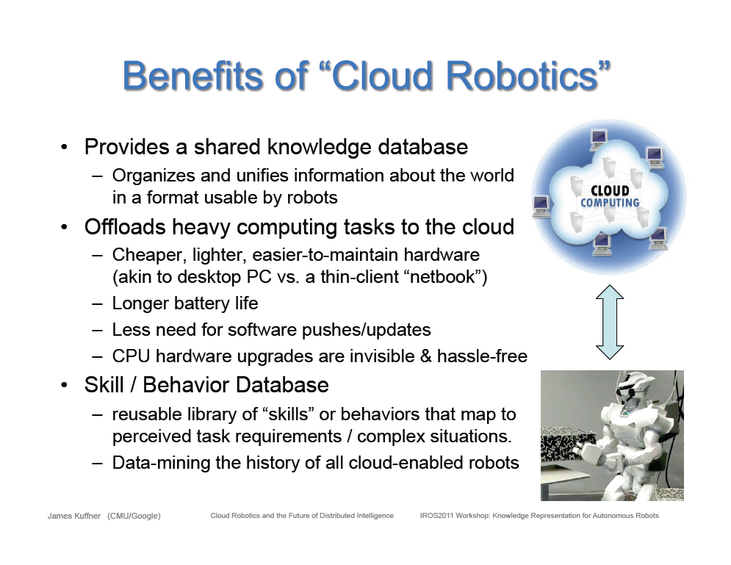
Cloud based robotics from Google

Slide 28
Infrastructure as a Service
Platforms as a Service
Software as a Service

Slide 29
Infrastructure, Platforms, Software as a Service
Software Services are building blocks of applications
The middleware or computing environment
We will cover virtual clusters, networks, management systems Nimbus, Eucalyptus, OpenStack

Slide 30
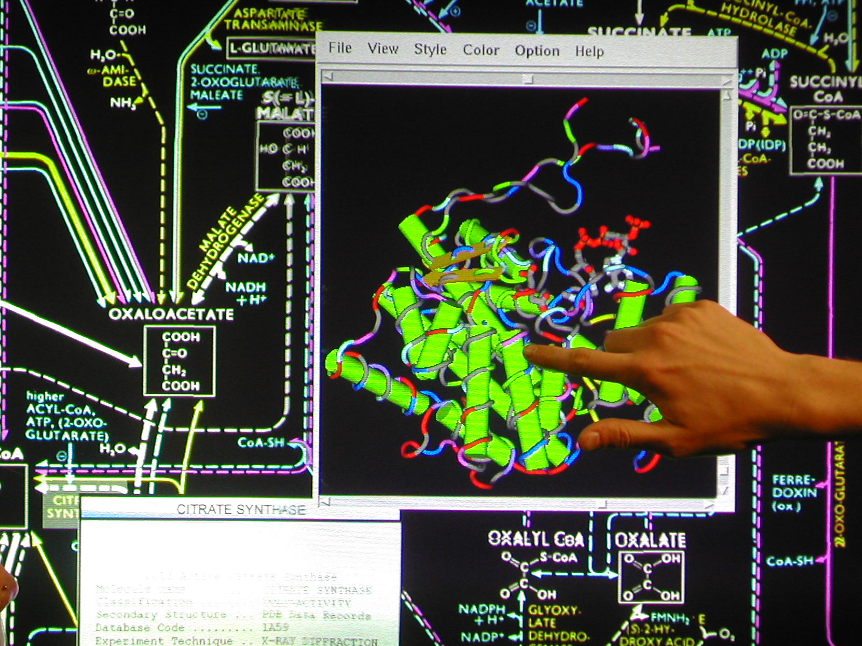
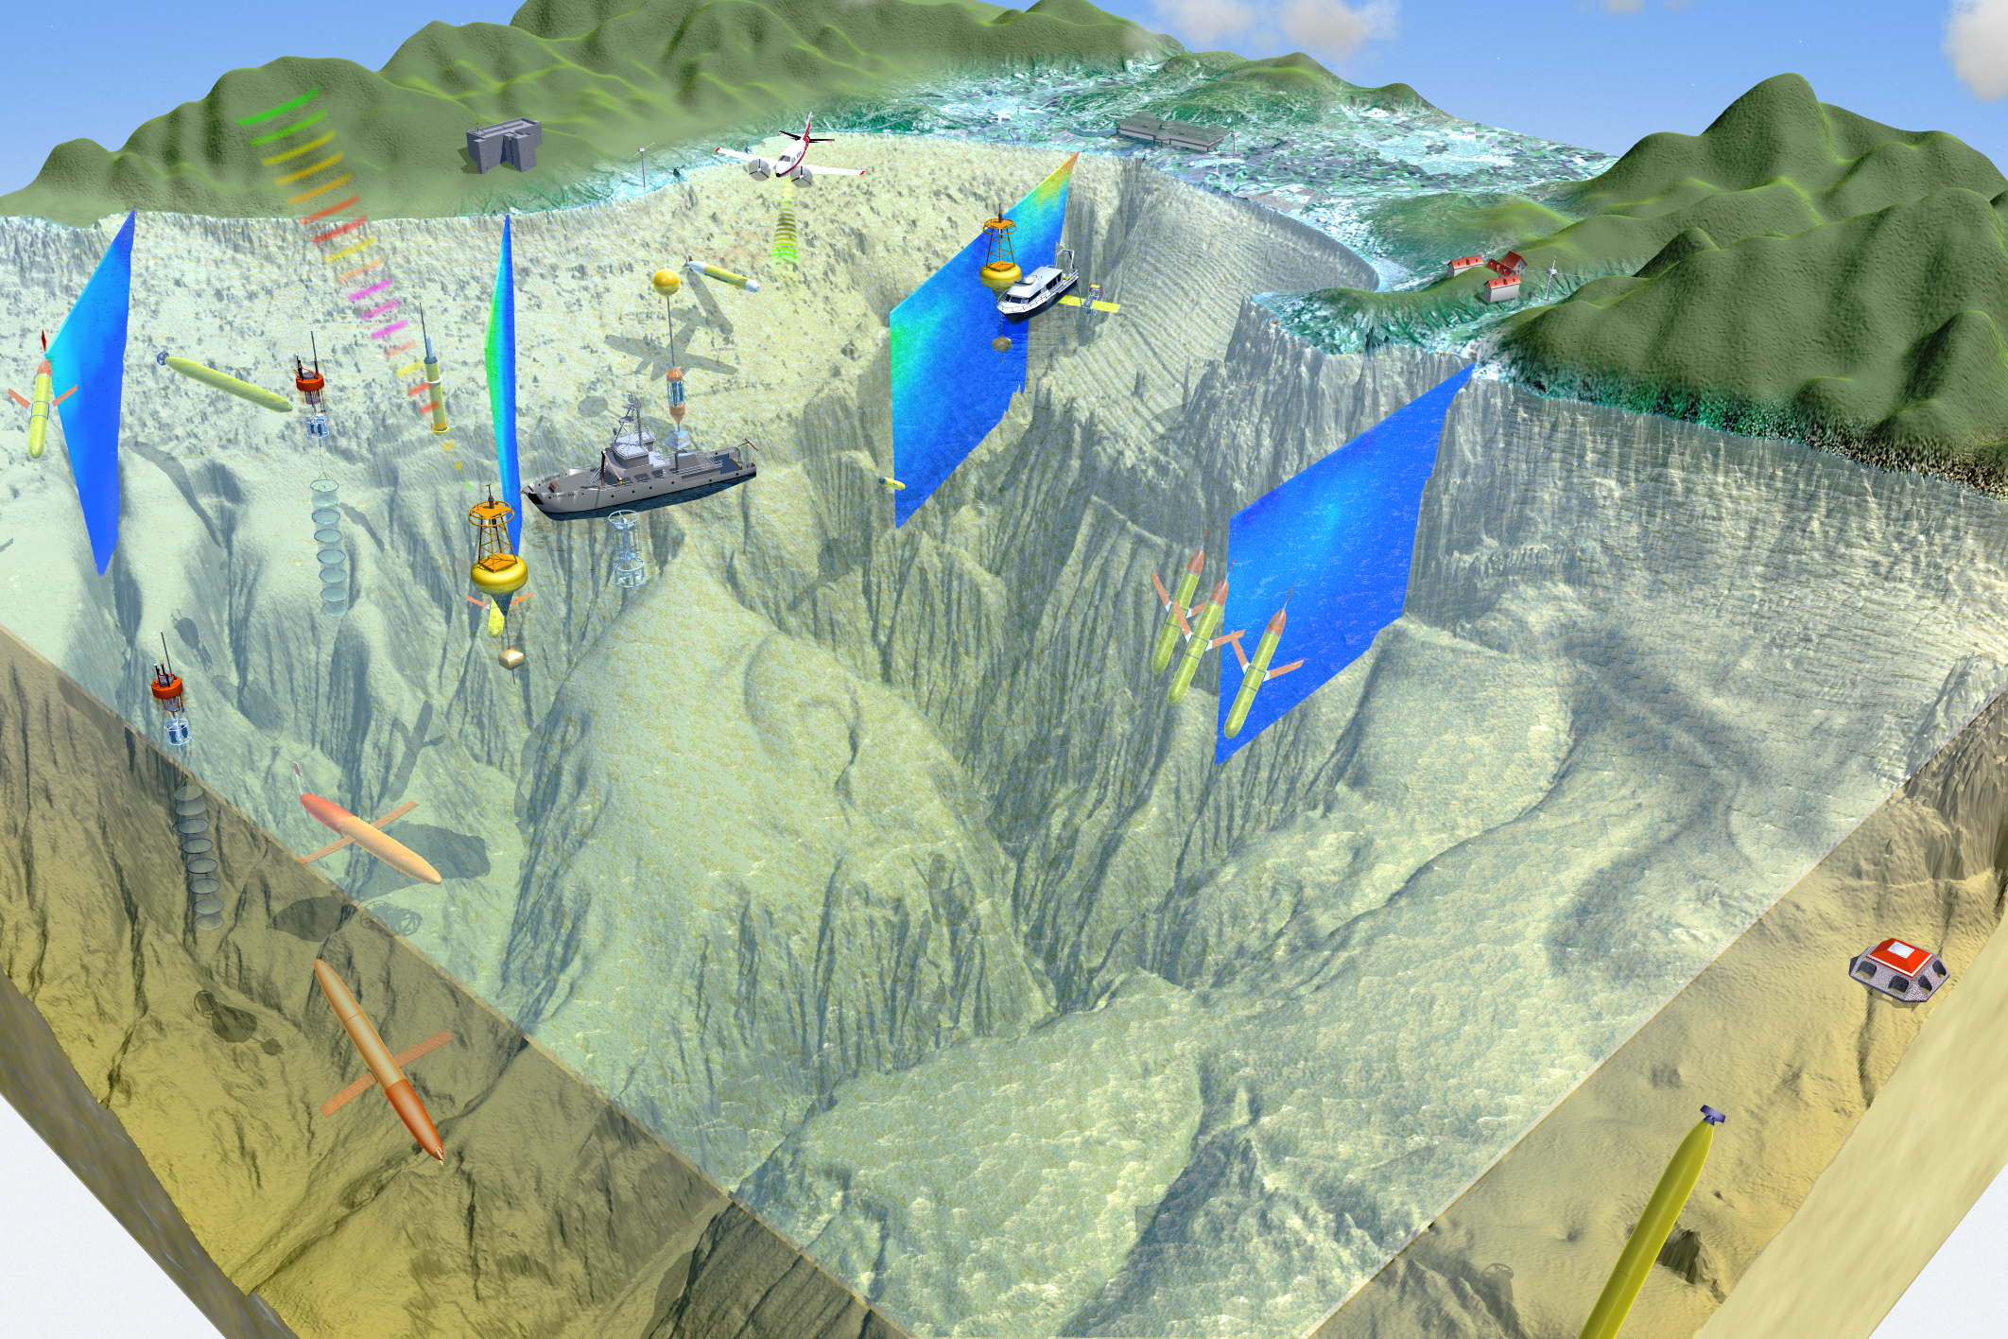
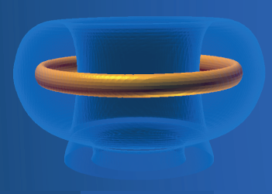
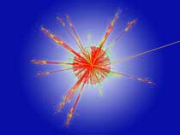


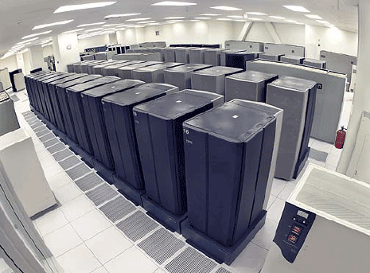
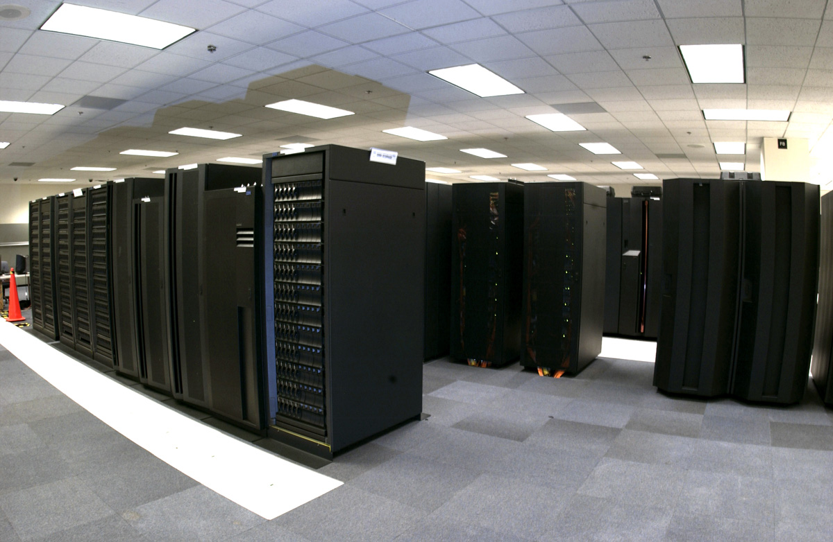



Everything as a Service
Next few slides courtesy
Kate Keahey (Nimbus)
Control
Software-as-a-Service (SaaS)
Community-specific tools,
applications and portals
Platform-as-a-Service (PaaS)
Infrastructure-as-a-Service (IaaS)
Specialization

Slide 31
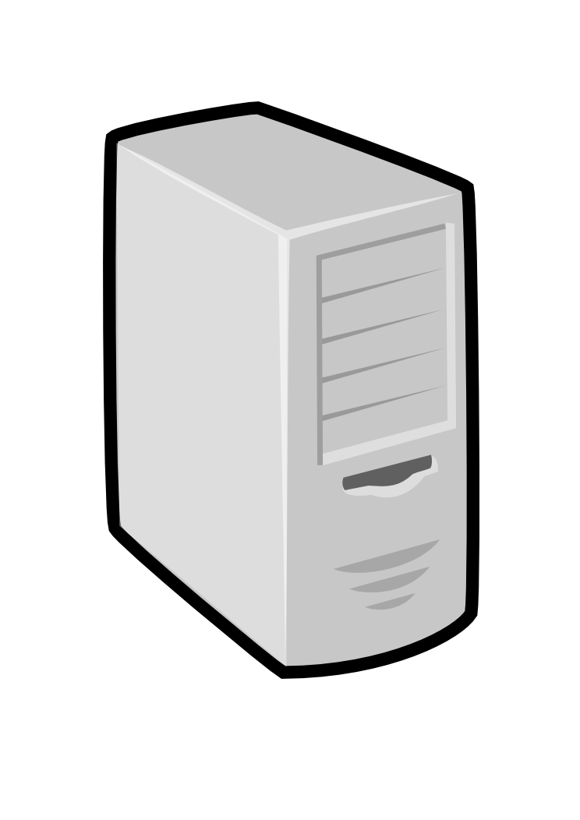
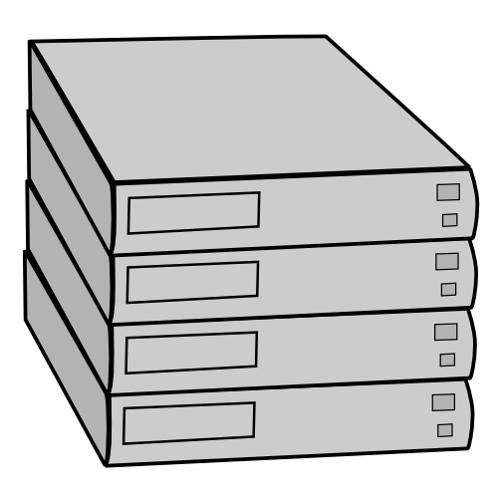

IaaS: How it Works
Pool
node
Pool
node
Pool
node
IaaS
Pool
node
Pool
node
Pool
node
Pool
node
Pool
node
Pool
node
Pool
node
Pool
node
Pool
node

Slide 32
IaaS: How it Works
The IaaS service publishes
information about each VM
Pool
node
Pool
node
Pool
node
IaaS
Pool
node
Pool
node
Pool
node
Users can find out
information about their
VM (e.g. what IP
the VM was bound to)
Pool
node
Pool
node
Pool
node
Pool
node
Pool
node
Pool
node
Users can interact directly with their VM in the same way the would with a physical machine (e.g., ssh).

Slide 33
Types of IaaS Resources
Resource shapes/types
  Bundles of virtual resource parameters
  Exact (memory/storage) and vague (I/O performance, “compute units”)
  Special hardware (e.g., GPUs)
  Different types of storage options: e.g., S3 vs EBS
Resource availability/persistence
  On-demand instances
  Subscription instances (“reserved” instance)
  Spot instances
  Standard vs reduced redundancy
Pricing models
  From 2 cents to ~$3 per hour for on-demand instances
  Consolidated billing
  Storage: per storage, access, and outgoing transfer

Slide 34


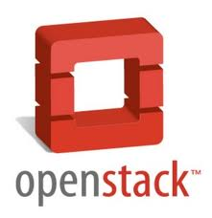

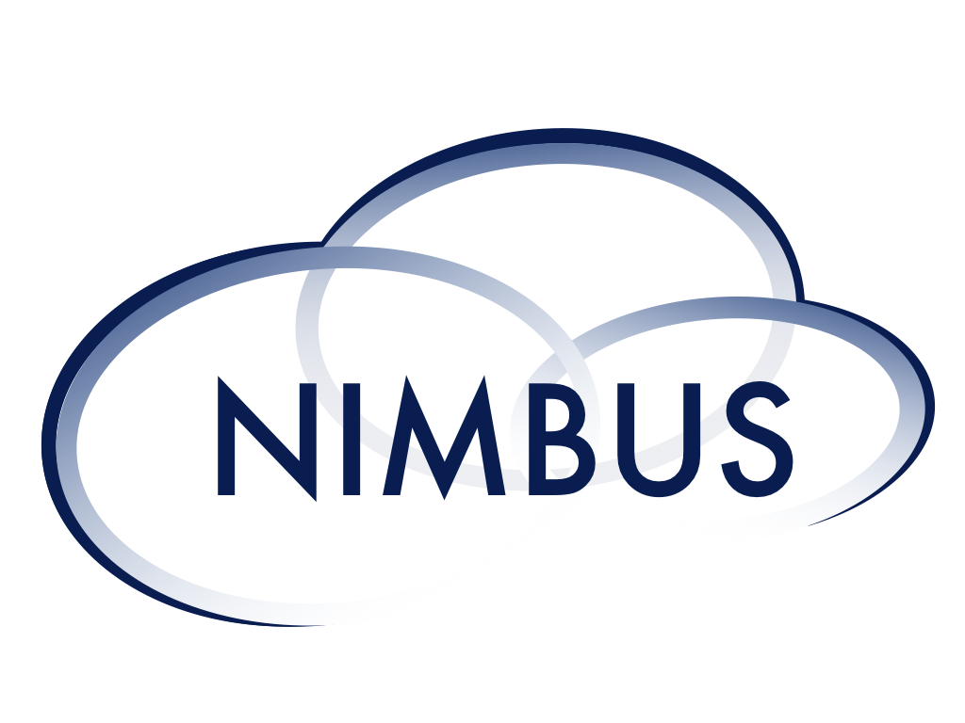
Infrastructure Cloud Resources
Community clouds
Commercial clouds
scienceclouds.org
… also various MRI projects,
WestGrid, Grid’5000
Configure your own private cloud

Slide 35
aaS and Roles/Appliances
Putting capabilities into Images (software for capability plus O/S) is key idea in clouds
  Can do in two different ways: aaS and Appliances
If you package a capability X as a service XaaS, it runs on a separate VM and you interact with messages
  SQLaaS offers databases via messages similar to old JDBC model
If you build a role or appliance with X, then X built into VM and you just need to add your own code and run
  i.e. base images can be customized
  Generic worker role in Venus-C (Azure) builds in I/O and scheduling
I expect a growing number of carefully designed images

Slide 36
What to use in Clouds: Cloud PaaS
Job Management
  Queues to manage multiple tasks
  Tables to track job information
  Workflow to link multiple services (functions)
Programming Model
  MapReduce and Iterative MapReduce to support parallelism
Data Management
  HDFS style file system to collocate data and computing
  Data Parallel Languages like Pig; more successful than HPF?
Interaction Management
  Services for everything
  Portals as User Interface
  Scripting for fast prototyping
  Appliances and Roles as customized images
New Generation Software tools
  like Google App Engine, memcached

Slide 37
What to use in Grids and Supercomputers?
HPC (including Grid) PaaS
Job Management
  Queues, Services Portals and Workflow as in clouds
Programming Model
  MPI and GPU/multicore threaded parallelism
  Wonderful libraries supporting parallel linear algebra, particle evolution, partial differential equation solution
Data Management
  GridFTP and high speed networking
  Parallel I/O for high performance in an application
  Wide area File System (e.g. Lustre) supporting file sharing
Interaction Management and Tools
  Globus, Condor, SAGA, Unicore, Genesis for Grids
  Scientific Visualization
Let’s unify Cloud and HPC PaaS and add Computer Science PaaS?

Slide 38
Computer Science PaaS
Tools to support Compiler Development
Performance tools at several levels
Components of Software Stacks
Experimental language Support
Messaging Middleware (Pub-Sub)
Semantic Web and Database tools
Simulators
System Development Environments
Open Source Software from Linux to Apache

Slide 39
Authentication and Authorization: Provide single sign in to All system architectures
Workflow: Support workflows that link job components between Grids and Clouds.
Provenance: Continues to be critical to record all processing and data sources
Data Transport: Transport data between job components on Grids and Commercial Clouds respecting custom storage patterns like Lustre v HDFS
Program Library: Store Images and other Program material
Blob: Basic storage concept similar to Azure Blob or Amazon S3
DPFS Data Parallel File System: Support of file systems like Google (MapReduce), HDFS (Hadoop) or Cosmos (dryad) with compute-data affinity optimized for data processing
Table: Support of Table Data structures modeled on Apache Hbase/CouchDB or Amazon SimpleDB/Azure Table. There is “Big” and “Little” tables – generally NOSQL
SQL: Relational Database
Queues: Publish Subscribe based queuing system
Worker Role: This concept is implicitly used in both Amazon and TeraGrid but was (first) introduced as a high level construct by Azure. Naturally support Elastic Utility Computing
MapReduce: Support MapReduce Programming model including Hadoop on Linux, Dryad on Windows HPCS and Twister on Windows and Linux. Need Iteration for Datamining
Software as a Service: This concept is shared between Clouds and Grids
Web Role: This is used in Azure to describe user interface and can be supported by portals in Grid or HPC systems
Components of a Scientific Computing Platform

Slide 40
Traditional File System?
S
Data
C
C
C
C
S
C
C
C
C
Archive
Data
S
C
C
C
C
Data
C
C
C
C
S
Data
Compute Cluster
Storage Nodes
Typically a shared file system (Lustre, NFS …) used to support high performance computing
Big advantages in flexible computing on shared data but doesn’t “bring computing to data”
Object stores similar structure (separate data and compute) to this

Slide 41
Data Parallel File System?
Block1
Replicate each block
File1
Block2
……
Breakup
BlockN
C
C
C
C
Data
Data
Data
Data
C
C
C
C
Data
Data
Data
Data
C
C
C
C
Data
Data
Data
Data
C
C
C
C
Data
Data
Data
Data
Block1
File1
Block2
……
Breakup
Replicate each block
BlockN
No archival storage and computing brought to data

Slide 42
Analytics and Parallel Computing on Clouds and HPC

Slide 43
Classic Parallel Computing
HPC: Typically SPMD (Single Program Multiple Data) “maps” typically processing particles or mesh points interspersed with multitude of low latency messages supported by specialized networks such as Infiniband and technologies like MPI
  Often run large capability jobs with 100K (going to 1.5M) cores on same job
  National DoE/NSF/NASA facilities run 100% utilization
  Fault fragile and cannot tolerate “outlier maps” taking longer than others
Clouds: MapReduce has asynchronous maps typically processing data points with results saved to disk. Final reduce phase integrates results from different maps
  Fault tolerant and does not require map synchronization
  Map only useful special case
HPC + Clouds: Iterative MapReduce caches results between “MapReduce” steps and supports SPMD parallel computing with large messages as seen in parallel kernels (linear algebra) in clustering and other data mining

Slide 44

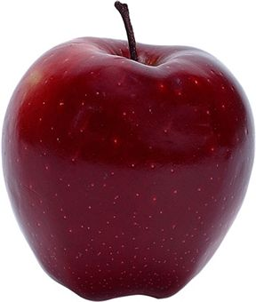
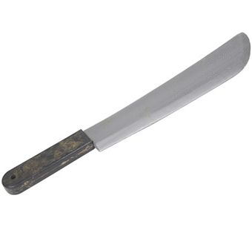
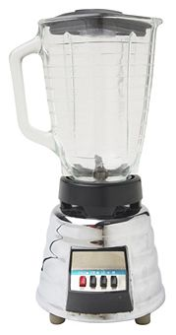

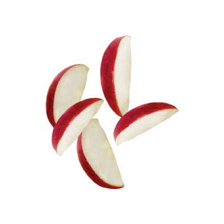
Introduction to MapReduce (Courtesy Judy Qiu)
One day
Sam thought of “drinking” the apple
He used a to cut the and a and a to make juice.

Slide 45
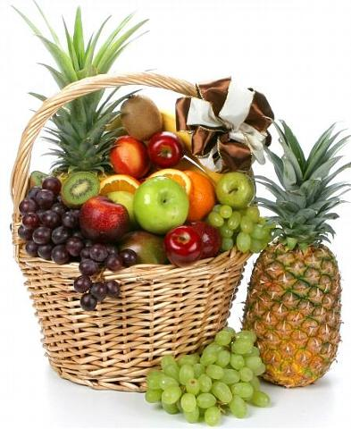
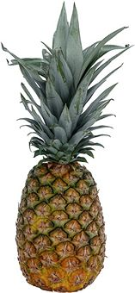
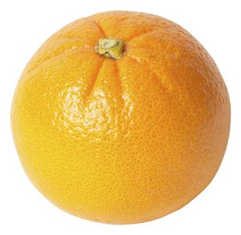

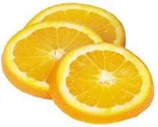
Next Day
Sam applied his invention to all the fruits he could find in the fruit basket
(map ‘( ))
A list of values mapped into another list of values, which gets reduced into a single value
( )
(reduce ‘( ))
Classical Notion of Map Reduce in Functional Programming

Slide 46
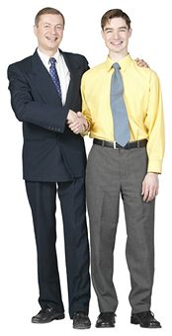
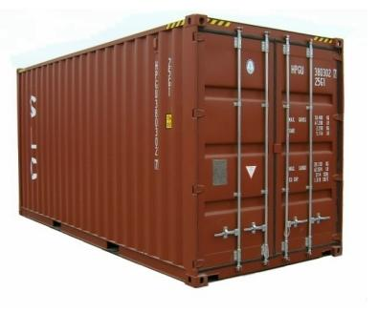
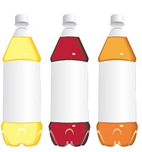
18 Years Later
Sam got his first job in JuiceRUs for his talent in making juice
Wait!
Now, it’s not just one basket but a whole container of fruits
Fruits
Large data and list of values for output
Also, they produce a list of juice types separately
But, Sam had just ONE and ONE
NOT ENOUGH !!

Slide 47



Brave Sam
Implemented a parallel version of his innovation
Fruits
Each input to a map is a list of <key, value> pairs
(<a, > , <o, > , <p, > , …)
Each output of a map is a list of <key, value> pairs
A list of <key, value> pairs mapped into another list of <key, value> pairs which gets grouped by the key and reduced into a list of values
(<a’, > , <o’, > , <p’, > , …)
Grouped by key
Each input to a reduce is a <key, value-list> (possibly a list of these, depending on the grouping/hashing mechanism)
e.g. <a’, ( …)>
Reduced into a list of values
The idea of Map Reduce in Data Intensive Computing

Slide 48
Afterwards
Sam realized,
  To create his favorite mix fruit juice he can use a combiner after the reducers
  If several <key, value-list> fall into the same group (based on the grouping/hashing algorithm) then use the blender (reducer) separately on each of them
  The knife (mapper) and blender (reducer) should not contain residue after use – Side Effect Free
  In general reducer should be associative and commutative
That’s All ─ We think everybody can be Sam ☺

Slide 49
MapReduce
Data Partitions
Map(Key, Value)
A hash function maps the results of the map tasks to r reduce tasks
Reduce(Key, List<Value>)
Reduce Outputs
Implementations support:
  Splitting of data
  Passing the output of map functions to reduce functions
  Sorting the inputs to the reduce function based on the intermediate keys
  Quality of service
We will cover Hadoop and Twister in Summer School

Slide 50
MapReduce for MPI Users
… MPI Communication
Do a bunch of Computing
Another MPI Communication
“Do a bunch of Computing” is a Map
MPI_Reduce corresponds to “Reduce” in MapReduce
Data tends to be in memory for MPI and starts on disk for MapReduce
MapReduce has simple automatic parallelization
MapReduce writes to disk which allows more dynamic fault tolerant operation
Reduce in MapReduce is a real program; in MPI it is either simple default like “add” or user function

Slide 51
Commercial “Web 2.0” Cloud Applications
Internet search, Social networking, e-commerce, cloud storage
These are larger systems than used in HPC with huge levels of parallelism coming from
  Processing of lots of users or
  An intrinsically parallel Tweet or Web search
Classic MapReduce is suitable (although Page Rank component of search is parallel linear algebra)
Data Intensive
Do not need microsecond messaging latency

Slide 52
Data Intensive Applications
Applications tend to be new and so can consider emerging technologies such as clouds
Do not have lots of small messages but rather large reduction (aka Collective) operations
  New optimizations e.g. for huge messages
  e.g. Expectation Maximization (EM) dominated by broadcasts and reductions
Not clearly a single exascale job but rather many smaller (but not sequential) jobs e.g. to analyze groups of sequences
Algorithms not clearly robust enough to analyze lots of data
  Current standard algorithms such as those in R library not designed for big data

Slide 53
4 Forms of MapReduce
(a) Map Only
(b) Classic MapReduce
(c) Iterative MapReduce
(d) Loosely Synchronous
Input
Input
Iterations
Input
map
map
map
P_{ij}
reduce
reduce
Output
BLAST Analysis
Parametric sweep
Pleasingly Parallel
High Energy Physics (HEP) Histograms
Distributed search
Expectation maximization Clustering e.g. Kmeans
Linear Algebra, Page Rank
Classic MPI
PDE Solvers and particle dynamics
Domain of MapReduce and Iterative Extensions
Science Clouds
MPI
Exascale

Slide 54
Using Clouds

Slide 55
How to use Clouds I
Build the application as a service. Because you are deploying one or more full virtual machines and because clouds are designed to host web services, you want your application to support multiple users or, at least, a sequence of multiple executions.
  If you are not using the application, scale down the number of servers and scale up with demand.
  Attempting to deploy 100 VMs to run a program that executes for 10 minutes is a waste of resources because the deployment may take more than 10 minutes.
  To minimize start up time one needs to have services running continuously ready to process the incoming demand.
Build on existing cloud deployments. For example use an existing MapReduce deployment such as Hadoop or existing Roles and Appliances (Images)

Slide 56
How to use Clouds II
Use PaaS if possible. For platform-as-a-service clouds like Azure use the tools that are provided such as queues, web and worker roles and blob, table and SQL storage.
  Note HPC systems don’t offer much in PaaS area
Design for failure. Applications that are services that run forever will experience failures. The cloud has mechanisms that automatically recover lost resources, but the application needs to be designed to be fault tolerant.
  In particular, environments like MapReduce (Hadoop, Daytona, Twister4Azure) will automatically recover many explicit failures and adopt scheduling strategies that recover performance "failures" from for example delayed tasks.
  One expects an increasing number of such Platform features to be offered by clouds and users will still need to program in a fashion that allows task failures but be rewarded by environments that transparently cope with these failures. (Need to build more such robust environments)

Slide 57
How to use Clouds III
Use “as a Service” where possible. Capabilities such as SQLaaS (database as a service or a database appliance) provide a friendlier approach than the traditional non-cloud approach exemplified by installing MySQL on the local disk.
  Suggest that many prepackaged aaS capabilities such as Workflow as a Service for eScience will be developed and simplify the development of sophisticated applications.
Moving Data is a challenge. The general rule is that one should move computation to the data, but if the only computational resource available is a the cloud, you are stuck if the data is not also there.
  Persuade Cloud Vendor to host your data free in cloud
  Persuade Internet2 to provide good link to Cloud
  Decide on Object Store v. HDFS style (or v. Lustre WAFS on HPC)

Slide 58
The Summer School
Program

Slide 59
Monday Morning
11:00am - 12:00 noon: Introduction, Geoffrey Fox, IU
  Introduction to Clouds
  General Applications on Cloud
  Intro to MapReduce and IaaS
12:00 noon - 1:00pm Application: Biology on the Cloud, Michael Schatz, Cold Spring Harbor
1:00pm - 1:30pm Infrastructure Used: FutureGrid, Geoffrey Fox, Indiana University
  Make certain we have SSH keys
2:30pm - 3:30pm: Introduction to virtual high performance computing clusters, Thomas J. Hacker, Purdue University
Notes:
Introduction to Cloud Computing, their use in Science and the Summer School
First Application Using clouds and MapReduce for Biology. Michael Schatz international leader in this area
Description of host for most exercises FutureGrid; you can keep account and win a prize – submit by September 15
One key idea of clouds is that you can create your own machines your own network and your own collection of machines. Tom hacker from nearby Purdue pioneer in this area

Slide 60
Monday Afternoon I
3:30pm - 4:30pm Nimbus: Infrastructure Cloud Computing for Science, Kate Keahey, University of Chicago/Argonne National Laboratory
  Benefits of cloud computing for science
  Nimbus Infrastructure
  Scientific Applications using Nimbus
  Nimbus Platform: virtual clusters, cloud bursting, elasticity, reliability, and failure management
5:00pm - 5:45pm Nimbus Infrastructure: Hands-on Using Infrastructure Clouds, John Bresnahan, University of Chicago/Argonne National Laboratory
  Cloud Client Exercises
  Virtual cluster Exercises
Notes:
Nimbus is the featured IaaS on FutureGrid and our first lab session. Kate Keahey is FutureGrid co-PI and inventor of Nimbus. She has used Nimbus to explore many important scince apps on clouds

Slide 61
Monday Afternoon II - Evening
5:45pm - 6:45pm Nimbus Platform: Managing Deployments in Multi-Cloud Environments, John Bresnahan, Mike Wilde, & Kate Keahey, University of Chicago/Argonne National Laboratory
Cloudinit.d: managing complex launches in multi-cloud environments (15 minutes)
  Using Chef and Cloudinit.d demonstration
Phantom: Cloudbursting and Availability (15 minutes)
  Autoscaling, Demonstration of Phantom web application
  Simple Application demonstration
Scientific Example: MODIS Satellite Image Processing (15 minutes)
  Satellite Image Processing
  Workflows as programming model for the cloud
  Demonstration
Question and Answer (15 minutes)
6:45pm - 7:00pm Wrap-Up Session
Notes:
Moving to a real application Kate is joined by Mike Wilde

Slide 62
Tuesday July 31 - CLOUD TECHNOLOGIES
11:00am - 12:00 noon Running MapReduce in Non-Traditional Environments, Abhishek Chandra, University of Minnesota
12:00 noon - 1:30pm Virtual Clusters Supporting MapReduce in Cloud, Jonathan Klinginsmith, IU
  Lab Session
2:30pm - 4:30pm MapReduce and NOSQL Cloud Storage, Jerome Mitchell & Xiaoming Gao, IU
  Hadoop and HDFS
  HBase and Bigtable Storage
  High Level Language: Pig
  Lab Session
5:00pm - 6:45pm Data Mining with Twister Iterative MapReduce, Judy Qiu, IU
  Lab Session
6:45pm - 7:00pm Wrap-Up Session
Notes:
Tuesday focusses on cloud (Platform) technologies
Abhishek Chandra discusses novel ways of using MapReduce
Then Professor Qiu’s group gets into detail
Jonathan Klinginsmith explains how to use virtual clusters to run MapReduce.
PhD students Mitchell and Gao discuss Hadoop, Its file system, NOSQL data models, Data parallel language
Qiu goes over

Slide 63
Wednesday August 1 - ACADEMIC AND COMMERCIAL CLOUD INFRASTRUCTURE I
11:00am - 1:00pm: Building Scalable Data Intensive Applications on the Cloud with Makeflow and WorkQueue, Douglas Thain, Notre Dame
  Lab Session
2:00pm - 3:30pm: Commercial IaaS/PaaS I: AWS for Scientists, Jamie Kinney, Amazon Web Services
  The types of problems that researchers are solving using HPC on the AWS today
  Introduction to Amazon EC2, S3 and other HPC-related services
  The power of programmable infrastructure
  Real-time demo of an on-demand HPC cluster
  Walk through a few customer use cases
  Q&A
Notes:
Thain from Notre Dame starts with tools to build complex applications
Kinney from Amazon introduces the first and still dominant commercial cloud Amazon

Slide 64
Wednesday August 1 - ACADEMIC AND COMMERCIAL CLOUD INFRASTRUCTURE II
3:30pm - 4:30pm : Commercial IaaS/PaaS II: Azure and Twister4Azure, Thilina Gunarathne, Indiana University
5:00pm - 5:45pm: Networking and Clouds, Martin Swany, Indiana University
5:45pm - 6:45pm: IaaS in Action II: OpenStack, Gregor von Laszewski & Javier Diaz, Indiana University
  Lab Session
IaaS in Action II: FutureGrid RAIN: Dynamic Provisioning on Bare Metal and IaaS in a Federated Cloud, Gregor von Laszewski & Javier Diaz, Indiana University
  Demo
6:45pm - 7:00pm: Wrap-Up Session
Notes:
Gunarathne from IU discusses another major cloud Microsoft Azure and using Twister (introduced by Qiu Tuesday) on it. Note Azure started with .NET and Windows but now supports Linux
Swany from IU follows with a discussion of networking and clouds
You saw Nimbus on day 1, Eucalyptus day 2 and now von Laszewski & Diaz from IU discuss a third major IaaS infrastructure OPenStack. They also cover technology to dynamically switch between different environments on same hardware – FutureGrid RAIN

Slide 65
Thursday August 2 - CYBERINFRASTRUCTURE/HPC AND CLOUDS: TECHNOLOGY AND APPLICATIONS
11:00am - 1:15pm: Federating HPC, Cyberinfrastructure and Clouds using CometCloud I, Manish Parashar, Rutgers University
  1. Introduction to CometCloud, CometCloud Programming Environments
  2. Development and deployment of master/worker and bag-of-tasks applications
2:15pm - 4:15pm: Federating HPC, Cyberinfrastructure and Clouds using CometCloud II, Manish Parashar, Rutgers University
  3. Development and deployment of MapReduce applications
  4. Additional Programming Paradigms
  5. Discussion and wrap-up
4:45pm - 5:45pm : Magellan: Evaluating Cloud Computing for Science, Lavanya Ramakrishnan, Lawrence Berkeley National Laboratory
5:45pm - 6:45pm : Scientific Workflows in the Cloud, Gideon Juve, USC
6:45pm - 7:00pm: Wrap-Up Session
Notes:
Thursday is devoted to Clouds and their interaction with HPC and Cyberinfrastructure
We start with Manish Parashar and CometCloud that builds on systems like Nimbus
Lavanya Ramakrishnan discusses experience with HPC application in cloud from DoE Magellan project
Finally Juve describes experience using Pegasus workflow systems in cloud

Slide 66
Friday August 3 - EDUCATION APPLICATIONS AND ADVANCED TECHNOLOGY
11:00am - 12:00 noon: Cloud Technology: Virtual Private Clusters: Virtual Appliances and Networks in the Cloud, Renato Figueiredo, University of Florida
12:00 noon - 1:00pm: Applications of Cloud: DOE Systems Biology Knowledgebase, Rick Stevens, Argonne and University of Chicago
1:00pm - 1:30pm: Survey
2:30pm - 3:30pm: Cloud Technology: Cloud Security: New Challenges and New Opportunities, XiaoFeng Wang, Indiana University
3:30pm - 4:30pm: Applications of Cloud: The iPlant Collaborative: Science in the Cloud for Plant Biology, Dan Stanzione, TACC
5:30pm - 5:15pm: Cloud Technology: GPU on Clouds, Andrew J. Younge, Indiana University
5:15pm - 5:30pm : Final Wrap-Up Session
Notes:
Friday discusses applications and advanced topics
Renato Figueiredo from Florida discusses appliances which are a key idea in clouds and how they can be combined with virtual networks
We have two more biology applications. Rick Stevens from Argonne on the DoE knowledgebase and Dan Stanzione on Plant Biology in the cloud
XiaoFeng Wang describes critical issue of Clouds and Security
Finally Andrew Younge, PhD student at IU discusses combining GPU’s with cloud

Slide 67
Summary

Slide 68
Using Science Clouds in a Nutshell
High Throughput Computing; pleasingly parallel; grid applications
Multiple users (long tail of science) and usages (parameter searches)
Internet of Things (Sensor nets) as in cloud support of smart phones
(Iterative) MapReduce including “most” data analysis
Exploiting elasticity and platforms (HDFS, Object Stores, Queues ..)
Use worker roles, services, portals (gateways) and workflow
Good Strategies:
  Build the application as a service;
  Build on existing cloud deployments such as Hadoop;
  Use PaaS if possible;
  Design for failure;
  Use as a Service (e.g. SQLaaS) where possible;
  Address Challenge of Moving Data

Slide 69
Topics Covered in Summer School
Several Applications with 3 talks on Life Sciences and talks on experiences with HPC on the cloud and use of specific technologies in particular applications
Virtual Machine management: Nimbus, Eucalyptus, OpenStack
Amazon and Azure commercial clouds
Combining/Federating clouds and bursting from one to another
Virtual Networks and Virtual Clusters
Appliances or Images – the building block of Cloud applications
Building Services and composing them with Workflow
Running loosely coupled collections of jobs
Parallel Computing on Clouds or HPC with MapReduce
Novel Data models: NOSQL, Data parallel file systems (HDFS), Object stores, Queues and Tables
Key cross cutting technologies: Security, Networks and Use of GPU’s

