Slide 1



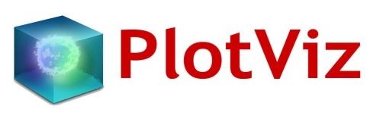
Iterative MapReduce Enabling HPC-Cloud Interoperability
SALSA HPC Group
http://salsahpc.indiana.edu
School of Informatics and Computing
Indiana University

Slide 2
A New Book from Morgan Kaufmann Publishers, an imprint of Elsevier, Inc.,
Burlington, MA 01803, USA. (ISBN: 9780123858801)
Distributed Systems and Cloud Computing:
From Parallel Processing to the Internet of Things
Kai Hwang, Geoffrey Fox, Jack Dongarra

Slide 3




SALSA HPC Group
Twister Bingjing Zhang, Richard Teng Funded by Microsoft Foundation Grant, Indiana University's Faculty Research Support Program and NSF OCI-1032677 Grant
 | Twister4Azure Thilina Gunarathne Funded by Microsoft Azure Grant
High-Performance Visualization Algorithms For Data-Intensive Analysis Seung-Hee Bae and Jong Youl Choi Funded by NIH Grant 1RC2HG005806-01

Slide 4







 | DryadLINQ CTP Evaluation Hui Li, Yang Ruan, and Yuduo Zhou Funded by Microsoft Foundation Grant
Cloud Storage, FutureGrid Xiaoming Gao, Stephen Wu Funded by Indiana University's Faculty Research Support Program and Natural Science Foundation Grant 0910812
Million Sequence Challenge Saliya Ekanayake, Adam Hughs, Yang Ruan Funded by NIH Grant 1RC2HG005806-01
 | Cyberinfrastructure for Remote Sensing of Ice Sheets Jerome Mitchell Funded by NSF Grant OCI-0636361

Slide 5
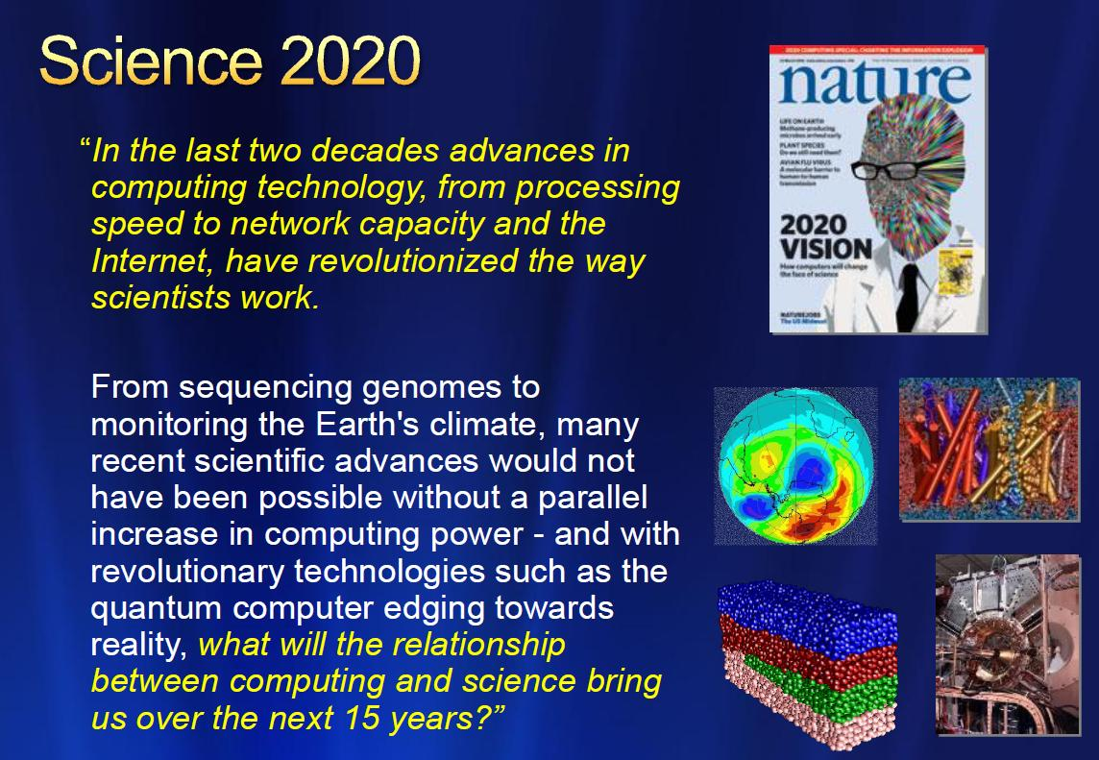
MICROSOFT

Slide 6
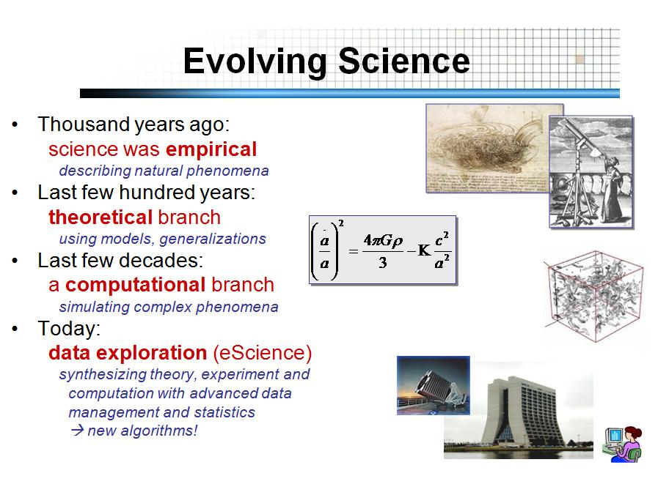
Alex Szalay, The Johns Hopkins University

Slide 7


Paradigm Shift in Data Intensive Computing

Slide 8
Intel’s Application Stack

Slide 9
(Iterative) MapReduce in Context
Support Scientific Simulations (Data Mining and Data Analysis)
Kernels, Genomics, Proteomics, Information Retrieval, Polar Science, Scientific Simulation Data Analysis and Management, Dissimilarity Computation, Clustering, Multidimensional Scaling, Generative Topological Mapping
Applications
Security, Provenance, Portal
Programming Model
Services and Workflow
High Level Language
Runtime
Cross Platform Iterative MapReduce (Collectives, Fault Tolerance, Scheduling)
Storage
Distributed File Systems
Object Store
Data Parallel File System
Linux HPC
Bare-system
Amazon Cloud
Windows Server HPC
Bare-system
Azure Cloud
Grid Appliance
Infrastructure
Virtualization
Virtualization
Hardware
CPU Nodes
GPU Nodes

Slide 10
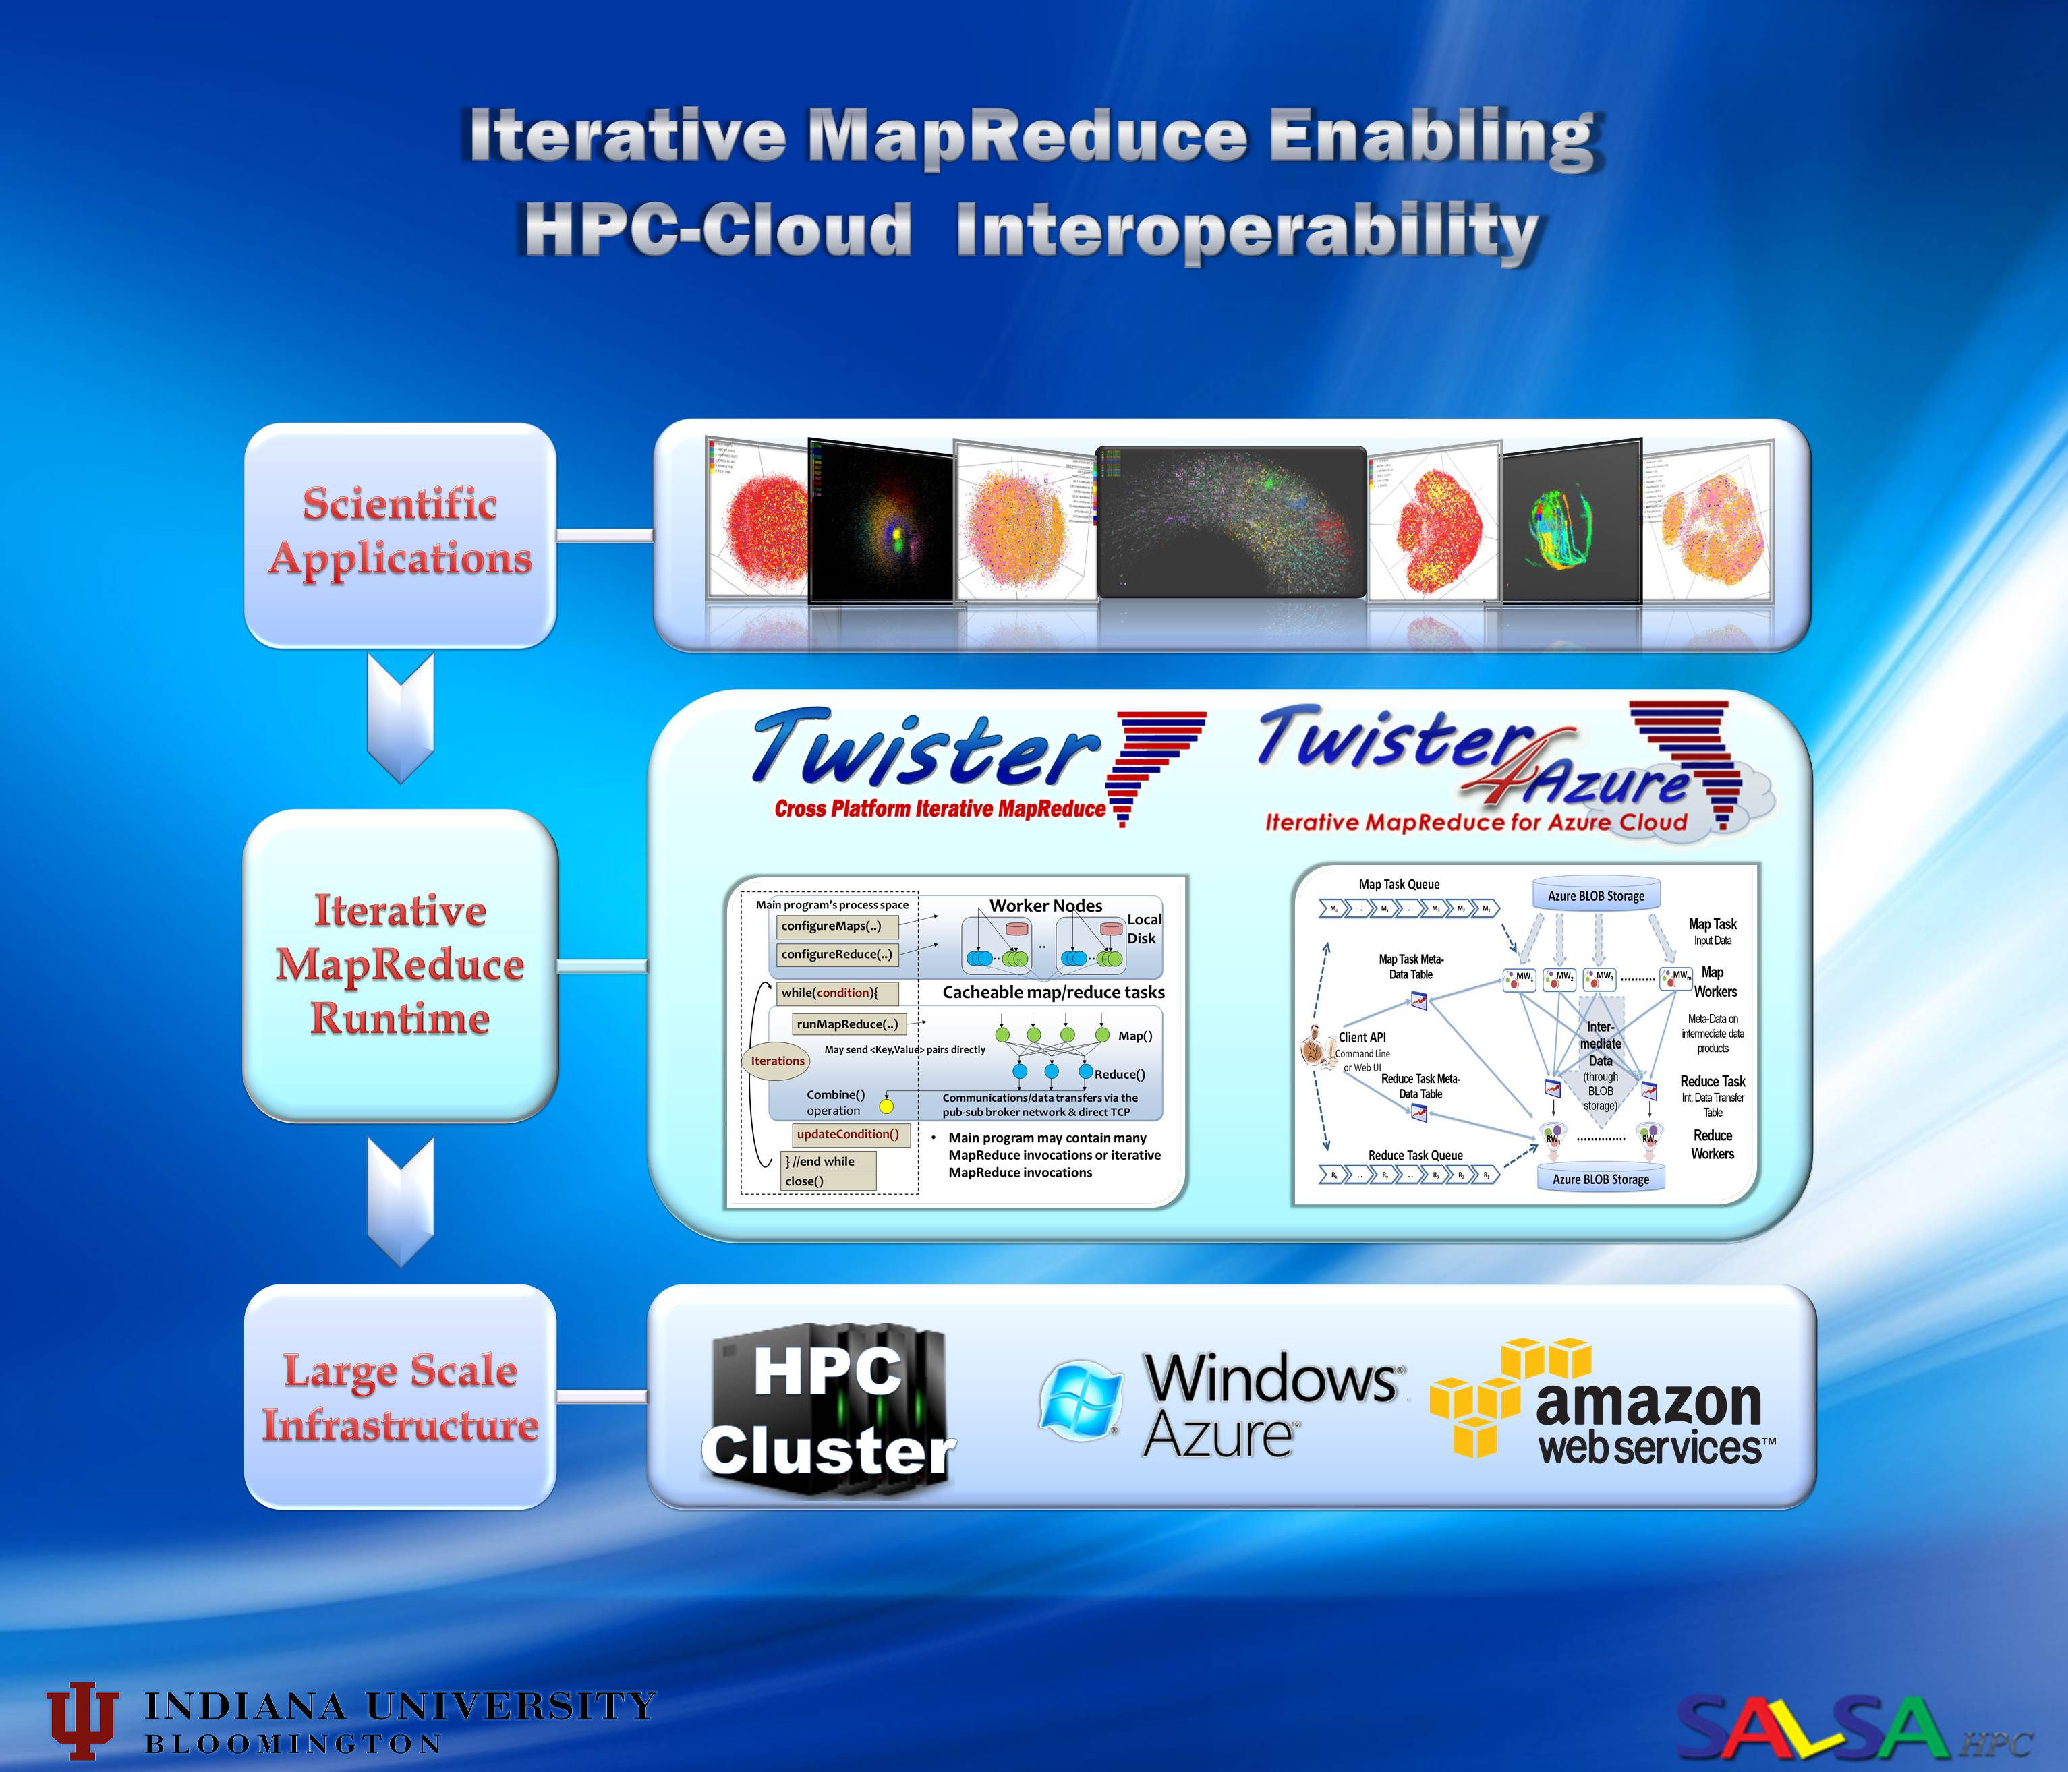

Slide 11
What are the challenges?
Providing both cost effectiveness and powerful parallel programming paradigms that is capable of handling the incredible increases in dataset sizes.
(large-scale data analysis for Data Intensive applications )
Research issues
portability between HPC and Cloud systems
scaling performance
fault tolerance
These challenges must be met for both computation and storage. If computation and storage are separated, it’s not possible to bring computing to data.
Data locality
its impact on performance;
the factors that affect data locality;
the maximum degree of data locality that can be achieved.
Factors beyond data locality to improve performance
To achieve the best data locality is not always the optimal scheduling decision. For instance, if the node where input data of a task are stored is overloaded, to run the task on it will result in performance degradation.
Task granularity and load balance
In MapReduce , task granularity is fixed.
This mechanism has two drawbacks
limited degree of concurrency
load unbalancing resulting from the variation of task execution time.

Slide 12
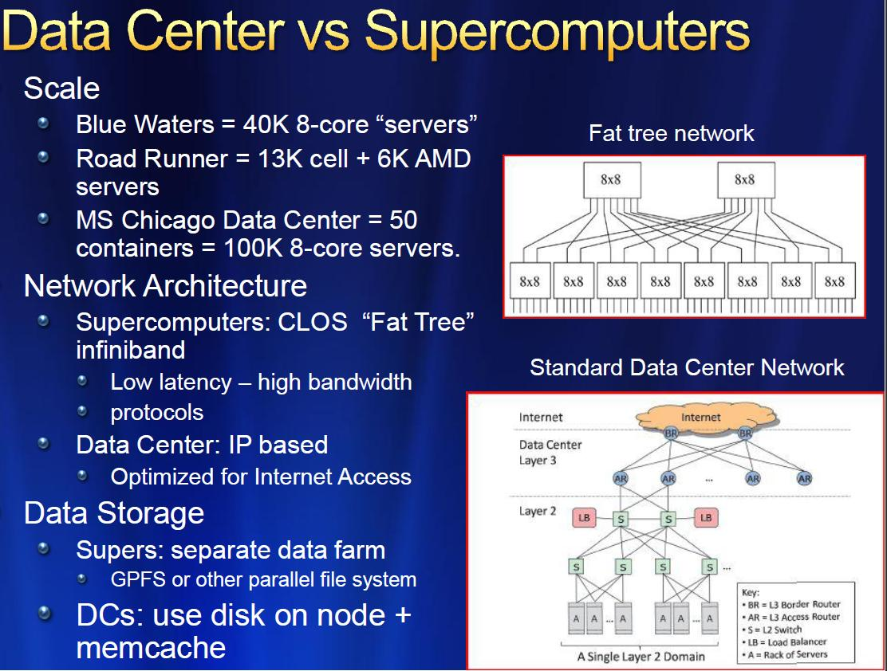
12
MICROSOFT

Slide 13
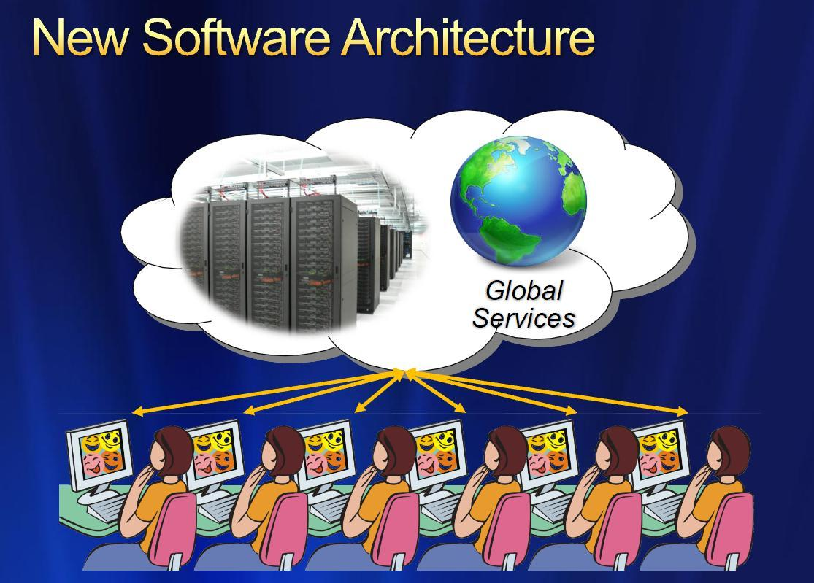
MICROSOFT

Slide 14
Clouds hide Complexity
Cyberinfrastructure
Is “Research as a Service”
SaaS: Software as a Service
(e.g. Clustering is a service)
PaaS: Platform as a Service
IaaS plus core software capabilities on which you build SaaS
(e.g. Azure is a PaaS; MapReduce is a Platform)
IaaS (HaaS): Infrasturcture as a Service
(get computer time with a credit card and with a Web interface like EC2)

Slide 15

Please sign and return your video waiver.
Plan to arrive early to your session in order to copy
your presentation to the conference PC.
Poster drop-off is at Scholars Hall on Wednesday
from 7:30 am – Noon. Please take your poster with
you after the session on Wednesday evening.

Slide 16

Gartner 2009 Hype Curve
Source: Gartner (August 2009)
HPC
?

Slide 17
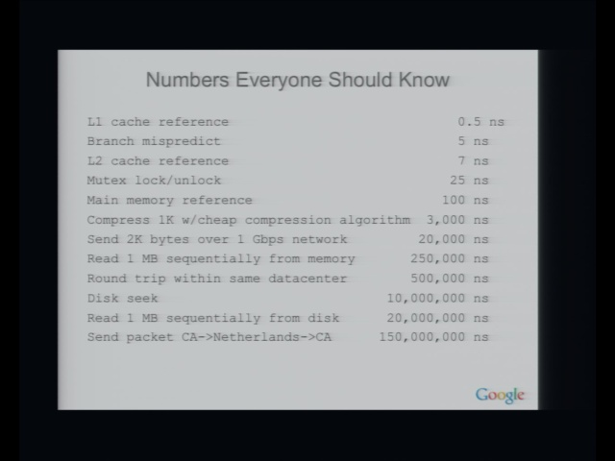
L1 cache reference | 0.5 ns
Branch mispredict | 5 ns
L2 cache reference | 7 ns
Mutex lock/unlock | 25 ns
Main memory reference | 100 ns
Compress 1K w/cheap compression algorithm | 3,000 ns
Send 2K bytes over 1 Gbps network | 20,000 ns
Read 1 MB sequentially from memory | 250,000 ns
Round trip within same datacenter | 500,000 ns
Disk seek | 10,000,000 ns
Read 1 MB sequentially from disk | 20,000,000 ns
Send packet CA->Netherlands->CA | 150,000,000 ns

Slide 18
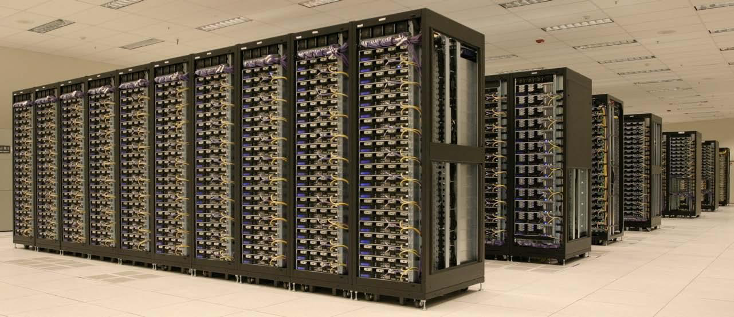
Programming on a Computer Cluster
Servers running Hadoop at Yahoo.com
http://thecloudtutorial.com/hadoop-tutorial.html

Slide 19
Parallel Thinking

Slide 20
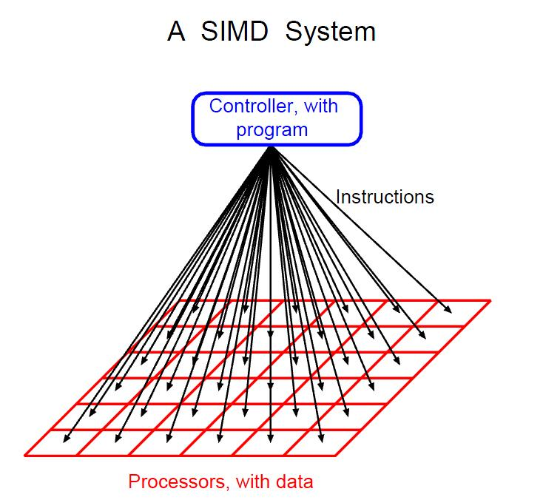

Slide 21
SPMD Software
Single Program Multiple Data (SPMD):
a coarse-grained SIMD approach to programming for MIMD systems.
Data parallel software:
do the same thing to all elements of a structure (e.g., many matrix algorithms). Easiest to write and understand.
Unfortunately, difficult to apply to complex problems (as were the SIMD machines; Mapreduce).
What applications are suitable for SPMD?
(e.g. Wordcount)

Slide 22
MPMD Software
Multiple Program Multiple Data (SPMD):
a coarse-grained MIMD approach to programming
Data parallel software:
do the same thing to all elements of a structure (e.g., many matrix algorithms). Easiest to write and understand.
It applies to complex problems (e.g. MPI, distributed system).
What applications are suitable for MPMD?
(e.g. wikipedia)

Slide 23
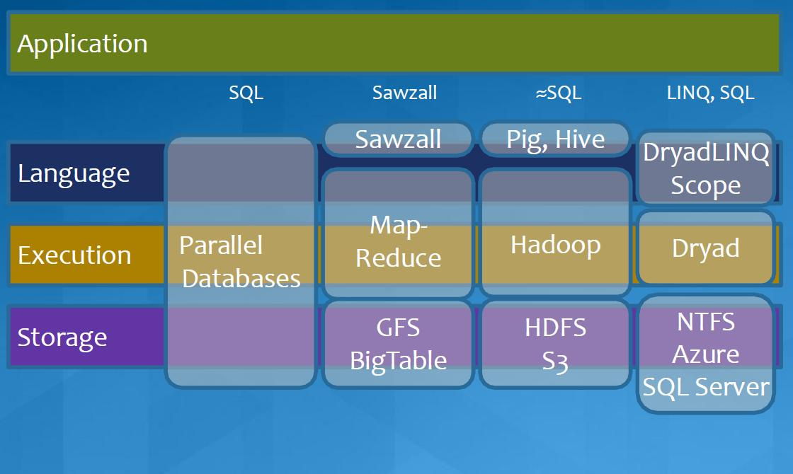
Programming Models and Tools
MapReduce in Heterogeneous Environment
MICROSOFT
23
Notes:
http://dss-vm.ncsa.illinois.edu/summerschool2010/bigdata/DistributedData.mov
http://groups.google.com/group/vscse-big-data-for-science-2010/web/course-presentations?hl=en

Slide 24
Next Generation Sequencing Pipeline on Cloud
MapReduce
Pairwise
clustering
FASTA File
N Sequences
block
Pairings
Pairwise
Distance
Calculation
Dissimilarity
Matrix
N(N-1)/2 values
Clustering
Visualization
Plotviz
Blast
Visualization
Plotviz
MPI
1
2
MDS
3
4
5
4
Users submit their jobs to the pipeline and the results will be shown in a visualization tool.
This chart illustrate a hybrid model with MapReduce and MPI. Twister will be an unified solution for the pipeline mode.
The components are services and so is the whole pipeline.
We could research on which stages of pipeline services are suitable for private or commercial Clouds.

Slide 25
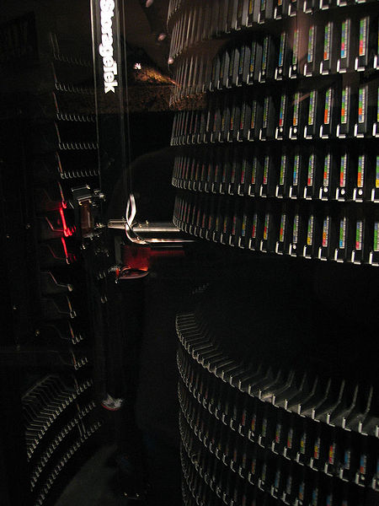
Motivation
Data Deluge
MapReduce
Classic Parallel Runtimes (MPI)
Data Centered, QoS
Efficient and Proven techniques
Experiencing in many domains
Expand the Applicability of MapReduce to more classes of Applications
Iterative MapReduce
Map-Only
MapReduce
More Extensions
iterations
Input
Input
Input
map
map
map
Pij
reduce
reduce
Output

Slide 26
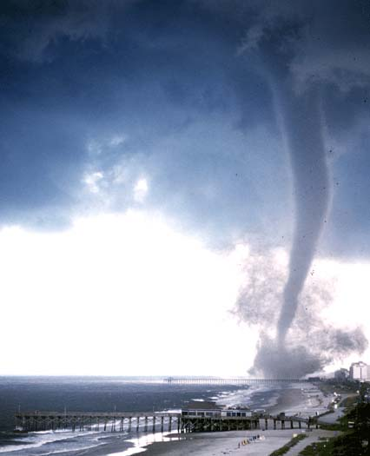

Twister v0.9
  New Infrastructure for Iterative MapReduce Programming
  Distinction on static and variable data
  Configurable long running (cacheable) map/reduce tasks
  Pub/sub messaging based communication/data transfers
  Broker Network for facilitating communication

Slide 27
Main program’s process space
Worker Nodes
configureMaps(..)
Local Disk
configureReduce(..)
Cacheable map/reduce tasks
while(condition){
runMapReduce(..)
May send <Key,Value> pairs directly
Map()
Iterations
Reduce()
Combine() operation
Communications/data transfers via the pub-sub broker network & direct TCP
updateCondition()
Main program may contain many MapReduce invocations or iterative MapReduce invocations
} //end while
close()

Slide 28
Master Node
B
Pub/sub
Broker Network
Twister
Driver
B
B
B
Main Program
One broker serves several Twister daemons
Twister Daemon
Twister Daemon
map
reduce
Cacheable tasks
Worker Pool
Worker Pool
Scripts perform:
Data distribution, data collection, and partition file creation
Local Disk
Local Disk
Worker Node
Worker Node

Slide 29
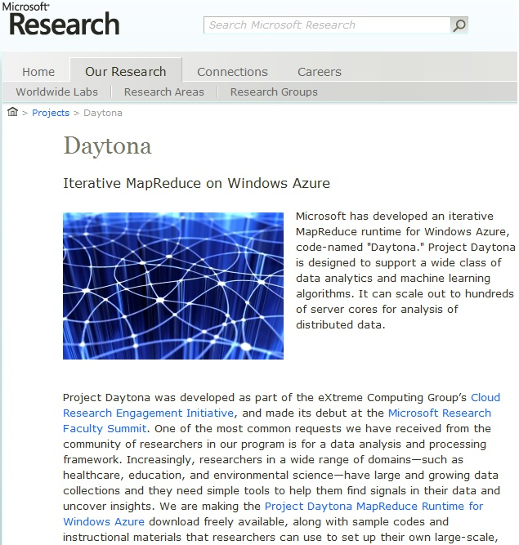

Slide 30
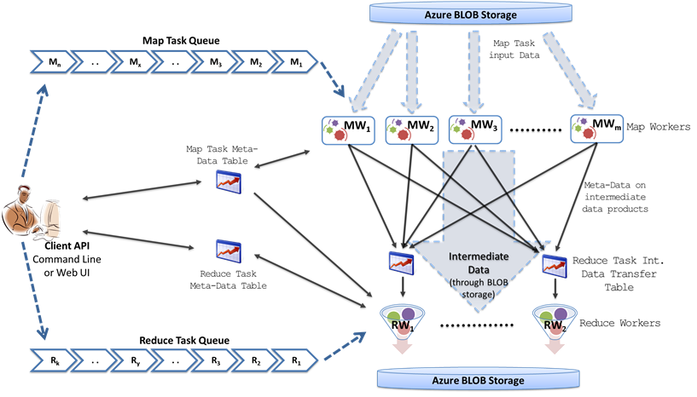
MRRoles4Azure
Azure Queues for scheduling, Tables to store meta-data and monitoring data, Blobs for input/output/intermediate data storage.

Slide 31
Iterative MapReduce for Azure
Programming model extensions to support broadcast data
Merge Step
In-Memory Caching of static data
Cache aware hybrid scheduling using Queues, bulletin board (special table) and execution histories
Hybrid intermediate data transfer

Slide 32
MRRoles4Azure
Distributed, highly scalable and highly available cloud services as the building blocks.
Utilize eventually-consistent , high-latency cloud services effectively to deliver performance comparable to traditional MapReduce runtimes.
Decentralized architecture with global queue based dynamic task scheduling
Minimal management and maintenance overhead
Supports dynamically scaling up and down of the compute resources.
MapReduce fault tolerance

Slide 33
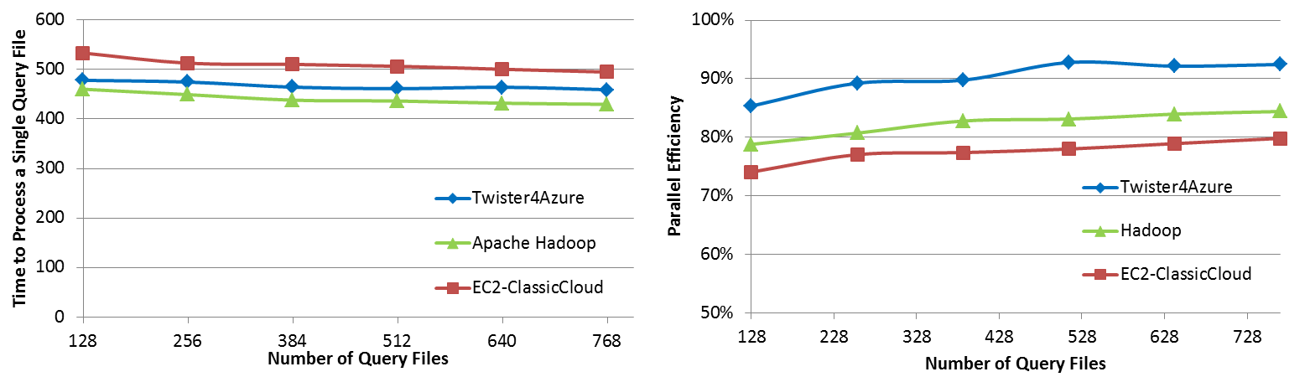

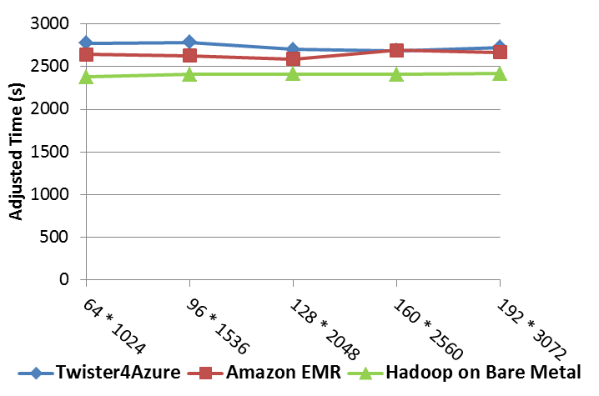
Performance Comparisons
BLAST Sequence Search
Smith Waterman Sequence Alignment
Cap3 Sequence Assembly

Slide 34

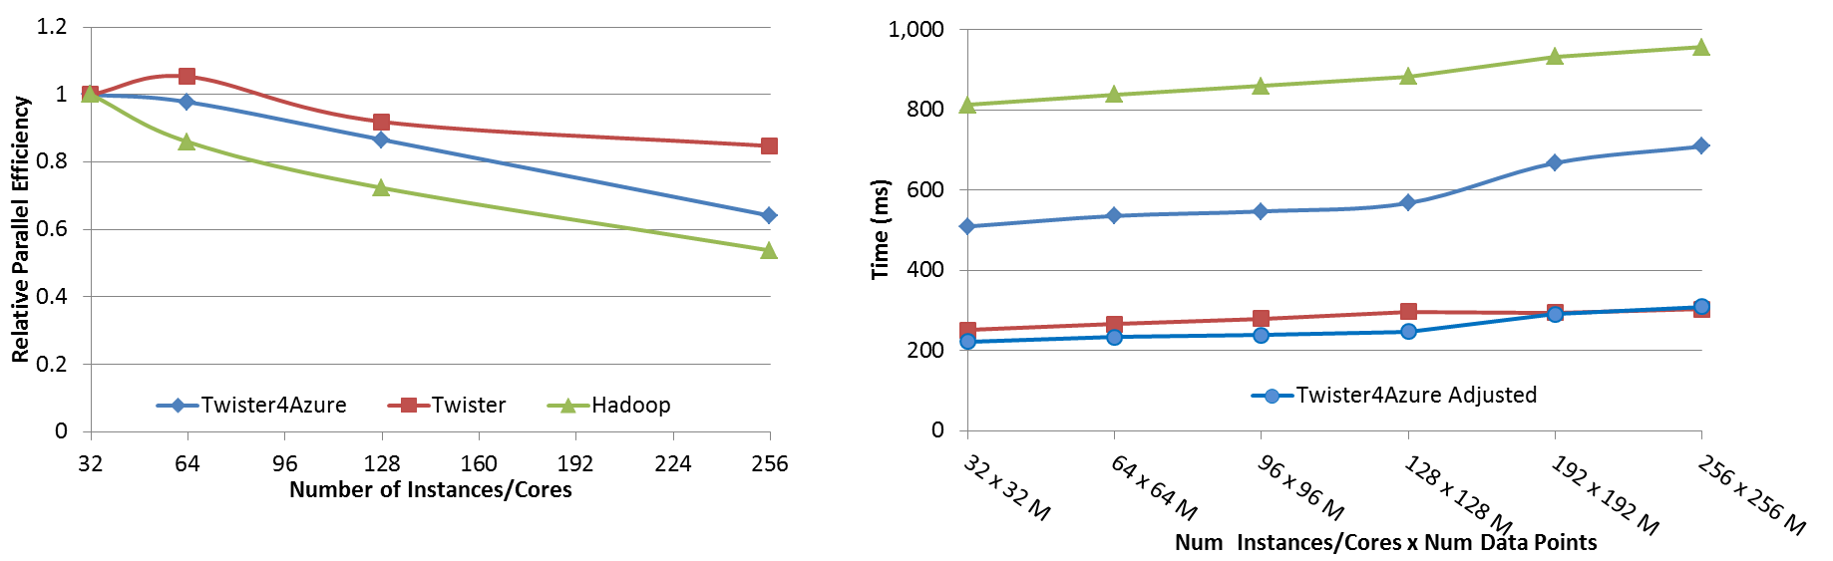




Performance – Kmeans Clustering
Task Execution Time Histogram
Number of Executing Map Task Histogram
Strong Scaling with 128M Data Points
Weak Scaling
Performance with/without
data caching
Speedup gained using data cache
Scaling speedup
Increasing number of iterations
Notes:
Right(c): Twister4Azure executing Map Task histogram for 128 million data points in 128 Azure small instances
Figure 5. KMeansClustering Scalability. Left(a): Relative parallel efficiency of strong scaling using 128 million data points.
Center(b): Weak scaling. Workload per core is kept constant (ideal is a straight horizontal line).

Slide 35
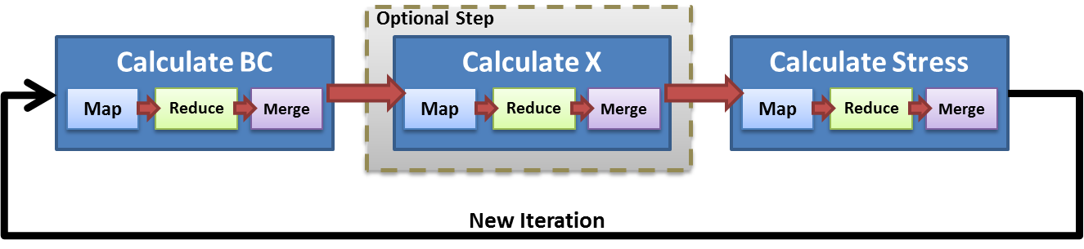
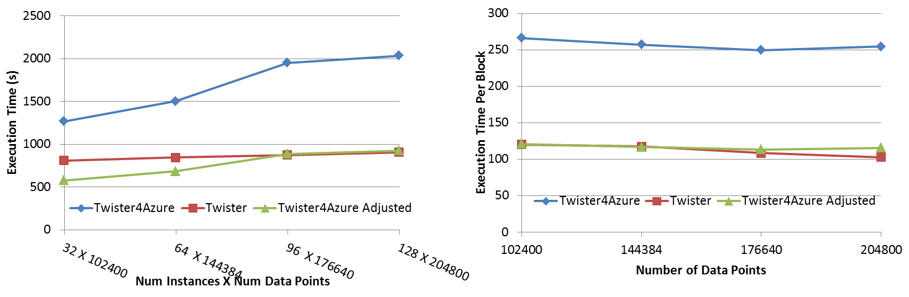
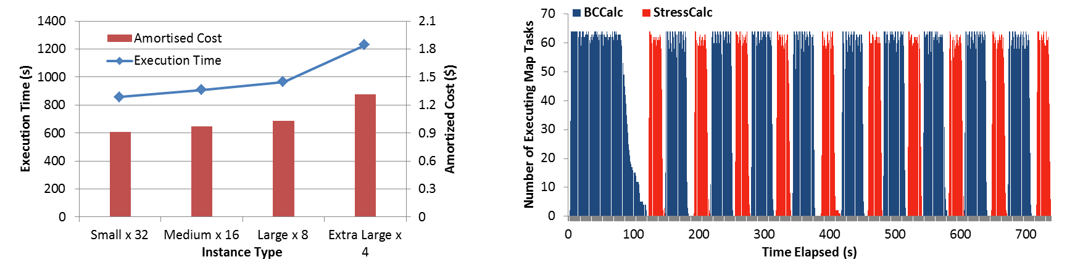
Performance – Multi Dimensional Scaling
Weak Scaling
Data Size Scaling
Task Execution Time Histogram
Azure Instance Type Study
Number of Executing Map Task Histogram
Performance with/without
data caching
Speedup gained using data cache
Scaling speedup
Increasing number of iterations
Notes:
Weak scaling where workload per core is ~constant. Ideal is a straight horizontal line. Center : Data size scaling with 128 Azure small instances/cores, 20 iterations.
Instance type study using 76800 data points, 32 instances, 20 iterations. Right: Twister4Azure executing Map Task histogram for 144384 x144384 distance matrix in 64 Azure small instances, 10 iterations

Slide 36


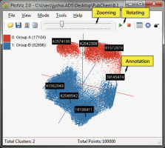
PlotViz, Visualization System
Parallel Visualization Algorithms
PlotViz
Parallel visualization algorithms (GTM, MDS, …)
Improved quality by using DA optimization
Interpolation
Twister Integration (Twister-MDS, Twister-LDA)
Provide Virtual 3D space
Cross-platform
Visualization Toolkit (VTK)
Qt framework

Slide 37
GTM vs. MDS
GTM
MDS (SMACOF)
Purpose
Non-linear dimension reduction
Find an optimal configuration in a lower-dimension
Iterative optimization method
Input
Vector-based data
Non-vector (Pairwise similarity matrix)
Objective
Function
Maximize Log-Likelihood
Minimize STRESS or SSTRESS
Complexity
O(KN) (K << N)
O(N²)
Optimization
Method
EM
Iterative Majorization (EM-like)

Slide 38

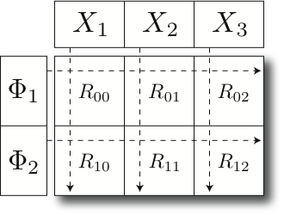
Parallel GTM
GTM / GTM-Interpolation
A
1
A
B
C
Parallel HDF5
ScaLAPACK
B
2
1
MPI / MPI-IO
C
Parallel File System
K latent
points
N data
points
2
Cray / Linux / Windows Cluster
Finding K clusters for N data points
    Relationship is a bipartite graph (bi-graph)
    Represented by K-by-N matrix (K << N)
Decomposition for P-by-Q compute grid
    Reduce memory requirement by 1/PQ
GTM Software Stack

Slide 39
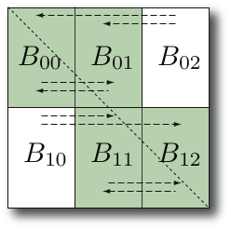
Scalable MDS
Parallel MDS
MDS Interpolation
O(N²) memory and computation required.
  100k data → 480GB memory
Balanced decomposition of NxN matrices by P-by-Q grid.
  Reduce memory and computing requirement by 1/PQ
Communicate via MPI primitives
Finding approximate mapping position w.r.t. k-NN’s prior mapping.
Per point it requires:
  O(M) memory
  O(k) computation
Pleasingly parallel
Mapping 2M in 1450 sec.
  vs. 100k in 27000 sec.
  7500 times faster than estimation of the full MDS.
c1
c2
c3
r1
r2

Slide 40
Interpolation extension to GTM/MDS
MPI, Twister
n
In-sample
Training
Trained data
1
N-n
Out-of-sample
Interpolated map
2
Interpolation
......
P-1
p
Total N data
Twister
Full data processing by GTM or MDS is computing- and memory-intensive
Two step procedure
  Training : training by M samples out of N data
  Interpolation : remaining (N-M) out-of-samples are approximated without training

Slide 41
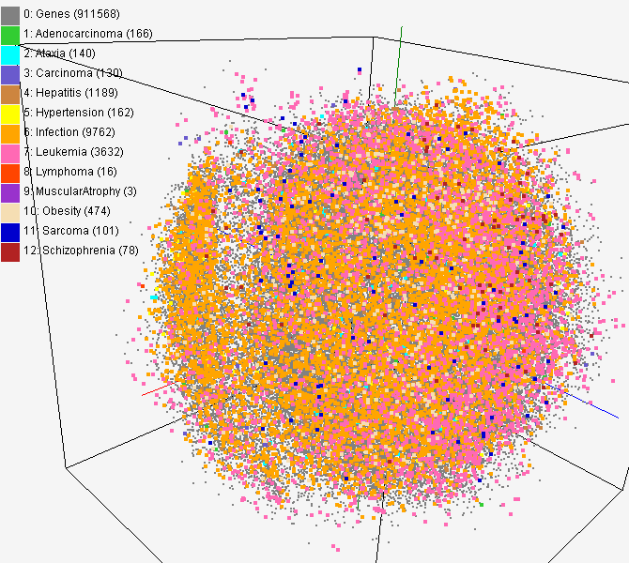
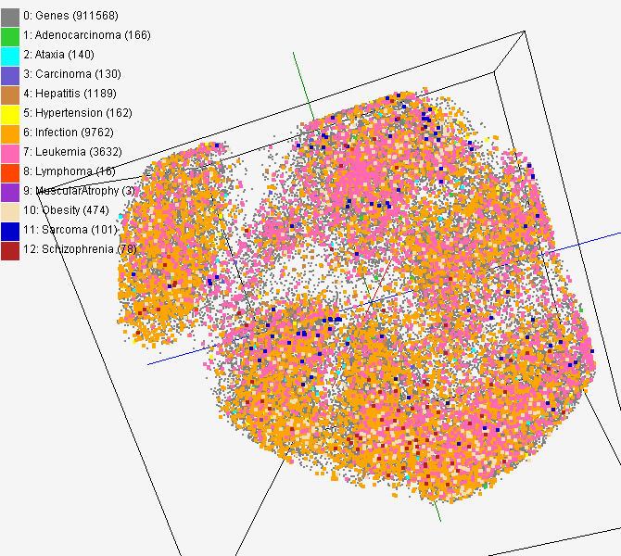
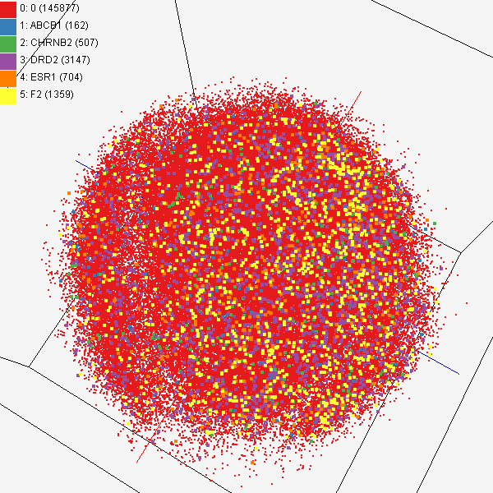
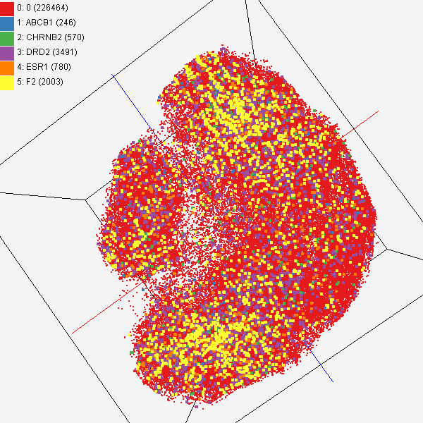
GTM/MDS Applications
PubChem data with CTD visualization by using MDS (left) and GTM (right)
About 930,000 chemical compounds are visualized as a point in 3D space, annotated by the related genes in Comparative Toxicogenomics Database (CTD)
Chemical compounds shown in literatures, visualized by MDS (left) and GTM (right)
Visualized 234,000 chemical compounds which may be related with a set of 5 genes of interest (ABCB1, CHRNB2, DRD2, ESR1, and F2) based on the dataset collected from major journal literatures which is also stored in Chem2Bio2RDF system.

Slide 42

Twister-MDS Demo
This demo is for real time visualization of the process of multidimensional scaling(MDS) calculation.
We use Twister to do parallel calculation inside the cluster, and use PlotViz to show the intermediate results at the user client computer.
The process of computation and monitoring is automated by the program.

Slide 43
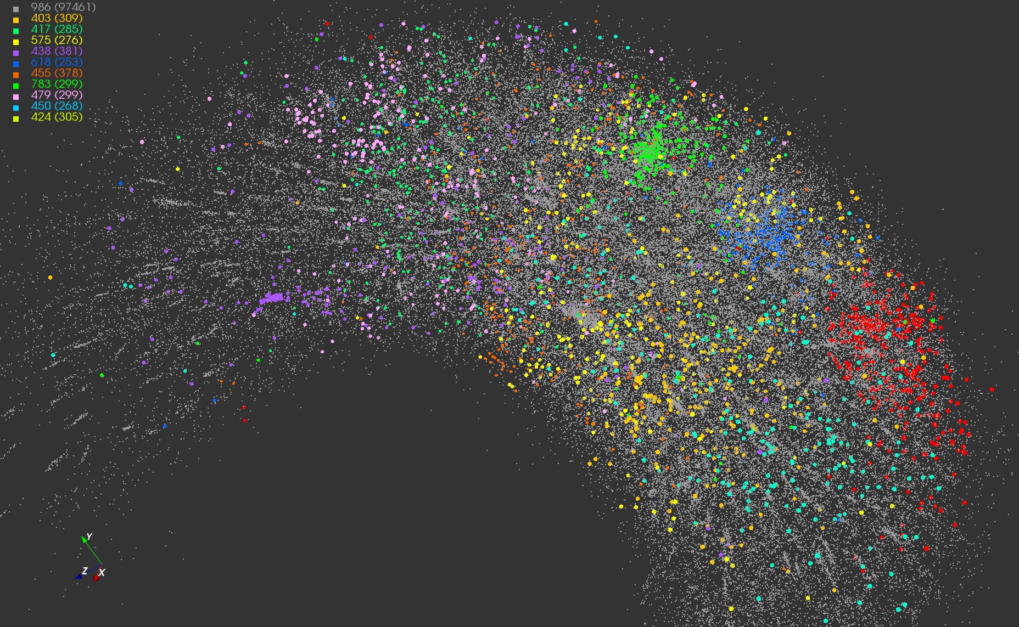
Twister-MDS Output
MDS projection of 100,000 protein sequences showing a few experimentally
identified clusters in preliminary work with Seattle Children’s Research Institute

Slide 44
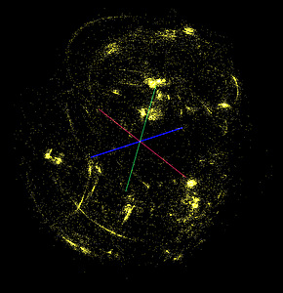
Twister-MDS Work Flow
Client Node
II. Send intermediate results
Master Node
ActiveMQ
Broker
Twister
Driver
MDS Monitor
Twister-MDS
PlotViz
I. Send message to start the job
III. Write data
IV. Read data
Local Disk

Slide 45
Twister-MDS Structure
Master Node
Twister
Driver
Pub/Sub Broker Network
MDS Output Monitoring Interface
Twister-MDS
Twister Daemon
Twister Daemon
map
reduce
calculateBC
map
reduce
calculateStress
Worker Pool
Worker Pool
Worker Node
Worker Node

Slide 46
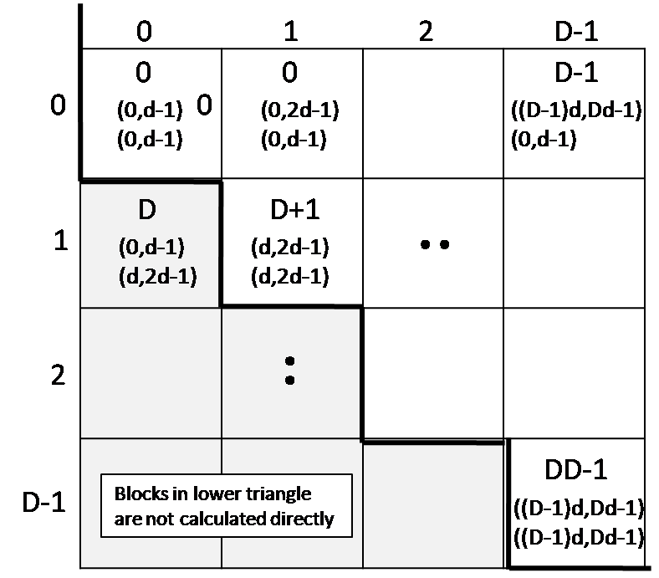
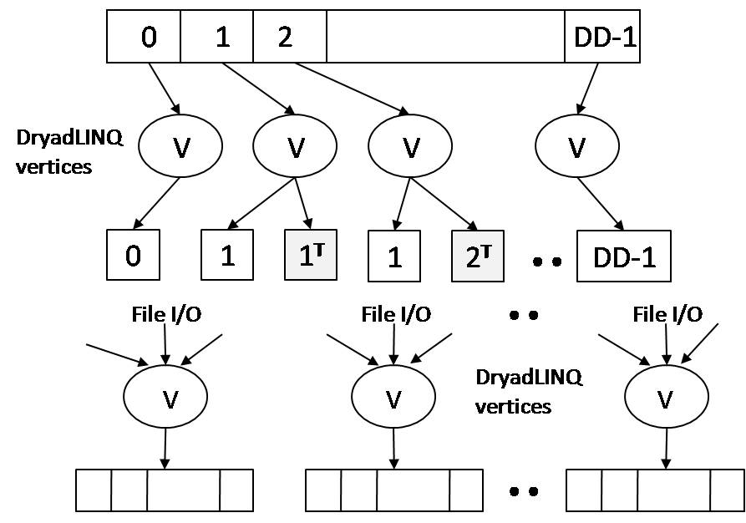
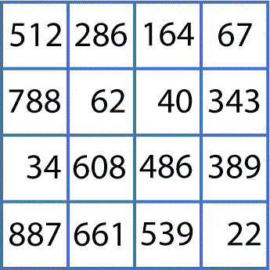
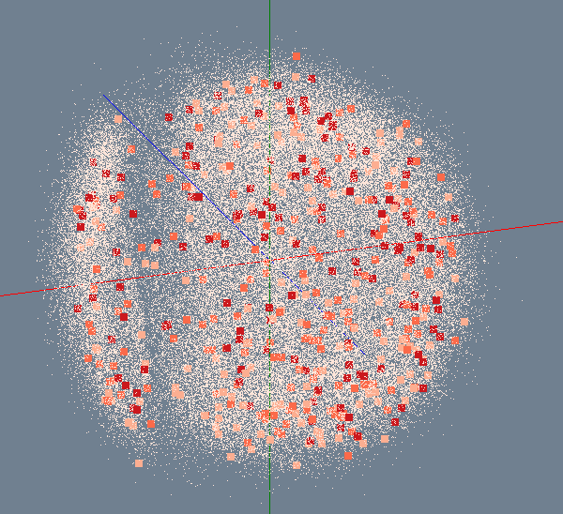

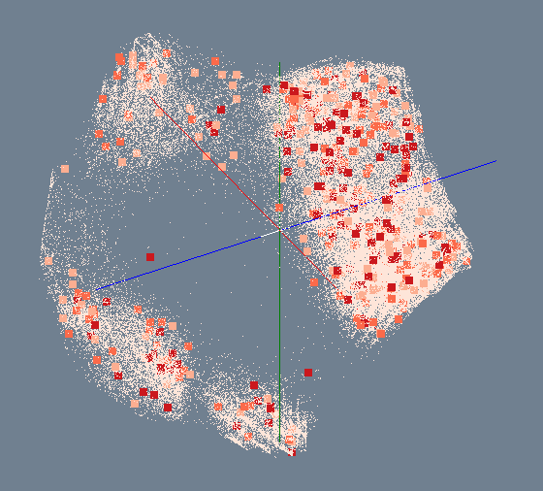
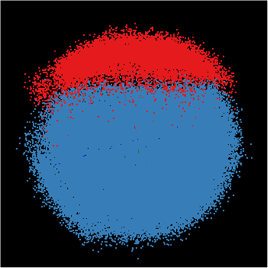
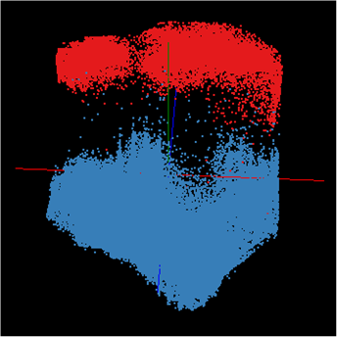
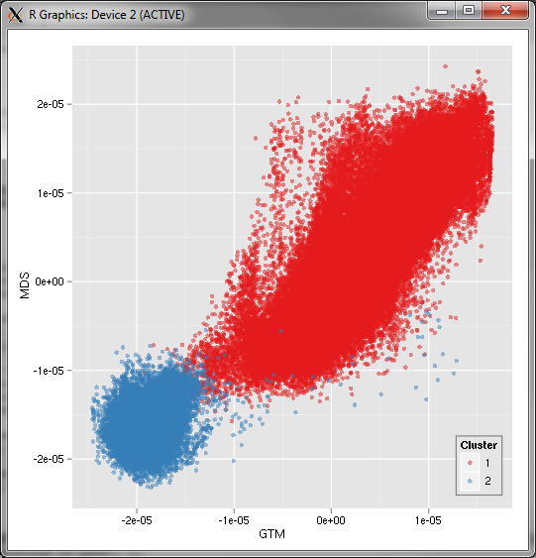
Bioinformatics Pipeline
Gene Sequences (N = 1 Million)
Pairwise Alignment & Distance Calculation
Distance Matrix
Select Reference
Reference Sequence Set (M = 100K)
Reference Coordinates
N - M Sequence Set (900K)
Interpolative MDS with Pairwise Distance Calculation
x, y, z
Multi-Dimensional Scaling (MDS)
O(N²)
N - M Coordinates
x, y, z
Visualization
3D Plot

Slide 47
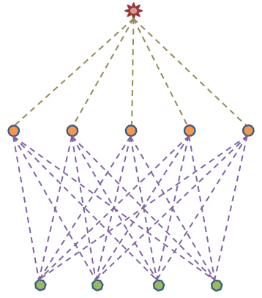
New Network of Brokers
Twister Daemon Node
ActiveMQ Broker Node
B. Hierarchical Sending
Twister Driver
Node
7 Brokers and 32 Computing Nodes in total
A. Full Mesh Network
5 Brokers and 4 Computing Nodes in total
Broker-Driver Connection
Broker-Daemon Connection
Broker-Broker Connection
C. Streaming

Slide 48
Performance Improvement

Slide 49
Broadcasting on 40 Nodes
(In Method C, centroids are split to 160 blocks, sent through 40 brokers in 4 rounds)

Slide 50
Twister New Architecture
Master Node
Worker Node
Worker Node
Broker
Broker
Broker
Configure Mapper
map broadcasting chain
Add to MemCache
map
Map
Cacheable tasks
merge
reduce
Reduce
reduce collection chain
Twister Driver
Twister Daemon
Twister Daemon

Slide 51
Chain/Ring Broadcasting
Twister Daemon Node
Twister Driver Node
Driver sender:
  send broadcasting data
  get acknowledgement
  send next broadcasting data
  …
Daemon sender:
  receive data from the last daemon (or driver)
  cache data to daemon
  Send data to next daemon (waits for ACK)
  send acknowledgement to the last daemon

Slide 52
Chain Broadcasting Protocol
Driver
Daemon 0
Daemon 1
Daemon 2
send
receive
I know this is the end of Daemon Chain
handle data
send
receive
get ack
ack
handle data
send
receive
send
receive
ack
handle data
handle data
ack
get ack
send
receive
get ack
ack
handle data
get ack
send
receive
ack
handle data
ack
get ack
get ack
ack
I know this is the end of Cache Block
get ack
ack

Slide 53
Broadcasting Time Comparison

Slide 54
Applications & Different Interconnection Patterns
Map Only | Classic MapReduce | Iterative Reductions Twister | Loosely Synchronous
CAP3 Analysis Document conversion (PDF -> HTML) Brute force searches in cryptography Parametric sweeps | High Energy Physics (HEP) Histograms SWG gene alignment Distributed search Distributed sorting Information retrieval | Expectation maximization algorithms Clustering Linear Algebra | Many MPI scientific applications utilizing wide variety of communication constructs including local interactions
- CAP3 Gene Assembly - PolarGrid Matlab data analysis | - Information Retrieval - HEP Data Analysis - Calculation of Pairwise Distances for ALU Sequences | Kmeans Deterministic Annealing Clustering - Multidimensional Scaling MDS | - Solving Differential Equations and - particle dynamics with short range forces
Input
iterations
Input
Input
map
map
map
Pij
reduce
Output
reduce
Domain of MapReduce and Iterative Extensions
MPI

Slide 55

Twister Futures
Development of library of Collectives to use at Reduce phase
  Broadcast and Gather needed by current applications
  Discover other important ones
  Implement efficiently on each platform – especially Azure
Better software message routing with broker networks using asynchronous I/O with communication fault tolerance
Support nearby location of data and computing using data parallel file systems
Clearer application fault tolerance model based on implicit synchronizations points at iteration end points
Later: Investigate GPU support
Later: run time for data parallel languages like Sawzall, Pig Latin, LINQ

Slide 56
Convergence is Happening
Multicore
Clouds
Data intensive application (three basic activities):
capture, curation, and analysis (visualization)
Data Intensive
Paradigms
Cloud infrastructure and runtime
Parallel threading and processes

Slide 57

FutureGrid: a Grid Testbed
IU Cray operational, IU IBM (iDataPlex) completed stability test May 6
UCSD IBM operational, UF IBM stability test completes ~ May 12
Network, NID and PU HTC system operational
UC IBM stability test completes ~ May 27; TACC Dell awaiting delivery of components
NID: Network Impairment Device
Private
Public
FG Network

Slide 58

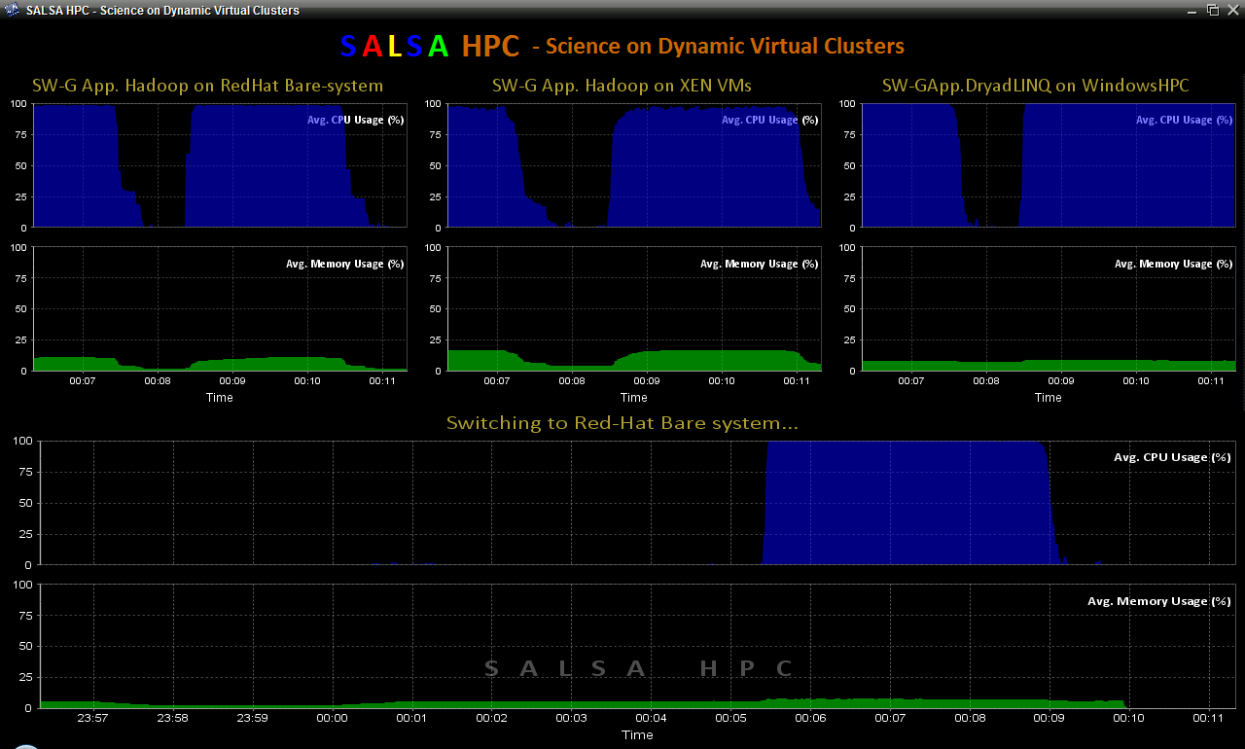
SALSAHPC Dynamic Virtual Cluster on FutureGrid -- Demo at SC09
Demonstrate the concept of Science on Clouds on FutureGrid
Dynamic Cluster Architecture
Monitoring & Control Infrastructure
Monitoring Infrastructure
Monitoring Interface
Pub/Sub Broker Network
SW-G Using Hadoop
SW-G Using Hadoop
SW-G Using DryadLINQ
Linux
Bare-system
Linux on Xen
Windows Server 2008 Bare-system
Virtual/Physical Clusters
Summarizer
XCAT Infrastructure
XCAT Infrastructure
Switcher
iDataplex Bare-metal Nodes
(32 nodes)
iDataplex Bare-metal Nodes
Switchable clusters on the same hardware (~5 minutes between different OS such as Linux+Xen to Windows+HPCS)
Support for virtual clusters
SW-G : Smith Waterman Gotoh Dissimilarity Computation as an pleasingly parallel problem suitable for MapReduce style applications

Slide 59
SALSAHPC Dynamic Virtual Cluster on FutureGrid -- Demo at SC09
Demonstrate the concept of Science on Clouds using a FutureGrid cluster
Top: 3 clusters are switching applications on fixed environment. Takes approximately 30 seconds.
Bottom: Cluster is switching between environments: Linux; Linux +Xen; Windows + HPCS.
Takes approxomately 7 minutes
SALSAHPC Demo at SC09. This demonstrates the concept of Science on Clouds using a FutureGrid iDataPlex.

Slide 60
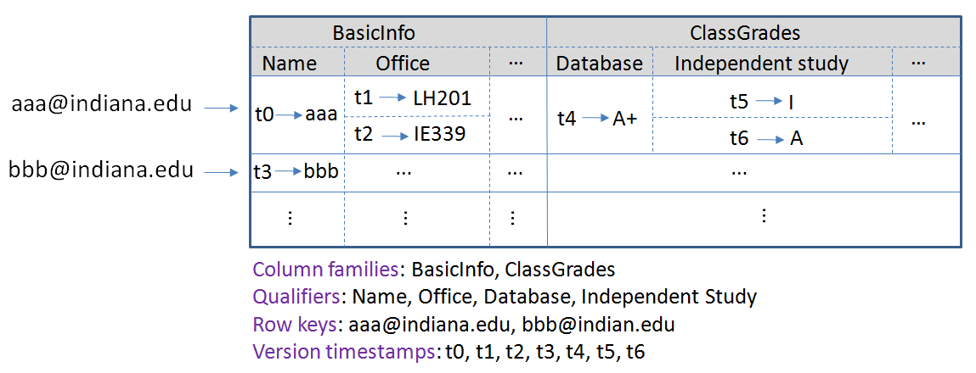
Experimenting Lucene Index on HBase in an HPC Environment
Background: data intensive computing requires storage solutions for huge amounts of data
One proposed solution: HBase, Hadoop implementation of Google’s BigTable

Slide 61
System design and implementation – solution
Inverted index:
“cloud” -> doc1, doc2, …
“computing” -> doc1, doc3, …
Apache Lucene:
- A library written in Java for building inverted indices and supporting full-text search
- Incremental indexing, document scoring, and multi-index search with merged results, etc.
- Existing solutions using Lucene store index data with files – no natural integration with HBase
Solution: maintain inverted indices directly in HBase as tables

Slide 62
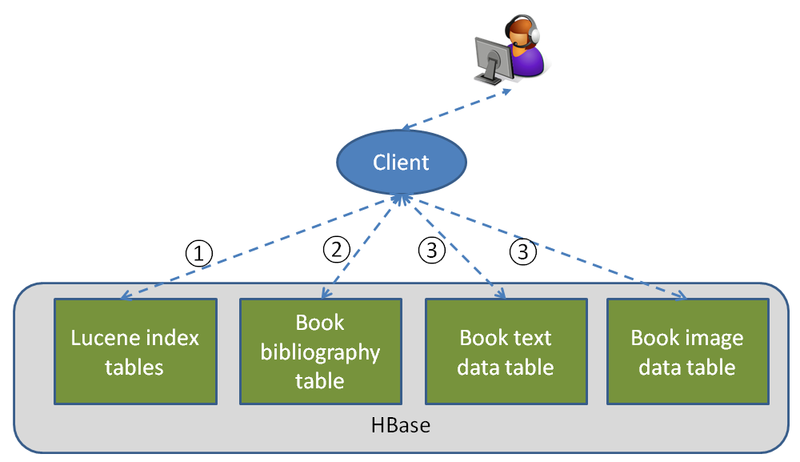
System design
Data from a real digital library application: bibliography data, page image data, texts data
System design:

Slide 63
System design
Table schemas:
- title index table: <term value> --> {frequencies:[<doc id>, <doc id>, ...]}
- texts index table: <term value> --> {frequencies:[<doc id>, <doc id>, ...]}
- texts term position vector table: <term value> --> {positions:[<doc id>, <doc id>, ...]}
Natural integration with HBase
Reliable and scalable index data storage
Real-time document addition and deletion
MapReduce programs for building index and analyzing index data

Slide 64
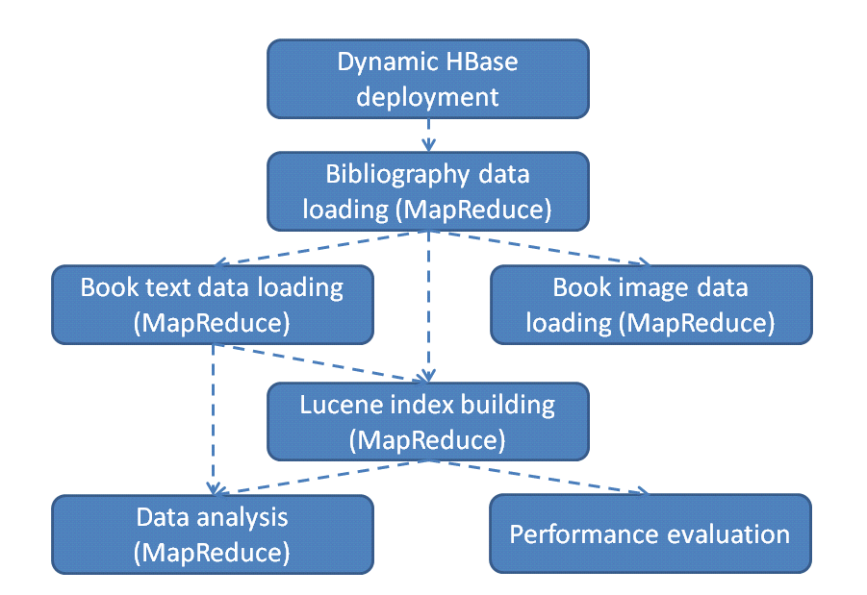
System implementation
Experiments completed in the Alamo HPC cluster of FutureGrid
MyHadoop -> MyHBase
Workflow:

Slide 65
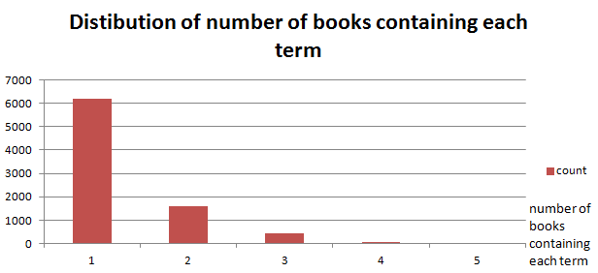
Index data analysis
Test run with 5 books
Total number of distinct terms: 8263
Following figures show different features about the text index table

Slide 66
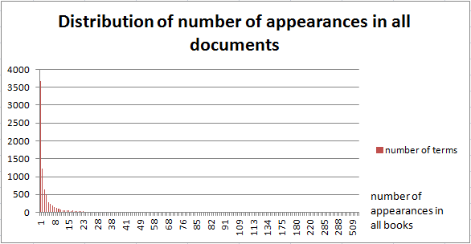
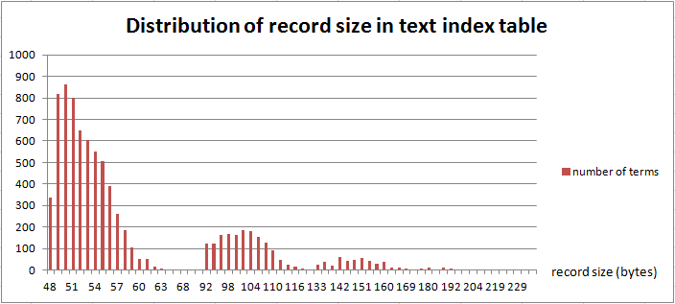
Index data analysis

Slide 67
Comparison with related work
Pig and Hive:
- Distributed platforms for analyzing and warehousing large data sets
- Pig Latin and HiveQL have operators for search
- Suitable for batch analysis to large data sets
SolrCloud, ElasticSearch, Katta:
- Distributed search systems based on Lucene indices
- Indices organized as files; not a natural integration with HBase
Solandra:
- Inverted index implemented as tables in Cassandra
- Different index table designs; no MapReduce support

Slide 68
Future work
Distributed performance evaluation
More data analysis or text mining based on the index data
Distributed search engine integrated with HBase region servers

Slide 69


Education and Broader Impact
We devote a lot to guide students
who are interested in computing

Slide 70

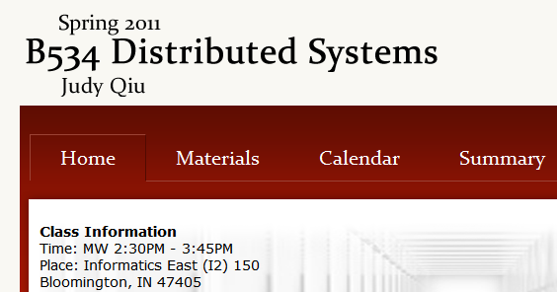
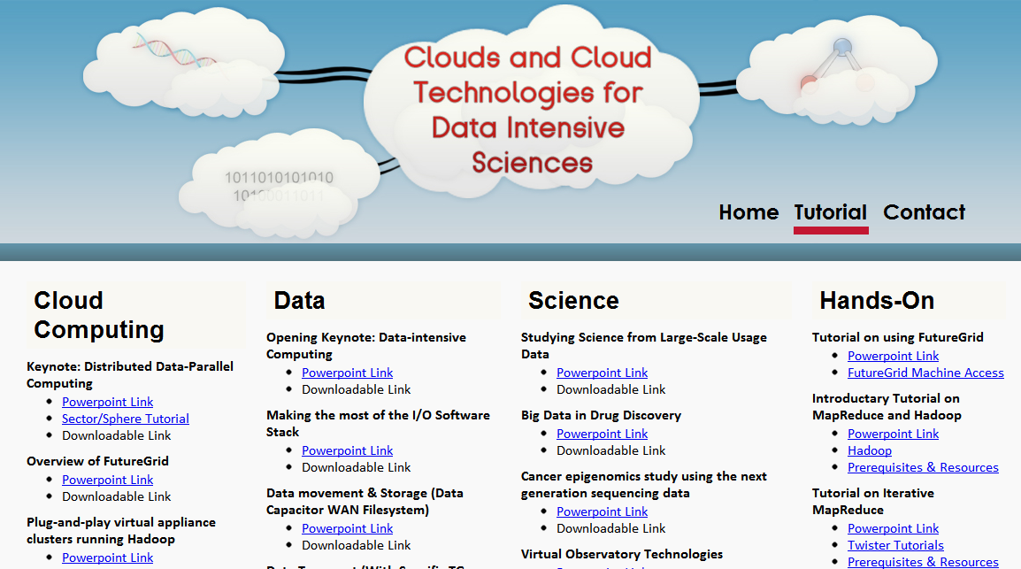
Education
We offer classes with emerging new topics
Together with tutorials on the most popular cloud computing tools

Slide 71
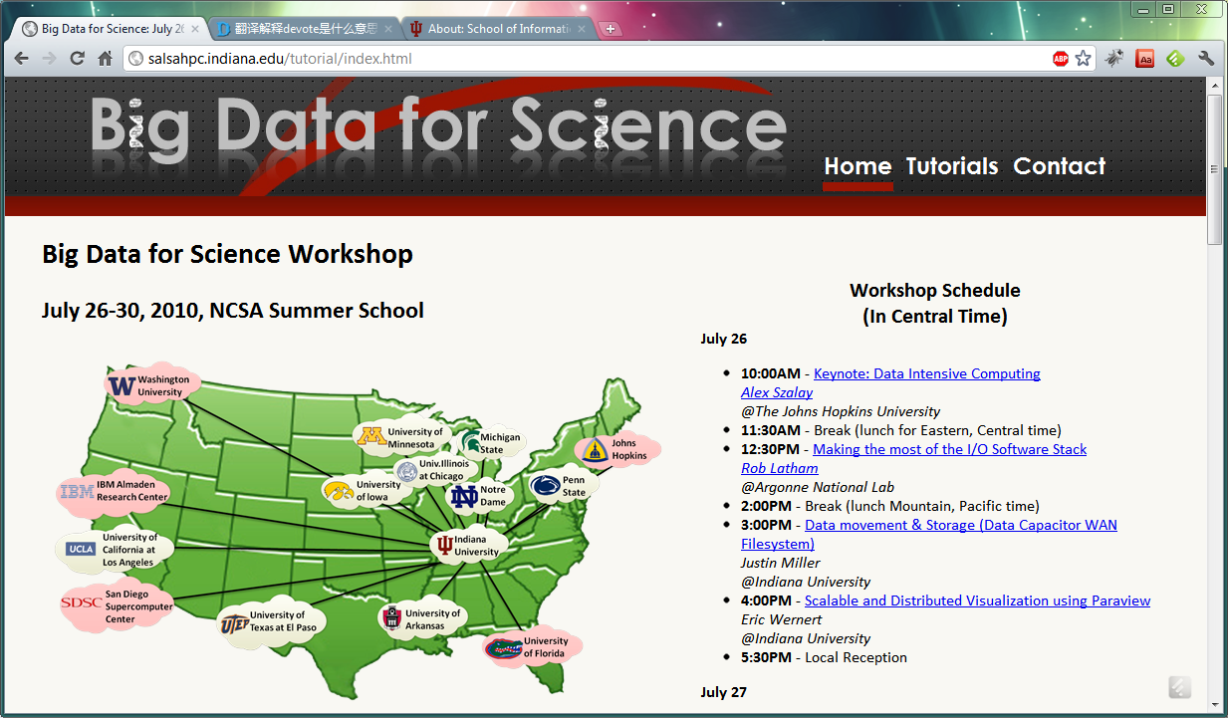
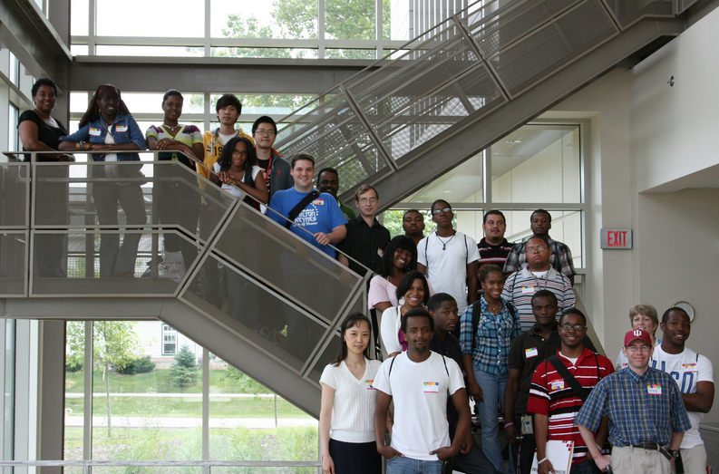

Broader Impact
Hosting workshops and spreading our technology across the nation
Giving students unforgettable research experience

Slide 72






Acknowledgement
SALSA HPC Group
Indiana University
http://salsahpc.indiana.edu

Slide 73

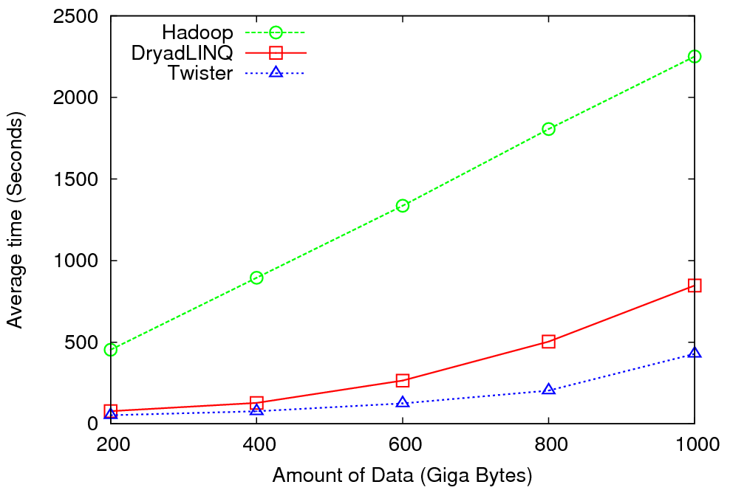
High Energy Physics Data Analysis
An application analyzing data from Large Hadron Collider (1TB but 100 Petabytes eventually)
Input to a map task: <key, value>
key = Some Id value = HEP file Name
Output of a map task: <key, value>
key = random # (0<= num<= max reduce tasks)
value = Histogram as binary data
Input to a reduce task: <key, List<value>>
key = random # (0<= num<= max reduce tasks)
value = List of histogram as binary data
Output from a reduce task: value
value = Histogram file
Combine outputs from reduce tasks to form the final histogram

Slide 74

Reduce Phase of Particle Physics
“Find the Higgs” using Dryad
Higgs in Monte Carlo
Combine Histograms produced by separate Root “Maps” (of event data to partial histograms) into a single Histogram delivered to Client
This is an example using MapReduce to do distributed histogramming.

Slide 75

The overall MapReduce HEP Analysis Process
Emit <Bin_{i}, 1>
Bin₁₁, 2
Bin₁₁, 1
Bin_{11,} 1
Bin₂₃, 1
Bin_{89,} 1
Bin₂₇, 1
0.11, 0.89, 0.27
Events (P_{i})
Bin_{23,} 1
Bin₂₃, 1
Bin₂₃, 1
Bin_{11,} 2
Bin_{23,} 3
Bin₂₉, 2
Bin_{89,} 2
Bin₂₃, 3
0.23, 0.89,0.27,
0.29,0.23, 0.89,
0.27, 0.23, 0.11
Bin_{29,} 1
Bin₂₃, 1
Bin_{89,} 1
0.29, 0.23, 0.89
Bin₂₇, 1
Bin₂₇, 1
Bin₂₇, 2
Bin₂₇, 1
Bin_{23,} 1
Bin₁₁, 1
0.27, 0.23, 0.11
Bin_{89,} 1
Bin₈₉, 1
Bin₈₉, 2
Sort
http://blog.jteam.nl/wp-content/uploads/2009/08/MapReduceWordCountOverview.png

Slide 76
From WordCount to HEP Analysis
18. | public void map(LongWritable key, Text value, OutputCollector<Text, IntWritable> output, Reporter reporter) throws IOException {
19. | String line = value.toString();
20. | StringTokenizer tokenizer = new StringTokenizer(line);
21. | while (tokenizer.hasMoreTokens()) {
22. | word.set(tokenizer.nextToken()); // Parsing
23. | output.collect(word, one);
24. | }
/* Multiple properties/histograms */
int PROPERTIES = 10;
int BIN_SIZE = 100; //assume properties are normalized
double eventVector[] = new double[VEC_LENGTH];
double bins[] = new double[BIN_SIZE];
…….
for (int i=0; i <VEC_LENGTH; i++) {
for (int j = 0; j < PROPERTIES; j++) {
if (eventVector[i] is in bins[j]) {//Pseudo
++bins[j];
}
}
}
output.collect(Property, bins[]) //Pseudo
/* Single property/histogram */
double event = 0;
int BIN_SIZE = 100;
double bins[] = new double[BIN_SIZE];
…….
if (event is in bin[i]) {//Pseudo
event.set (i);
}
output.collect(event, one);

Slide 77
K-Means Clustering
In statistics and machine learning, k-means clustering is a method of cluster analysis which aims to partition n observations into k clusters in which each observation belongs to the cluster with the nearest mean. It is similar to the expectation-maximization algorithm (EM) for mixtures of Gaussians in that they both attempt to find the centers of natural clusters in the data as well as in the iterative refinement approach employed by both algorithms.
E-step: the "assignment" step as expectation step
M-step: the "update step" as maximization step
wikipedia

Slide 78

How it works?
wikipedia

Slide 79
K-means Clustering Algorithm for MapReduce
* Do
* Broadcast Cn
*
* [Perform in parallel] –the map() operation
* for each Vi
* for each Cn,j
* Dij <= Euclidian (Vi,Cn,j)
* Assign point Vi to Cn,j with minimum Dij
* for each Cn,j
* Cn,j <=Cn,j/K
*
* [Perform Sequentially] –the reduce() operation
* Collect all Cn
* Calculate new cluster centers Cn+1
* Diff<= Euclidian (Cn, Cn+1)
*
* while (Diff <THRESHOLD)
Map
E-Step
Reduce
Global reduction
M-Step
Vi refers to the ith vector
Cn,j refers to the jth cluster center in nth * iteration
Dij refers to the Euclidian distance between ith vector and jth * cluster center
K is the number of cluster centers

Slide 80
Parallelization of K-means Clustering
Broadcast
Partition
Partition
Partition
C1
C2
C3
…
…
…
Ck
C1
C2
C3
…
…
…
Ck
x1 | y1 | count1
x2 | y2 | count2
x3 | y3 | count3
…
…
…
xk | yk | countk
C1
C2
C3
…
…
…
Ck
…
C1 | C2 | C3 | … | … | … | Ck

Slide 81

Twister K-means Execution
<c, File1 >
<c, File2 >
<c, Filek >
<K, >
<K, >
<K, >
<K, >
C1 C2 C3 … Ck
C1 C2 C3 … Ck
C1 C2 C3 … Ck
C1 C2 C3 … Ck
<K, > <K, >
C1 C2 C3 … Ck
C1 C2 C3 … Ck
C1 C2 C3 … Ck
C1 C2 C3 … Ck
C1 C2 C3 … Ck
C1 C2 C3 … Ck

