Slide 1
Scalable Programming and Algorithms for Data Intensive Life Science Applications
Data Intensive
Seattle, WA
Judy Qiu
http://salsahpc.indiana.edu
Assistant Professor, School of Informatics and Computing
Assistant Director, Pervasive Technology Institute
Indiana University

Slide 2
Important Trends
  In all fields of science and throughout life (e.g. web!)
  Impacts preservation, access/use, programming model
    new commercially supported data center model building on compute grids
Data Deluge
Cloud Technologies
Multicore/
Parallel Computing
eScience
  Implies parallel computing important again
    Performance from extra cores – not extra clock speed
  A spectrum of eScience or eResearch applications (biology, chemistry, physics social science and
  humanities …)
  Data Analysis
  Machine learning

Slide 3
Data We’re Looking at
  Public Health Data (IU Medical School & IUPUI Polis Center)
  (65535 Patient/GIS records / 100 dimensions each)
  Biology DNA sequence alignments (IU Medical School & CGB)
  (10 million Sequences / at least 300 to 400 base pair each)
  NIH PubChem (IU Cheminformatics)
  (60 million chemical compounds/166 fingerprints each)
High volume and high dimension require new efficient computing approaches!

Slide 4
Some Life Sciences Applications
EST (Expressed Sequence Tag) sequence assembly program using DNA sequence assembly program software CAP3.
Metagenomics and Alu repetition alignment using Smith Waterman dissimilarity computations followed by MPI applications for Clustering and MDS (Multi Dimensional Scaling) for dimension reduction before visualization
Mapping the 60 million entries in PubChem into two or three dimensions to aid selection of related chemicals with convenient Google Earth like Browser. This uses either hierarchical MDS (which cannot be applied directly as O(N²)) or GTM (Generative Topographic Mapping).
Correlating Childhood obesity with environmental factors by combining medical records with Geographical Information data with over 100 attributes using correlation computation, MDS and genetic algorithms for choosing optimal environmental factors.

Slide 5



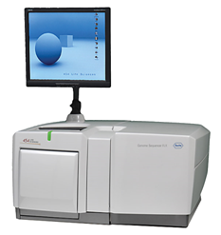
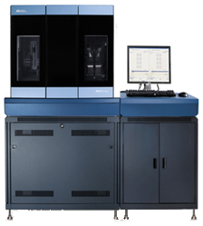
DNA Sequencing Pipeline
MapReduce
Pairwise
clustering
Sequence
alignment
Dissimilarity
Matrix
N(N-1)/2 values
Visualization
Plotviz
FASTA File
N Sequences
Blocking
block
Pairings
MPI
MDS
Read Alignment
This chart illustrate our research of a pipeline mode to provide services on demand (Software as a Service SaaS)
User submit their jobs to the pipeline. The components are services and so is the whole pipeline.
Illumina/Solexa Roche/454 Life Sciences Applied Biosystems/SOLiD
Internet
Modern Commerical Gene Sequences

Slide 6






MapReduce “File/Data Repository” Parallelism
Map = (data parallel) computation reading and writing data
Reduce = Collective/Consolidation phase e.g. forming multiple global sums as in histogram
Instruments
MPI and Iterative MapReduce
Map Map Map Map
Reduce Reduce Reduce
Communication
Reduce
Portals
/Users
Disks
Map₁
Map₂
Map₃

Slide 7
 | Google MapReduce | Apache Hadoop | Microsoft Dryad | Twister | Azure Twister
Programming Model | MapReduce | MapReduce | DAG execution, Extensible to MapReduce and other patterns | Iterative MapReduce | MapReduce-- will extend to Iterative MapReduce
Data Handling | GFS (Google File System) | HDFS (Hadoop Distributed File System) | Shared Directories & local disks | Local disks and data management tools | Azure Blob Storage
Scheduling | Data Locality | Data Locality; Rack aware, Dynamic task scheduling through global queue | Data locality; Network topology based run time graph optimizations; Static task partitions | Data Locality; Static task partitions | Dynamic task scheduling through global queue
Failure Handling | Re-execution of failed tasks; Duplicate execution of slow tasks | Re-execution of failed tasks; Duplicate execution of slow tasks | Re-execution of failed tasks; Duplicate execution of slow tasks | Re-execution of Iterations | Re-execution of failed tasks; Duplicate execution of slow tasks
High Level Language Support | Sawzall | Pig Latin | DryadLINQ | Pregel has related features | N/A
Environment | Linux Cluster. | Linux Clusters, Amazon Elastic Map Reduce on EC2 | Windows HPCS cluster | Linux Cluster EC2 | Window Azure Compute, Windows Azure Local Development Fabric
Intermediate data transfer | File | File, Http | File, TCP pipes, shared-memory FIFOs | Publish/Subscribe messaging | Files, TCP

Slide 8
MapReduce
A parallel Runtime coming from Information Retrieval
Data Partitions
Map(Key, Value)
A hash function maps the results of the map tasks to r reduce tasks
Reduce(Key, List<Value>)
Reduce Outputs
Implementations support:
  Splitting of data
  Passing the output of map functions to reduce functions
  Sorting the inputs to the reduce function based on the intermediate keys
  Quality of services

Slide 9
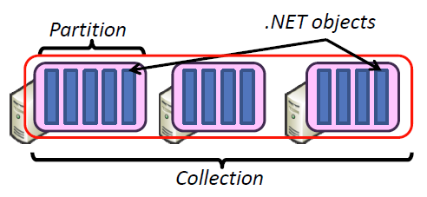
Hadoop & DryadLINQ
Apache Hadoop
Microsoft DryadLINQ
Master Node
Data/Compute Nodes
Standard LINQ operations
Job
Tracker
M
M
M
M
DryadLINQ operations
R
R
R
R
DryadLINQ Compiler
Name
Node
HDFS
Data
blocks
Directed Acyclic Graph (DAG) based execution flows
1
2
Vertex :
execution task
2
3
3
4
Edge :
communication path
Dryad Execution Engine
Apache Implementation of Google’s MapReduce
Hadoop Distributed File System (HDFS) manage data
Map/Reduce tasks are scheduled based on data locality in HDFS (replicated data blocks)
Dryad process the DAG executing vertices on compute clusters
LINQ provides a query interface for structured data
Provide Hash, Range, and Round-Robin partition patterns
  Job creation; Resource management; Fault tolerance& re-execution of failed taskes/vertices

Slide 10


Applications using Dryad & DryadLINQ
CAP3 - Expressed Sequence Tag assembly to re-construct full-length mRNA
Input files (FASTA)
DryadLINQ
CAP3
CAP3
CAP3
Output files
Perform using DryadLINQ and Apache Hadoop implementations
Single “Select” operation in DryadLINQ
“Map only” operation in Hadoop
X. Huang, A. Madan, “CAP3: A DNA Sequence Assembly Program,” Genome Research, vol. 9, no. 9, pp. 868-877, 1999.

Slide 11
Classic Cloud Architecture
Amazon EC2 and Microsoft Azure
MapReduce Architecture
Apache Hadoop and Microsoft DryadLINQ
HDFS
Input Data Set
Data File
exe
exe
Map()
Map()
Executable
Optional
Reduce
Phase
Reduce
HDFS
Results

Slide 12
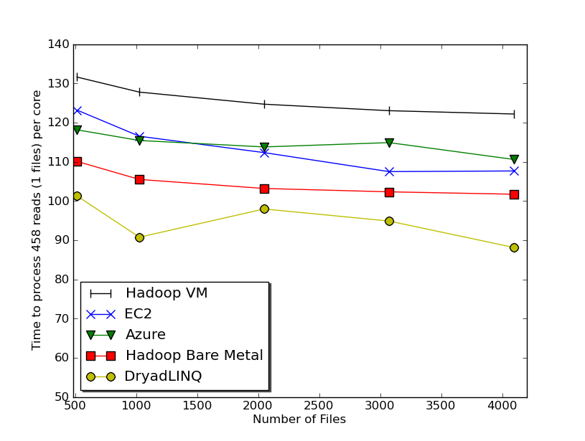

Usability and Performance of Different Cloud Approaches
Cap3 Performance
Cap3 Efficiency
Ease of Use – Dryad/Hadoop are easier than EC2/Azure as higher level models
Lines of code including file copy
  Azure : ~300 Hadoop: ~400 Dyrad: ~450 EC2 : ~700
Efficiency = absolute sequential run time / (number of cores * parallel run time)
Hadoop, DryadLINQ - 32 nodes (256 cores IDataPlex)
EC2 - 16 High CPU extra large instances (128 cores)
Azure- 128 small instances (128 cores)
Notes:
Emerging technologies we cannot draw too much conclusion yet but all look promising at the moment
Ease of development. Dryad and Hadoop >> EC2 and Azure
Why Azure is worse than EC2 although less code lines?
Simplest model

Slide 13
Alu and Metagenomics Workflow
“All pairs” problem
Data is a collection of N sequences. Need to calcuate N² dissimilarities (distances) between sequnces (all pairs).
  These cannot be thought of as vectors because there are missing characters
  “Multiple Sequence Alignment” (creating vectors of characters) doesn’t seem to work if N larger than O(100), where 100’s of characters long.
Step 1: Can calculate N² dissimilarities (distances) between sequences
Step 2: Find families by clustering (using much better methods than Kmeans). As no vectors, use vector free O(N²) methods
Step 3: Map to 3D for visualization using Multidimensional Scaling (MDS) – also O(N²)
Results:
N = 50,000 runs in 10 hours (the complete pipeline above) on 768 cores
Discussions:
Need to address millions of sequences …..
Currently using a mix of MapReduce and MPI
Twister will do all steps as MDS, Clustering just need MPI Broadcast/Reduce

Slide 14

All-Pairs Using DryadLINQ
125 million distances
4 hours & 46 minutes
Calculate Pairwise Distances (Smith Waterman Gotoh)
Calculate pairwise distances for a collection of genes (used for clustering, MDS)
Fine grained tasks in MPI
Coarse grained tasks in DryadLINQ
Performed on 768 cores (Tempest Cluster)
Moretti, C., Bui, H., Hollingsworth, K., Rich, B., Flynn, P., & Thain, D. (2009). All-Pairs: An Abstraction for Data Intensive Computing on Campus Grids. IEEE Transactions on Parallel and Distributed Systems , 21, 21-36.

Slide 15


Biology MDS and Clustering Results
Alu Families
This visualizes results of Alu repeats from Chimpanzee and Human Genomes. Young families (green, yellow) are seen as tight clusters. This is projection of MDS dimension reduction to 3D of 35399 repeats – each with about 400 base pairs
Metagenomics
This visualizes results of dimension reduction to 3D of 30000 gene sequences from an environmental sample. The many different genes are classified by clustering algorithm and visualized by MDS dimension reduction

Slide 16
Hadoop/Dryad Comparison
Inhomogeneous Data I
Inhomogeneity of data does not have a significant effect when the sequence lengths are randomly distributed
Dryad with Windows HPCS compared to Hadoop with Linux RHEL on Idataplex (32 nodes)
Notes:
10k data size

Slide 17
Hadoop/Dryad Comparison
Inhomogeneous Data II
This shows the natural load balancing of Hadoop MR dynamic task assignment using a global pipe line in contrast to the DryadLinq static assignment
Dryad with Windows HPCS compared to Hadoop with Linux RHEL on Idataplex (32 nodes)
Notes:
10k data size

Slide 18
Hadoop VM Performance Degradation
Perf. Degradation = (T_{vm} – T_{baremetal})/T_{baremetal}
15.3% Degradation at largest data set size
Notes:
Overhead is independent of computation time. With the size of data go up, overall overhead is reduced.

Slide 19


Twister(MapReduce++)
Pub/Sub Broker Network
Map Worker
M
Streaming based communication
Intermediate results are directly transferred from the map tasks to the reduce tasks – eliminates local files
Cacheable map/reduce tasks
  Static data remains in memory
Combine phase to combine reductions
User Program is the composer of MapReduce computations
Extends the MapReduce model to iterative computations
Worker Nodes
R
Reduce Worker
D
D
MR
Driver
User
Program
M
M
M
M
D
MRDeamon
R
R
R
R
Data Read/Write
Communication
Data Split
File System
Iterate
Static
data
Configure()
User Program
Map(Key, Value)
δ flow
Reduce (Key, List<Value>)
Combine (Key, List<Value>)
Different synchronization and intercommunication mechanisms used by the parallel runtimes
Close()

Slide 20
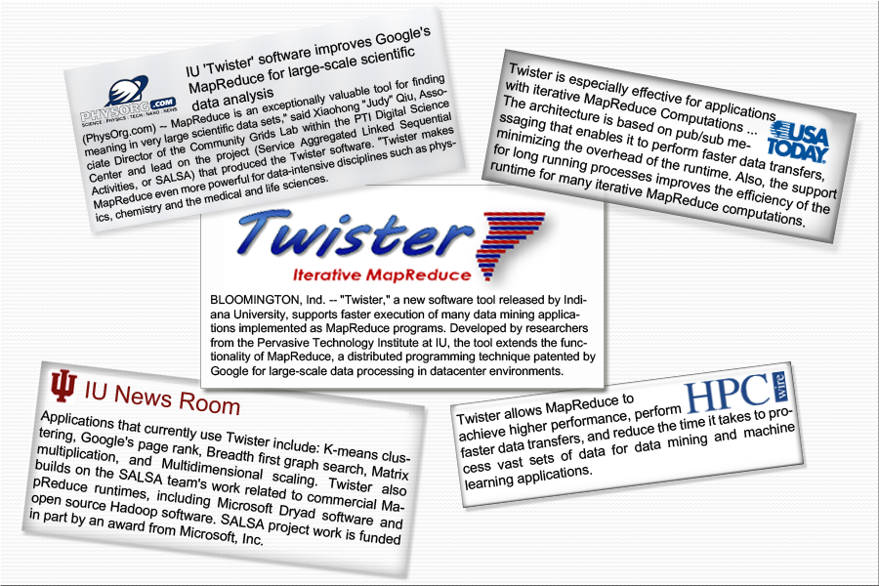
Twister New Release

Slide 21


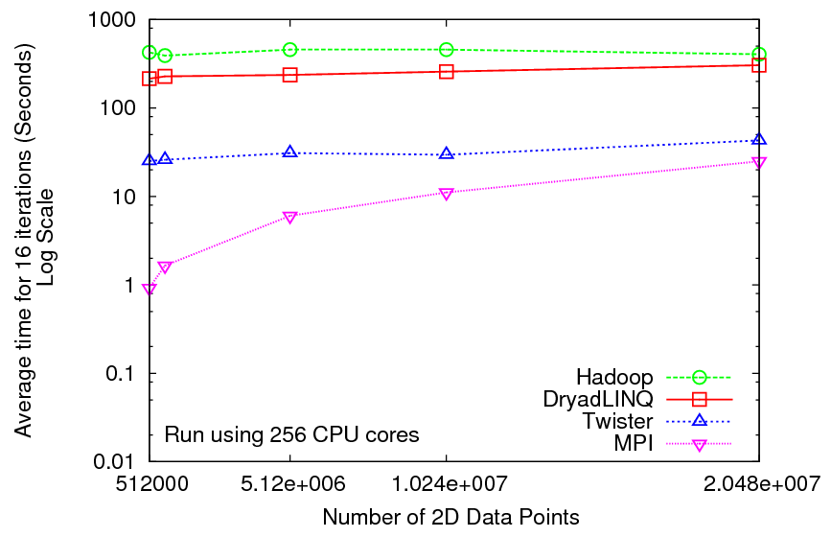
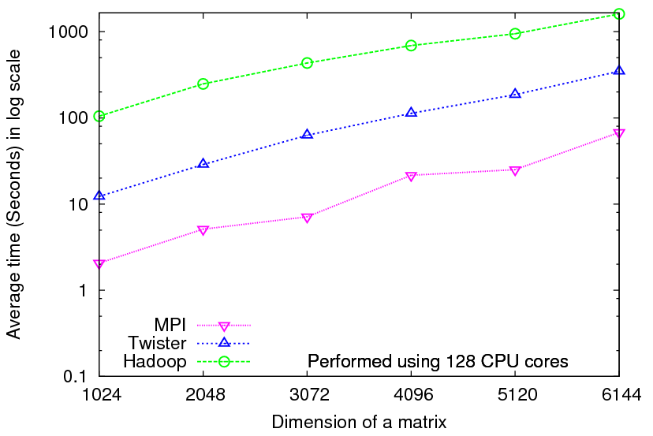
Iterative Computations
K-means
Matrix Multiplication
Performance of K-Means
Parallel Overhead Matrix Multiplication

Slide 22
Applications & Different Interconnection Patterns
Map Only | Classic MapReduce | Iterative Reductions MapReduce++ | Loosely Synchronous
CAP3 Analysis Document conversion (PDF -> HTML) Brute force searches in cryptography Parametric sweeps | High Energy Physics (HEP) Histograms SWG gene alignment Distributed search Distributed sorting Information retrieval | Expectation maximization algorithms Clustering Linear Algebra | Many MPI scientific applications utilizing wide variety of communication constructs including local interactions
- CAP3 Gene Assembly - PolarGrid Matlab data analysis | - Information Retrieval - HEP Data Analysis - Calculation of Pairwise Distances for ALU Sequences | Kmeans Deterministic Annealing Clustering - Multidimensional Scaling MDS | - Solving Differential Equations and - particle dynamics with short range forces
Input
iterations
Input
Input
map
map
map
Pij
reduce
Output
reduce
Domain of MapReduce and Iterative Extensions
MPI

Slide 23
Summary of Initial Results
Cloud technologies (Dryad/Hadoop/Azure/EC2) promising for Biology computations
Dynamic Virtual Clusters allow one to switch between different modes
Overhead of VM’s on Hadoop (15%) acceptable
Twister allows iterative problems (classic linear algebra/datamining) to use MapReduce model efficiently
  Prototype Twister released

Slide 24
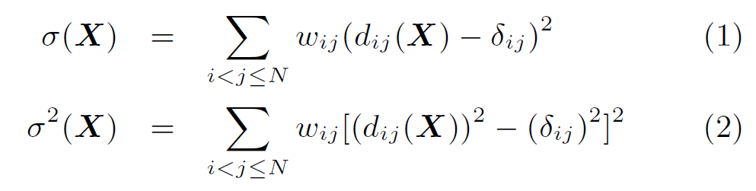

Dimension Reduction Algorithms
Multidimensional Scaling (MDS) [1]
  Given the proximity information among points.
  Optimization problem to find mapping in target dimension of the given data based on pairwise proximity information while minimize the objective function.
  Objective functions: STRESS (1) or SSTRESS (2)
  Only needs pairwise distances δ_{ij} between original points (typically not Euclidean)
  d_{ij}(X) is Euclidean distance between mapped (3D) points
Generative Topographic Mapping
(GTM) [2]
  Find optimal K-representations for the given data (in 3D), known as
  K-cluster problem (NP-hard)
  Original algorithm use EM method for optimization
  Deterministic Annealing algorithm can be used for finding a global solution
  Objective functions is to maximize log-likelihood:
[1] I. Borg and P. J. Groenen. Modern Multidimensional Scaling: Theory and Applications. Springer, New York, NY, U.S.A., 2005.
[2] C. Bishop, M. Svens´en, and C. Williams. GTM: The generative topographic mapping. Neural computation, 10(1):215–234, 1998.
Notes:
MDS implemented in C#; GTM in R and C/C++

Slide 25
Threading versus MPI on node
Always MPI between nodes
Clustering by Deterministic Annealing
(Parallel Overhead = [PT(P) – T(1)]/T(1), where T time and P number of parallel units)
MPI
MPI
Parallel Overhead
MPI
Thread
Thread
Thread
Thread
Thread
MPI
MPI
MPI
MPI
Thread
Thread
Parallel Patterns (ThreadsxProcessesxNodes)
Note MPI best at low levels of parallelism
Threading best at Highest levels of parallelism (64 way breakeven)
Uses MPI.Net as an interface to MS-MPI

Slide 26
Typical CCR Comparison with TPL
Efficiency = 1 / (1 + Overhead)
Hybrid internal threading/MPI as intra-node model works well on Windows HPC cluster
Within a single node TPL or CCR outperforms MPI for computation intensive applications like clustering of Alu sequences (“all pairs” problem)
TPL outperforms CCR in major applications

Slide 27
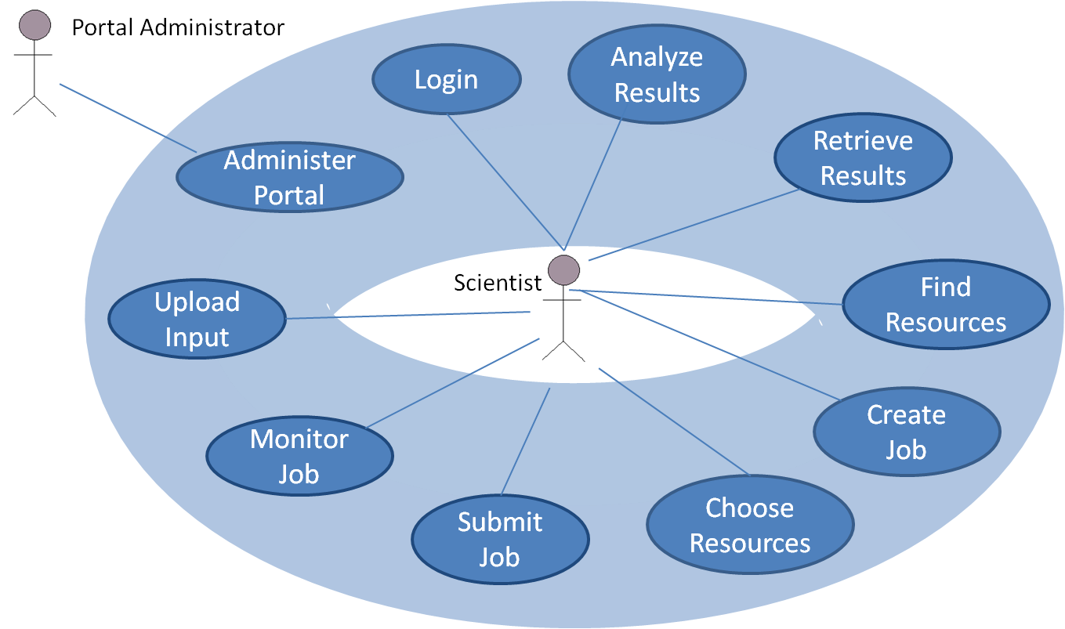
SALSA Portal web services Collection in Biosequence Classification
This use-case diagram shows the functionalities for high-performance computing resource and job management

Slide 28
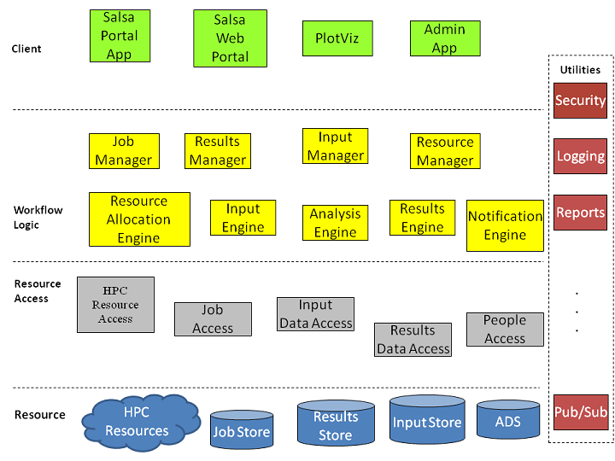
The multi-tiered, service-oriented architecture of the SALSA Portal services
All Manager components are exposed as web services and provide a loosely-coupled set of HPC functionalities that can be used to compose many different types of client applications.

Slide 29
Convergence is Happening
Multicore
Clouds
Data intensive application with basic activities:
capture, curation, preservation, and analysis (visualization)
Data Intensive
Paradigms
Cloud infrastructure and runtime
Parallel threading and processes

Slide 30
“Data intensive science, Cloud computing and Multicore computing are converging and revolutionize next generation of computing in architectural design and programming challenges. They enable the pipeline: data becomes information becomes knowledge becomes wisdom.”
- Judy Qiu, Distributed Systems and Cloud Computing

Slide 31
A New Book from Morgan Kaufmann Publishers, an imprint of Elsevier, Inc.,
Burlington, MA 01803, USA. (Outline updated August 26, 2010)
Distributed Systems and
Cloud Computing
Clusters, Grids/P2P, Internet Clouds
Kai Hwang, Geoffrey Fox, Jack Dongarra

Slide 32

FutureGrid: a Grid Testbed
IU Cray operational, IU IBM (iDataPlex) completed stability test May 6
UCSD IBM operational, UF IBM stability test completes ~ May 12
Network, NID and PU HTC system operational
UC IBM stability test completes ~ May 27; TACC Dell awaiting delivery of components
NID: Network Impairment Device
Private
Public
FG Network
Notes:
Support development of new applications and new middleware using Cloud, Grid and Parallel computing (Nimbus, Eucalyptus, Hadoop, Globus, Unicore, MPI, OpenMP. Linux, Windows …) looking at functionality, interoperability, performance
Put the “science” back in the computer science of grid computing by enabling replicable experiments
Open source software built around Moab/xCAT to support dynamic provisioning from Cloud to HPC environment, Linux to Windows ….. with monitoring, benchmarks and support of important existing middleware
June 2010 Initial users; September 2010 All hardware (except IU shared memory system) accepted and major use starts; October 2011 FutureGrid allocatable via TeraGrid process

Slide 33
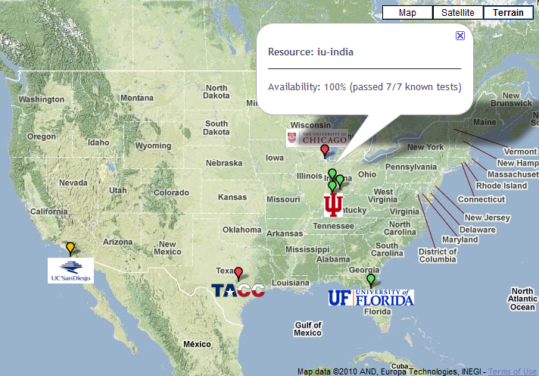
FutureGrid: a Grid/Cloud Testbed
Operational: IU Cray operational; IU , UCSD, UF & UC IBM iDataPlex operational
Network, NID operational
TACC Dell running acceptance tests
NID: Network Impairment Device
Private
Public
FG Network

Slide 34
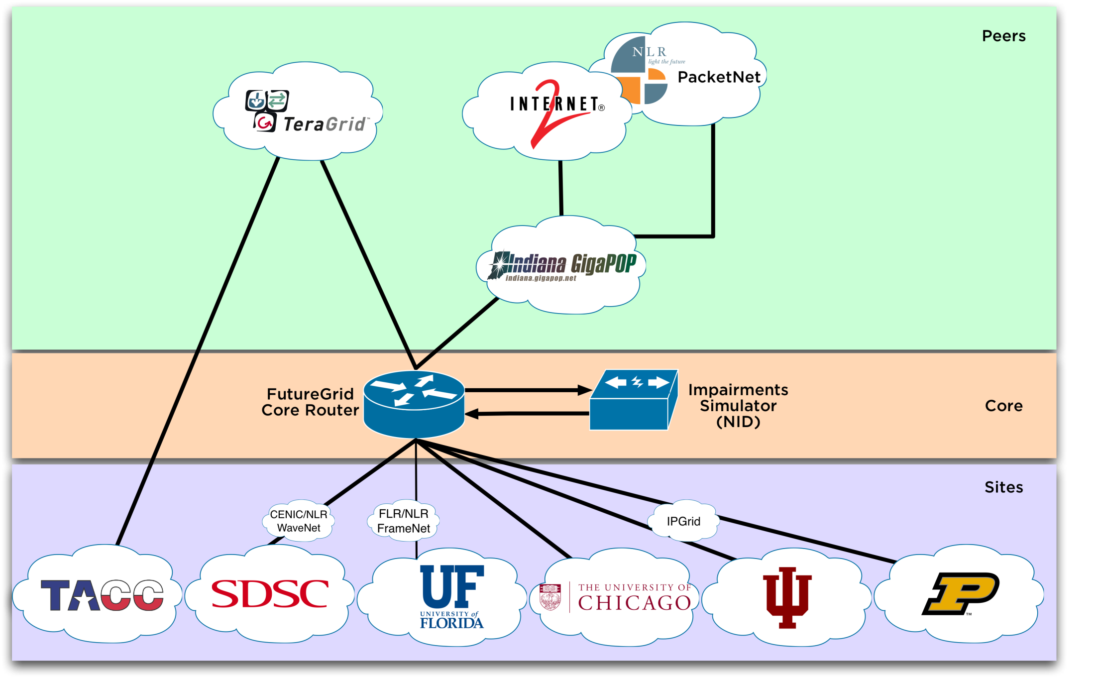
Logical Diagram

Slide 35
Compute Hardware
System type | # CPUs | # Cores | TFLOPS | Total RAM (GB) | Secondary Storage (TB) | Site | Status
Dynamically configurable systems
IBM iDataPlex | 256 | 1024 | 11 | 3072 | 339* | IU | Operational
Dell PowerEdge | 192 | 768 | 8 | 1152 | 30 | TACC | Being installed
IBM iDataPlex | 168 | 672 | 7 | 2016 | 120 | UC | Operational
IBM iDataPlex | 168 | 672 | 7 | 2688 | 96 | SDSC | Operational
Subtotal | 784 | 3136 | 33 | 8928 | 585
Systems not dynamically configurable
Cray XT5m | 168 | 672 | 6 | 1344 | 339* | IU | Operational
Shared memory system TBD | 40 | 480 | 4 | 640 | 339* | IU | New System TBD
IBM iDataPlex | 64 | 256 | 2 | 768 | 1 | UF | Operational
High Throughput Cluster | 192 | 384 | 4 | 192 |  | PU | Not yet integrated
Subtotal | 464 | 1792 | 16 | 2944 | 1
Total | 1248 | 4928 | 49 | 11872 | 586

Slide 36
Storage Hardware
System Type | Capacity (TB) | File System | Site | Status
DDN 9550 (Data Capacitor) | 339 | Lustre | IU | Existing System
DDN 6620 | 120 | GPFS | UC | New System
SunFire x4170 | 96 | ZFS | SDSC | New System
Dell MD3000 | 30 | NFS | TACC | New System

Slide 37
Cloud Technologies and Their Applications
Swift, Taverna, Kepler,Trident
Workflow
SaaS
Applications
Smith Waterman Dissimilarities, PhyloD Using DryadLINQ, Clustering, Multidimensional Scaling, Generative Topological Mapping
Higher Level Languages
Apache PigLatin/Microsoft DryadLINQ
Cloud Platform
Apache Hadoop / Twister/ Sector/Sphere
Microsoft Dryad / Twister
Nimbus, Eucalyptus, Virtual appliances, OpenStack, OpenNebula,
Cloud
Infrastructure
Linux Virtual Machines
Linux Virtual Machines
Windows Virtual Machines
Windows Virtual Machines
Hypervisor/
Virtualization
Xen, KVM Virtualization / XCAT Infrastructure
Hardware
Bare-metal Nodes

Slide 38

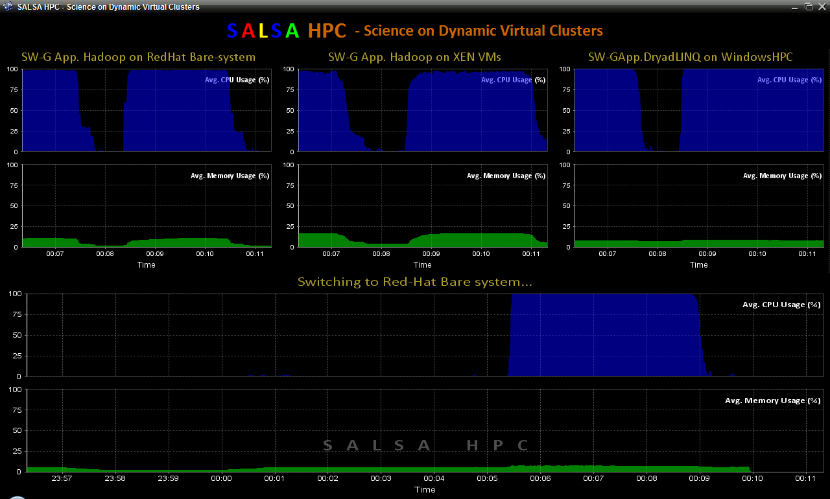
SALSAHPC Dynamic Virtual Cluster on FutureGrid -- Demo at SC09
Demonstrate the concept of Science on Clouds on FutureGrid
Dynamic Cluster Architecture
Monitoring & Control Infrastructure
Monitoring Infrastructure
Monitoring Interface
Pub/Sub Broker Network
SW-G Using Hadoop
SW-G Using Hadoop
SW-G Using DryadLINQ
Linux
Bare-system
Linux on Xen
Windows Server 2008 Bare-system
Virtual/Physical Clusters
Summarizer
XCAT Infrastructure
XCAT Infrastructure
Switcher
iDataplex Bare-metal Nodes
(32 nodes)
iDataplex Bare-metal Nodes
Switchable clusters on the same hardware (~5 minutes between different OS such as Linux+Xen to Windows+HPCS)
Support for virtual clusters
SW-G : Smith Waterman Gotoh Dissimilarity Computation as an pleasingly parallel problem suitable for MapReduce style applications

Slide 39
SALSAHPC Dynamic Virtual Cluster on FutureGrid -- Demo at SC09
Demonstrate the concept of Science on Clouds using a FutureGrid cluster
Top: 3 clusters are switching applications on fixed environment. Takes approximately 30 seconds.
Bottom: Cluster is switching between environments: Linux; Linux +Xen; Windows + HPCS.
Takes approxomately 7 minutes
SALSAHPC Demo at SC09. This demonstrates the concept of Science on Clouds using a FutureGrid iDataPlex.

Slide 40
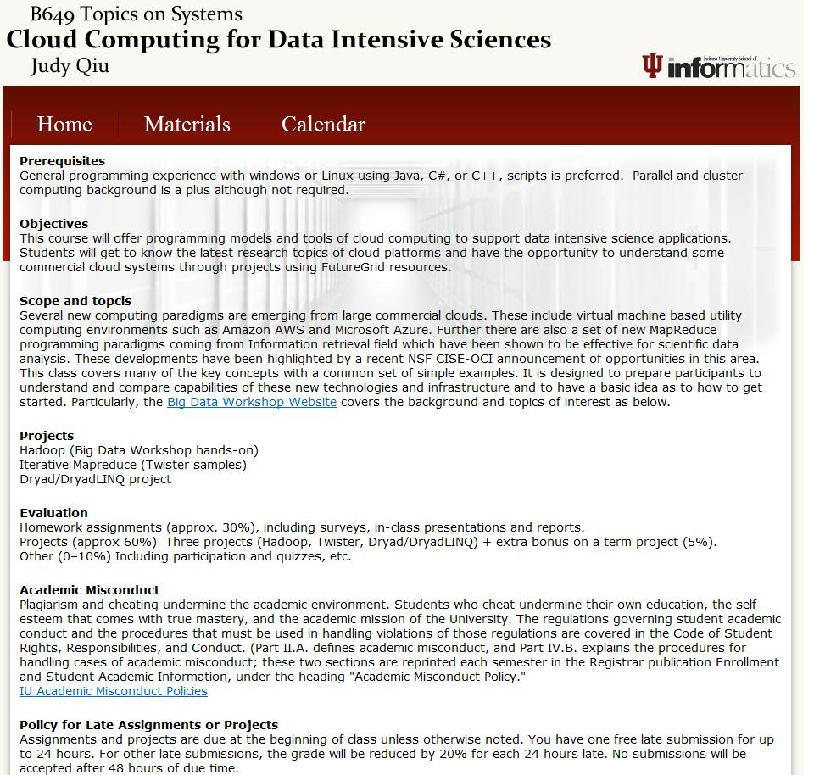

Slide 41


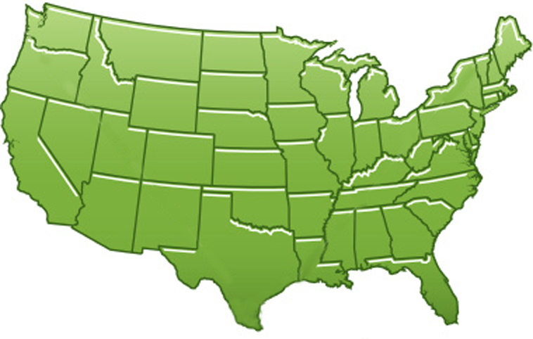















300+ Students learning about Twister & Hadoop
MapReduce technologies, supported by FutureGrid.
July 26-30, 2010 NCSA Summer School Workshop
http://salsahpc.indiana.edu/tutorial
Washington
University
University of
Minnesota
Michigan
State
Johns
Hopkins
Univ.Illinois
at Chicago
Iowa
State
Penn
State
IBM Almaden
Research Center
Notre
Dame
University of
California at
Los Angeles
Indiana
University
San Diego
Supercomputer
Center
University of
Texas at El Paso
University of
Arkansas
University
of Florida

Slide 42






Acknowledgements
SALSAHPC Group
http://salsahpc.indiana.edu
… and Our Collaborators at Indiana University
School of Informatics and Computing, IU Medical School, College of Art and Science, UITS (supercomputing, networking and storage services)
… and Our Collaborators outside Indiana
Seattle Children’s Research Institute

Slide 43
Questions?

Slide 44


Slide 45

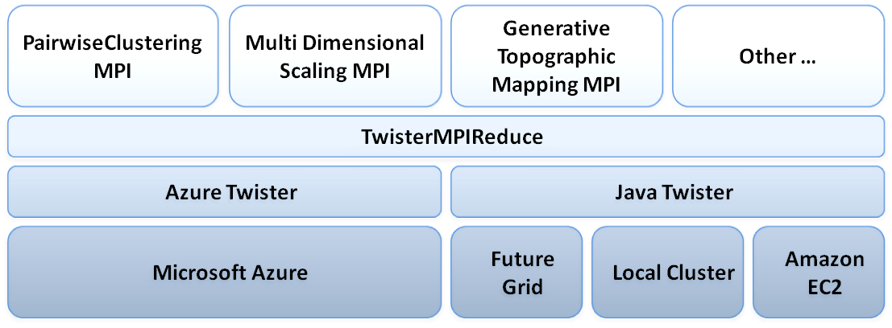
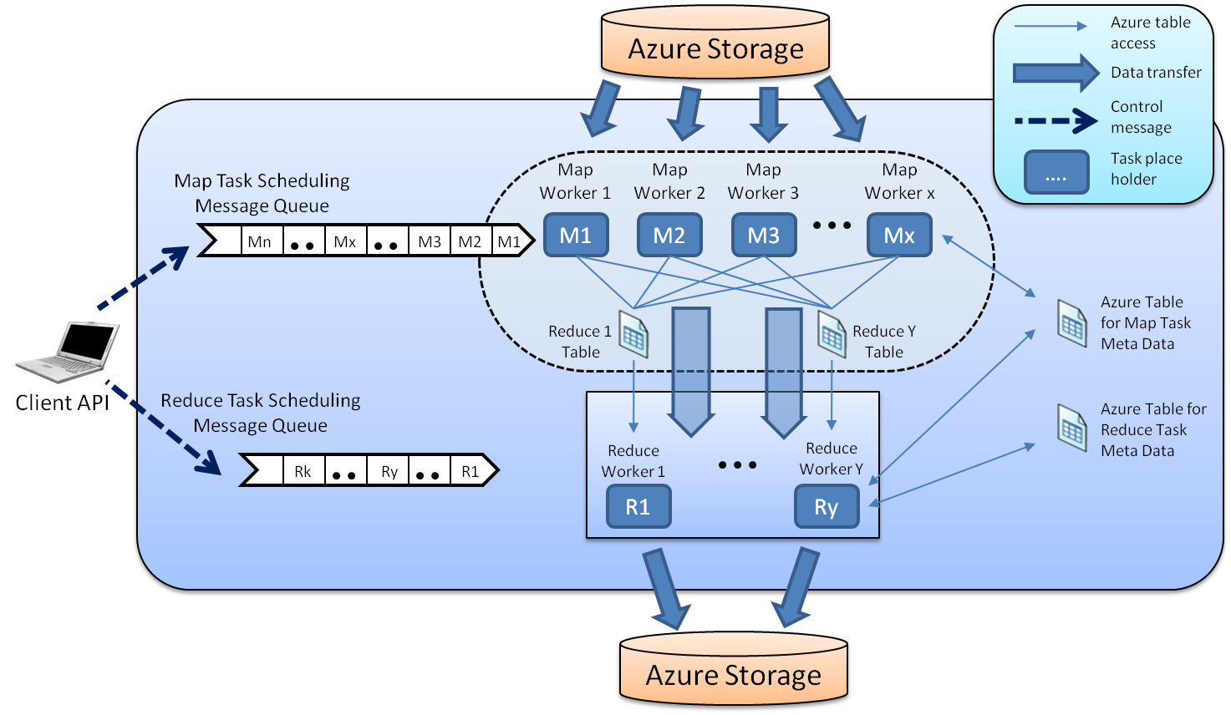
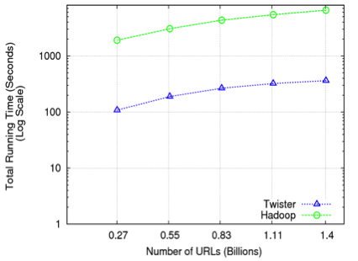
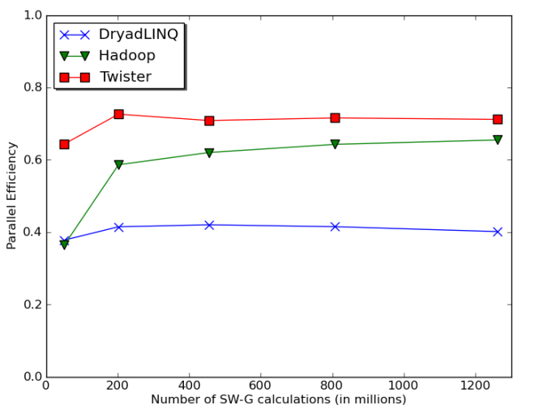
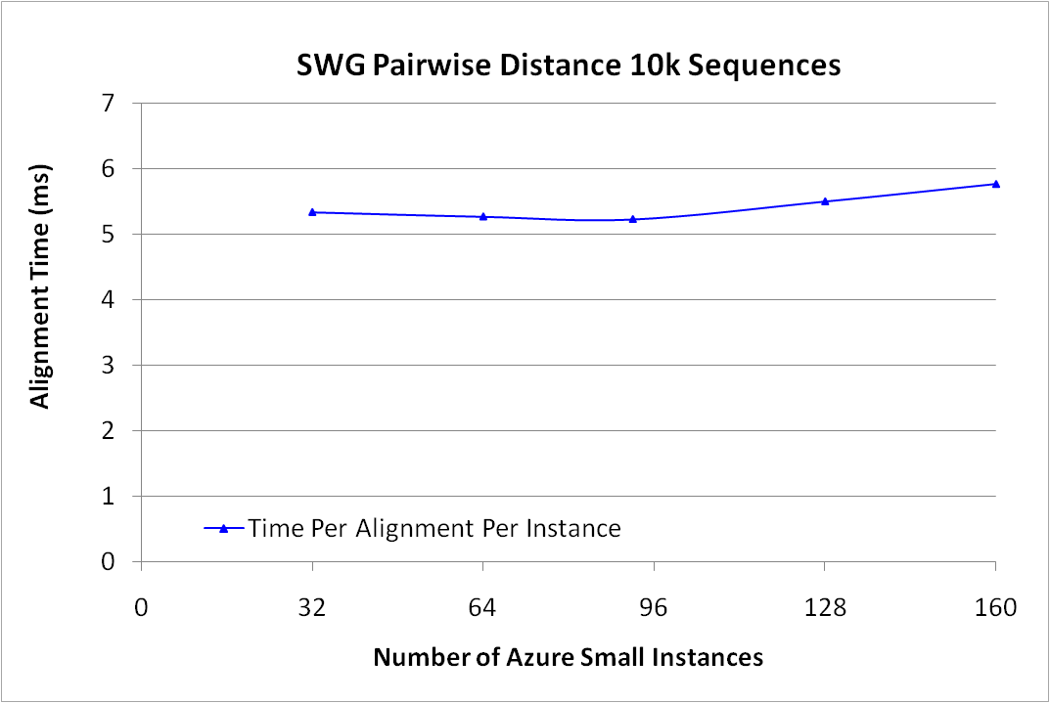


MapReduce and Clouds for Science http://salsahpc.indiana.edu
Indiana University Bloomington
Judy Qiu, SALSA Group
SALSA project (salsahpc.indiana.edu) investigates new programming models of parallel multicore computing and Cloud/Grid computing. It aims at developing and applying parallel and distributed Cyberinfrastructure to support large scale data analysis. We illustrate this with a study of usability and performance of different Cloud approaches. We will develop MapReduce technology for Azure that matches that available on FutureGrid in three stages: AzureMapReduce (where we already have a prototype), AzureTwister, and TwisterMPIReduce. These offer basic MapReduce, iterative MapReduce, and a library mapping a subset of MPI to Twister. They are matched by a set of applications that test the increasing sophistication of the environment and run on Azure, FutureGrid, or in a workflow linking them.
Iterative MapReduce using Java Twister
http://www.iterativemapreduce.org/
Twister supports iterative MapReduce Computations and allows MapReduce to achieve higher performance, perform faster data transfers, and reduce the time it takes to process vast sets of data for data mining and machine learning applications. Open source code supports streaming communication and long running processes.
MPI is not generally suitable for clouds. But the subclass of MPI style operations supported by Twister – namely, the equivalent of MPI-Reduce, MPI-Broadcast (multicast), and MPI-Barrier – have large messages and offer the possibility of reasonable cloud performance. This hypothesis is supported by our comparison of JavaTwister with MPI and Hadoop. Many linear algebra and data mining algorithms need only this MPI subset, and we have used this in our initial choice of evaluating applications. We wish to compare Twister implementations on Azure with MPI implementations (running as a distributed workflow) on FutureGrid. Thus, we introduce a new runtime, TwisterMPIReduce, as a software library on top of Twister, which will map applications using the broadcast/reduce subset of MPI to Twister.
Architecture of Twister
MapReduce on Azure − AzureMapReduce
AzureMapReduce uses Azure Queues for map/reduce task scheduling, Azure Tables for metadata and monitoring data storage, Azure Blob Storage for input/output/intermediate data storage, and Azure Compute worker roles to perform the computations. The map/reduce tasks of the AzureMapReduce runtime are dynamically scheduled using a global queue.
Architecture of TwisterMPIReduce
Usability and Performance of Different Cloud and MapReduce Models
The cost effectiveness of cloud data centers combined with the comparable performance reported here suggests that loosely coupled science applications will increasingly be implemented on clouds and that using MapReduce will offer convenient user interfaces with little overhead. We present three typical results with two applications (PageRank and SW-G for biological local pairwise sequence alignment) to evaluate performance and scalability of Twister and AzureMapReduce.
Architecture of AzureMapReduce
Total running time for 20 iterations of Pagerank algorithm on ClueWeb data with Twister and Hadoop on 256 cores
Parallel Efficiency of the different parallel runtimes for the Smith Waterman Gotoh algorithm
Performance of AzureMapReduce on Smith Waterman Gotoh distance computation as a function of number of instances used

Slide 46
Outline
Course Projects and Study Groups
Programming Models: MPI vs. MapReduce
Introduction to FutureGrid
Using FutureGrid

Slide 47

Performance of Pagerank using
ClueWeb Data (Time for 20 iterations)
using 32 nodes (256 CPU cores) of Crevasse

Slide 48
Distributed Memory
Distributed memory systems have shared memory nodes (today multicore) linked by a messaging network
Core
Core
Core
Core
Cache
Cache
Cache
Cache
Cache
Cache
Cache
Cache
L2 Cache
L2 Cache
L2 Cache
L2 Cache
L3 Cache
L3 Cache
L3 Cache
L3 Cache
Main
Memory
Main
Memory
Main
Memory
Main
Memory
Dataflow
MPI
Dataflow
MPI
MPI
MPI
Interconnection Network
“Deltaflow” or Events
DSS/Mash up/Workflow

Slide 49
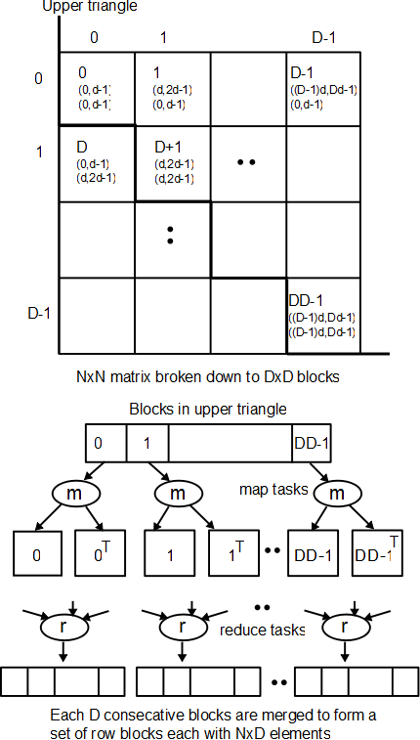
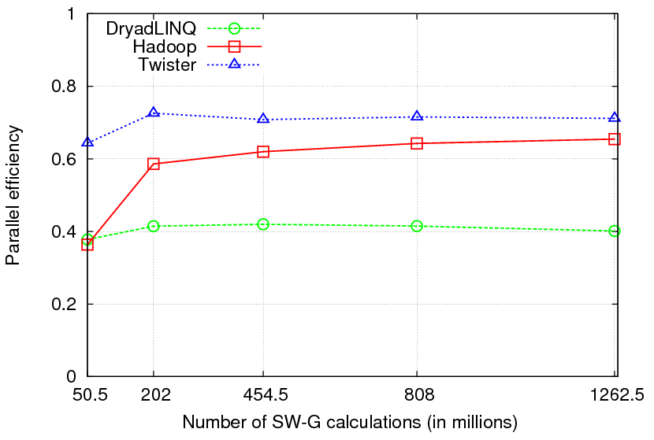

Pair wise Sequence Comparison using Smith Waterman Gotoh
Typical MapReduce computation
Comparable efficiencies
Twister performs the best
Xiaohong Qiu, Jaliya Ekanayake, Scott Beason, Thilina Gunarathne, Geoffrey Fox, Roger Barga, Dennis Gannon “Cloud Technologies for Bioinformatics Applications”, Proceedings of the 2nd ACM Workshop on Many-Task Computing on Grids and Supercomputers (SC09), Portland, Oregon, November 16th, 2009

Slide 50

Sequence Assembly in the Clouds
CAP3 - Expressed Sequence Tagging
Input files (FASTA)
CAP3
CAP3
Output files
Cap3 parallel efficiency
Cap3 – Per core per file (458 reads in each file) time to process sequences
Thilina Gunarathne, Tak-Lon Wu, Judy Qiu, and Geoffrey Fox,
“Cloud Computing Paradigms for Pleasingly Parallel Biomedical Applications”, March 21, 2010. Proceedings of Emerging Computational Methods for the Life Sciences Workshop of ACM HPDC 2010 conference, Chicago, Illinois, June 20-25, 2010.

