Slide 1
Performance of MapReduce on Multicore Clusters
UMBC, Maryland
Judy Qiu
http://salsahpc.indiana.edu
School of Informatics and Computing
Pervasive Technology Institute
Indiana University

Slide 2
Important Trends
  In all fields of science and throughout life (e.g. web!)
  Impacts preservation, access/use, programming model
    new commercially supported data center model building on compute grids
Data Deluge
Cloud Technologies
Multicore/
Parallel Computing
eScience
  Implies parallel computing important again
    Performance from extra cores – not extra clock speed
  A spectrum of eScience or eResearch applications (biology, chemistry, physics social science and
  humanities …)
  Data Analysis
  Machine learning

Slide 3
Grand Challenges
Data
Information
Knowledge

Slide 4



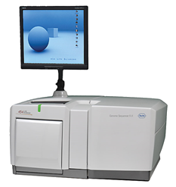
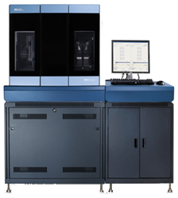
DNA Sequencing Pipeline
MapReduce
Pairwise
clustering
Sequence
alignment
Dissimilarity
Matrix
N(N-1)/2 values
Visualization
Plotviz
FASTA File
N Sequences
Blocking
block
Pairings
MPI
MDS
Read Alignment
This chart illustrate our research of a pipeline mode to provide services on demand (Software as a Service SaaS)
User submit their jobs to the pipeline. The components are services and so is the whole pipeline.
Illumina/Solexa Roche/454 Life Sciences Applied Biosystems/SOLiD
Internet
Modern Commerical Gene Sequences

Slide 5
Parallel Thinking
a

Slide 6
Flynn’s Instruction/Data Taxonomy of Computer Architecture
Single Instruction Single Data Stream (SISD)
A sequential computer which exploits no parallelism in either the instruction or data streams. Examples of SISD architecture are the traditional uniprocessor machines like a old PC.
Single Instruction Multiple Data (SIMD)
A computer which exploits multiple data streams against a single instruction stream to perform operations which may be naturally parallelized. For example, GPU.
Multiple Instruction Single Data (MISD)
Multiple instructions operate on a single data stream. Uncommon architecture which is generally used for fault tolerance. Heterogeneous systems operate on the same data stream and must agree on the result. Examples include the Space Shuttle flight control computer.
Multiple Instruction Multiple Data (MIMD)
Multiple autonomous processors simultaneously executing different instructions on different data. Distributed systems are generally recognized to be MIMD architectures; either exploiting a single shared memory space or a distributed memory space.

Slide 7
Questions
If we extend Flynn’s Taxonomy to software,
What classification is MPI?
What classification is MapReduce?

Slide 8
MapReduce is a new programming model for processing and generating large data sets
From Google

Slide 9






MapReduce “File/Data Repository” Parallelism
Map = (data parallel) computation reading and writing data
Reduce = Collective/Consolidation phase e.g. forming multiple global sums as in histogram
Instruments
MPI and Iterative MapReduce
Map Map Map Map
Reduce Reduce Reduce
Communication
Reduce
Portals
/Users
Disks
Map₁
Map₂
Map₃

Slide 10
MapReduce
A parallel Runtime coming from Information Retrieval
Data Partitions
Map(Key, Value)
A hash function maps the results of the map tasks to r reduce tasks
Reduce(Key, List<Value>)
Reduce Outputs
Implementations support:
  Splitting of data
  Passing the output of map functions to reduce functions
  Sorting the inputs to the reduce function based on the intermediate keys
  Quality of services

Slide 11
 | Google MapReduce | Apache Hadoop | Microsoft Dryad | Twister | Azure Twister
Programming Model | MapReduce | MapReduce | DAG execution, Extensible to MapReduce and other patterns | Iterative MapReduce | MapReduce-- will extend to Iterative MapReduce
Data Handling | GFS (Google File System) | HDFS (Hadoop Distributed File System) | Shared Directories & local disks | Local disks and data management tools | Azure Blob Storage
Scheduling | Data Locality | Data Locality; Rack aware, Dynamic task scheduling through global queue | Data locality; Network topology based run time graph optimizations; Static task partitions | Data Locality; Static task partitions | Dynamic task scheduling through global queue
Failure Handling | Re-execution of failed tasks; Duplicate execution of slow tasks | Re-execution of failed tasks; Duplicate execution of slow tasks | Re-execution of failed tasks; Duplicate execution of slow tasks | Re-execution of Iterations | Re-execution of failed tasks; Duplicate execution of slow tasks
High Level Language Support | Sawzall | Pig Latin | DryadLINQ | Pregel has related features | N/A
Environment | Linux Cluster. | Linux Clusters, Amazon Elastic Map Reduce on EC2 | Windows HPCS cluster | Linux Cluster EC2 | Window Azure Compute, Windows Azure Local Development Fabric
Intermediate data transfer | File | File, Http | File, TCP pipes, shared-memory FIFOs | Publish/Subscribe messaging | Files, TCP

Slide 12
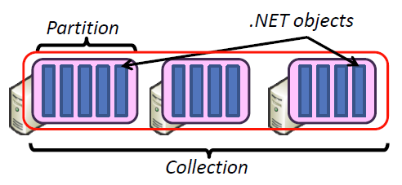
Hadoop & DryadLINQ
Apache Hadoop
Microsoft DryadLINQ
Master Node
Data/Compute Nodes
Standard LINQ operations
Job
Tracker
M
M
M
M
DryadLINQ operations
R
R
R
R
DryadLINQ Compiler
Name
Node
HDFS
Data
blocks
Directed Acyclic Graph (DAG) based execution flows
1
2
Vertex :
execution task
2
3
3
4
Edge :
communication path
Dryad Execution Engine
Apache Implementation of Google’s MapReduce
Hadoop Distributed File System (HDFS) manage data
Map/Reduce tasks are scheduled based on data locality in HDFS (replicated data blocks)
Dryad process the DAG executing vertices on compute clusters
LINQ provides a query interface for structured data
Provide Hash, Range, and Round-Robin partition patterns
  Job creation; Resource management; Fault tolerance& re-execution of failed taskes/vertices

Slide 13


Applications using Dryad & DryadLINQ
CAP3 - Expressed Sequence Tag assembly to re-construct full-length mRNA
Input files (FASTA)
DryadLINQ
CAP3
CAP3
CAP3
Output files
Perform using DryadLINQ and Apache Hadoop implementations
Single “Select” operation in DryadLINQ
“Map only” operation in Hadoop
X. Huang, A. Madan, “CAP3: A DNA Sequence Assembly Program,” Genome Research, vol. 9, no. 9, pp. 868-877, 1999.

Slide 14
Classic Cloud Architecture
Amazon EC2 and Microsoft Azure
MapReduce Architecture
Apache Hadoop and Microsoft DryadLINQ
HDFS
Input Data Set
Data File
exe
exe
Map()
Map()
Executable
Optional
Reduce
Phase
Reduce
HDFS
Results

Slide 15
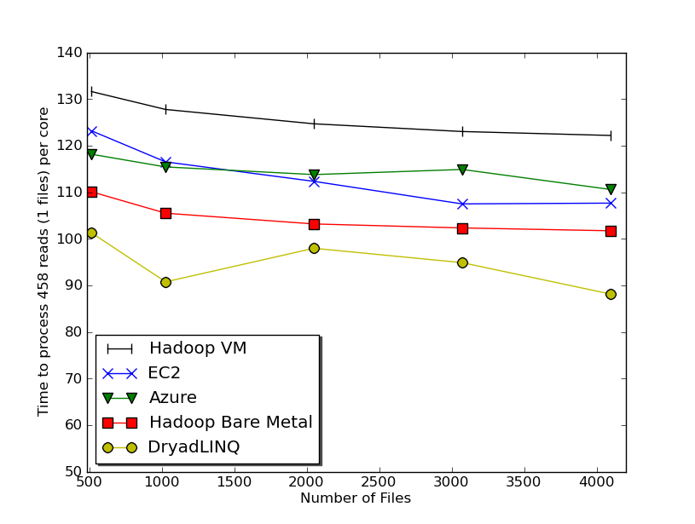

Usability and Performance of Different Cloud Approaches
Cap3 Performance
Cap3 Efficiency
Ease of Use – Dryad/Hadoop are easier than EC2/Azure as higher level models
Lines of code including file copy
  Azure : ~300 Hadoop: ~400 Dyrad: ~450 EC2 : ~700
Efficiency = absolute sequential run time / (number of cores * parallel run time)
Hadoop, DryadLINQ - 32 nodes (256 cores IDataPlex)
EC2 - 16 High CPU extra large instances (128 cores)
Azure- 128 small instances (128 cores)
Notes:
Emerging technologies we cannot draw too much conclusion yet but all look promising at the moment
Ease of development. Dryad and Hadoop >> EC2 and Azure
Why Azure is worse than EC2 although less code lines?
Simplest model

Slide 16
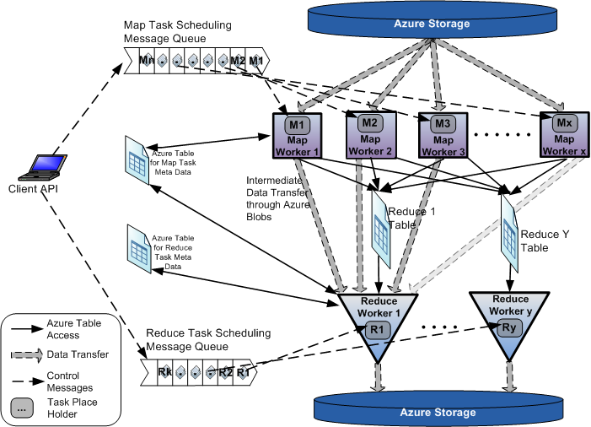
AzureMapReduce

Slide 17
Scaled Timing with
Azure/Amazon MapReduce

Slide 18
Cap3 Cost
Notes:
This is just the cost for the compute instances. In addition to this, there will be minor charges for the data storage for EMR & AzureMR. Also there will be additional minor charges for the queue service and table service for AzureMR.
Cost presented here are amortized for the actual time (time/3600 * num_instances * instance_price_per_hour), assuming the remaining time of the instance hour have been put to useful work.
Note: EMR & Hadoop-EC2 requires one extra node to act as the master node (included in the cost calculation)

Slide 19
Alu and Metagenomics Workflow
“All pairs” problem
Data is a collection of N sequences. Need to calcuate N² dissimilarities (distances) between sequnces (all pairs).
  These cannot be thought of as vectors because there are missing characters
  “Multiple Sequence Alignment” (creating vectors of characters) doesn’t seem to work if N larger than O(100), where 100’s of characters long.
Step 1: Can calculate N² dissimilarities (distances) between sequences
Step 2: Find families by clustering (using much better methods than Kmeans). As no vectors, use vector free O(N²) methods
Step 3: Map to 3D for visualization using Multidimensional Scaling (MDS) – also O(N²)
Results:
N = 50,000 runs in 10 hours (the complete pipeline above) on 768 cores
Discussions:
Need to address millions of sequences …..
Currently using a mix of MapReduce and MPI
Twister will do all steps as MDS, Clustering just need MPI Broadcast/Reduce

Slide 20

All-Pairs Using DryadLINQ
125 million distances
4 hours & 46 minutes
Calculate Pairwise Distances (Smith Waterman Gotoh)
Calculate pairwise distances for a collection of genes (used for clustering, MDS)
Fine grained tasks in MPI
Coarse grained tasks in DryadLINQ
Performed on 768 cores (Tempest Cluster)
Moretti, C., Bui, H., Hollingsworth, K., Rich, B., Flynn, P., & Thain, D. (2009). All-Pairs: An Abstraction for Data Intensive Computing on Campus Grids. IEEE Transactions on Parallel and Distributed Systems , 21, 21-36.

Slide 21


Biology MDS and Clustering Results
Alu Families
This visualizes results of Alu repeats from Chimpanzee and Human Genomes. Young families (green, yellow) are seen as tight clusters. This is projection of MDS dimension reduction to 3D of 35399 repeats – each with about 400 base pairs
Metagenomics
This visualizes results of dimension reduction to 3D of 30000 gene sequences from an environmental sample. The many different genes are classified by clustering algorithm and visualized by MDS dimension reduction

Slide 22
Hadoop/Dryad Comparison
Inhomogeneous Data I
Inhomogeneity of data does not have a significant effect when the sequence lengths are randomly distributed
Dryad with Windows HPCS compared to Hadoop with Linux RHEL on Idataplex (32 nodes)
Notes:
10k data size

Slide 23
Hadoop/Dryad Comparison
Inhomogeneous Data II
This shows the natural load balancing of Hadoop MR dynamic task assignment using a global pipe line in contrast to the DryadLinq static assignment
Dryad with Windows HPCS compared to Hadoop with Linux RHEL on Idataplex (32 nodes)
Notes:
10k data size

Slide 24
Hadoop VM Performance Degradation
Perf. Degradation = (T_{vm} – T_{baremetal})/T_{baremetal}
15.3% Degradation at largest data set size
Notes:
Overhead is independent of computation time. With the size of data go up, overall overhead is reduced.

Slide 25
Student Research Generates Impressive Results
Publications
Jaliya Ekanayake, Thilina Gunarathne, Xiaohong Qiu, Cloud Technologies for Bioinformatics Applications, invited paper accepted by the Journal of IEEE Transactions on Parallel and Distributed Systems. Special Issues on Many-Task Computing.
Software Release
Twister (Iterative MapReduce)
http://www.iterativemapreduce.org/

Slide 26

Twister: An iterative MapReduce Programming Model
Worker Nodes
configureMaps(..)
Local Disk
configureReduce(..)
Cacheable map/reduce tasks
while(condition){
runMapReduce(..)
May send <Key,Value> pairs directly
Map()
Iterations
Reduce()
Combine() operation
Communications/data transfers via the pub-sub broker network
updateCondition()
Two configuration options :
Using local disks (only for maps)
Using pub-sub bus
} //end while
close()
User program’s process space

Slide 27
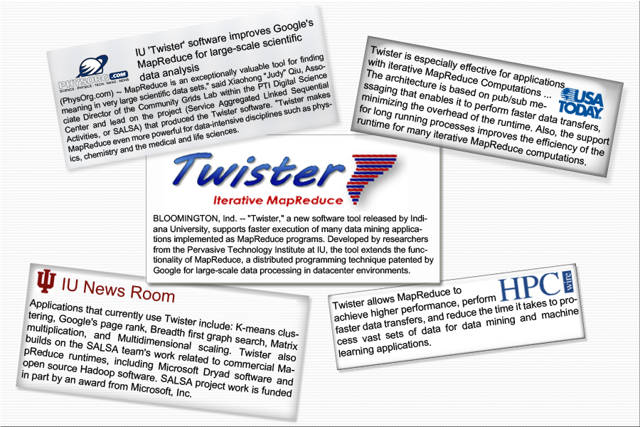
Twister New Release

Slide 28


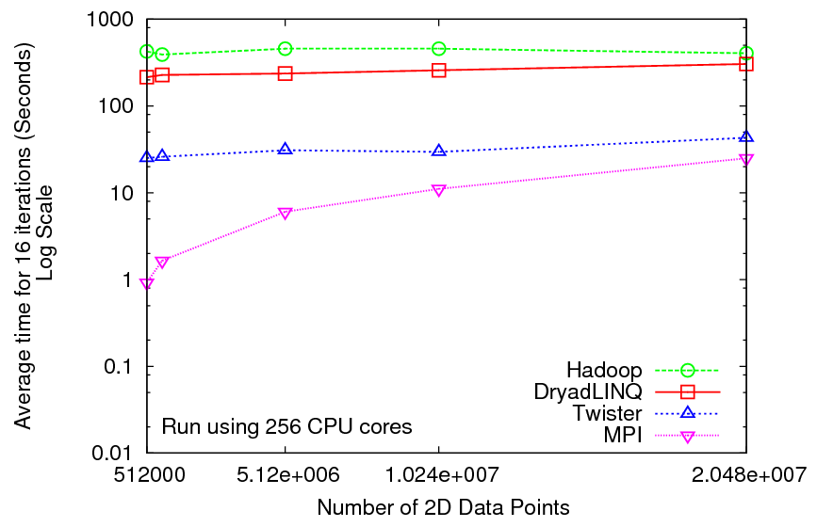
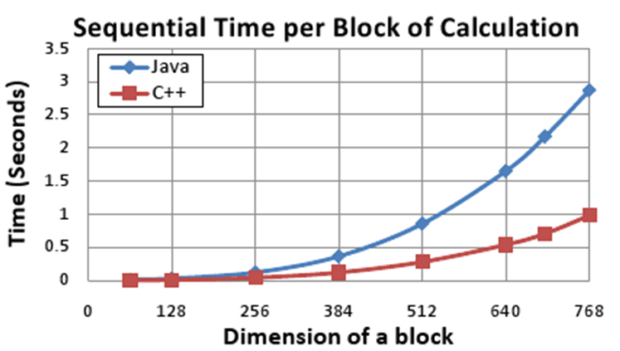
Iterative Computations
K-means
Matrix Multiplication
Performance of K-Means
Parallel Overhead Matrix Multiplication
Overhead OpenMPI vs Twister negative overhead due to cache

Slide 29

Pagerank – An Iterative MapReduce Algorithm
Performance of Pagerank using
ClueWeb Data (Time for 20 iterations)
using 32 nodes (256 CPU cores) of Crevasse
Partial Adjacency Matrix
Current
Page ranks (Compressed)
M
Partial
Updates
R
C
Partially merged
Updates
Iterations
Well-known pagerank algorithm [1]
Used ClueWeb09 [2] (1TB in size) from CMU
Reuse of map tasks and faster communication pays off
[1] Pagerank Algorithm, http://en.wikipedia.org/wiki/PageRank
[2] ClueWeb09 Data Set, http://boston.lti.cs.cmu.edu/Data/clueweb09/

Slide 30
Applications & Different Interconnection Patterns
Map Only | Classic MapReduce | Iterative Reductions MapReduce++ | Loosely Synchronous
CAP3 Analysis Document conversion (PDF -> HTML) Brute force searches in cryptography Parametric sweeps | High Energy Physics (HEP) Histograms SWG gene alignment Distributed search Distributed sorting Information retrieval | Expectation maximization algorithms Clustering Linear Algebra | Many MPI scientific applications utilizing wide variety of communication constructs including local interactions
- CAP3 Gene Assembly - PolarGrid Matlab data analysis | - Information Retrieval - HEP Data Analysis - Calculation of Pairwise Distances for ALU Sequences | Kmeans Deterministic Annealing Clustering - Multidimensional Scaling MDS | - Solving Differential Equations and - particle dynamics with short range forces
Input
iterations
Input
Input
map
map
map
Pij
reduce
Output
reduce
Domain of MapReduce and Iterative Extensions
MPI

Slide 31
Cloud Technologies and Their Applications
Swift, Taverna, Kepler,Trident
Workflow
SaaS
Applications
Smith Waterman Dissimilarities, PhyloD Using DryadLINQ, Clustering, Multidimensional Scaling, Generative Topological Mapping
Higher Level Languages
Apache PigLatin/Microsoft DryadLINQ
Cloud Platform
Apache Hadoop / Twister/ Sector/Sphere
Microsoft Dryad / Twister
Nimbus, Eucalyptus, Virtual appliances, OpenStack, OpenNebula,
Cloud
Infrastructure
Linux Virtual Machines
Linux Virtual Machines
Windows Virtual Machines
Windows Virtual Machines
Hypervisor/
Virtualization
Xen, KVM Virtualization / XCAT Infrastructure
Hardware
Bare-metal Nodes

Slide 32

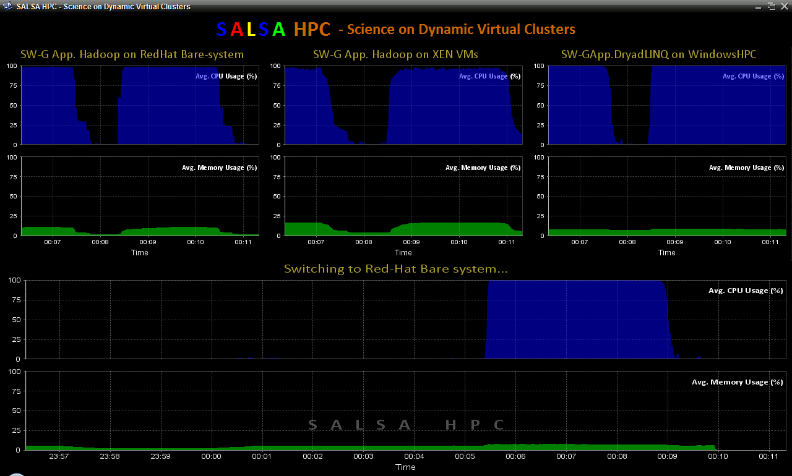
SALSAHPC Dynamic Virtual Cluster on FutureGrid -- Demo at SC09
Demonstrate the concept of Science on Clouds on FutureGrid
Dynamic Cluster Architecture
Monitoring & Control Infrastructure
Monitoring Infrastructure
Monitoring Interface
Pub/Sub Broker Network
SW-G Using Hadoop
SW-G Using Hadoop
SW-G Using DryadLINQ
Linux
Bare-system
Linux on Xen
Windows Server 2008 Bare-system
Virtual/Physical Clusters
Summarizer
XCAT Infrastructure
XCAT Infrastructure
Switcher
iDataplex Bare-metal Nodes
(32 nodes)
iDataplex Bare-metal Nodes
Switchable clusters on the same hardware (~5 minutes between different OS such as Linux+Xen to Windows+HPCS)
Support for virtual clusters
SW-G : Smith Waterman Gotoh Dissimilarity Computation as an pleasingly parallel problem suitable for MapReduce style applications

Slide 33
SALSAHPC Dynamic Virtual Cluster on FutureGrid -- Demo at SC09
Demonstrate the concept of Science on Clouds using a FutureGrid cluster
Top: 3 clusters are switching applications on fixed environment. Takes approximately 30 seconds.
Bottom: Cluster is switching between environments: Linux; Linux +Xen; Windows + HPCS.
Takes approxomately 7 minutes
SALSAHPC Demo at SC09. This demonstrates the concept of Science on Clouds using a FutureGrid iDataPlex.

Slide 34
Summary of Initial Results
Cloud technologies (Dryad/Hadoop/Azure/EC2) promising for Life Science computations
Dynamic Virtual Clusters allow one to switch between different modes
Overhead of VM’s on Hadoop (15%) acceptable
Twister allows iterative problems (classic linear algebra/datamining) to use MapReduce model efficiently
  Prototype Twister released

Slide 35


FutureGrid: a Grid Testbed
http://www.futuregrid.org/
NID: Network Impairment Device
Private
Public
FG Network

Slide 36
FutureGrid key Concepts
FutureGrid provides a testbed with a wide variety of computing services to its users
  Supporting users developing new applications and new middleware using Cloud, Grid and Parallel computing (Hypervisors – Xen, KVM, ScaleMP, Linux, Windows, Nimbus, Eucalyptus, Hadoop, Globus, Unicore, MPI, OpenMP …)
  Software supported by FutureGrid or users
  ~5000 dedicated cores distributed across country
The FutureGrid testbed provides to its users:
  A rich development and testing platform for middleware and application users looking at interoperability, functionality and performance
  Each use of FutureGrid is an experiment that is reproducible
  A rich education and teaching platform for advanced cyberinfrastructure classes
  Ability to collaborate with the US industry on research projects

Slide 37
FutureGrid key Concepts II
Cloud infrastructure supports loading of general images on Hypervisors like Xen; FutureGrid dynamically provisions software as needed onto “bare-metal” using Moab/xCAT based environment
Key early user oriented milestones:
  June 2010 Initial users
  November 2010-September 2011 Increasing number of users allocated by FutureGrid
  October 2011 FutureGrid allocatable via TeraGrid process
To apply for FutureGrid access or get help, go to homepage www.futuregrid.org. Alternatively for help send email to help@futuregrid.org. Please send email to PI: Geoffrey Fox gcf@indiana.edu if problems

Slide 38
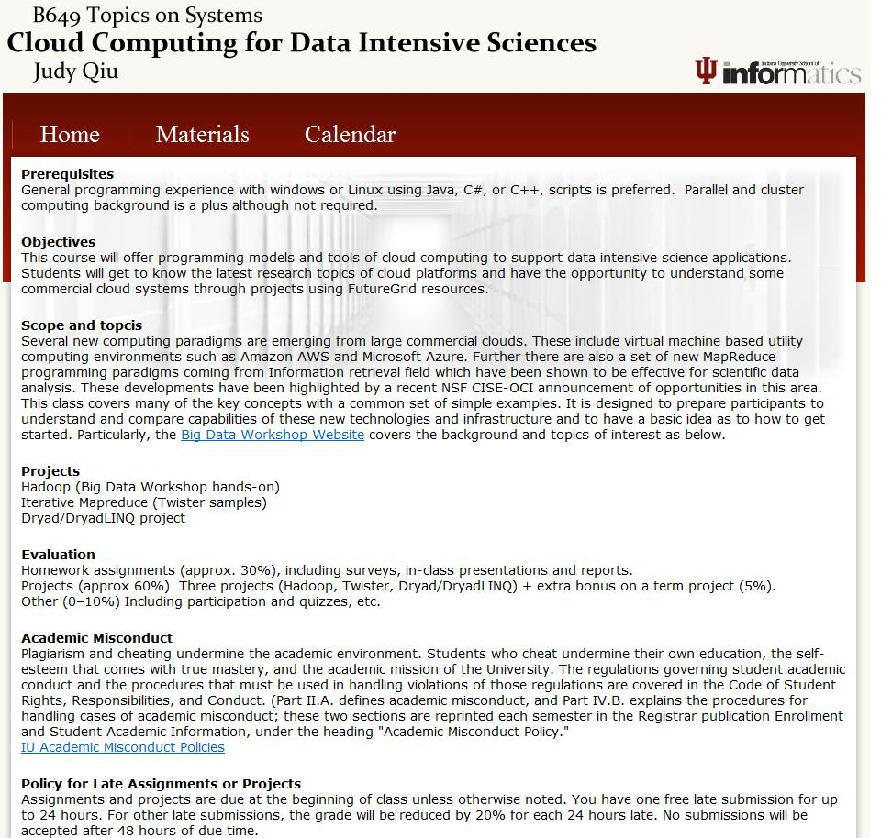

Slide 39


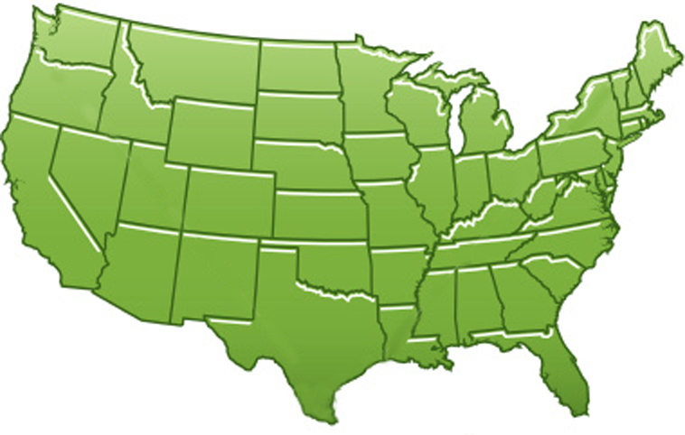















300+ Students learning about Twister & Hadoop
MapReduce technologies, supported by FutureGrid.
July 26-30, 2010 NCSA Summer School Workshop
http://salsahpc.indiana.edu/tutorial
Washington
University
University of
Minnesota
Michigan
State
Johns
Hopkins
Univ.Illinois
at Chicago
Iowa
State
Penn
State
IBM Almaden
Research Center
Notre
Dame
University of
California at
Los Angeles
Indiana
University
San Diego
Supercomputer
Center
University of
Texas at El Paso
University of
Arkansas
University
of Florida

Slide 40


Slide 41
Summary
A New Science
“A new, fourth paradigm for science is based on data intensive computing” … understanding of this new paradigm from a variety of disciplinary perspective
– The Fourth Paradigm: Data-Intensive Scientific Discovery
A New Architecture
“Understanding the design issues and programming challenges for those potentially ubiquitous next-generation machines”
– The Datacenter As A Computer

Slide 42





Acknowledgements
SALSAHPC Group
http://salsahpc.indiana.edu
… and Our Collaborators
− David’s group
− Ying’s group

