Slide 1


Scientific Data Analytics on Cloud and HPC Platforms
Judy Qiu
SALSA HPC Group
http://salsahpc.indiana.edu
School of Informatics and Computing
Indiana University
CAREER Award

Slide 2
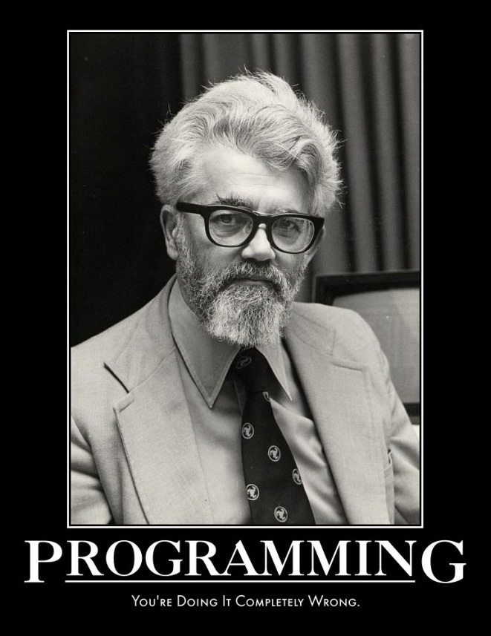
"... computing may someday be organized as a public utility just as
the telephone system is a public utility... The computer utility could
become the basis of a new and important industry.”
-- John McCarthy
Emeritus at Stanford
Inventor of LISP
1961

Slide 3
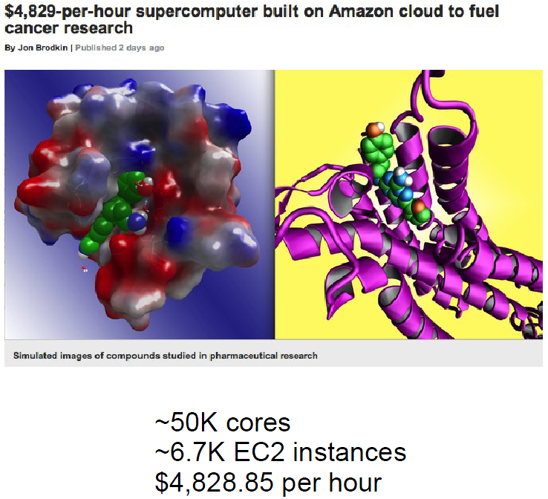
Joseph L. Hellerstein, Google

Slide 4
Challenges and Opportunities
Iterative MapReduce
  A Programming Model instantiating the paradigm of bringing computation to data
  Supporting for Data Mining and Data Analysis
Interoperability
  Using the same computational tools on HPC and Cloud
  Enabling scientists to focus on science not programming distributed systems
Reproducibility
  Using Cloud Computing for Scalable, Reproducible Experimentation
  Sharing results, data, and software

Slide 5
Intel’s Application Stack

Slide 6
(Iterative) MapReduce in Context
Support Scientific Simulations (Data Mining and Data Analysis)
Kernels, Genomics, Proteomics, Information Retrieval, Polar Science, Scientific Simulation Data Analysis and Management, Dissimilarity Computation, Clustering, Multidimensional Scaling, Generative Topological Mapping
Applications
Security, Provenance, Portal
Programming Model
Services and Workflow
High Level Language
Runtime
Cross Platform Iterative MapReduce (Collectives, Fault Tolerance, Scheduling)
Storage
Distributed File Systems
Object Store
Data Parallel File System
Linux HPC
Bare-system
Amazon Cloud
Windows Server HPC
Bare-system
Azure Cloud
Grid Appliance
Infrastructure
Virtualization
Virtualization
Hardware
CPU Nodes
GPU Nodes

Slide 7





Map Reduce
Programming Model
Moving Computation to Data
Scalable
Fault Tolerance
  Simple programming model
  Excellent fault tolerance
  Moving computations to data
  Works very well for data intensive pleasingly parallel applications
  Ideal for data intensive loosely coupled (pleasingly parallel) applications
Notes:
MapReduce provides a easy to use programming model together with very good fault tolerance and scalability for large scale applications. MapReduce model is proving to be Ideal for data intensive pleasingly parallel applications in commodity hardware and in clouds.

Slide 8
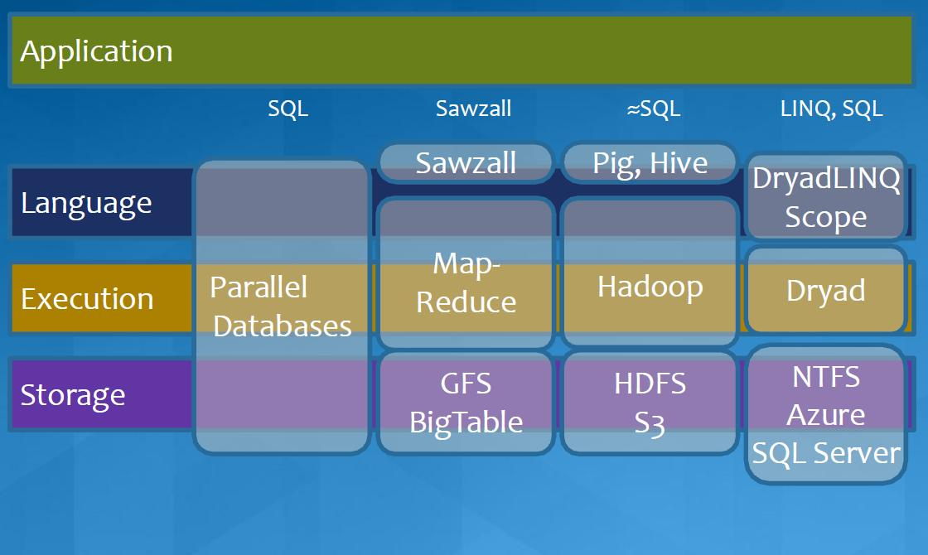
MapReduce in Heterogeneous Environment
MICROSOFT

Slide 9
Iterative MapReduce Frameworks
Twister^{[1]}
  Map->Reduce->Combine->Broadcast
  Long running map tasks (data in memory)
  Centralized driver based, statically scheduled.
Daytona^{[3]}
  Iterative MapReduce on Azure using cloud services
  Architecture similar to Twister
Haloop^{[4]}
  On disk caching, Map/reduce input caching, reduce output caching
  Spark^{[5]}
  Iterative Mapreduce Using Resilient Distributed Dataset to ensure the fault tolerance
  Pregel^{[6]}
  Graph processing from Google
Notes:
iMapReduce, Twister -> single wave..
Iterative MapReduce: Haloop, Twister @IU, Spark
Map-Reduce-Merge: enable processing heterogeneous data sets
MapReduce online: online aggregation, and continuous queries

Slide 10
Others
Mate-EC2^{[6]}
  Local reduction object
Network Levitated Merge^{[7]}
  RDMA/infiniband based shuffle & merge
Asynchronous Algorithms in MapReduce^{[8]}
  Local & global reduce
MapReduce online^{[9]}
  online aggregation, and continuous queries
  Push data from Map to Reduce
Orchestra^{[10]}
  Data transfer improvements for MR
iMapReduce^{[11]}
  Async iterations, One to one map & reduce mapping, automatically joins loop-variant and invariant data
CloudMapReduce^{[12]} & Google AppEngine MapReduce^{[13]}
  MapReduce frameworks utilizing cloud infrastructure services
Notes:
Orchestra : Broadcast and shuffle improvements…

Slide 11
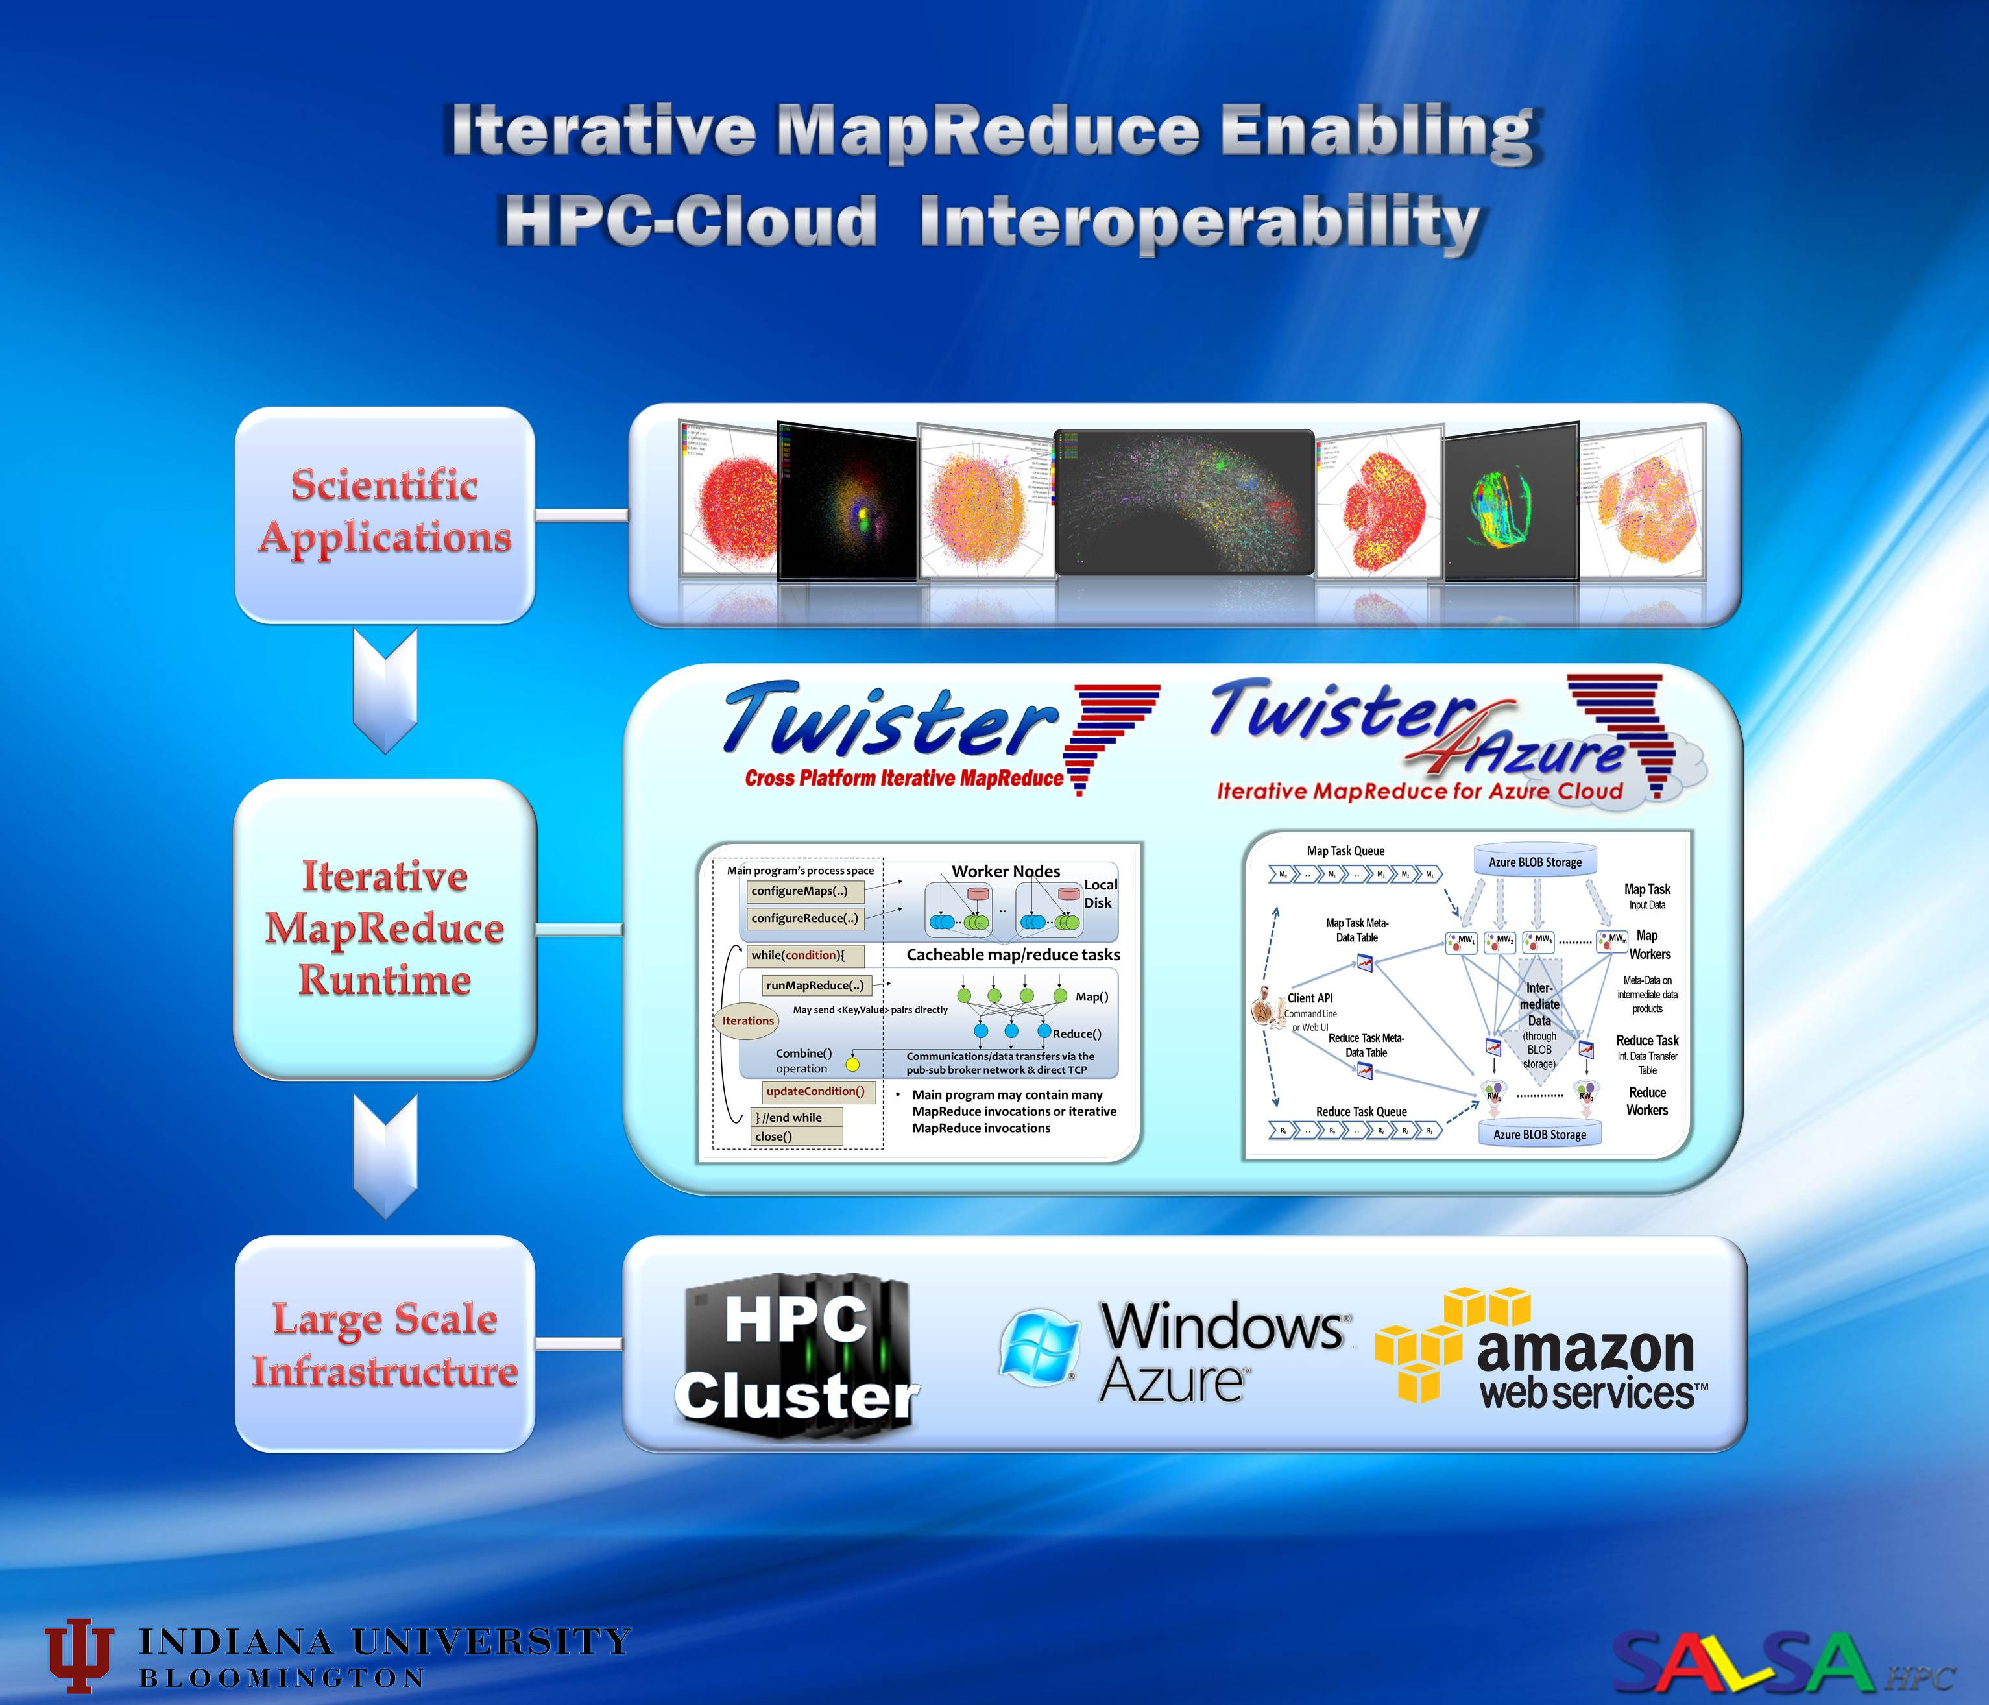

Slide 12
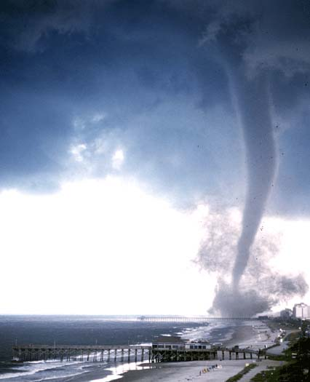

Twister v0.9
  New Infrastructure for Iterative MapReduce Programming
  Distinction on static and variable data
  Configurable long running (cacheable) map/reduce tasks
  Pub/sub messaging based communication/data transfers
  Broker Network for facilitating communication

Slide 13
Main program’s process space
Worker Nodes
configureMaps(..)
Local Disk
configureReduce(..)
Cacheable map/reduce tasks
while(condition){
runMapReduce(..)
May send <Key,Value> pairs directly
Map()
Iterations
Reduce()
Combine() operation
Communications/data transfers via the pub-sub broker network & direct TCP
updateCondition()
Main program may contain many MapReduce invocations or iterative MapReduce invocations
} //end while
close()

Slide 14
Master Node
B
Pub/sub
Broker Network
Twister
Driver
B
B
B
Main Program
One broker serves several Twister daemons
Twister Daemon
Twister Daemon
map
reduce
Cacheable tasks
Worker Pool
Worker Pool
Scripts perform:
Data distribution, data collection, and partition file creation
Local Disk
Local Disk
Worker Node
Worker Node

Slide 15
Applications of Twister4Azure
Implemented
  Multi Dimensional Scaling
  KMeans Clustering
  PageRank
  SmithWatermann-GOTOH sequence alignment
  WordCount
  Cap3 sequence assembly
  Blast sequence search
  GTM & MDS interpolation
Under Development
  Latent Dirichlet Allocation

Slide 16
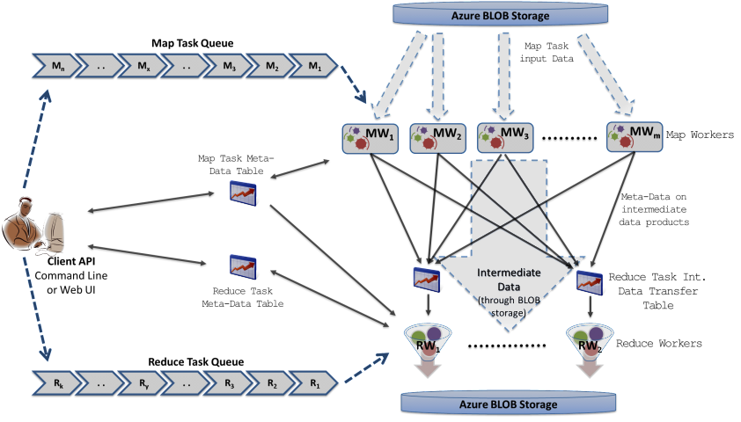
Twister4Azure Architecture
Azure Queues for scheduling, Tables to store meta-data and monitoring data, Blobs for input/output/intermediate data storage.
Notes:
Ability to dynamically scale up/down
Easy testing and deployment
Combiner step
Web based monitoring console

Slide 17
Data Intensive Iterative Applications
Compute
Communication
Reduce/ barrier
Smaller Loop-Variant Data
Broadcast
New Iteration
Larger Loop-Invariant Data
Growing class of applications
  Clustering, data mining, machine learning & dimension reduction applications
  Driven by data deluge & emerging computation fields
Notes:
Most of these applications consists of iterative computation and communication steps where single iterations can easily be specified as MapReduce computations.
Large input data sizes which are loop-invariant and can be reused across iterations.
Loop-variant results.. Orders of magnitude smaller…
While these can be performed using traditional MapReduce frameworks, Traditional is not efficient for these types of computations. MR leaves lot of room for improvements in terms of iterative applications.

Slide 18

Iterative MapReduce for Azure Cloud
http://salsahpc.indiana.edu/twister4azure
Extensions to support broadcast data
Hybrid intermediate data transfer
Merge step
Cache-aware Hybrid Task Scheduling
Collective Communication Primitives
Multi-level caching of static data
Portable Parallel Programming on Cloud and HPC: Scientific Applications of Twister4Azure, Thilina Gunarathne, BingJing Zang, Tak-Lon Wu and Judy Qiu, (UCC 2011) , Melbourne, Australia.

Slide 19

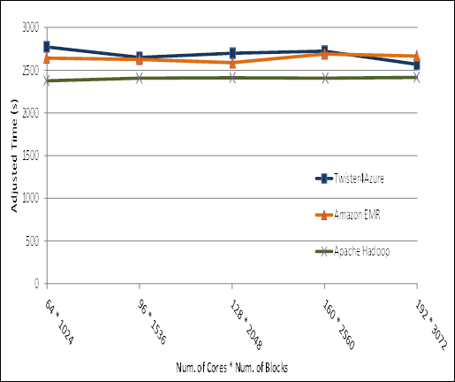
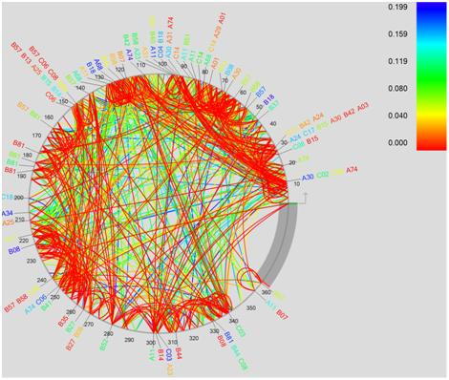
Performance of Pleasingly Parallel Applications on Azure
BLAST Sequence Search
Smith Watermann
Sequence Alignment
Cap3 Sequence Assembly
MapReduce in the Clouds for Science, Thilina Gunarathne, et al. CloudCom 2010, Indianapolis, IN.

Slide 20





Performance – Kmeans Clustering
Overhead between iterations
First iteration performs the initial data fetch
Task Execution Time Histogram
Number of Executing Map Task Histogram
Scales better than Hadoop on bare metal
Strong Scaling with 128M Data Points
Weak Scaling
Performance with/without
data caching
Speedup gained using data cache
Scaling speedup
Increasing number of iterations

Slide 21
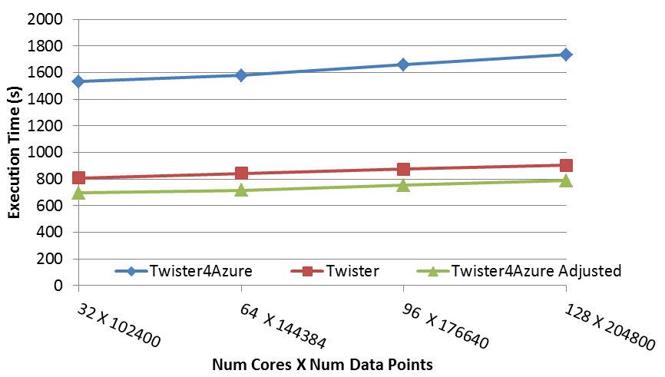
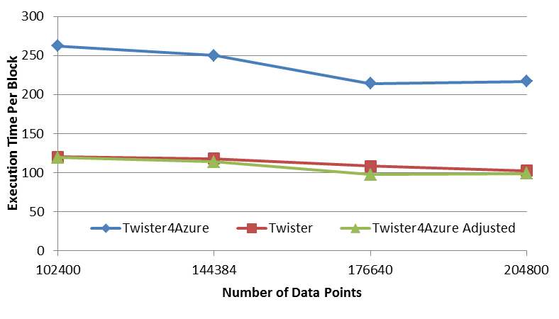
Performance – Multi Dimensional Scaling
BC: Calculate BX
X: Calculate invV (BX)
Calculate Stress
Map
Reduce
Merge
Map
Reduce
Merge
Map
Reduce
Merge
New Iteration
Performance adjusted for sequential performance difference
Weak Scaling
Data Size Scaling
Scalable Parallel Scientific Computing Using Twister4Azure. Thilina Gunarathne, BingJing Zang, Tak-Lon Wu and Judy Qiu. Submitted to Journal of Future Generation Computer Systems. (Invited as one of the best 6 papers of UCC 2011)

Slide 22
Parallel Data Analysis using Twister
MDS (Multi Dimensional Scaling)
Clustering (Kmeans)
SVM (Scalable Vector Machine)
Indexing
Xiaoming Gao, Vaibhav Nachankar and Judy Qiu, Experimenting Lucene Index on HBase in an HPC Environment, position paper in the proceedings of ACM High Performance Computing meets Databases workshop (HPCDB'11) at SuperComputing 11, December 6, 2011

Slide 23
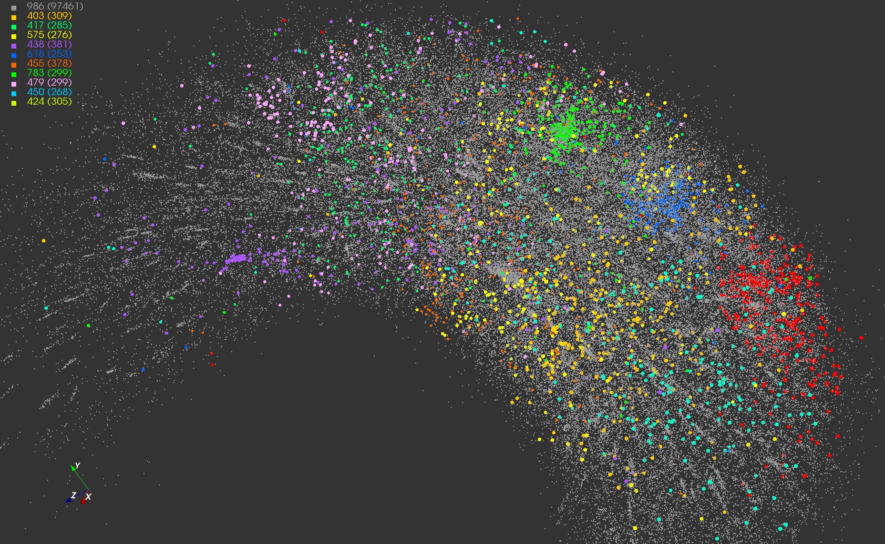
Application #1
Twister-MDS Output
MDS projection of 100,000 protein sequences showing a few experimentally
identified clusters in preliminary work with Seattle Children’s Research Institute

Slide 24
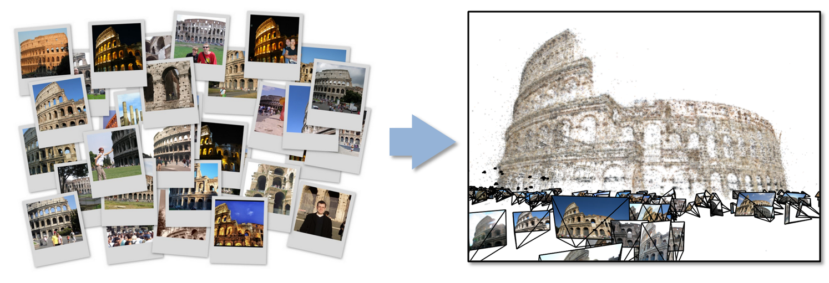
Data Intensive Kmeans Clustering
Application #2
  ─ Image Classification: 1.5 TB; 500 features per image;10k clusters
  1000 Map tasks; 1GB data transfer per Map task

Slide 25
Twister Communications
Broadcast
Broadcasting
  Data could be large
  Chain & MST
Map Collectives
  Local merge
Reduce Collectives
  Collect but no merge
Combine
  Direct download or Gather
Map Tasks
Map Tasks
Map Tasks
Map Collective
Map Collective
Map Collective
Reduce Tasks
Reduce Tasks
Reduce Tasks
Reduce Collective
Reduce Collective
Reduce Collective
Gather

Slide 26
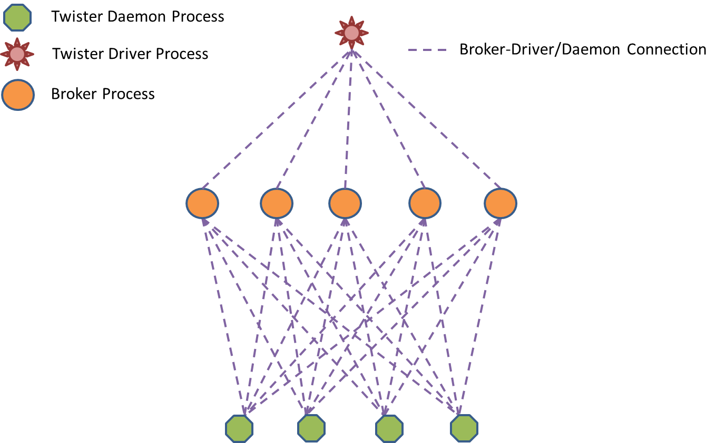
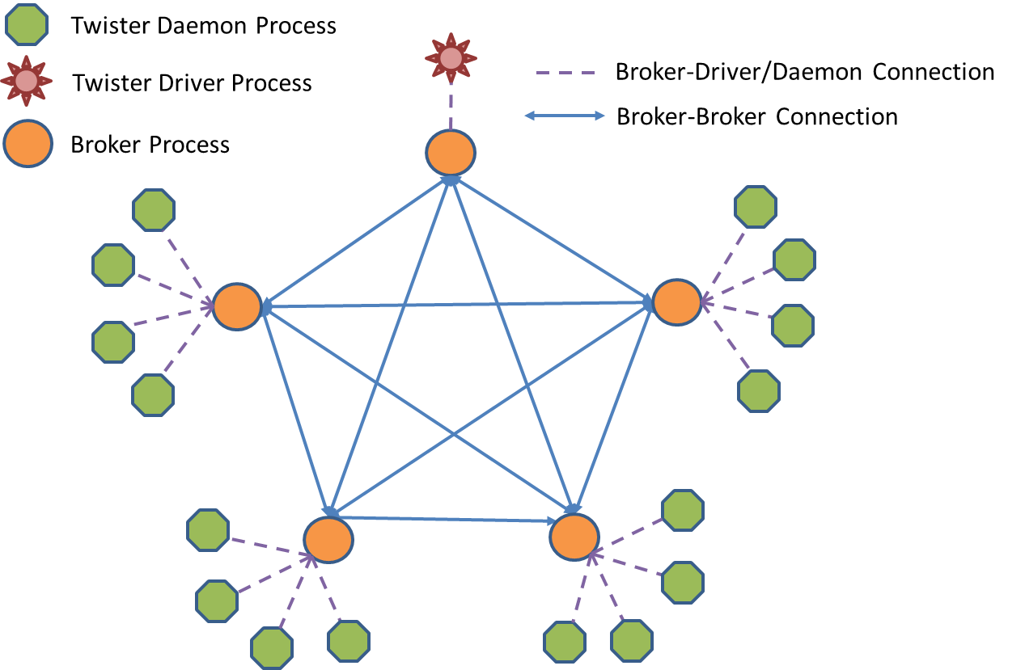
Improving Performance of Map Collectives
Full Mesh Broker Network
Scatter and Allgather

Slide 27
Polymorphic Scatter-Allgather in Twister

Slide 28
Twister Performance on Kmeans Clustering

Slide 29
Twister on InfiniBand
InfiniBand successes in HPC community
  More than 42% of Top500 clusters use InfiniBand
  Extremely high throughput and low latency
    Up to 40Gb/s between servers and 1μsec latency
  Reduce CPU overhead up to 90%
Cloud community can benefit from InfiniBand
  Accelerated Hadoop (sc11)
  HDFS benchmark tests
RDMA can make Twister faster
  Accelerate static data distribution
  Accelerate data shuffling between mappers and reducer
In collaboration with ORNL on a large InfiniBand cluster
Notes:
Even higher between switches

Slide 30
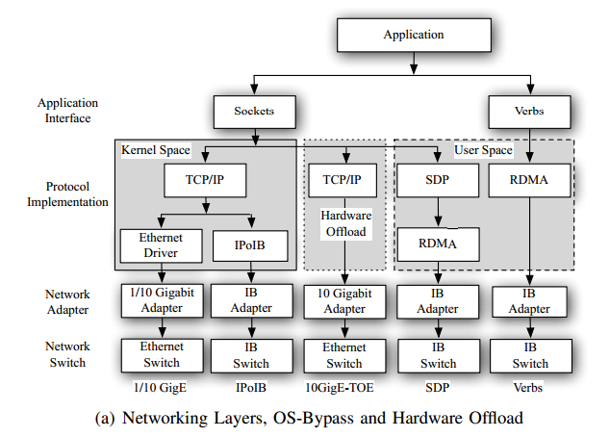
Using RDMA for Twister on InfiniBand

Slide 31
Twister Broadcast Comparison: Ethernet vs. InfiniBand

Slide 32

Building Virtual Clusters
Towards Reproducible eScience in the Cloud
Separation of concerns between two layers
Infrastructure Layer – interactions with the Cloud API
Software Layer – interactions with the running VM

Slide 33
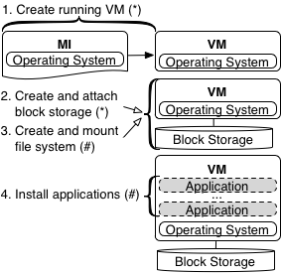
Separation Leads to Reuse
Infrastructure Layer = (*) Software Layer = (#)
By separating layers, one can reuse software layer artifacts in separate clouds

Slide 34
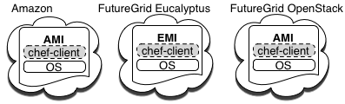

Design and Implementation
Equivalent machine images (MI) built in separate clouds
Common underpinning in separate clouds for software installations and configurations
Extend to Azure
Configuration management used for software automation

Slide 35
Cloud Image Proliferation

Slide 36
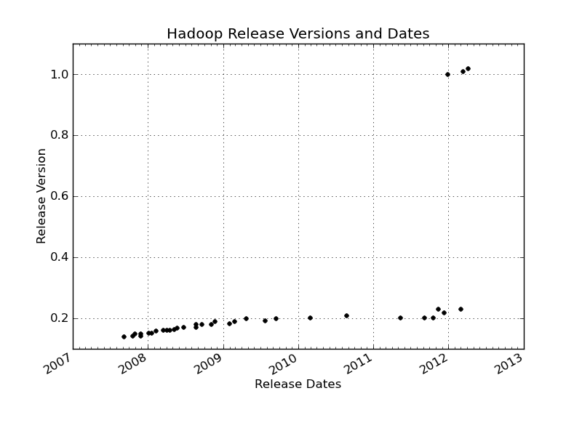
Changes of Hadoop Versions

Slide 37
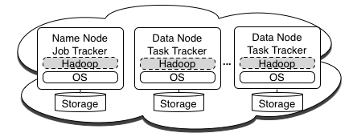
Implementation - Hadoop Cluster
Hadoop cluster commands
knife hadoop launch {name} {slave count}
knife hadoop terminate {name}

Slide 38
Running CloudBurst on Hadoop
Running CloudBurst on a 10 node Hadoop Cluster
knife hadoop launch cloudburst 9
echo ‘{"run list": "recipe[cloudburst]"}' > cloudburst.json
chef-client -j cloudburst.json
CloudBurst on a 10, 20, and 50 node Hadoop Cluster

Slide 39
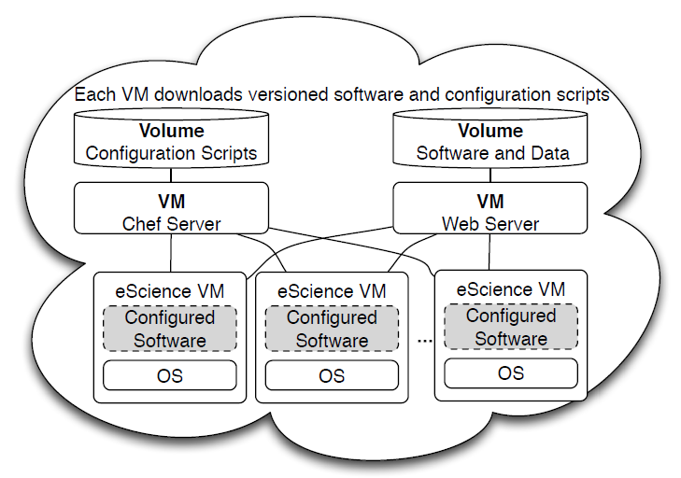

Slide 40
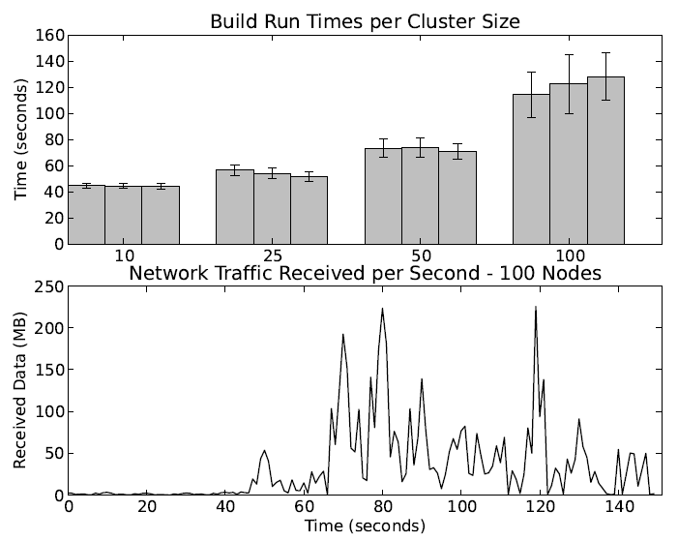

Slide 41
Applications & Different Interconnection Patterns
Map Only | Classic MapReduce | Iterative MapReduce Twister | Loosely Synchronous
CAP3 Analysis Document conversion (PDF -> HTML) Brute force searches in cryptography Parametric sweeps | High Energy Physics (HEP) Histograms SWG gene alignment Distributed search Distributed sorting Information retrieval | Expectation maximization algorithms Clustering Linear Algebra | Many MPI scientific applications utilizing wide variety of communication constructs including local interactions
- CAP3 Gene Assembly - PolarGrid Matlab data analysis | - Information Retrieval - HEP Data Analysis - Calculation of Pairwise Distances for ALU Sequences | Kmeans Deterministic Annealing Clustering - Multidimensional Scaling MDS | - Solving Differential Equations and - particle dynamics with short range forces
Input
iterations
Input
Input
map
map
map
Pij
reduce
Output
reduce
Domain of MapReduce and Iterative Extensions
MPI

Slide 42


Slide 43




Ackowledgements
SALSA HPC Group
http://salsahpc.indiana.edu
School of Informatics and Computing
Indiana University

