Slide 1
Matching Data Intensive Applications and Hardware/Software Architectures
LBNL Berkeley CA
June 19 2014
Geoffrey Fox
gcf@indiana.edu
http://www.infomall.org
School of Informatics and Computing
Digital Science Center
Indiana University Bloomington

Slide 2
Abstract
There is perhaps a broad consensus as to important issues in practical parallel computing as applied to large scale simulations; this is reflected in supercomputer architectures, algorithms, libraries, languages, compilers and best practice for application development. However the same is not so true for data intensive problems even though commercial clouds presumably devote more resources to data analytics than supercomputers devote to simulations. We try to establish some principles that allow one to compare data intensive architectures and decide which applications fit which machines and which software.
We use a sample of over 50 big data applications to identify characteristics of data intensive applications and propose a big data version of the famous Berkeley dwarfs and NAS parallel benchmarks. We consider hardware from clouds to HPC. Our software analysis builds on the Apache software stack (ABDS) that is well used in modern cloud computing, which we enhance with HPC concepts to derive HPC-ABDS.
We illustrate issues with examples including kernels like clustering, and multi-dimensional scaling; cyberphysical systems; databases; and variants of image processing from beam lines, Facebook and deep-learning.

Slide 3
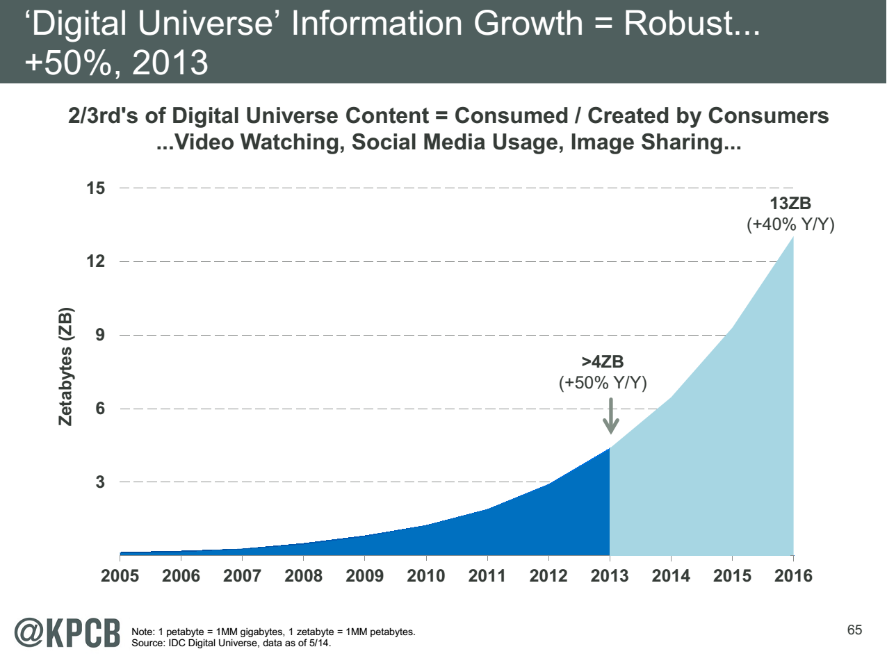
Note largest science ~100 petabytes = 0.000025 total
http://www.kpcb.com/internet-trends

Slide 4
HPC-ABDS
Integrating High Performance Computing with Apache Big Data Stack
Shantenu Jha, Judy Qiu, Andre Luckow

Slide 5
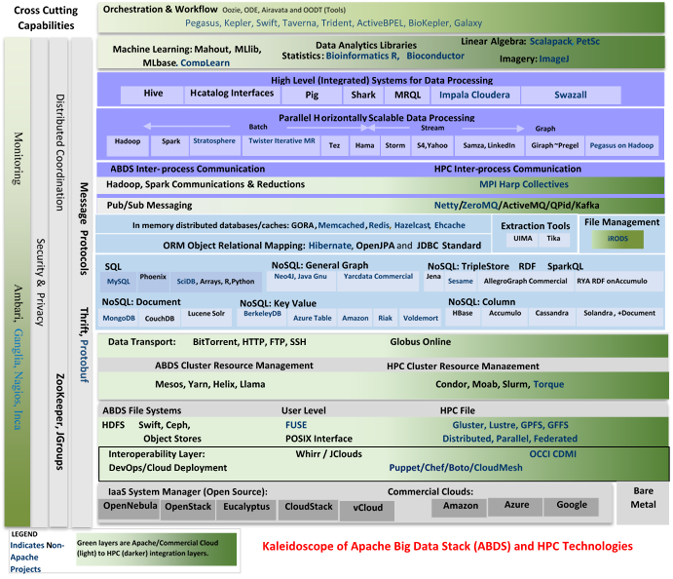

Slide 6
HPC-ABDS
~120 Capabilities
>40 Apache
Green layers have strong HPC Integration opportunities
Goal
Functionality of ABDS
Performance of HPC

Slide 7
Broad Layers in HPC-ABDS
Workflow-Orchestration
Application and Analytics: Mahout, MLlib, R…
High level Programming
Basic Programming model and runtime
  SPMD, Streaming, MapReduce, MPI
Inter process communication
  Collectives, point-to-point, publish-subscribe
In-memory databases/caches
Object-relational mapping
SQL and NoSQL, File management
Data Transport
Cluster Resource Management (Yarn, Slurm, SGE)
File systems(HDFS, Lustre …)
DevOps (Puppet, Chef …)
IaaS Management from HPC to hypervisors (OpenStack)
Cross Cutting
  Message Protocols
  Distributed Coordination
  Security & Privacy
  Monitoring

Slide 8
Useful Set of Analytics Architectures
Pleasingly Parallel: including local machine learning as in parallel over images and apply image processing to each image
- Hadoop could be used but many other HTC, Many task tools
Search: including collaborative filtering and motif finding implemented using classic MapReduce (Hadoop)
Map-Collective or Iterative MapReduce using Collective Communication (clustering) – Hadoop with Harp, Spark …..
Map-Communication or Iterative Giraph: (MapReduce) with point-to-point communication (most graph algorithms such as maximum clique, connected component, finding diameter, community detection)
  Vary in difficulty of finding partitioning (classic parallel load balancing)
Shared memory: thread-based (event driven) graph algorithms (shortest path, Betweenness centrality)
Ideas like workflow are “orthogonal” to this

Slide 9
Getting High Performance on Data Analytics (e.g. Mahout, R…)
On the systems side, we have two principles:
  The Apache Big Data Stack with ~120 projects has important broad functionality with a vital large support organization
  HPC including MPI has striking success in delivering high performance,
  however with a fragile sustainability model
There are key systems abstractions which are levels in HPC-ABDS software stack where Apache approach needs careful integration with HPC
  Resource management
  Storage
  Programming model -- horizontal scaling parallelism
  Collective and Point-to-Point communication
  Support of iteration
  Data interface (not just key-value)
In application areas, we define application abstractions to support:
  Graphs/network
  Geospatial
  Genes
  Images, etc.

Slide 10

HPC-ABDS Hourglass
HPC ABDS
System (Middleware)
120 Software Projects
System Abstractions/standards
Data format
Storage
HPC Yarn for Resource management
Horizontally scalable parallel programming model
Collective and Point-to-Point communication
Support of iteration (in memory databases)
Application Abstractions/standards
Graphs, Networks, Images, Geospatial ….
SPIDAL (Scalable Parallel Interoperable Data Analytics Library) or High performance Mahout, R, Matlab…
High performance
Applications

Slide 11
NIST Big Data Use Cases
Chaitin Baru, Bob Marcus, Wo Chang co-leaders

Slide 12

Use Case Template
26 fields completed for 51 areas
Government Operation: 4
Commercial: 8
Defense: 3
Healthcare and Life Sciences: 10
Deep Learning and Social Media: 6
The Ecosystem for Research: 4
Astronomy and Physics: 5
Earth, Environmental and Polar Science: 10
Energy: 1

Slide 13
51 Detailed Use Cases: Contributed July-September 2013
Covers goals, data features such as 3 V’s, software, hardware
26 Features for each use case
Biased to science
http://bigdatawg.nist.gov/usecases.php
https://bigdatacoursespring2014.appspot.com/course (Section 5)
Government Operation(4): National Archives and Records Administration, Census Bureau
Commercial(8): Finance in Cloud, Cloud Backup, Mendeley (Citations), Netflix, Web Search, Digital Materials, Cargo shipping (as in UPS)
Defense(3): Sensors, Image surveillance, Situation Assessment
Healthcare and Life Sciences(10): Medical records, Graph and Probabilistic analysis, Pathology, Bioimaging, Genomics, Epidemiology, People Activity models, Biodiversity
Deep Learning and Social Media(6): Driving Car, Geolocate images/cameras, Twitter, Crowd Sourcing, Network Science, NIST benchmark datasets
The Ecosystem for Research(4): Metadata, Collaboration, Language Translation, Light source experiments
Astronomy and Physics(5): Sky Surveys including comparison to simulation, Large Hadron Collider at CERN, Belle Accelerator II in Japan
Earth, Environmental and Polar Science(10): Radar Scattering in Atmosphere, Earthquake, Ocean, Earth Observation, Ice sheet Radar scattering, Earth radar mapping, Climate simulation datasets, Atmospheric turbulence identification, Subsurface Biogeochemistry (microbes to watersheds), AmeriFlux and FLUXNET gas sensors
Energy(1): Smart grid

Slide 14

Part of Property Summary Table

Slide 15
10 Suggested Generic Use Cases
Multiple users performing interactive queries and updates on a database with basic availability and eventual consistency (BASE)
Perform real time analytics on data source streams and notify users when specified events occur
Move data from external data sources into a highly horizontally scalable data store, transform it using highly horizontally scalable processing (e.g. Map-Reduce), and return it to the horizontally scalable data store (ELT)
Perform batch analytics on the data in a highly horizontally scalable data store using highly horizontally scalable processing (e.g MapReduce) with a user-friendly interface (e.g. SQL-like)
Perform interactive analytics on data in analytics-optimized database
Visualize data extracted from horizontally scalable Big Data score
Move data from a highly horizontally scalable data store into a traditional Enterprise Data Warehouse
Extract, process, and move data from data stores to archives
Combine data from Cloud databases and on premise data stores for analytics, data mining, and/or machine learning
Orchestrate multiple sequential and parallel data transformations and/or analytic processing using a workflow manager

Slide 16
10 Security & Privacy Use Cases
Consumer Digital Media Usage
Nielsen Homescan
Web Traffic Analytics
Health Information Exchange
Personal Genetic Privacy
Pharma Clinic Trial Data Sharing
Cyber-security
Aviation Industry
Military - Unmanned Vehicle sensor data
Education - “Common Core” Student Performance Reporting
Need to integrate 10 “generic” and 10 “security & privacy” with 51 “full use cases”

Slide 17
Big Data Patterns – the Ogres

Slide 18
Would like to capture “essence of these use cases”
“small” kernels, mini-apps
Or Classify applications into patterns
Do it from HPC background not database viewpoint
e.g. focus on cases with detailed analytics
Section 5 of my class https://bigdatacoursespring2014.appspot.com/preview classifies 51 use cases with ogre facets

Slide 19
What are “mini-Applications”
Use for benchmarks of computers and software (is my parallel compiler any good?)
In parallel computing, this is well established
  Linpack for measuring performance to rank machines in Top500 (changing?)
  NAS Parallel Benchmarks (originally a pencil and paper specification to allow optimal implementations; then MPI library)
  Other specialized Benchmark sets keep changing and used to guide procurements
    Last 2 NSF hardware solicitations had NO preset benchmarks – perhaps as no agreement on key applications for clouds and data intensive applications
  Berkeley dwarfs capture different structures that any approach to parallel computing must address
  Templates used to capture parallel computing patterns
Also database benchmarks like TPC

Slide 20
HPC Benchmark Classics
Linpack or HPL: Parallel LU factorization for solution of linear equations
NPB version 1: Mainly classic HPC solver kernels
  MG: Multigrid
  CG: Conjugate Gradient
  FT: Fast Fourier Transform
  IS: Integer sort
  EP: Embarrassingly Parallel
  BT: Block Tridiagonal
  SP: Scalar Pentadiagonal
  LU: Lower-Upper symmetric Gauss Seidel

Slide 21
13 Berkeley Dwarfs
Dense Linear Algebra
Sparse Linear Algebra
Spectral Methods
N-Body Methods
Structured Grids
Unstructured Grids
MapReduce
Combinational Logic
Graph Traversal
Dynamic Programming
Backtrack and Branch-and-Bound
Graphical Models
Finite State Machines
First 6 of these correspond to Colella’s original.
Monte Carlo dropped.
N-body methods are a subset of Particle in Colella.
Note a little inconsistent in that MapReduce is a programming model and spectral method is a numerical method.
Need multiple facets!

Slide 22
51 Use Cases: What is Parallelism Over?
People: either the users (but see below) or subjects of application and often both
Decision makers like researchers or doctors (users of application)
Items such as Images, EMR, Sequences below; observations or contents of online store
  Images or “Electronic Information nuggets”
  EMR: Electronic Medical Records (often similar to people parallelism)
  Protein or Gene Sequences;
  Material properties, Manufactured Object specifications, etc., in custom dataset
  Modelled entities like vehicles and people
Sensors – Internet of Things
Events such as detected anomalies in telescope or credit card data or atmosphere
(Complex) Nodes in RDF Graph
Simple nodes as in a learning network
Tweets, Blogs, Documents, Web Pages, etc.
  And characters/words in them
Files or data to be backed up, moved or assigned metadata
Particles/cells/mesh points as in parallel simulations

Slide 23
51 Use Cases: Low-Level (Run-time) Computational Types
PP(26): Pleasingly Parallel or Map Only
MR(18 +7 MRStat): Classic MapReduce
MRStat(7): Simple version of MR where key computations are simple reduction as coming in statistical averages
MRIter(23): Iterative MapReduce
Graph(9): complex graph data structure needed in analysis
Fusion(11): Integrate diverse data to aid discovery/decision making; could involve sophisticated algorithms or could just be a portal
Streaming(41): some data comes in incrementally and is processed this way
(Count) out of 51

Slide 24
51 Use Cases: Higher-Level Computational Types or Features
Classification(30): divide data into categories
S/Q/Index(12): Search and Query
CF(4): Collaborative Filtering
Local ML(36): Local Machine Learning
Global ML(23): Deep Learning, Clustering, LDA, PLSI, MDS, Large Scale Optimizations as in Variational Bayes, Lifted Belief Propagation, Stochastic Gradient Descent, L-BFGS, Levenberg-Marquardt (Sometimes call EGO or Exascale Global Optimization)
Workflow: (Left out of analysis but very common)
GIS(16): Geotagged data and often displayed in ESRI, Microsoft Virtual Earth, Google Earth, GeoServer etc.
HPC(5): Classic large-scale simulation of cosmos, materials, etc. generates big data
Agent(2): Simulations of models of data-defined macroscopic entities represented as agents
Not Independent

Slide 25
Global Machine Learning aka EGO – Exascale Global Optimization
Typically maximum likelihood or χ² with a sum over the N data items – documents, sequences, items to be sold, images etc. and often links (point-pairs). Usually it’s a sum of positive number as in least squares
Covering clustering/community detection, mixture models, topic determination, Multidimensional scaling, (Deep) Learning Networks
PageRank is “just” parallel linear algebra
Note many Mahout algorithms are sequential – partly as MapReduce limited; partly because parallelism unclear
  MLLib (Spark based) better
SVM and Hidden Markov Models do not use large scale parallelization in practice?
Detailed papers on particular parallel graph algorithms

Slide 26
Image based Applications

Slide 27
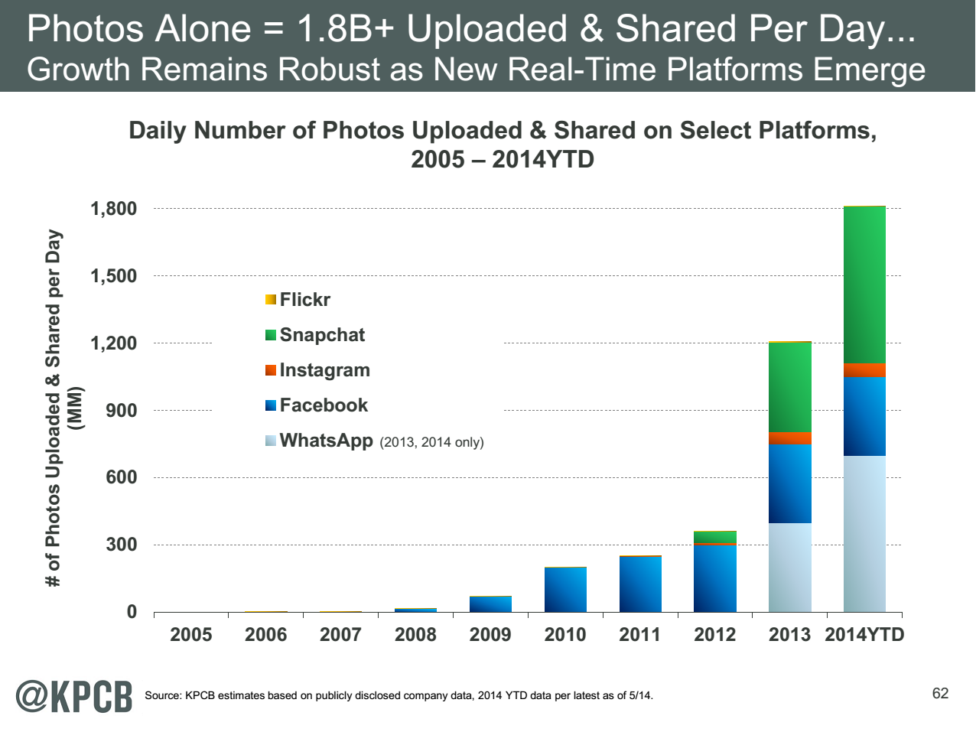
http://www.kpcb.com/internet-trends

Slide 28
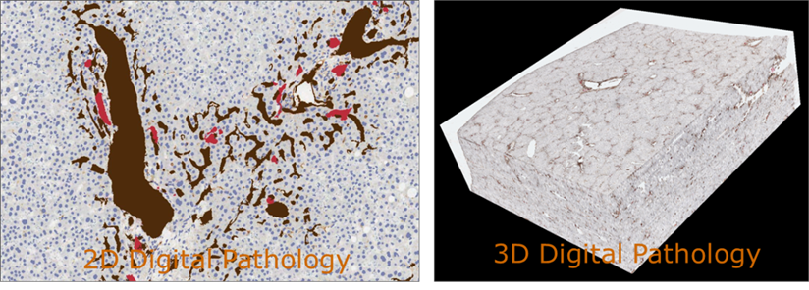
17:Pathology Imaging/ Digital Pathology I
Healthcare
Life Sciences
Application: Digital pathology imaging is an emerging field where examination of high resolution images of tissue specimens enables novel and more effective ways for disease diagnosis. Pathology image analysis segments massive (millions per image) spatial objects such as nuclei and blood vessels, represented with their boundaries, along with many extracted image features from these objects. The derived information is used for many complex queries and analytics to support biomedical research and clinical diagnosis.
MR, MRIter, PP, Classification
Streaming
Parallelism over Images

Slide 29
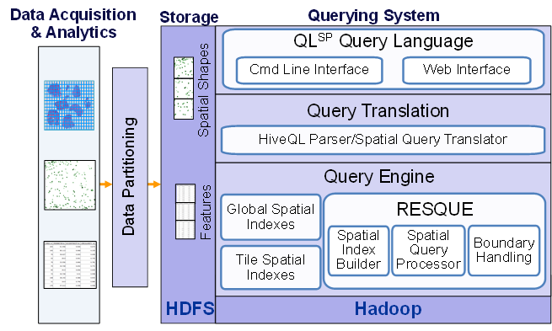
17:Pathology Imaging/ Digital Pathology II
Healthcare
Life Sciences
Current Approach: 1GB raw image data + 1.5GB analytical results per 2D image. MPI for image analysis; MapReduce + Hive with spatial extension on supercomputers and clouds. GPU’s used effectively. Figure below shows the architecture of Hadoop-GIS, a spatial data warehousing system over MapReduce to support spatial analytics for analytical pathology imaging.
Futures: Recently, 3D pathology imaging is made possible through 3D laser technologies or serially sectioning hundreds of tissue sections onto slides and scanning them into digital images. Segmenting 3D microanatomic objects from registered serial images could produce tens of millions of 3D objects from a single image. This provides a deep “map” of human tissues for next generation diagnosis. 1TB raw image data + 1TB analytical results per 3D image and 1PB data per moderated hospital per year.
Architecture of Hadoop-GIS, a spatial data warehousing system over MapReduce to support spatial analytics for analytical pathology imaging
Parallelism over images or over pixels within image (especially for GPU)

Slide 30
18: Computational Bioimaging
Healthcare
Life Sciences
Application: Data delivered from bioimaging is increasingly automated, higher resolution, and multi-modal. This has created a data analysis bottleneck that, if resolved, can advance the biosciences discovery through Big Data techniques.
Current Approach: The current piecemeal analysis approach does not scale to situation where a single scan on emerging machines is 32 TB and medical diagnostic imaging is annually around 70 PB even excluding cardiology. One needs a web-based one-stop-shop for high performance, high throughput image processing for producers and consumers of models built on bio-imaging data.
Futures: Goal is to solve that bottleneck with extreme scale computing with community-focused science gateways to support the application of massive data analysis toward massive imaging data sets. Workflow components include data acquisition, storage, enhancement, minimizing noise, segmentation of regions of interest, crowd-based selection and extraction of features, and object classification, organization, and search. Use ImageJ, OMERO, VolRover, advanced segmentation and feature detection software.
Largely Local Machine Learning and Pleasingly Parallel

Slide 31
26: Large-scale Deep Learning
Deep Learning
Social Networking
Application: Large models (e.g., neural networks with more neurons and connections) combined with large datasets are increasingly the top performers in benchmark tasks for vision, speech, and Natural Language Processing. One needs to train a deep neural network from a large (>>1TB) corpus of data (typically imagery, video, audio, or text). Such training procedures often require customization of the neural network architecture, learning criteria, and dataset pre-processing. In addition to the computational expense demanded by the learning algorithms, the need for rapid prototyping and ease of development is extremely high.
Current Approach: The largest applications so far are to image recognition and scientific studies of unsupervised learning with 10 million images and up to 11 billion parameters on a 64 GPU HPC Infiniband cluster. Both supervised (using existing classified images) and unsupervised applications
Futures: Large datasets of 100TB or more may be necessary in order to exploit the representational power of the larger models. Training a self-driving car could take 100 million images at megapixel resolution. Deep Learning shares many characteristics with the broader field of machine learning. The paramount requirements are high computational throughput for mostly dense linear algebra operations, and extremely high productivity for researcher exploration. One needs integration of high performance libraries with high level (python) prototyping environments
Classified OUT
IN
MRIter,EGO Classification
Parallelism over Nodes in NN, Data being classified
Global Machine Learning but Stochastic Gradient Descent only use small fraction of total images (100’s) at each iteration so parallelism over images not clearly useful

Slide 32
27: Organizing large-scale, unstructured collections of consumer photos I
Application: Produce 3D reconstructions of scenes using collections of millions to billions of consumer images, where neither the scene structure nor the camera positions are known a priori. Use resulting 3D models to allow efficient browsing of large-scale photo collections by geographic position. Geolocate new images by matching to 3D models. Perform object recognition on each image. 3D reconstruction posed as a robust non-linear least squares optimization problem where observed relations between images are constraints and unknowns are 6-D camera pose of each image and 3D position of each point in the scene.
Current Approach: Hadoop cluster with 480 cores processing data of initial applications. Note over 500 billion images (too small) on Facebook and over 5 billion on Flickr with over 1800 (was 500 a year ago) million images added to social media sites each day.
Deep Learning
Social Networking
Global Machine Learning after Initial Local steps

Slide 33
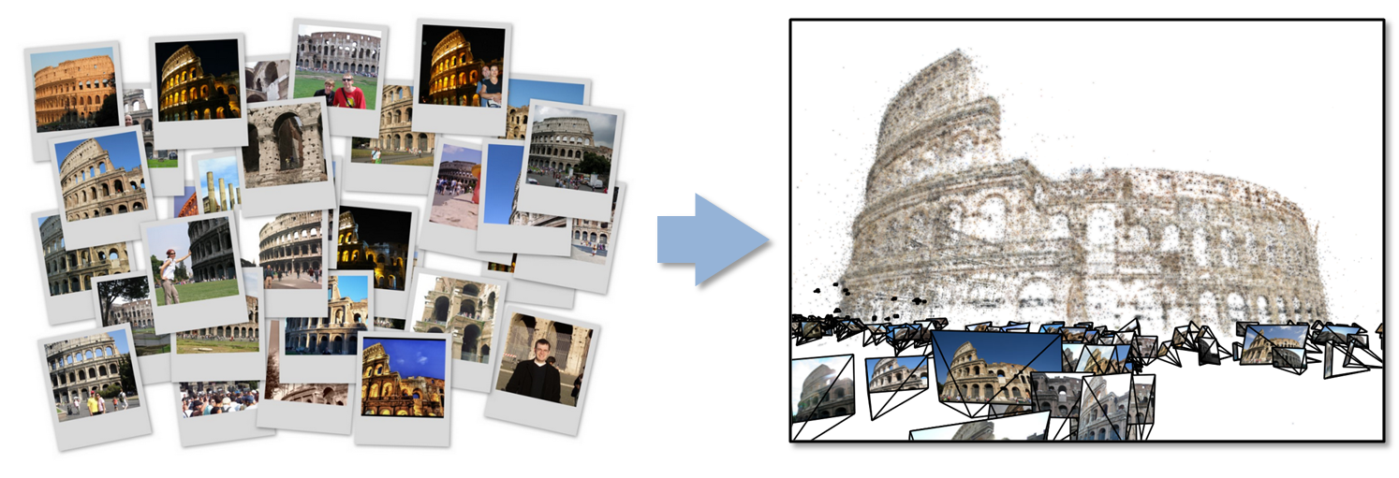
27: Organizing large-scale, unstructured collections of consumer photos II
Futures: Need many analytics, including feature extraction, feature matching, and large-scale probabilistic inference, which appear in many or most computer vision and image processing problems, including recognition, stereo resolution, and image denoising. Need to visualize large-scale 3D reconstructions, and navigate large-scale collections of images that have been aligned to maps.
Deep Learning
Social Networking
Global Machine Learning after Initial Local ML pleasingly parallel steps

Slide 34
36: Catalina Real-Time Transient Survey (CRTS): a digital, panoramic, synoptic sky survey I
Astronomy & Physics
Application: The survey explores the variable universe in the visible light regime, on time scales ranging from minutes to years, by searching for variable and transient sources. It discovers a broad variety of astrophysical objects and phenomena, including various types of cosmic explosions (e.g., Supernovae), variable stars, phenomena associated with accretion to massive black holes (active galactic nuclei) and their relativistic jets, high proper motion stars, etc. The data are collected from 3 telescopes (2 in Arizona and 1 in Australia), with additional ones expected in the near future (in Chile).
Current Approach: The survey generates up to ~ 0.1 TB on a clear night with a total of ~100 TB in current data holdings. The data are preprocessed at the telescope, and transferred to Univ. of Arizona and Caltech, for further analysis, distribution, and archiving. The data are processed in real time, and detected transient events are published electronically through a variety of dissemination mechanisms, with no proprietary withholding period (CRTS has a completely open data policy). Further data analysis includes classification of the detected transient events, additional observations using other telescopes, scientific interpretation, and publishing. In this process, it makes a heavy use of the archival data (several PB’s) from a wide variety of geographically distributed resources connected through the Virtual Observatory (VO) framework.
PP, ML, Classification
Streaming, workflow
Parallelism over Images and Events: Celestial events identified in Telescope Images

Slide 35
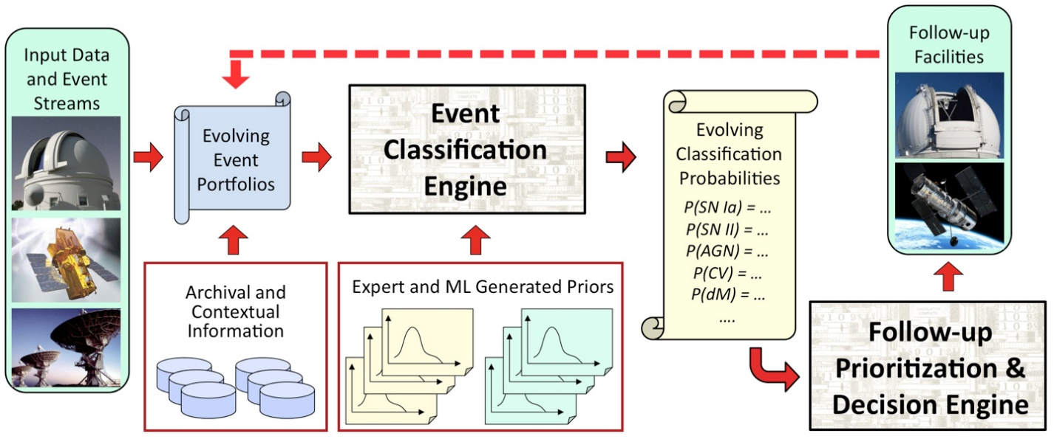
36: Catalina Real-Time Transient Survey (CRTS): a digital, panoramic, synoptic sky survey II
Astronomy & Physics
Futures: CRTS is a scientific and methodological testbed and precursor of larger surveys to come, notably the Large Synoptic Survey Telescope (LSST), expected to operate in 2020’s and selected as the highest-priority ground-based instrument in the 2010 Astronomy and Astrophysics Decadal Survey. LSST will gather about 30 TB per night.

Slide 36
43: Radar Data Analysis for CReSIS Remote Sensing of Ice Sheets IV
Earth, Environmental and Polar Science
Typical CReSIS echogram with Detected Boundaries. The upper (green) boundary is between air and ice layer while the lower (red) boundary is between ice and terrain
PP, GIS
Streaming
Parallelism over Radar Images

Slide 37
44: UAVSAR Data Processing, Data Product Delivery, and Data Services II
Earth, Environmental and Polar Science
Combined unwrapped coseismic interferograms for flight lines 26501, 26505, and 08508 for the October 2009 – April 2010 time period. End points where slip can be seen on the Imperial, Superstition Hills, and Elmore Ranch faults are noted. GPS stations are marked by dots and are labeled.
PP, GIS
Streaming
Parallelism over Radar Images

Slide 38
Facets of the Ogres

Slide 39
Application Class Facet of Ogres
Classification (30) divide data into categories
Search Index and query (12)
Maximum Likelihood or χ² minimizations
Expectation Maximization (often Steepest descent)
Local (pleasingly parallel) Machine Learning (36) contrasted to
(Exascale) Global Optimization (23) (such as Learning Networks, Variational Bayes and Gibbs Sampling)
Do they Use Agents (2) as in epidemiology (swarm approaches)?
Higher-Level Computational Types or Features in earlier slide also has
CF(4): Collaborative Filtering in Core Analytics Facet
and two categories in data source and style
GIS(16): Geotagged data and often displayed in ESRI, Microsoft Virtual Earth, Google Earth, GeoServer etc.
HPC(5): Classic large-scale simulation of cosmos, materials, etc. generates big data

Slide 40
Problem Architecture Facet of Ogres (Meta or MacroPattern)
Pleasingly Parallel – as in BLAST, Protein docking, some (bio-)imagery including Local Analytics or Machine Learning – ML or filtering pleasingly parallel, as in bio-imagery, radar images (pleasingly parallel but sophisticated local analytics)
Classic MapReduce for Search and Query
Global Analytics or Machine Learning requiring iterative programming models
Problem set up as a graph as opposed to vector, grid
SPMD (Single Program Multiple Data)
Bulk Synchronous Processing: well-defined compute-communication phases
Fusion: Knowledge discovery often involves fusion of multiple methods.
Workflow (often used in fusion)
Note problem and machine architectures are related
Slight expansion of an earlier slides on:
Major Analytics Architectures in Use Cases
Pleasingly parallel
Search (MapReduce)
Map-Collective
Map-Communication as in MPI
Shared Memory
Low-Level (Run-time) Computational Types used to label 51 use cases
PP(26): Pleasingly Parallel
MR(18 +7 MRStat): Classic MapReduce
MRStat(7)
MRIter(23)
Graph(9)
Fusion(11)
Streaming(41) In data source
Notes:
Big dwarfs are Ogres
Implement Ogres in ABDS+

Slide 41
4 Forms of MapReduce
(a) Map Only
(b) Classic MapReduce
(c) Iterative Map Reduce or Map-Collective
(d) Point to Point
Input
Input
Iterations
Input
map
map
map
P_{ij}
reduce
reduce
Output
BLAST Analysis
Local Machine Learning
Pleasingly Parallel
High Energy Physics (HEP) Histograms
Distributed search
Expectation maximization Clustering e.g. K-means
Linear Algebra, PageRank
Classic MPI
PDE Solvers and particle dynamics
Domain of MapReduce and Iterative Extensions
MPI
Giraph
All of them are Map-Communication?

Slide 42
One Facet of Ogres has Computational Features
Flops per byte;
Communication Interconnect requirements;
Is application (graph) constant or dynamic?
Most applications consist of a set of interconnected entities; is this regular as a set of pixels or is it a complicated irregular graph?
Is communication BSP or Asynchronous? In latter case shared memory may be attractive;
Are algorithms Iterative or not?
Data Abstraction: key-value, pixel, graph, vector
  Are data points in metric or non-metric spaces?
Core libraries needed: matrix-matrix/vector algebra, conjugate gradient, reduction, broadcast

Slide 43
Data Source and Style Facet of Ogres
(i) SQL
(ii) NOSQL based
(iii) Other Enterprise data systems (10 examples from Bob Marcus)
(iv) Set of Files (as managed in iRODS)
(v) Internet of Things
(vi) Streaming and
(vii) HPC simulations
(viii) Involve GIS (Geographical Information Systems)
Before data gets to compute system, there is often an initial data gathering phase which is characterized by a block size and timing. Block size varies from month (Remote Sensing, Seismic) to day (genomic) to seconds or lower (Real time control, streaming)
There are storage/compute system styles: Shared, Dedicated, Permanent, Transient
Other characteristics are needed for permanent auxiliary/comparison datasets and these could be interdisciplinary, implying nontrivial data movement/replication
Notes:
Big dwarfs are Ogres
Implement Ogres in ABDS+

Slide 44
Analytics Facet (kernels) of the Ogres

Slide 45
Core Analytics Facet of Ogres (microPattern) I
Map-Only
Pleasingly parallel - Local Machine Learning
MapReduce: Search/Query
Summarizing statistics as in LHC Data analysis (histograms)
Recommender Systems (Collaborative Filtering)
Linear Classifiers (Bayes, Random Forests)
Global Analytics
Nonlinear Solvers (structure depends on objective function)
  Stochastic Gradient Descent SGD
  (L-)BFGS approximation to Newton’s Method
  Levenberg-Marquardt solver
Map-Collective I (need to improve/extend Mahout, MLlib)
Outlier Detection, Clustering (many methods),
Mixture Models, LDA (Latent Dirichlet Allocation), PLSI (Probabilistic Latent Semantic Indexing)

Slide 46
Core Analytics Facet of Ogres (microPattern) II
Map-Collective II
Use matrix-matrix,-vector operations, solvers (conjugate gradient)
SVM and Logistic Regression
PageRank, (find leading eigenvector of sparse matrix)
SVD (Singular Value Decomposition)
MDS (Multidimensional Scaling)
Learning Neural Networks (Deep Learning)
Hidden Markov Models
Map-Communication
Graph Structure (Communities, subgraphs/motifs, diameter, maximal cliques, connected components)
Network Dynamics - Graph simulation Algorithms (epidemiology)
Asynchronous Shared Memory
Graph Structure (Betweenness centrality, shortest path)

Slide 47
Parallel Global Machine Learning Examples

Slide 48
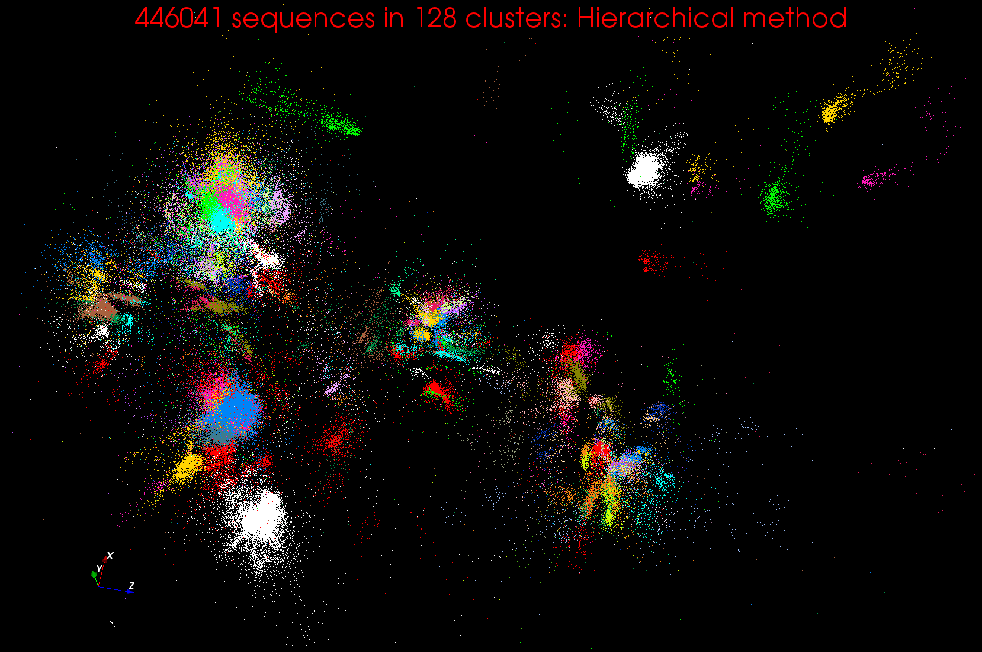
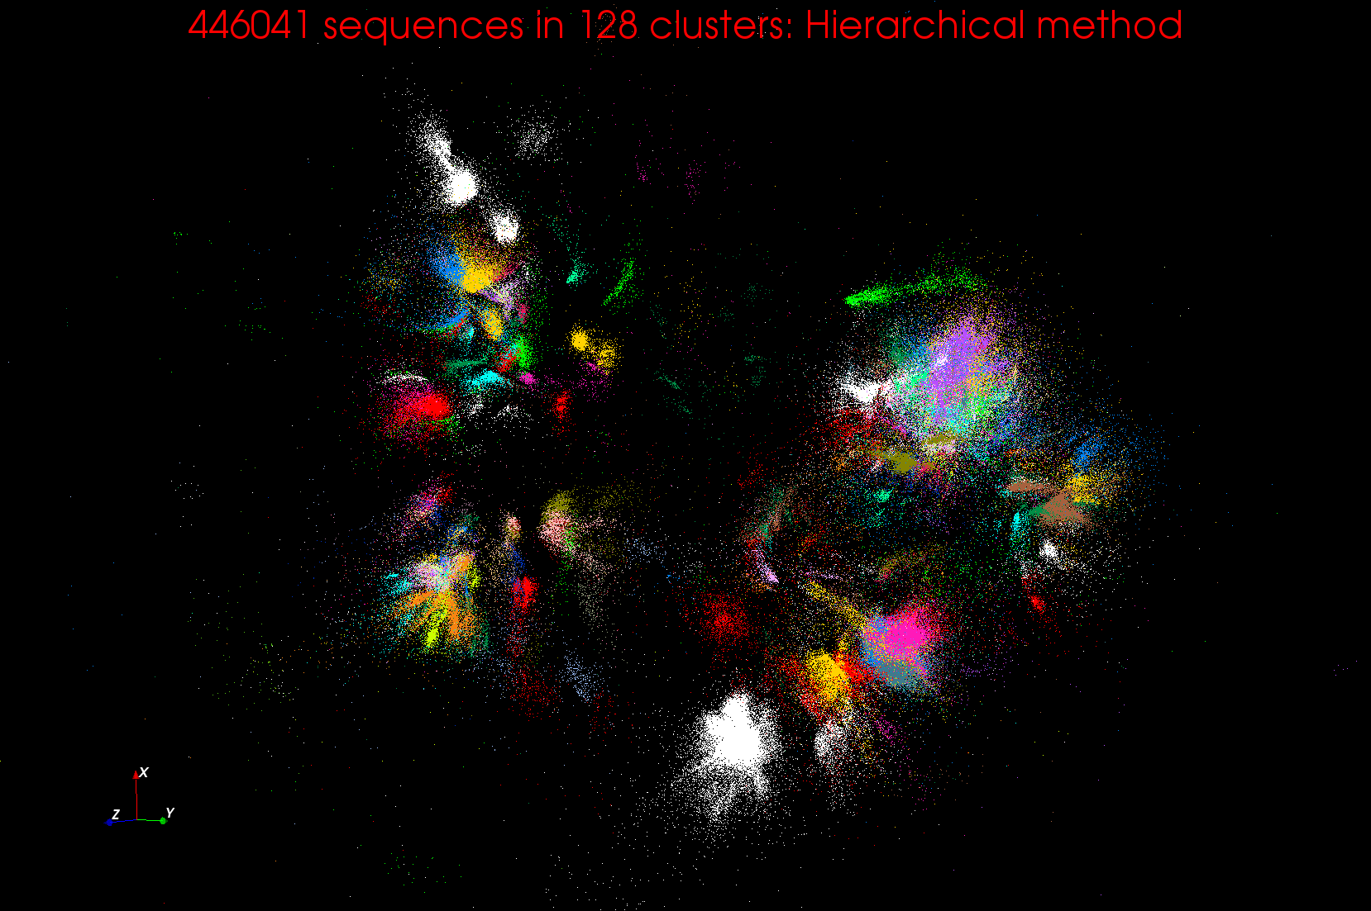
Clustering and MDS Large Scale O(N²) GML

Slide 49
WDA SMACOF MDS (Multidimensional Scaling) using Harp on Big Red 2
Parallel Efficiency: on 100-300K sequences
Conjugate Gradient (dominant time) and Matrix Multiplication

Slide 50
Features of Harp Hadoop Plugin
Hadoop Plugin (on Hadoop 1.2.1 and Hadoop 2.2.0)
Hierarchical data abstraction on arrays, key-values and graphs for easy programming expressiveness.
Collective communication model to support various communication operations on the data abstractions
Caching with buffer management for memory allocation required from computation and communication
BSP style parallelism
Fault tolerance with checkpointing

Slide 51
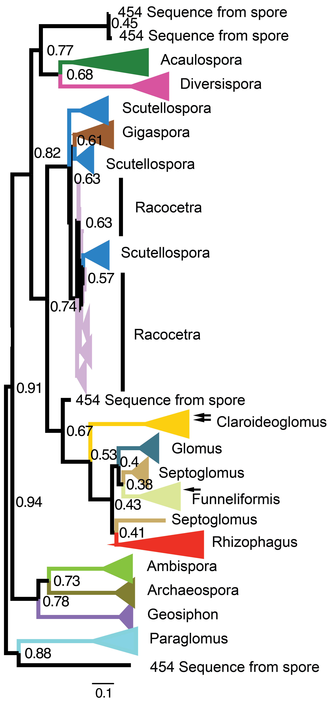
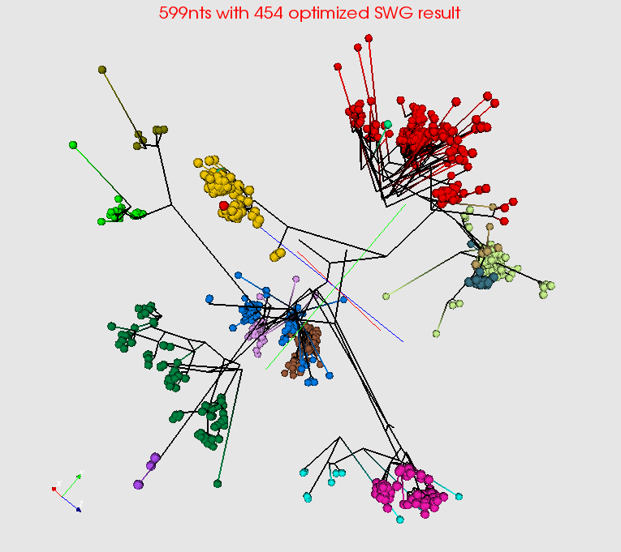
Summarize a million Fungi Sequences
Spherical Phylogram Visualization
Spherical Phylogram from new MDS method visualized in PlotViz
RAxML result visualized to right.

Slide 52
Comparing Data Intensive and Simulation Problems

Slide 53
Comparison of Data Analytics with Simulation I
Pleasingly parallel often important in both
Both are often SPMD and BSP
  Non-iterative MapReduce is major big data paradigm
  not a common simulation paradigm except where “Reduce” summarizes pleasingly parallel execution
Big Data often has large collective communication
  Classic simulation has a lot of smallish point-to-point messages
Simulation dominantly sparse (nearest neighbor) data structures
  “Bag of words (users, rankings, images..)” algorithms are sparse, as is PageRank
  Important data analytics involves full matrix algorithms

Slide 54
Comparison of Data Analytics with Simulation II
There are similarities between some graph problems and particle simulations with a strange cutoff force.
  Both Map-Communication
Note many big data problems are “long range force” as all points are linked.
  Easiest to parallelize. Often full matrix algorithms
  e.g. in DNA sequence studies, distance δ(i, j) defined by BLAST, Smith-Waterman, etc., between all sequences i, j.
  Opportunity for “fast multipole” ideas in big data.
In image-based deep learning, neural network weights are block sparse (corresponding to links to pixel blocks) but can be formulated as full matrix operations on GPUs and MPI in blocks.
In HPC benchmarking, Linpack being challenged by a new sparse conjugate gradient benchmark HPCG, while I am diligently using non- sparse conjugate gradient solvers in clustering and Multi-dimensional scaling.

Slide 55


“Force Diagrams” for macromolecules and Facebook

Slide 56
Sensors and the Internet of Things
Covers many streaming applications

Slide 57

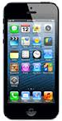
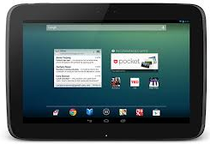


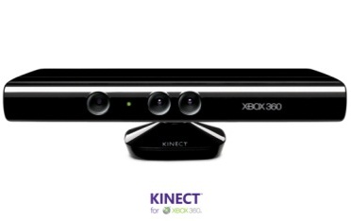
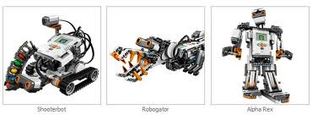
Sensors as a Service
Military Command & Control
Personalized Medicine
Disaster Informatics (Earthquakes)
Manage Sensors and their data
Image Processing
Robot Planning
Software
As a Service
Security
SaaS
API
Secure Publish Subscribe
MapReduce, Workflow
Metadata(iRODS)
SQL/noSQL stores (MongoDB)
Automatic Cloud Bursting
Platform
As a Service
PaaS
Infrastructure
As a Service
Virtual Clusters, Networks (software defined system)
Hypervisor
GPU, Multi-core CPU
IaaS
Execution Environment
Sensor, Local Cluster, XSEDE, FutureGrid, Cloud

Slide 58
Internet of Things and the Cloud
It is projected that there will be 24 (Mobile Industry Group) -50 (Cisco) billion devices on the Internet by 2020. Most will be small sensors that send streams of information into the cloud where it will be processed and integrated with other streams and turned into knowledge that will help our lives in a multitude of small and big ways.
The cloud will become increasing important as a controller of and resource provider for the Internet of Things.
As well as today’s use for smart phone and gaming console support, “Intelligent River” “smart homes and grid” and “ubiquitous cities” build on this vision and we could expect a growth in cloud supported/controlled robotics.
Some of these “things” will be supporting science
Natural parallelism over “things”
“Things” are distributed and so form a Grid

Slide 59
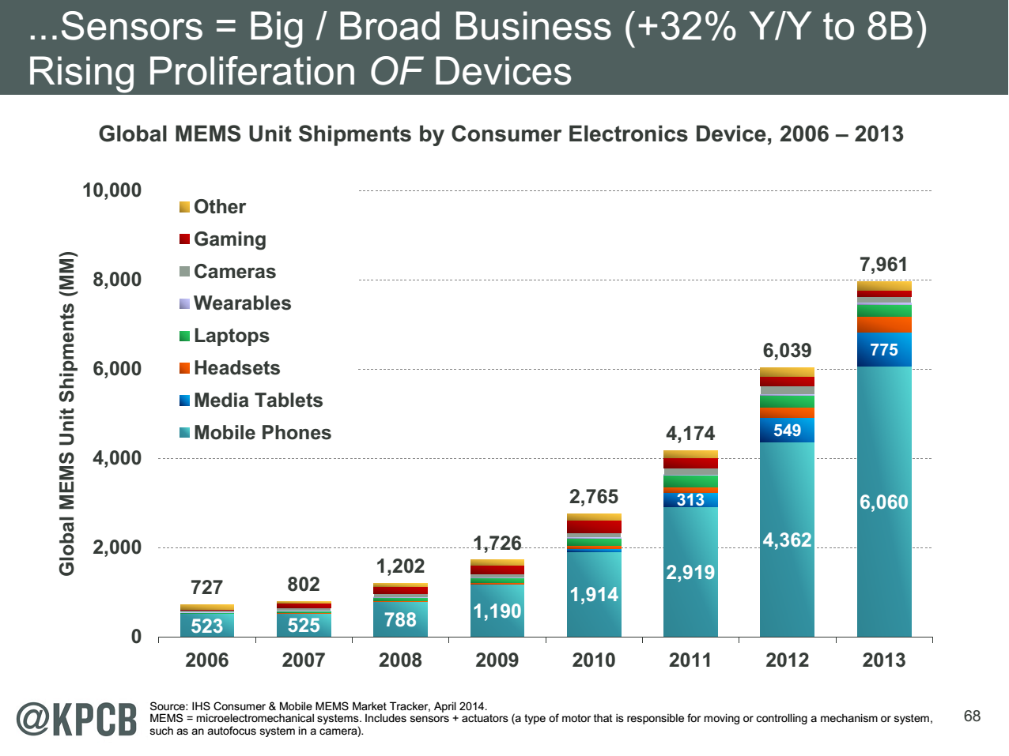
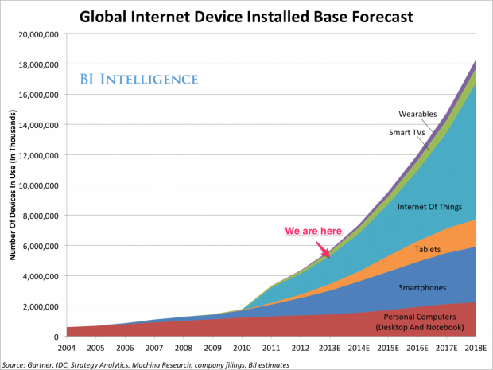
http://www.kpcb.com/internet-trends

Slide 60

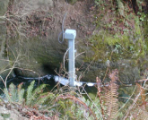
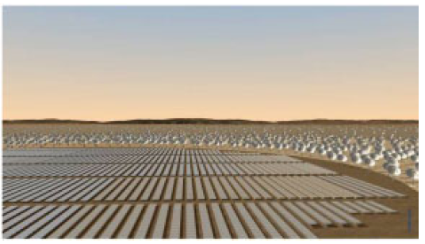
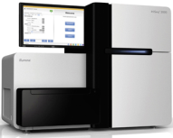
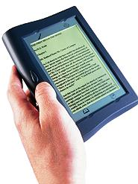





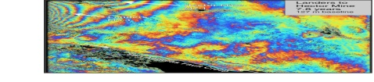
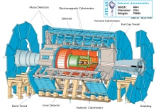
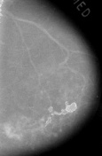

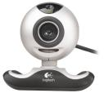

Raw Data → Data → Information → Knowledge → Wisdom → Decisions
Another
Grid
SS
SS
SS
SS
SS
SS
SS
Filter
Cloud
Discovery
Cloud
Portal
Filter
Cloud
Fusion for Discovery/Decisions
SS
Filter
Cloud
Another
Service
SS
Filter
Cloud
Filter
Cloud
Filter
Cloud
Discovery
Cloud
SS
SS
SS: Sensor or Data
Interchange
Service
Workflow through multiple filter/discovery clouds
Filter
Cloud
Filter
Cloud
Filter
Cloud
Filter
Cloud
SS
Another
Cloud
SS
SS
SS
SS
SS
SS
SS
SS
SS
SS
SS
SS
SS
Compute
Cloud
Storage
Cloud
Distributed
Grid
Hadoop Cluster
Database

Slide 61
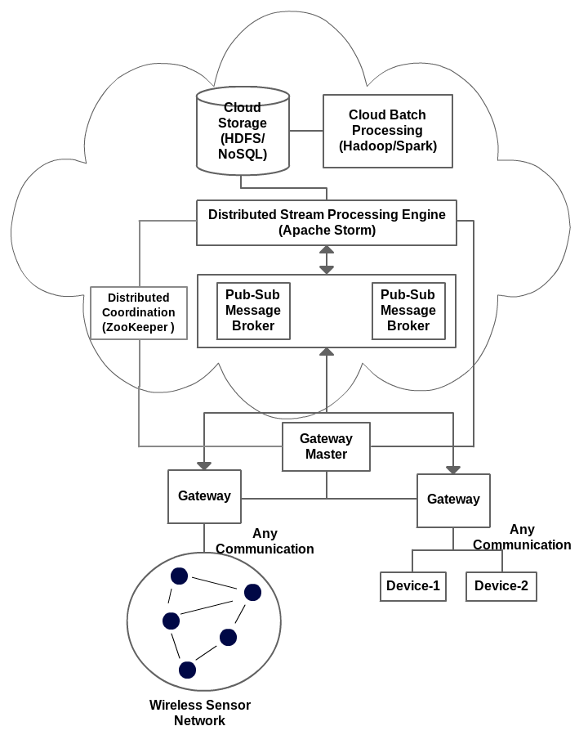
IOTCloud
Device → Pub-Sub→Storm → Datastore → Data Analysis
Apache Storm provides scalable distributed system for processing data streams coming from devices in real time.
For example Storm layer can decide to store the data in cloud storage for further analysis or to send control data back to the devices
Evaluating Pub-Sub Systems ActiveMQ, RabbitMQ, Kafka, Kestrel

Slide 62
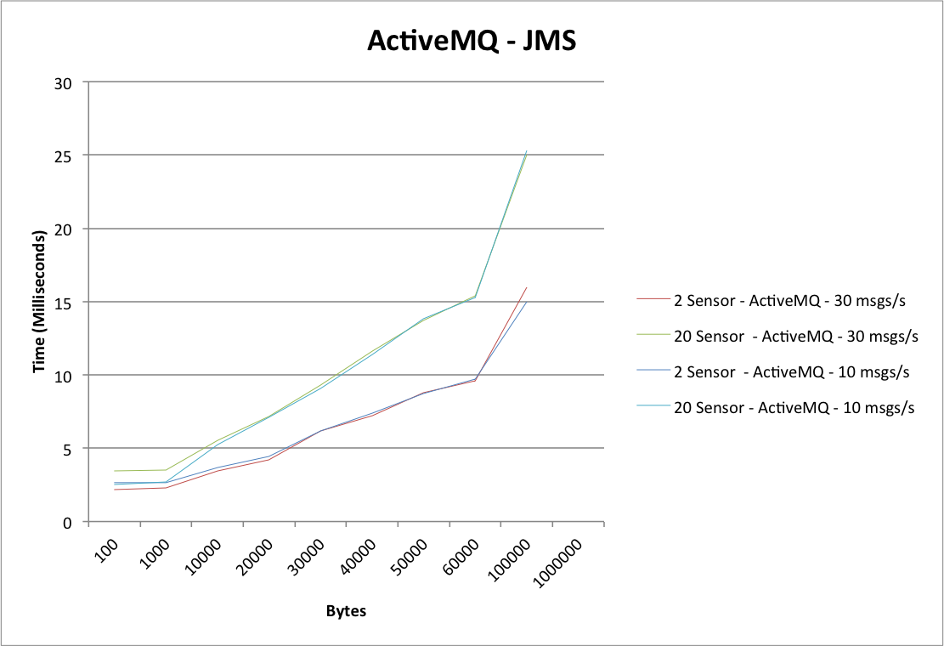
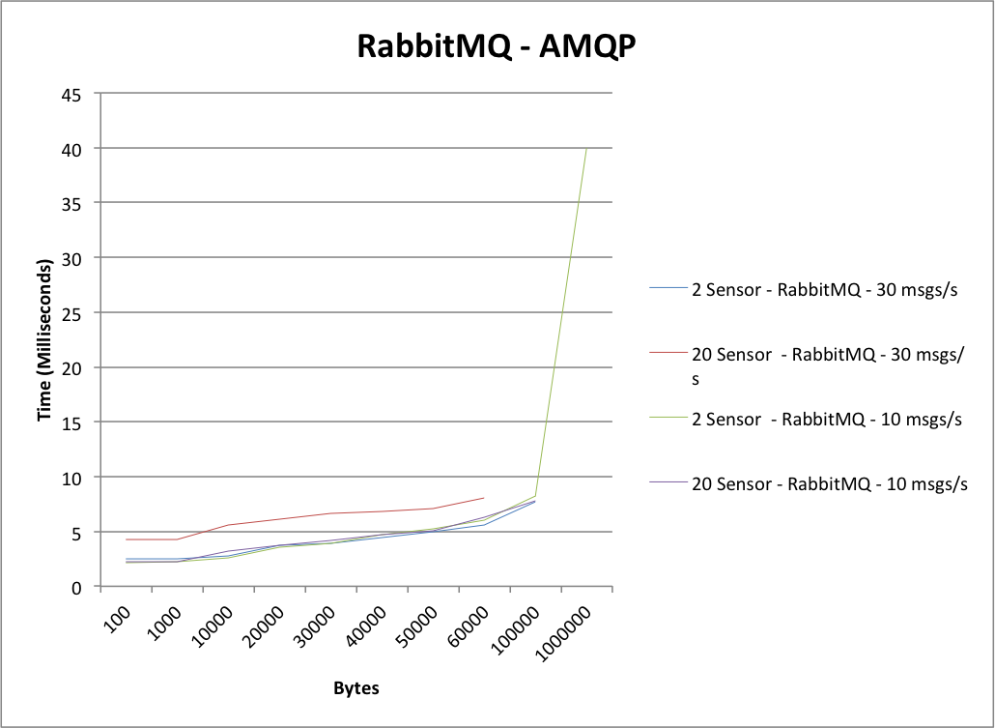
Performance
From Device to Cloud
6 FutureGrid India Medium OpenStack machines
1 Broker machine, RabbitMQ or ActiveMQ
1 machine hosting ZooKeeper and Storm – Nimbus (Master for Storm)
2 Sensor sites generating data
2 Storm nodes sending back the same data and we measure the unidirectional latency
Using drones and Kinects

Slide 63
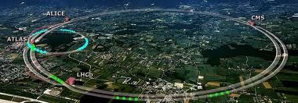
39: Particle Physics: Analysis of LHC Large Hadron Collider Data: Discovery of Higgs particle I
Astronomy & Physics
CERN LHC Accelerator Ring (27 km circumference. Up to 175m depth) at Geneva with 4 Experiment positions marked
Application: One analyses collisions at the CERN LHC (Large Hadron Collider) Accelerator and Monte Carlo producing events describing particle-apparatus interaction. Processed information defines physics properties of events (lists of particles with type and momenta). These events are analyzed to find new effects; both new particles (Higgs) and present evidence that conjectured particles (Supersymmetry) have not been detected. LHC has a few major experiments including ATLAS and CMS. These experiments have global participants (for example CMS has 3600 participants from 183 institutions in 38 countries), and so the data at all levels is transported and accessed across continents.
June 19 2014: Kaggle competition for machine learning to uncover Higgs to pair of tau leptons
MRStat or PP, MC
Parallelism over observed collisions

Slide 64
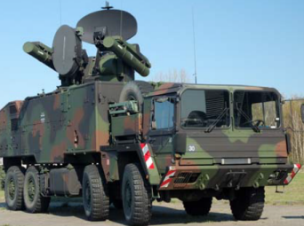
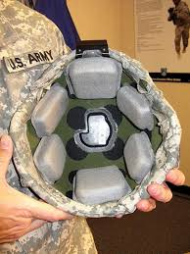
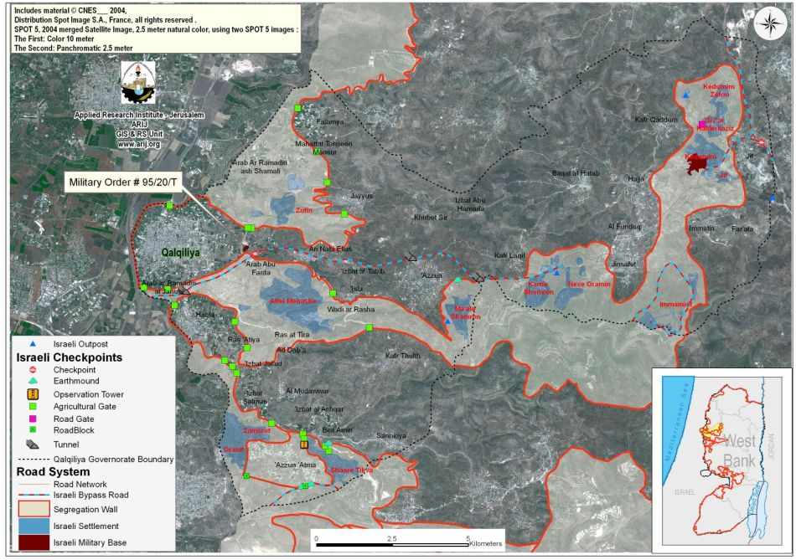
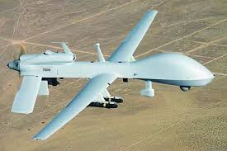
13: Large Scale Geospatial Analysis and Visualization
Defense
Application: Need to support large scale geospatial data analysis and visualization with number of geospatially aware sensors and the number of geospatially tagged data sources rapidly increasing.
PP, GIS, Classification
Streaming
Parallelism over Sensors and people accessing data

Slide 65
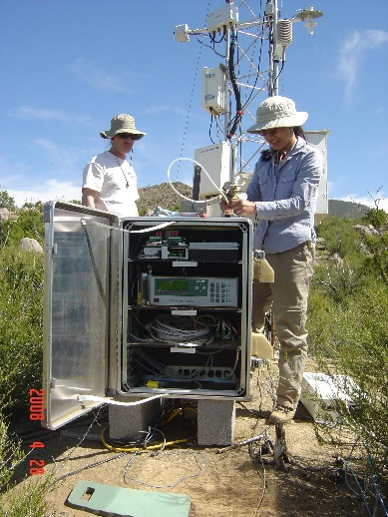
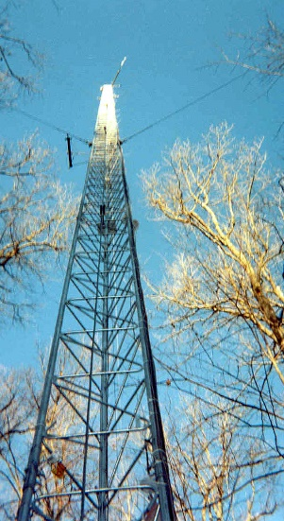
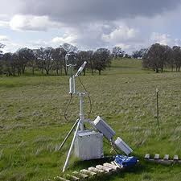
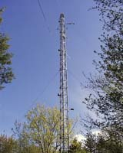
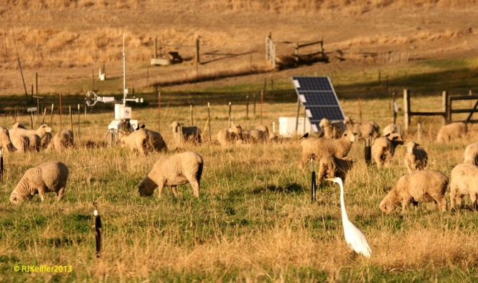
50: DOE-BER AmeriFlux and FLUXNET Networks I
Earth, Environmental and Polar Science
Application: AmeriFlux and FLUXNET are US and world collections respectively of sensors that observe trace gas fluxes (CO₂, water vapor) across a broad spectrum of times (hours, days, seasons, years, and decades) and space. Moreover, such datasets provide the crucial linkages among organisms, ecosystems, and process-scale studies—at climate-relevant scales of landscapes, regions, and continents—for incorporation into biogeochemical and climate models.
Current Approach: Software includes EddyPro, Custom analysis software, R, python, neural networks, Matlab. There are ~150 towers in AmeriFlux and over 500 towers distributed globally collecting flux measurements.
Futures: Field experiment data taking would be improved by access to existing data and automated entry of new data via mobile devices. Need to support interdisciplinary study integrating diverse data sources.
Fusion, PP, GIS
Streaming
Parallelism over Sensors

Slide 66
51: Consumption forecasting in Smart Grids
Energy
Application: Predict energy consumption for customers, transformers, sub-stations and the electrical grid service area using smart meters providing measurements every 15-mins at the granularity of individual consumers within the service area of smart power utilities. Combine Head-end of smart meters (distributed), Utility databases (Customer Information, Network topology; centralized), US Census data (distributed), NOAA weather data (distributed), Micro-grid building information system (centralized), Micro-grid sensor network (distributed). This generalizes to real-time data-driven analytics for time series from cyber physical systems
Current Approach: GIS based visualization. Data is around 4 TB a year for a city with 1.4M sensors in Los Angeles. Uses R/Matlab, Weka, Hadoop software. Significant privacy issues requiring anonymization by aggregation. Combine real time and historic data with machine learning for predicting consumption.
Futures: Wide spread deployment of Smart Grids with new analytics integrating diverse data and supporting curtailment requests. Mobile applications for client interactions.
Fusion, PP, MR, ML, GIS, Classification
Streaming
Parallelism over Sensors

Slide 67
Java Grande

Slide 68
Java Grande
I once tried to encourage use of Java in HPC with Java Grande Forum but Fortran, C and C++ remain central HPC languages.
  Not helped by .com and Sun collapse in 2000-2005
The pure Java CartaBlanca, a 2005 R&D100 award-winning project, was an early successful example of HPC use of Java in a simulation tool for non-linear physics on unstructured grids.
Of course Java is a major language in ABDS and as data analysis and simulation are naturally linked, should consider broader use of Java
Using Habanero Java (from Rice University) for Threads and mpiJava or FastMPJ for MPI, gathering collection of high performance parallel Java analytics
  Converted from C# and sequential Java faster than sequential C#
So will have either Hadoop+Harp of classic Threads/MPI versions in Java Grande version of mahout

Slide 69
Performance of MPI Kernel Operations
Pure Java as in FastMPJ slower than Java interfacing to C version of MPI

Slide 70
DAVS Performance
Charge2 Proteomics 241605 points
Pure MPI Times
MPI with Threads
Pure MPI Speedup

Slide 71
Cluster Count v. Temperature for 2 Runs
All start with one cluster at far left
T=1 special as measurement errors divided out
DA2D counts clusters with 1 member as clusters. DAVS(2) does not

Slide 72
Lessons / Insights
Integrate (don’t compete) HPC with “Commodity Big data” (Google to Amazon to Enterprise Data Analytics)
  i.e. improve Mahout; don’t compete with it
  Use Hadoop plug-ins rather than replacing Hadoop
Enhanced Apache Big Data Stack HPC-ABDS has ~120 members
Opportunities at Resource management, Data/File, Streaming, Programming, monitoring, workflow layers for HPC and ABDS integration
Data intensive algorithms do not have the well developed high performance libraries familiar from HPC
Strong case for high performance Java (Grande) run time supporting all forms of parallelism

Slide 73
Spare Slides

Slide 74
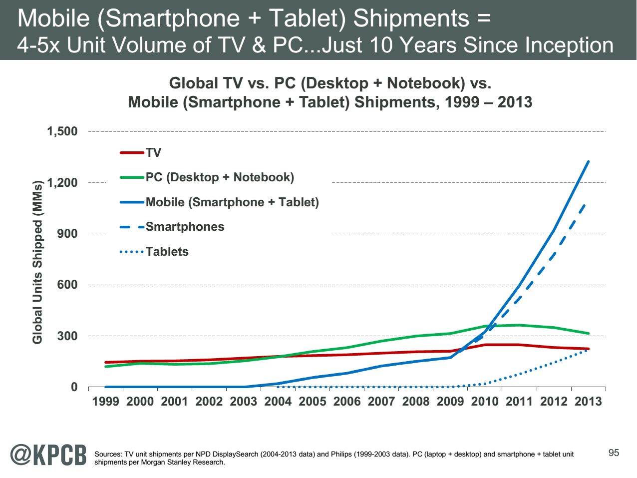
http://www.kpcb.com/internet-trends

Slide 75
Iterative MapReduce
Implementing HPC-ABDS
Judy Qiu, Bingjing Zhang, Dennis Gannon, Thilina Gunarathne

Slide 76
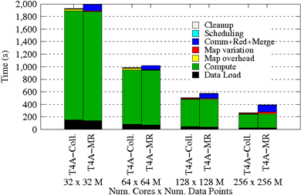
Using Optimal “Collective” Operations
Twister4Azure Iterative MapReduce with enhanced collectives
  Map-AllReduce primitive and MapReduce-MergeBroadcast
Strong Scaling on K-means for up to 256 cores on Azure

Slide 77
Kmeans and (Iterative) MapReduce
Shaded areas are computing only where Hadoop on HPC cluster is fastest
Areas above shading are overheads where T4A smallest and T4A with AllReduce collective have lowest overhead
Note even on Azure Java (Orange) faster than T4A C# for compute

Slide 78
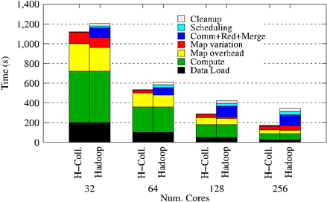
Collectives improve traditional MapReduce
Poly-algorithms choose the best collective implementation for machine and collective at hand
This is K-means running within basic Hadoop but with optimal AllReduce collective operations
Running on Infiniband Linux Cluster

