Slide 1
New Approaches to Scientific Computing
Presentation to visitors from Lilly
September 25, 2009, Bloomington
Geoffrey Fox
gcf@indiana.edu www.infomall.org
School of Informatics and Computing
and Community Grids Laboratory,
Digital Science Center
Pervasive Technology Institute
Indiana University

Slide 2
PTI Activities in Digital Science Center
Community Grids Laboratory led by Fox
  Gregor von Lazewski: FutureGrid architect
  Marlon Pierce: Grids, Services, Portals including Chemistry and Polar Science applications
  Judy Qiu: Multicore and Data Intensive Computing including Biology and Cheminformatics applications
Open Software Laboratory led by Andrew Lumsdaine
  Software like MPI, Scientific Computing Environments
  Parallel Graph Algorithms
Complex Networks and Systems led by Alex Vespignani
  Very successful H1N1 spread simulations run on Big Red
  Can be extended to other epidemics and to “critical infrastructure” simulations such as transportation

Slide 3
FutureGrid
September 10, 2009 Press Release
BLOOMINGTON, Ind. -- The future of scientific computing will be developed with the leadership of Indiana University and nine national and international partners as part of a $15 million project largely supported by a $10.1 million grant from the National Science Foundation (NSF). The award will be used to establish FutureGrid—one of only two experimental systems (other one is GPU enhanced cluster) in the NSF Track 2 program that funds the most powerful, next-generation scientific supercomputers in the nation.
http://uitspress.iu.edu/news/page/normal/11841.html

Slide 4
FutureGrid
FutureGrid is part of TeraGrid – NSF’s national network of supercomputers – and is aimed at providing a distributed testbed of ~9 clusters for both application and computer scientists exploring
  Clouds
  Grids
  Multicore and architecture diversity
Testbed enabled by virtual machine technology including virtual network
  Dedicated network connects allowing experiments to be isolated
Modest number of cores (5000) but will be relatively large as a Science Cloud

Slide 5
Add 768 core Windows Server at IU and Network Fault Generator

Slide 6
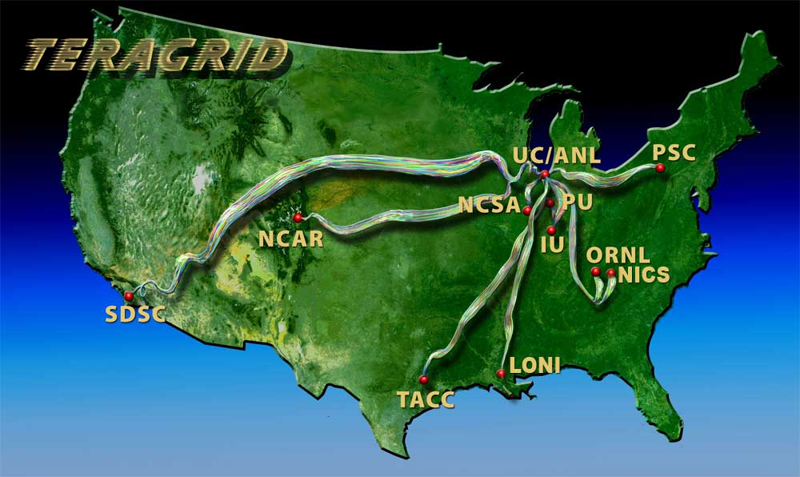
Indiana University is already part of base TeraGrid through Big Red and services

Slide 8

CICC Chemical Informatics and Cyberinfrastructure
Collaboratory Web Service Infrastructure
GTM and MDS
OSCAR Document Analysis
InChI Generation/Search
Computational Chemistry (Gamess, Jaguar etc.)
Varuna.net
Quantum Chemistry
Core Grid Services
Service Registry
Job Submission and Management
Local Clusters
IU Big Red, TeraGrid, Open Science Grid
Portal Services
RSS Feeds
User Profiles
Collaboration as in Sakai

Slide 9
Science Gateways in PTI
Science gateways provide Web user interfaces and Web services for accessing Grids and Clouds.
  NSF TeraGrid, Amazon EC2, etc
Workflow and large scale job submission to Grids and Clouds.
Web 2.0 approaches to Web-based science.
  JavaScript Grid APIs for building Gadgets and Mash-ups.
  Open Social-based social networking gadgets
  iGoogle style gadget containers

Slide 10
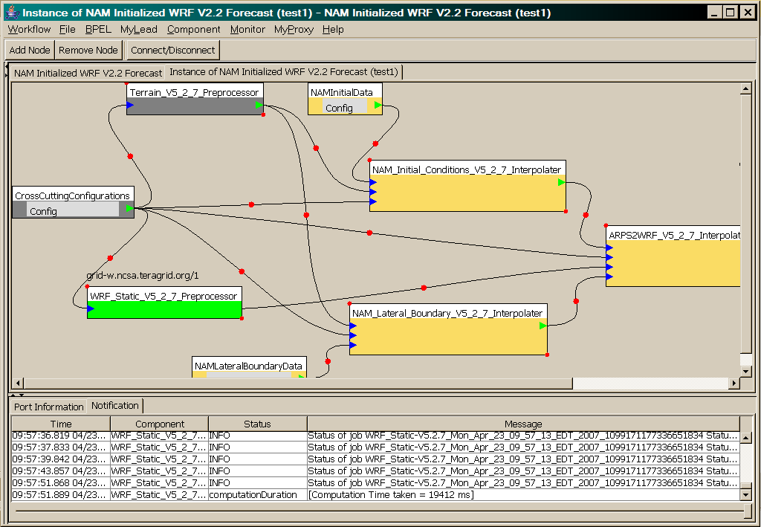
OGCE Workflow Tools Wrap and Execute Codes on the TeraGrid
WRF-Static running on Tungsten

Slide 11
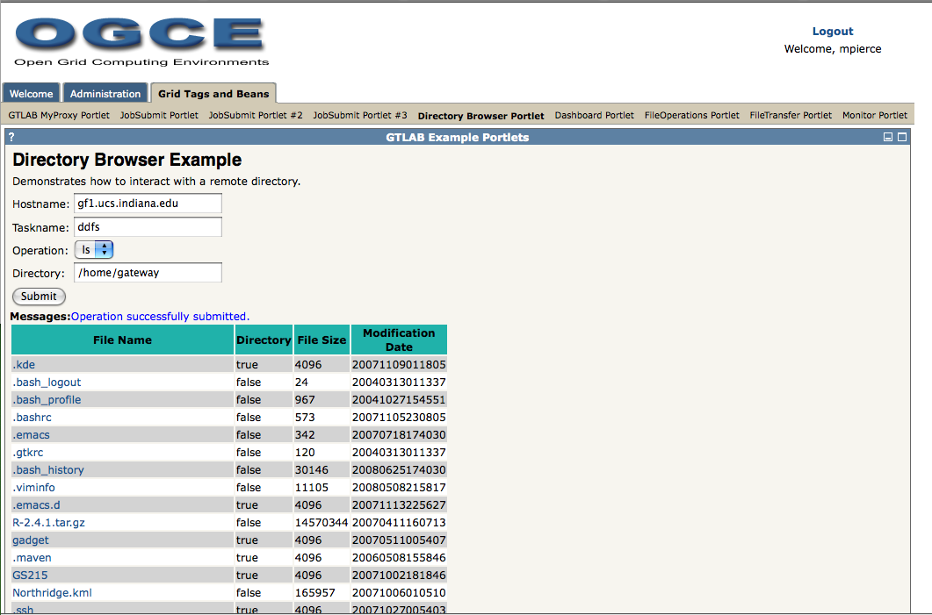
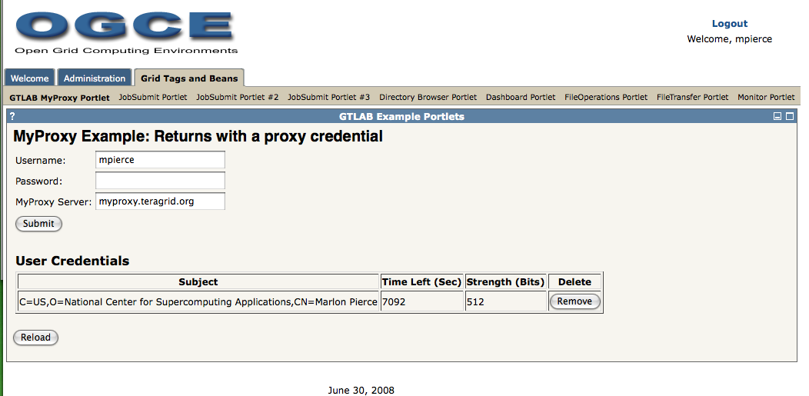
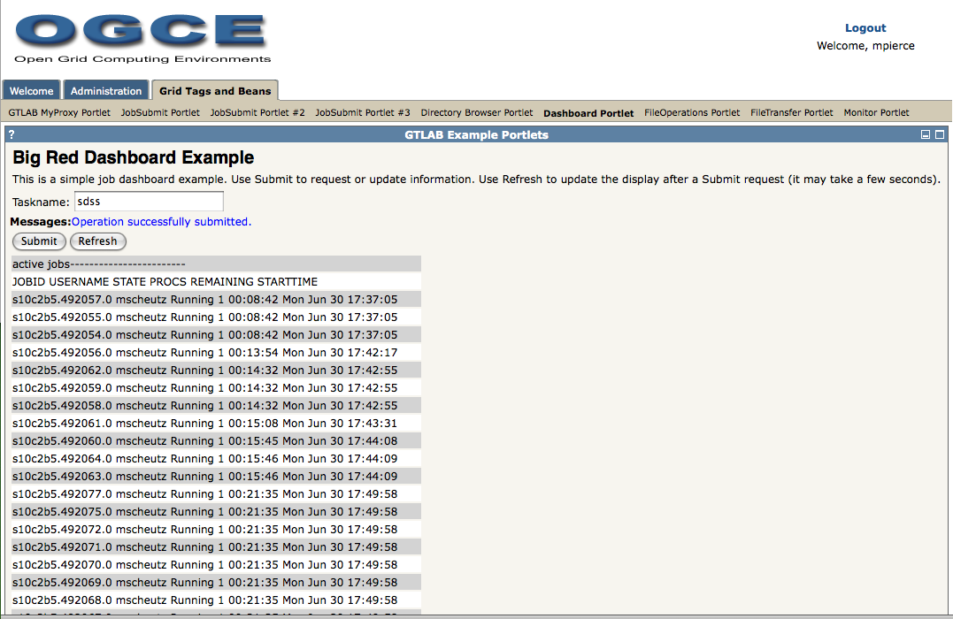
Various portal services deployed as portlets:
Remote directory browsing, proxy management, and LoadLeveler queues.

Slide 12
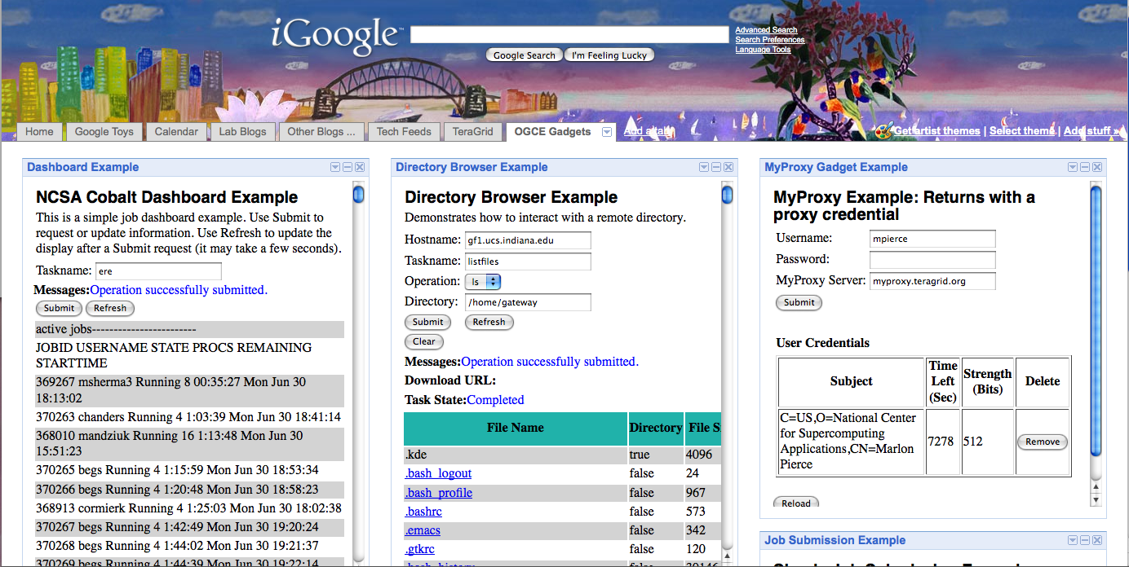
Similar set of services deployed as Google Gadgets: MOAB dashboard, remote directory browser, and proxy management.

Slide 13
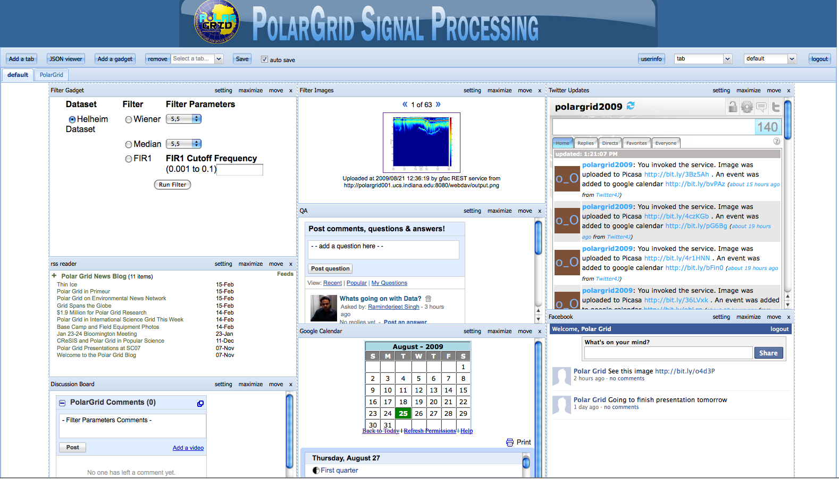
Web 2.0 PolarGrid Portal

Slide 14
ORE-CHEM Project
Object Reuse and Exchange (ORE): simple semantic markup for describing distributed digital documents.
  Atom/XML and RDF bindings
  Multiple versions, formats, supplemental data, authors, citations, etc are all URIs in a master document.
ORE-CHEM project is Semantic web application applied to chemistry.
  Link papers to experiments, computing runs.
  Create searchable RDF triple stores of linked information.

Slide 15
IU’s ORE-CHEM Pipeline (Phase I)
Harvest NIH PubChem for 3D Structures
Convert Gaussian Output to CML
Convert CML to RDF->ORE-Chem
Convert PubChem XML to CML
Submit Jobs to TeraGrid with Swarm
Insert RDF into RDF Triple Store
Goal is to create a public, searchable triple store populated with ORE-CHEM data on drug-like molecules.
Convert PubChem XML to CML
Convert CML to Gaussian Input
Conversions are done with Jumbo/CML tools from Peter Murray Rust’s group at Cambridge. Swarm is a Web service capable of managing 10,000’s of jobs on the TeraGrid. We hope to use Dryad to manage this pipeline.

Slide 16
Data Intensive (Science) Applications
From 1980-200?, we largely looked at HPC for simulation; now we have data deluge
1) Data starts on some disk/sensor/instrument
  It needs to be decomposed/partitioned; often partitioning natural from source of data
2) One runs a filter of some sort extracting data of interest and (re)formatting it
  Pleasingly parallel with often “millions” of jobs
  Communication latencies can be many milliseconds and can involve disks
3) Using same (or map to a new) decomposition, one runs a possibly parallel application that could require iterative steps between communicating processes or could be pleasing parallel
  Communication latencies may be at most some microseconds and involves shared memory or high speed networks
Workflow links 1) 2) 3) with multiple instances of 2) 3)
  Pipeline or more complex graphs
Filters are “Maps” or “Reductions” in MapReduce language

Slide 17






MapReduce “File/Data Repository” Parallelism
Instruments
Map = (data parallel) computation reading and writing data
Reduce = Collective/Consolidation phase e.g. forming multiple global sums as in histogram
Communication via Messages/Files
Portals
/Users
Disks
Map₁
Map₂
Map₃
Reduce
Computers/Disks

Slide 18
Cloud Computing: Infrastructure and Runtimes
Cloud infrastructure: outsourcing of servers, computing, data, file space, etc.
  Handled through Web services that control virtual machine lifecycles.
Cloud runtimes:: tools (for using clouds) to do data-parallel computations.
  Apache Hadoop, Google MapReduce, Microsoft Dryad, and others
  Designed for information retrieval but are excellent for a wide range of science data analysis applications
  Can also do much traditional parallel computing for data-mining if extended to support iterative operations
  Not usually on Virtual Machines

Slide 19
Application Classes
In the past I discussed application—parallel software/hardware in terms of 5 “Application Architecture” Structures
  1) Synchronous – Lockstep Operation as in SIMD architectures
  2) Loosely Synchronous – Iterative Compute-Communication stages with independent compute (map) operations for each CPU. Heart of most MPI jobs
  3) Asynchronous – Compute Chess; Combinatorial Search often supported by dynamic threads
  4) Pleasingly Parallel – Each component independent – in 1988, I estimated at 20% total in hypercube conference
  5) Metaproblems – Coarse grain (asynchronous) combinations of classes 1)-4). The preserve of workflow.
Grids greatly increased work in classes 4) and 5)
The above largely described simulations and not data processing. Now we should admit the class which crosses classes 2) 4) 5) above
  6) MapReduce++ which describe file(database) to file(database) operations
  6a) Pleasing Parallel Map Only
  6b) Map followed by reductions
  6c) Iterative “Map followed by reductions” – Extension of Current Technologies that supports much linear algebra and datamining
Note overheads in 1) 2) 6c) go like Communication Time/Calculation Time and basic MapReduce pays file read/write costs while MPI is microseconds

Slide 20
Applications & Different Interconnection Patterns
Map Only | Classic MapReduce | Iterative Reductions | Loosely Synchronous
CAP3 Analysis Document conversion (PDF -> HTML) Brute force searches in cryptography Parametric sweeps | High Energy Physics (HEP) Histograms Distributed search Distributed sorting Information retrieval | Expectation maximization algorithms Clustering Linear Algebra | Many MPI scientific applications utilizing wide variety of communication constructs including local interactions
- CAP3 Gene Assembly - PolarGrid Matlab data analysis | - Information Retrieval - HEP Data Analysis - Calculation of Pairwise Distances for ALU Sequences | Kmeans Deterministic Annealing Clustering - Multidimensional Scaling MDS | - Solving Differential Equations and - particle dynamics with short range forces
Input
iterations
Input
Input
map
map
map
Pij
reduce
Output
reduce
Domain of MapReduce and Iterative Extensions
MPI

Slide 21
Cluster Configurations
Feature | GCB-K18 @ MSR | iDataplex @ IU | Tempest @ IU
CPU | Intel Xeon CPU L5420 2.50GHz | Intel Xeon CPU L5420 2.50GHz | Intel Xeon CPU E7450 2.40GHz
# CPU /# Cores per node | 2 / 8 | 2 / 8 | 4 / 24
Memory | 16 GB | 32GB | 48GB
# Disks | 2 | 1 | 2
Network | Giga bit Ethernet | Giga bit Ethernet | Giga bit Ethernet / 20 Gbps Infiniband
Operating System | Windows Server Enterprise - 64 bit | Red Hat Enterprise Linux Server -64 bit | Windows Server Enterprise - 64 bit
# Nodes Used | 32 | 32 | 32
Total CPU Cores Used | 256 | 256 | 768
DryadLINQ
Hadoop / MPI
DryadLINQ / MPI

Slide 22
Current Bio/Cheminformatics work
EST (Expressed Sequence Tag) sequence assembly program using DNA sequence assembly program software CAP3.
Metagenomics and Pairwise Alu gene alignment using Smith Waterman dissimilarity computations followed by MPI applications for Clustering and MDS (Multi Dimensional Scaling)
Correlating Childhood obesity with environmental factors by combining medical records with Geographical Information data with over 100 attributes using correlation computation, MDS and genetic algorithms for choosing optimal environmental factors.
Mapping the >20 million entries in PubChem into two or three dimensions to aid selection of related chemicals with convenient Google Earth like Browser. This uses either hierarchical MDS (which cannot be applied directly as O(N²)) or GTM (Generative Topographic Mapping).

Slide 23


CAP3 - DNA Sequence Assembly Program
EST (Expressed Sequence Tag) corresponds to messenger RNAs (mRNAs) transcribed from the genes residing on chromosomes. Each individual EST sequence represents a fragment of mRNA, and the EST assembly aims to re-construct full-length mRNA sequences for each expressed gene.
Input files (FASTA)
GCB-K18-N01
\DryadData\cap3\cap3data
10
0,344,CGB-K18-N01
1,344,CGB-K18-N01
…
9,344,CGB-K18-N01
Cap3data.pf
V
V
Cap3data.00000000
\\GCB-K18-N01\DryadData\cap3\cluster34442.fsa
\\GCB-K18-N01\DryadData\cap3\cluster34443.fsa
...
\\GCB-K18-N01\DryadData\cap3\cluster34467.fsa
Output files
Input files
(FASTA)
IQueryable<LineRecord> inputFiles=PartitionedTable.Get <LineRecord>(uri);
IQueryable<OutputInfo> = inputFiles.Select(x=>ExecuteCAP3(x.line));
[1] X. Huang, A. Madan, “CAP3: A DNA Sequence Assembly Program,” Genome Research, vol. 9, no. 9, pp. 868-877, 1999.

Slide 24
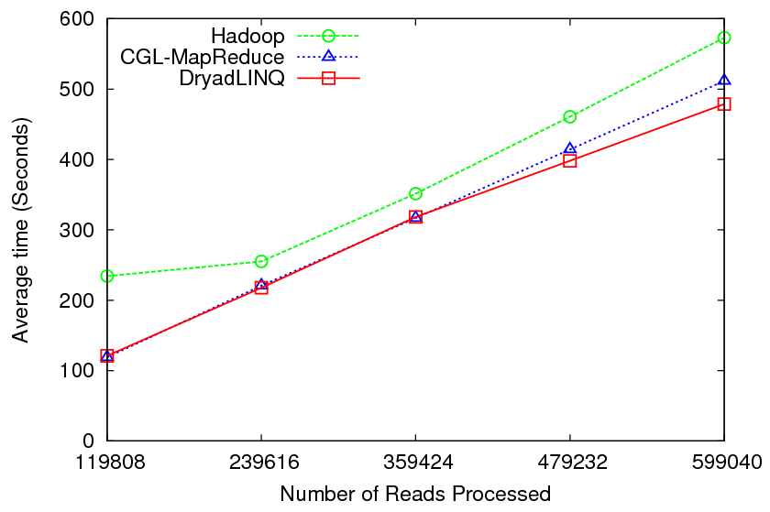
CAP3 - Performance

Slide 25
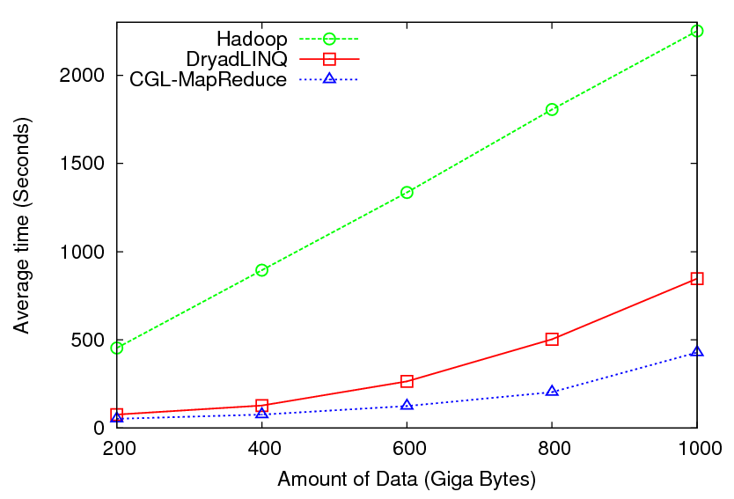

High Energy Physics Data Analysis
Histogramming of events from a large (up to 1TB) data set
Data analysis requires ROOT framework (ROOT Interpreted Scripts)
Performance depends on disk access speeds
Hadoop implementation uses a shared parallel file system (Lustre)
  ROOT scripts cannot access data from HDFS
  On demand data movement has significant overhead
Dryad stores data in local disks
  Better performance

Slide 26

Reduce Phase of Particle Physics
“Find the Higgs” using Dryad
Combine Histograms produced by separate Root “Maps” (of event data to partial histograms) into a single Histogram delivered to Client

Slide 27
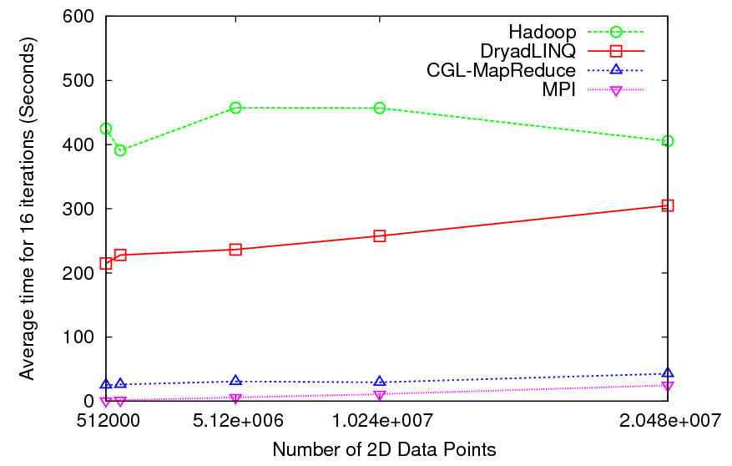

Kmeans Clustering
Time for 20 iterations
Iteratively refining operation
New maps/reducers/vertices in every iteration
File system based communication
Loop unrolling in DryadLINQ provide better performance
The overheads are extremely large compared to MPI
Large
Overheads

Slide 28
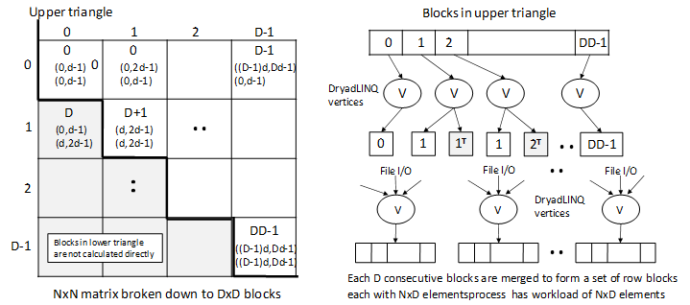
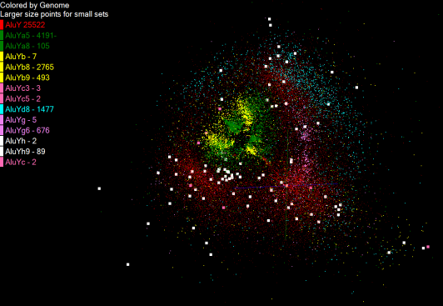
Pairwise Distances – ALU Sequencing
125 million distances
4 hours & 46 minutes
Calculate pairwise distances for a collection of genes (used for clustering, MDS)
O(N^2) problem
“Doubly Data Parallel” at Dryad Stage
Performance close to MPI
Performed on 768 cores (Tempest Cluster)
Processes work better than threads when used inside vertices
100% utilization vs. 70%
Notes:
1~180 lines without threading in DryadLINQ, with threading, it is about 400 lines
MPI ~500 lines
The Alu clustering problem [27] is one of the most challenging problems for sequencing clustering because Alus represent the largest repeat families in human genome. There are about 1 million copies of Alu sequences in human genome, in which most insertions can be found in other primates and only a small fraction (~ 7000) are human-specific. This indicates that the classification of Alu repeats can be deduced solely from the 1 million human Alu elements. Notable, Alu clustering can be viewed as a classical case study for the capacity of computational infrastructures because it is not only of great intrinsic biological interests, but also a problem of a scale that will remain as the upper limit of many other clustering problem in bioinformatics for the next few years, e.g. the automated protein family classification for a few millions of proteins predicted from large metagenomics projects. In our work here we examine Alu samples of 35339 and 50,000 sequences.

Slide 29
Dryad versus MPI for Smith Waterman
Flat is perfect scaling

Slide 30
Dryad versus MPI for Smith Waterman
Flat is perfect scaling

Slide 31
Alu and Sequencing Workflow
Data is a collection of N sequences – 100’s of characters long
  These cannot be thought of as vectors because there are missing characters
  “Multiple Sequence Alignment” (creating vectors of characters) doesn’t seem to work if N larger than O(100)
Can calculate N² dissimilarities (distances) between sequences (all pairs)
Find families by clustering (much better methods than Kmeans). As no vectors, use vector free O(N²) methods
Map to 3D for visualization using Multidimensional Scaling MDS – also O(N²)
N = 50,000 runs in 10 hours (all above) on 768 cores
Our collaborators just gave us 170,000 sequences and want to look at 1.5 million – will develop new algorithms!
MapReduce++ will do all steps as MDS, Clustering just need MPI Broadcast/Reduce

Slide 32


Slide 33
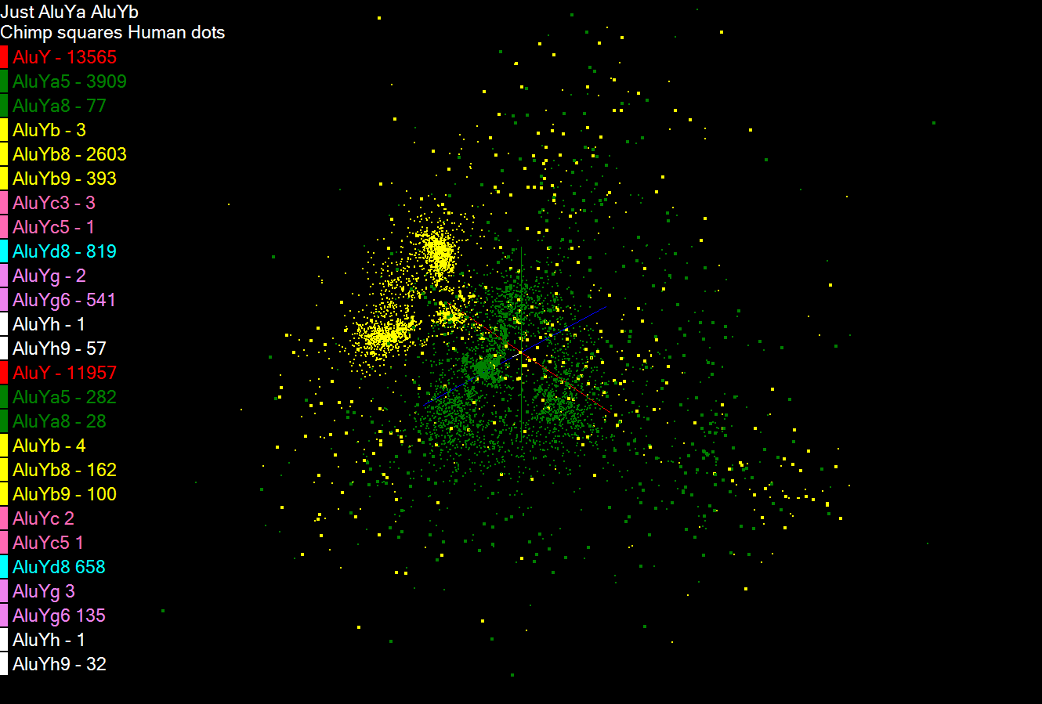

Slide 34


Slide 35
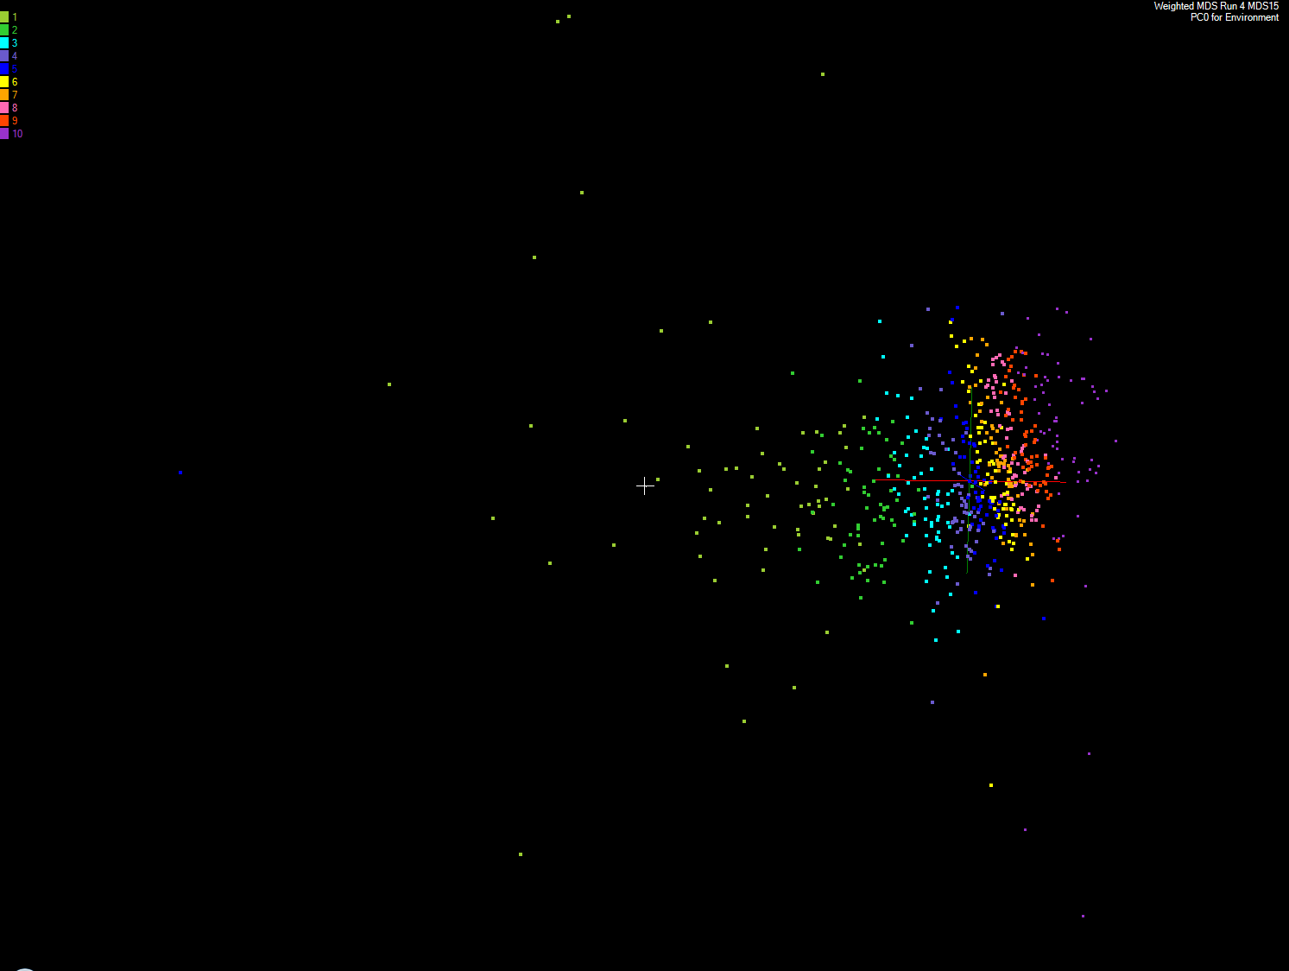
Apply MDS to Patient Record Data
and correlation to GIS properties
MDS and Primary PCA Vector
MDS of 635 Census Blocks with 97 Environmental Properties
Shows expected Correlation with Principal Component – color varies from greenish to reddish as projection of leading eigenvector changes value
Ten color bins used

Slide 36
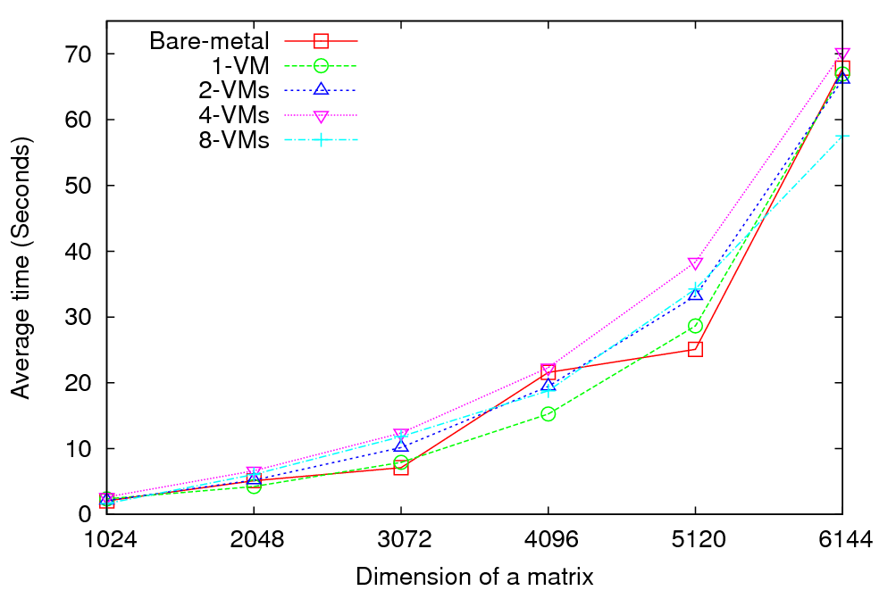
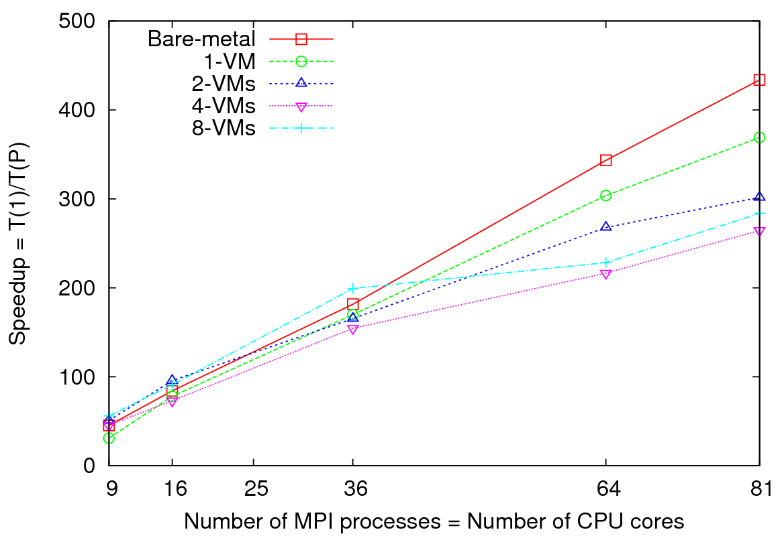
MPI on Clouds: Matrix Multiplication
Performance - 64 CPU cores
Speedup – Fixed matrix size (5184x5184)
Implements Cannon’s Algorithm [1]
Exchange large messages
More susceptible to bandwidth than latency
At 81 MPI processes, at least 14% reduction in speedup is noticeable

Slide 37
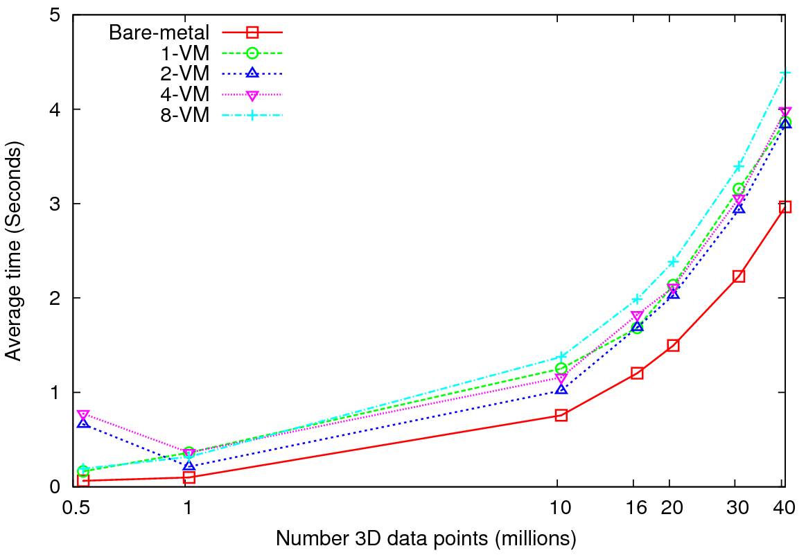
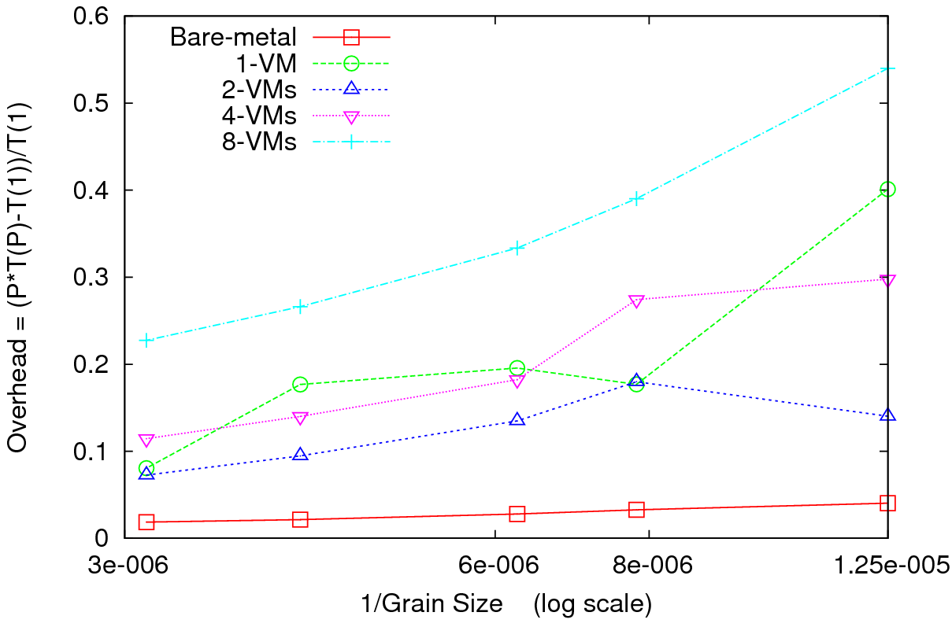
MPI on Clouds Kmeans Clustering
Performance – 128 CPU cores
Overhead
Perform Kmeans clustering for up to 40 million 3D data points
Amount of communication depends only on the number of cluster centers
Amount of communication << Computation and the amount of data processed
At the highest granularity VMs show at least 3.5 times overhead compared to bare-metal
Extremely large overheads for smaller grain sizes

Slide 38
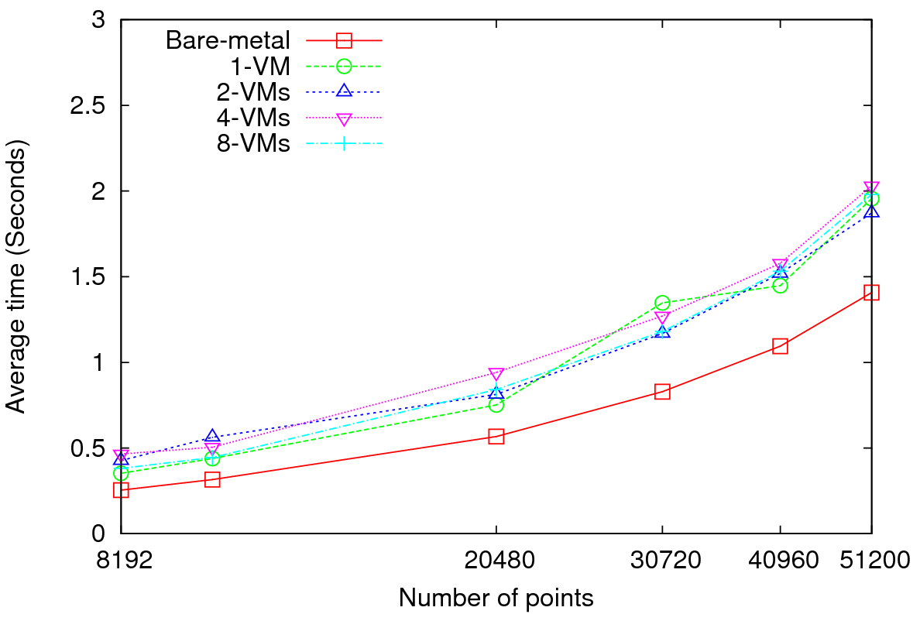
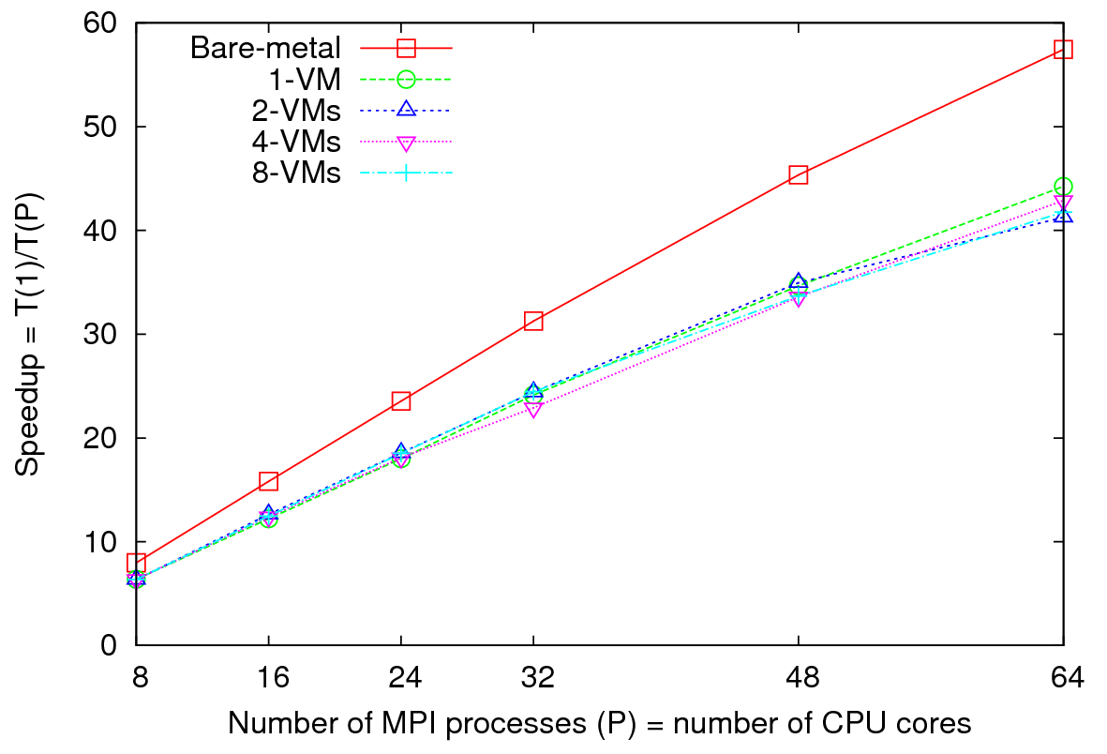
MPI on Clouds
Parallel Wave Equation Solver
Performance - 64 CPU cores
Total Speedup – 30720 data points
Clear difference in performance and speedups between VMs and bare-metal
Very small messages (the message size in each MPI_Sendrecv() call is only 8 bytes)
More susceptible to latency
At 51200 data points, at least 40% decrease in performance is observed in VMs

Slide 39
PWDA Parallel Pairwise data clustering
by Deterministic Annealing run on 24 core computer
Parallel
Overhead
Intra-node
MPI
Inter-node
MPI
Threading
Parallel Pattern (Thread X Process X Node)

Slide 40
Pairwise Clustering: 4 Clusters 35339 Points
Parallel Overhead
0.46 hours
0.19 hours
Threads x MPI Processes x Nodes

Slide 41
MG30000 Clustering by Deterministic Annealing
MPI
Parallel Overhead
Thread
Thread
Thread
Thread
Thread
Thread
Parallelism
MPI
MPI

Slide 42
Conclusions
We looked at several applications with various computation, communication, and data access requirements
All DryadLINQ applications work, and in many cases perform better than Hadoop
We can definitely use DryadLINQ (and Hadoop) for scientific analyses
Coding is much simpler in DryadLINQ than Hadoop
A key issue is support of inhomogeneous data
Data deluge implies need for very large datamining applications requiring clouds and new technologies

Slide 43
High end Multi Dimension scaling MDS
Given dissimilarities D(i,j), find the best set of vectors x_{i} in d (any number) dimensions minimizing
Σ_{i,j} weight(i,j) (D(i,j) – |x_{i} – x_{j}|^{n})² (*)
Weight chosen to refelect importance of point or perhaps a desire (Sammon’s method) to fit smaller distance more than larger ones
n is typically 1 (Euclidean distance) but 2 also useful
Normal approach is Expectation Maximation and we are exploring adding deterministic annealing to improve robustness
Currently mainly note (*) is “just” γ² and one can use very reliable nonlinear optimizers
  We have good results with Levenberg–Marquardt approach to γ² solution (adding suitable multiple of unit matrix to nonlinear second derivative matrix). However EM also works well
We have some novel features
  Fully parallel over unknowns x_{i}
  Allow “incremental use”; fixing MDS from a subset of data and adding new points
  Allow general d, n and weight(i,j)
  Can optimally align different versions of MDS (e.g. different choices of weight(i,j) to allow precise comparisons
Feeds directly to powerful Point Visualizer

Slide 44
Deterministic Annealing Clustering
Clustering methods like Kmeans very sensitive to false minima but some 20 years ago an EM (Expectation Maximization) method using annealing (deterministic NOT Monte Carlo) developed by Ken Rose (UCSB), Fox and others
Annealing is in distance resolution – Temperature T looks at distance scales of order T^{0.5}.
Method automatically splits clusters where instability detected
Highly efficient parallel algorithm
Points are assigned probabilities for belonging to a particular cluster
Original work based in a vector space e.g. cluster has a vector as its center
Major advance 10 years ago in Germany showed how one could use vector free approach – just the distances D(i,j) at cost of O(N²) complexity.
We have extended this and implemented in threading and/or MPI
We will release this as a service later this year followed by vector version
  Gene Sequence applications naturally fit vector free approach.

Slide 45
Key Features of our Approach
Initially we will make key capabilities available as services that we eventually be implemented on virtual clusters (clouds) to address very large problems
  Basic Pairwise dissimilarity calculations
  R (done already by us and others)
  MDS in various forms
  Vector and Pairwise Deterministic annealing clustering
Point viewer (Plotviz) either as download (to Windows!) or as a Web service
Note all our code written in C# (high performance managed code) and runs on Microsoft HPCS 2008 (with Dryad extensions)

Slide 46
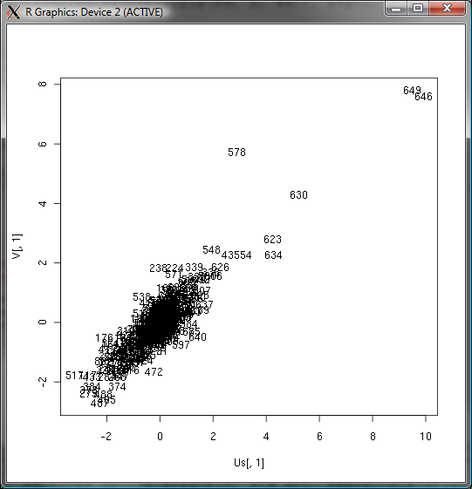
Canonical Correlation
Choose vectors a and b such that the random variables U = a^{T}.X and V = b^{T}.Y maximize the correlation
ρ= cor(a^{T}.X, b^{T}.Y).
X Environmental Data
Y Patient Data
Use R to calculate ρ = 0.76

Slide 47
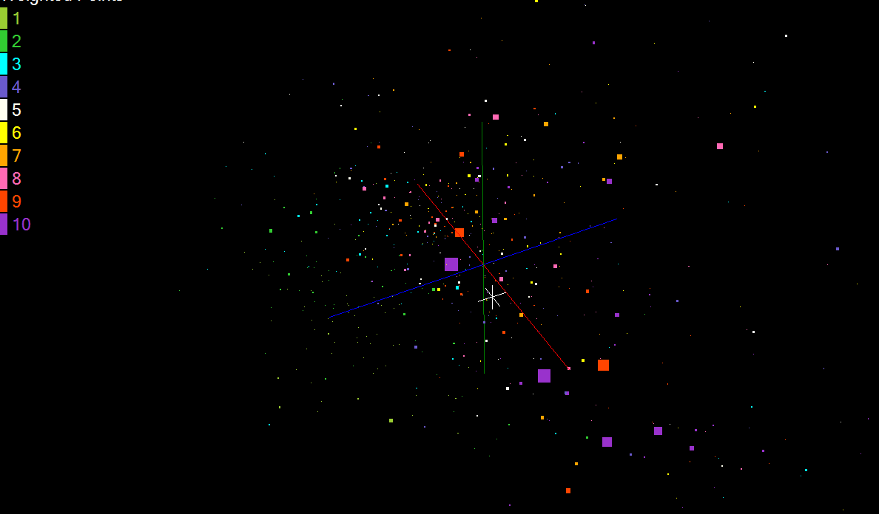
CCA vector u correlation with MDS is 0.68

