Slide 1
Some remarks on Use of Clouds to Support Long Tail of Science
July 18 2012
XSEDE 2012 Chicago ILL July 2012
Geoffrey Fox
gcf@indiana.edu
Informatics, Computing and Physics
Pervasive Technology Institute
Indiana University Bloomington

Slide 2
What Applications work in Clouds
Pleasingly parallel applications of all sorts with roughly independent data or spawning independent simulations
Long tail of science and integration of distributed sensors
Commercial and Science Data analytics that can use MapReduce (some of such apps) or its iterative variants (most other data analytics apps)
Which science applications are using clouds?
Many demonstrations –Conferences, OOI, HEP ….
Venus-C (Azure in Europe): 27 applications not using Scheduler, Workflow or MapReduce (except roll your own)
50% of applications on FutureGrid are from Life Science but there is more computer science than total applications
Locally Lilly corporation is major commercial cloud user (for drug discovery) but Biology department is not

Slide 3
27 Venus-C Azure “Long Tail” Applications chosen from ~70
Chemistry (3)
• Lead Optimization in Drug Discovery
• Molecular Docking
Civil Protection (1)
• Fire Risk estimation and fire propagation
Biodiversity &
Biology (2)
• Biodiversity maps in marine species
• Gait simulation
Civil Eng. and Arch. (4)
• Structural Analysis
• Building information Management
• Energy Efficiency in Buildings
• Soil structure simulation
Physics (1)
• Simulation of Galaxies configuration
Earth Sciences (1)
• Seismic propagation
Mol, Cell. & Gen. Bio. (7)
• Genomic sequence analysis
• RNA prediction and analysis
• System Biology
• Loci Mapping
• Micro-arrays quality.
ICT (2)
• Logistics and vehicle routing
• Social networks analysis
Medicine (3)
• Intensive Care Units decision support.
• IM Radiotherapy planning.
• Brain Imaging
Mathematics (1)
• Computational Algebra
Mech, Naval & Aero. Eng. (2)
• Vessels monitoring
• Bevel gear manufacturing simulation

Slide 4
Internet of Things and the Cloud
It is projected that there will be 24 billion devices on the Internet by 2020. Most will be small sensors that send streams of information into the cloud where it will be processed and integrated with other streams and turned into knowledge that will help our lives in a multitude of small and big ways.
The cloud will become increasing important as a controller of and resource provider for the Internet of Things.
As well as today’s use for smart phone and gaming console support, “smart homes” and “ubiquitous cities” build on this vision and we could expect a growth in cloud supported/controlled robotics.
Some of these “things” will be supporting science
All will be studied by Computer Science
Natural parallelism over “things”

Slide 5
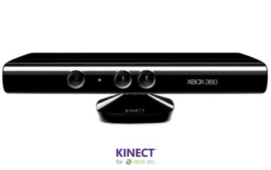
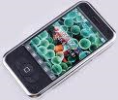
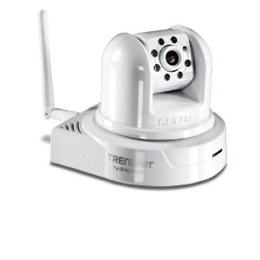
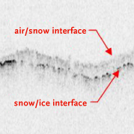
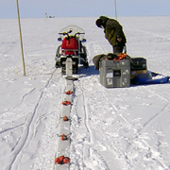
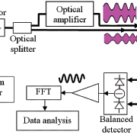
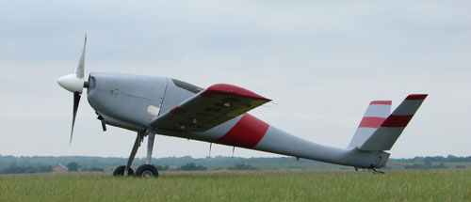
Sensors as a Service
Output Sensor
Sensors as a Service
Sensor Processing as a Service (could use MapReduce)
A larger sensor ………
https://sites.google.com/site/opensourceiotcloud/ Open Source Sensor (IoT) Cloud

Slide 6
What to use in Clouds: Cloud PaaS
HDFS style file system to collocate data and computing
Queues to manage multiple tasks
Tables to track job information
MapReduce and Iterative MapReduce to support parallelism
Services for everything
Portals as User Interface
Appliances and Roles as customized images
Software tools like Google App Engine, memcached
Workflow to link multiple services (functions)
Data Parallel Languages like Pig; more successful than HPF?

Slide 7
What to use in Grids and Supercomputers? HPC PaaS
Services Portals and Workflow as in clouds
MPI and GPU/multicore threaded parallelism
GridFTP and high speed networking
Wonderful libraries supporting parallel linear algebra, particle evolution, partial differential equation solution
Globus, Condor, SAGA, Unicore, Genesis for Grids
Parallel I/O for high performance in an application
Wide area File System (e.g. Lustre) supporting file sharing
This is a rather different style of PaaS from clouds – could we unify Cloud and HPC PaaS as SciencePaaS?

Slide 8
aaS versus Roles/Appliances
If you package a capability X as XaaS, it runs on a separate VM and you interact with messages
SQLaaS offers databases via messages similar to old JDBC model
If you build a X-role or X-appliance, then X built into VM and you just need to add your own code and run
Azure Generic worker role builds in I/O and scheduling
Lets take all useful capabilities – MPI, MapReduce, Workflow .. – and offer as roles or aaS (or both)
Perhaps workflow has a controller aaS with graphical design tool while runtime packaged in a role?
Use virtual clusters to support parallelism

Slide 9
Data Intensive Applications
Applications tend to be new and so can consider emerging technologies such as clouds
Do not have lots of small messages but rather large reduction (aka Collective) operations
New optimizations e.g. for huge messages
e.g. Expectation Maximization (EM) dominated by broadcasts and reductions
Not clearly a single exascale job but rather many smaller (but not sequential) jobs e.g. to analyze groups of sequences
Algorithms not clearly robust enough to analyze lots of data
Current standard algorithms such as those in R library not designed for big data?
Need to develop appliances and libraries supporting data intensive applications

Slide 10
Computational Science as a Service
Traditional Computer Center has a variety of capabilities supporting (scientific computing/scholarly research) users.
Lets call this Computational Science as a Service
IaaS, PaaS and SaaS are lower level parts of these capabilities but commercial clouds do not include
Developing roles/appliances for particular users
Supplying custom SaaS aimed at user communities
Community Portals
Integration across disparate resources for data and compute (i.e. grids)
Data transfer and network link services
Archival storage, preservation
Consulting on use of particular appliances and SaaS i.e. on particular software components
Debugging and other problem solving
Administrative issues such as (local) accounting
This allows us to develop a new model of a computer center where commercial companies operate base hardware/software
A combination of XSEDE, Internet2 and computer center supply 1) to 9)?

Slide 11
FutureGrid Key Concepts I
FutureGrid is an international testbed modeled on Grid5000
July 14 2012: 223 Projects, 968 users
Supporting international Computer Science and Computational Science research in cloud, grid and parallel computing (HPC)
FutureGrid has ~4400 distributed cores (including GPU’s, large memory and disk) with a dedicated network and a Spirent XGEM network fault and delay generator
The FutureGrid testbed provides to long tail of science:
User-customizable Interactive Environment supporting Grid, Cloud and HPC software with and without virtualization.
A rich education and teaching platform for advanced cyberinfrastructure (computer/computational science) classes
Library of Images and Appliances

Slide 12
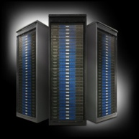
FutureGrid key Concepts II
9 Partners
Rather than loading images onto VM’s as in Amazon or Azure, FutureGrid supports Cloud, Grid and Parallel computing environments by provisioning software as needed onto “bare-metal” using RAIN software
Supports Appliances with tutorials on use
Use it at Virtual Science Cloud Summer School July 30—August 3 2012.
Several application talks
10 HBCU faculty from ADMI
Image1
Image2
…
ImageN
Choose
Load
Run

Slide 13
5 Use Types for FutureGrid (red latest)
223 approved projects (968 users) July 14 2012
USA, China, India, Pakistan, lots of European countries
Industry, Government, Academia
Training Education and Outreach (8%)(10%)
Semester and short events; interesting outreach to HBCU
Interoperability test-beds (3%)(2%)
Grids and Clouds; Standards; from Open Grid Forum OGF
Domain Science applications (31%)(26%)
Life science highlighted (18%)(14%), Non Life Science (13%)(12%)
Computer science (47%)(57%)
Largest current category
Computer Systems Evaluation (27%)(29%)
XSEDE (TIS, TAS), OSG, EGI
See Andrew Grimshaw’s discussion of XSEDE testing in Book Chapter

